Slide 1
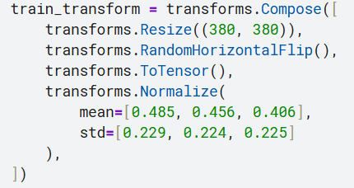
Data Processing & Preprocessing
Dataset description: Binary image classification
Class 0: Real (human-generated)，Class 1: AI-generated
Image Preprocessing:
Resize all images to 380 × 380 to match EfficientNet-B4 input size
Convert images to RGB format and Normalize mean and standard deviation
Data Augmentation(Training):
Random horizontal flipping
Mild rotations for robustness
Semi-supervised learning with unlabeled data
Used model predictions to generate pseudo-labels for unlabeled images
Only samples with high confidence (≥ 0.99) were selected
Pseudo-labeled samples were combined with original training data
112705007 解孟修

Slide 2
Model Architecture
Backbone selection:
EfficientNet-B4 (pretrained on ImageNet) ，Chosen for its strong ability to capture fine-grained textures and frequency patterns
Architecture modification:
Replaced the final classifier layer with a 2-class linear layer
Output: {Real, AI-generated}
Fine-tuning strategy:
Freeze most backbone parameters
Unfreeze classifier (and optionally last block) for fine-tuning
Performance improvement:
EfficientNet-B4 significantly outperformed ResNet-based models
Higher public F1 score due to better feature representation
112705007 解孟修

Slide 3
Training Strategy & Performance Boost
Training setup:
Loss function: Cross-Entropy Loss
Optimizer: Adam / AdamW
Batch size: adjusted for GPU memory
Training on GPU
Semi-supervised training:
Generated pseudo-labels from unlabeled data
Only high-confidence predictions (≥ 0.99) were used
Combined labeled and pseudo-labeled data for final training
Test-Time Augmentation:
Applied horizontal flip (and rotation) during inference
Averaged predictions across augmented versions
112705007 解孟修

Slide 4
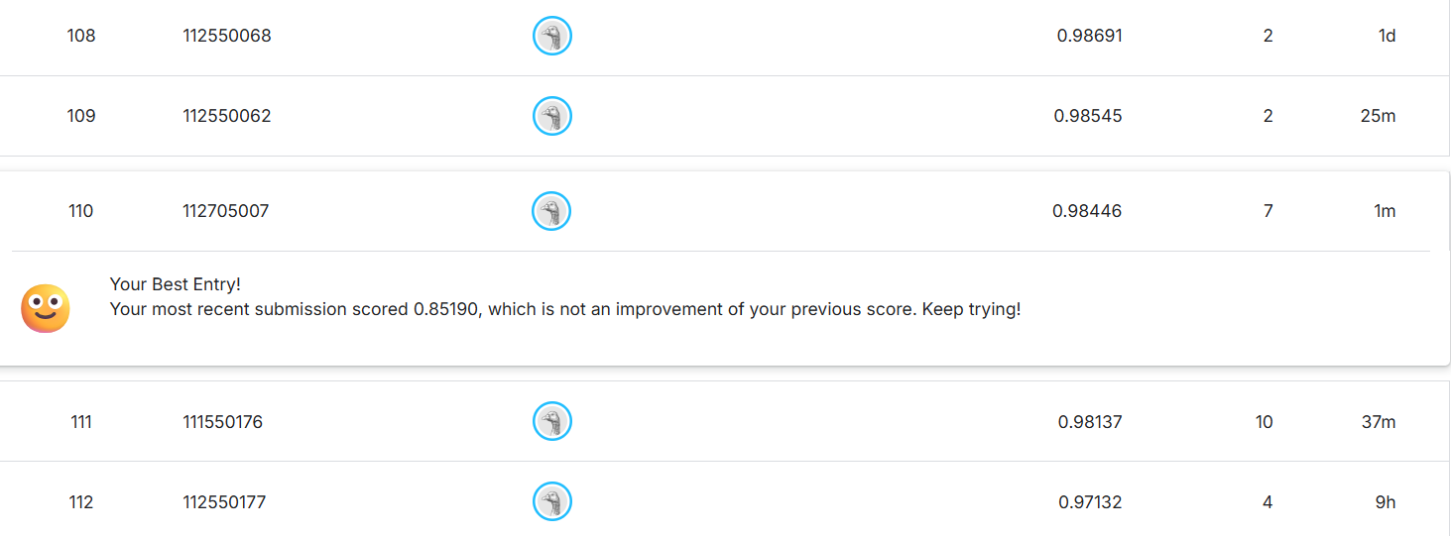
Appendix
112705007 解孟修

