Slide 1
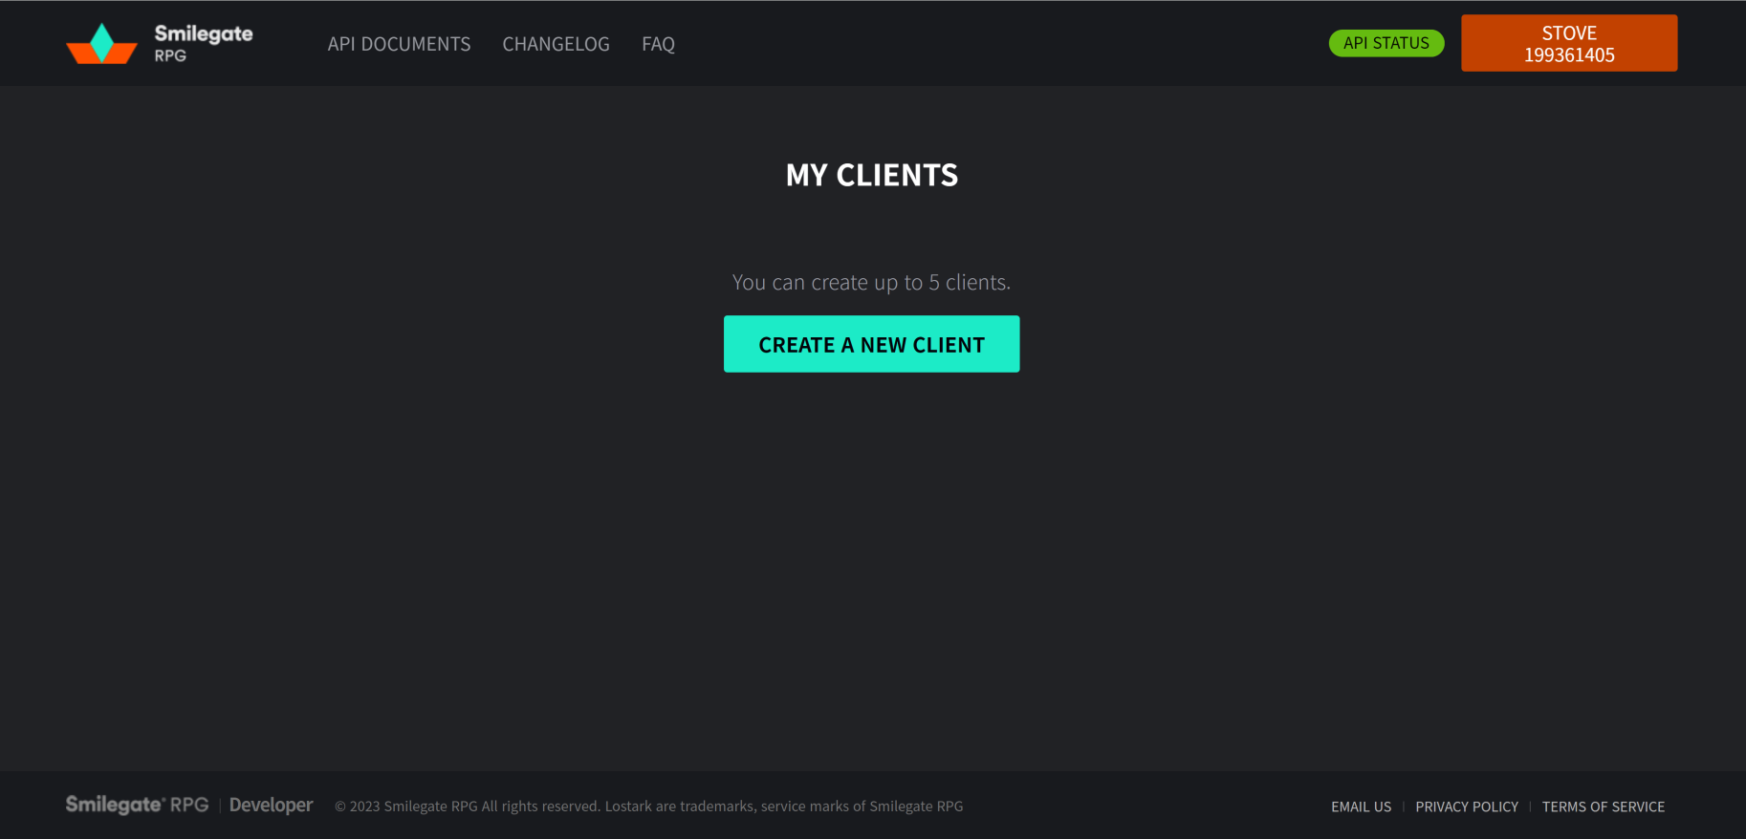
3

Slide 2
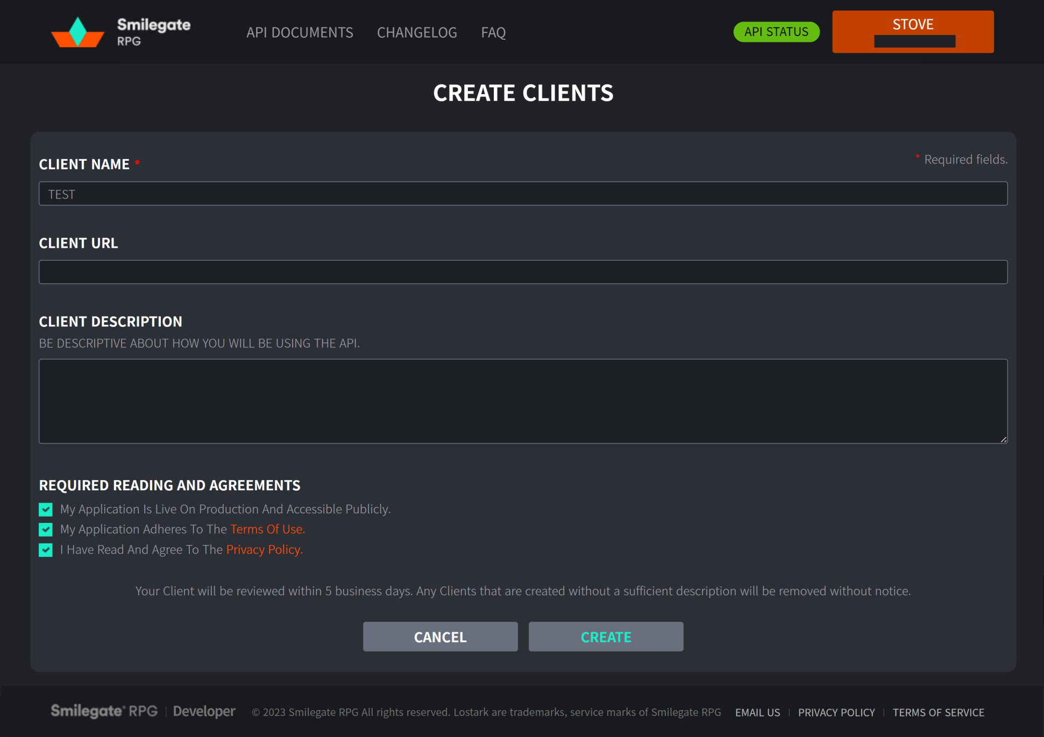
4-1
4-2
4-3

Slide 3
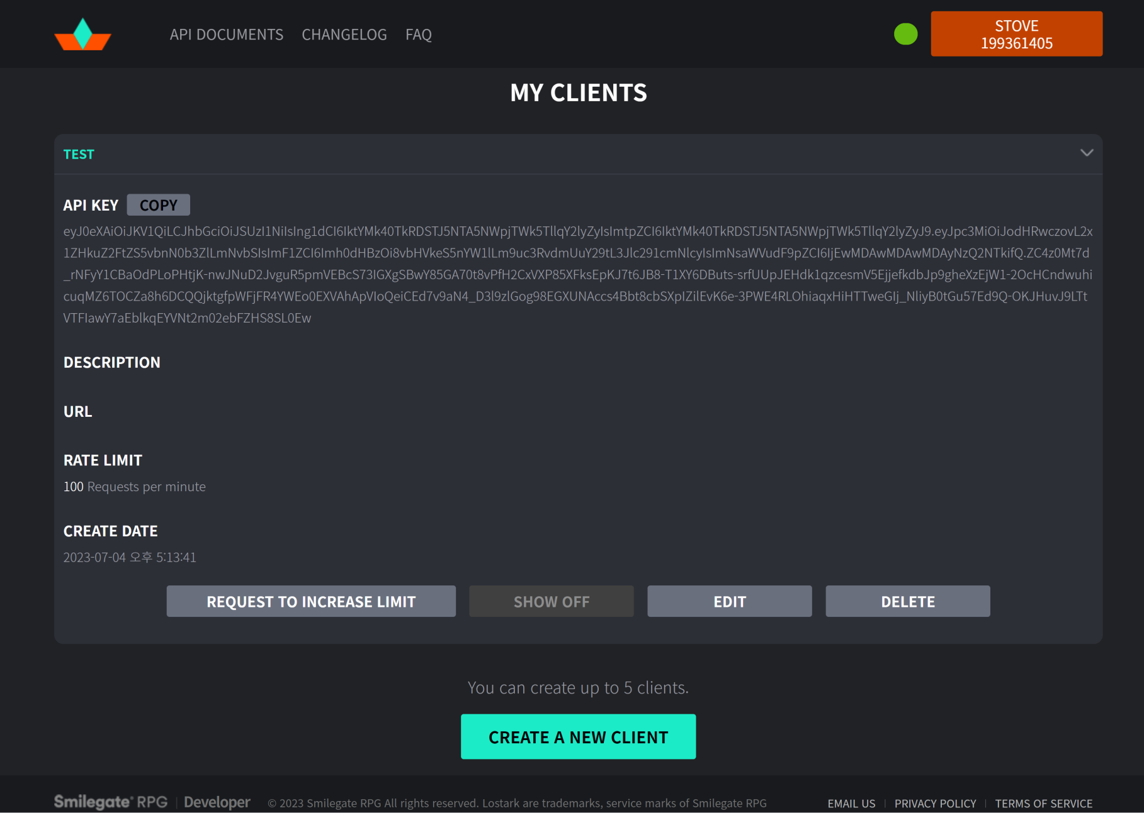
5-1

Slide 4


5-2
5-3

