Slide 1
Communication-Efficient Learning of Deep Networks from Decentralized Data
分享人：罗双

Slide 2
目录
联邦学习介绍
FederatedAveraging算法介绍
实验过程和结果分析

Slide 3
Federated Learning
Modern mobile devices have access to a wealth of data suitable for learning models, which in turn can greatly improve the user experience on the device.
However, this rich data is often privacy sensitive, large in quantity, or both, which may preclude logging to the data center and training there using conventional approaches.
Leaves the training data distributed on the mobile devices, and learns a shared model by aggregating locally-computed updates.

Slide 4
Federated Learning
中心服务器将初始全局模型发送至分布式终端（即数据提供方）
大量边缘节点独立地利用所拥有的数据进行训练，生成局部模型
数据提供方将梯度下降法所产生的局部权重更新传给中心节点
中心节点对获得的大量局部权重更新取均值之后产生新的模型，并把新模型广播给所有的边缘节点
图：联合学习

Slide 5
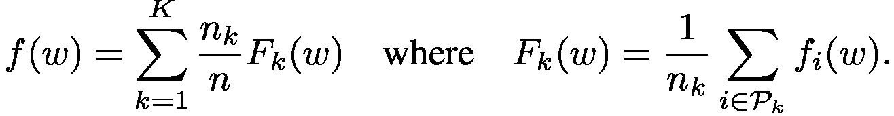
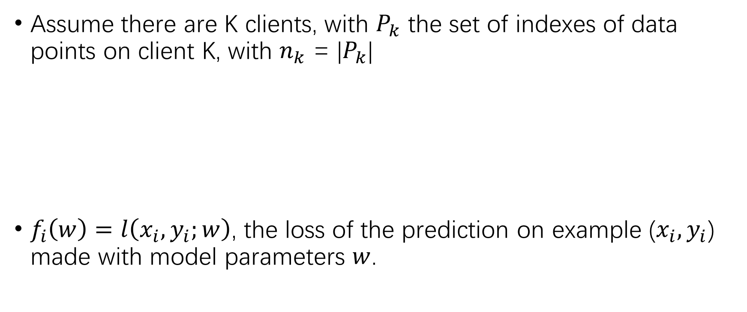
Loss Function
Assume there are K clients, with $P_{k}$ the set of indexes of data points on client K, with $n_{k}$ = |$P_{k}$|
$f_{i}\left(w\right)=l\left(x_{i},y_{i};w\right)$, the loss of the prediction on example ($x_{i},y_{i}$) made with model parameters $w$.

Slide 6
Federated Optimization
Non-IID
Unbalanced
Massively distributed
Limited communication

Slide 7
Our goal
In federated optimization, communication costs dominate
We will typically be limited by an upload bandwidth of 1 MB/s or less.
Computation becomes essentially free compared to communication costs for many model types
Our goal is to use additional computation in order to decrease the number of rounds of communication needed to train a model
Increased parallelism
Increased computation on each client

Slide 8
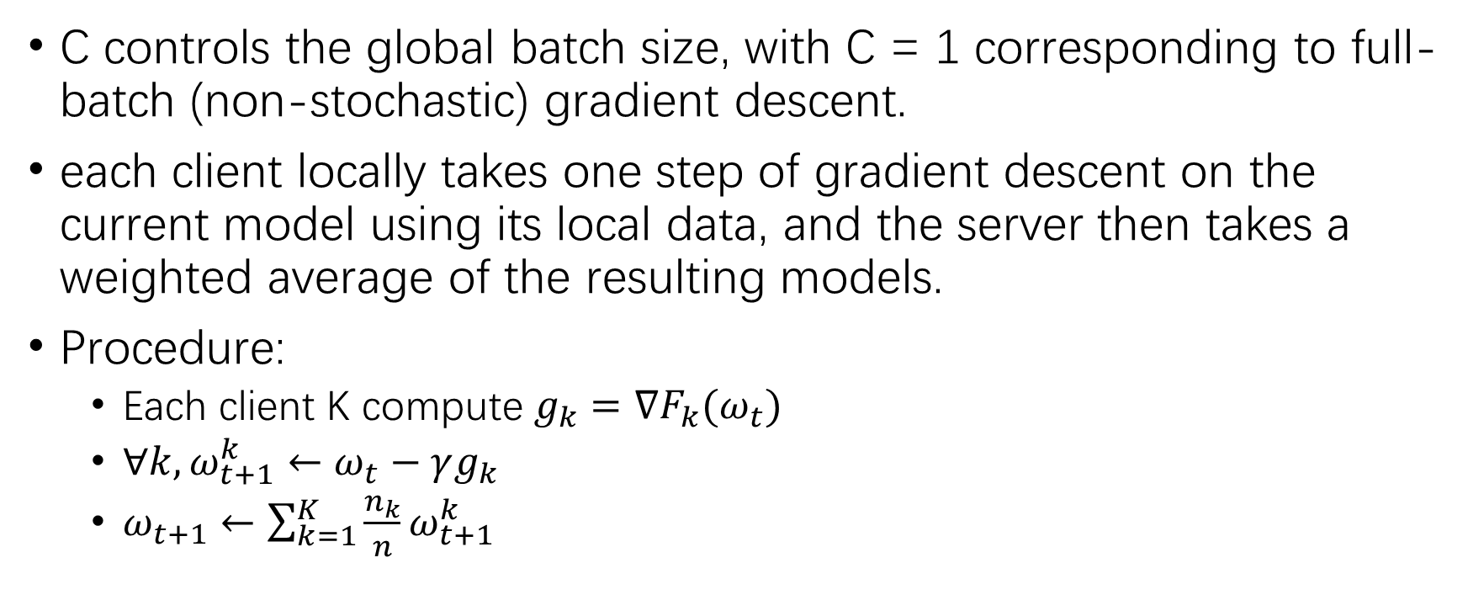
Baseline Algorithm: FederatedSGD (or FedSGD)
C controls the global batch size, with C = 1 corresponding to full-batch (non-stochastic) gradient descent.
each client locally takes one step of gradient descent on the current model using its local data, and the server then takes a weighted average of the resulting models.
Procedure:
Each client K compute $g_{k}=∇F_{k}(ω_{t})$
$∀k, ω_{t+1}^{k}←ω_{t}−γg_{k}$
$ω_{t+1}←\sum_{k=1}^{K}{\frac{n_{k}}{n}}ω_{t+1}^{k}$

Slide 9
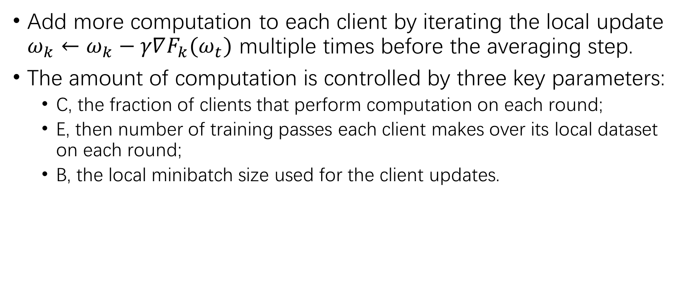
FederatedAveraging Algorithm (or FedAvg)
Add more computation to each client by iterating the local update $ω_{k}←ω_{k}−γ∇F_{k}(ω_{t})$ multiple times before the averaging step.
The amount of computation is controlled by three key parameters:
C, the fraction of clients that perform computation on each round;
E, then number of training passes each client makes over its local dataset on each round;
B, the local minibatch size used for the client updates.

Slide 10
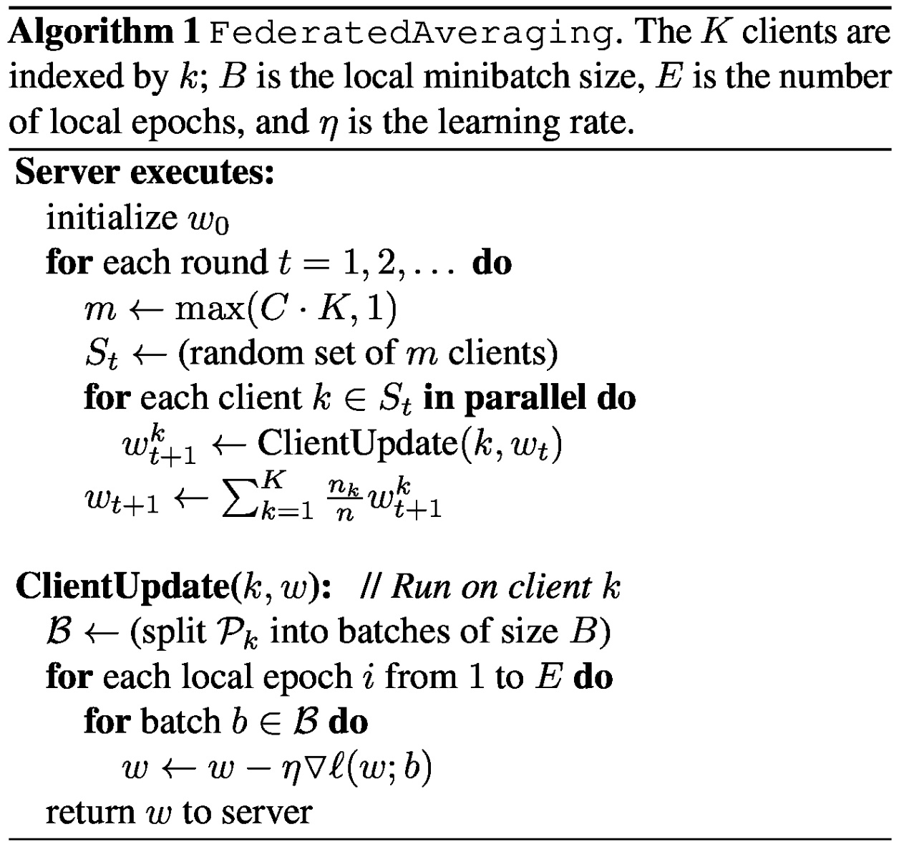
FederatedAveraging Algorithm (or FedAvg)

Slide 11
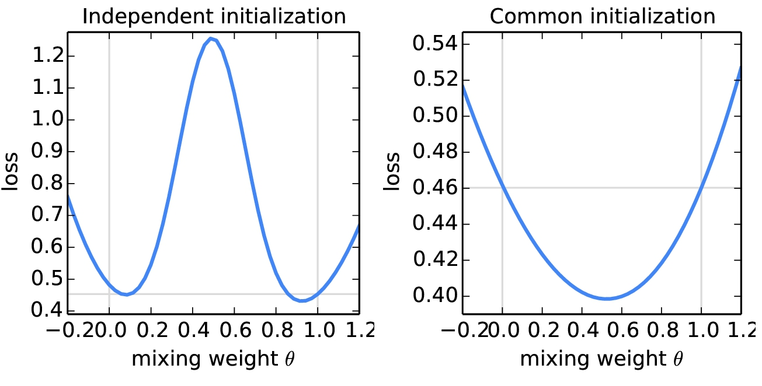

Experimental Results
For the left plot, $ω$ and $ω^{′}$ were initialized using different random seeds; for the right plot, a shared seed was used.
The horizontal line gives the best loss achieved by $ω$ and $ω^{′}$.

Slide 12
Experimental Results
Considering five different model architectures and four datasets.
Our initial study includes three model families on two datasets.
The first two are for the MNIST digit recognition task:
1) A simple multilayer-perceptron with 2-hidden layers with 200 units each using ReLu activations (199,210 total parameters), which we refer to as the MNIST 2NN.
2) A CNN with two 5x5 convolution layers (the first with 32 channels, the second with 64, each followed with 2x2 max pooling), a fully connected layer with 512 units and ReLu activation, and a ﬁnal softmax output layer (1,663,370 total parameters).

Slide 13
Experimental Results
To study federated optimization, we also need to specify how the data is distributed over the clients.
We study two ways of partitioning the MNIST data over clients:
IID, where the data is shuffled, and then partitioned into 100 clients each receiving 600 examples
Non-IID, where we first sort the data by digit label, divide it into 200 shards of size 300, and assign each of 100 clients 2 shards.

Slide 14
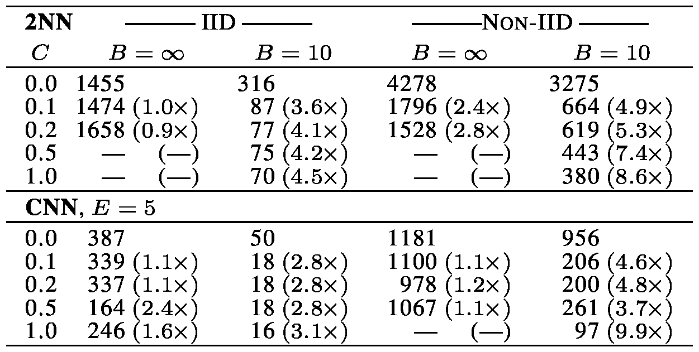
Increasing parallelism
Effect of the client fraction C on the MNIST 2NN with E = 1 and CNN with E = 5.
Note C = 0.0 corresponds to one client per round

Slide 15
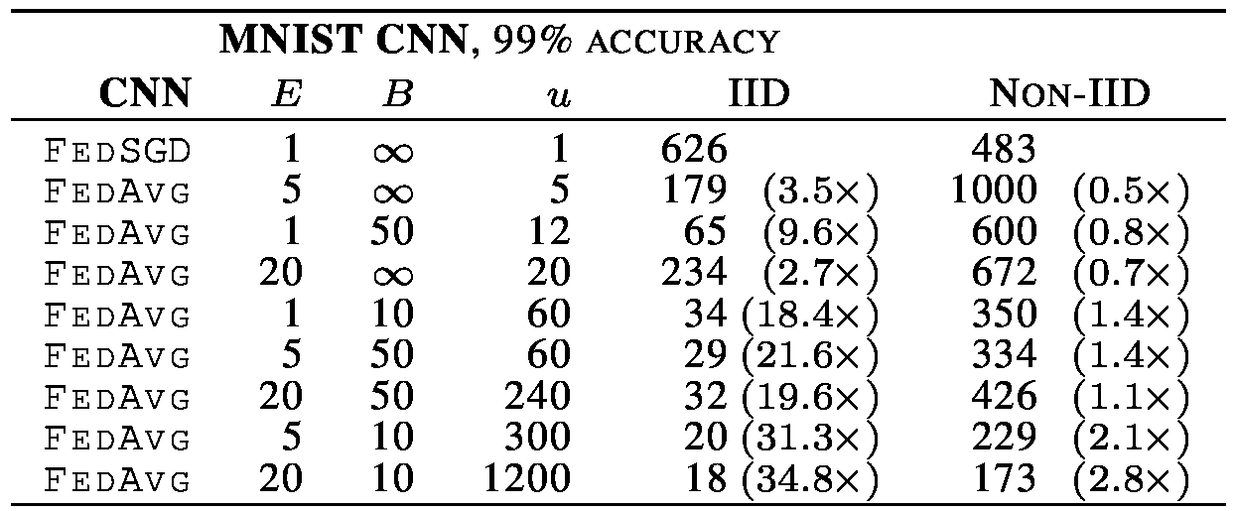
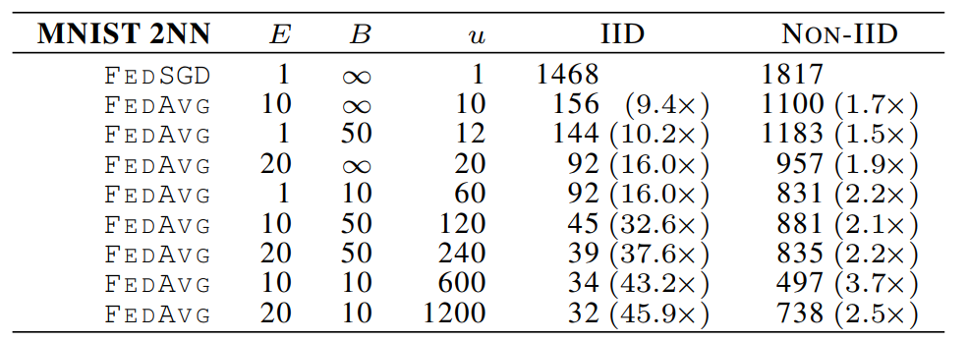
Increasing computation per client
fix C = 0.1, and add more computation per client on each round, either decreasing B, increasing E, or both.

Slide 16
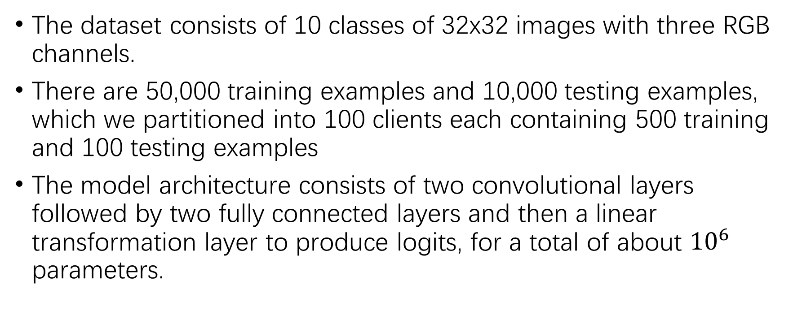
CIFAR experiments
The dataset consists of 10 classes of 32x32 images with three RGB channels.
There are 50,000 training examples and 10,000 testing examples, which we partitioned into 100 clients each containing 500 training and 100 testing examples
The model architecture consists of two convolutional layers followed by two fully connected layers and then a linear transformation layer to produce logits, for a total of about ${10}^{6}$ parameters.

Slide 17
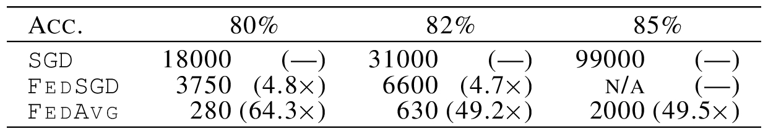
CIFAR experiments
SGD training on the full training set using minibatches of size 100. We achieved an 86% test accuracy after 197,500 minibatch.
FedAvg achieves a similar test accuracy of 85% after only 2,000 communication rounds.

Slide 18
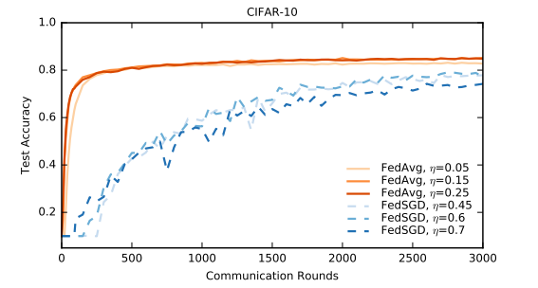
CIFAR experiments
SGD training on the full training set using minibatches of size 100. We achieved an 86% test accuracy after 197,500 minibatch.
FedAvg achieves a similar test accuracy of 85% after only 2,000 communication rounds.

Slide 19
Large-scale LSTM experiments
Training dataset consists 10 million public posts from a large social network. We grouped the posts by author, for a total of over 500,000 clients.
Limited each client dataset to at most 5000 words, and report accuracy on a test set of 1e5 posts from different (non-training) authors.
Model is a 256 node LSTM on a vocabulary of 10,000 words. The input and output embeddings for each word were of dimension 192, and co-trained with the model; there are 4,950,544 parameters in all.

Slide 20
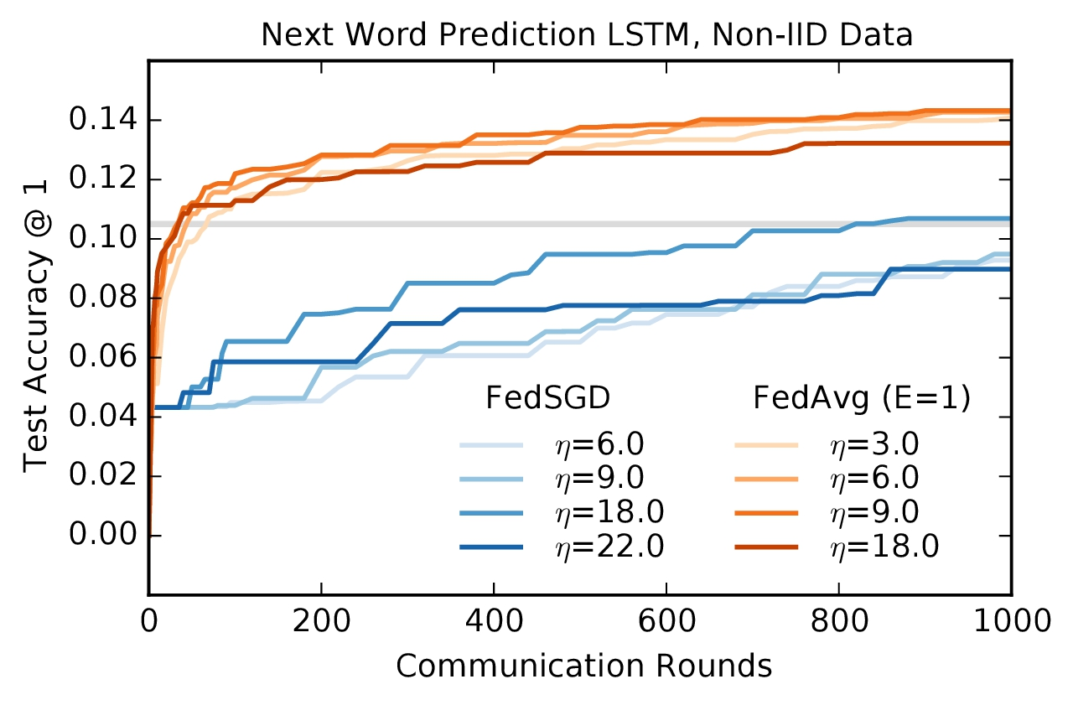
Large-scale LSTM experiments

Slide 21
Conclusions
Experiments show that federated learning can be made practical, as FedAvg trains high-quality models using relatively few rounds of communication, as demonstrated by results on a variety of model architectures
These experiments demonstrate the approach is robust to the unbalanced and non-IID data distributions that are a defining characteristic of this setting.
Communication costs are the principal constraint, and we show a reduction in required communication rounds by 10–100× as compared to synchronized stochastic gradient descent.

Slide 22
Thank you
分享人：罗双

