Slide 1
ArcFace
Additive Angular Margin Loss for Deep Face Recognition

Slide 2
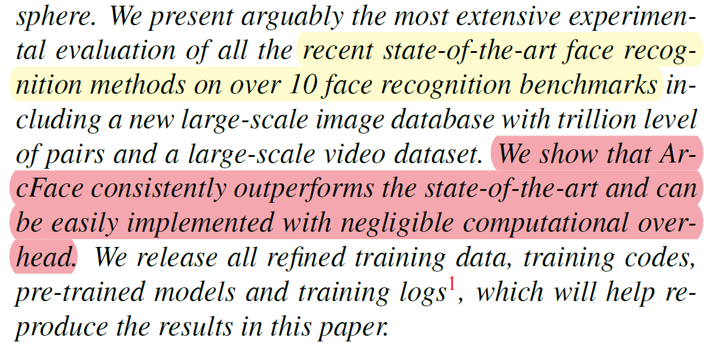
简介
全文给出了
12张图 9张表

Slide 3
简介
Engaging（解释性）. ArcFace directly optimises the geodesic dis-tance margin by virtue of the exact correspondence between the angle and arc in the normalised hypersphere. We intuitively illustrate what happens in the 512-D space via analysing the angle statistics between features and weights.
Effective（高性能）. ArcFace achieves state-of-the-art performance on ten face recognition benchmarks including large-scale image and video datasets.
Easy（简单）. ArcFace only needs several lines of code as given in Algorithm 1 and is extremely easy to implement in the computational-graph-based deep learning frameworks, e.g. MxNet [8], Pytorch [25] and Tensorflow [4]. Furthermore, contrary to the works in [18, 19], ArcFace does not need to be combined with other loss functions in order to have stable performance, and can easily converge on any training datasets.
Efficient（高效）. ArcFace only adds negligible computational complexity during training. Current GPUs can easily support millions of identities for training and the model parallel strategy can easily support many more identities.

Slide 4
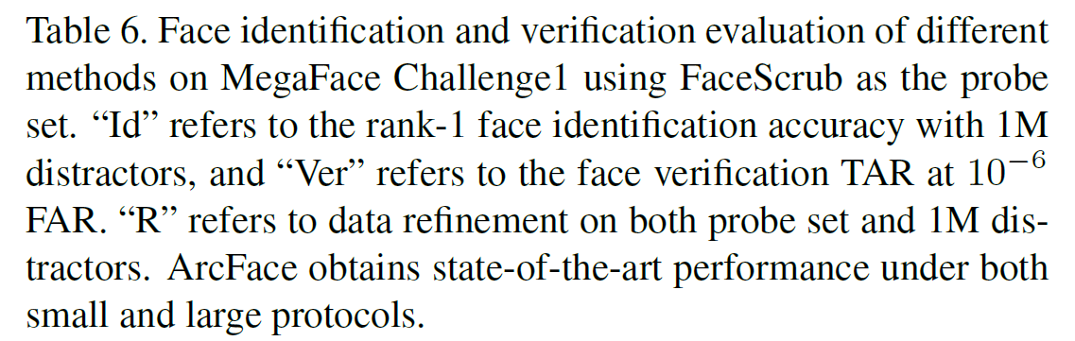
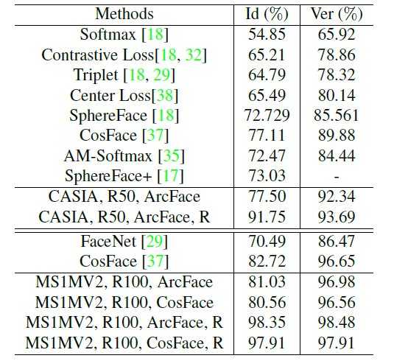
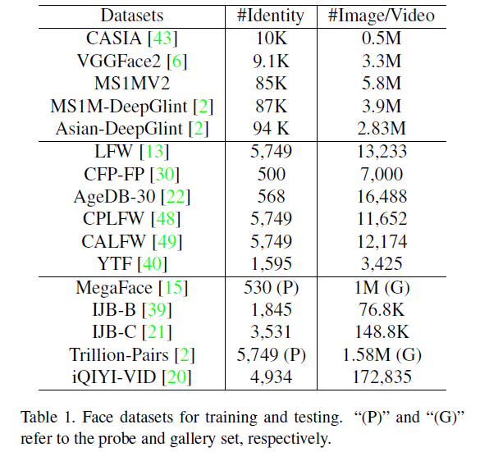
简介

Slide 5
特征提取
基于特征点的提取方法
基于降维方法
PCA方法
LDA方法
神经网络方法
ResNet ——CNN

Slide 6
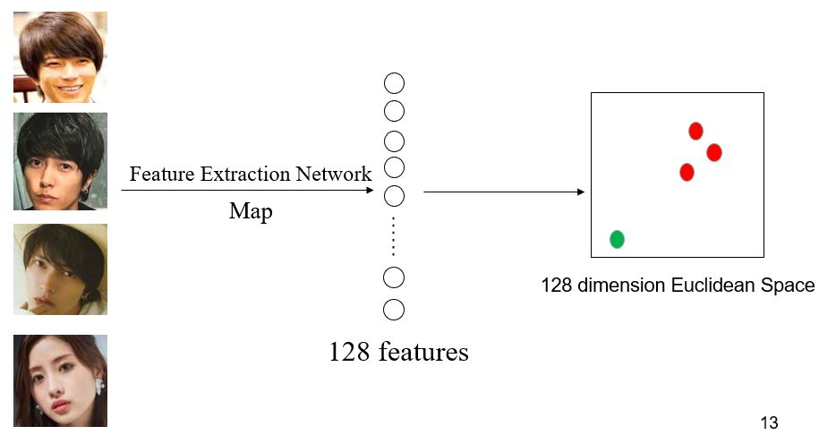
特征提取

Slide 7
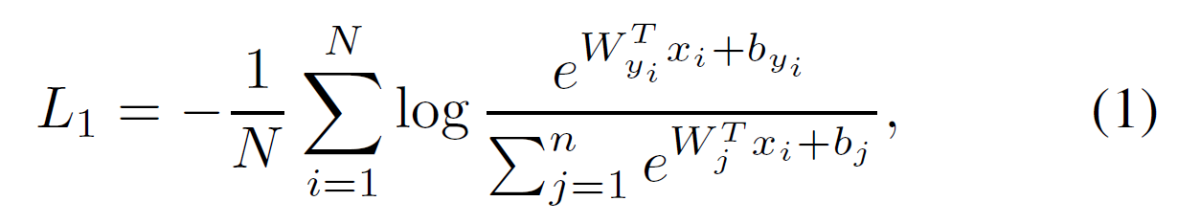
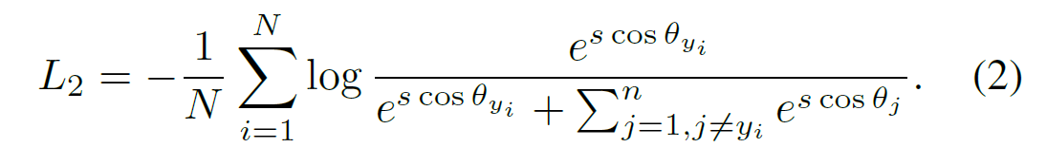
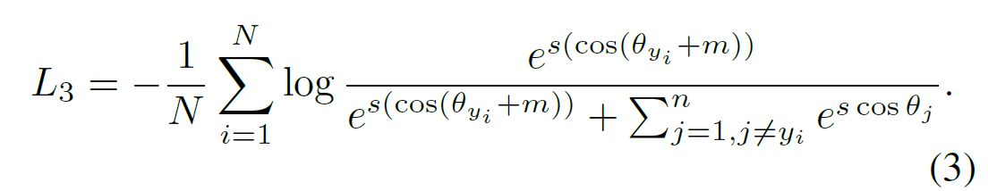
损失计算

Slide 8
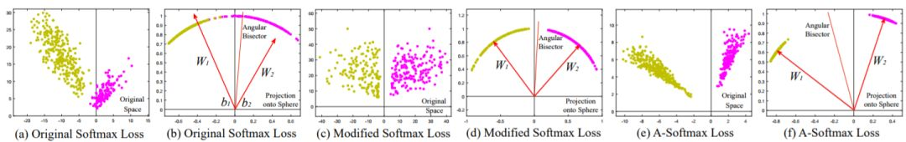
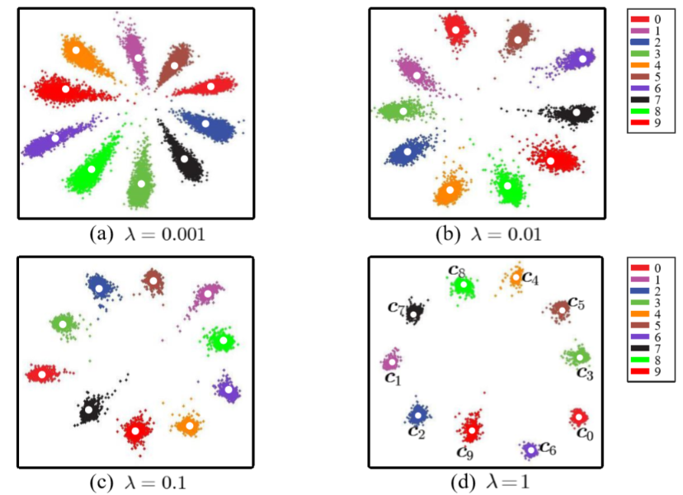
损失计算

Slide 9
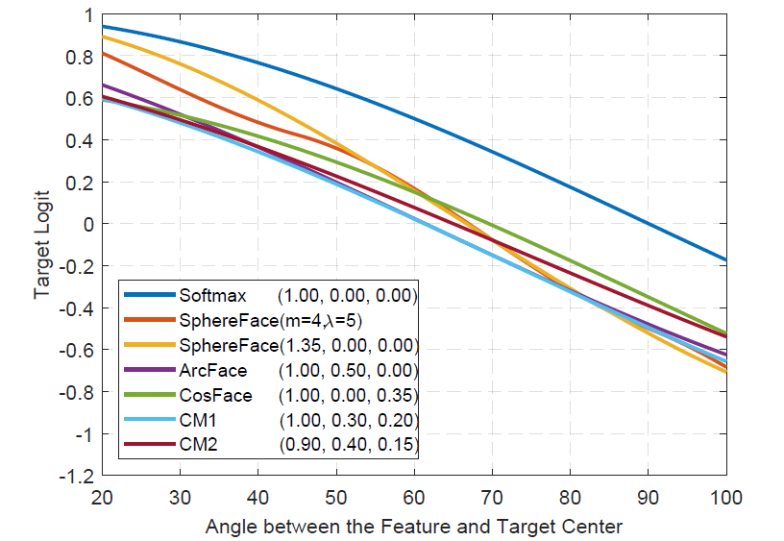
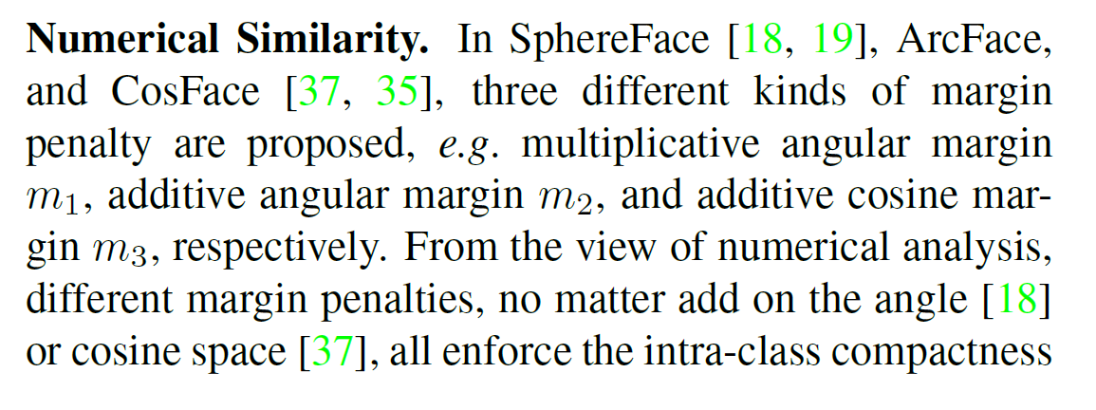
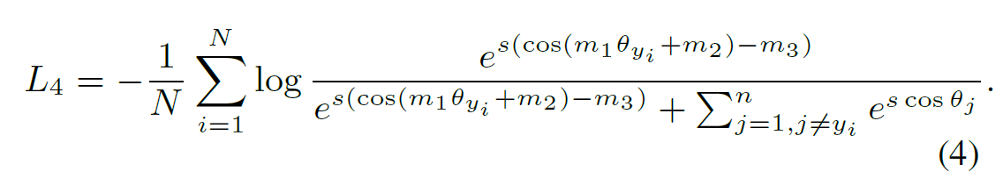
损失计算

Slide 10
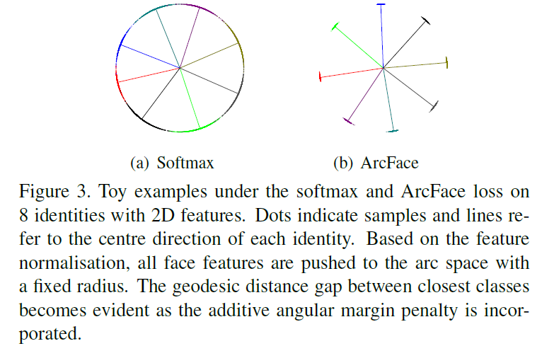
损失计算

Slide 11
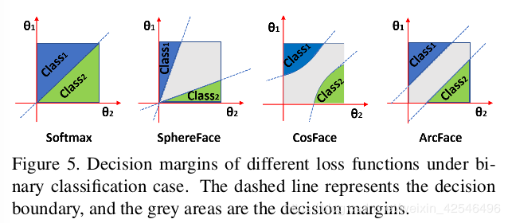
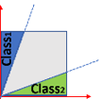
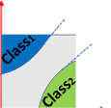
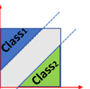
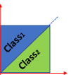
损失计算

Slide 12
损失计算

Slide 13
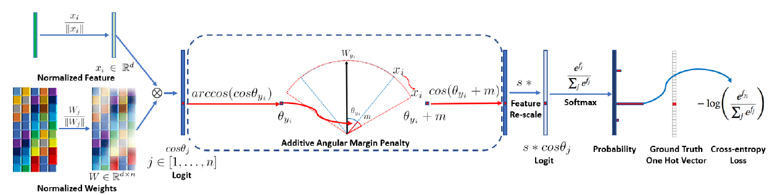
损失计算

Slide 14
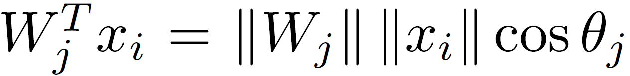
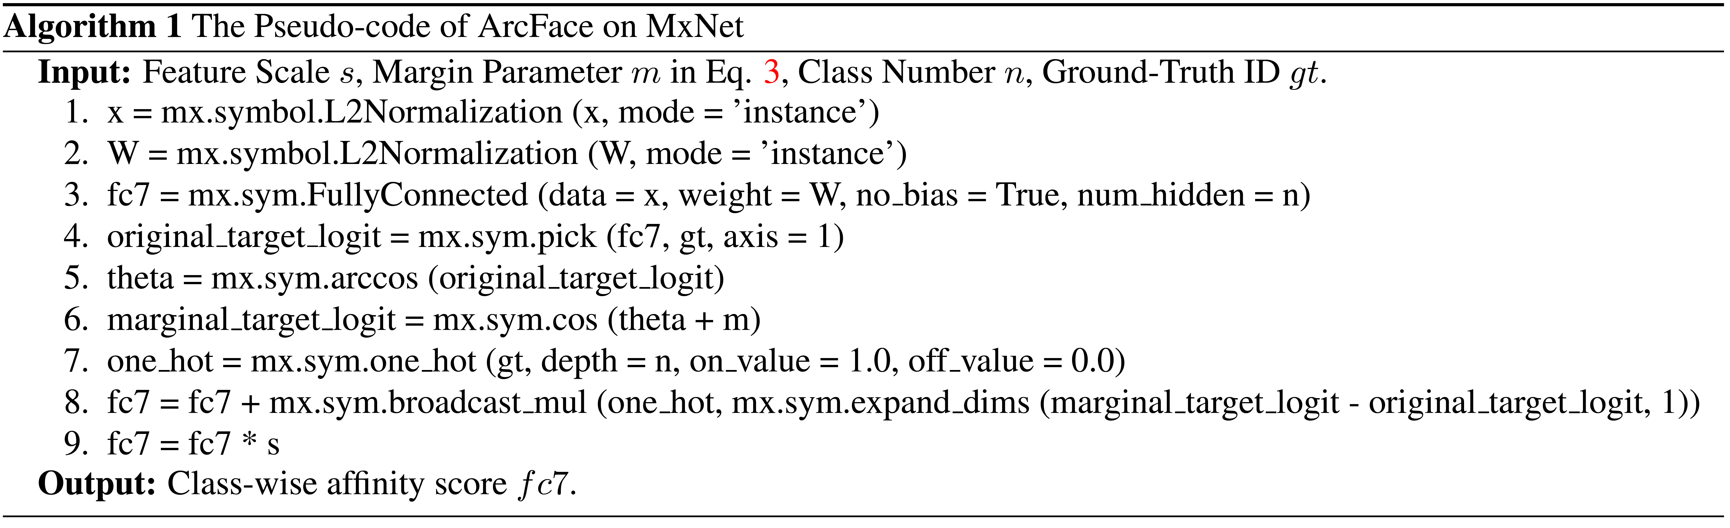
伪代码实现

Slide 15
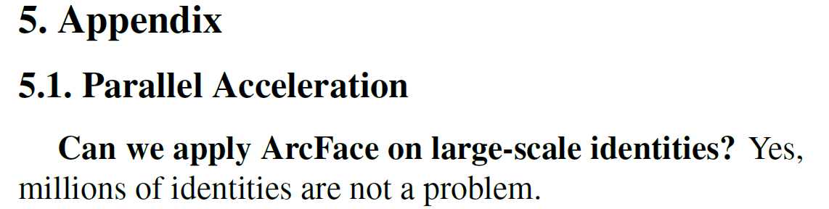
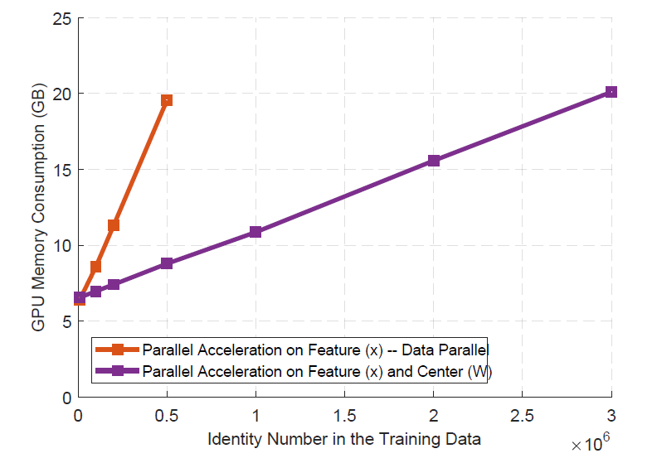
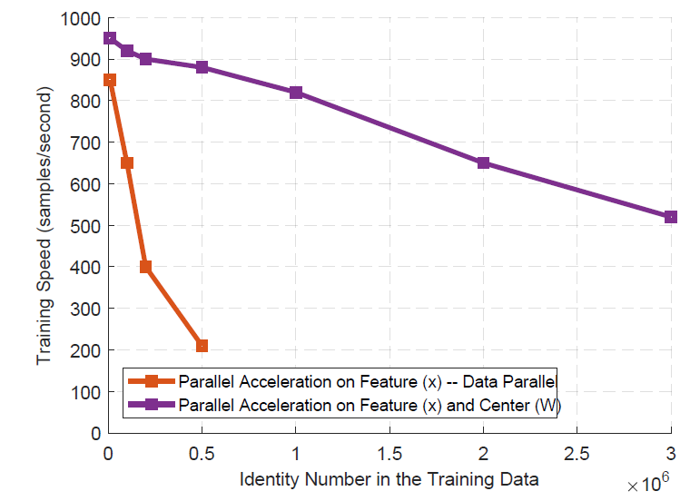
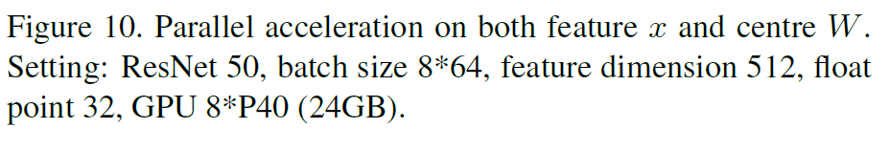
探索实验

Slide 16
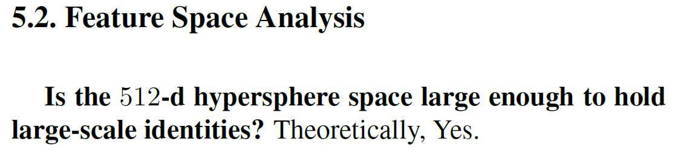
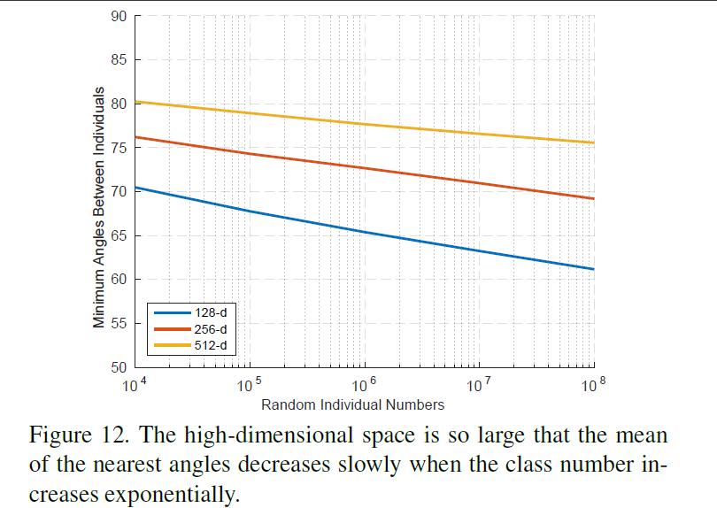
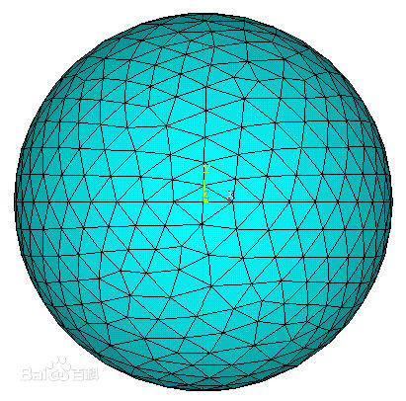
探索实验

