Slide 1
Genetic Algorithm
Traveling Salesman
Team 527: Abdusamed Shamsuddin, Yanfei Peng

Slide 2
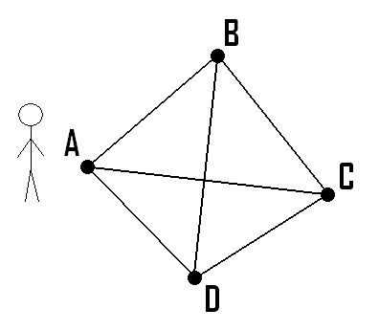
Problem Description
The Travelling Salesman Problem (often called TSP) is a classic algorithmic problem in the field of computer science and operations research^{[1]}. It is focused on optimization. In this context better solution often means a solution that is cheaper. TSP is a mathematical problem. It is most easily expressed as a graph describing the locations of a set of nodes.
Our goal in this problem is to find the shortest path to visit all cities(points) exactly once.

Slide 3
Approach
Initial Population Size(50) : Randomly generated individuals , filled with different Route.
Population: { [MA,CA,NY,MI],[CA,MA,NY,MI],[NY,CA,MA,MI].......}
Genotype: Each Route consists with City objects(Array of Cities).
Single Route: [MA,CA,NY,MI]
Gene Expression: Cities are randomly distributed within the array.
The index of city is random. [MA,CA,NY,MI] and [CA,NY,MI,MA] are in different gene expression

Slide 4
Approach
Tournament Size(5): Randomly pick 5 individuals from entire population as tournament array
Fitness Score: Sum of the distance of all city in a route in consecutive order. For better illustration, we used total distance as fitness score instead of 1/distance. Thus, best fitness score = lowest fitness score, worst fitness score = highest fitness score, the lower the score, the shorter the path, the better fit.
Distance: Calculated as the line distance between two cities x, y coordinate

Slide 5


Approach
Parents: Select two best fitness score individuals as parents
CrossOver: Randomly generate a START and END point. Pick START and END point element from Parent A. Pick rest of element(no duplicate) from Parent B.

Slide 6

Approach
Mutation (0.015 Possibility): after crossover, child is produced. The child will have certain possibility to mutate. Swap city by index to mutate.
Eliminate: if new child fitness score is better than the worst fitness score individual in origin population, replace the lowest fitness score individual with child.

Slide 7
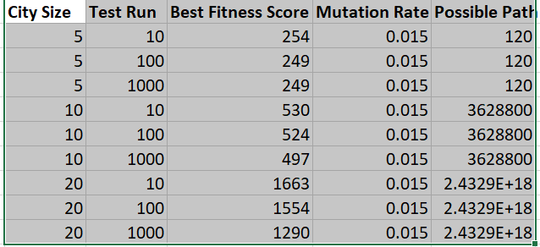
Experiment
Kept City Size at 5
All possible path solution is 120
10 Evolution : 254m
100 Evolution, 100Evlotion: 249m(Find Best Case)
Kept City Size at 20
All possible path solution is 2.4329E + 18
10 Evolution: 1663m
100 Evolution: 1554m
1000 Evolution: 1290m

Slide 8
Conclusion
GA is useful to find best solution. The larger the number of element is the individual, the more possible combination of solution.
When mutation is high, the result is not stable.
For a 5 city sized array, the number of possible route is 120. For a 10 city sized array, the number of possible route is 3628800. For a 20 city sized array, the number of possible route is 2.4329E +18. The more times of test run(evolution), the better chance we find best fit path(shortest distance path).

Slide 9
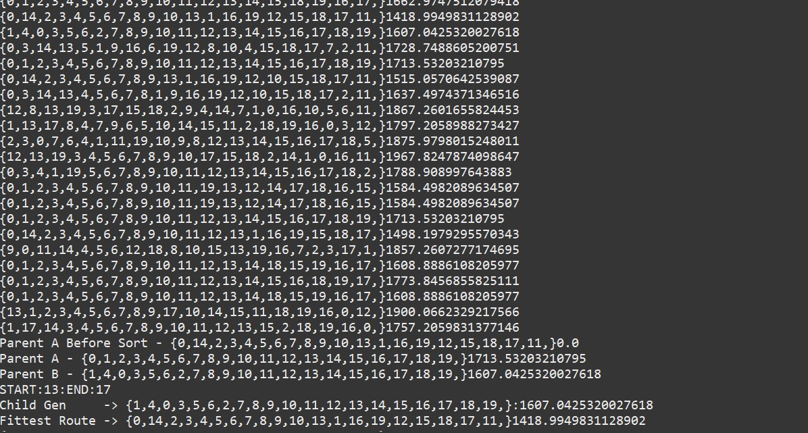
Main Run Screenshot

Slide 10
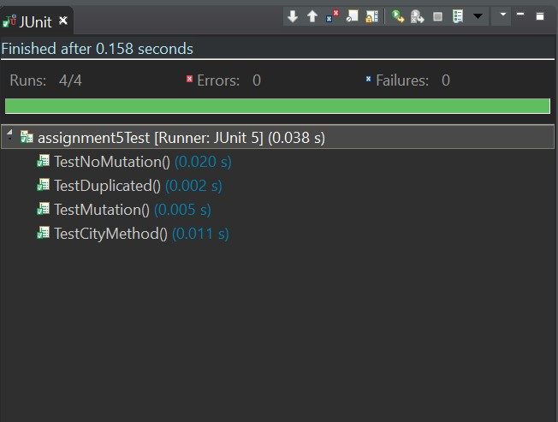
Unit Test Passed

