Slide 1
Semester Project
1
N-queen problem visualizer
presented By: Husnain momin, Muhammad qasim and imran

Slide 2
Overview
2
N-Queen Algorithm
The idea is to place queens one by one in different columns, starting from the leftmost column. When we place a queen in a column, we check for clashes with already placed queens. In the current column, if we find a row for which there is no clash, we mark this row and column as part of the solution. If we do not find such a row due to clashes, then we backtrack and return false.

Slide 3
Algorithm
3
Start in the leftmost column
If all queens are placed return true
Try all rows in the current column. Do the following for every row.
If the queen can be placed safely in this row
Then mark this [row, column] as part of the solution and recursively check if placing queen here leads to a solution.
If placing the queen in [row, column] leads to a solution then return true.
If placing queen doesn’t lead to a solution then unmark this [row, column] then backtrack and try other rows.
If all rows have been tried and valid solution is not found return false to trigger backtracking.

Slide 4
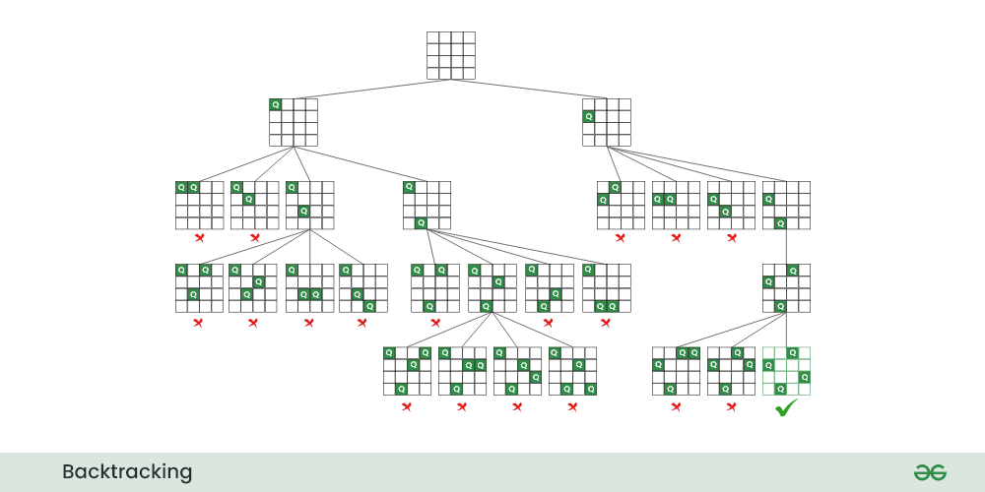
Recursion Tree
4

Slide 5
Points to Note in Code
5
It uses a simple 2D array to represent the chessboard. The elements of the array are either 0 or 1, indicating whether a queen is placed or not
The isSafe function checks if it's safe to place a queen in a given row and column. It checks the row, upper left diagonal, and lower left diagonal for any other queens.
The solveNQUtil function uses a recursive backtracking approach to try placing queens in different columns, backtracking if it reaches an invalid state.

Slide 6
Time and Space Complexity
6
Time Complexity: O(N!) Auxiliary Space: O(N^2)

Slide 7
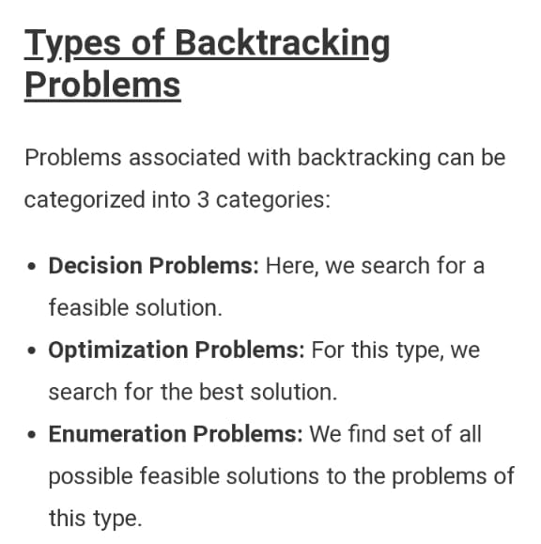
NP-Hard Problem
7
The N-Queens problem is an NP-hard problem, meaning that the time complexity can be exponential in the worst case. Different implementations of the backtracking algorithm may explore the solution space in different orders, leading to variations in the number of iterations.

Slide 8
Applications
8
Puzzle and Recreational Games
Constraint Satisfaction Problems (CSP)

Slide 9
Thank You
9

