Slide 1
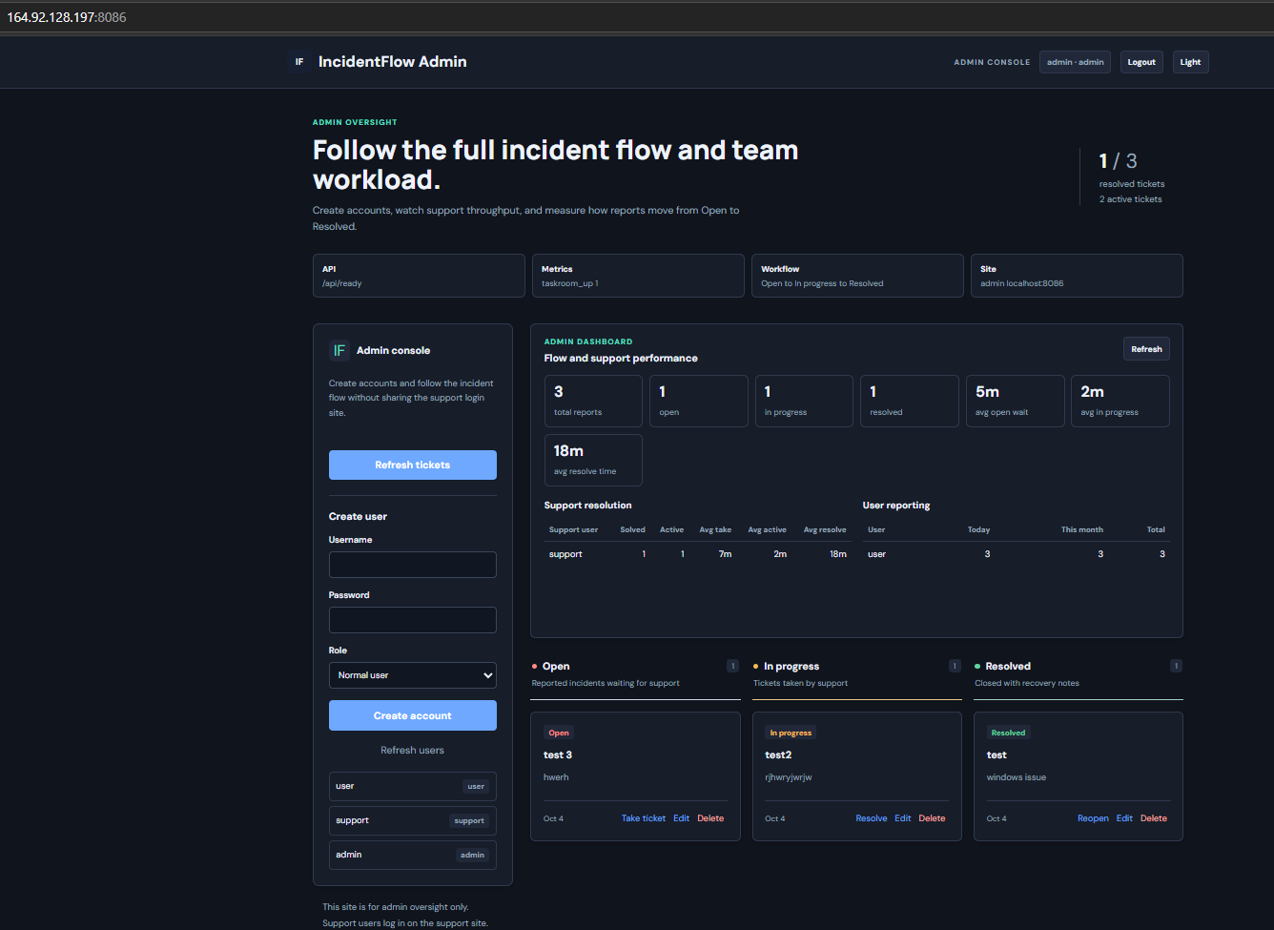
INCIDENTFLOW / DIGITALOCEAN
01 / 08
IncidentFlow
DigitalOcean Proof
A short-lived cloud deployment proving Terraform, Ansible, Docker Compose, and a working incident workflow.
Terraform + Ansible + Docker Compose
Cloud proof cost: about $0.06
IncidentFlow / Terraform / Ansible / DigitalOcean
Notes:
Evidence: admin portal screenshot from 2026-10-04 at 164.92.128.197:8086.

Slide 2
INCIDENTFLOW / DIGITALOCEAN
02 / 08
Short-lived cloud
environment
The goal was proof, not permanent hosting: create the smallest useful VM, test the workflow, capture evidence, then shut it down.
01 PROVISION
Terraform creates cloud resources
Droplet, SSH key, firewall, and output URLs
02 CONFIGURE
Ansible prepares the server
Docker, environment file, Compose stack, and image pulls
03 RUN
Five containers start cleanly
API, PostgreSQL, user UI, support UI, and admin UI
04 VERIFY
Readiness and workflow checks pass
user report -> support resolve -> admin metrics
05 DESTROY
Resources are removed after evidence
cost stays low because the proof is short-lived
IncidentFlow / Terraform / Ansible / DigitalOcean
Notes:
Narrative based on the DigitalOcean proof workflow completed on 2026-10-04.

Slide 3
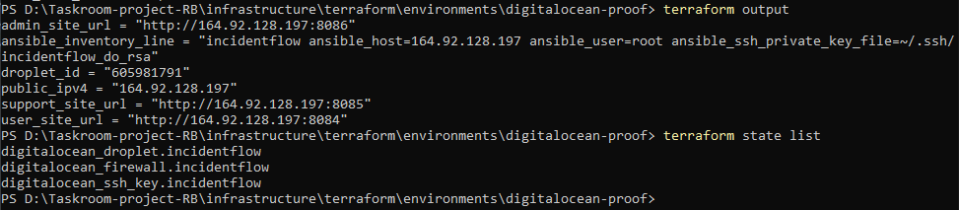
INCIDENTFLOW / DIGITALOCEAN
03 / 08
Terraform created
the infrastructure
The cloud state exposed the public IP, site URLs, Droplet ID, and managed resources needed for the proof.
Output confirmed: user :8084, support :8085, admin :8086
State list showed DigitalOcean Droplet, firewall, and SSH key resources.
IncidentFlow / Terraform / Ansible / DigitalOcean
Notes:
Evidence: Terraform output screenshot showing public_ipv4 164.92.128.197 and DigitalOcean resources.

Slide 4
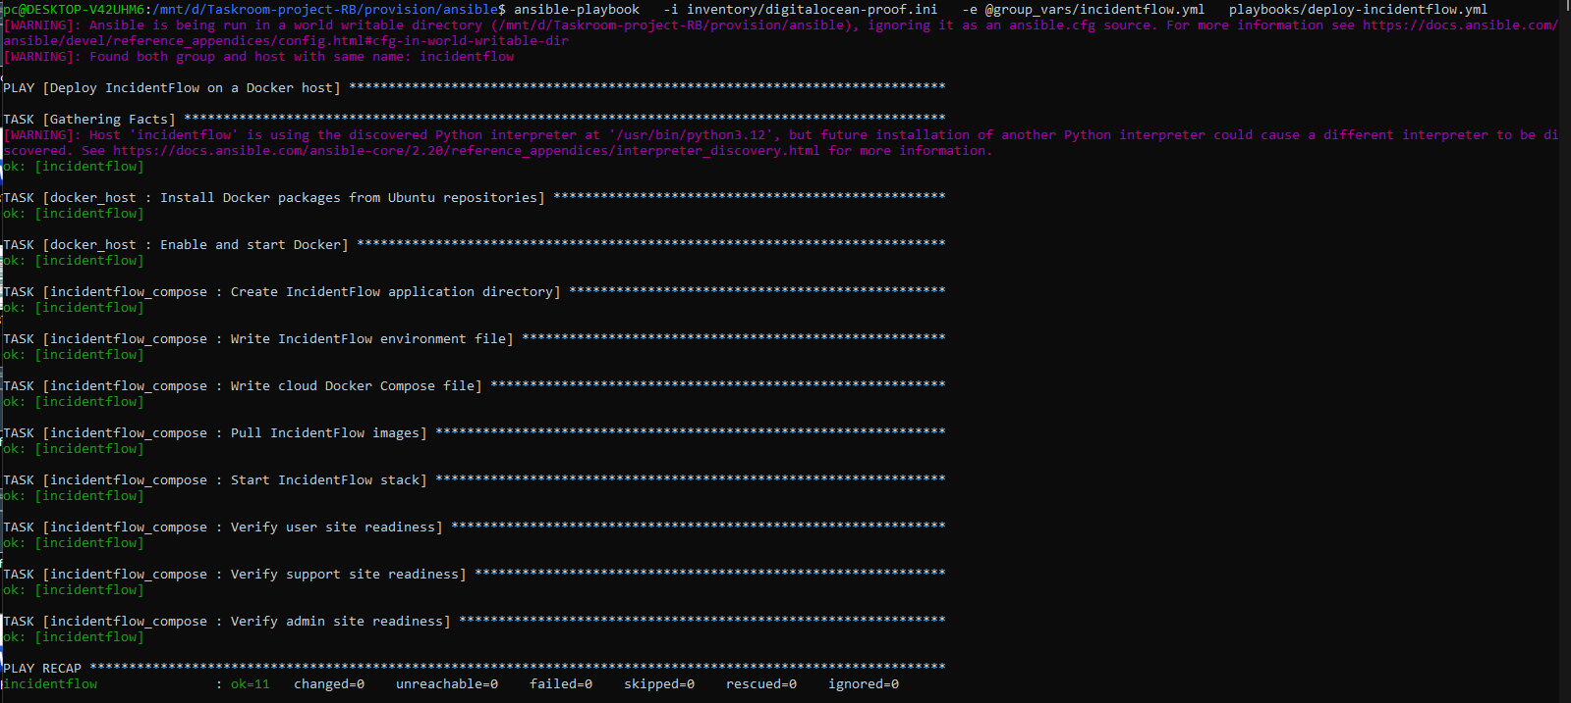
INCIDENTFLOW / DIGITALOCEAN
04 / 08
Ansible deployed
the stack
The playbook prepared the server, wrote the application environment, pulled images, started Compose, and verified all three sites.
Idempotence result: ok=11, changed=0, failed=0
That second clean run is the proof that the automation can be repeated safely.
IncidentFlow / Terraform / Ansible / DigitalOcean
Notes:
Evidence: Ansible playbook screenshot from WSL showing all tasks OK and no failures.

Slide 5
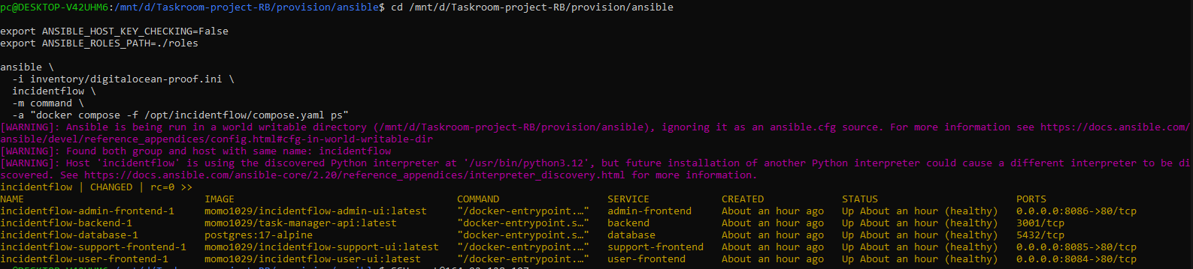
INCIDENTFLOW / DIGITALOCEAN
05 / 08
Containers healthy
on the Droplet
The running server showed every service up and healthy, with public ports mapped only for the three portals.
BACKEND
USER
SUPPORT + ADMIN
3001
8084
8085 / 8086
internal API
public portal
separate sites
IncidentFlow / Terraform / Ansible / DigitalOcean
Notes:
Evidence: remote docker compose ps output showing database, backend, user frontend, support frontend, and admin frontend healthy.

Slide 6
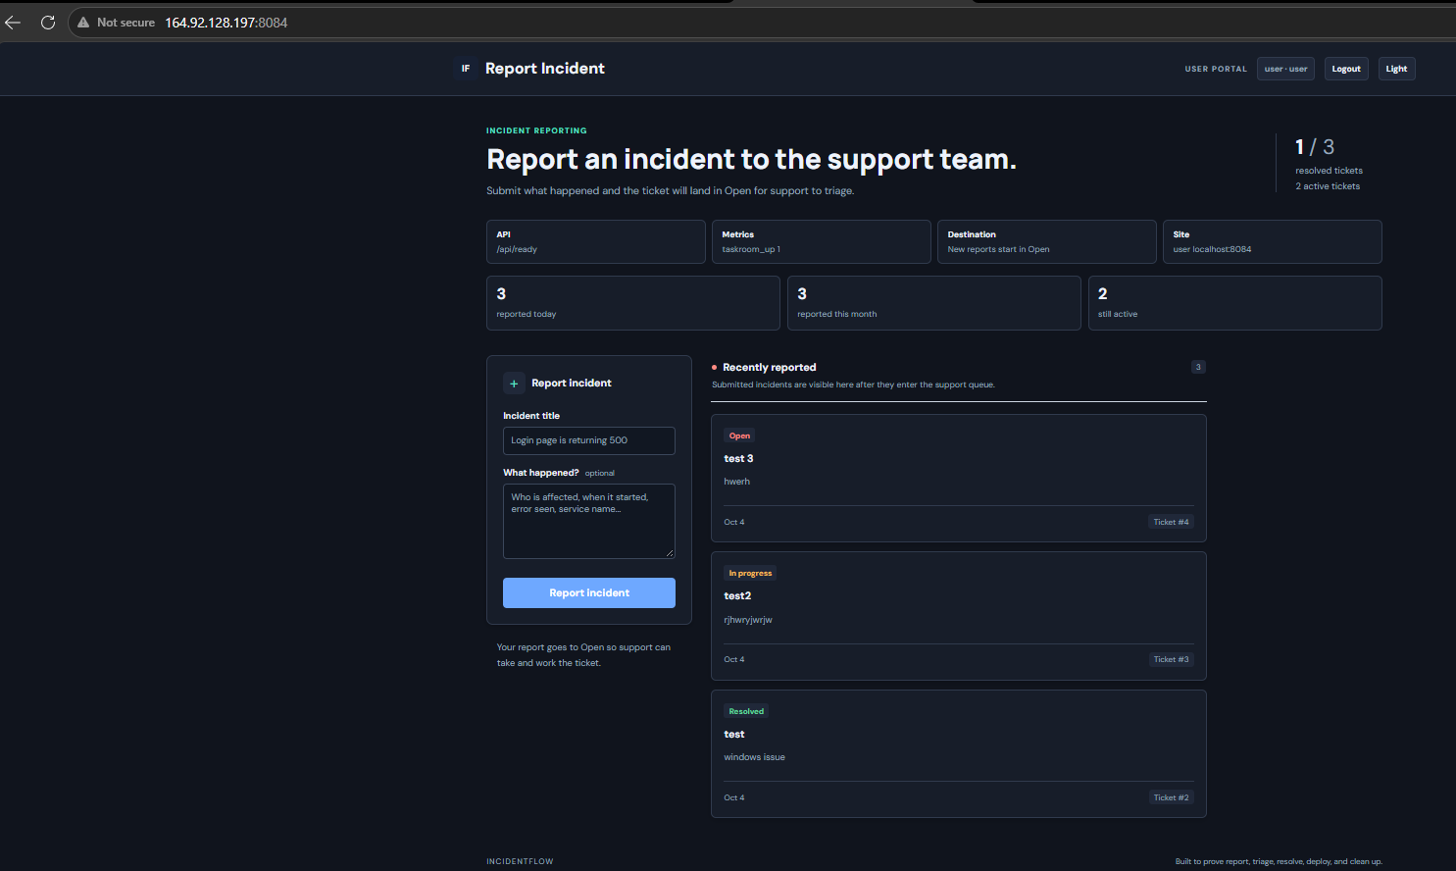
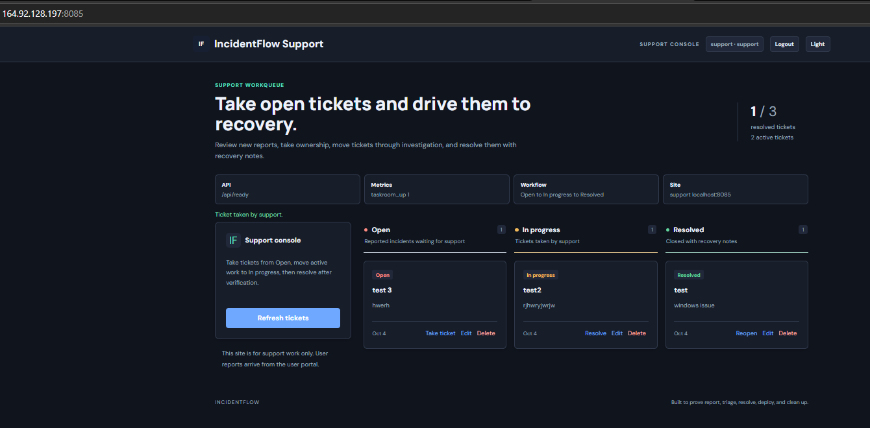
INCIDENTFLOW / DIGITALOCEAN
06 / 08
Three portals,
one cloud VM
IncidentFlow runs as separate web entry points so users, support, and admins do not share the same console.
User reports incidents. Support takes and resolves tickets. Admin follows the whole flow.
IncidentFlow / Terraform / Ansible / DigitalOcean
Notes:
Evidence: screenshots of user, support, and admin portals on 164.92.128.197 ports 8084, 8085, and 8086.

Slide 7
INCIDENTFLOW / DIGITALOCEAN
07 / 08
Admin dashboard
measured the flow
The admin view tracked active tickets, resolved work, support ownership, and split timing for Open and In progress stages.
TOTAL REPORTS
OPEN WAIT
IN PROGRESS
3
5m
2m
submitted in proof
avg open stage
avg active stage
This proves the app is more than static hosting: it has roles, data, workflow, and metrics.
IncidentFlow / Terraform / Ansible / DigitalOcean
Notes:
Evidence: admin dashboard screenshot showing support resolution metrics and user reporting counts.

Slide 8
INCIDENTFLOW / DIGITALOCEAN
08 / 08
Proof first,
then AWS
DigitalOcean was the cheapest practical checkpoint: prove the deployment discipline, then repeat it on AWS with the same cost-control rule.
DONE
Terraform infrastructure created and recorded
public IP, site URLs, Droplet ID, state list
DONE
Ansible deployment repeated cleanly
second run: ok=11, changed=0, failed=0
DONE
Application workflow tested live
user report -> support resolution -> admin metrics
NEXT
AWS proof with small resources only
run, screenshot, document, destroy
Rule: small first, prove the skill, capture evidence, destroy resources.
IncidentFlow / Terraform / Ansible / DigitalOcean
Notes:
Summary slide for publishing after the DigitalOcean proof and before the AWS proof.

