Slide 1
Data Mining and Exploration
Samia M. Abd-Alhalem
11

Slide 2
Course’s Information:
Course: Data Mining and Exploration (CSC213) Credits: 3 Hrs
Pre- Requisites:Database Management Systems (CSC125)
Department : General
Instructor: Dr. Samia M. Abd-Alhalem
email: samia.mohammed@deltauni.edu.eg

Slide 3
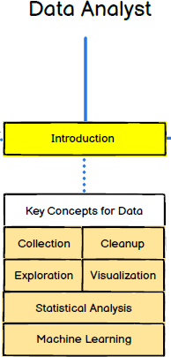

Slide 4
Course’s Description:
- This course has been designed to
give the students
an introduction to data mining and
hands on
experience with all phases
of the data mining
process using and modern tools.
real data
- It covers many topics such as and
data formats,
cleaning
;
make predication using supervised and
unsupervised learning using python and other
tools, and sound evaluation methods; and
data /
knowledge visualization.

Slide 5
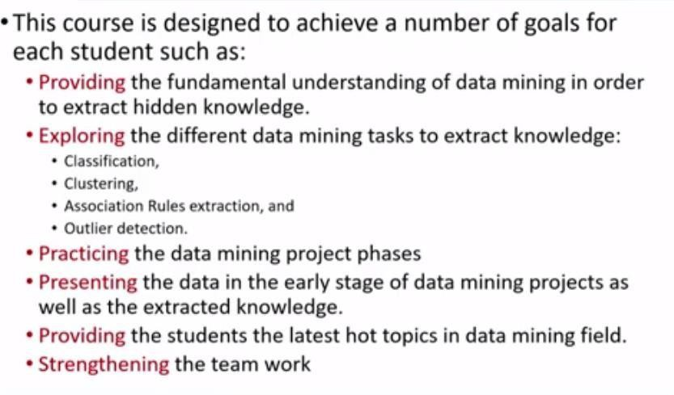
Course’s Objectives
Regression.
4

Slide 6
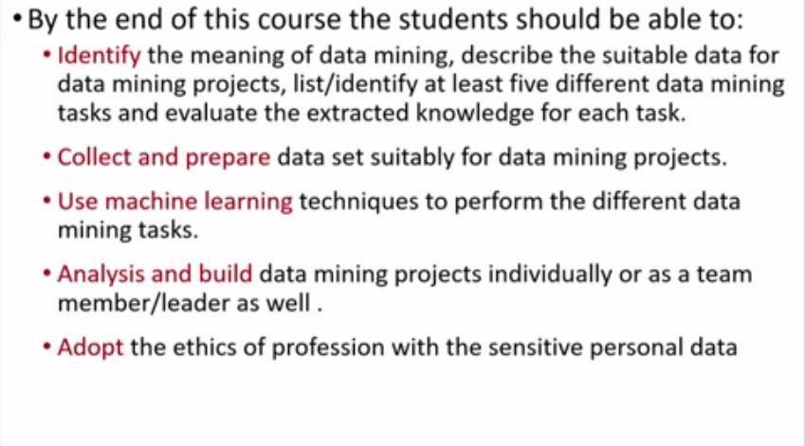
Course’s Outcome

Slide 7
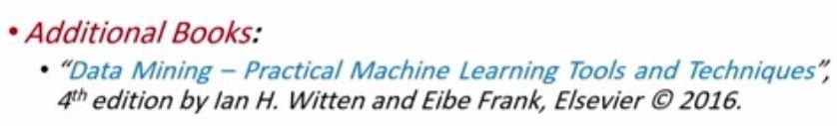
Textbook & Course Coverage
Text book: “Data Mining: Concepts and Techniques, 3rd Edition” by J. Han, M. Kamber, and J. Pei – 2012.

Slide 8
Course’s Outline
Introduction (Chapter 1)
Getting to Know Your Data (Chapter 2)
Data Preprocessing (Chapter 3)
Mining Frequent Patterns & Association: Basic Concepts (Chapter 6)
Classification: Basic Concepts (Chapter 8)
Cluster Analysis: Basic Concepts and Methods(Chapter10)
Outlier Analysis (Chapter 12)
Data Mining Trends and Research Frontiers (Chapter
13)

Slide 9
Teaching Methods:
Lectures, Sections,
Discussion Groups,
Team Work
Using Presentations.

Slide 10

Evaluation Criterion “Grades”:
Data Mining: Concepts and Techniques

Slide 11
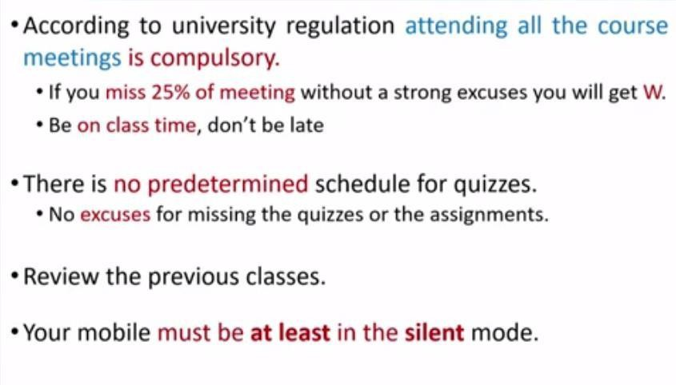
Course Requirements:

Slide 12
Agenda (Lec. 1)
Introduction (Chapter 1)
  Why Data Mining?
  What is Data Mining?
  Knowledge Discovery Process
  Data Mining Tasks
  What Kinds of Technologies Are Used?
  Summary

Slide 13
Data Mining Function: Classification
Classification and label prediction
  Construct models (functions) based on some training examples
  Describe and distinguish classes or concepts for future prediction
    E.g., classify countries based on (climate), or classify cars based on (gas mileage)
  Predict some unknown class labels
Typical methods
  Decision trees, naïve Bayesian classification, support vector machines, neural networks, rule-based classification, pattern-based classification, logistic regression, …
Typical applications:
  Credit card fraud detection, direct marketing, classifying stars, diseases, web-pages, …
5

Slide 14
Data Mining Function: Association and Correlation Analysis
Frequent patterns (or frequent itemsets)
  What items are frequently purchased together in your Walmart?
Association, correlation vs. causality
  A typical association rule
    Diaper → Beer [0.5%, 75%] (support, confidence)
Are strongly associated items also strongly correlated?
How to mine such patterns and rules efficiently in large datasets?
How to use such patterns for classification, clustering, and other applications?
1

Slide 15
Data Mining Function: Cluster Analysis
Unsupervised learning (i.e., Class label is unknown)
Group data to form new categories (i.e., clusters), e.g., cluster houses to find distribution patterns
Principle: Maximizing intra-class similarity & minimizing
interclass similarity
Many methods and applications
1

Slide 16
Data Mining: Concepts and Techniques
Data Mining plays a crucial role in today's data-centric world. It involves the practice of inspecting, cleansing, transforming, and modeling data to extract valuable insights for decision-making.
A Data Analyst is a professional primarily tasked with collecting, processing, and performing statistical analysis on large datasets. They discover how data can be used to answer questions and solve problems. With the rapid expansion of data in modern firms, the role of a data analyst has been evolving greatly, making them a significant asset in business strategy and decision-making processes.

Slide 17
Data Mining: Concepts and Techniques
Data Mining is a core component of a Data Analyst's role. The field involves extracting meaningful insights from raw data to drive decision-making processes.
It includes a wide range of techniques and disciplines ranging from the simple data compilation to advanced algorithms and statistical analysis.
As a data analyst, you are expected to understand and interpret complex digital data, such as the usage statistics of a website, the sales figures of a company, or client engagement over social media, etc.
This knowledge businesses in
enables data analysts to identifying trends, making
support informed
decisions, predicting potential outcomes - hence playing a crucial role in shaping business strategies.

Slide 18
Key Concepts for Data mining
Data can be classified into various types like nominal, ordinal, interval and ratio, each with a specific role and analysis technique.
Higher-dimensional data types like time-series, panel data, and multi-dimensional arrays are also critical.
On the other hand, data quality and data management are key concepts to ensure clean and reliable datasets. With an understanding of these fundamental concepts, a data analyst can transform raw data into meaningful insights.

Slide 19
Data Collection
Data collection is the process of collecting and evaluating information or data from multiple sources to find answers to research problems, answer questions, evaluate outcomes, and forecast trends and probabilities. It is an essential phase in all types of research, analysis, and decision-making, including that done in the social sciences, business, and healthcare.
During data collection, researchers must identify the data types, the sources of data, and the methods being used.

Slide 20
Exploration
Exploration of data is a key concept that data analysts leverage to understand and interpret data effectively. Typically, this exploration process involves discerning
patterns, identifying anomalies, examining
underlying structures, and testing hypothesis, which often gets
accomplished via descriptive statistics, visual methods, or sophisticated algorithms.
It's a fundamental stepping-stone for any data analyst, ultimately guiding them in shaping the direction of further analysis or modeling. This concept serves as a foundation for dealing with complexities and uncertainties in data, hence improving decision-making in various fields ranging from business and finance to healthcare and social sciences.

Slide 21
Machine Learning
Machine learning, a subset of artificial intelligence, is an indispensable tool in the hands of a data analyst.
It provides the ability to automatically learn, improve from experience and make decisions without being explicitly programmed.
In the context of a data analyst, machine learning contributes significantly in uncovering hidden insights, recognising patterns or making predictions based on large amounts of data. Through the use of varying algorithms and models, data analysts are able to leverage machine learning to convert raw data into meaningful information, making it a critical concept in data analysis.

Slide 22
Why Data Mining?
The Explosive Growth of Data: from terabytes to petabytes
  Data collection and data availability
    Automated data collection tools, database systems, Web, computerized society
  Major sources of abundant data
    Business: Web, e-commerce, transactions, stocks, …
    Science: Remote sensing, bioinformatics, scientific simulation, …
    Society and everyone: news, digital cameras, YouTube
We are drowning in data, but starving for knowledge!
“Necessity is the mother of invention”—Data mining—Automated analysis of massive data sets

Slide 23
Evolution of Sciences
Before 1600, empirical science
1600-1950s, theoretical science
  Each discipline has grown a theoretical component. Theoretical models often motivate experiments and generalize our understanding.
1950s-1990s, computational science
  Over the last 50 years, most disciplines have grown a third, computational branch
(e.g. empirical, theoretical, and computational ecology, or physics, or linguistics.)
  Computational Science traditionally meant simulation. It grew out of our inability to find closed-form solutions for complex mathematical models.
1990-now, data science
  The flood of data from new scientific instruments and simulations
  The ability to economically store and manage petabytes of data online
  The Internet and computing Grid that makes all these archives universally accessible
  Scientific info. management, acquisition, organization, query, and visualization tasks scale almost linearly with data volumes. Data mining is a major new challenge!
Jim Gray and Alex Szalay, The World Wide Telescope: An Archetype for Online Science,
Comm. ACM, 45(11): 50-54, Nov. 2002

Slide 24
Chapter 1. Introduction
Why Data Mining?
What Is Data Mining?
Data Mining Tasks
What Kind of Applications Are Targeted?
Major Issues in Data Mining
Summary

Slide 25







What Is Data Mining?
Data mining (knowledge discovery from data)
  Extraction of interesting (non-trivial, implicit, previously unknown and potentially useful) patterns or knowledge from huge amount of data
  Data mining: a misnomer?
Alternative names
  Knowledge discovery (mining) in databases (KDD), knowledge extraction, data/pattern analysis, data archeology, data dredging, information harvesting, business intelligence, etc.

Slide 26




KDD Process: A Typical View from ML and Statistics
Input Data
Data Pre-Processing
Data Mining
Post-
Processing
Data integration Normalization Feature selection Dimension reduction
Pattern discovery Association & correlation Classification
Clustering
Outlier analysis
… … … …
Pattern evaluation Pattern selection Pattern interpretation Pattern visualization
This is a view from typical machine learning and statistics communities

Slide 27
Data Mining: Confluence of Multiple Disciplines
Machine Learning
Pattern Recognition
Statistics
Applications
Data Mining
Visualization
Algorithm
Database
High-Performance Computing
Technology

Slide 28
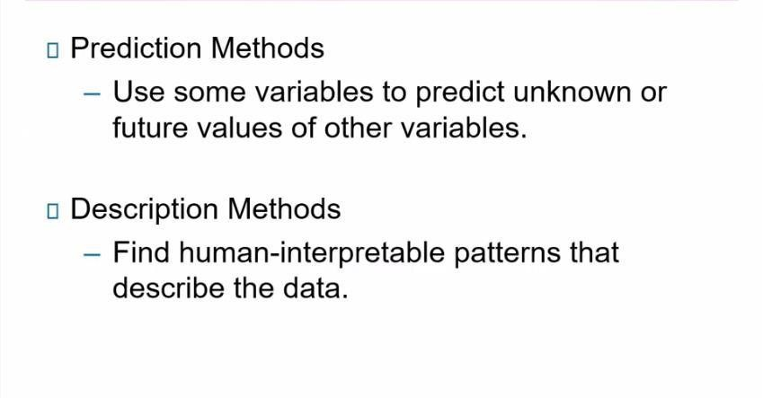
Data Mining Tasks

Slide 29
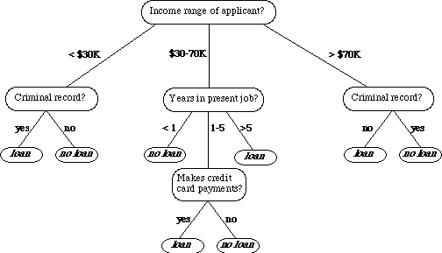
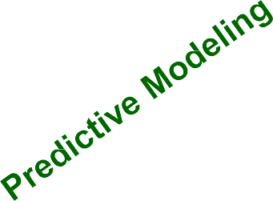

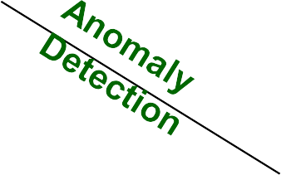
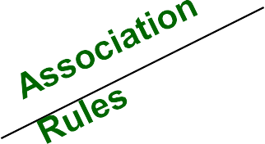





Data Mining Tasks …
Data
Tid | Refund | Marital Status | Taxable Income | Cheat
1 2 3 4 5 6 7 8 9 10 11 12 13 14 15 | Yes No No Yes No No Yes No No No No Yes No No No | Single Married Single Married Divorced Married Divorced Single Married Single Married Divorced Single Married Single | 125K 100K 70K 120K 95K 60K 220K 85K 75K 90K 60K 220K 85K 75K 90K | No No No No Yes No No Yes No Yes No No Yes No Yes
10
Milk
29

Slide 30
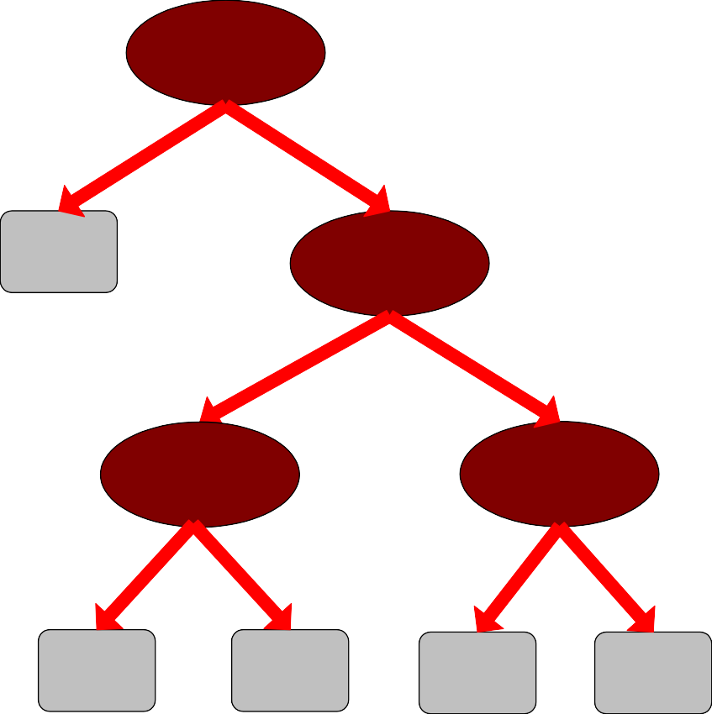
Predictive Modeling: Classification
l Find a model for class attribute as a function of
the values of other attributes
Model for predicting credit worthiness
Class
Employed
Tid | Employed | Level of Education | # years at present address | Credit Worthy
1 | Yes | Graduate | 5 | Yes
2 | Yes | High School | 2 | No
3 | No | Undergrad | 1 | No
4 | Yes | High School | 10 | Yes
… | … | … | … | …
Yes
No
No
Education
Graduate
{ High school, Undergrad }
10
Number of years
Number of years
7 yrs < 7 yrs
3 yr
< 3 yr
Yes
No
Yes
No
29

Slide 31



Classification Example
Tid | Employed | Level of Education | # years at present address | Credit Worthy
1 | Yes | Undergrad | 7 | ?
2 | No | Graduate | 3 | ?
3 | Yes | High School | 2 | ?
… | … | … | … | …
Tid | Employed | Level of Education | # years at present address | Credit Worthy
1 | Yes | Graduate | 5 | Yes
2 | Yes | High School | 2 | No
3 | No | Undergrad | 1 | No
4 | Yes | High School | 10 | Yes
… | … | … | … | …
10
Test Set
10
Learn
Classifier
Training Set
Model
29

Slide 32




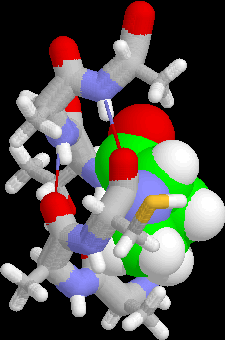
Examples of Classification Task
l Classifying credit card transactions as legitimate or fraudulent
l Classifying land covers (water bodies, urban areas,
forests, etc.) using satellite data
l Categorizing news stories as finance, weather, entertainment, sports, etc
l Identifying intruders in the cyberspace
l Predicting tumor cells as benign or malignant
l Classifying secondary structures of protein
as alpha-helix, beta-sheet, or random coil
29

Slide 33
Regression
l Predict a value of a given continuous valued variable based on the values of other variables, assuming a linear or nonlinear model of dependency.
l Extensively studied in statistics, neural network fields.
l Examples:
Predicting sales amounts of new product based on advetising expenditure.
Predicting wind velocities as a function of temperature, humidity, air pressure, etc.
Time series prediction of stock market indices.
29

Slide 34




Clustering
l Finding groups of objects such that the objects in a group will be similar (or related) to one another and different from (or unrelated to) the objects in other groups
Inter-cluster
Intra-cluster distances are minimized
distances are maximized
29

Slide 35
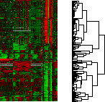
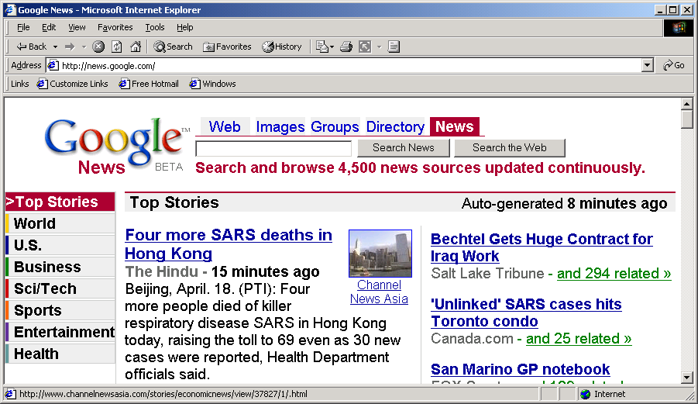
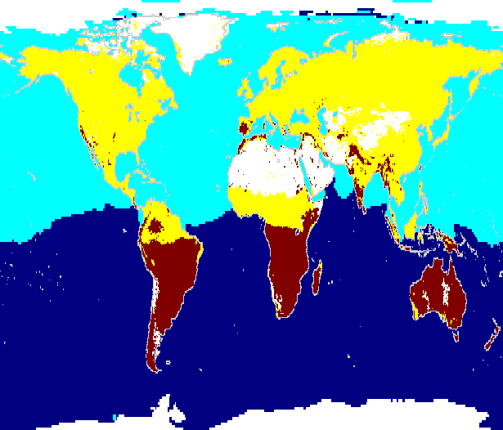
Applications of Cluster Analysis
l Understanding
Custom profiling for targeted marketing
Group related documents for browsing
Group genes and proteins that
have similar functionality
Group stocks with similar price fluctuations
l Summarization
– Reduce the size of large data sets
Courtesy: Michael Eisen
90
Clusters for Raw SST and Raw NPP
Use of K-means to partition Sea Surface Temperature (SST) and Net Primary Production (NPP) into clusters that reflect the Northern and Southern Hemispheres.
60
Land Clus
30
latitude
Land Clus
0
Ice or No
-30
Sea Clust
-60
Sea Clust
35
-90
-180 -150 -120 -90 -60 -30 0 30 60 90 120 150
longitude
¹⁸⁰ Cluster

Slide 36
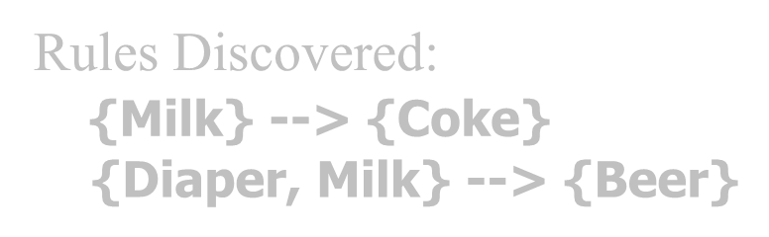

Association Rule Discovery: Definition
l Given a set of records each of which contain some number of items from a given collection
– Produce dependency rules which will predict occurrence of an item based on occurrences of other items.
TID | Items
1 | Bread, Coke, Milk
2 | Beer, Bread
3 | Beer, Coke, Diaper, Milk
4 | Beer, Bread, Diaper, Milk
5 | Coke, Diaper, Milk
Rules Discovered:
{Milk} --> {Coke}
{Diaper, Milk} --> {Beer}
36

Slide 37
Association Analysis: Applications
l Market-basket analysis
– Rules are used for sales promotion, shelf
management, and inventory management
l Telecommunication alarm diagnosis
– Rules are used to find combination of alarms that occur together frequently in the same time period
l Medical Informatics
– Rules are used to find combination of patient symptoms and test results associated with certain diseases
36

Slide 38
Motivating Challenges
l Scalability
l High Dimensionality
l Heterogeneous and Complex Data
l Data Ownership and Distribution
l Non-traditional Analysis
36

Slide 39
Chapter 1. Introduction
Why Data Mining?
What Is Data Mining?
Data Mining Tasks
What Kind of Applications Are Targeted?
Summary

Slide 40
Applications of Data Mining
Web page analysis: from web page classification, clustering to PageRank & HITS algorithms
Collaborative analysis & recommender systems
Basket data analysis to targeted marketing
Biological and medical data analysis: classification, cluster analysis (microarray data analysis), biological sequence analysis, biological network analysis
Data mining and software engineering (e.g., IEEE Computer, Aug. 2009 issue)
From major dedicated data mining systems/tools (e.g., SAS, MS SQL-Server Analysis Manager, Oracle Data Mining Tools) to invisible data mining

Slide 41
Chapter 1. Introduction
Why Data Mining?
What Is Data Mining?
What Kind of Applications Are Targeted?
Summary

Slide 42
Summary
Data mining: Discovering interesting patterns and knowledge from massive amount of data
A natural evolution of database technology, in great demand, with wide applications
A KDD process includes data cleaning, data integration, data selection, transformation, data mining, pattern evaluation, and knowledge presentation
Mining can be performed in a variety of data
Data mining functionalities: association, classification, clustering,
outlier and trend analysis, etc.
Data mining technologies and applications
Major issues in data mining

