Slide 1
Lecture 1 : Introduction TO Operations Research
Foundations, Methodology & Applications of a Science for Better Decisions

Slide 2
TODAY'S LECTURE
Agenda
1
What is Operations Research?
5
Common Model Types
2
A Brief History
6
Spotlight: Linear Programming
3
Core Characteristics
7
Real-World Applications
4
The OR Methodology
8
Benefits & Limitations
Roughly 45 minutes, with time for questions throughout.
Introduction to Operations Research
2

Slide 3
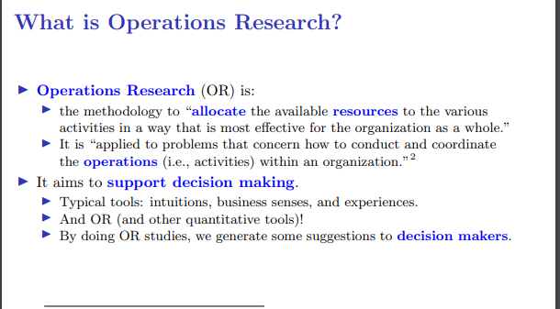
DEFINITION
What Is Operations Research?
Operations Research (OR) is the discipline of applying advanced analytical and mathematical methods to help organizations make better decisions. It uses techniques such as mathematical modeling, statistical analysis, and optimization to arrive at optimal or near-optimal solutions to complex decision-making problems.
Real-World
Problem
Mathematical
Model
Optimal
Solution
Introduction to Operations Research
3

Slide 4
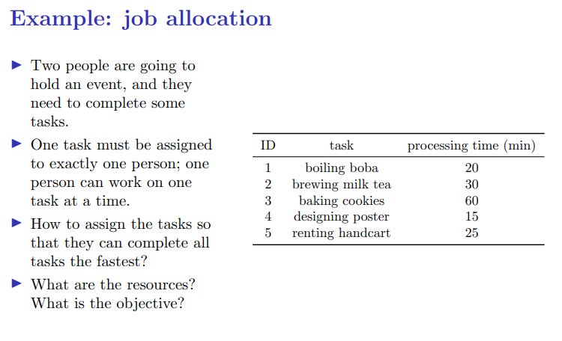
DEFINITION
What Is Operations Research?
Introduction to Operations Research

Slide 5
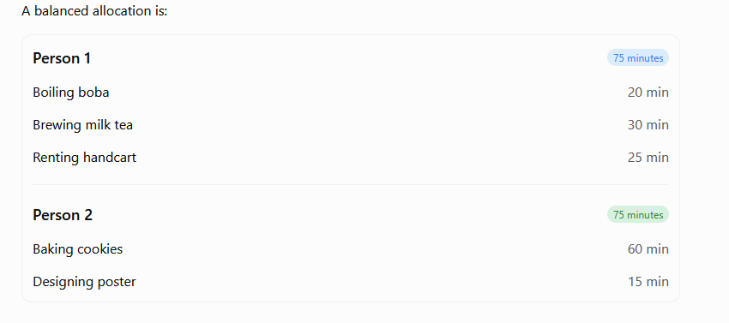
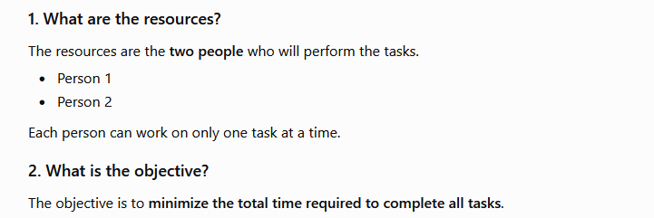
DEFINITION
What Is Operations Research?
Introduction to Operations Research

Slide 6
ORIGINS
A Brief History
1937
1947
Today
Bawdsey Research
Simplex Method
Data & AI Era
UK scientists study radar-directed air defense at Bawdsey Research Station.
George Dantzig develops the simplex algorithm, making linear programming practical.
OR merges with big data, machine learning, and computing power for large-scale optimization.
1939-45
1950s-60s
Wartime Teams
Industry Adoption
Allied “operational research” teams optimize convoy routing, radar use, and bombing strategy.
OR spreads to manufacturing, logistics, and business planning worldwide.
Introduction to Operations Research
4

Slide 7
HOW OR IS APPLIED
The OR Methodology
1
2
3
4
5
6
Problem
Formulation
Model
Construction
Data
Collection
Solving the
Model
Model
Validation
Implementation
& Control
Define objectives, decision variables, and constraints.
Translate the problem into a mathematical model.
Gather accurate, relevant input data.
Apply algorithms to compute a solution.
Test the solution against reality before acting on it.
Deploy the solution and monitor performance over time.
Introduction to Operations Research
6

Slide 8






THE TOOLBOX
Common OR Model Types
Linear Programming
Integer Programming
Network Models
Optimize a linear objective subject to linear constraints.
Like LP, but some or all variables must be whole numbers.
Transportation, assignment, and shortest-path problems.
Queuing Theory
Inventory Models
Simulation & Game Theory
Analyze waiting lines to balance service level and cost.
Decide how much stock to order, and when, to minimize cost.
Model uncertainty and strategic, multi-party decisions.
Introduction to Operations Research
7

Slide 9
A CLOSER LOOK
Spotlight: Linear Programming
General Formulation
x₂
Maximize Z = c₁x₁ + c₂x₂ + … + cₙxₙ
subject to:
aᵢ₁x₁ + aᵢ₂x₂ + … + aᵢₙxₙ ≤ bᵢ
x₁, x₂, …, xₙ ≥ 0
Optimal solution
(corner point)
Where a decision must choose quantities that maximize profit or minimize cost while respecting limits on resources such as time, budget, or materials, linear programming finds the best feasible combination.
Feasible
Region
x₁
Introduction to Operations Research
8

Slide 10






WHERE IT'S USED
Real-World Applications
Manufacturing
Transportation & Logistics
Healthcare
Production scheduling, line balancing, quality control.
Vehicle routing, supply chain, warehouse location.
Staff scheduling, bed allocation, ambulance dispatch.
Finance & Banking
Military & Defense
Telecommunications
Portfolio optimization, risk analysis, credit scoring.
Logistics planning, resource deployment, strategy.
Network design, capacity planning, routing.
Introduction to Operations Research
9

Slide 11
THE BALANCED VIEW
Benefits & Limitations
Benefits
Limitations
Leads to more objective, data-driven decisions
Models are simplifications — real systems may not fit assumptions
Reveals the true cost and trade-offs of each option
Requires accurate, often hard-to-obtain data
Improves efficiency and resource utilization
Can be computationally expensive for very large problems
Provides a framework for handling complex, large-scale problems
Results still depend on sound managerial judgment
Enables “what-if” analysis before committing resources
Non-quantifiable factors (politics, morale) are hard to model
Introduction to Operations Research
10

Slide 12
Assignment 1 : Investigating a Real-World Application of Operations Research
Select one real-world application of Operations Research and prepare a report explaining the problem, the OR techniques used to solve it, and the benefits of applying OR in that field.
(Word File)
Introduction to Operations Research
11

Slide 13
Questions?
Thank you for your attention.
Next lecture: Formulating Linear Programming Models

