Slide 1

Insurance Industry
By
Mohammad Hossein Movahedi

Slide 2

INTRODUCTION
Insurance is a risk-based business. The more information a company has on someone, the more accurately they can tell what kind of a risk that person represents. That’s why some car insurance companies started to use technological tools to help track their customers.

Slide 3
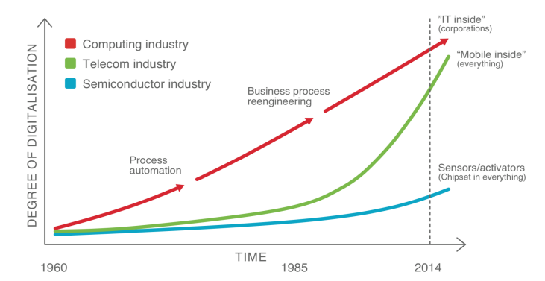
Digitalization and Datafication

Slide 4
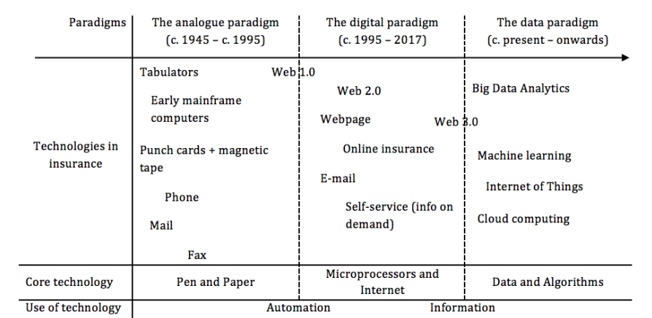
Three technological paradigm

Slide 5
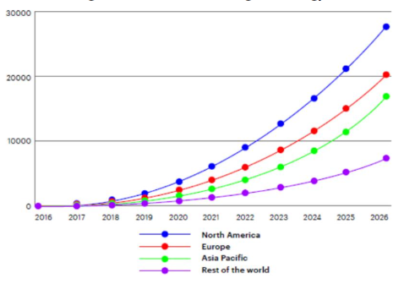
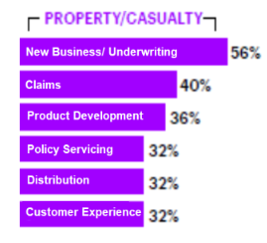

The Impact of Machine Learning on the Future of Insurance Industry

Slide 6
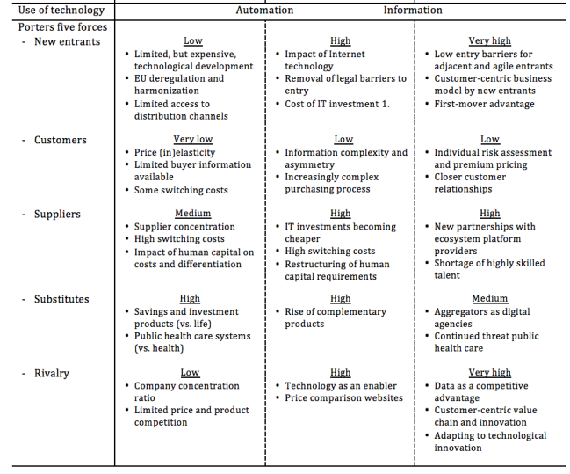
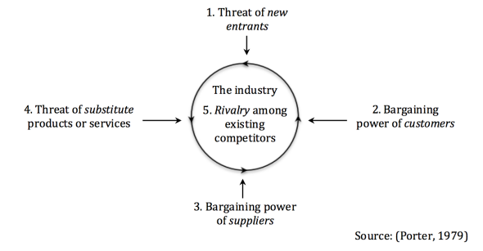
But why?

Slide 7
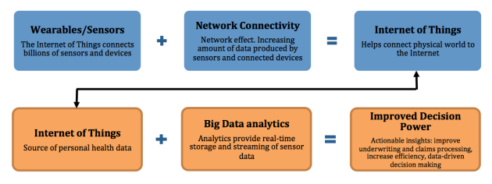
Decision Power

Slide 8
A solution that might meet key necessities
Lower costs
Genomic
Electronic health records
Evidence + insight
Public health
Behavioral
Improved outcomes through smarter decisions

Slide 9

My Verdict
It is worth thinking about it

Slide 10

THANK YOU

Slide 11

Bibliography
scott2 (2018). Technology: Making Car Insurance Better with AI - Money Beagle - Find Savings Fast. [online] Money Beagle - Find Savings Fast. Available at: https://www.moneybeagle.com/technology-making-car-insurance-better-with-ai/ [Accessed 19 Feb. 2022].
Gupta, S., & Tripathi, P. (2016, February). An emerging trend of big data analytics with health insurance in India. In 2016 International Conference on Innovation and Challenges in Cyber Security (ICICCS-INBUSH) (pp. 64-69). IEEE.
‌Paruchuri, H. (2020). The Impact of Machine Learning on the Future of Insurance Industry. American Journal of Trade and Policy, 7(3), 85-90.
Hedegaard, N. A. (2018). Big Data and the Future of Insurance.

