Slide 1
SECURE DATA HIDING IN IMAGES USING STEGNOGRAPHY
CAPSTONE PROJECT
Presented By: Divyanka Raghuvanshi
Student Name : Divyanka Raghuvanshi
College Name : Gyan Ganga Institute of Technology and Sciences
Department :Computer Science and Engineering With Specialization in IoT and Cyber Security Including Blockchain technology.

Slide 2
OUTLINE
Problem Statement
Technology used
Wow factor
End users
Result
Conclusion
Git-hub Link
Future scope

Slide 3
Problem Statement
In an era of increasing cyber threats and data breaches, ensuring secure communication and data confidentiality has become a critical challenge. Traditional encryption techniques, while effective, often raise suspicion and can be easily detected by adversaries monitoring network traffic. To develop a Python program that uses steganography to hide a secret message within an image and retrieve it upon providing the correct passcode.

Slide 4
Technology used
Python : Python is the primary programming language used for writing the code. It is known for its simplicity and versatility, making it a popular choice for a wide range of applications, including image processing and encryption.
OpenCV (cv2): OpenCV (Open Source Computer Vision Library) is a powerful tool for image and video processing. In this program OpenCV is used for loading, converting, and manipulating images.
OS Module (os): The OS module provides a way to interact with the operating system. In this program, it is used for file handling and executing system commands.
String Manipulation: Python's string manipulation capabilities are used to process and encode the secret message.
The secret message is encoded into the image's RGB values by iterating through each character and updating the pixel values

Slide 5
Wow factors
Steganography: Hides a secret message within an image discreetly.
Custom Encryption: Unique method using ASCII values for encoding.
User Interaction: Engaging program with user inputs.
Image Manipulation: Advanced tasks using OpenCV.
Practical Application: Real-world uses in data security.
Error Handling: Ensures graceful program exit.
Security: Passcode protection for message access

Slide 6
End users
Cybersecurity Professionals: They can use this tool to securely communicate sensitive information by hiding messages within images.
Journalists and Whistleblowers: They can share confidential information without attracting attention.
Government and Intelligence Agencies: For secure and covert communication.
Digital Forensics Experts: To investigate hidden messages within digital media.
Privacy-Conscious Individuals: For personal use to protect their private communications.

Slide 7
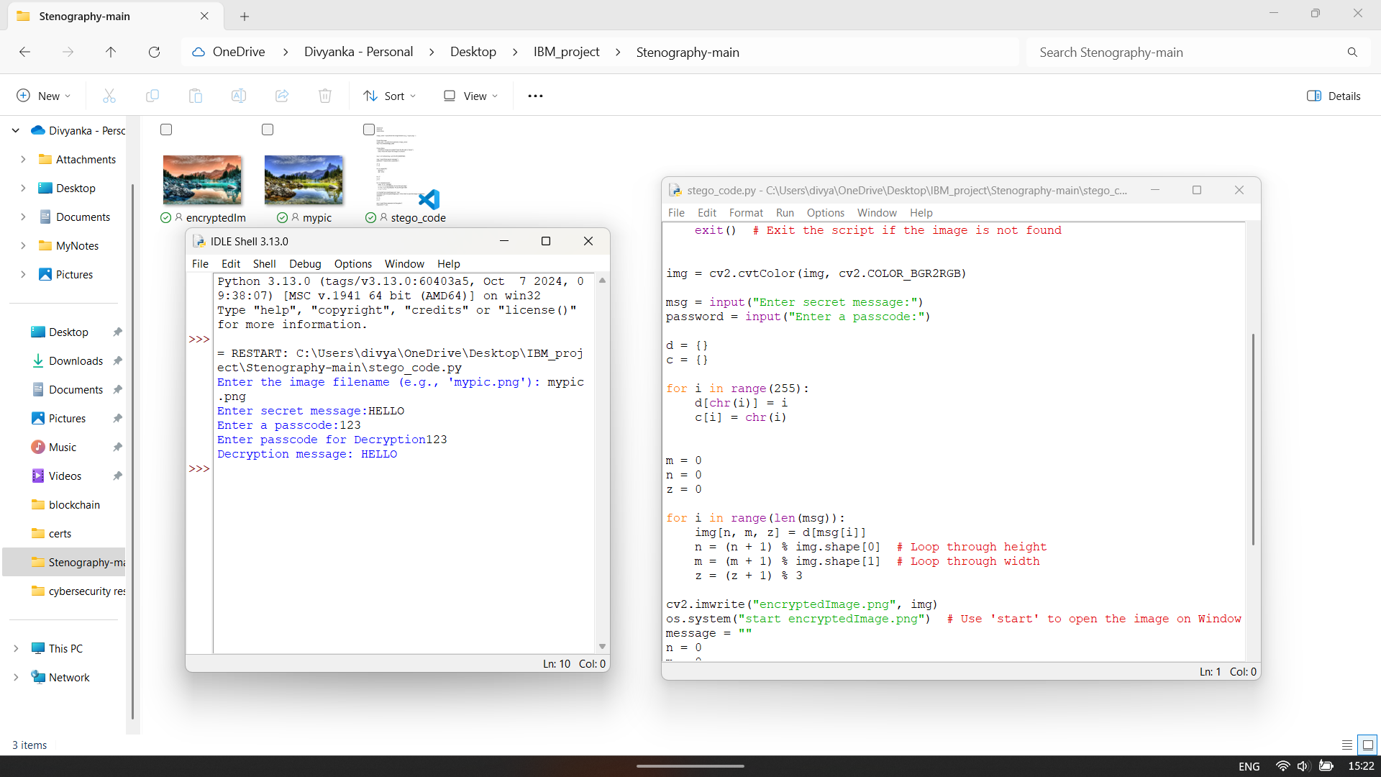
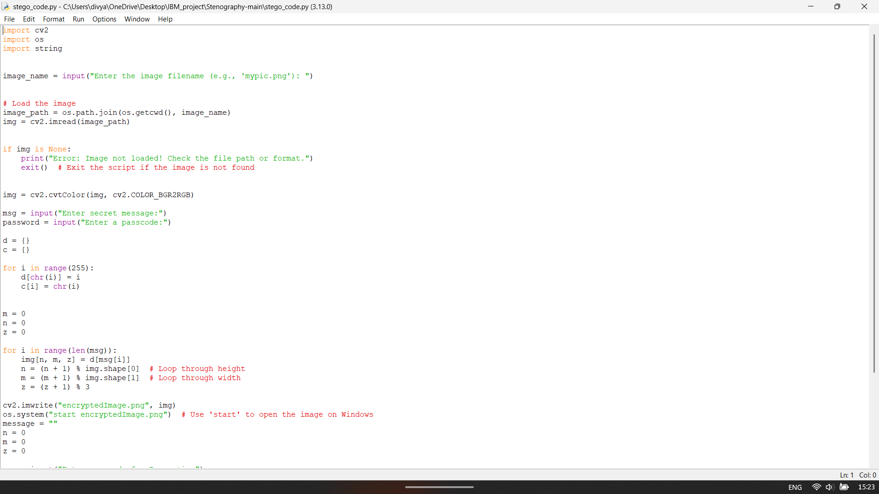
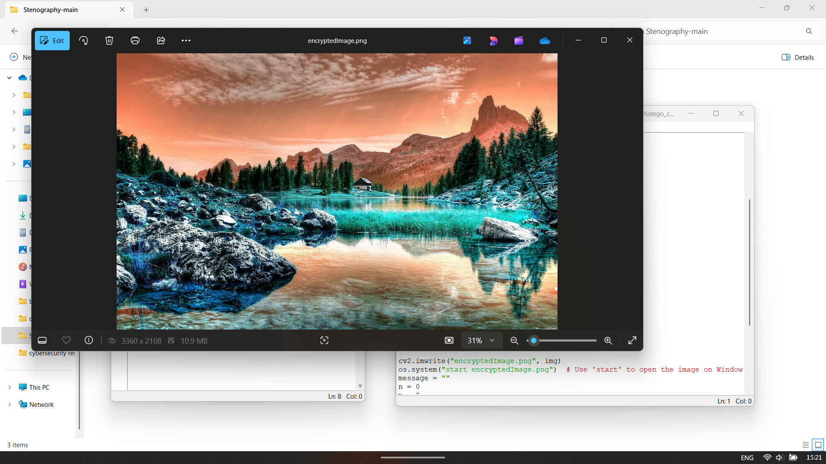
Results

Slide 8
Conclusion
Steganography, the art of hiding information within digital media, provides an additional layer of security by concealing messages in seemingly innocent files such as images. This project aims to develop a simple yet effective image-based steganography technique that embeds secret messages within the pixel values of an image while preserving its visual integrity. The approach involves encoding textual data into the RGB channels of an image, ensuring minimal perceptible changes. Additionally, a passcode-based decryption mechanism enhances security by restricting unauthorized access to hidden messages.

Slide 9
GitHub Link
https://github.com/mon074/Stegnography.git

Slide 10
Future scope(optional)
Enhanced Security: Incorporate advanced encryption algorithms for added security.
GUI Development: Create a user-friendly graphical interface.
Multi-format Support: Extend support to various image and file formats.
Cloud Integration: Store and process images securely in the cloud.

Slide 11
THANK YOU

