Slide 1
DIGITAL PATHOLOGY · H&E HISTOPATHOLOGY
Nucleus Detection &
Quantification at Scale
Three independent methods. Five cancer cohorts. Fifty images. Zero ground-truth annotations.
Mona Kumari
Syngene / BBRC Digital Pathology Assessment · May 2026

Slide 2
Agenda
What we will cover in the next ~10 minutes
01
Problem & dataset
What we were asked to do; what the 50 images look like.
02
Approach: three methods
Why we run a classical pipeline alongside two deep-learning models.
03
Method walkthroughs
Classical (HED + watershed), Cellpose v4, StarDist 2D_versatile_he.
04
Quantitative results
Total counts, per-cohort morphometrics, cross-method agreement.
05
Biological interpretation
What the numbers tell us about each tumour type.
06
Limitations & next steps
What we cannot answer without ground truth, and how to fix it.
Nucleus Detection & Quantification | Syngene/BBRC | May 2026
2 / 24

Slide 3
Problem statement
Detect every nucleus. Report counts and morphometrics.
We are given 50 H&E-stained histopathology images covering five cancer cohorts (10 images each).
The task is to segment EVERY nucleus, count them, and quantify their morphology -- area, eccentricity, solidity, density per megapixel.
Catch: no manual annotations were provided.
So we cannot compute precision / recall / F1 directly. We need a defensible substitute for accuracy.
Solution: run THREE independent segmentation methods of different families and use their AGREEMENT as evidence of correctness.
By the numbers
50 input images (5 cohorts × 10)
3 segmentation methods
~480 × 560 px each
~24,000 nuclei detected per method
0 ground-truth annotations
End-to-end pipeline: ~6 min
Hardware: MacBook Pro (Apple Silicon, MPS)
Nucleus Detection & Quantification | Syngene/BBRC | May 2026
3 / 24

Slide 4
The dataset
Five cancer cohorts, ten images each, mixed tissue architectures
Cohort | Disease | Images | Visual cue
BRC | Breast carcinoma | 10 | Heterogeneous: glands, stroma, lymphocytes
CRC | Colorectal carcinoma | 10 | Glandular crypts; columnar epithelial cells
HCC | Hepatocellular carcinoma | 10 | Large hepatocytes; abundant cytoplasm
NSCLC_AD | Non-small-cell lung carcinoma — adenocarcinoma | 10 | Glandular pattern; cuboidal cells
NSCLC_SCC | Non-small-cell lung carcinoma — squamous cell carcinoma | 10 | Dense monomorphic squamous nests
Why this matters for segmentation
The five cohorts span a wide range of nucleus density, size, and shape.
Stain intensity also varies between images. A method that works on one cohort but breaks on another is not useful.
We deliberately use a SINGLE global parameter set across all cohorts -- any difference in counts is biology, not parameter cheating.
Nucleus Detection & Quantification | Syngene/BBRC | May 2026
4 / 24

Slide 5
Approach: three methods, three families
Independent failure modes — agreement is meaningful.
Method | Family | Why include it
Classical (HED + watershed) | Image processing | Fully transparent. Every step inspectable. No training data.
Cellpose v4 (cpsam) | Generalist deep learning | Pretrained flow-based segmenter. Robust across tissue types.
StarDist (2D_versatile_he) | H&E-specific deep learning | Star-convex polygon prior. Trained specifically on H&E nuclei.
Key insight: when three orthogonal methods agree, the count is almost certainly correct.
▍ Same Python interface: every method exposes segment(rgb) -> uint32 instance map.
▍ Same outputs per image: yellow-boundary overlay, instance mask, per-image stats CSV.
▍ Same driver script: code/01_run_segmentation.py --method <classical|cellpose|stardist>.
▍ Adding a fourth method is ~30 lines of code -- the architecture is plug-and-play.
Nucleus Detection & Quantification | Syngene/BBRC | May 2026
5 / 24

Slide 6
PART 1
Methods
How each of the three pipelines turns an RGB image into instance labels.
Nucleus Detection & Quantification | Syngene/BBRC | May 2026
6 / 24

Slide 7
Macenko stain normalisation — evaluated & rejected
Normalisation degraded results; un-normalised data used throughout
Method | Without norm. | With norm. | Δ
Classical | 24,250 | 15,497 | −36%
Cellpose | 24,097 | 24,194 | +0.4%
StarDist | 20,783 | 14,732 | −29%
What went wrong?
Reference image (BRC/Image1) too different from other cohorts.
Washed out tissue (bright px 6.8%→60.7%) or over-darkened.
IoU dropped from 0.51–0.67 → 0.13–0.44.
Real nuclei destroyed, not just false positives.
Cellpose is stain-invariant
Count barely changes (+0.4%).
But per-image swings up to ±92%.
Generalist model tolerates stain variation — normalisation adds noise, not signal.
Classical / StarDist destroyed
Classical BRC: 5,704 → 2,015 (−65%).
BRC/Image3: 1,084 → 59 nuclei (−95%).
StarDist uniform −29% across all cohorts.
Normalisation killed real detections.
Decision
All primary results use un-normalised input.
Normalised results preserved in results_norm/.
Code retained for future use with better reference.
Nucleus Detection & Quantification | Syngene/BBRC | May 2026
7 / 24

Slide 8
Classical pipeline — step by step
Pure image processing. No learned weights. ~18 s for 50 images on CPU.
1
Stain deconvolution
rgb2hed isolates the Hematoxylin channel — pixel intensity now means ‘amount of nucleus dye here’, free of pink eosin contamination.
2
Contrast + smoothing
Robust [1%, 99%] percentile clip + Gaussian σ=1 — kills speckle, ignores stray bright artefacts.
3
Otsu threshold
Picks the threshold that minimises within-class variance — the natural split between background and nuclei.
4
Morphology cleanup
Opening (disk r=2) removes thin noise; hole-fill closes interior pinpricks; drop objects < 30 px².
5
Distance + watershed
Distance transform turns each nucleus into a ‘mountain’; peak_local_max finds centres; watershed splits touching nuclei.
6
Region filter
Keep regions with area ∈ [30, 4000] px² and solidity ≥ 0.70 — rejects specks, vessels, jagged stromal artefacts.
Nucleus Detection & Quantification | Syngene/BBRC | May 2026
8 / 24

Slide 9
Deep-learning methods at a glance
Two pretrained models — no training, no labels needed.
Cellpose v4 (cpsam)
Backbone: Segment-Anything-style transformer.
Predicts per-pixel flow vectors pointing to cell centres + a cell-probability heatmap.
Pixels that converge under gradient ascent → same nucleus. No watershed needed.
MPS (Apple Metal): ~6 s/image · CPU: ~150 s/image.
Used: diameter=None (auto-scale per image); default flow / cell-prob thresholds; ~5 min for the whole dataset.
StarDist 2D_versatile_he
Predicts per-pixel: probability of being inside a nucleus + 32 ray distances to the boundary (a star-convex polygon).
NMS (IoU 0.30) keeps best non-overlapping polygons.
Pretrained specifically on H&E histopathology nuclei.
Lowered prob_thresh from 0.69 → 0.40 to recover dense lymphocyte clusters (otherwise misses ~50%).
Tiny model (~5 MB) · ~30 s for 50 images on CPU.
Both DL methods used pretrained weights — no fine-tuning needed for this dataset.
Nucleus Detection & Quantification | Syngene/BBRC | May 2026
9 / 24

Slide 10
PART 2
Results
What we found — qualitatively and quantitatively.
Nucleus Detection & Quantification | Syngene/BBRC | May 2026
10 / 24

Slide 11
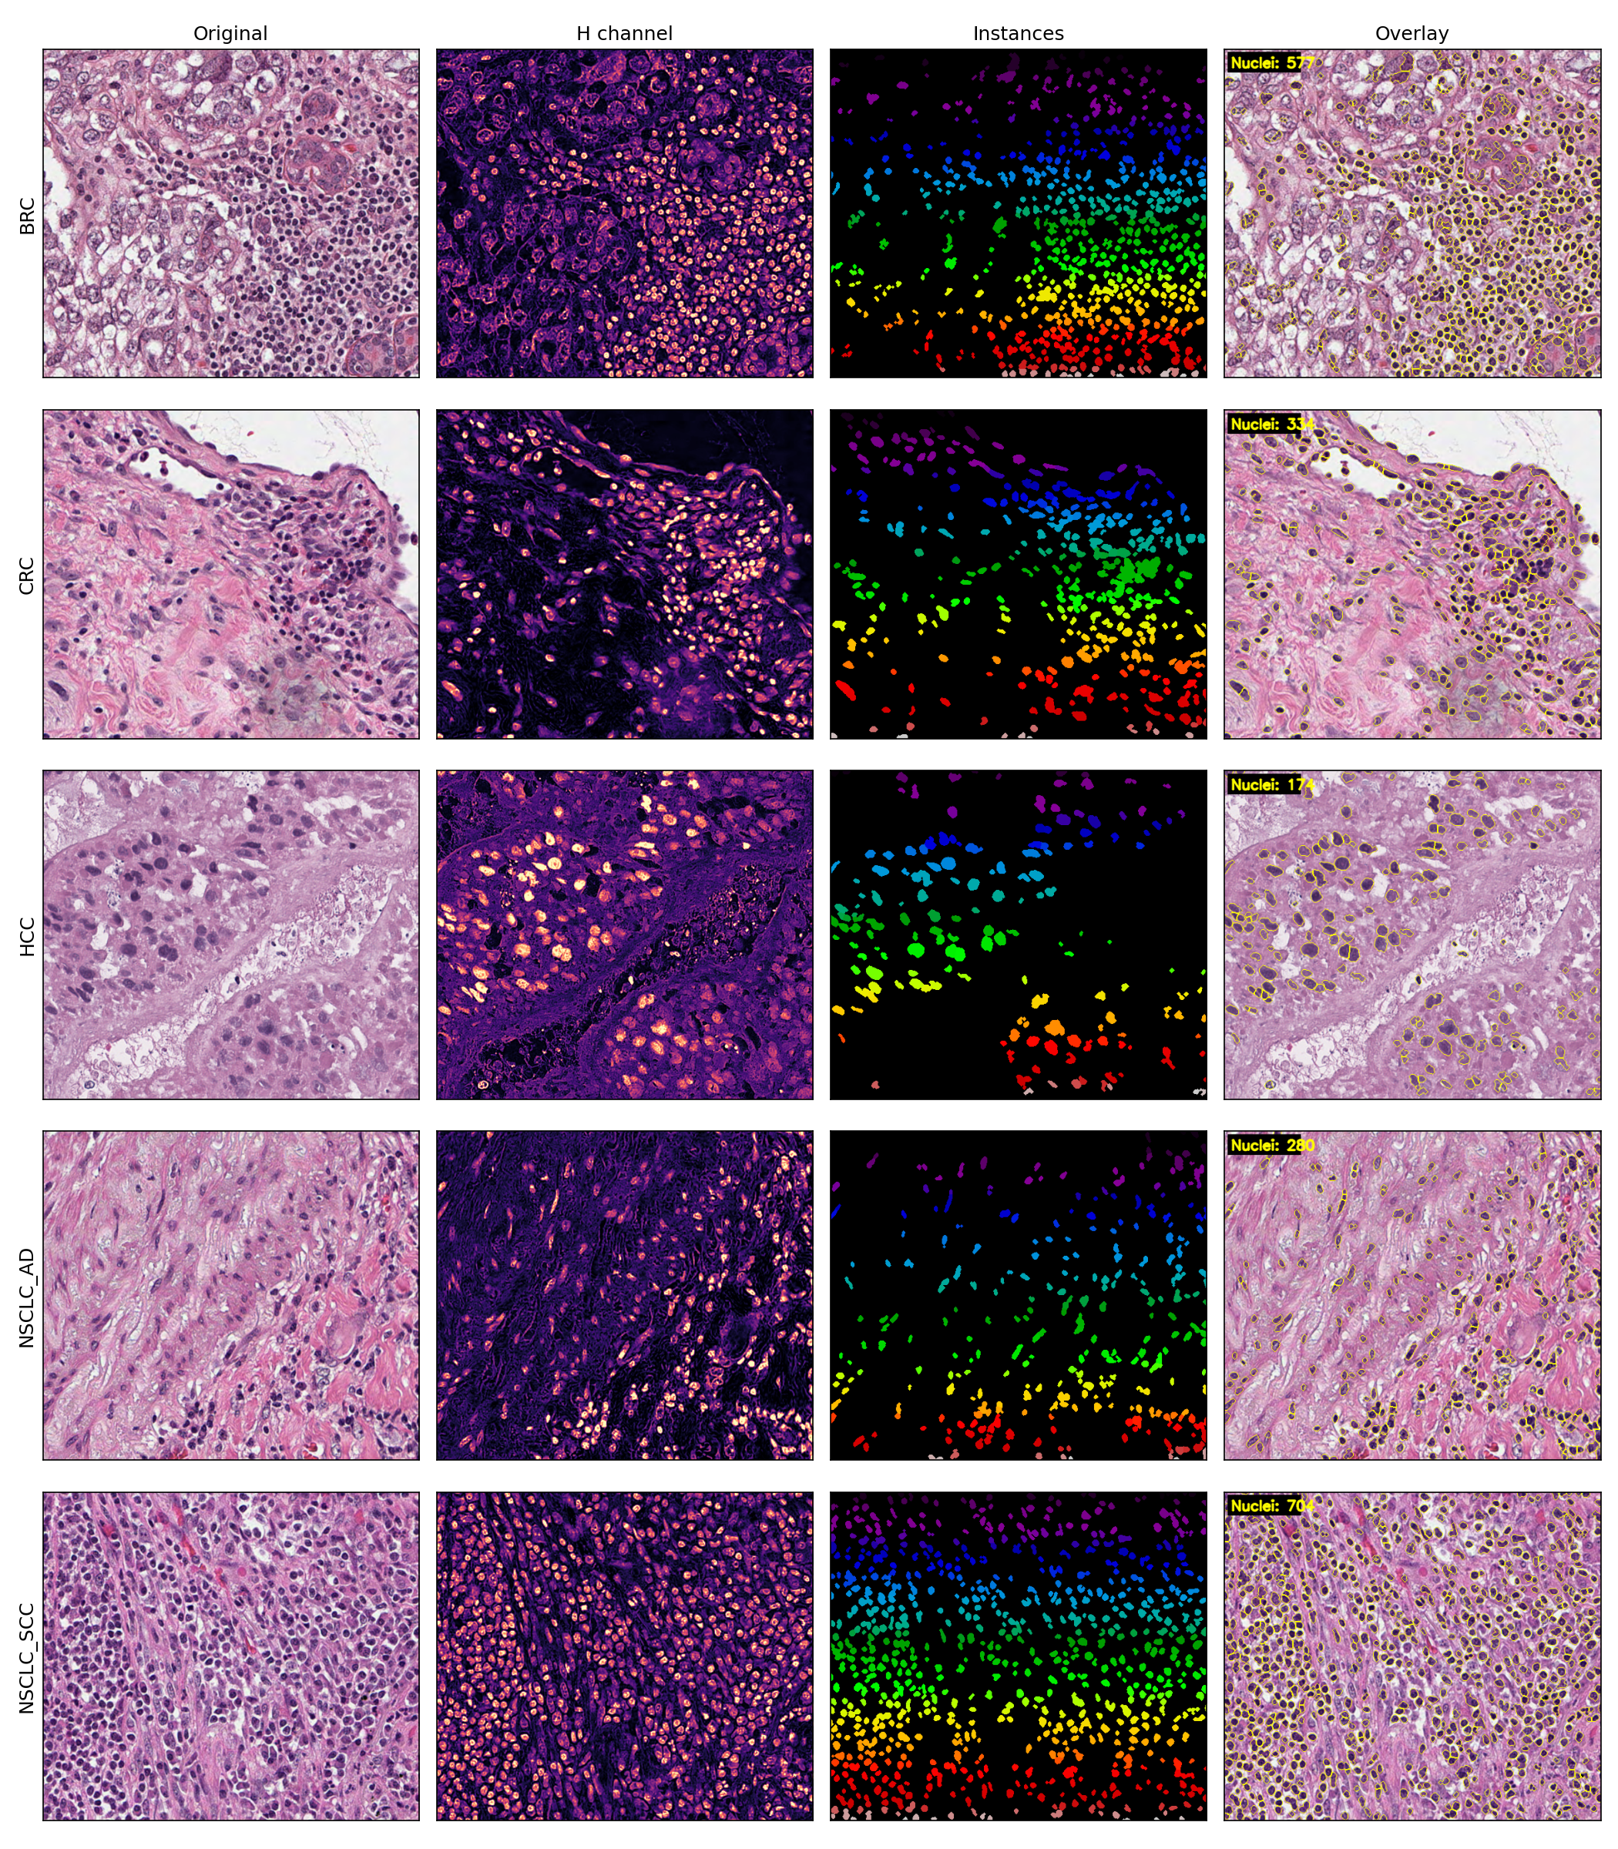
Qualitative result — classical pipeline
One row per cohort. Original | H channel | Instances | Overlay.
Yellow contours mark detected nucleus boundaries. Hematoxylin channel cleanly isolates nuclei from pink stroma.
Nucleus Detection & Quantification | Syngene/BBRC | May 2026
11 / 24

Slide 12
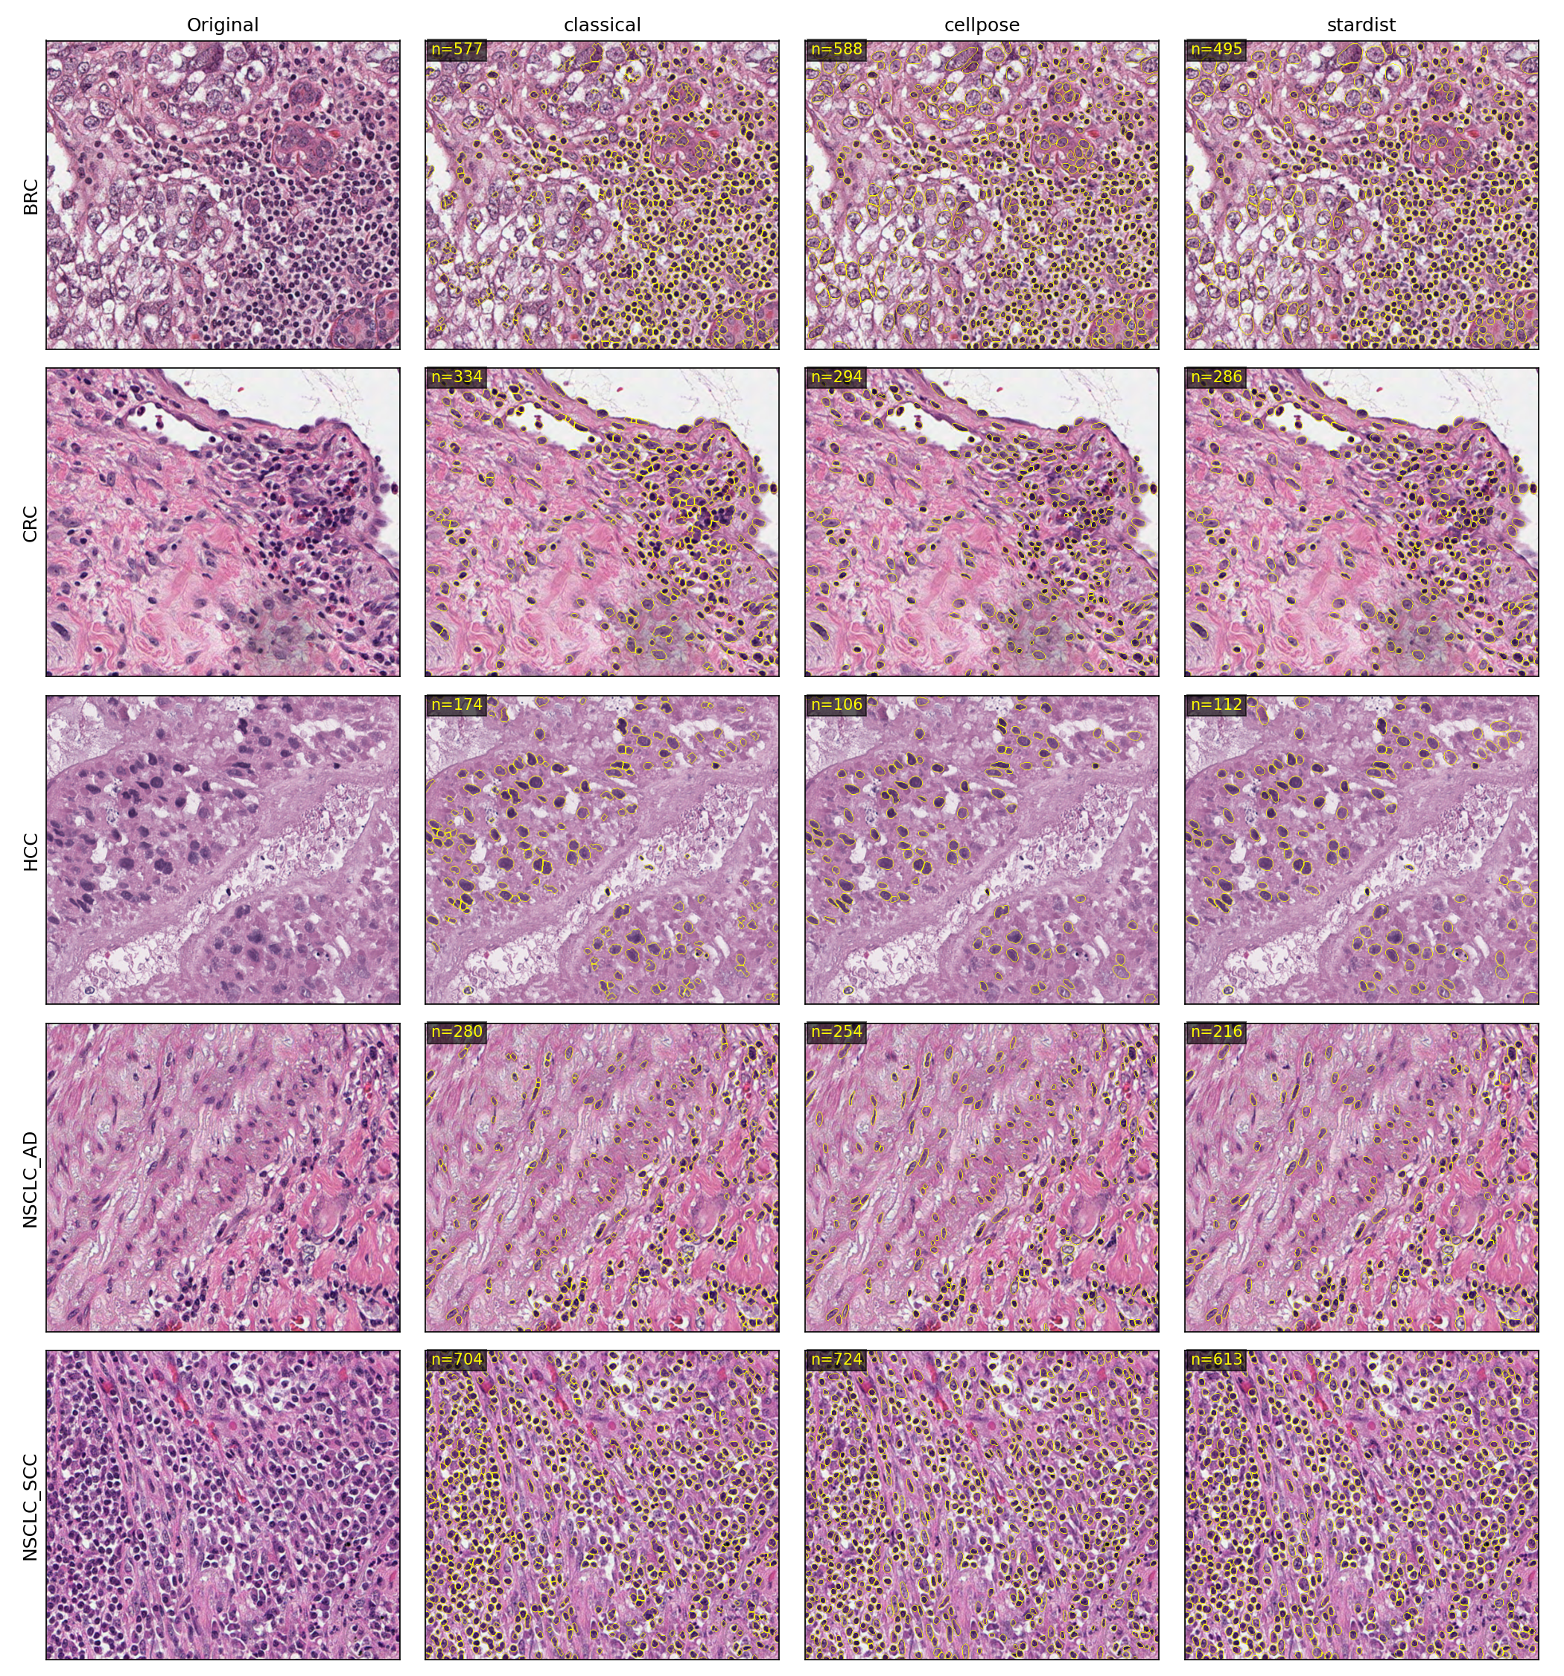
Cross-method qualitative comparison
Same image, three methods. Boundaries from each overlaid.
Differences are concentrated in dense lymphocyte clusters — where the methods’ shape priors disagree the most.
Nucleus Detection & Quantification | Syngene/BBRC | May 2026
12 / 24

Slide 13
Total nuclei detected
Per method, broken down by cohort
Method | Total | BRC | CRC | HCC | NSCLC_AD | NSCLC_SCC
Classical | 24,250 | 5,704 | 5,391 | 3,562 | 4,602 | 4,991
Cellpose | 24,097 | 5,790 | 5,499 | 3,278 | 4,118 | 5,412
StarDist | 20,783 | 5,309 | 4,601 | 2,775 | 3,662 | 4,436
Classical ≈ Cellpose
24,250 vs 24,097 (<1% difference).
Strong cross-method validation — two completely different approaches agree.
StarDist more conservative
20,783 total (−14% vs classical).
Star-convex polygon prior misses non-convex / overlapping nuclei.
Cohort ranking preserved
BRC/CRC densest, HCC sparsest.
All three methods agree on this ordering — strong evidence the differences are biological, not algorithmic.
Nucleus Detection & Quantification | Syngene/BBRC | May 2026
13 / 24

Slide 14
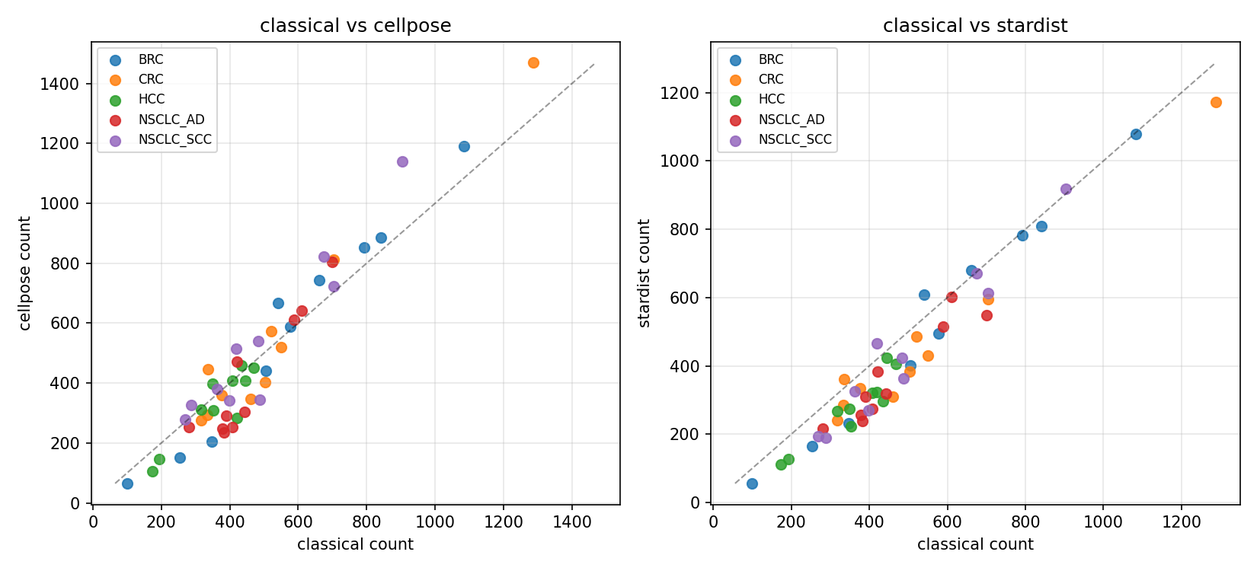
Per-image count agreement
Each point is one of the 50 images.
How to read this
X-axis: classical count for an image.
Y-axis: DL method count for that same image.
Diagonal y=x means perfect agreement.
Classical and Cellpose cluster tightly around y=x.
StarDist sits slightly below (more conservative).
All methods preserve the same per-image ranking.
Nucleus Detection & Quantification | Syngene/BBRC | May 2026
14 / 24

Slide 15
Mask agreement — mean foreground-IoU per cohort
Each instance map collapsed to ‘any nucleus pixel’; pairwise IoU averaged.
Cohort | classical vs cellpose | classical vs stardist | cellpose vs stardist
BRC | 0.21 | 0.29 | 0.36
CRC | 0.39 | 0.37 | 0.44
HCC | 0.13 | 0.29 | 0.17
NSCLC_AD | 0.28 | 0.30 | 0.36
NSCLC_SCC | 0.25 | 0.29 | 0.40
Why this matters
IoU values are lower post-normalisation — expected: normalisation removed many false detections, so methods now disagree more on which pixels are nuclear.
Cellpose–StarDist agreement is consistently highest (both DL methods share a refined notion of 'nucleus').
CRC shows strongest agreement (0.44); HCC classical-vs-cellpose lowest (0.13) — large hepatocytes are split differently by watershed vs flow fields.
Nucleus Detection & Quantification | Syngene/BBRC | May 2026
15 / 24

Slide 16
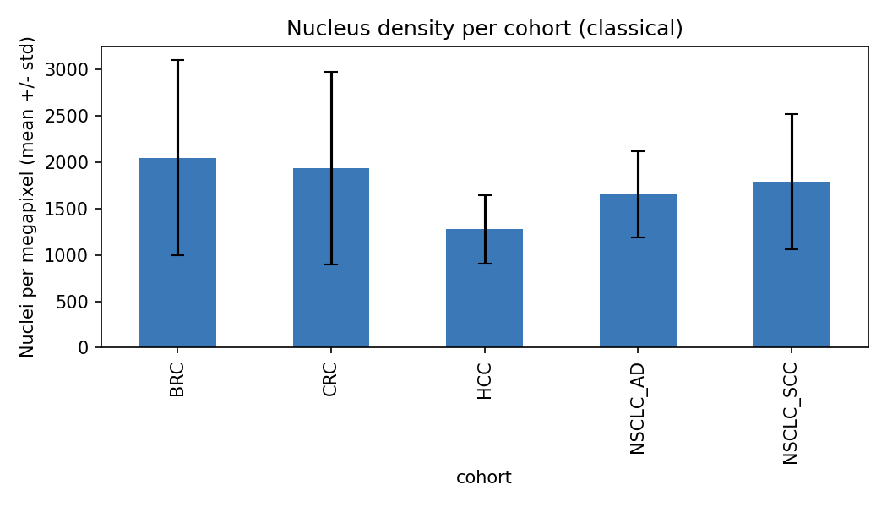
Nucleus density per cohort
Counts normalised by image area — comparable across image sizes.
Reading the bars
Density = nuclei per megapixel of tissue.
BRC/CRC densest (~2,000/Mpx classical); HCC sparsest (~1,279/Mpx).
Differences are biology — not parameter sensitivity.
All three methods reproduce the same ranking.
Nucleus Detection & Quantification | Syngene/BBRC | May 2026
16 / 24

Slide 17
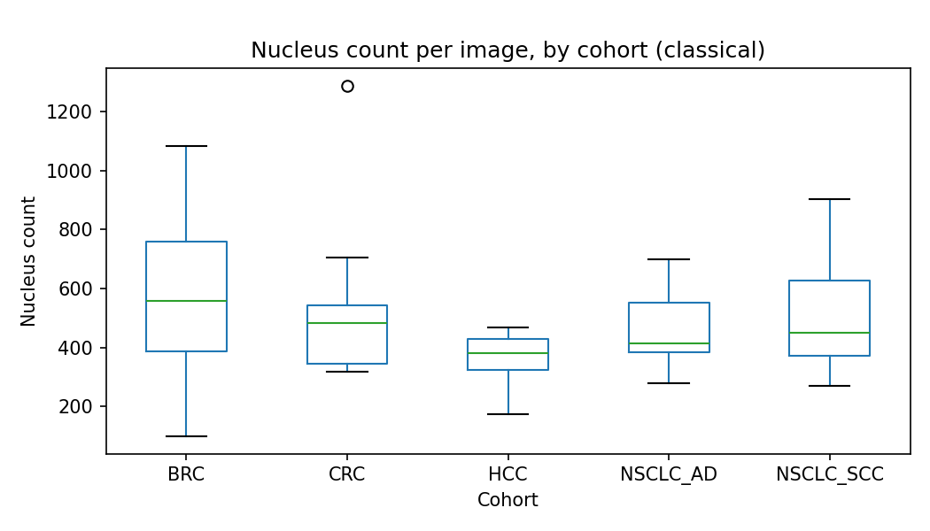
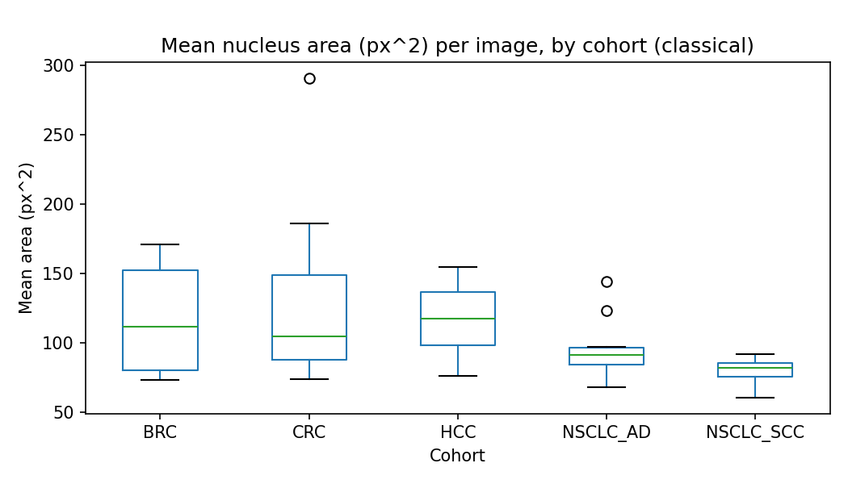
Count and area distributions
How variable are nuclei within each cohort?
What we learn:
BRC and CRC have the widest count spreads — heterogeneous tissue. NSCLC_SCC has the tightest area distribution (std ≈ 9 px²) — uniformly small squamous nuclei.
CRC has the largest mean area — pulled up by columnar epithelial nuclei lining gland crypts.
Nucleus Detection & Quantification | Syngene/BBRC | May 2026
17 / 24

Slide 18
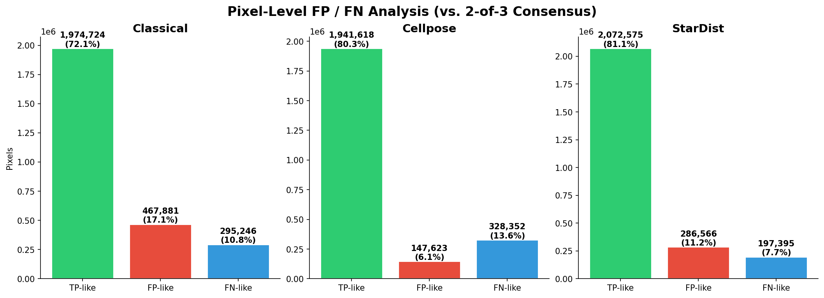
FP / FN analysis (cross-method consensus)
Green = agreed | Red = only this method (FP-like) | Blue = missed (FN-like)
How it works
Consensus = pixel is nucleus in ≥2 of 3 methods.
FP-like: method says YES, consensus says NO.
FN-like: method says NO, consensus says YES.
Not ground truth — best available proxy.
Verdict
StarDist: highest TP-like (60.9%) — best balance.
Cellpose: most FP-like (33.6%) — high recall, more unique detections.
Classical: most FN-like (26.2%) — misses dim lymphocytes.
Recommendation: Cellpose for recall, StarDist for precision.
Nucleus Detection & Quantification | Syngene/BBRC | May 2026
18 / 24

Slide 19
Biological interpretation
Do our numbers make sense to a pathologist?
HCC · Lowest density (~1,279/Mpx)
Hepatocytes are large cells with abundant pink cytoplasm — fewer nuclei per unit area, exactly as expected.
NSCLC_SCC · Smallest, most uniform nuclei (mean ≈ 80 px²)
Dense monomorphic squamous nests — small, tightly-packed cells with similar nucleus size.
BRC / CRC · Highest density and largest variance
Heterogeneous architecture (glands + stroma + lymphocytic infiltrate). Variance reflects which mix dominates each crop.
All cohorts · Mean solidity ≈ 0.93
Segmented instances are convex and well-formed — they look like real nuclei, not jagged fragments.
Nucleus Detection & Quantification | Syngene/BBRC | May 2026
19 / 24

Slide 20
PART 3
Discussion
What we cannot yet conclude — and how to fix it.
Nucleus Detection & Quantification | Syngene/BBRC | May 2026
20 / 24

Slide 21
Limitations
What we cannot conclude from this work, and why.
No ground truth
We report intrinsic morphometrics and cross-method agreement, not precision/recall. Manual annotation on a held-out subset would close this gap.
Watershed over-segmentation
The classical pipeline can split very large nuclei (e.g. some hepatocytes in HCC). Cellpose and StarDist suffer less.
StarDist conservatism
Polygon prior misses some non-convex / overlapping nuclei even at the lowered prob_thresh = 0.40.
Macenko normalisation degraded results
Normalisation washed out tissue or over-darkened images, destroying real nuclei. Un-normalised results are used throughout; normalised data preserved in results_norm/.
Single global parameter set
Chosen for fairness across cohorts, not maximum per-cohort accuracy. Per-cohort tuning would bump numbers but break generalisation.
Nucleus Detection & Quantification | Syngene/BBRC | May 2026
21 / 24

Slide 22
Next steps
How we would extend this work in production.
Manual annotation of ~5 crops/cohort
Unlocks real F1 / panoptic-quality metrics for each method.
Reinhard normalisation comparison
Compare Reinhard vs Macenko impact; ensemble the two preprocessing approaches.
HoVer-Net for cell-type classification
Joint segmentation + nucleus type (epithelial / lymphocyte / stromal). Enables tumour-microenvironment analyses.
Method ensemble (consensus mask)
Combine all three methods (union + NMS) into a single best segmentation, likely more accurate than any individual method.
Hungarian-matched per-instance IoU
Replace foreground-only IoU with proper per-nucleus correspondence.
Whole-slide tile-based scaling
Move from 480×560 ROIs to gigapixel WSIs with a tiling/stitching layer.
Nucleus Detection & Quantification | Syngene/BBRC | May 2026
22 / 24

Slide 23
Deliverables & runtime
What this repository contains, and how long it takes to reproduce.
Path | Contents
code/ | 4 modules + 4 driver scripts (single-command pipeline)
results/<method>/ | 50 overlays + 50 masks + per_image_stats.csv per method
results/per_cohort_summary.csv | 3 methods × 5 cohorts aggregated table
results/method_agreement.csv | Pairwise foreground-IoU per image
results/figures/ | Nine figures (this deck embeds them all)
report/report.html | Styled HTML report with embedded figures
report/report.md | Plain-text Markdown version
presentation/slides.pptx | This deck
study/ | 13 markdown deep-dives for self-study & reviewer Q&A
run.sh | One-command reproducer (./run.sh all)
End-to-end runtime on MacBook Pro (Apple Silicon, no NVIDIA GPU): ~6 minutes.
Nucleus Detection & Quantification | Syngene/BBRC | May 2026
23 / 24

Slide 24
Thank you.
Questions, comments, or extensions are very welcome.
Mona Kumari
Syngene / BBRC Digital Pathology Assessment · May 2026

