Slide 1
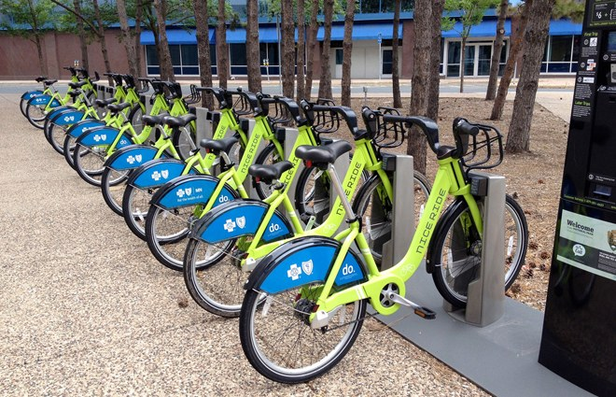

Bike Sharing Prediction
Shashank V. Maiya
Data Science Intensive Capstone Project
October 1, 2018 Cohort

Slide 2
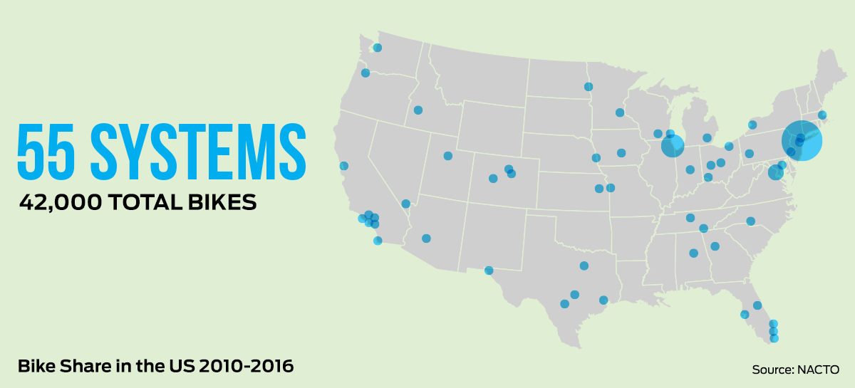
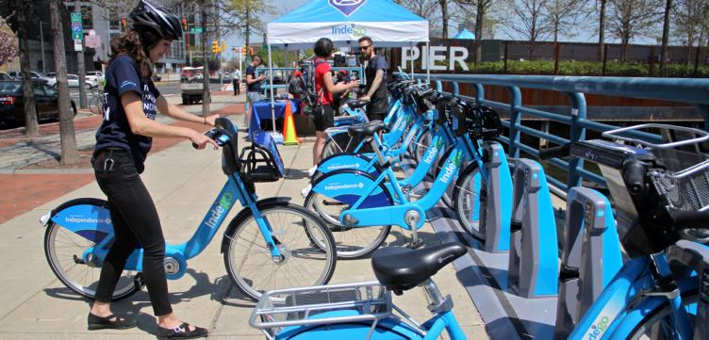
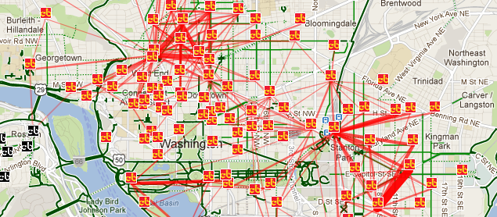
Bike Sharing Systems
Very prevalent in major metropolitan cities – Washington D.C., Chicago, New York City, Boston, Miami, San Diego, San Francisco, etc.
Bike Sharing Systems – Facilities which let people borrow bikes from a ‘dock’ or a bike rack and return it back at another ‘dock’ belonging to the same system
Used for short distance commutes
Mostly used by commuters for daily office commutes, by tourists for short distance travel

Slide 3

Prediction Problem
Over 35 Million trips made in the year of 2017
Number of bikes rented out at a particular time of the day varies from <10 to >1000
What factors affect Bike Sharing rental count?
How many Bikes will be required at a given time of the day?

Slide 4






Who might care?
Bike Company Vendors
Mobile Apps
Government Bodies
Parking Facilities
Bike Lanes

Slide 5
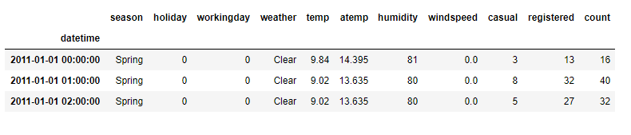
Data Overview
Data set obtained from Kaggle
Provided feature set
Weather conditions – Temperature, Humidity, Windspeed
Day – Working day or not
Time of the day

Slide 6

Exploratory Data Analysis (EDA)

Slide 7
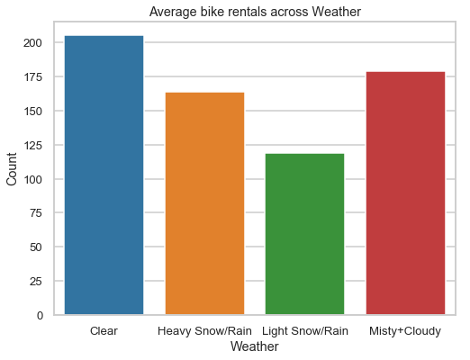
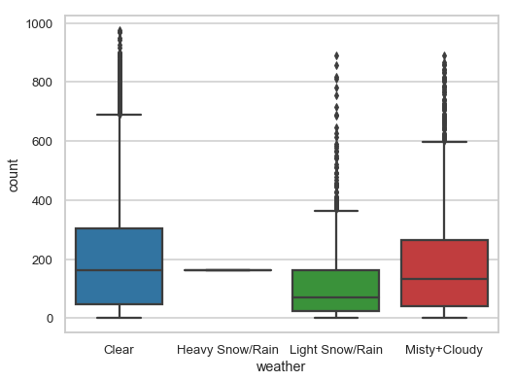
EDA – Weather
Higher bike rental when weather is more clear and sunny
Single instance of a Heavy Snow/Rain condition → Changed to Light Snow/Rain condition

Slide 8
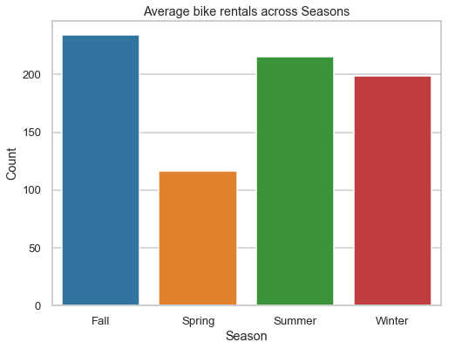
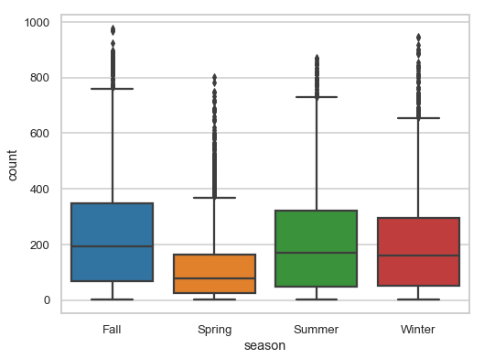
EDA – Season
Highest bike reservations during Summer (April to June) and Fall (July to September) and lowest in Spring (January to March)

Slide 9
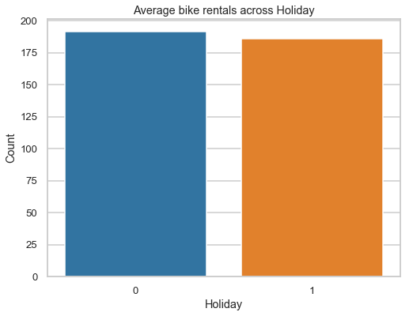
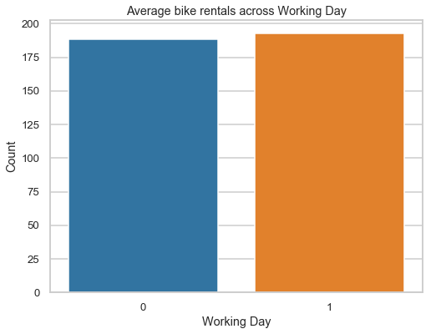
EDA– Working Day
Overall average bike rental count on a Working day or Non-working day are sa

Slide 10
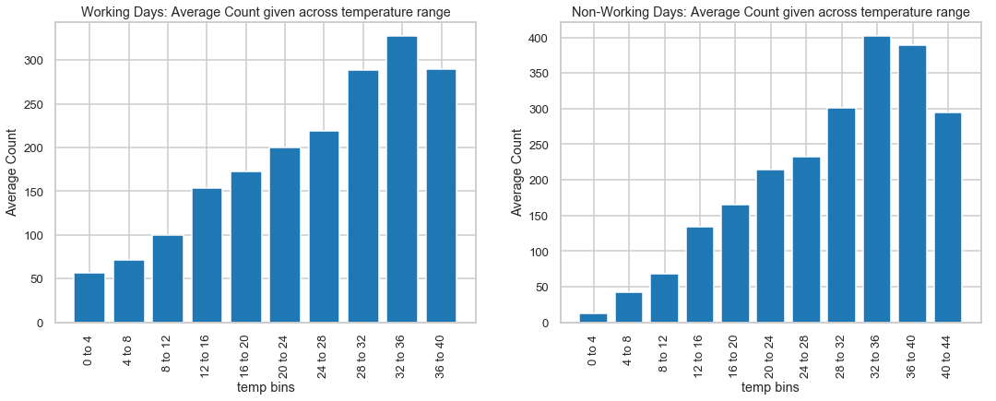
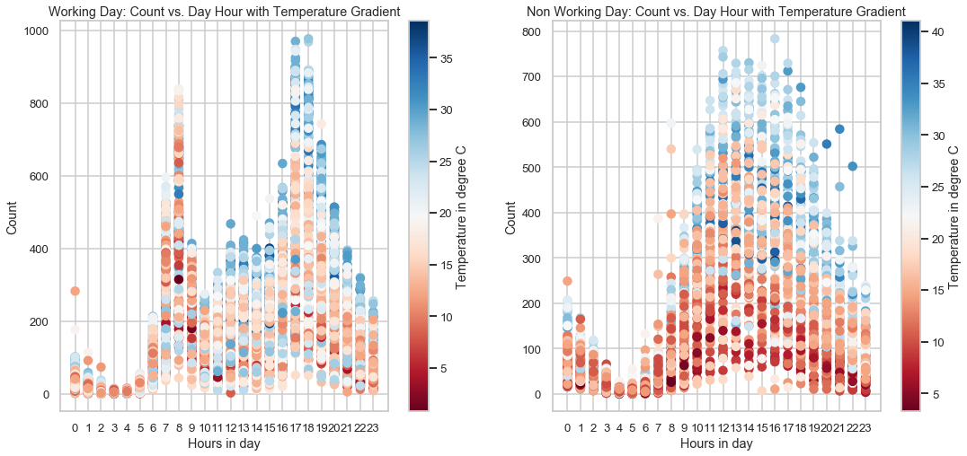
EDA – Temperature
Steady increase in biking count with temperature
Ideal temperature for biking is between 32 and 36 degree Celsius

Slide 11
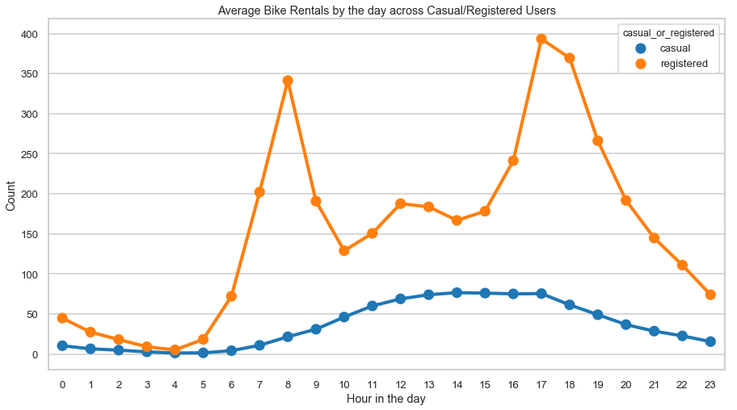
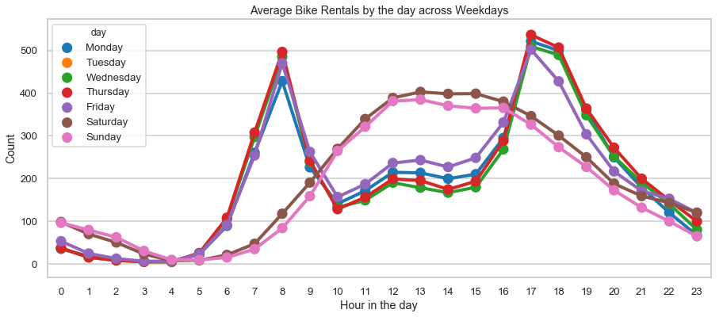
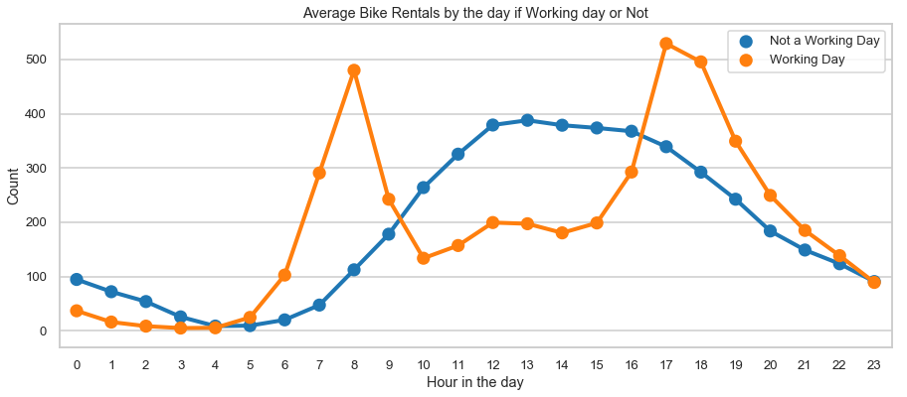
EDA – Hourly Distribution
Two biking patterns
Working Day Pattern: Registered Users + Working daily Commuters + 8am & 5pm peak hours
Non-Working Day Pattern: Casual Users + Tourists on Holidays + Steady pattern with ~12 noon peak count

Slide 12
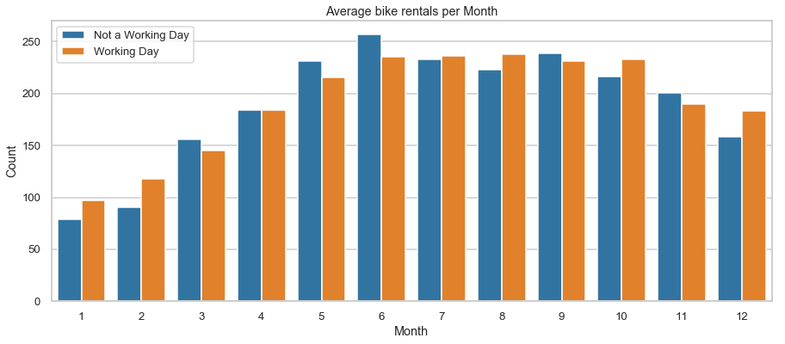
EDA – Monthly Distribution
Most rentals are in the months of June and May while least are on January and February.

Slide 13
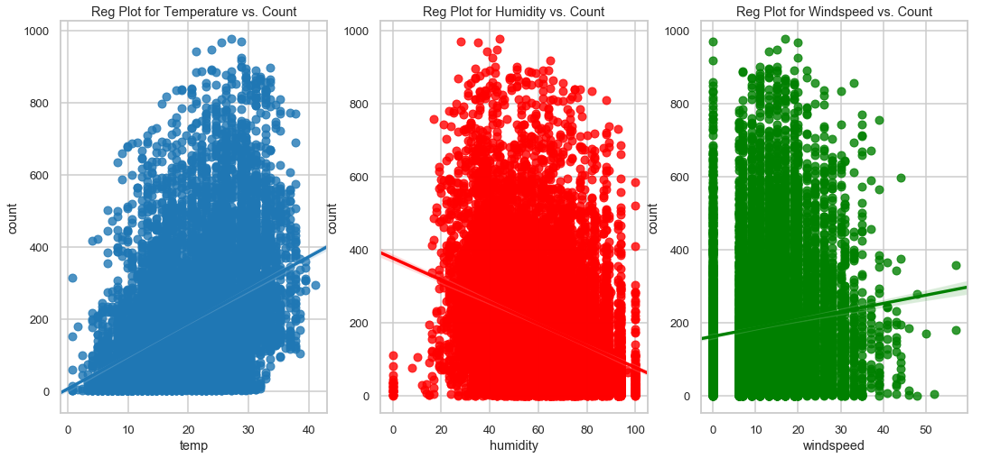
Regression Plots
We see a strong positive correlation between count and temperature
We see a strong negative correlation between count and humidity
Count has a weak dependence on windspeed and several missing (or erroneous) data points (labeled as 0s)

Slide 14
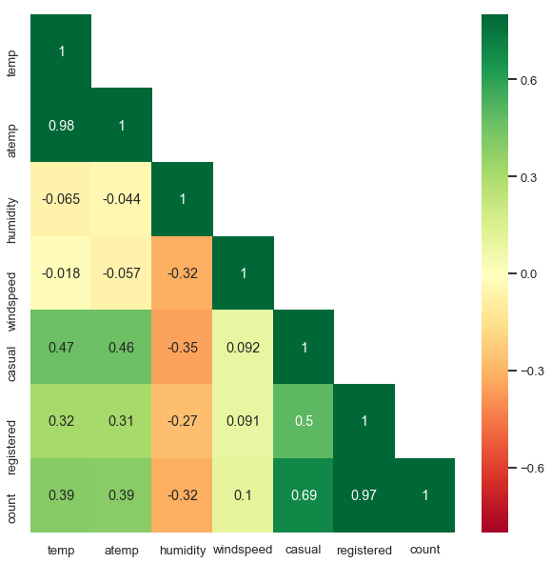
Correlation Analysis – Heatmap
temp (true temperature) and atemp (feels like temperature) are highly correlated
count = casual + registered ➔ count is highly correlated with casual and registered

Slide 15
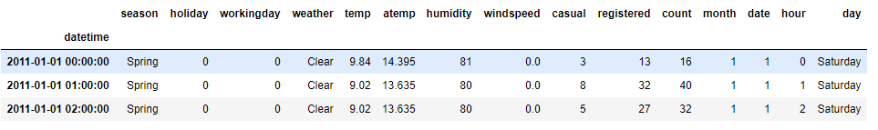
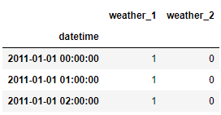
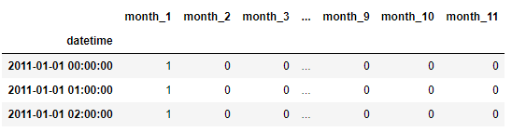
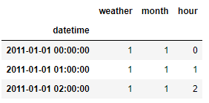
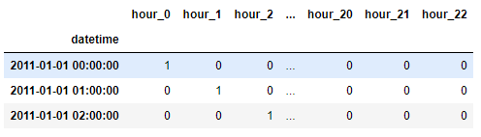
Feature Engineering
Dropped Feature
Retained Feature
Target Feature
OneHotEncoding

Slide 16
Modeling

Slide 17

Modeling Overview
Type: Supervised Learning
Regression Problem: Possible Target values [0, $∞)$

Slide 18
Train/Test Split
Used for Hyperparameter Tuning
Kaggle Test Set (Labels not available)
Used for Model Evaluation

Slide 19
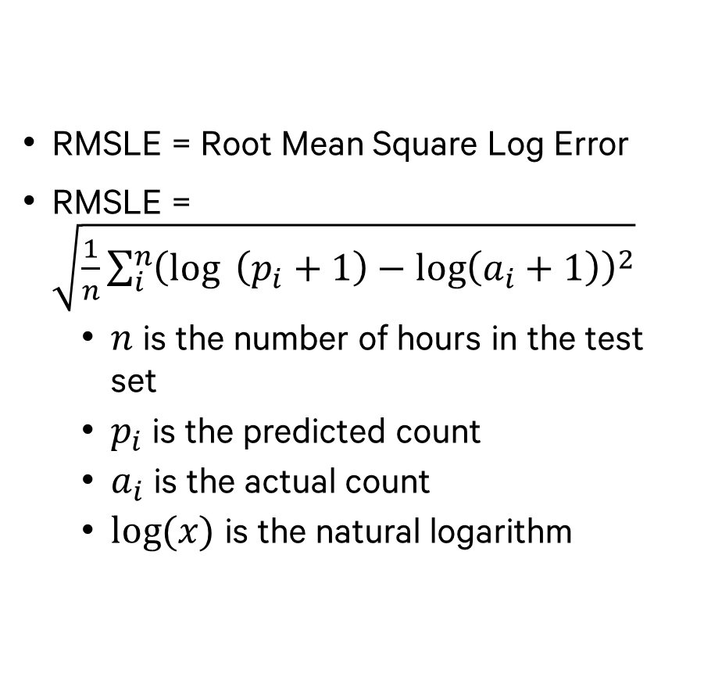
Evaluation Metric - RMSLE
RMSLE = Root Mean Square Log Error
RMSLE = $\sqrt{\frac{1}{n}\sum_{i}^{n}{{\left(\log{ \left(p_{i}+1\right)}−\log\left(a_{i}+1\right)\right)}^{2}}}$
$n$ is the number of hours in the test set
$p_{i}$ is the predicted count
$a_{i}$ is the actual count
$log⁡(x)$ is the natural logarithm

Slide 20
Regression Algorithms Used
Category | Regression Algorithms
Linear | Linear Regression
 | Ridge
 | Lasso
Ensemble | Random Forest – 1
 | Random Forest – 2
 | Random Forest – 3
 | Gradient Boost – 1
 | Gradient Boost – 2
 | Adaboost
Stacking | Linear Regression
 | Random Forest
 | Gradient Boost
3 Categories
Linear Algorithms
Ensemble Algorithms
Stacking Algorithms where predictions from Linear and Ensemble methods were used to make final predictions

Slide 21
Stacking Model Details

Slide 22
Stacking Model Summary

Slide 23
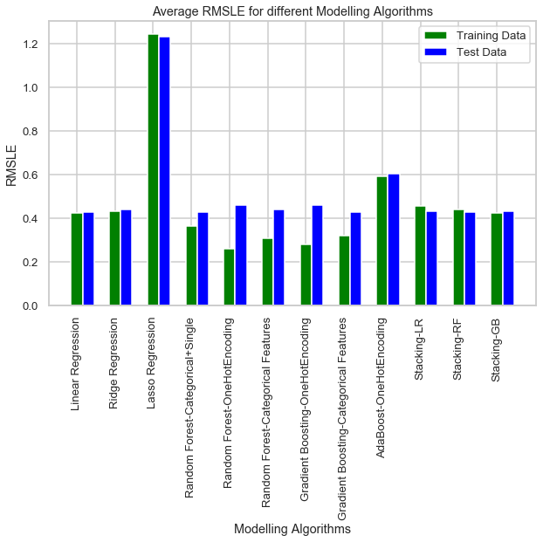
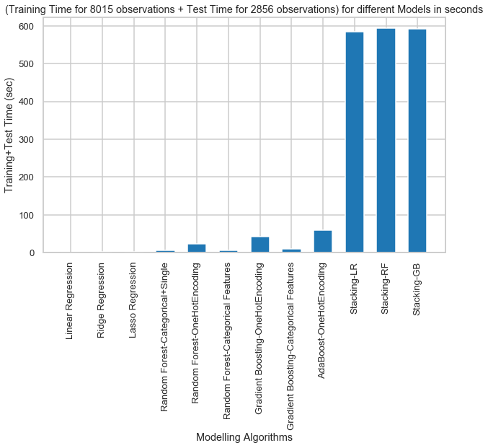
RMSLE & Modeling Time Summary
Stacking Models didn’t provide any substantial gains in prediction accuracy (RMSLE)
Very high Train+Test times for Stacking Models
Random Forest Modeling Algorithm used as our Final Model
Uses Categorical Features (No OneHotEncoding)
Uses Single Model for Working and Non-Working Days

Slide 24
Final Model – Random Forest Regressor

Slide 25
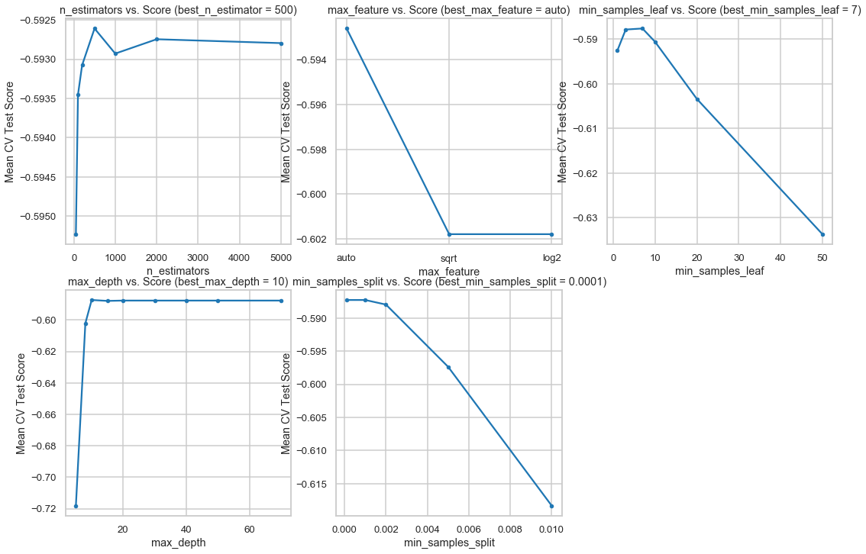
Hyperparameter Tuning
5 Hyperparameters Tuned
N_estimators = number of trees in the forest = 500
Max_features = max number of features considered for splitting a node = ‘auto’ = all features used
Min_sample_leaf = min number of samples allowed in a leaf node = 7
Max_depth = max number of levels in each decision tree = 10
Min_samples_split = min number of data points placed in a node before the node is split ~ 2

Slide 26
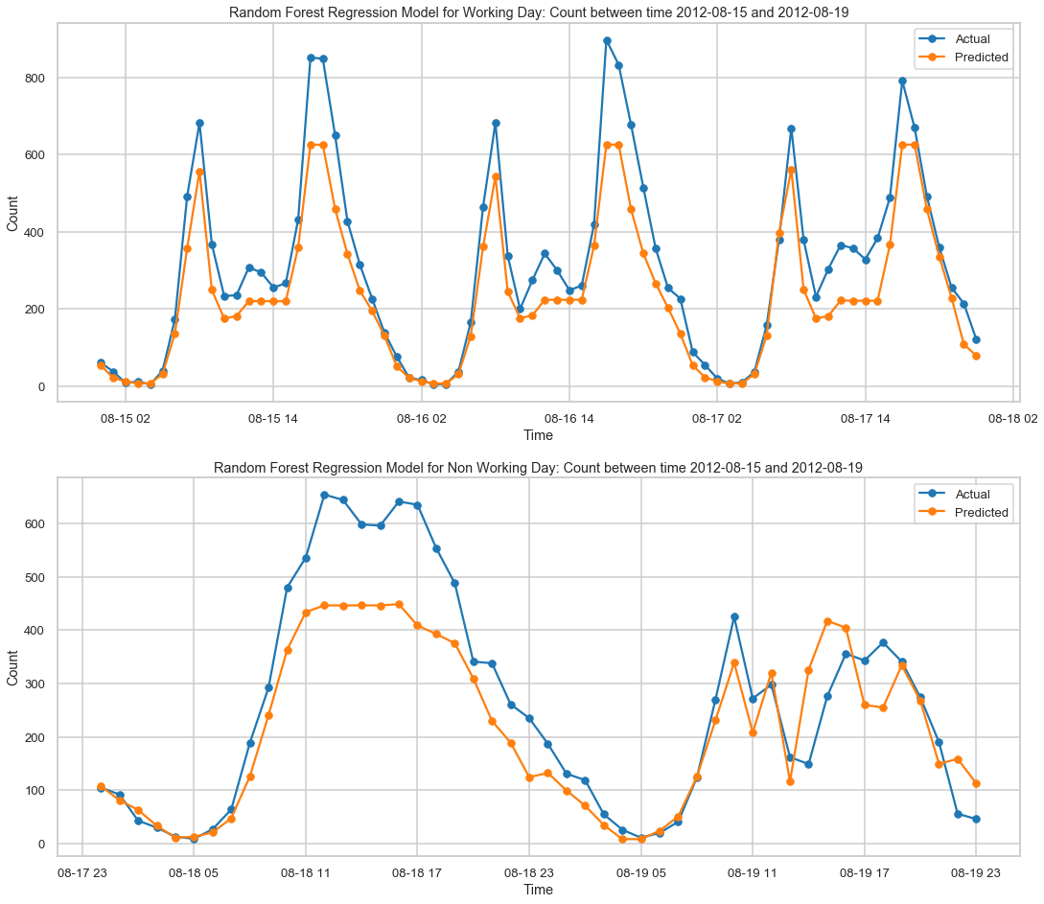
Model Performance
Actual vs. Predicted Bike Rental Count on Test Data

Slide 27
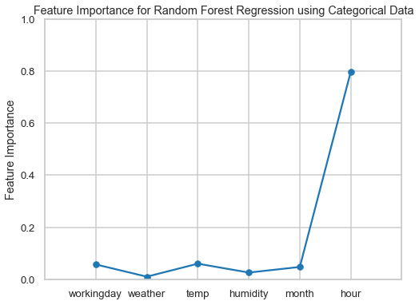
Feature Importance
‘Hour’ feature has the highest importance by far

Slide 28
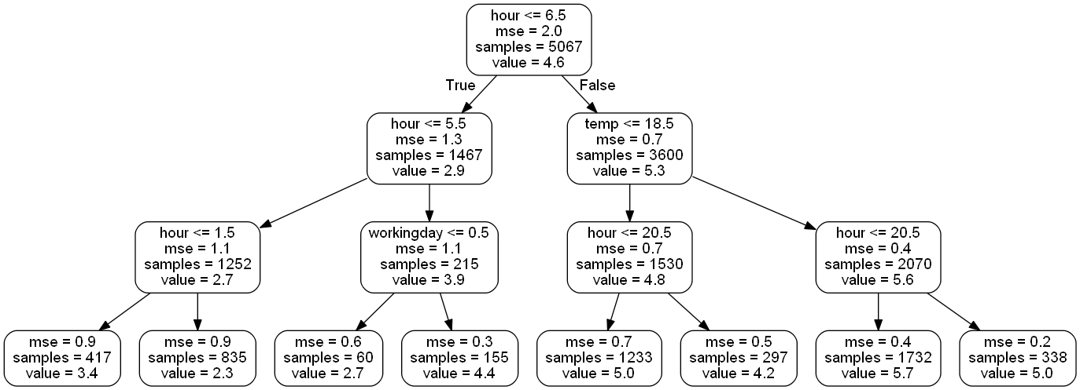
One Sample Decision Tree
Split based on hour
Split based on temp
Split based on workingday
Visualizing One Sample Decision Tree with max_depth = 3
First few splits are mostly based on ‘hour’ feature (indicating the relative importance of ‘hour’ feature)

Slide 29
Conclusions
Out of the 12 models tried, Random Forest yielded best prediction accuracy (lowest RMSLE) with a RMSLE score of 0.42 on Test Data
Stacking individual models doesn’t provide any improvement in RMSLE score
‘Hour’ of the day holds the most importance in prediction
We see two rental patterns across the day
Working Day pattern – peak bike counts at 8am & 5pm peak hours
Non-working day pattern – Steady pattern with peak bike count at ~12 noon

Slide 30
Limitations and Ideas for Model Improvement
Model Limitations
Lack of extreme weather condition (weather = ‘Heavy Snow/Rain’). Hence, we cannot predict bike rental counts accurately under those constraints
Model Improvement Ideas
Use of ‘casual’ and ‘registered’ users data. Estimate these two separately and add them to get the final count
Using Windspeed data. First Predict windspeed (for all the instances where we have 0) using other columns and then use it for prediction.

Slide 31
Thank You!
Shashank V. Maiya
Email: shashank.maiya@gmail.com
Linkedin Profile: https://www.linkedin.com/in/shashank-maiya-3468546/
Github: https://github.com/shashankvmaiya
Project Report: Final_Report.pdf

