Slide 1
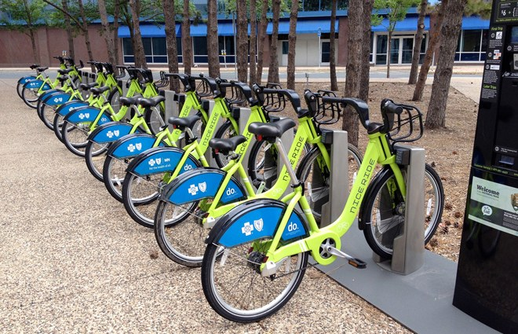

Bike Sharing Prediction
Shashank V. Maiya
Data Science Intensive Capstone Project
October 1, 2018 Cohort

Slide 2
The Problem
Bike Sharing Facilities very prevalent in major metropolitan cities
Used by commuters for daily office commutes
Used by tourists for short distance travel
For example in Washington D.C, Number of bikes rented out at a particular time varies from <10 to 1000
What factors affect Bike Sharing rental count?
How many Bikes will be required at a given time of the day?

Slide 3
Who might care?
Bike Company Vendors
Capital BikeShare
Citi Bike
Bird
Mobile Apps
Kiosks/Bike stores
Government Bodies – Parking Facilities

Slide 4
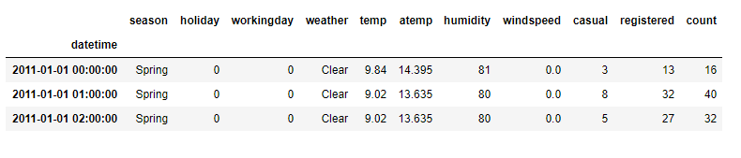
Data Overview
Data set obtained from Kaggle
Factors that affect Bike Sharing count
Weather conditions – Temperature, Humidity, Windspeed
Day – Working day or not
Time of the day

Slide 5
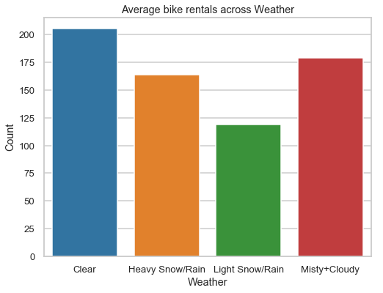
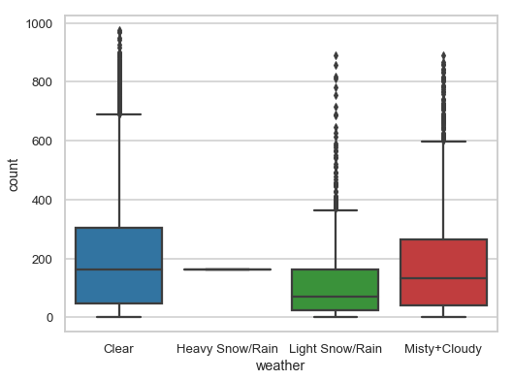
Exploratory Data Analysis – Weather
Higher bike rental when weather is more clear and sunny
Single instance of a Heavy Snow/Rain condition → Changed to Light Snow/Rain condition

Slide 6
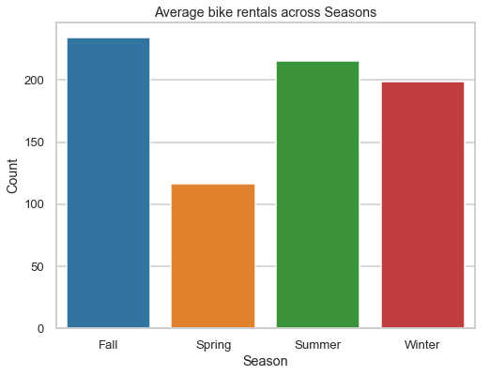
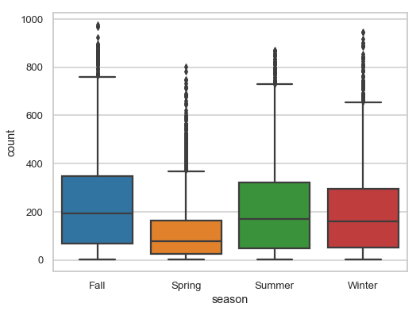
Exploratory Data Analysis – Season
Highest bike reservations during Summer (April to June) and Fall (July to September) and lowest in Spring (January to March)

Slide 7
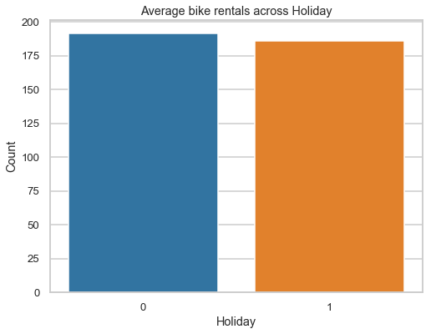
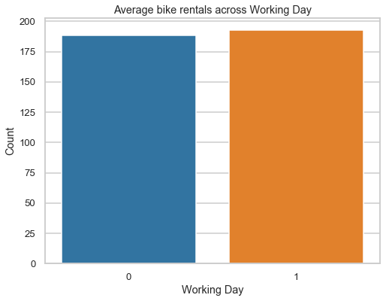
Exploratory Data Analysis – Working Day
Overall average bike rental count on a Working day or Non-working day are sa

Slide 8
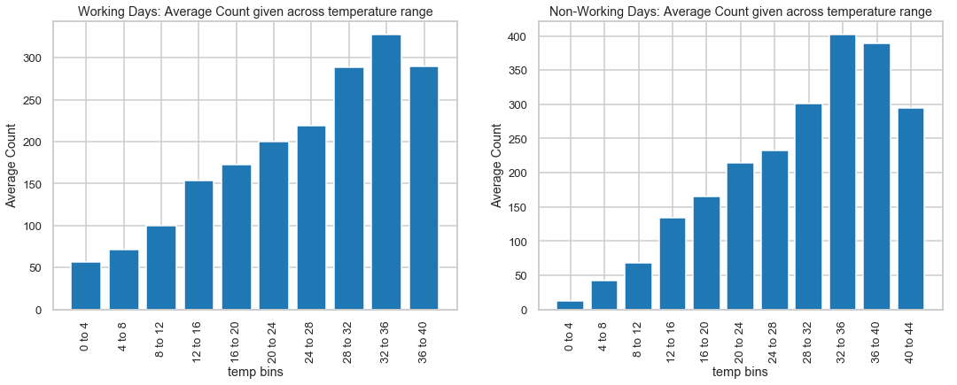
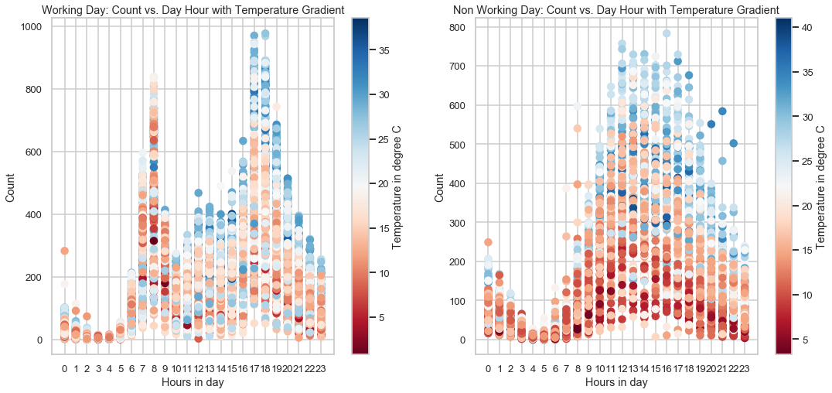
Exploratory Data Analysis - Temperature
Steady increase in biking count with temperature
Ideal temperature for biking is between 32 and 36 degree Celsius

Slide 9
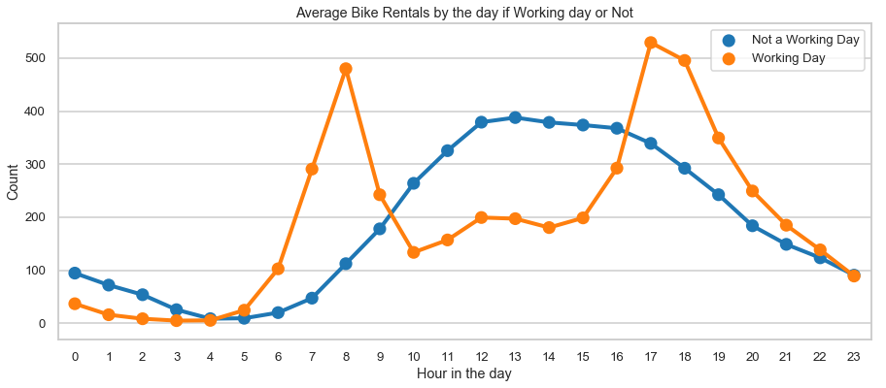
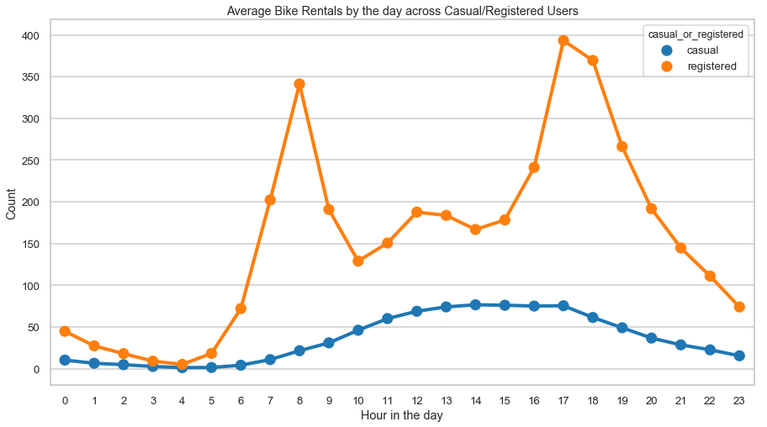
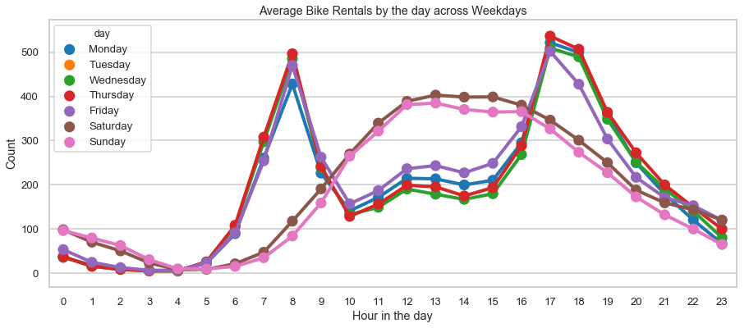
Exploratory Data Analysis – Hourly Distribution
Two biking patterns
Working Day Pattern: Registered Users + Working daily Commuters + 8am & 5pm peak hours
Non-Working Day Pattern: Casual Users + Tourists on Holidays + Steady pattern with ~12 noon peak count

Slide 10
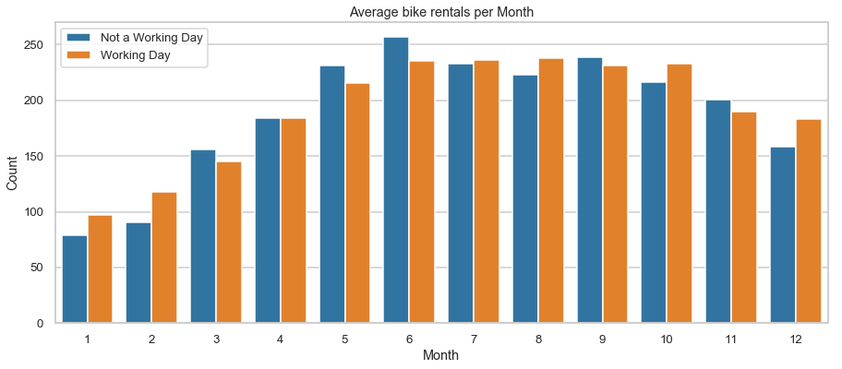
Exploratory Data Analysis – Monthly Distribution
Most rentals are in the months of June and May while least are on January and February.

Slide 11
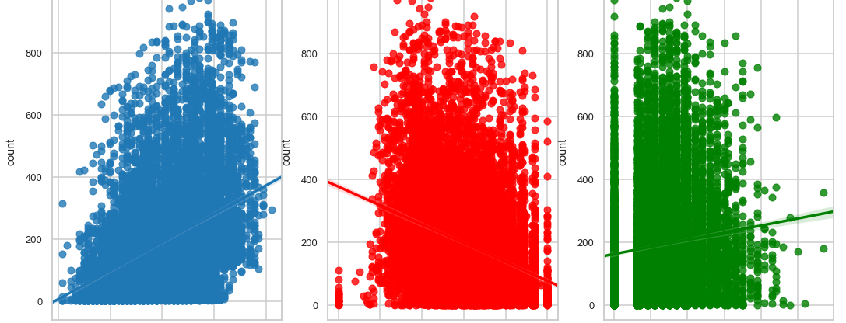
Regression Plots
We see a positive correlation between count and temperature
We see a negative correlation between count and humidity
Count has a weak dependence on windspeed and several missing (or erroneous) data points (labeled as 0s)

Slide 12
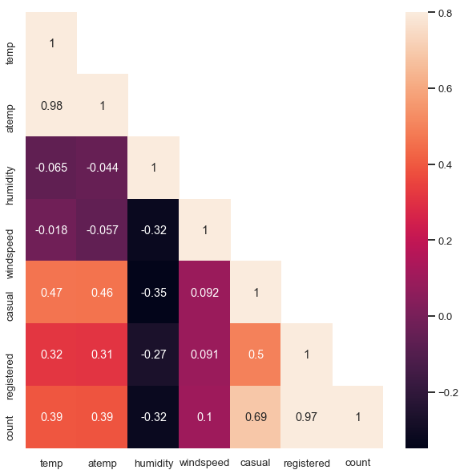
Correlation Analysis – Heatmap
temp (true temperature) and atemp (feels like temperature) are highly correlated
count = casual + registered ➔ count is highly correlated with casual and registered

Slide 13

Modeling Overview
Type: Supervised Learning
Regression Problem: Possible Target values [0, $∞)$

Slide 14
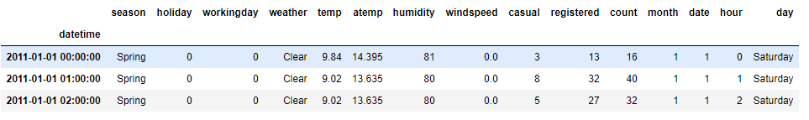
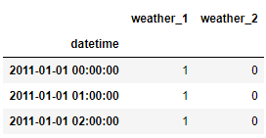
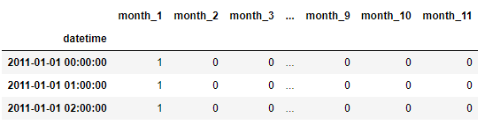
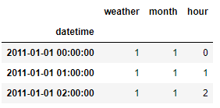
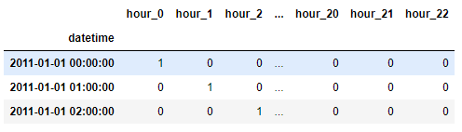
Feature Engineering
OneHotEncoding

Slide 15
Train/Test Split

Slide 16
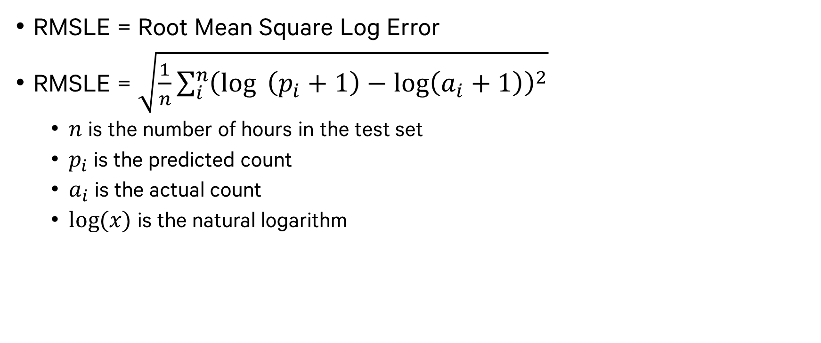
Evaluation Metric - RMSLE
RMSLE = Root Mean Square Log Error
RMSLE = $\sqrt{\frac{1}{n}\sum_{i}^{n}{{\left(\log{ \left(p_{i}+1\right)}−\log\left(a_{i}+1\right)\right)}^{2}}}$
$n$ is the number of hours in the test set
$p_{i}$ is the predicted count
$a_{i}$ is the actual count
$log⁡(x)$ is the natural logarithm

Slide 17
Regression Algorithms Used
Category | Regression Algo
Linear | Linear Regression
 | Ridge
 | Lasso
Ensemble | Random Forest – 1
 | Random Forest – 2
 | Random Forest – 3
 | Gradient Boost – 1
 | Gradient Boost – 2
 | Adaboost
Stacking | Linear Regression
 | Random Forest
 | Gradient Boost
3 Categories
Linear Algorithms
Ensemble Algorithms
Stacking Algorithms where predictions from Linear and Ensemble methods were used to make final predictions

Slide 18
Stacking Model Details

Slide 19
Stacking Model Summary

Slide 20
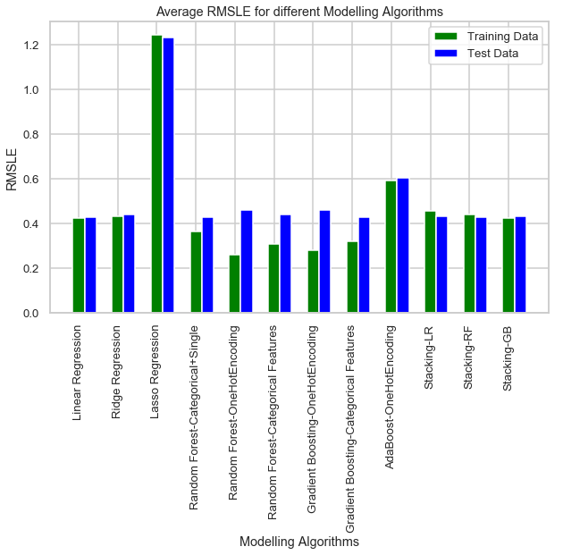
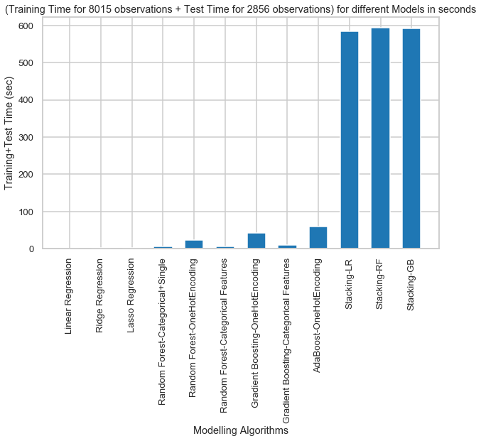
RMSLE & Modeling Time Summary

Slide 21
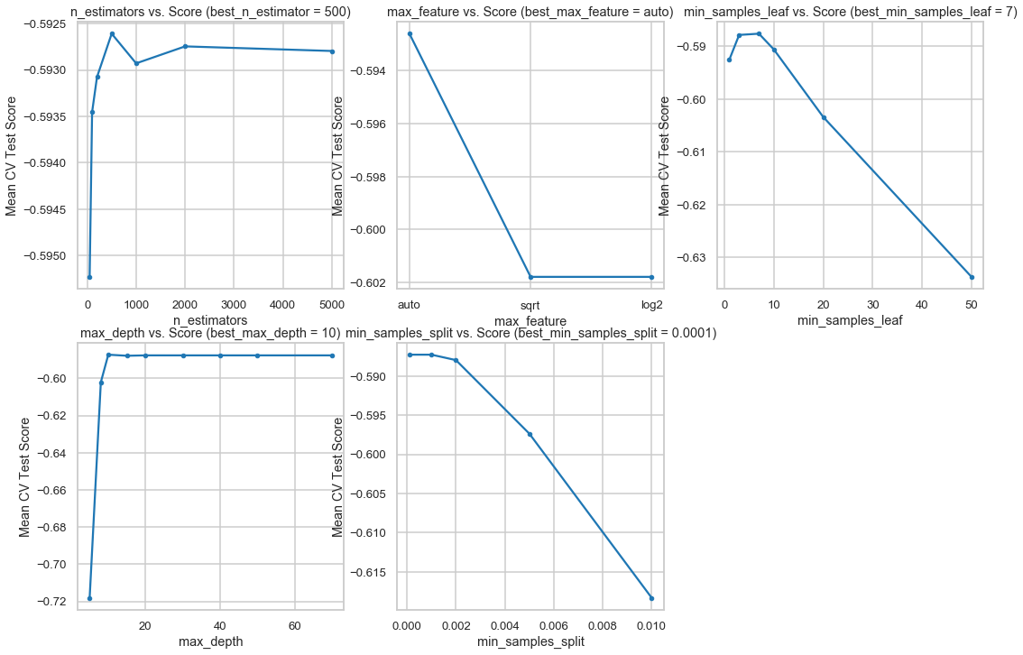
Random Forest Regression Hyperparameter Tuning

Slide 22
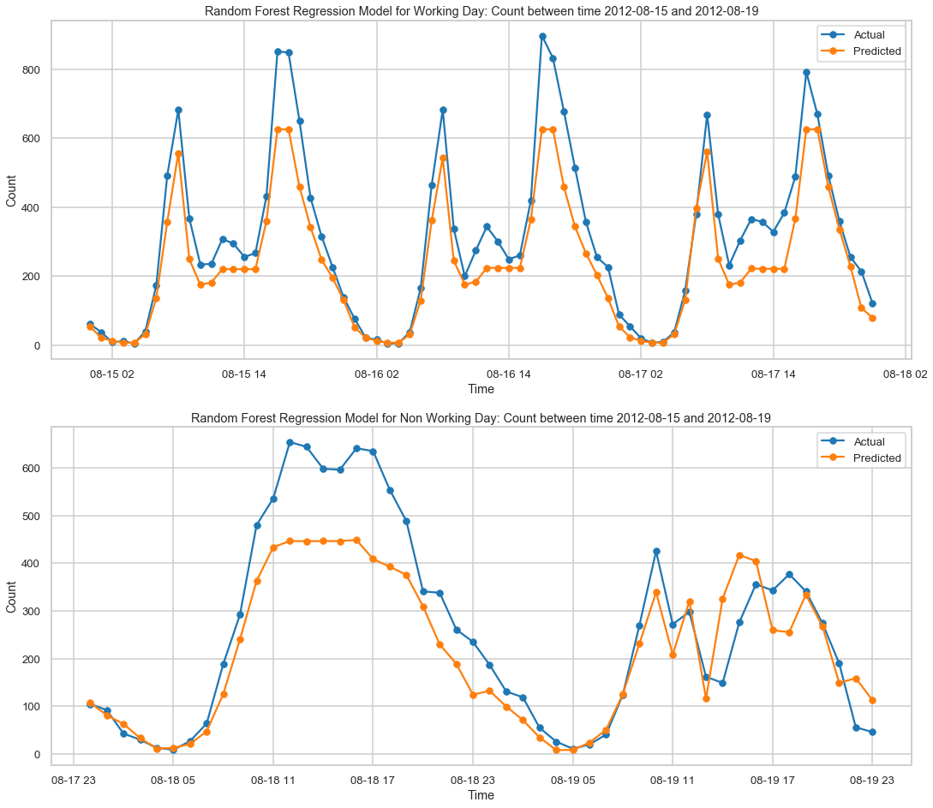
Random Forest Regression Model Performance

Slide 23
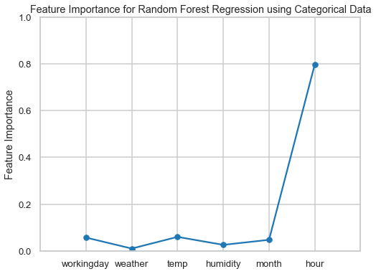
Random Forest Regression Feature Importance

Slide 24
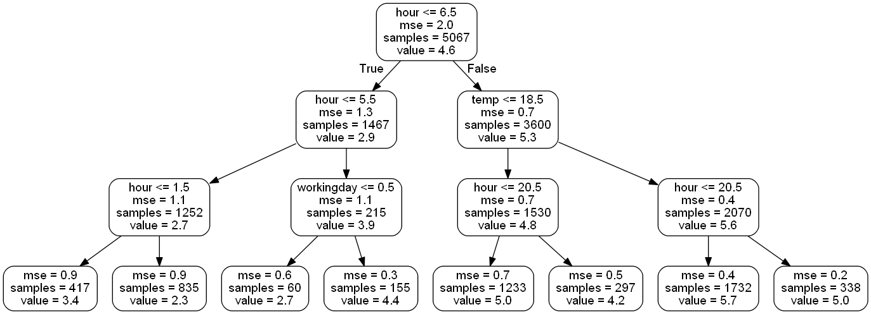
Random Forest Regression One Sample Decision Tree

Slide 25
Limitations and Ideas for Model Imporvement

Slide 26
Conclusions

