Slide 1
AURA
Customer Ordering System
CSE323 · Spring 2026 · Flask · Firebase · SQLite
Phase 1
Phase 2
Phase 3
Phase 4
Requirements
Design
Implementation
Validation

Slide 2
1
PHASE 1
Requirement Discovery
Actor Classification
Traceability Heatmap
Persona Edge Cases

Slide 3




Actors
Customer
Admin
Delivery
Firebase
role: customer
role: admin
role: delivery
Identity Toolkit
PRIMARY
SUPPORTING
SUPPORTING
OFFSTAGE

Slide 4
Traceability
35
0
3
8
Requirements
Orphaned
Gaps Disclosed
REQ Categories
AUTH
7
CHK
5
PRO
5
ADM
3
MENU
3
CART
3
Requirements by category

Slide 5
8 Edge Cases Found
via AI Persona Avatar
⚠️
⏱️
📦
🔒
Typo Referral Code
Stock Depleted at Checkout
Cart > Stock
Cancel After PREPARING
400
FAIL
FAIL
ERROR
📧
🚛
💰
🏷️
Unverified Email Login
Advance Wrong Status
Promo Below Min Order
Expired Voucher
401
FAIL
REJECT
EXPIRED

Slide 6
2
PHASE 2
Design & Specification
Gherkin Scenarios
UML Diagrams
API Contracts
QA Refinement

Slide 7
Gherkin Scenarios
1
Feature: Customer Registration
🔑
🛒
2
3
Scenario: Successful registration
Auth
Cart
4
Given
Firebase is configured
5
When
💳
⚙️
POST with valid fields
6
Then
User row created in DB
Checkout
Admin
7
8
Scenario: Promo below min order
🚛
🏷️
9
Given
Subtotal < $30
10
When
Validate AURA20 promo
Delivery
Vouchers
11
Then
Error: min order message

Slide 8
Order Lifecycle
CONFIRMED
PREPARING
READY
OUT FOR
DELIVERY
DELIVERED
→
→
→
→
Order Created
Admin Update
Admin Update
Delivery
Delivery
CANCELLED
Delivery Pipeline
Customer/Admin · PENDING or CONFIRMED only
READY → OUT_FOR_DELIVERY → DELIVERED

Slide 9
QA Refinement
❌ VAGUE
✅ MEASURABLE
"Secure Login"
→
Werkzeug hash (staff)
Firebase + emailVerified (customer)
UID mismatch → 401
"Valid Card"
→
Luhn algorithm pass
Length 13–19 digits
CVV 3–4 digits · expiry not past
"Active Voucher"
→
is_used == False
AND utcnow() < expires_at
"Minimum Order"
→
subtotal ≥ promo.min_order
before discount applied

Slide 10
3
PHASE 3
Test-Driven Implementation
8 Sprints · Vertical Slices
TDP: Failing → Padlock → Iterate
AI Prompts Disclosed

Slide 11
8 Sprints
1
2
3
4
🔐
🛒
💳
⚙️
Auth & RBAC
Menu & Cart
Checkout
Admin Panel
5
6
7
8
🚛
📍
⭐
📄
Delivery
Order Tracking
Profile & Rewards
Static Pages

Slide 12
Edge Case Cage
📝
🔒
🤖
✅
→
→
→
Write
Failing Test
Add
Padlocks
Prompt
AI
Iterate to
Passing
⭐
Rating 1–5
🔑
Password
💳
Card CVV
📦
Cart Qty
inclusive
≥ 8 chars
3 or 4 digits
≤ stock
💰
Points Redeem
🏷️
Promo Min
🚛
Delivery Advance
👥
Referral Reward
≥ 500
subtotal ≥ min
READY or OUT
1st DELIVERED

Slide 13
4
PHASE 4
Validation & Pipeline
70% Unit · 20% Integration · 10% E2E
10 Test Modules
Playwright POM (Planned)

Slide 14
Testing Pyramid
10%
E2E · Playwright (Planned)
20%
Integration · DB + Flask client
70%
Unit Tests · Services + Logic
🧪 10 Test Modules · pytest -v --cov=app

Slide 15
Verified vs Validated
🔧
🎯
VERIFICATION
VALIDATION
Did we build
it RIGHT?
Did we build the
RIGHT THING?
✓ Routes → correct templates/JSON
✓ Browse → Cart → Checkout
✓ RBAC → 403/401 enforced
✓ Admin: PREPARING → READY
✓ Luhn + CVV validation
✓ Delivery: OUT → DELIVERED
✓ Services enforce business rules
✓ Customer receives loyalty points

Slide 16
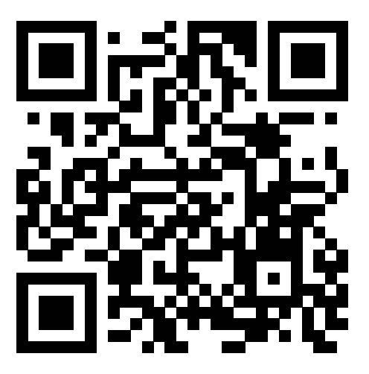
🔗
GitHub Repository
github.com/mona585/Customer-Ordering-System
Website link
https://customer-ordering-system.onrender.com
AURA · CSE323 · Spring 2026

