Slide 1
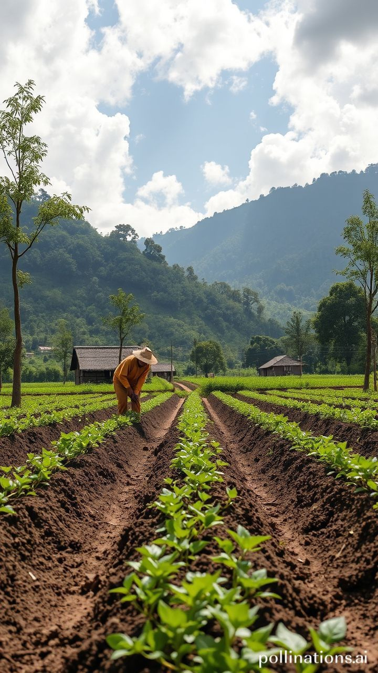


Climate Change
Impact
&
ON
Agriculture
Data Analysis Project
Python & Powe BI
BY:
Lekaa Gamal
Ola Yasser
Mona Abo Alhassan

Slide 2
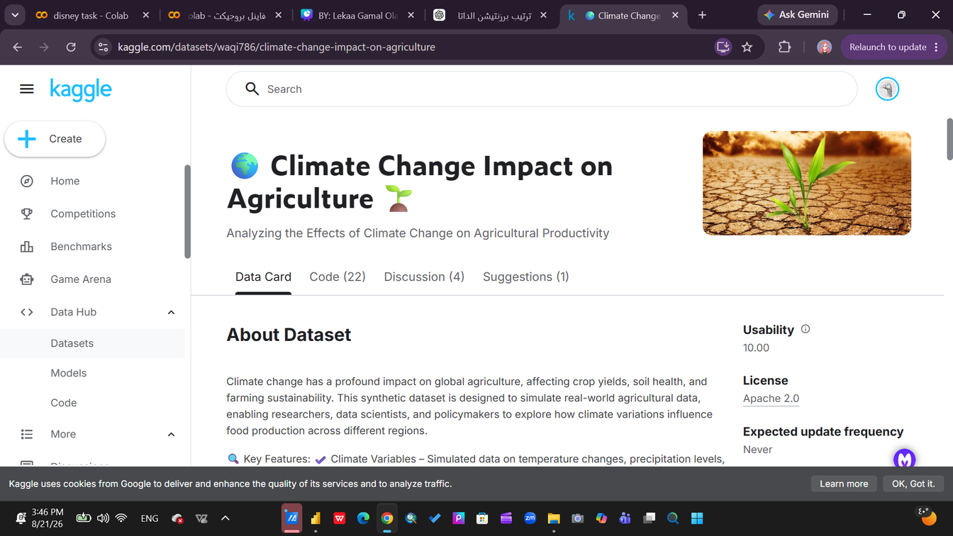
Dataset
Rows:
10,000
Columns:
15
Main Variables:
Temprature
Precipitation
CO₂ Emissions
Crop Yield
Extreme Weather Events
Irrigation Access
Soil Health
Economic Impa
From

Slide 3
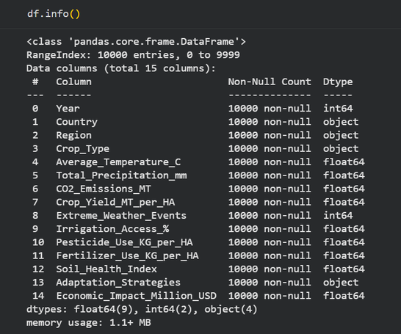
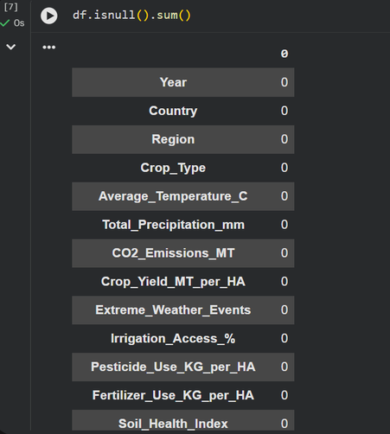
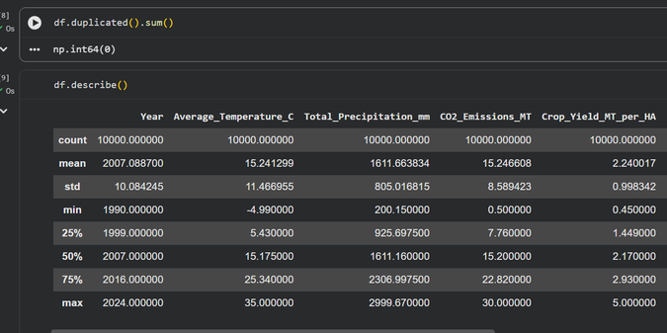
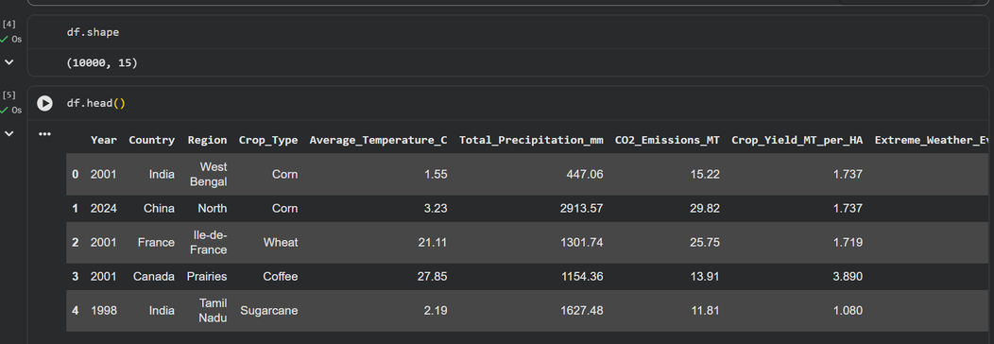
Data Cleaning
Using Python
Before Cleaning
Cleaning Process

Slide 4
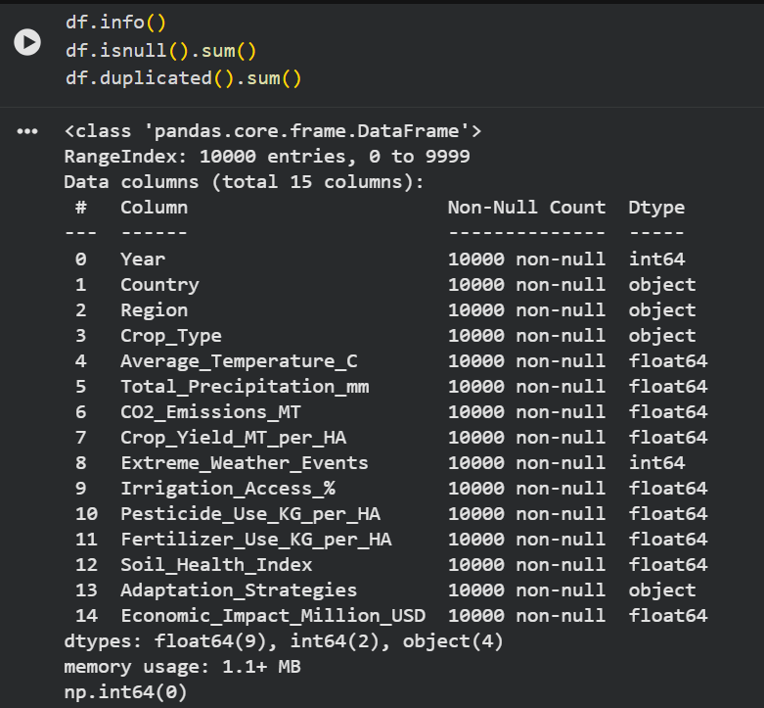
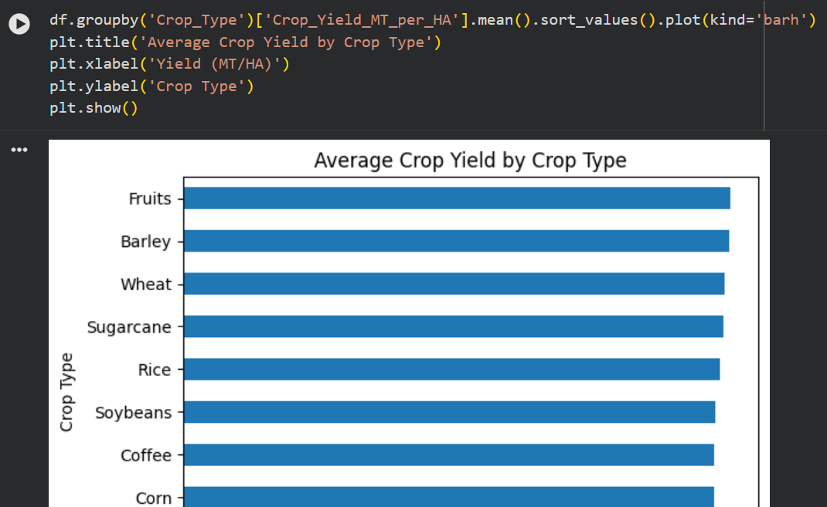
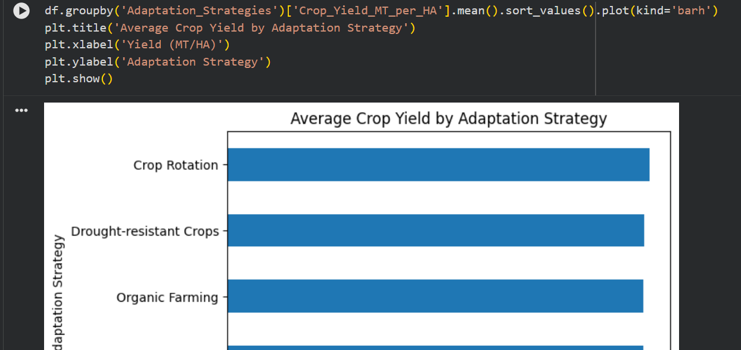
After Cleaning
Data Cleaning
Using Python

Slide 5
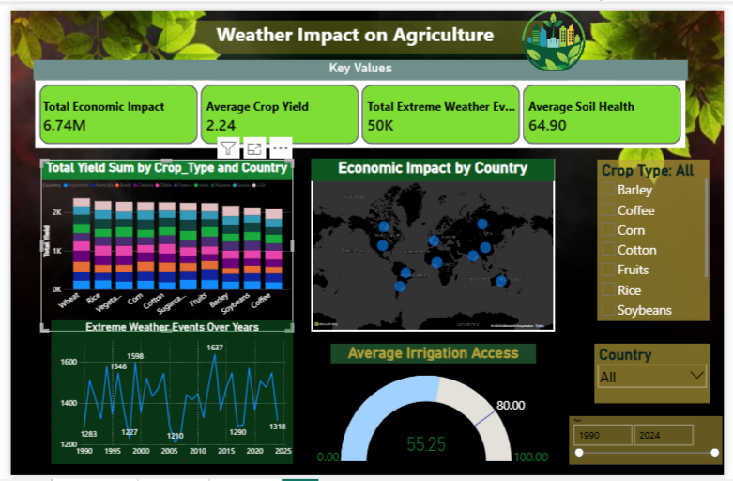
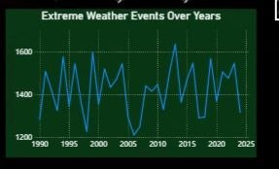
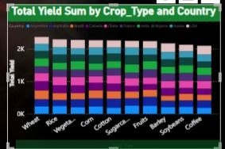
Main Dashboard
Key Values and KPIs
  Total Economic Impact
  Average Crop Yield
  Extreme Weather Events
  Average Soil Health Index
Visual Title: Total Yield Sum by Crop Type and Country
Extreme Weather Events Over Years
Your paragraph text

Slide 6
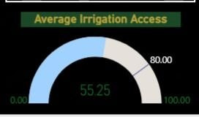
Main Dashboard
Key Values and KPIs
  Monitors water distribution efficiency, showing a global average coverage of 55.25%.
  Takeaway: Visualizes the gap between current operations and the sustainable 80.00% Target, backing the urgent call for irrigation infrastructure funding.

Slide 7
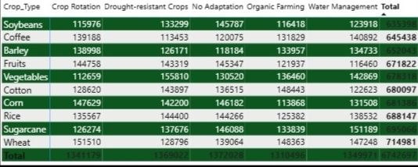
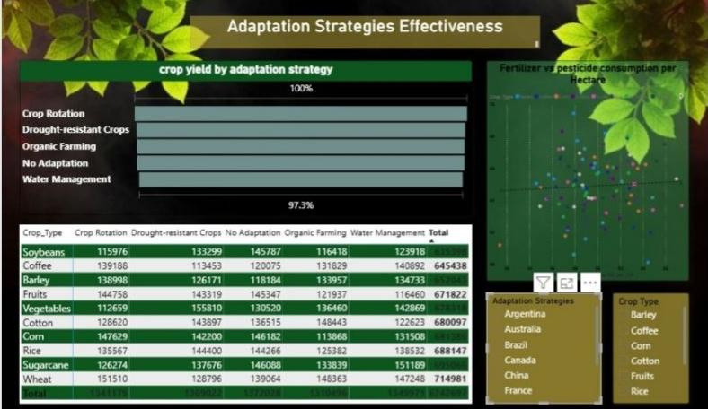
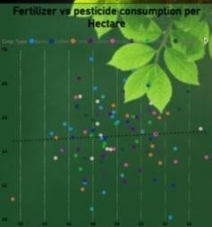
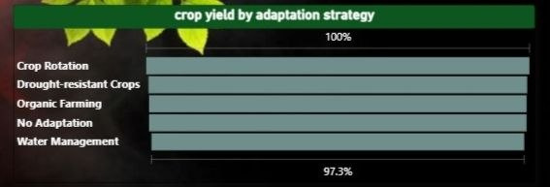
DashBoard

Slide 8

Insights
Economic Impact has a strong positive relationship with Crop Yield
Crop performance differs significantly across crop types
Crop Rotation has the highest average yield among the adaptation strategies
Adaptation strategies can be associated with different yield levels

Slide 9

Recommendations
Focus on strategies that improve agricultural productivity
Consider crop rotation as an adaptation strategy to support productivity
Reduce emissions and promote sustainable practices
Irrigation Investment: Elevate irrigation access from 55% to 80% to eliminate high dependency on unpredictable rainfall.
Sustainable Transformation: Data proves that smart adaptation strategies deliver superior performance over traditional farming.

Slide 10

Thank You

