Slide 1
Bird-Strike Database Design
Mohsen Nabian
8/8/2015

Slide 2
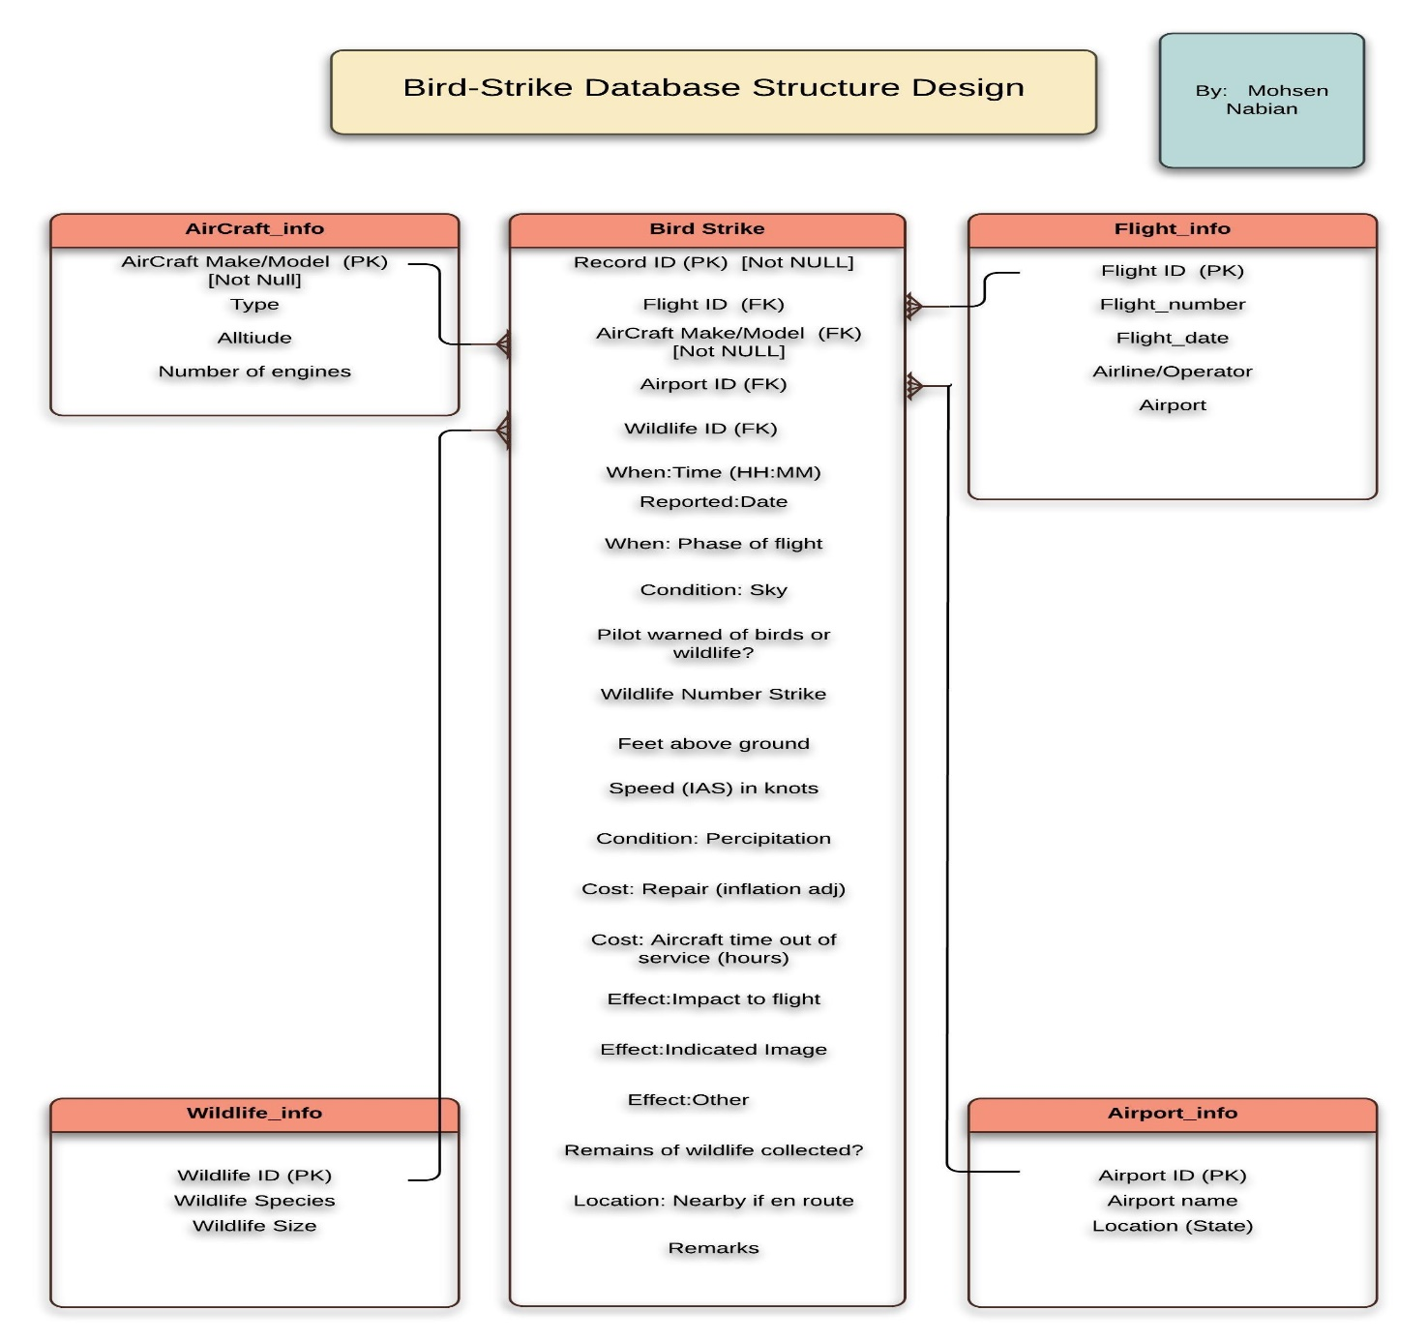

Slide 3
Data Frames Prepration
After designing the normalized tables it is time to prepare data :
1) we need to create data frames for different tables
2) remove repetitive raws from non_based tables
3) putting id for those non_based tables as primary key
4) finding the corresponding raws in base tables from non_based tables.
5) put the corresponding ids in the foreign key columns in the base table

Slide 4
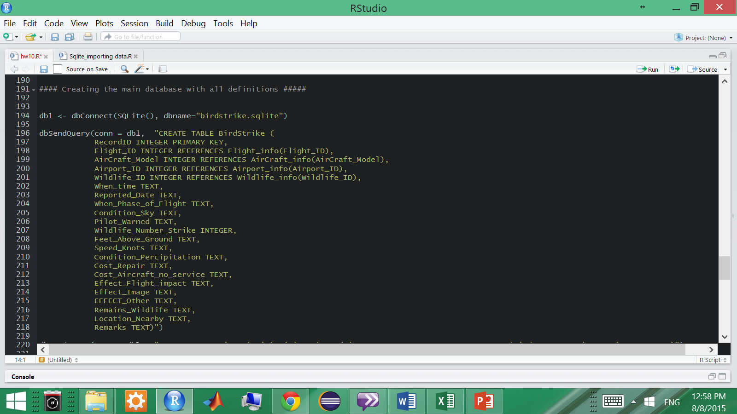
Creating Database and defining the tables in the database

Slide 5
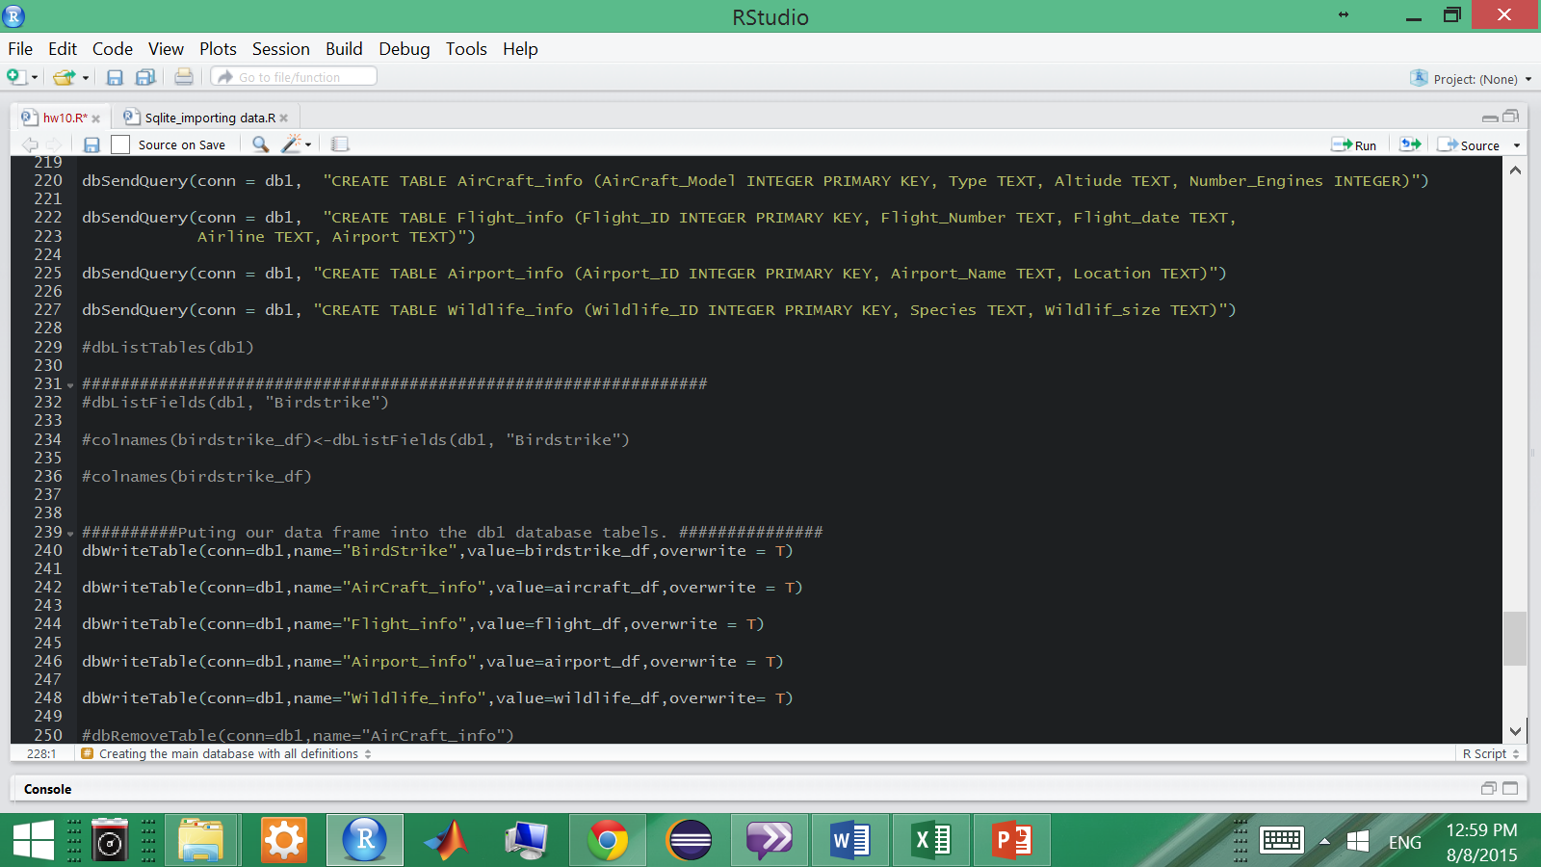
Defining the tables in the database and loading data frames in to the database tables

Slide 6
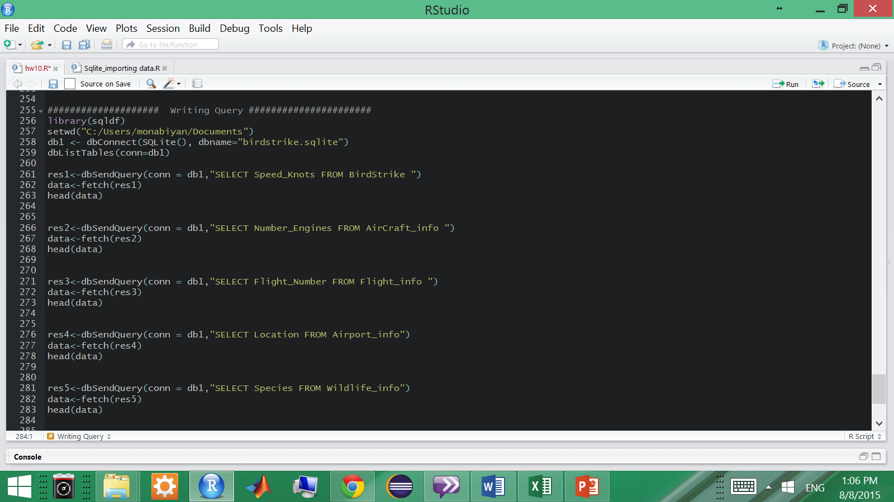
Writing Queries for each table in the database

Slide 7
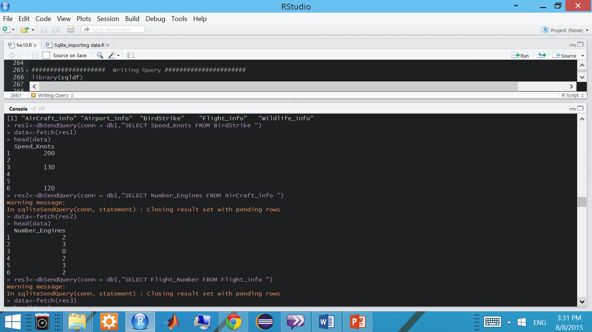
Writing Queries for each table in the database

Slide 8
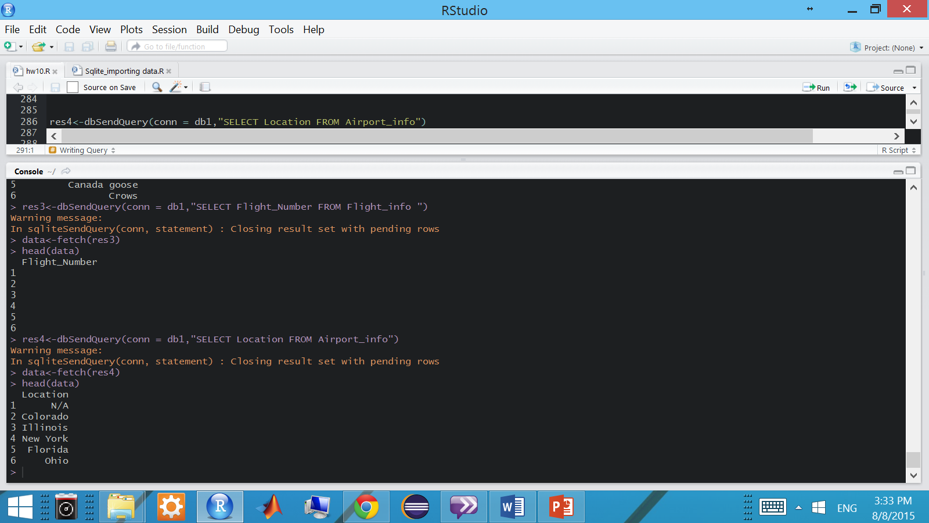
Writing Queries for each table in the database

Slide 9

Writing Queries for each table in the database

