Slide 1
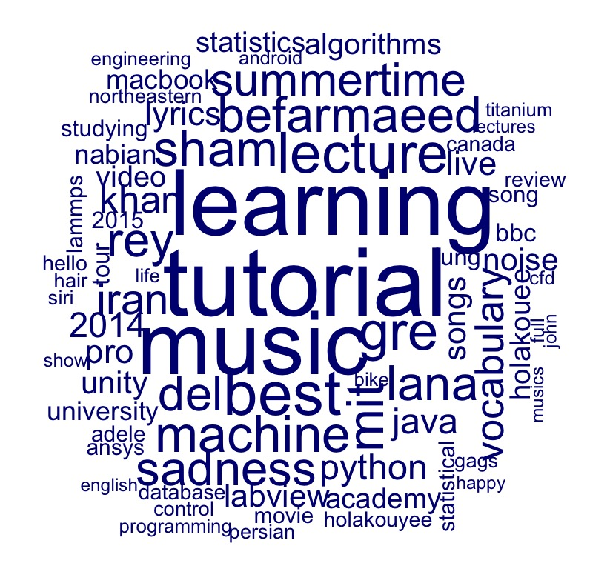
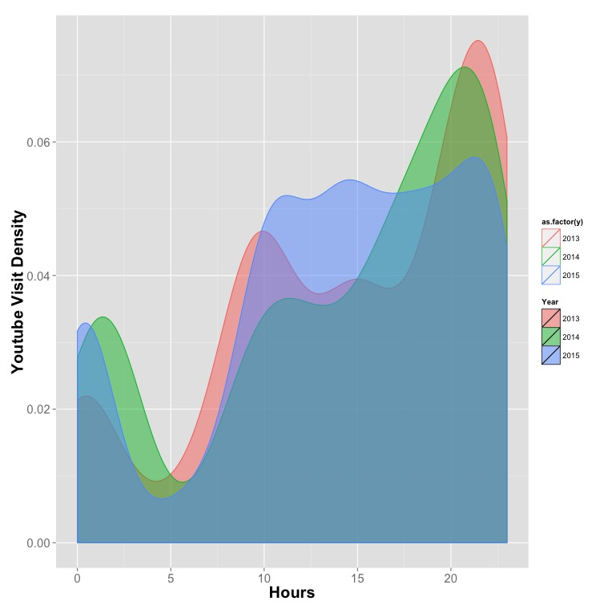
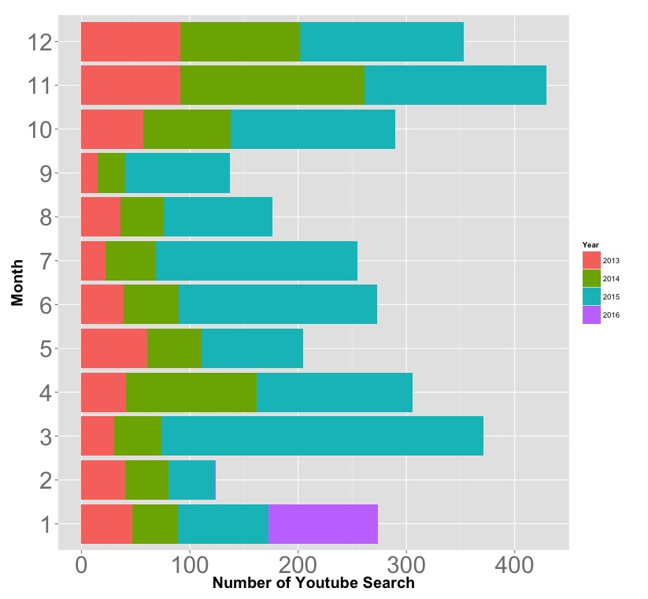

Slide 2

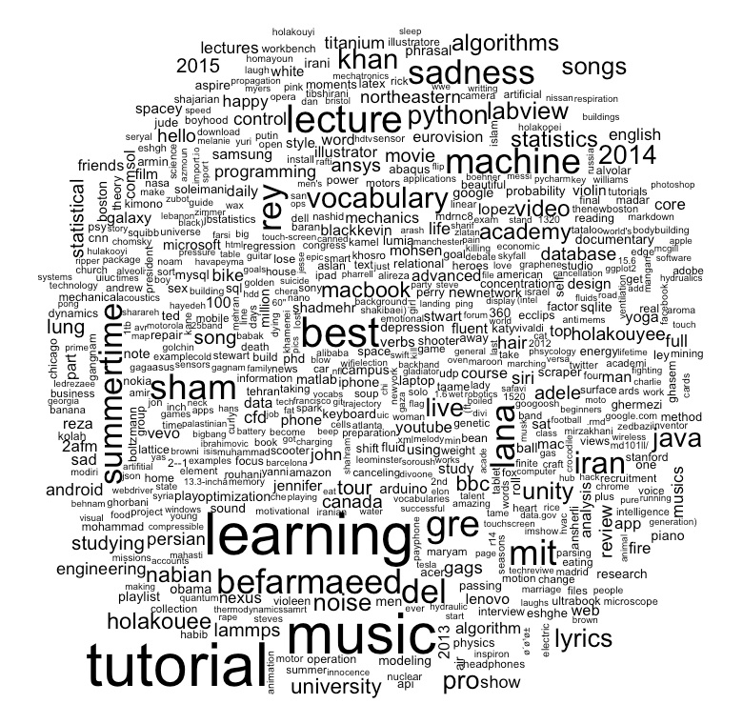
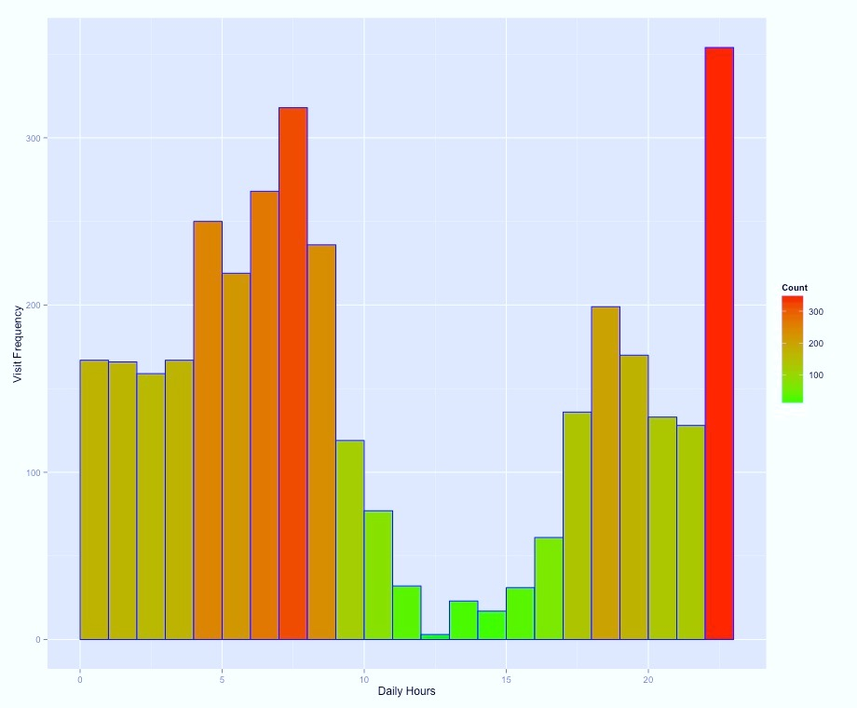
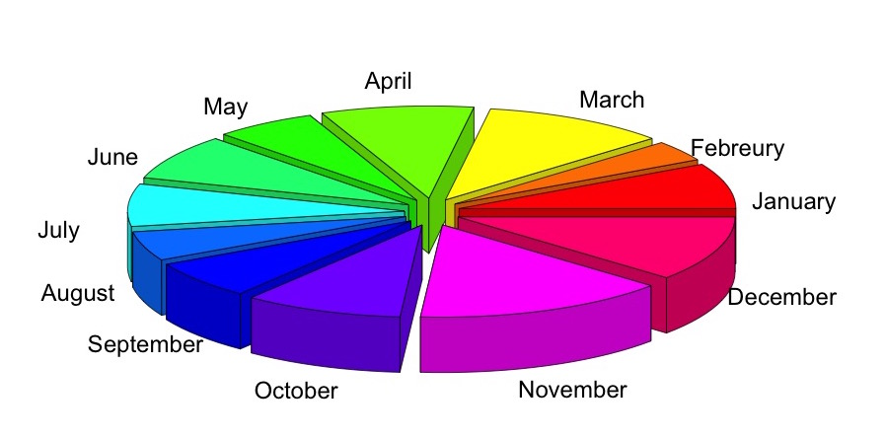
My
Activities:
2012-2015
Search Content
My Activities in Daily Hours
My Activities in Months

Slide 3
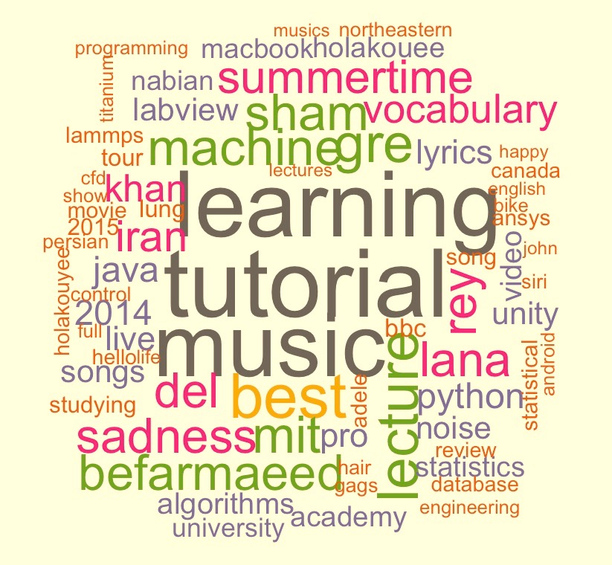
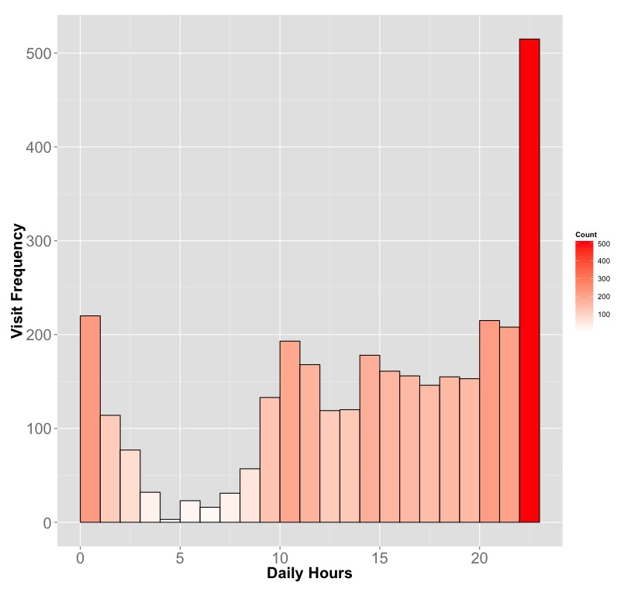
My
Activities:
2013-2015

Slide 4

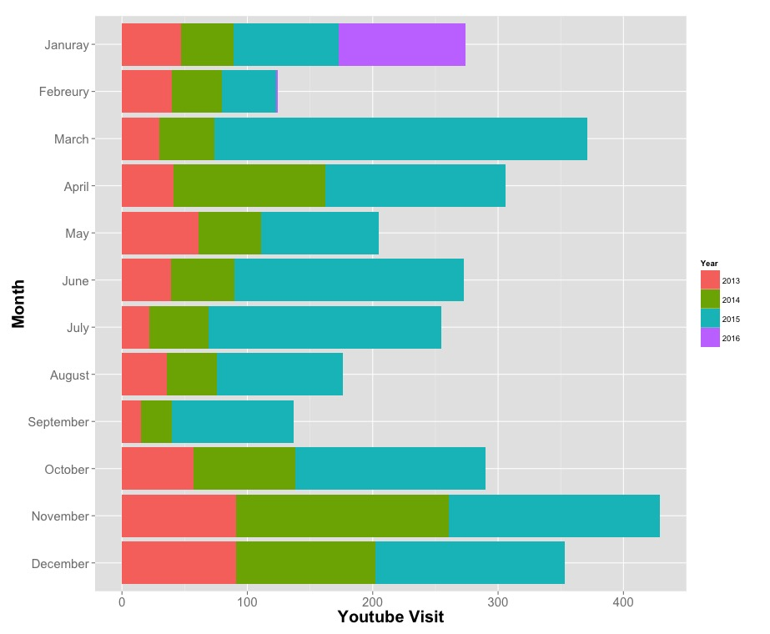
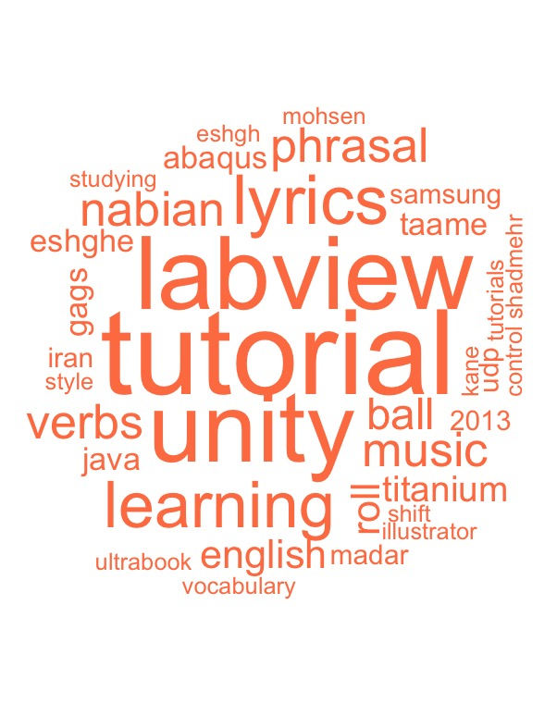
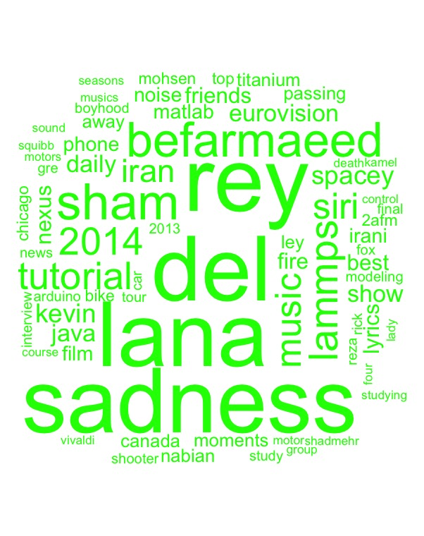
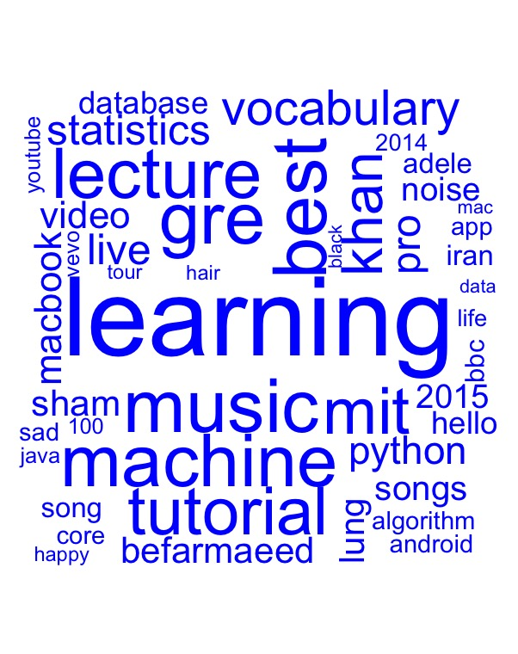
My
Activities:
2013-2015
2013
2014
2015

Slide 5
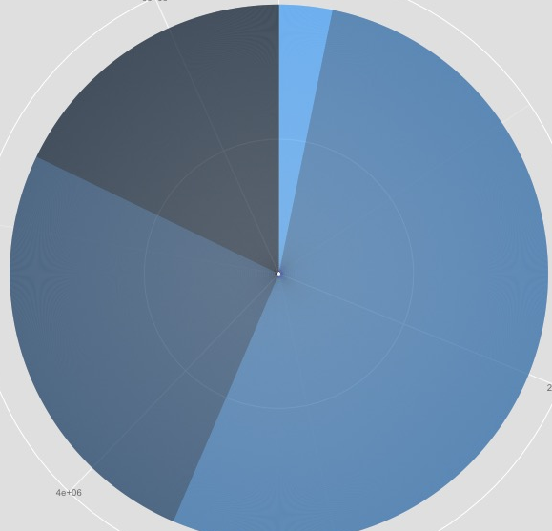
My
Activities:
2012
2016
2013-2016
0.6
2013
2015
Jan
Feb
Mar
0.4
Apr
My YouTube Visit Density
May
Month
Jun
Jul
0.2
Aug
My Digital Shadow- Mohsen Nabian -Feb 2016
Sep
Oct
Nov
Dec
0.0
0
100
200
300
400
12:00 AM
5:00 AM
10:00 AM
3:00 PM
8:00 PM
11:00 PM
My YouTube Visit
Hours
The amount of my YouTube visits is NOT uniform during a year. I have frequent visits on March, November and December and less visits on February and September. (Left Figure)
My daily activity patterns are similar in 2013 and 2014. However, it was changed in 2015(Right-Top Figure). I explored this variation by looking into my videos contents.
Word Clouds highlight the major contents of my YouTube searches in 2013,2014 and 2015 (Right-Bottom Figure). It is apparent that in 2013 and 2014 I was mostly watching many tutorials and music videos after school or during my breaks. While, in 2015, I watched many lectures during my school time due to my NEW research subject ! The results are perfectly consistent with my personal experience.
It is shown that the amount of my YouTube activities has a significant increasing trend every year. (Pie chart, Right-Top Figure)
The background portrays the overall contents of my video searches!
2013
2014
2015

