Slide 1
HW 3 Plots
Mohsen Nabian

Slide 2
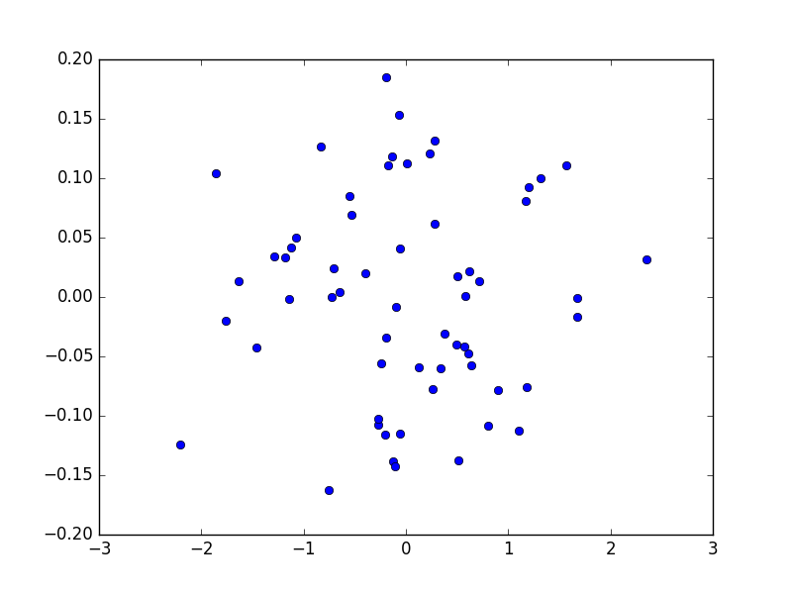
Problem 1 (PCA1 vs PCA2)

Slide 3
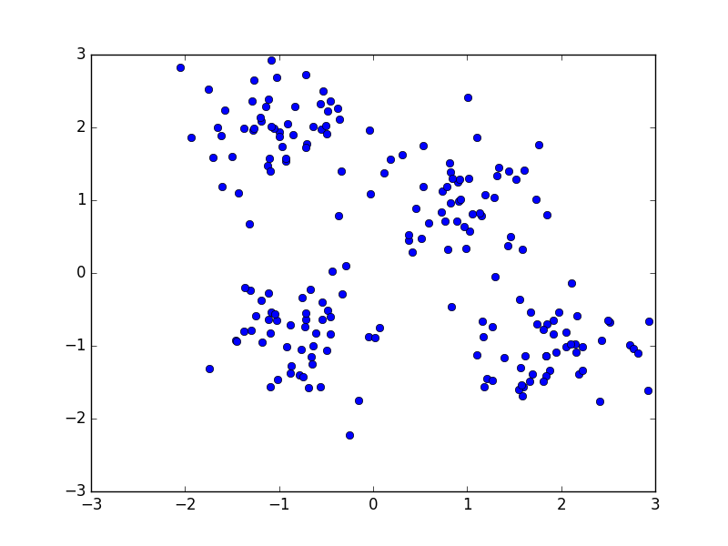
Problem 2 Original X

Slide 4
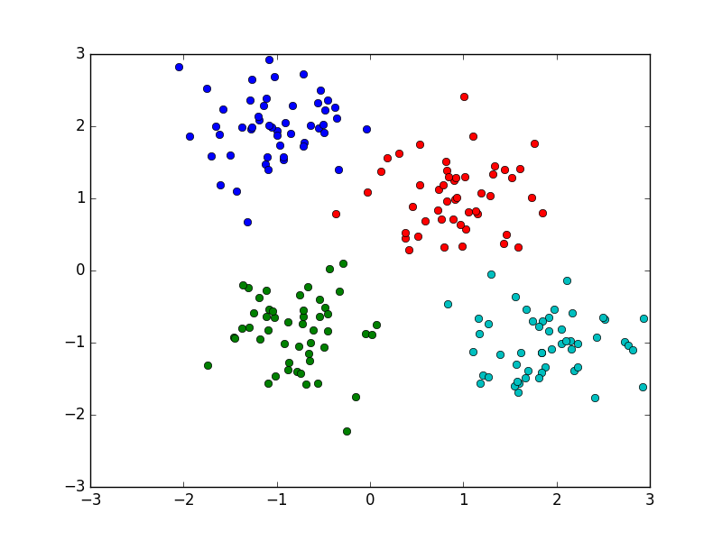
Problem 2 Kmeans

Slide 5

Problem 3 sigma=0.1

Slide 6
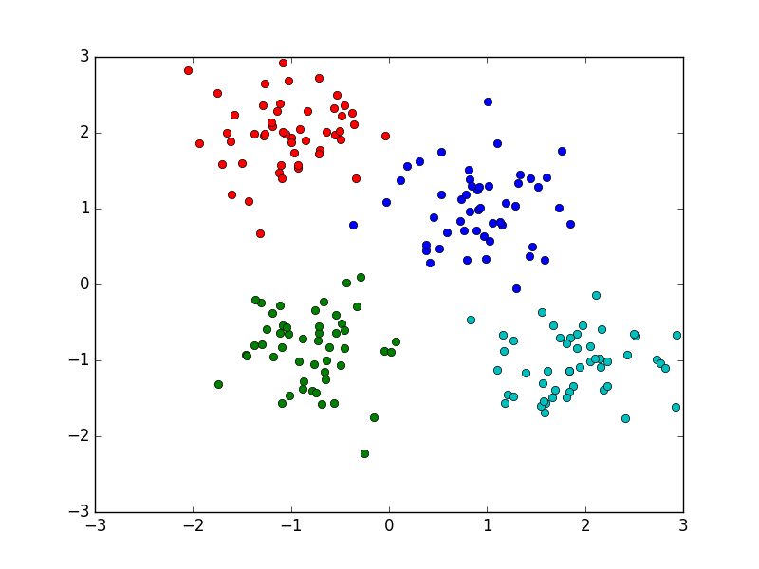
Problem 3 sigma=1

Slide 7
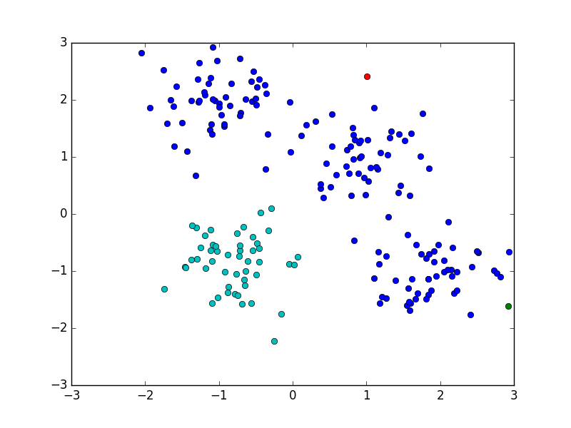
Problem 3 sigma=0.01

Slide 8
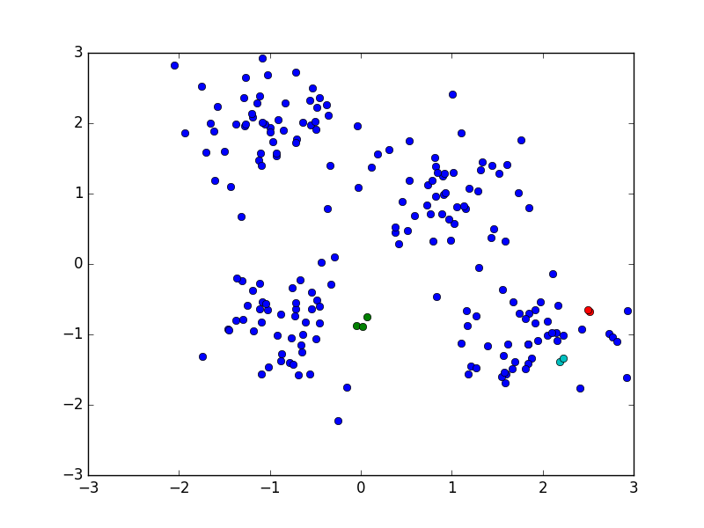
Problem 3 sigma=0.001

