Slide 1
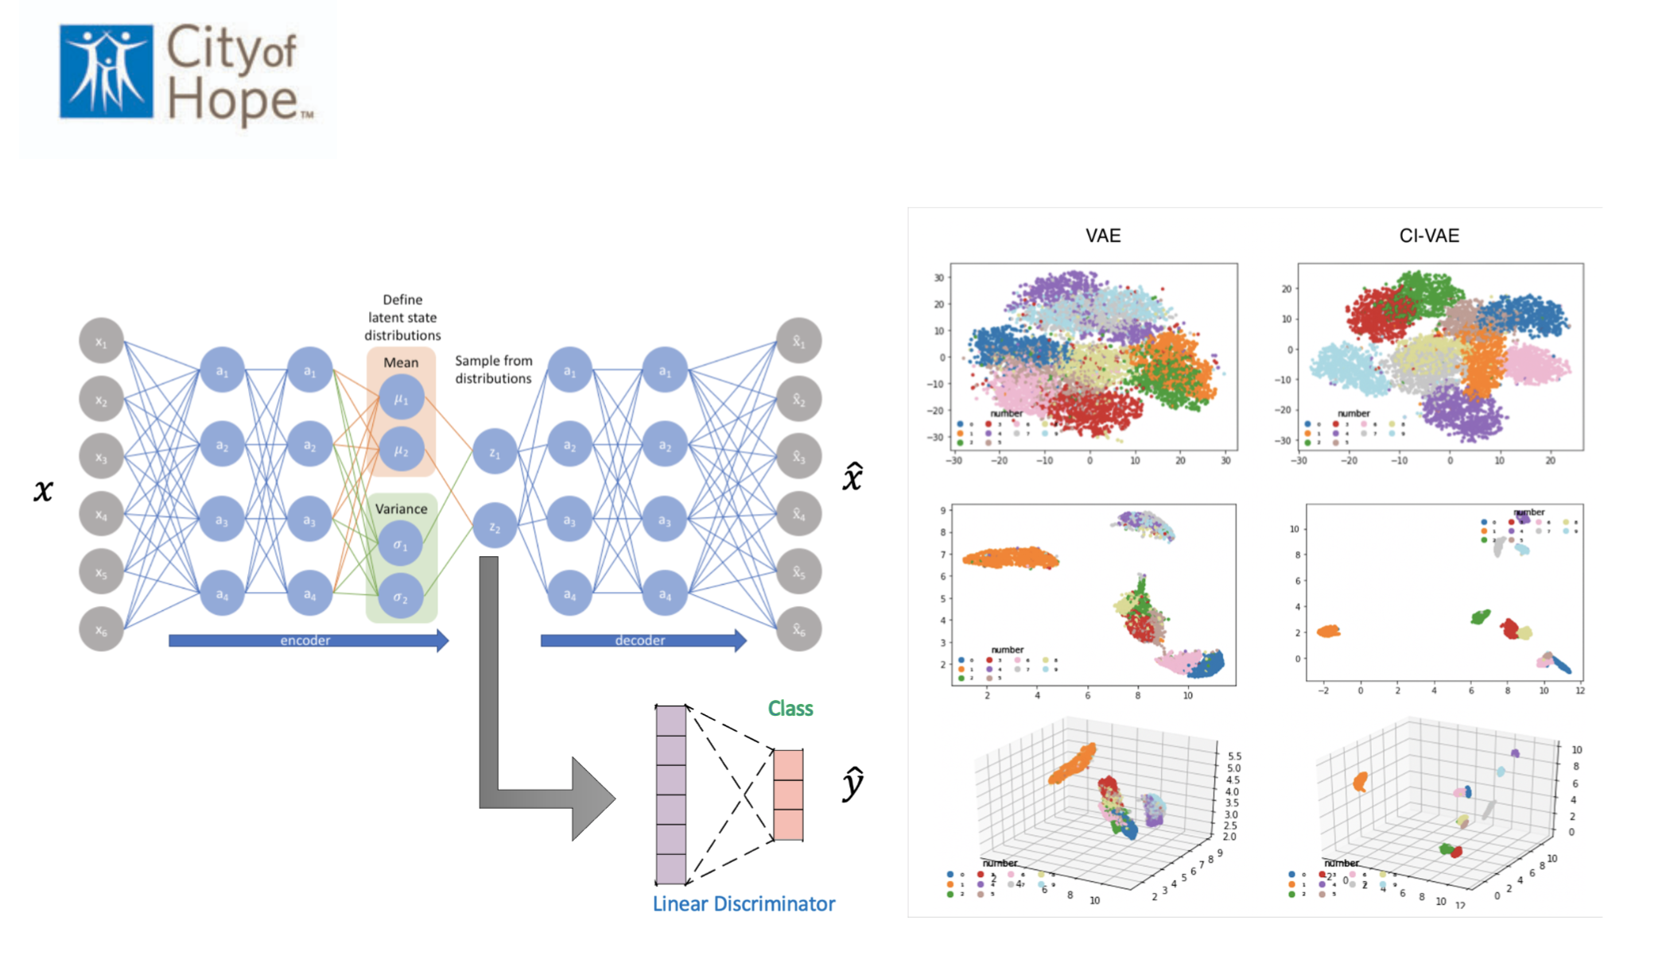

Slide 2
CI-VAE
for disease understanding

