Slide 1

https://www.youtube.com/watch?v=VVn9OG9nfH0
Spring Boot and Spring Security with JWT including Access and Refresh Tokens

Slide 2
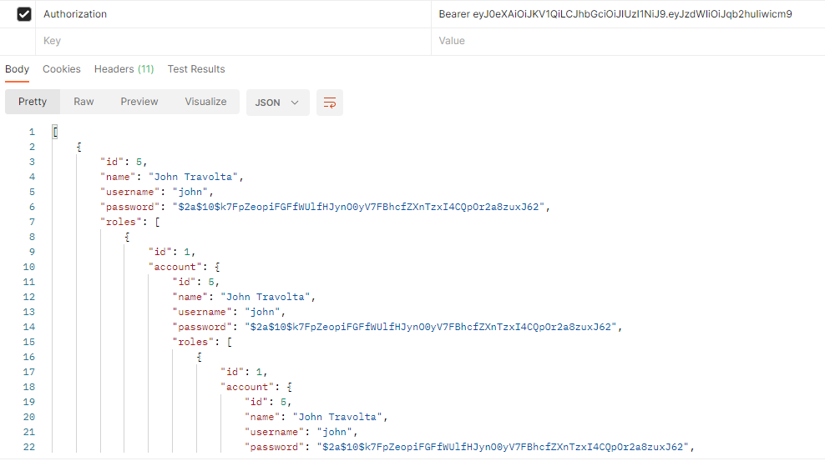
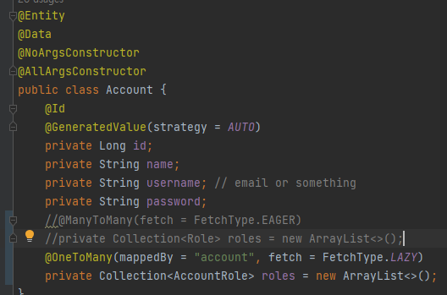
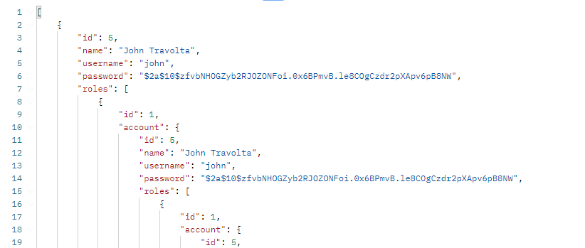
http://localhost:8080/api/accounts
FetchType.LAZY을 추가
FetchType.LAZY을 추가해도 잠깐의 시간 이후 같은 결과를 표시
Request processing failed; nested exception is org.springframework.http.converter.HttpMessageNotWritableException: Could not write JSON: Infinite recursion (StackOverflowError);

Slide 3
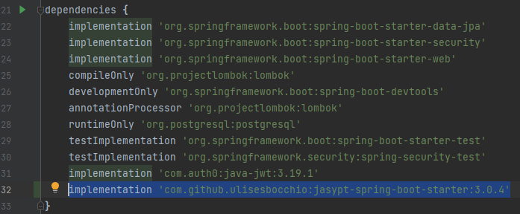
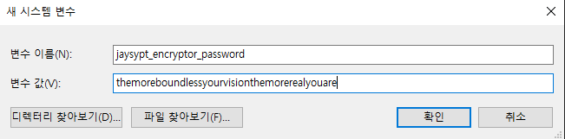
프로퍼티 암호화
https://bamdule.tistory.com/251

