Slide 1
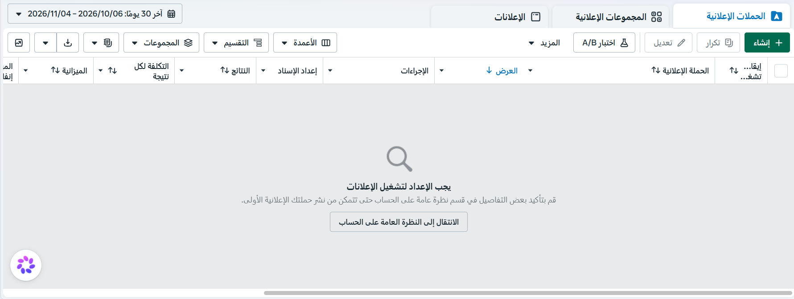
08 / META CAMPAIGN IMPLEMENTATION
Ads Manager workspace
Initial account setup screen
Academic simulation. Campaign retained as a draft; no paid delivery results reported.
DJET

Slide 2
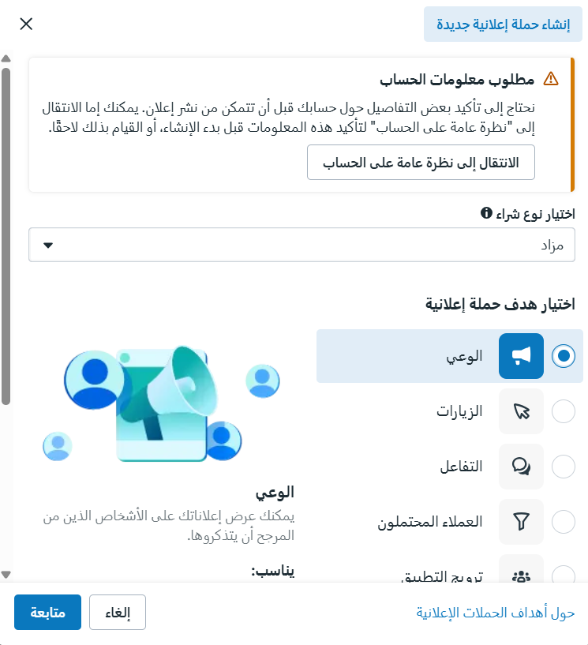
08 / META CAMPAIGN IMPLEMENTATION
Campaign objective
CONFIGURATION EVIDENCE
Auction buying type
Awareness objective
Academic campaign setup
Screenshots document the setup process.
They do not demonstrate live delivery or campaign results.
Academic simulation. Campaign retained as a draft; no paid delivery results reported.
DJET

Slide 3
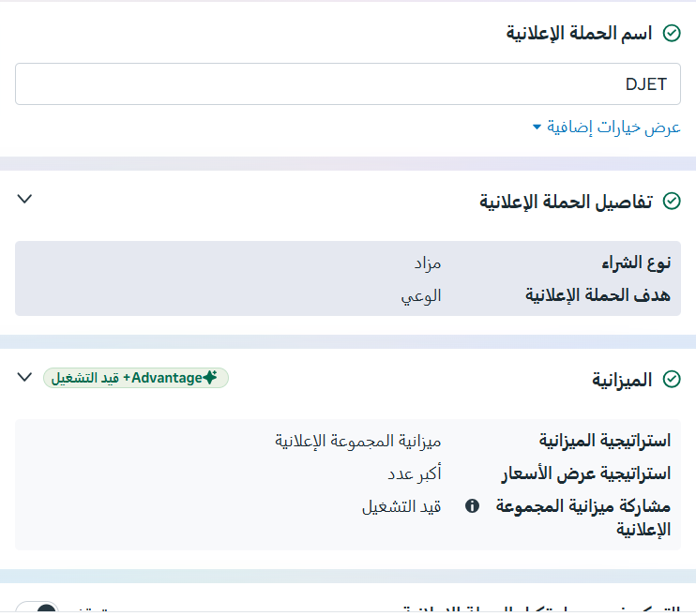
08 / META CAMPAIGN IMPLEMENTATION
Campaign configuration
CONFIGURATION EVIDENCE
Campaign name: DJET
Awareness objective
Ad set budget strategy
Screenshots document the setup process.
They do not demonstrate live delivery or campaign results.
Academic simulation. Campaign retained as a draft; no paid delivery results reported.
DJET

Slide 4
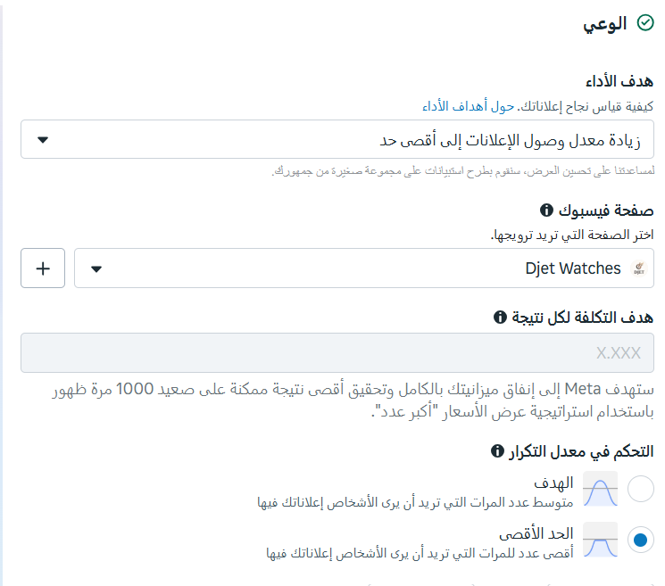
08 / META CAMPAIGN IMPLEMENTATION
Reach optimization & page identity
CONFIGURATION EVIDENCE
Performance goal: maximize reach
Facebook Page: Djet Watches
Frequency cap selected
Screenshots document the setup process.
They do not demonstrate live delivery or campaign results.
Academic simulation. Campaign retained as a draft; no paid delivery results reported.
DJET

Slide 5
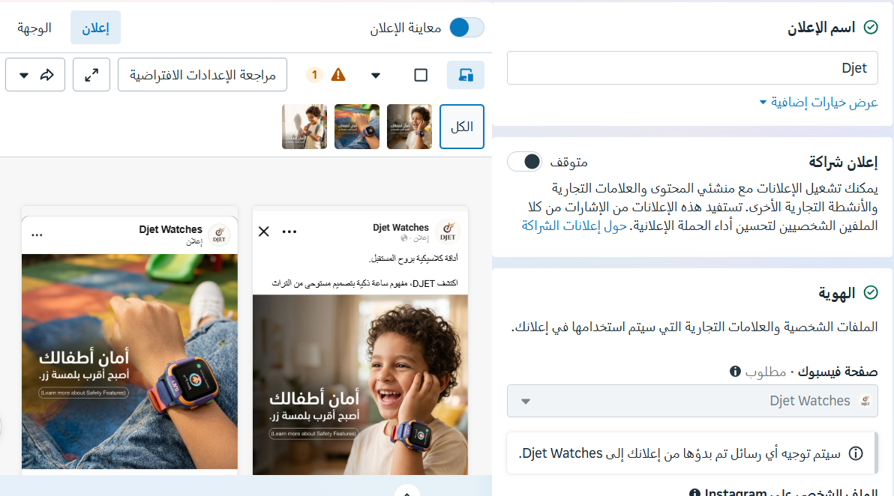
08 / META CAMPAIGN IMPLEMENTATION
Ad creative & placement preview
Family and child-connectivity creative shown in the draft preview
Academic simulation. Campaign retained as a draft; no paid delivery results reported.
DJET

Slide 6
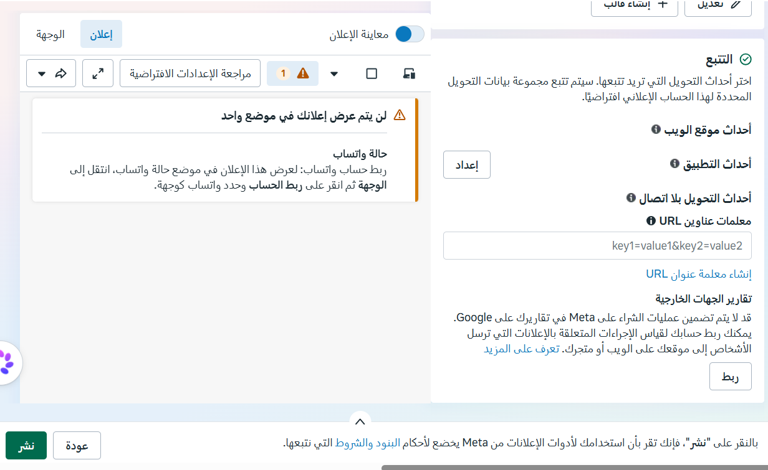
08 / META CAMPAIGN IMPLEMENTATION
Tracking setup & draft limitations
Tracking options shown; WhatsApp Status requires an account connection
Academic simulation. Campaign retained as a draft; no paid delivery results reported.
DJET

