Slide 1
Contents
First week: algorithms for exact string matching:
  One pattern: The algorithm depends on |p| and |Σ|
  k patterns: The algorithm depends on k, |p| and |Σ|
Second week: Alignment of sequences.
  Edit distance between two strings: dynamic programming
  ^{Alignment of sequences:}
      ^{2 sequences}
      ^{3 or more sequences}
Third week: dealing with long sequences.
Notes:
24/02/15

Slide 2
Dealing with genomes
What can be done with a genome or with a chromosome?
Compare it with other genomes.
The distribution of patterns of a given length.
The most frequent patterns of a given length.
Look for the repeats (short and long)

Slide 3
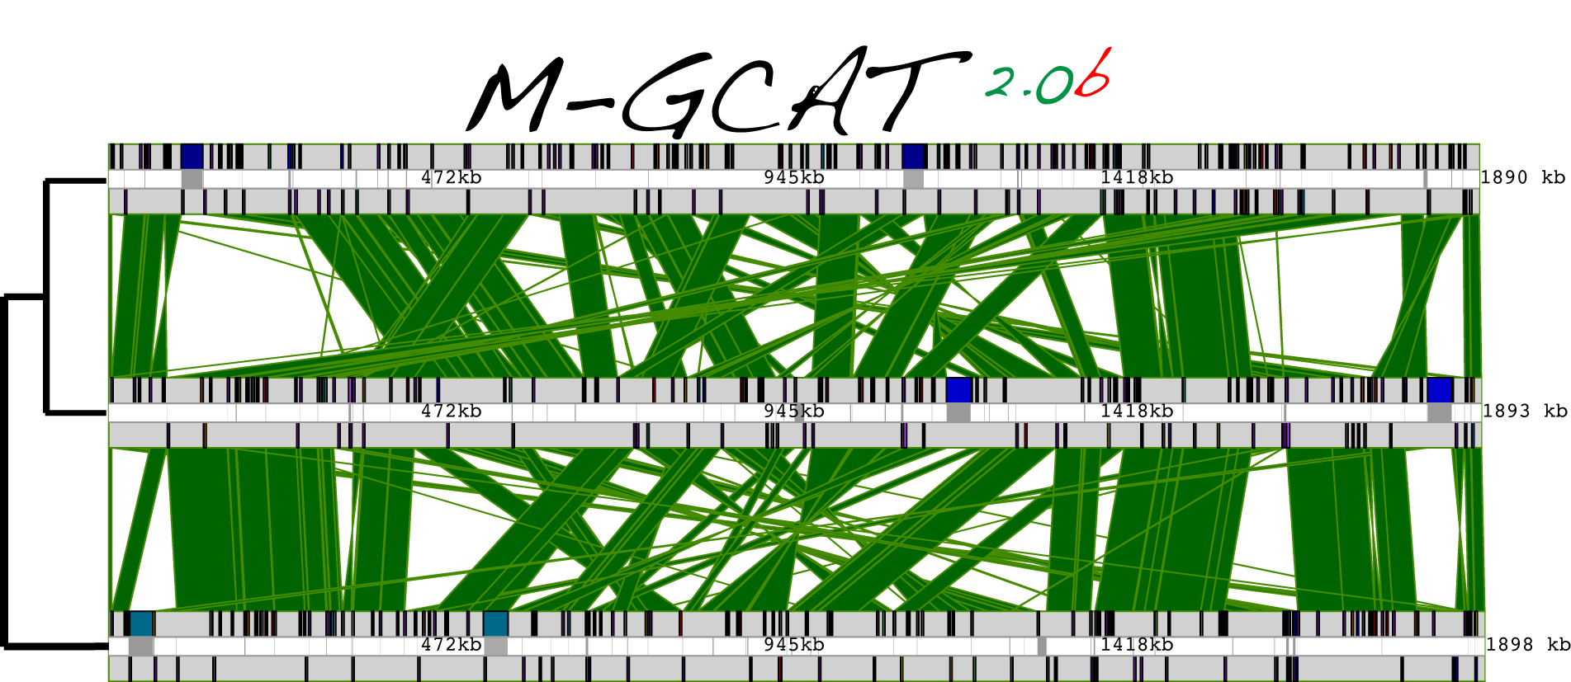
Comparison of genomes
What's the meaning?

Slide 4
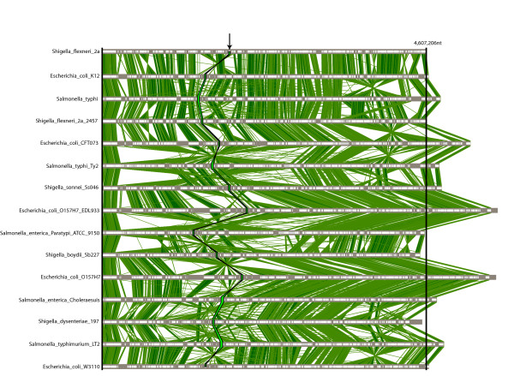
Comparison of genomes
15 microbial genomes:

Slide 5


Comparison of genomes
2 pyrococus genomes:

Slide 6
MUM
… a a t g….c t g...
Maximal
Unique
Matching
MUM
… c g t g….c c c ...
… and parallel MUMs
form a CLUSTER

Slide 7
Suffix data structures
1a. Part: Suffix trees
Algorithms on strings, trees and sequences,
Dan Gusfield
Cambridge University Press
2a. Part: Suffix arrays
Suffix-arrays: a new method for on-line string searches,
G. Myers, U. Manber

Slide 8
Suffix trees
Given string ababaas:
Suffixes:
7: s
s,7
s,7
s,6
6: as
s,6
a
5: aas
a
as,5
as,5
as,3
3: abaas
ba
as,3
ba
baas,1
1: ababaas
baas,1
ba
ba
as,4
as,4
4: baas
baas,2
baas,2
2: babaas
What kind of queries?

Slide 9
Applications of Suffix trees
1. Exact string matching
Does the sequence ababaas contain any ocurrence of patterns abab, aab, and ab?
…………………………
s,7
s,6
a
as,5
ba
as,3
baas,1
ba
as,4
baas,2

Slide 10
Quadratic insertion algorithm
Invariant Properties:
Given the string …………………………......
α
and the suffix-tree
…...
P1: the leaves of suffixes from α have been inserted

Slide 11
Quadratic insertion algorithm
Given the string ababaabbs
ababaabbs,1

Slide 12
Quadratic insertion algorithm
Given the string ababaabbs
ababaabbs,1
babaabbs,2

Slide 13
Quadratic insertion algorithm
Given the string ababaabbs
aba
ababaabbs,1
baabbs,1
babaabbs,2

Slide 14
Quadratic insertion algorithm
Given the string ababaabbs
abbs,3
aba
baabbs,1
babaabbs,2

Slide 15
Quadratic insertion algorithm
Given the string ababaabbs
abbs,3
aba
baabbs,1
ba
babaabbs,2
baabbs,2

Slide 16
Quadratic insertion algorithm
Given the string ababaabbs
abbs,3
aba
baabbs,1
ba
abbs,4
baabbs,2

Slide 17
Quadratic insertion algorithm
Given the string ababaabbs
abbs,3
aba
a
baabbs,1
ba
abbs,3
baabbs,1
ba
abbs,4
abbs,4
baabbs,2

Slide 18
Quadratic insertion algorithm
Given the string ababaabbs
abbs,5
a
ba
abbs,3
baabbs,1
ba
abbs,4
abbs,4
baabbs,2

Slide 19
Quadratic insertion algorithm
Given the string ababaabbs
abbs,5
a
ba
abbs,3
baabbs,1
ba
abbs,4
abbs,4
baabbs,2

Slide 20
Quadratic insertion algorithm
Given the string ababaabbs
a
abbs,5
ba
b
a
abbs,3
ba
abbs,4
abbs,4
baabbs,1
baabbs,2

Slide 21
Quadratic insertion algorithm
Given the string ababaabbs
a
abbs,5
bs,6
b
a
abbs,3
ba
abbs,4
abbs,4
baabbs,1
baabbs,2

Slide 22
Quadratic insertion algorithm
Given the string ababaabbs
a
abbs,5
bs,6
b
a
abbs,3
ba
abbs,4
abbs,4
baabbs,1
baabbs,2

Slide 23
Quadratic insertion algorithm
Given the string ababaabbs
a
abbs,5
bs,6
b
a
abbs,3
b
bs,7
baabbs,1
a
abbs,4
baabbs,2

Slide 24
Quadratic insertion algorithm
Given the string ababaabbs
a
abbs,5
bs,6
b
a
abbs,3
b
bs,7
baabbs,1
a
abbs,4
s,7
baabbs,2

Slide 25
Quadratic insertion algorithm
Given the string ababaabbs
a
abbs,5
bs,6
b
a
abbs,3
b
bs,7
baabbs,1
s,7
a
abbs,4
s,7
baabbs,2

Slide 26
Generalizad suffix tree
The suffix tree of many strings …
is called the generalized suffix tree …
and it is the suffix tree of the concatenation
of strings.
For instance,
the generalized suffix tree of ababaabb and aabaat …
is the suffix tree of ababaabαaabaatβ, :

Slide 27
Generalizad suffix tree
Construction of the suffix tree of ababaabbαaabaaβ :
Given the suffix tree of ababaabα :
a
abbα,5
bα,6
b
a
abbα,3
b
bα,7
baabbα,1
α,7
a
abbα,4
α,7
baabbα,2

Slide 28
Generalizad suffix tree
Construction of the suffix tree of ababaabbαaabaaβ :
a
abbα,5
bα,6
b
a
abbα,3
b
bα,7
baabbα,1
α,7
a
abbα,4
α,7
baabbα,2

Slide 29
Generalizad suffix tree
Construction of the suffix tree of ababaabbαaabaaβ :
aaβ,1
ab
a
bα,5
bα,6
b
a
abbα,3
b
bα,7
baabbα,1
α,7
a
abbα,4
α,7
baabbα,2

Slide 30
Generalizad suffix tree
Construction of the suffix tree of ababaabbαaabaaβ :
aaβ,1
ab
a
bα,5
bα,6
b
a
abbα,3
b
bα,7
baabbα,1
α,7
a
abbα,4
α,7
baabbα,2

Slide 31
Generalizad suffix tree
Construction of the suffix tree of ababaabbαaabaaβ :
aaβ,1
ab
a
bα,5
bα,6
β,2
b
a
a
bbα,3
b
bα,7
baabbα,1
α,7
a
abbα,4
α,7
baabbα,2

Slide 32
Generalizad suffix tree
Construction of the suffix tree of ababaabbαaabaaβ :
aaβ,1
ab
a
bα,5
bα,6
β,2
b
a
a
bbα,3
b
bα,7
baabbα,1
α,7
a
abbα,4
α,7
baabbα,2

Slide 33
Generalizad suffix tree
Construction of the suffix tree of ababaabbαaabaaβ :
aaβ,1
ab
a
bα,5
bα,6
β,2
b
a
a
bbα,3
b
bα,7
baabbα,1
α,7
a
β,3
a
bbα,4
α,7
baabbα,2

Slide 34
Generalizad suffix tree
Construction of the suffix tree of ababaabbαaabaaβ :
aaβ,1
ab
a
bα,5
bα,6
β,2
b
a
a
bbα,3
b
bα,7
baabbα,1
α,7
a
β,3
a
bbα,4
α,7
baabbα,2

Slide 35
Generalizad suffix tree
Construction of the suffix tree of ababaabbαaabaaβ :
β,4
aaβ,1
a
b
a
bα,5
bα,6
β,2
b
a
a
bbα,3
b
bα,7
baabbα,1
α,7
a
β,3
a
bbα,4
α,7
baabbα,2

Slide 36
Generalizad suffix tree
Construction of the suffix tree of ababaabbαaabaaβ :
β,4
aaβ,1
a
b
a
bα,5
bα,6
β,2
b
a
a
bbα,3
b
bα,7
baabbα,1
α,7
a
β,3
a
bbα,4
α,7
baabbα,2

Slide 37
Generalizad suffix tree
Construction of the suffix tree of ababaabbαaabaaβ :
β,4
β,4
aaβ,1
a
b
a
bα,5
bα,6
β,2
b
a
a
bbα,3
b
bα,7
baabbα,1
α,7
a
β,3
a
bbα,4
α,7
baabbα,2

Slide 38
Generalizad suffix tree
Construction of the suffix tree of ababaabbαaabaaβ :
β,4
β,4
aaβ,1
a
b
a
bα,5
bα,6
β,2
b
a
a
bbα,3
b
bα,7
baabbα,1
α,7
a
β,3
a
bbα,4
α,7
baabbα,2

Slide 39
Generalizad suffix tree
Construction of the suffix tree of ababaabbαaabaaβ :
β,4
β,4
β,4
aaβ,1
a
b
a
bα,5
bα,6
β,2
b
a
a
bbα,3
b
bα,7
baabbα,1
α,7
a
β,3
a
bbα,4
α,7
baabbα,2

Slide 40
Generalizad suffix tree
Generalized suffix tree of ababaabbαaabaaβ :
β,4
β,4
β,4
aaβ,1
a
b
a
bα,5
bα,6
β,2
b
a
a
bbα,3
b
bα,7
baabbα,1
α,7
a
a
β,3
bbα,4
α,7
baabbα,2

Slide 41
Applications of Generalized Suffix trees
1. The substring problem for a database of strings DB
Does the DB contain any ocurrence of patterns abab, aab, and ab?
β,4
β,4
β,4
aaβ,1
a
b
a
bα,5
bα,6
β,2
b
a
a
bbα,3
b
bα,7
baabbα,1
α,7
a
a
β,3
bbα,4
α,7
baabbα,2

Slide 42
Applications of Generalized Suffix trees
2. The longest common substring of two strings
β,4
β,4
β,4
aaβ,1
a
b
a
bα,5
bα,6
β,2
b
a
a
bbα,3
b
bα,7
baabbα,1
α,7
a
a
β,3
bbα,4
α,7
baabbα,2

Slide 43
Applications of Generalized Suffix trees
3. Finding MUMs.
β,4
β,4
β,4
aaβ,1
a
b
a
bα,5
bα,6
β,2
b
a
a
bbα,3
b
bα,7
baabbα,1
α,7
a
a
β,3
bbα,4
α,7
baabbα,2

Slide 44
Quadratic insertion algorithm
Invariant Properties:
Given the string …………………………......
α
and the suffix-tree
…...
P1: the leaves of suffixes from α have been inserted

Slide 45
Linear insertion algorithm
Invariant Properties:
β
Given the string …………………………......
α
and the suffix-tree
β
…...
P1: the leaves of suffixes from α have been inserted
P2: the string β is the longest string that can be
spelt through the tree.

Slide 46
Linear insertion algorithm: example
β
Given the string ababaababb...
α
a
ababb...,5
ba
ababb...,3
baababb...,1
ba
ababb...,4
baababb...,2

Slide 47
Linear insertion algorithm: example
β
Given the string ababaababb...
α
6 7 8
a
ababb...,5
ba
ababb...,3
baababb...,1
ba
ababb...,4
baababb...,2

Slide 48
Linear insertion algorithm: example
β
Given the string ababaababb...
α
6 7 8
a
ababb...,5
ba
ababb...,3
baababb...,1
ba
ababb...,4
baababb...,2

Slide 49
Linear insertion algorithm: example
β
Given the string ababaababb...
α
6 7 89
a
ababb...,5
ba
ababb...,3
baababb...,1
ba
ababb...,4
baababb...,2

Slide 50
Linear insertion algorithm: example
β
Given the string ababaababb...
α
6 7 89
a
ababb...,5
ba
ababb...,3
b
ababb...,1
baababb...,1
baababb...,1
ba
ababb...,4
b...,6
baababb...,2

Slide 51
Linear insertion algorithm: example
β
Given the string ababaababb...
α
7 89
a
ababb...,5
ba
ababb...,3
b
ababb...,1
ba
ababb...,4
b...,6
baababb...,2

Slide 52
Linear insertion algorithm: example
β
γ
Given the string ababaababb...
α
7 89
aγ
a
ababb...,5
ba
ababb...,3
b
ababb...,1
ba
ababb...,4
b...,6
baababb...,2

Slide 53
Linear insertion algorithm: example
β
Given the string ababaababb...
α
7 89
a
ababb...,5
ba
ababb...,3
b
ababb...,1
ba
ababb...,4
b...,6
baababb...,2

Slide 54
Linear insertion algorithm: example
β
Given the string ababaababb...
α
7 89
a
ababb...,5
ba
ababb...,3
b
ababb...,1
ba
ababb...,4
b...,6
b
aababb...,2
baababb...,2
baababb...,2

Slide 55
Linear insertion algorithm: example
β
Given the string ababaababb...
α
7 8…
a
ababb...,5
ba
ababb...,3
b
ababb...,1
ba
ababb...,4
b...,6
b
aababb...,2
baababb...,2
baababb...,2
b...,7

Slide 56
Linear insertion algorithm: example
β
Given the string ababaababb...
α
89
a
ababb...,5
ba
ababb...,3
b
ababb...,1
ba
ababb...,4
b...,6
b
aababb...,2
b...,7

Slide 57
Linear insertion algorithm: example
β
Given the string ababaababb...
α
89
a
ababb...,5
ba
ababb...,3
b
ababb...,1
ba
ababb...,4
b...,6
b
aababb...,2
b...,7

Slide 58
Linear insertion algorithm: example
β
Given the string ababaababb...
α
89
a
ababb...,5
ba
ababb...,3
b
ababb...,1
ba
ababb...,4
b...,6
b
aababb...,2
b...,7

Slide 59
Linear insertion algorithm: example
β
Given the string ababaababb...
α
89
a
ababb...,5
ababb...,3
a
b
b
ababb...,1
ba
ababb...,4
b...,6
b
aababb...,2
b...,7

Slide 60
Linear insertion algorithm: example
β
Given the string ababaababb...
α
89
a
ababb...,5
ababb...,3
a
b
b
ababb...,1
b...,8
ba
ababb...,4
b...,6
b
aababb...,2
b...,7

Slide 61
Linear insertion algorithm: example
β
Given the string ababaababb...
α
9
a
ababb...,5
ababb...,3
a
b
b
ababb...,1
b...,8
ba
ababb...,4
b...,6
b
aababb...,2
b...,7

Slide 62
Linear insertion algorithm: example
β
Given the string ababaababb...
α
9
a
ababb...,5
ababb...,3
a
b
b
ababb...,1
b...,8
ba
ababb...,4
b...,6
b
aababb...,2
b...,7

Slide 63
Linear insertion algorithm: example
β
Given the string ababaababb...
α
9
a
ababb...,5
ababb...,3
a
b
b
ababb...,1
b...,8
b
a
ababb...,4
b...,6
b
aababb...,2
b...,7

Slide 64
Linear insertion algorithm: example
β
Given the string ababaababb...
α
9
a
ababb...,5
ababb...,3
a
b
b
ababb...,1
b...,8
b
a
ababb...,4
b...,6
b...,9
b
aababb...,2
b...,7

Slide 65
Linear insertion algorithm: example
Given the string ababaababb...
α
9
a
ababb...,5
ababb...,3
a
b
b
ababb...,1
b...,8
b
a
ababb...,4
b...,6
b...,9
b
aababb...,2
b...,7

Slide 66
Linear insertion algorithm: example
β
Given the string ababaababb...
α
9
a
ababb...,5
ababb...,3
a
b
b
ababb...,1
b...,8
b
a
ababb...,4
b...,6
b...,9
b
aababb...,2
b...,7

Slide 67
Suffix data structures
1a. Part: Suffix trees
Algorithms on strings, trees and sequences,
Dan Gusfield
Cambridge University Press
2a. Part: Suffix arrays
Suffix-arrays: a new method for on-line string searches,
G. Myers, U. Manber

Slide 68
Suffix arrays
Given string ababaa#:
Suffixes:
1: ababaa#
… but lexicographically sorted
2: babaa#
3: abaa#
1
2
3
4
5
6
7
1: #
6: a#
4: baa#
5: aa#
5: aa#
3: abaa#
1: ababaa#
6: a#
4: baa#
7: #
2: babaa#
Which is the cost?
O(n log(n))

Slide 69
Applications of suffix arrays
1. Exact string matching
Does the sequence ababaas contain any ocurrence of patterns abab, aab, and ab?
1
2
3
4
5
6
7
1: #
6: a#
5: aa#
Binary search
3: abaa#
1: ababaa#
4: baa#
2: babaa#

Slide 70
Search with cost O(log(n) |P|)
Suffix array
Query:
1
2
… …
n
Invariant Properties:
P1: α < query ≤ β
α
β

Slide 71
Search with cost O(log(n) |P|)
Suffix array
Query:
1
2
… …
n
Invariant Properties:
P1: α < query ≤ β
α
Algorithm:
If γ<query then α = γ
else β = γ
γ
Cost:
O(log(n) |P|)
β
Can it be improved to … O(log(n)+|P|) ?

Slide 72
Fast search with cost O(log(n)+|P|)
Suffix array
Query:
1
2
… …
n
Invariant Properties:
P1: α < query ≤ β
α
P2: matches pref( query)
β

Slide 73
Fast search with cost O(log(n)+|P|)
Suffix array
Query:
y
1
2
… …
n
Invariant Properties:
P1: α < query ≤ β
α
P2: matches pref( query)
x
γ
Algorithm:
If
x<y then α = γ
x>y then β = γ
x=y then …
fi
β

Slide 74
Dealing with genomes
What can be done with a genome or with a chromosome?
Compare it with other genomes.
The distribution of patterns of a given length.
The most frequent patterns of a given length.
Look for the repeats (short and long)

Slide 75
The distribution of patterns of a given length
… of length 10, how can we compute it?
...ACCTGACTCGATAGCTACGTACGTGCATCGTACTGAT....
...ACCTGACTCGATAGCTACGTACGTGCATCGTACTGAT....

Slide 76
Mosts frequents patterns of a given length
… of length 10, how can we find them?
...ACCTGACTCGATAGCTACGTACGTGCATCGTACTGAT....
… and then a sequential search or ...

