Slide 1
Hypothesis testing Statıstıcal ınference
Pau Fonseca, Phd
Nihan Acar-Denizli, Phd

Slide 2
Statistical Inference
Statistical Inference
Estimation
Point Estimation
Interval estimation (Confidence Intervals)
Hypothesis Testing

Slide 3
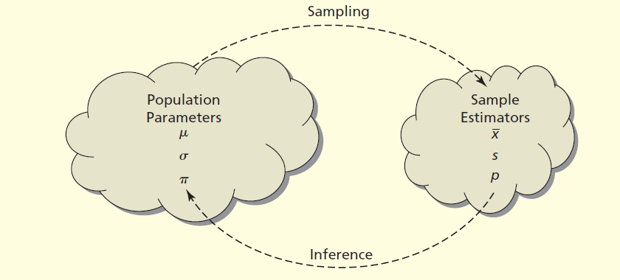
Statistical Inference
An estimator is statistic derived from a sample to infer the value of a population parameter.
An estimate is the value of the estimatr in a particular sample.

Slide 4
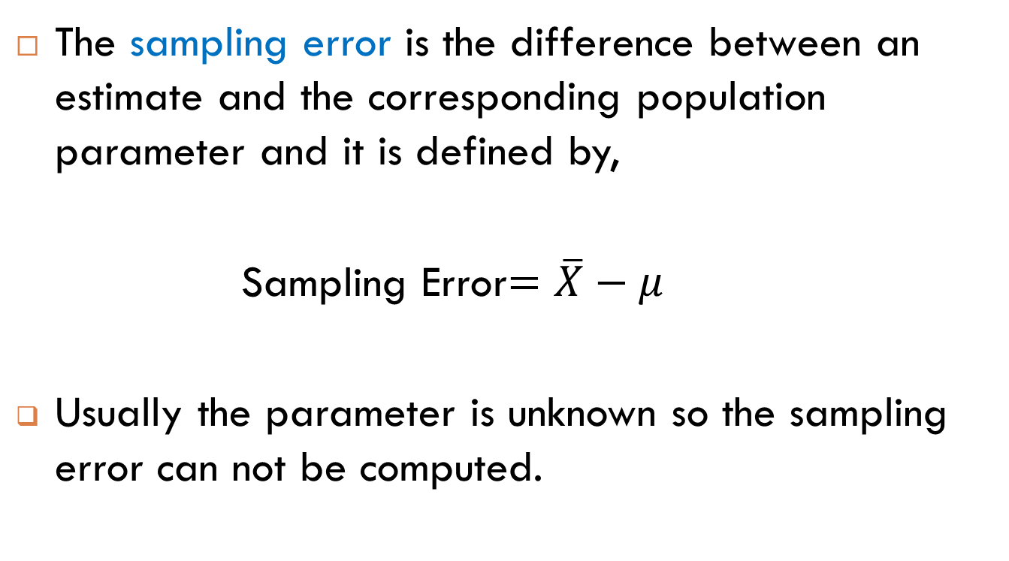
Sampling Error
The sampling error is the difference between an estimate and the corresponding population parameter and it is defined by,
Sampling Error$=\overline{X}−μ$
Usually the parameter is unknown so the sampling error can not be computed.

Slide 5
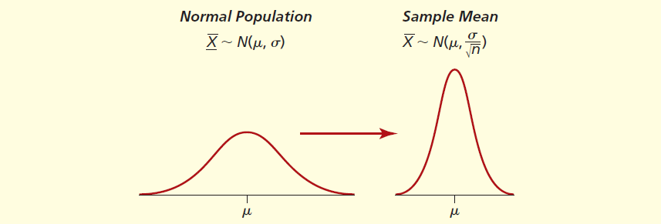

Central Limit Theorem
If the population is exactly normal, the sample mean has exactly a normal distribution centered at $μ$ with the standard deviation,
$$σ_{x}=\frac{σ}{\sqrt{n}}$$

Slide 6
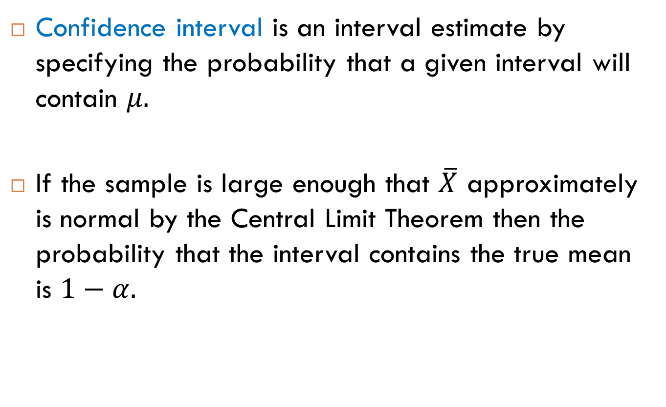
Confidence Intervals
Confidence interval is an interval estimate by specifying the probability that a given interval will contain $μ.$
If the sample is large enough that $\overline{X}$ approximately is normal by the Central Limit Theorem then the probability that the interval contains the true mean is $1−α.$

Slide 7
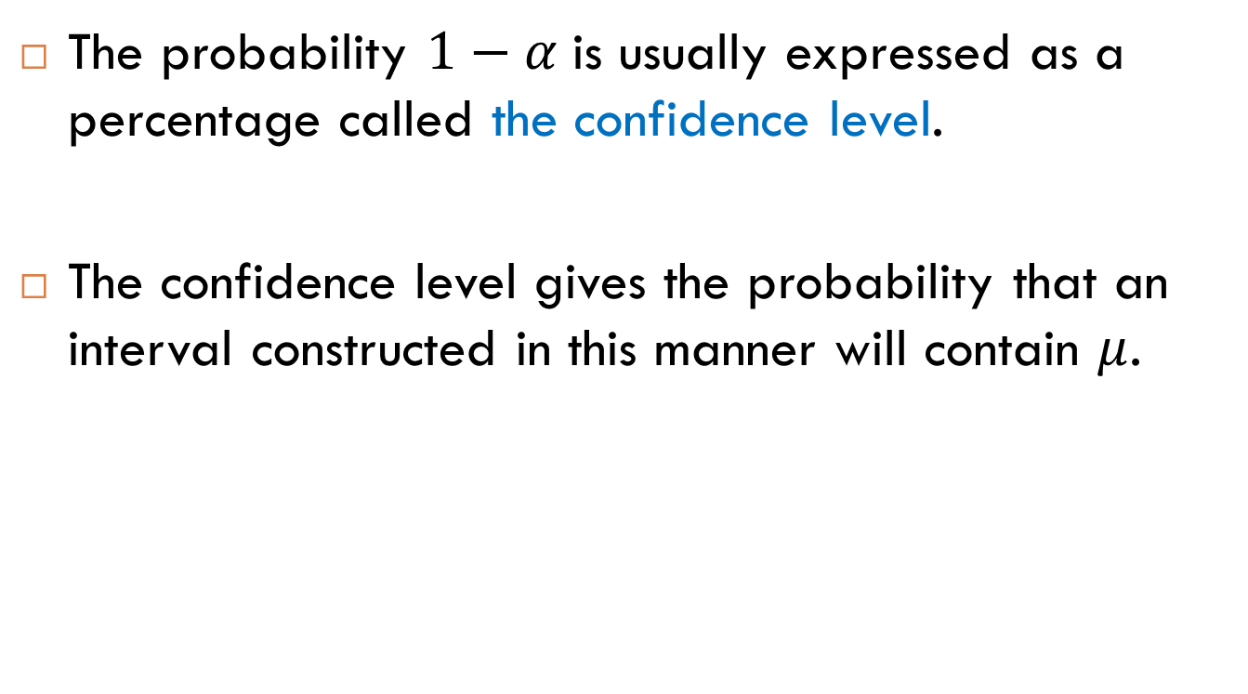
Confidence Level
The probability $1−α$is usually expressed as a percentage called the confidence level.
The confidence level gives the probability that an interval constructed in this manner will contain $μ$.

Slide 8


Confidence Intervals for the Mean
Confidence Interval of a Mean when the Variance is Known:
$$P(\overline{X}−z_{α/2} \frac{σ}{\sqrt{n}}<μ<\overline{X}+z_{α/2}\frac{σ}{\sqrt{n}})=1−α$$
$\overline{X}±z_{α/2 }\frac{σ}{√n}$

Slide 9


Confidence Intervals for the Mean
Confidence Interval of a Mean when the Variance is Unknown:
$P(\overline{X}−t_{α/2} \frac{s}{\sqrt{n}}<μ<\overline{X}+t_{α/2}\frac{s}{\sqrt{n}})=1−α$
$\overline{X}±t_{α/2 }\frac{s}{√n}$

Slide 10
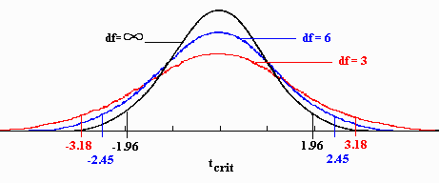
The Standard Nomal (z) and t distributions

Slide 11

Degrees of Freedom
Degrees of freedom indicates the number of sample values that are free to vary.
If a sample contains n number of observations, then the degrees of freedom is, df = n-1.

Slide 12
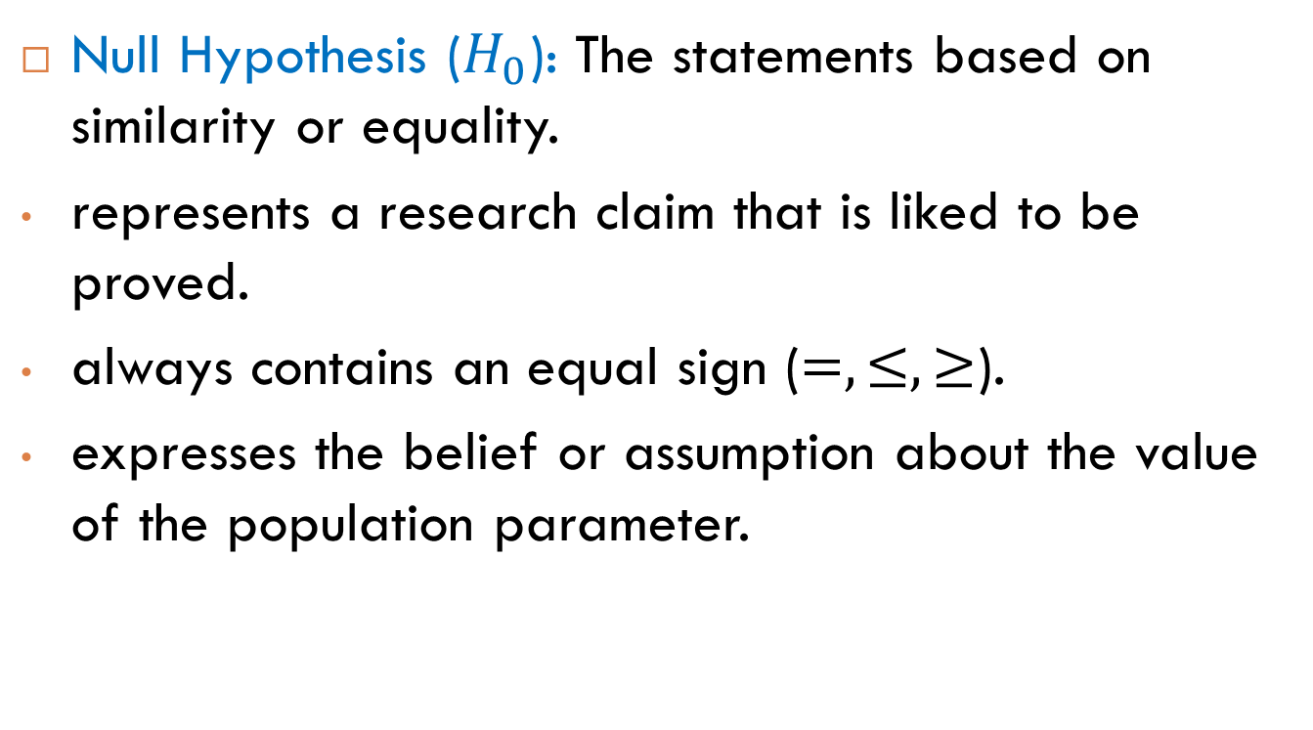
Hypotheses
Null Hypothesis ($H_{0}$): The statements based on similarity or equality.
represents a research claim that is liked to be proved.
always contains an equal sign ($=,≤,≥$).
expresses the belief or assumption about the value of the population parameter.

Slide 13
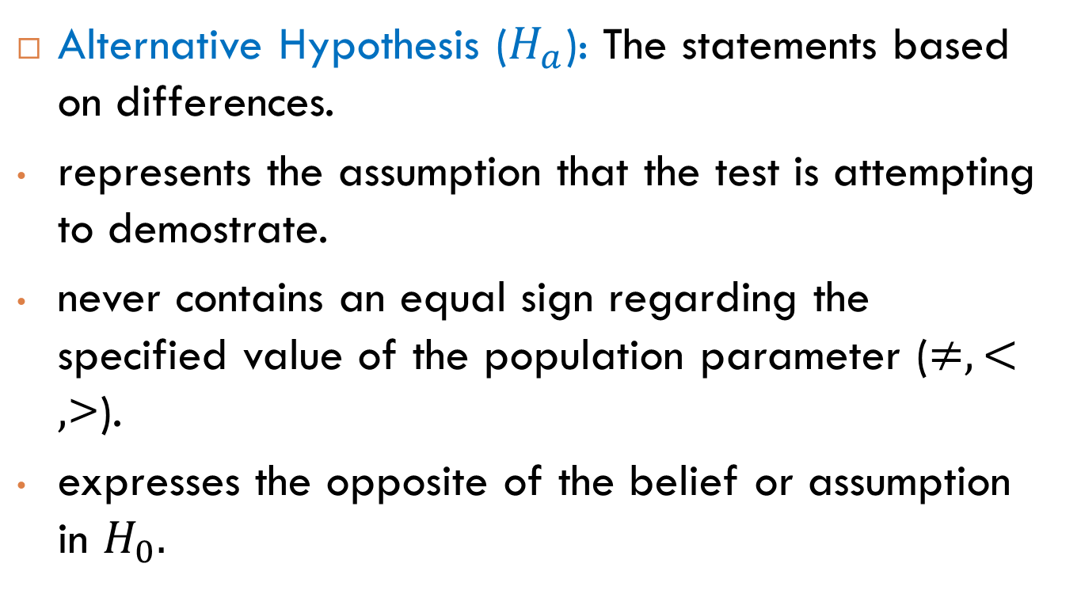
Hypotheses
Alternative Hypothesis ($H_{a}$): The statements based on differences.
represents the assumption that the test is attempting to demostrate.
never contains an equal sign regarding the specified value of the population parameter ($≠,<,$>).
expresses the opposite of the belief or assumption in $H_{0}.$

Slide 14
Hypotheses
The average connection speed is 54 Mbps, as claimed by the internet service provider.
The average number of users increased by 2000 this year.
The service times have Normal distribution.

Slide 15
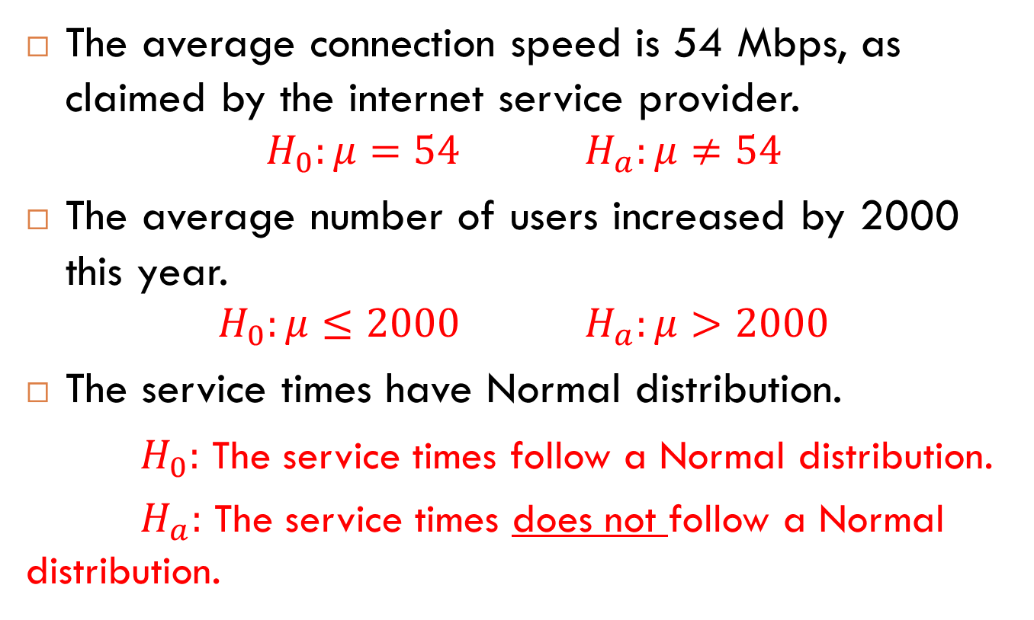
Hypotheses
The average connection speed is 54 Mbps, as claimed by the internet service provider.
$$H_{0}:μ=54 H_{a}:μ≠54$$
The average number of users increased by 2000 this year.
$$H_{0}:μ≤2000 H_{a}:μ>2000$$
The service times have Normal distribution.
$H_{0}:$ The service times follow a Normal distribution.
$H_{a}:$ The service times does not follow a Normal distribution.

Slide 16
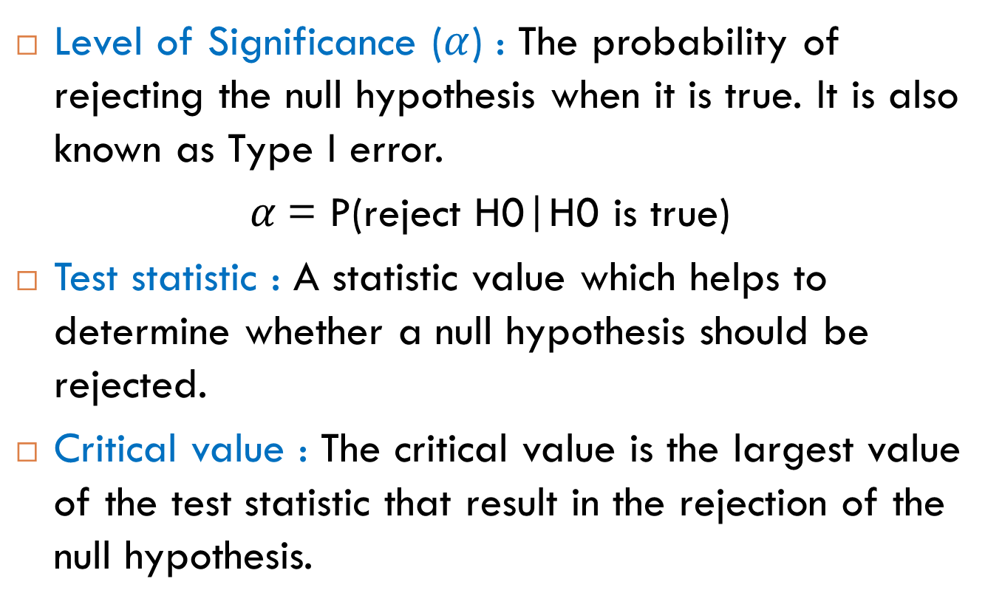
Some Important Definitions
Level of Significance ($α$) : The probability of rejecting the null hypothesis when it is true. It is also known as Type I error.
$α$= P(reject H0|H0 is true)
Test statistic : A statistic value which helps to determine whether a null hypothesis should be rejected.
Critical value : The critical value is the largest value of the test statistic that result in the rejection of the null hypothesis.

Slide 17
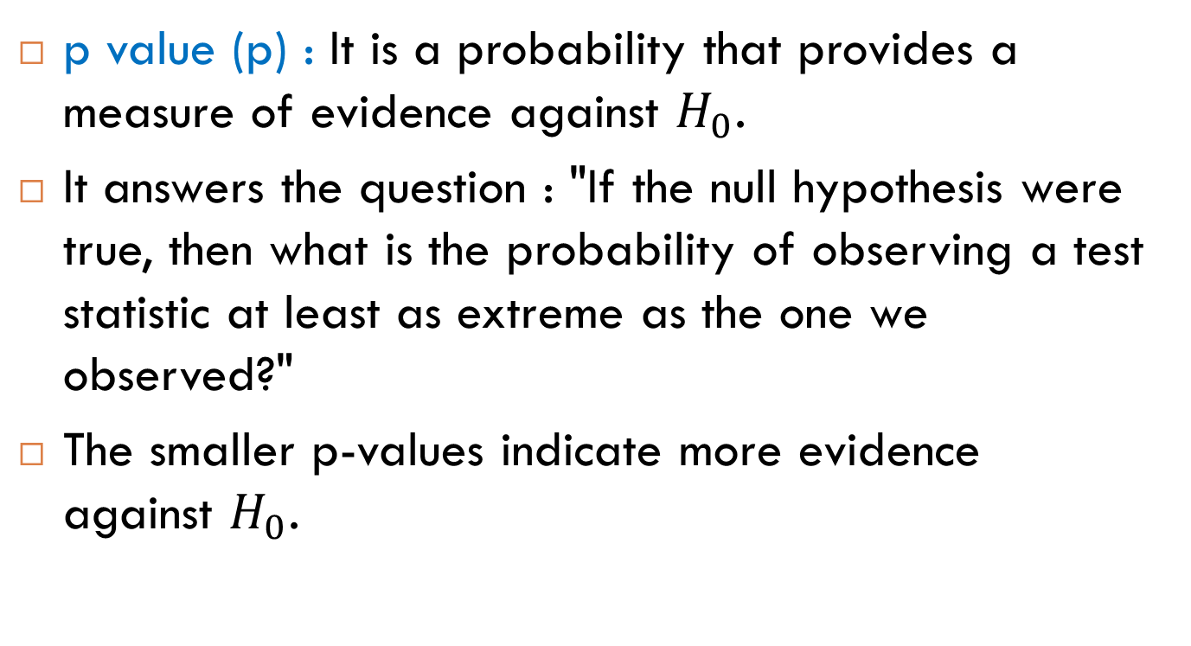
Some Important Definitions
p value (p) : It is a probability that provides a measure of evidence against $H_{0}$.
It answers the question : "If the null hypothesis were true, then what is the probability of observing a test statistic at least as extreme as the one we observed?"
The smaller p-values indicate more evidence against $H_{0}$.

Slide 18

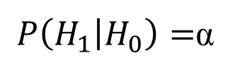
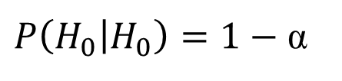

Type of errors
An error in the analysis!
More work is needed.
 | H₀ is True | H₀ is False
Reject H₀ | Type I error (α) (False Positive) | Correct inference (True Positive) (1-β)
Fail to reject H₀ | Correct inference (True Negative) (1-α) | Type II error (β) (False Negative)
$P\left(H_{1} | H_{0}\right)=$α
$$P\left(H_{1} | H_{1}\right)=1−β$$
(Power of Test)
$$P\left(H_{o} | H_{1}\right)=β$$
$P\left(H_{0} | H_{0}\right)=1−$ α
(Confidence level)

Slide 19
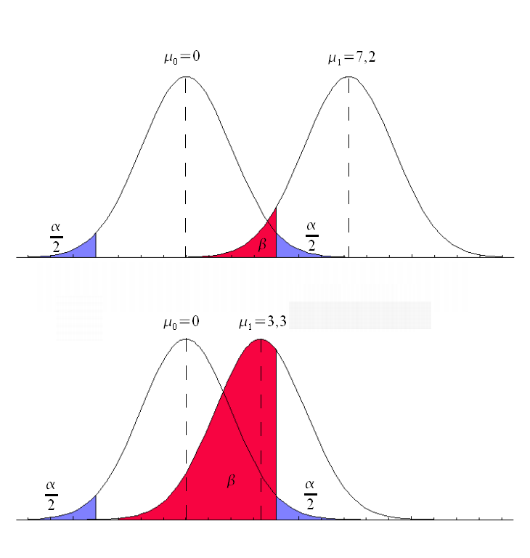
Type of errors
α: Significance level.
Usually at 0.05 (5%), implying that it is acceptable to have a 5% probability of incorrectly rejecting the null hypothesis
1-β: The power of test is equal to the probability of rejecting a false hypothesis.

Slide 20
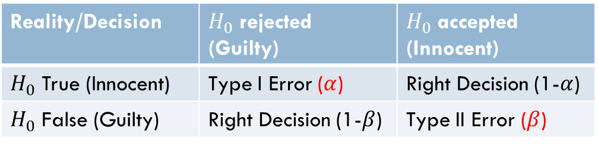
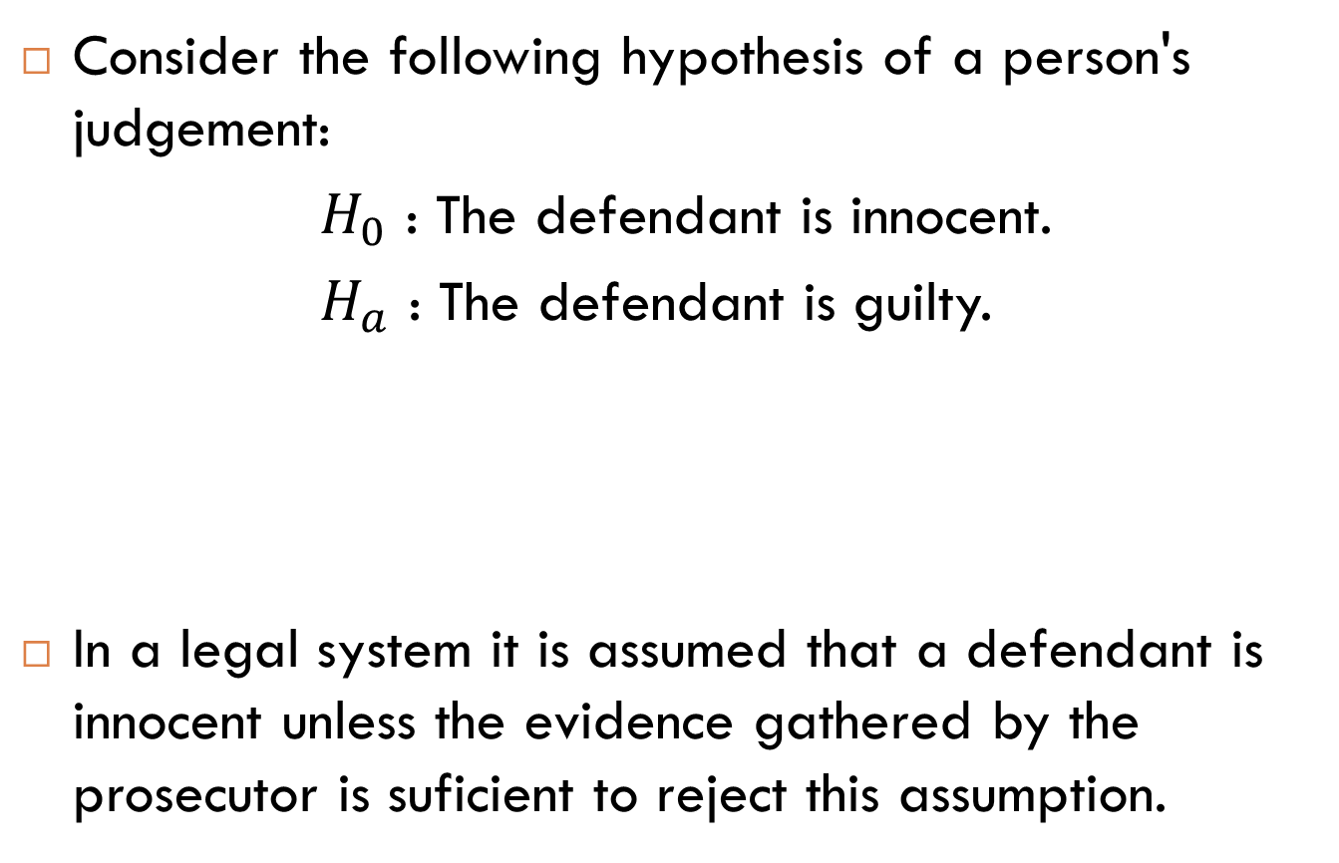
Example: Type I vs. Type II Error
Consider the following hypothesis of a person's judgement:
$H_{0}$ : The defendant is innocent.
$H_{a}$ : The defendant is guilty.
In a legal system it is assumed that a defendant is innocent unless the evidence gathered by the prosecutor is suficient to reject this assumption.
Reality/Decision | $H_{0}$ rejected (Guilty) | $H_{0}$ accepted (Innocent)
$H_{0}$ True (Innocent) | Type I Error ($α$) | Right Decision (1-$α$)
$H_{0}$ False (Guilty) | Right Decision (1-$β$) | Type II Error ($β$)

Slide 21
Type of errors
Type I error (False Positive): "rejecting the null hypothesis when it is true".
Type II error (False negative): "accepting the null hypothesis when it is false".
Type III error: “solving the wrong problem [representation]“.
Type IV error: "the incorrect interpretation of a correctly rejected hypothesis".
Joking?
Dirty Rotten Strategies: How We Trick Ourselves and Others into Solving the Wrong Problems Precisely (High Reliability and Crisis Management), Ian I. Mitroff, Abraham Silvers. ISBN-13: 978-0804759960

Slide 22
Type of errors
Type 1 errors are more important than Type 2 errors → evidence.
p-values are only correlated with evidence.
Evidence in science is necessarily relative. When data is more likely assuming one model is true (e.g., a null model) compared to another model (e.g., the alternative model), we can say the model provides evidence for the null compared to the alternative hypothesis. p-values only give you the probability of the data under one model – what you need for evidence is the relative likelihood of two models.

Slide 23
Steps of Hypothesis Testing
Determine the null and alternative hypothesis
Specify the level of significance and the decision rules
Calculate the related test statistic to test the hypothesis
Make a decision (by using p value or critical value approach)

Slide 24
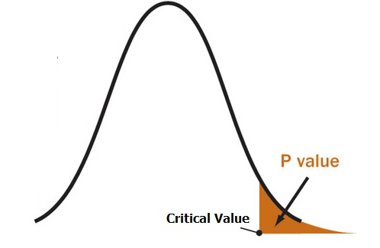

Hypothesis Testing
p-value approach:
Use the test statistic to compute the p value.
Reject $H_{0}$ if the p-value $≤α$.

Slide 25
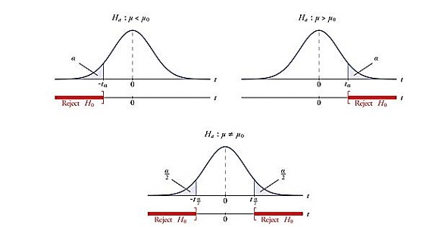
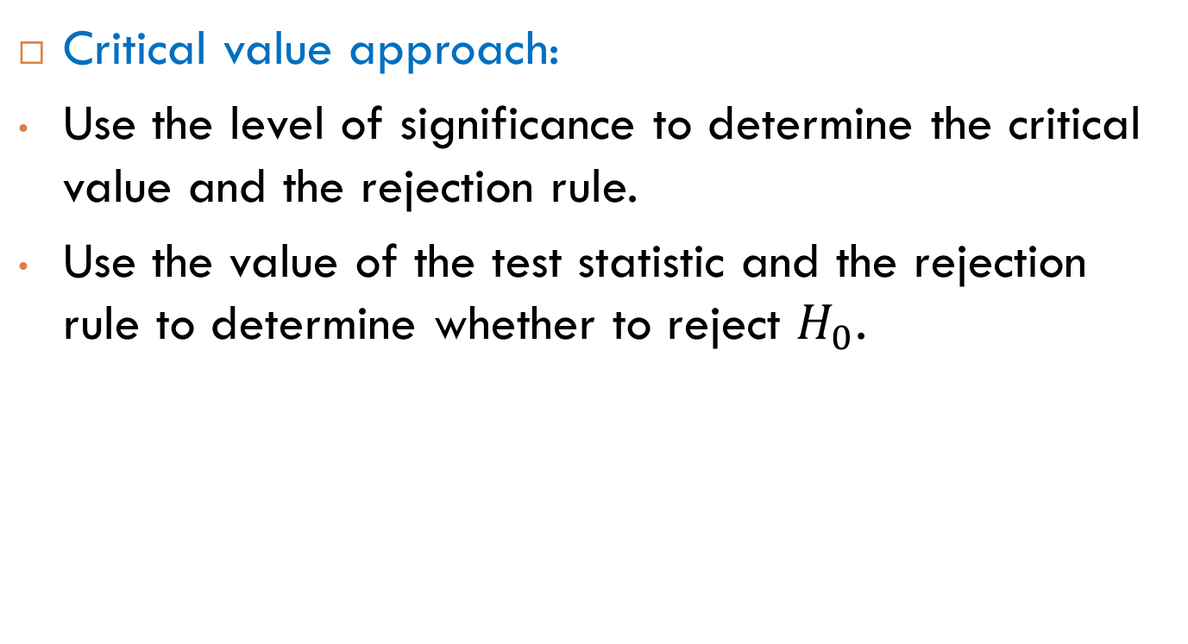
Hypothesis Testing
Critical value approach:
Use the level of significance to determine the critical value and the rejection rule.
Use the value of the test statistic and the rejection rule to determine whether to reject $H_{0}$.

Slide 26
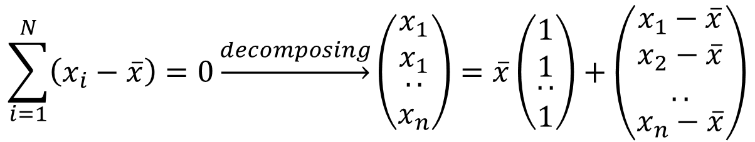
Degrees of freedom
The number of values in the final calculation of a statistic that are free to vary.
$$\sum_{i=1}^{N}{\left(x_{i}−\overline{x}\right)=0\underset{→}{decomposing}\left(\begin{matrix}x_{1} \\ x_{1} \\ \begin{aligned}.. \\ x_{n}\end{aligned}\end{matrix}\right)=\overline{x}\left(\begin{matrix}1 \\ 1 \\ \begin{aligned}.. \\ 1\end{aligned}\end{matrix}\right)+\left(\begin{matrix}x_{1}−\overline{x} \\ \begin{aligned}x_{2}−\overline{x} \\ ..\end{aligned} \\ x_{n}−\overline{x}\end{matrix}\right)}$$
Notes:
To calculate the s², we must first calculate the mean of that sample and then compute the sum of the several squared deviations from that mean.
While there will be n such squared deviations only (n - 1) of them are, in fact, free to assume any value whatsoever.
This is because the final squared deviation from the mean must include the one value of X such that the sum of all the Xs divided by n will equal the obtained mean of the sample. All of the other (n - 1) squared deviations from the mean can, theoretically, have any values whatsoever. For these reasons, the statistic s² is said to have only (n - 1) degrees of freedom.

Slide 27
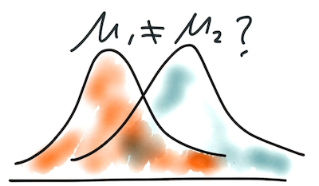
Comparison of Means

Slide 28
Comparison of Two Distributions with Equal Variances

Slide 29
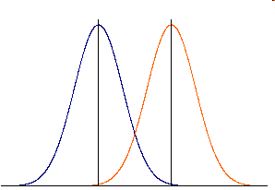
Comparison of two configurations with equal variances.

Slide 30

Comparison of two configurations with equal variances.
We define the hypothesis test:
$H_{0}:μ_{A}≤μ_{B}$
$H_{1}:μ_{A}>μ_{B}$
Thanks the central limit theorem we obtain that:

Slide 31
Comparison of two configurations with equal variances.
We can deduce that:

Slide 32
Comparison of two configurations with equal variances.
We define the test, and calculate s, the common sample variance:
Where n=n_{A}+n_{B}-2
Notes:
When to Use the T-Distribution vs. the Normal Distribution for Confidence Interval and Hypothesis Testing Problems for Means
Main Point to Remember:
You must use the t-distribution table when working problems when the population standard deviation (σ) is not known and the sample size is small (n<30).
General Correct Rule:
If σ is not known, then using t-distribution is correct. If σ is known, then using the normal distribution is correct.
What is Most Common Practice:
Since people often prefer to use the normal, and since the t-distribution becomes equivalent to the normal when the number of cases becomes large, common practice often is:
If σ known, then use normal.
If σ not known:
If n is large, then use normal.
If n is small, then use t-distribution.
What is Another Common Way Textbooks Teach This:
Textbooks often simplify this to “large-sample” vs. “small-sample” methods; use normal distribution with large samples and t-distribution with small samples. This is right almost all the time, because in real sampling problems we seldom have a basis for knowing σ. However, there can be some situations when we do have a basis for assuming a value for σ, such as using a σ based on past data, and in those situations even if sample size is small the correct procedure would be to use the normal distribution, so the simplified “large-sample” vs. “small sample” approach would lead to an error.

Slide 33

Confidence Interval for the Difference of Means (Equal Variances)
For the case of equal variances:
where $s_{p}$ is a pooled variance,

Slide 34
Comparison of two configurations with equal variances.
The test is defined as is shown:
We reject H₀ if this is true.

Slide 35
Example
Equal variances

Slide 36
Example
Observation | Values for pop A | Values for pop B
1 | 24.3 | 24.4
2 | 25.6 | 21.5
3 | 26.7 | 25.1
4 | 22.7 | 22.8
5 | 24.8 | 25.2
6 | 23.8 | 23.5
7 | 25.9 | 22.2
8 | 26.4 | 23.5
9 10 | 25.8 | 23.3
 | 25.4 | 24.7

Slide 37

Example
Mean of the sample.
A=25.14; B=23.62
$H_{0}:μ_{A}≤μ_{B}$
$H_{1}:μ_{A}>μ_{B}$

Slide 38
Example
Equal variances:

Slide 39
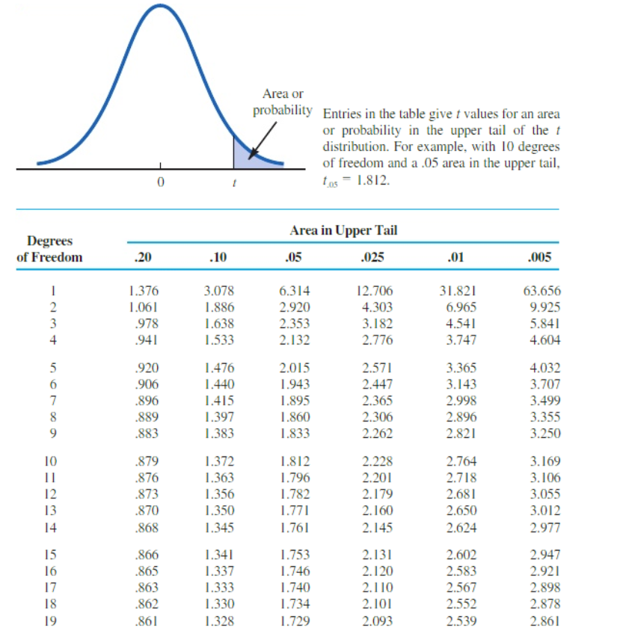
t-table

Slide 40

Example
The standard deviation is:
$S_{A}$=1.242; $S_{B}=$1.237
Reject H₀

Slide 41
Comparison of Two Distributions with Unequal Variances

Slide 42
Comparison of two configurations with unequal variances
If we cannot assume equal variances.

Slide 43
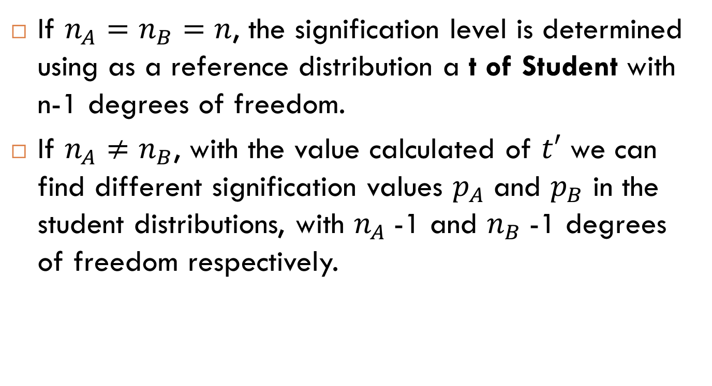
Two configurations comparison.
If $n_{A}=n_{B}=n$, the signification level is determined using as a reference distribution a t of Student with n-1 degrees of freedom.
If $n_{A}≠n_{B}$, with the value calculated of $t′$ we can find different signification values $p_{A}$ and $p_{B}$ in the student distributions, with $n_{A}$-1 and $n_{B}$-1 degrees of freedom respectively.

Slide 44
Two configurations comparison
The signification level of the test:
with:

Slide 45
Confidence Interval for the Difference of Means (Unequal Variances)
For the case of unequal variances:

Slide 46
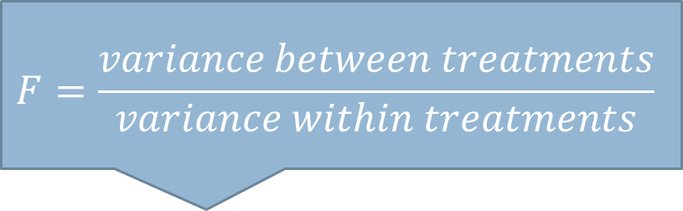
Equal variance test
Hypothesis test:
H0: σ_{A}² = σ_{B}²
H1: σ_{A}² ≠ σ_{B}²
F of Snedecor
n = n_{A} - 1
m = n_{B}-1.
$$F=\frac{variance between treatments}{variance within treatments}$$

Slide 47
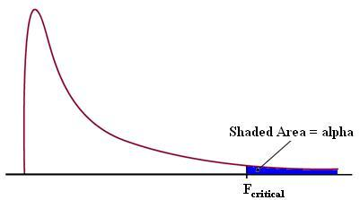
F distribution and F table
F table: http://www.z-table.com/f-distribution-table.html

Slide 48
Example
S_{A}² =1.54
S_{B}² = 2.18
Accept H₀

Slide 49
Example
S_{A}² =1.54
S_{B}² = 16.3
Reject H₀

Slide 50
To know more
Part III: Statistics and Chapter 9.4: Statistical Inference I of Probability and Statistics for Computer Scientists (2014 Ed.)

