Slide 1
Random variables
Pau Fonseca, Ph. D. , Nihan Acar-Denizli, Ph.D.
Kristin L. Sainani, PhD
Notes:
Kristin L. Sainani, PhD (née Cobb)
http://www.stanford.edu/~kcobb/index.html

Slide 2
Random variables

Slide 3
Random variable
We already know about experiments, sample spaces, and events. Now, we are interested in a number that is associated with the experiment. We conduct a random experiment E and after learning the outcome ω in S we calculate a number X.
That is, to each outcome ω in the sample space we associate a number X(ω) = x.
A random variable is a numeric description of the outcome of an experiment.
A random variable X is a function X : S → R that associates to each outcome ω∈S exactly one number X(ω) = x.

Slide 4
Random variables can be discrete or continuous
Discrete random variables have a countable number of outcomes.
Examples: Dead/alive, treatment/placebo, dice, counts, the number of units sold, the number of costumers enter a bank by unit of time…
Continuous random variables have an infinite continuum of possible values.
Examples: blood pressure, weight, the speed of a car, the real numbers from 1 to 6, time between arrivals…

Slide 5
Random Variable
A variable X that takes “random” values. We assume that it follows a probability distribution, P(x).
Discrete variable: p₁, p₂, …
Continuous variable: P(x)dx gives the probability that X falls between x and x +dx.
Notes:
In statistics, we distinguish a random variable X, and its particular concrete value x. X can take many different possible values, but x is just a given number. There are many good books on statistics, e.g., G. Casella and R. L. Berger, “Statistical Inference”, 2nd ed, Duxbury (2002).

Slide 6
Probability functions
A probability function, maps the possible values of x against their respective probabilities of occurrence, p(x).
p(x) is a number from 0 to 1.0.
The area under a probability function is always 1.
Notes:
It turns out that if you were to go out and sample many, many times, most sample statistics that you could calculate would follow a normal distribution.
What are the 2 parameters (from last time) that define any normal distribution?
Remember that a normal curve is characterized by two parameters, a mean and a variability (SD)
What do you think the mean value of a sample statistic would be? The standard deviation?
Remember standard deviation is natural variability of the population
Standard error can be standard error of the mean or standard error of the odds ratio or standard error of the difference of 2 means, etc. The standard error of any sample statistic.

Slide 7
Gaussian (Normal) Distribution
Notes:
Problem: compute <x^{n}> in the Gasussian distribution for any integer n.

Slide 8
Cumulative Distribution Function (CDF)
The distribution function is defined as
F(x) = P(X ≤ x).
This definition applies equally well for discrete and continuous random variables.
Notes:
What does the distribution function F(x) look like for a discrete distribution?
F(x) is monotone increase from 0 to 1 with x and continuous from the right.

Slide 9
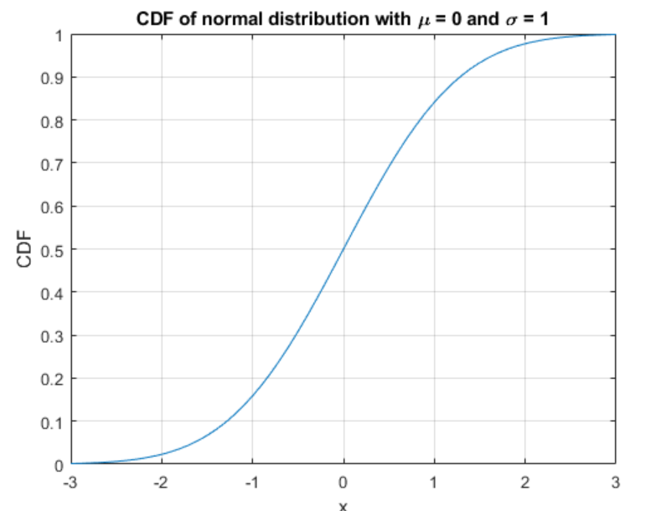
CDF of Standard Normal Distribution

Slide 10
Discrete probability functions

Slide 11
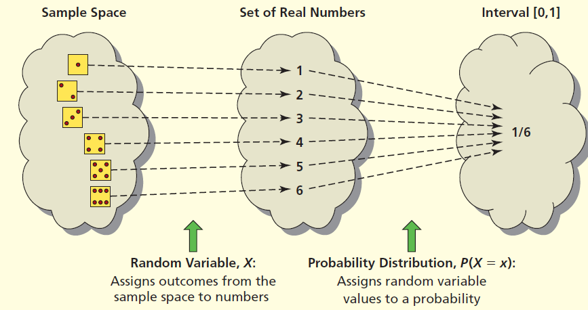
Discrete Probability Function

Slide 12
Discrete example: roll of a die
p(x)
1/6
x
1
2
3
4
5
6

Slide 13
Probability mass function (pmf)
x
p(x)
1
p(x=1) = 1/6
2
p(x=2) = 1/6
3
p(x=3) = 1/6
4
p(x=4) = 1/6
5
p(x=5) = 1/6
6
p(x=6) = 1/6
Notes:
la distribución de probabilidad (si es v.a. discreta)
la función de densidad (si es v.a. continua)

Slide 14
Cumulative distribution function (CDF)
1.0
P(x)
5/6
2/3
1/2
1/3
1/6
1
2
3
4
5
6
x

Slide 15
Cumulative distribution function
x
P(x≤A)
1
P(x≤1) = 1/6
2
P(x≤2) = 2/6
3
P(x≤3) = 3/6
4
P(x≤4) = 4/6
5
P(x≤5) = 5/6
6
P(x≤6) = 6/6

Slide 16
Examples
What’s the probability that you roll a 3 or less?
P(x≤3)=1/2.
What’s the probability that you roll a 5 or higher?
P(x≥5) = 1 – P(x≤4) = 1-2/3 = 1/3.

Slide 17
Practice Problem:
The number of ships to arrive at a harbor on any given day is a random variable represented by x. The probability distribution for x is:
Find the probability that on a given day:
exactly 14 ships arrive: p(x=14)=?
More than12 ships arrive: p(x≥12)=?
Less than11 ships arrive: p(x≤11)=?
x
10
11
12
13
14
P(x)
.4
.2
.2
.1
.1

Slide 18
Practice Problem:
The number of ships to arrive at a harbor on any given day is a random variable represented by x. The probability distribution for x is:
Find the probability that on a given day:
exactly 14 ships arrive: p(x=14)= 0.1
More than12 ships arrive: p(x≥12)= (.2 + .1 +.1) = 0 .4
Less than11 ships arrive: p(x≤11)= (.4 +.2) = 0 .6
x
10
11
12
13
14
P(x)
.4
.2
.2
.1
.1

Slide 19
Practice Problem:
You are lecturing to a group of 1000 students. You ask them to each randomly pick an integer between 1 and 10. Assuming, their picks are truly random:
What’s your best guess for how many students picked the number 9?
What percentage of the students would you expect picked a number less than or equal to 6?

Slide 20
Practice Problem:
You are lecturing to a group of 1000 students. You ask them to each randomly pick an integer between 1 and 10. Assuming, their picks are truly random:
What’s your best guess for how many students picked the number 9?
Since p(x=9) = 1/10, we’d expect about 1/10th of the 1000 students to pick 9. Then, 100 students.
What percentage of the students would you expect picked a number less than or equal to 6?
Since p(x≤ 6) = 1/10 + 1/10 + 1/10 + 1/10 + 1/10 + 1/10 =.6 So, 60%.

Slide 21
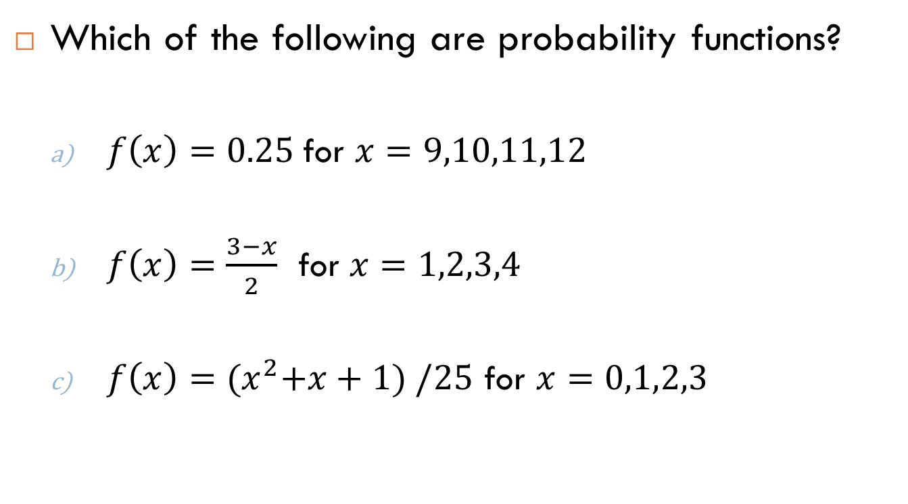
Practice Problem
Which of the following are probability functions?
$f\left(x\right)=0.25$for $x=9,10,11,12$
$f\left(x\right)=\frac{3−x}{2}$ for $x=1,2,3,4$
$f\left(x\right)={(x}^{2}+x+1) /25$ for $x=0,1,2,3$

Slide 22

Answer (a)
a) $f\left(x\right)=0.25$for $x=9,10,11,12$
x | f(x)
9 | .25
10 | .25
11 | .25
12 | .25
Yes, probability function!
1.0

Slide 23

Answer (b)
b) $f\left(x\right)=\frac{3−x}{2}$ for $x=1,2,3,4$
x | f(x)
1 | (3-1)/2=1.0
2 | (3-2)/2=.5
3 | (3-3)/2=0
4 | (3-4)/2=-.5
Though this sums to 1, you can’t have a negative probability; therefore, it’s not a probability function.

Slide 24

Answer (c)
c) $f\left(x\right)={(x}^{2}+x+1) /25$ for $x=0,1,2,3$
x | f(x)
0 | 1/25
1 | 3/25
2 | 7/25
3 | 13/25
Doesn’t sum to 1. Thus, it’s not a probability function.
24/25

Slide 25
Important discrete distributions
Binomial Distribution
Yes/no outcomes (dead/alive, treated/untreated, smoker/non-smoker, sick/well, etc.)
Poisson Distribution
Counts (e.g., how many cases of disease in a given area)
The probability of getting exactly k successes in n trials
The probability of x occurances in a given period.

Slide 26
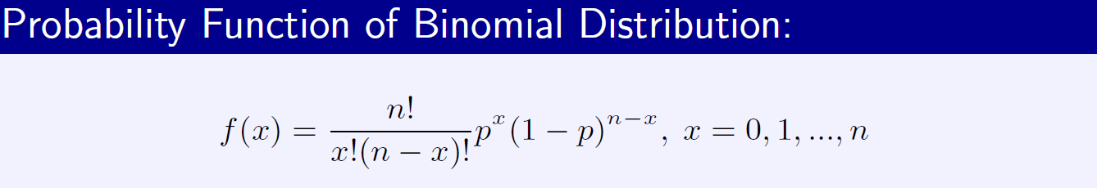
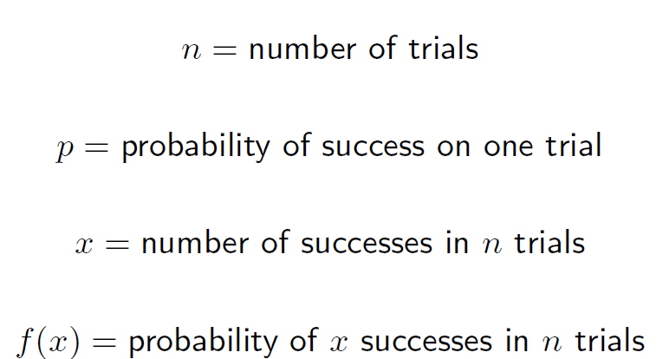
Binomial distribution
Example: The probability of 4 customers making a purchase out of 10 customers given that the probability of a customer making a purchase is 0.30.

Slide 27
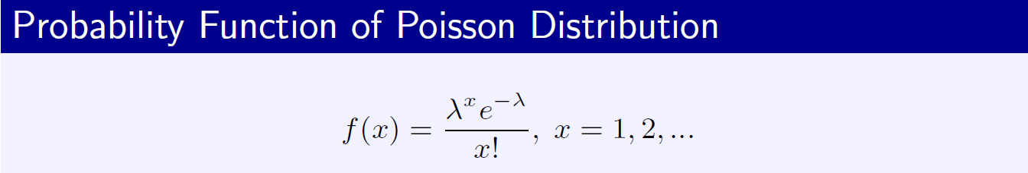
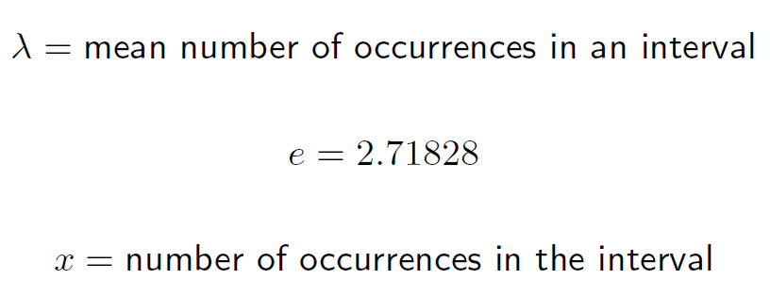
Poisson distribution
Example: The probability that two customers will arrive to the bank per minute while we know that the mean number of customers arriving to the bank during corresponding period is 3.

Slide 28
Poisson Approximation to Binomial
If n is "large" and p is "small" enough, then Poisson distribution can be used to approximate a Binomial distribution.
Suppose 1000 women are screened for a rare type of cancer that has a nationwide incidence of 6 cases per 10,000 (i.e., p = 0.0006).
What is the probability of finding two or fewer cases?
Then, the Poisson mean is set equal to Binomial mean.

Slide 29
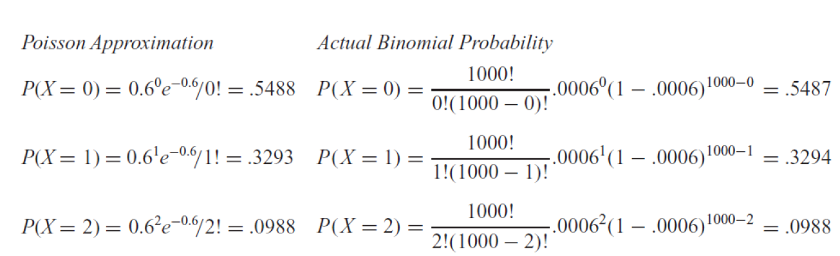
Poisson Approximation to Binomial

Slide 30
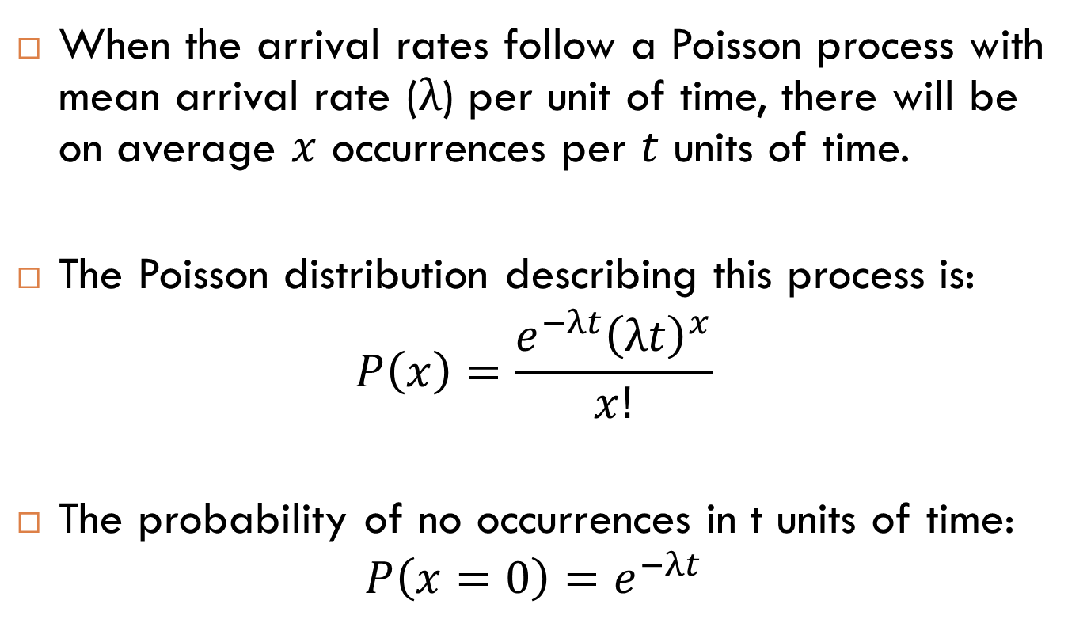
Poisson and Exponential
When the arrival rates follow a Poisson process with mean arrival rate ($λ$) per unit of time, there will be on average $x$ occurrences per $t$ units of time.
The Poisson distribution describing this process is:
$$P\left(x\right)=\frac{e^{−λt}{\left(λt\right)}^{x}}{x!}$$
The probability of no occurrences in t units of time:
$$P\left(x=0\right)=e^{−λt}$$

Slide 31
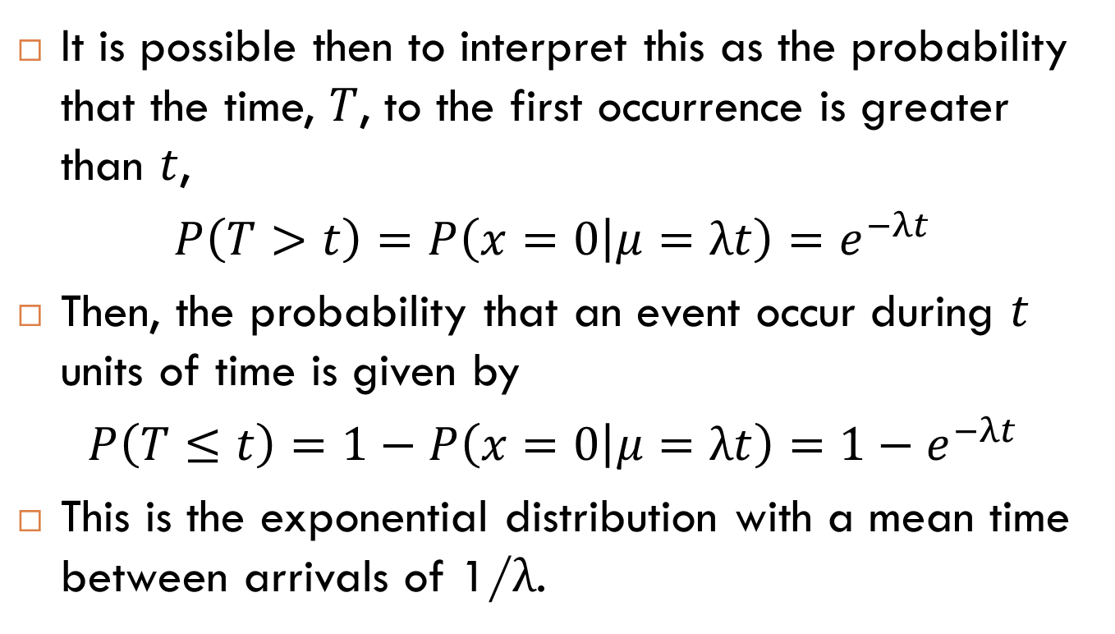
Poisson and Exponential
It is possible then to interpret this as the probability that the time, $T$, to the first occurrence is greater than $t$,
$P\left(T>t\right)=P\left(x=0 | μ=λt\right)=e^{−λt}$
Then, the probability that an event occur during $t$ units of time is given by
$P\left(T≤t\right)=1−P\left(x=0 | μ=λt\right)=1−e^{−λt}$
This is the exponential distribution with a mean time between arrivals of 1/λ.

Slide 32
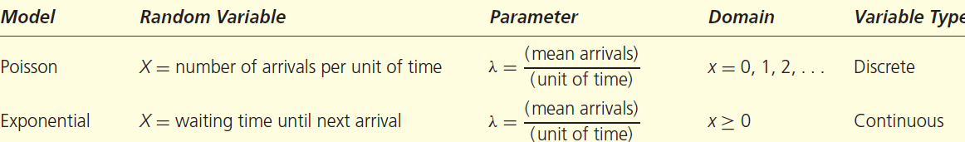
Poisson and Exponential
Suppose that the number of cars arriving at a car wash during one hour is described by a Poisson distribution with a mean of 10 cars per hour.
Since the average number of arrivals 10 cars per hour, the average time between cars is
1 hour/10 cars =0.1 hour/car

Slide 33
Poisson and Exponential
The exponential distribution, then, is also representative of a Poisson process but describes the time between arrivals and specifies that these time intervals are completely random.

Slide 34
Continuous probability functions

Slide 35
Continuous case
The probability function that accompanies a continuous random variable is a continuous mathematical function that integrates to 1.
The probabilities associated with continuous functions are just areas under the curve.
Probabilities are given for a range of values, rather than a particular value

Slide 36
Continuous case
For example, recall the negative exponential function (in probability, this is called an “exponential distribution”):
This function integrates to 1

Slide 37
Continuous case: “probability density function” (pdf)
The probability that x is any exact particular value (such as 1.9976) is 0; we can only assign probabilities to possible ranges of x.
p(x)=e^{-x}
1
x

Slide 38
For example, the probability of x falling within 1 to 2
p(x)=e^{-x}
1
x
1
2

Slide 39
Cumulative distribution function
As in the discrete case, we can specify the “cumulative distribution function” (CDF):
The CDF here = P(x≤A)=

Slide 40
Example
p(x)
1
x
2

Slide 41
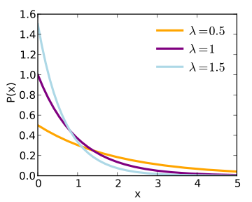
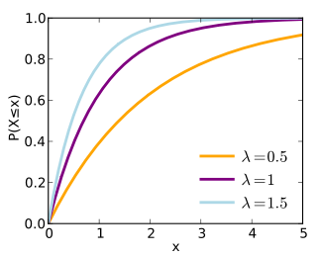
CDF and pdf for exponential
pdf
cdf
By Skbkekas - Own work This graphic was created with matplotlib., CC BY 3.0, https://commons.wikimedia.org/w/index.php?curid=9508326

Slide 42
Example 2: Uniform distribution
The uniform distribution: all values are equally likely.
The pdf of Uniform distribution is:
f(x) = 1/b-a , for b ≥ x ≥ a
The uniform distribution: f(x) = 1 , for 1≥ x ≥0
p(x)
1
x
1

Slide 43
Example 2: Uniform distribution
We can see it’s a probability distribution because it integrates to 1 (the area under the curve is 1):

Slide 44
Example: Uniform distribution
What’s the probability that x is between ¼ and ½?
P (½ ≥ x ≥ ¼ ) = ¼
p(x)
1
¼
½
x
1

Slide 45
Expected value and variance

Slide 46
Statistics of a Random Variable
Mean <X> = (1/N) ∑ x_{i}
Variance σ² = <X²> - <X>²
Correlation <X Y> - <X><Y>
Other higher moments are also useful:
skewness
kurtosis
Notes:
Other higher moments are also useful: skewness <(x -<x>)³>/σ³, kurtosis <(x -<x>)⁴>/σ⁴ – 3. What is skewness and kurtosis for a Gaussian distribution?
skewness is a measure of the asymmetry of the probability distribution
kurtosis is a measure of the "tailedness" of the probability distribution

Slide 47
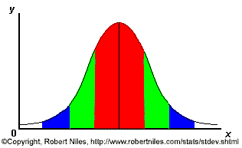
For example, bell-curve (normal) distribution
One standard deviation from the mean (σ)
Mean (μ)

Slide 48
Expected value, or mean
If we understand the underlying probability function of a certain phenomenon, then we can make informed decisions based on how we expect x to behave on-average over the long-run…(so called “frequentist” theory of probability).
Expected value is just the weighted average or mean (µ) of random variable x. Imagine placing the masses p(x) at the points X on a beam; the balance point of the beam is the expected value of x.

Slide 49
Example: Expected value
Recall the following probability distribution of ship arrivals:
x
10
11
12
13
14
P(x)
.4
.2
.2
.1
.1

Slide 50
Empirical Mean is a special case of Expected Value…
Sample mean, for a sample of n subjects: =
The probability (frequency) of each person in the sample is 1/n.

Slide 51
Expected value, formally
Discrete case:
Continuous case:

Slide 52
Expected Value
If the probability distribution is known, the expected value (average value) can be computed as (for continuous variable)

Slide 53
Extension to continuous case: uniform distribution
p(x)
1
x
1

Slide 54
Expected value
E(X) = µ
these symbols are used interchangeably.
Expected value is an extremely useful concept for good decision-making.

Slide 55
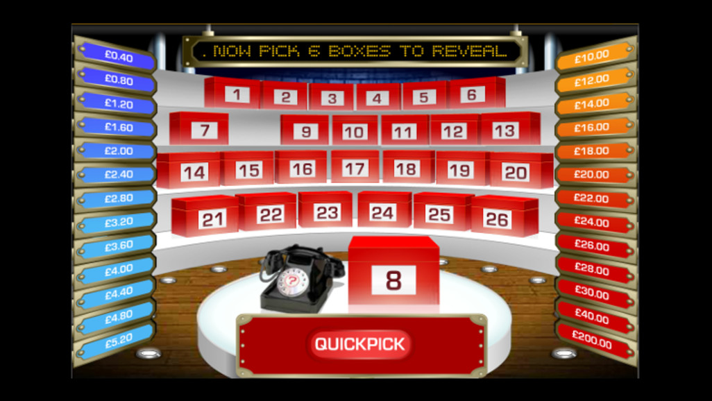
To Deal or Not to Deal?

Slide 56
Gambling
A roulette wheel has the numbers 1 through 36, as well as 0 and 00. If you bet $1 that an odd number comes up, you win or lose $1 according to whether or not that event occurs.
Let the random variable X denotes your net gain,
X=1 with the probability18/38 and
X= -1 with probability 20/38.
If the cost is $10 per game, the casino wins an average of 53 cents per game.
If 10,000 games are played in a night, that’s a cool $5300.

Slide 57
Gambling
A roulette wheel has the numbers 1 through 36, as well as 0 and 00. If you bet $1 that an odd number comes up, you win or lose $1 according to whether or not that event occurs. If random variable X denotes your net gain, X=1 with probability 18/38 and X= -1 with probability 20/38.
E(X) = 1(18/38) – 1 (20/38) = -$.053
On average, the casino wins (and the player loses) 5 cents per game.
If the cost is $10 per game, the casino wins an average of 53 cents per game. If 10,000 games are played in a night, that’s a cool $5300.
E(X) = 10(18/38) – 10 (20/38) = -$.53

Slide 58
Example: the lottery
A certain lottery works by picking 6 numbers from 1 to 49. It costs $1.00 to play the lottery, and if you win, you win $2 million after taxes.
If you play the lottery once, what are your expected winnings or losses?

Slide 59
Lottery
Calculate the probability of winning in 1 try:
The probability function (note, sums to 1.0):
“49 choose 6”
Out of 49 numbers, this is the number of distinct combinations of 6.
x$
p(x)
-1
.999999928
+ 2 million
7.2 x 10⁻⁻⁸

Slide 60
Expected Value
The probability function
Expected Value:
E(X) = P(win)*$2,000,000 + P(lose)*-$1.00
= (2.0 x 10⁶)* (7.2 x 10⁻⁸)+(0.999999928) (-1)
= 0.144 - 0.999999928 = -$.86
Negative expected value is never good!
You shouldn’t play if you expect to lose money!
x$
p(x)
-1
.999999928
+ 2 million
7.2 x 10⁻⁻⁸

Slide 61
Expected Value
If you play the lottery every week for 10 years, what are your expected winnings or losses?
520 x (-.86) = -$447.20

Slide 62
Expected Value as a mathematical operator
If c= a constant number (i.e., not a variable) and X and Y are any random variables…
E(c) = c
No randomness. You always expect to get c.
E(cX) = c E(X)
E(c + X)=c + E(X)
E(X+Y)= E(X) + E(Y)

Slide 63
E(cX)=c E(X)
E(cX)=c E(X)
Example: If the casino charges $10 per game instead of $1, then the casino expects to make 10 times as much on average from the game.

Slide 64
E(c + X)= c + E(X)
E(c + X) = c + E(X)
Example, if the casino throws in a free drink worth exactly $5.00 every time you play a game, you always expect to (and do) gain an extra $5.00 regardless of the outcome of the game.

Slide 65
E(X+Y)= E(X) + E(Y)
E(X+Y)= E(X) + E(Y)
Example: If you play the lottery twice, you expect to lose: -$.86 + -$.86.
This works even if X and Y are dependent.
Does not require independence.

Slide 66
Variance/standard deviation
“The average (expected) squared distance (or deviation) from the mean”
Notes:
**We square because squaring has better properties than absolute value. Take square root to get back linear average distance from the mean (=”standard deviation”).

Slide 67
Variance, formally
Discrete case:
Continuous case:

Slide 68

Similarity to empirical variance
The variance of a sample:
$Var\left(X\right)=σ^{2}$
these symbols are used interchangeably
Division by n-1 reflects the fact that we have lost a “degree of freedom” (piece of information) because we had to estimate the sample mean before we could estimate the sample variance.

Slide 69
Practice Problem
A roulette wheel has the numbers 1 through 36, as well as 0 and 00. If you bet $1.00 that an odd number comes up, you win or lose $1.00 according to whether or not that event occurs.
If X denotes your net gain, X=1 with probability 18/38 and X= -1 with probability 20/38.
We already calculated the mean to be = -$.053. What’s the variance of X?

Slide 70
Answer
Standard deviation is $.99. Interpretation: On average, you’re either 1 dollar above or 1 dollar below the mean, which is just under zero. Makes sense!

Slide 71
Handy calculation formula

Slide 72
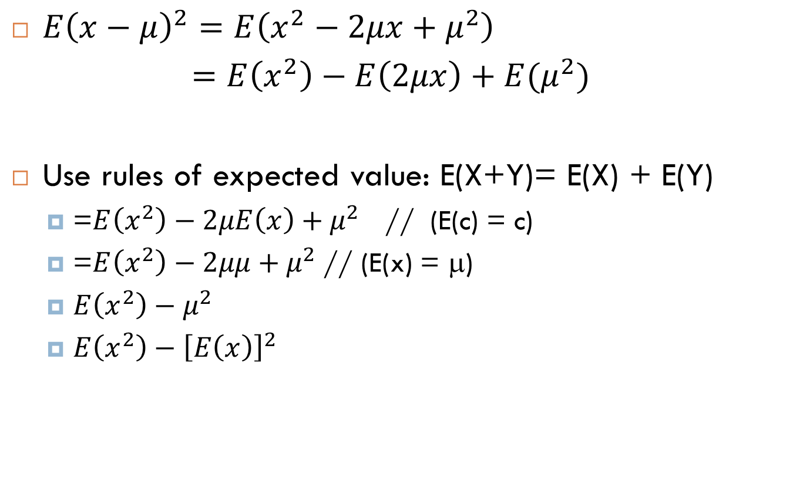
Handy calculation formula
$E{\left(x−μ\right)}^{2}=E\left(x^{2}−2μx+μ^{2}\right)$
$=E\left(x^{2}\right)−E\left(2μx\right)+E(μ^{2})$
Use rules of expected value: E(X+Y)= E(X) + E(Y)
=$E\left(x^{2}\right)−2μE\left(x\right)+μ^{2}$ // (E(c) = c)
=$E\left(x^{2}\right)−2μμ+μ^{2}$// (E(x) = μ)
$E\left(x^{2}\right)−μ^{2}$
$E\left(x^{2}\right)−{\left[E\left(x\right)\right]}^{2}$

Slide 73
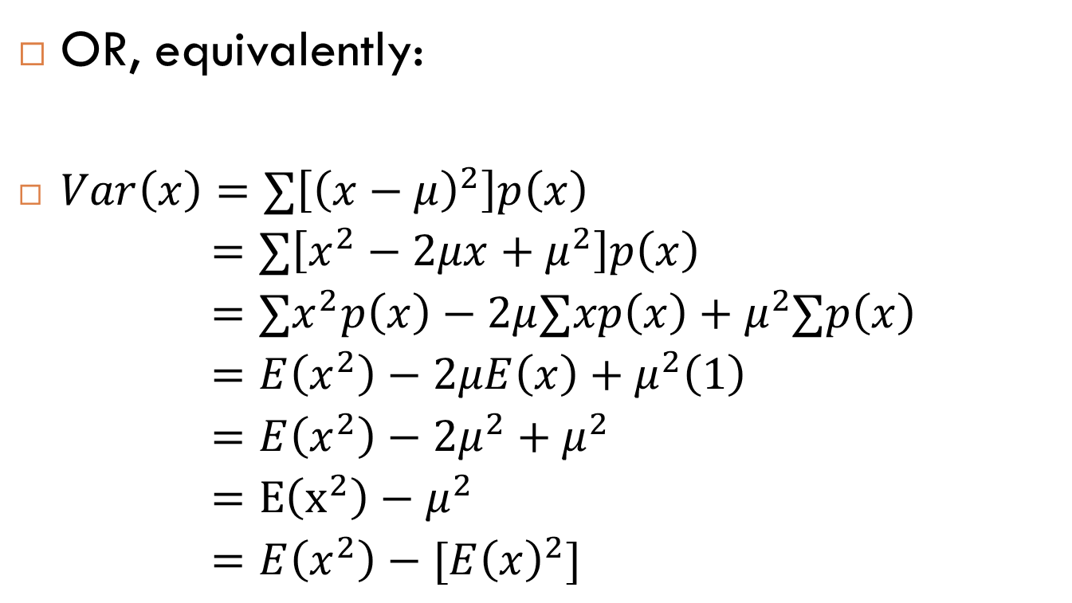
Handy calculation formula
OR, equivalently:
$Var\left(x\right)=∑\left[{\left(x−μ\right)}^{2}\right]p\left(x\right)$
$=∑\left[x^{2}−2μx+μ^{2}\right]p\left(x\right)$
$=∑x^{2}p\left(x\right)−2μ∑xp\left(x\right)+μ^{2}∑p\left(x\right)$
$=E\left(x^{2}\right)−2μE\left(x\right)+μ^{2}\left(1\right)$
$=E\left(x^{2}\right)−2μ^{2}+μ^{2}$
$=E\left(x^{2}\right)−μ^{2}$
$=E\left(x^{2}\right)−[E{\left(x\right)}^{2}]$

Slide 74
For example, what’s the variance and standard deviation of the roll of a die?
x
p(x)
1
p(x=1)=1/6
p(x)
average distance from the mean
2
p(x=2)=1/6
3
p(x=3)=1/6
4
p(x=4)=1/6
1/6
5
p(x=5)=1/6
1
2
3
4
5
6
x
6
p(x=6)=1/6
1.0
mean

Slide 75
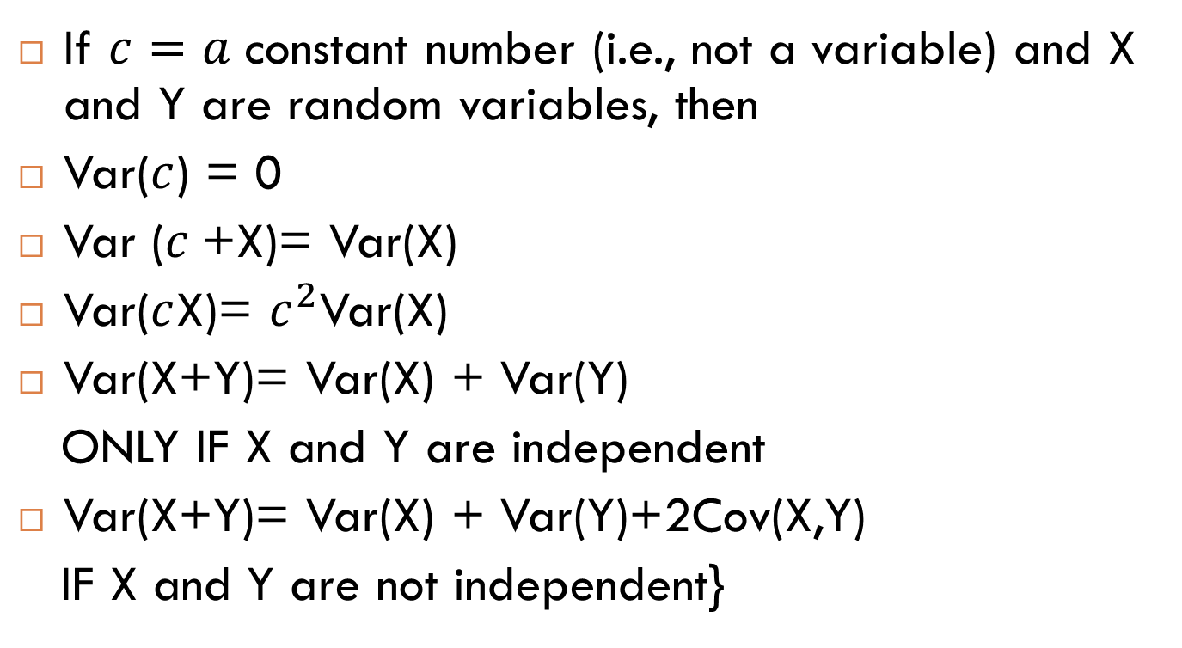
Variance as a mathematical operator:
If $c=a$ constant number (i.e., not a variable) and X and Y are random variables, then
Var($c$) = 0
Var ($c$+X)= Var(X)
Var($c$X)= $c^{2}$Var(X)
Var(X+Y)= Var(X) + Var(Y)
ONLY IF X and Y are independent
Var(X+Y)= Var(X) + Var(Y)+2Cov(X,Y)
IF X and Y are not independent}

Slide 76

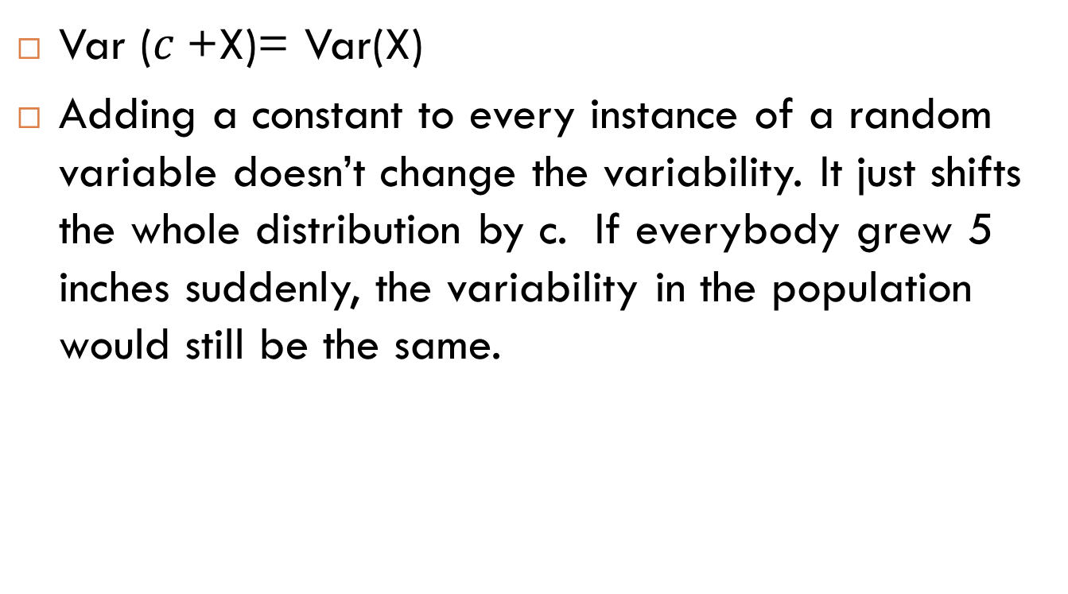
Var ($c$+X)= Var(X)
Var ($c$+X)= Var(X)
Adding a constant to every instance of a random variable doesn’t change the variability. It just shifts the whole distribution by c. If everybody grew 5 inches suddenly, the variability in the population would still be the same.
+ c

Slide 77

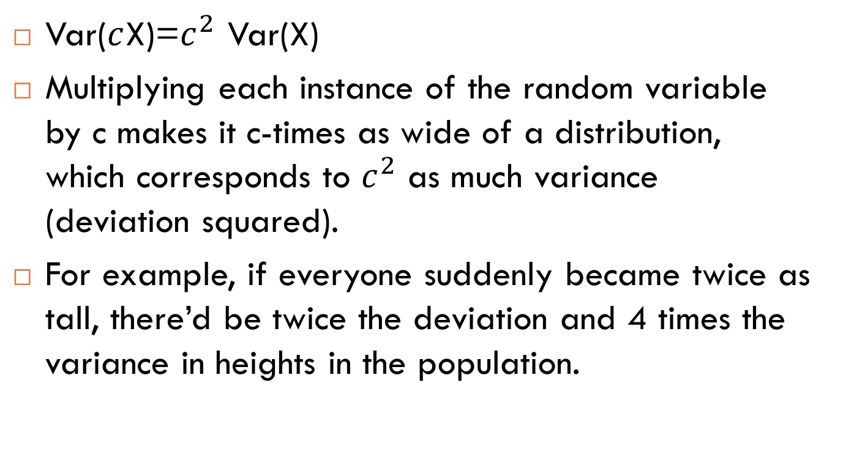
Var($c$X)=$c^{2}$ Var(X)
Var($c$X)=$c^{2}$ Var(X)
Multiplying each instance of the random variable by c makes it c-times as wide of a distribution, which corresponds to $c^{2}$ as much variance (deviation squared).
For example, if everyone suddenly became twice as tall, there’d be twice the deviation and 4 times the variance in heights in the population.

Slide 78
Var(X+Y)= Var(X) + Var(Y)
Var(X+Y)= Var(X) + Var(Y)
ONLY IF X and Y are independent!!!!!!!!
With two random variables, you have more opportunity for variation, unless they vary together (are dependent, or have covariance):
Var(X+Y)= Var(X) + Var(Y) + 2Cov(X, Y)

Slide 79
To know more
Chapter 3: Discrete Random Variables and Their Distributions and Chapter 4: Continuous Distributions of Variables of Probability and Statistics and for Computer Scientists (2014 Ed.)

