Slide 1



Suppliers, Pricing & Inventory Optimization
Findings & Recommendations

Slide 2
Main Business Concerns :
1. Loss Driver Identification
Identify top loss-contributing product categories that are draining profitability
Assess impact of inventory holding costs on overall profitability
2. Inventory Optimization Analysis
Identify slow-moving and dead stock contributing to storage costs
Analyze optimal reorder points to minimize stockouts vs. holding costs
Determine inventory-to-sales ratios for efficient capital allocation
3. Supplier Performance Evaluation
Rank suppliers by profitability contribution (revenue vs. cost analysis)
Analyze supplier delivery reliability and its impact on sales
Assess bulk purchase advantages vs. carrying cost implications
4. Pricing Strategy Assessment
Identify products with negative profit margins requiring immediate action
Assess impact of promotional pricing on overall profitability

Slide 3
Key Findings :
The analysis of purchase prices shows a high standard deviation, which means there’s a lot of variation in product costs. Some items are very cheap, while others are very expensive. This makes it important for the business to negotiate better deals and evaluate whether these purchases are actually generating healthy margins.
When we look at Total Purchase Quantity, the spread is quite wide, showing there’s no clear or consistent purchasing policy in place.
Many items are being bought in bulk, but we need to ask if this really benefits the business in the long run and whether it has an impact on freight charges.
Freight expenses also show high variability, with both the average and deviation coming in high. This points toward inefficiencies in logistics and the possibility that some vendors are overcharging for shipments.
Profitability metrics bring up some serious concerns. While a few products deliver very strong gross profits, the overall negative mean profit margin percentage tells us that many items are being sold at a loss, which is pulling down overall performance.
On the inventory side, the data shows that most products move slowly, with low turnover and high variability. At the same time, a handful of items sell very quickly.
This presents a clear opportunity: streamline or reduce slow-moving stock while putting more focus and resources on fast-moving winner

Slide 4
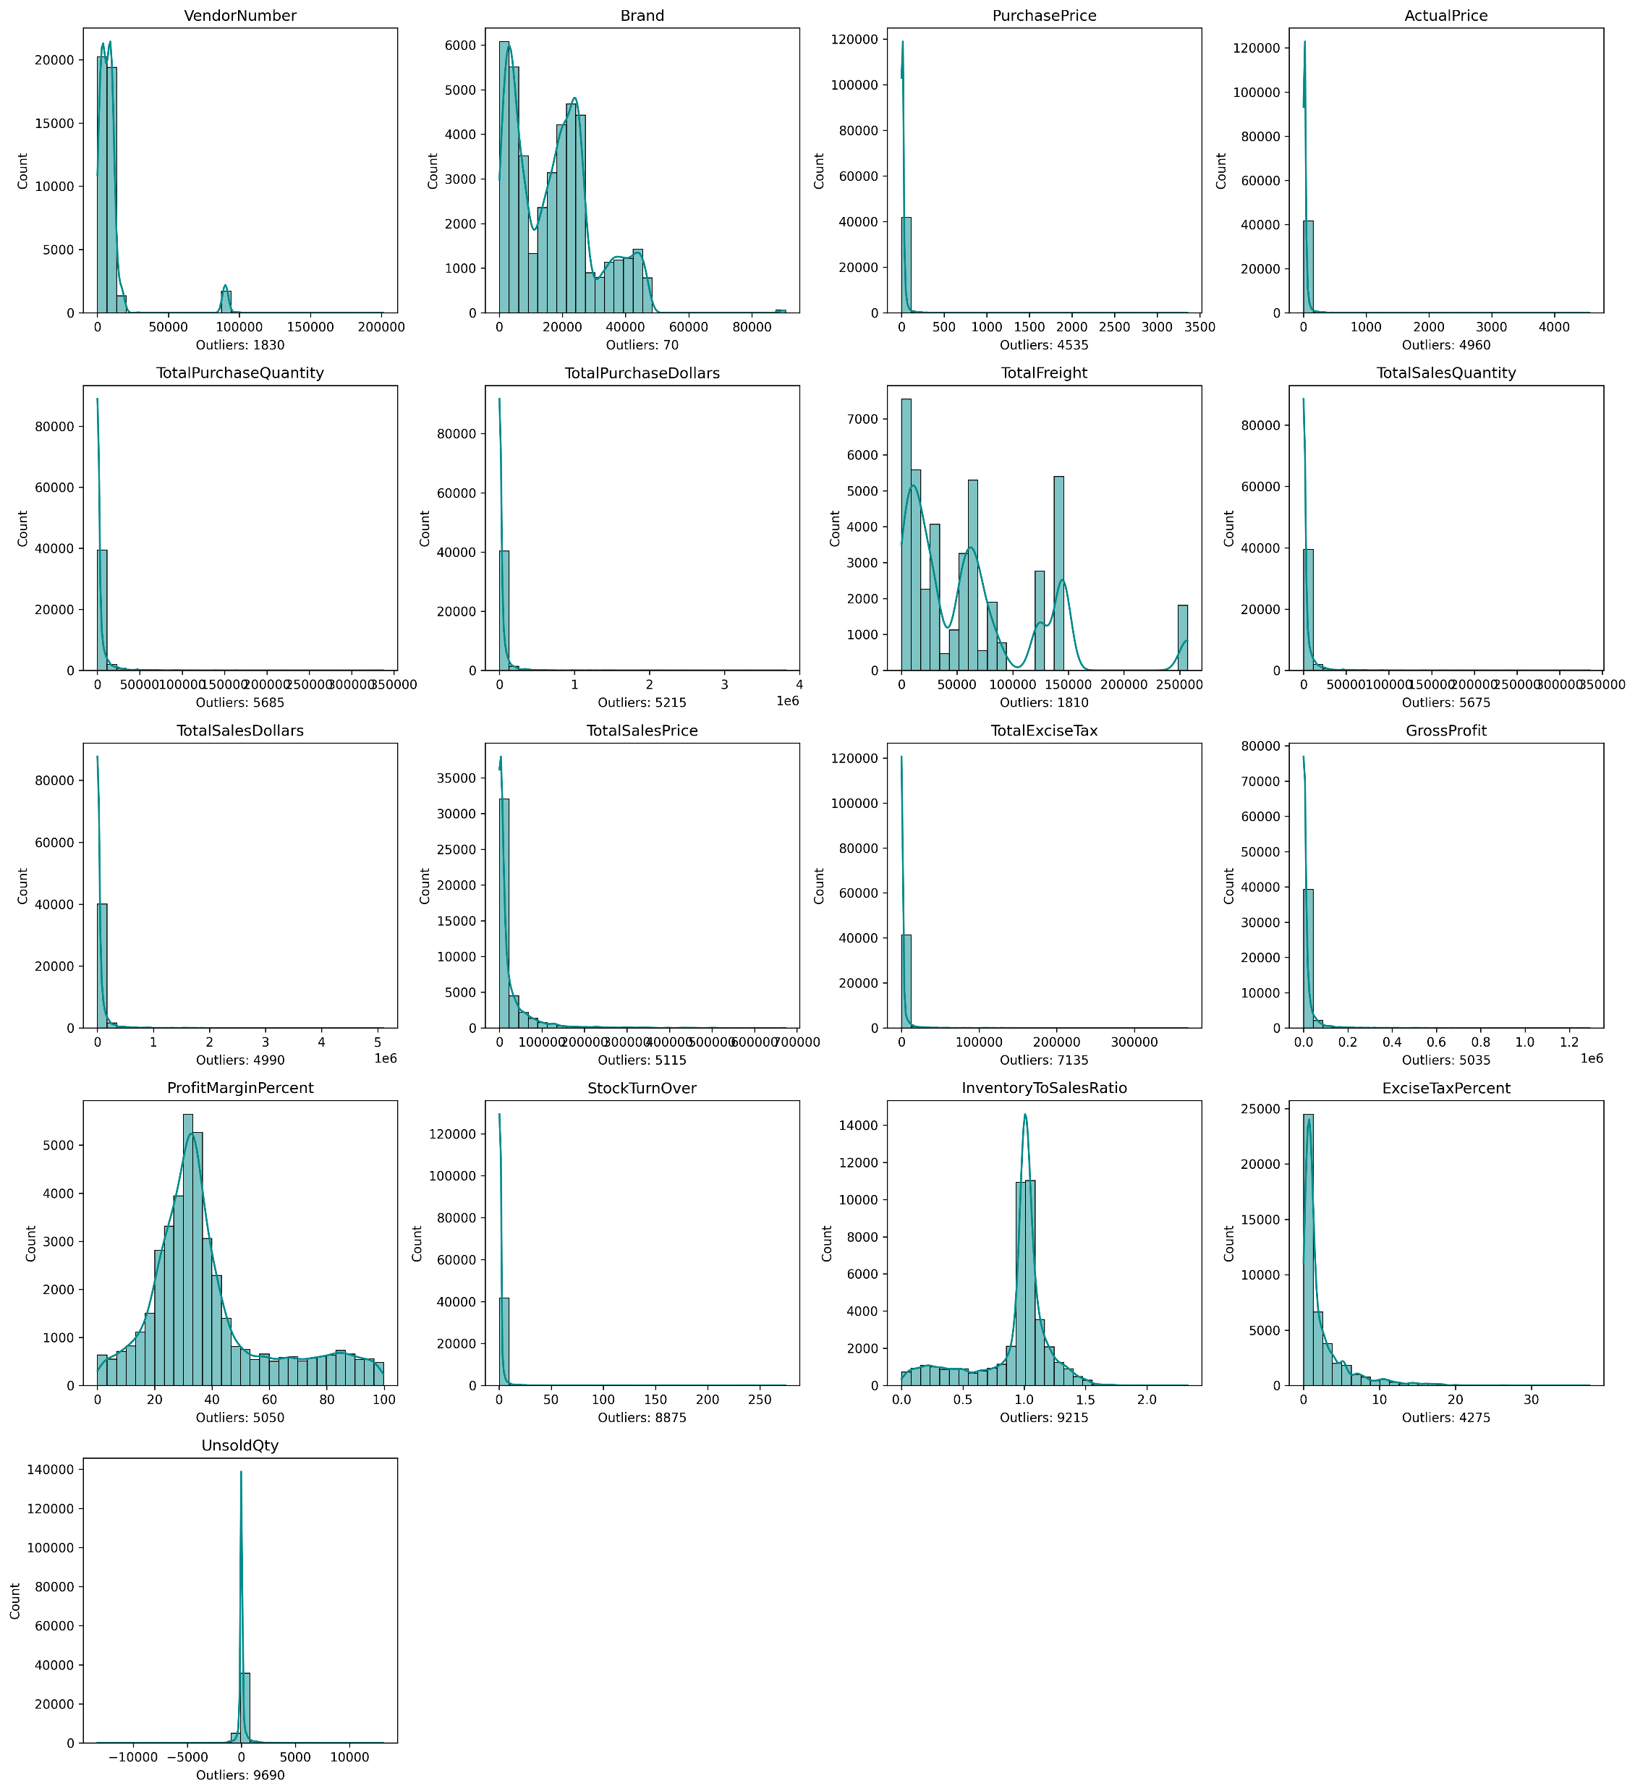
This shows our business is imbalanced: most products are small-scale, while a few outliers dominate sales, profit, and costs.
These histograms show our business data is heavily skewed — most values are very small, but a few extreme outliers dominate...also inefficiencies in freight, margins, and inventory.

Slide 5
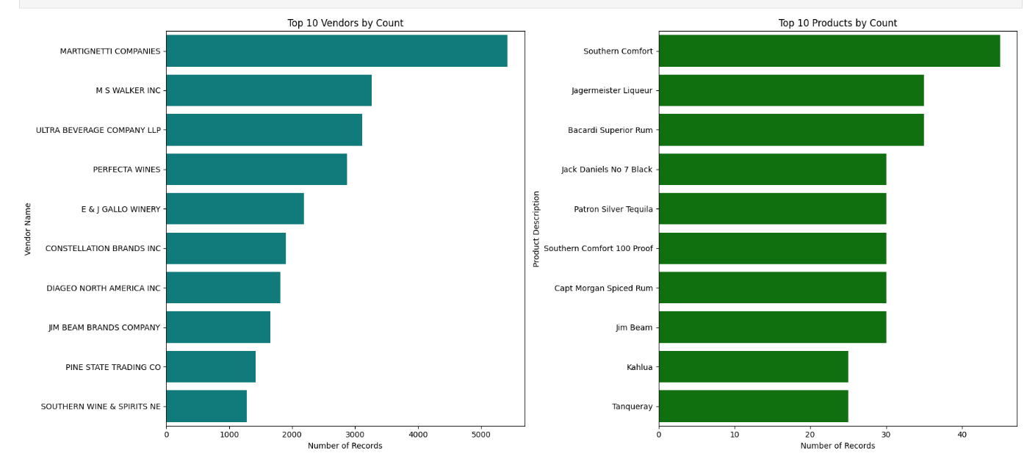
Top 10 vendors by Count : The chart on the left lists the Top 10 Vendors by Count, meaning it ranks vendors by how many times they appear in the company’s records. MARTIGNETTI COMPANIES is by far the most frequent vendor, followed by others like ULTRA BEVERAGE COMPANY LLP and M S WALKER INC. This suggests that a large portion of orders or purchases are concentrated among just a few main suppliers. Top 10 Products by Count : The chart on the right shows the Top 10 Products by Count—the products the company purchases most often. Southern Comfort is the most frequently purchased product, followed by brands like Bacardi Superior Rum and Jager meister Liqueur. The fact that a few products dominate purchasing activity could mean these are best-sellers or essentials for the business.

Slide 6
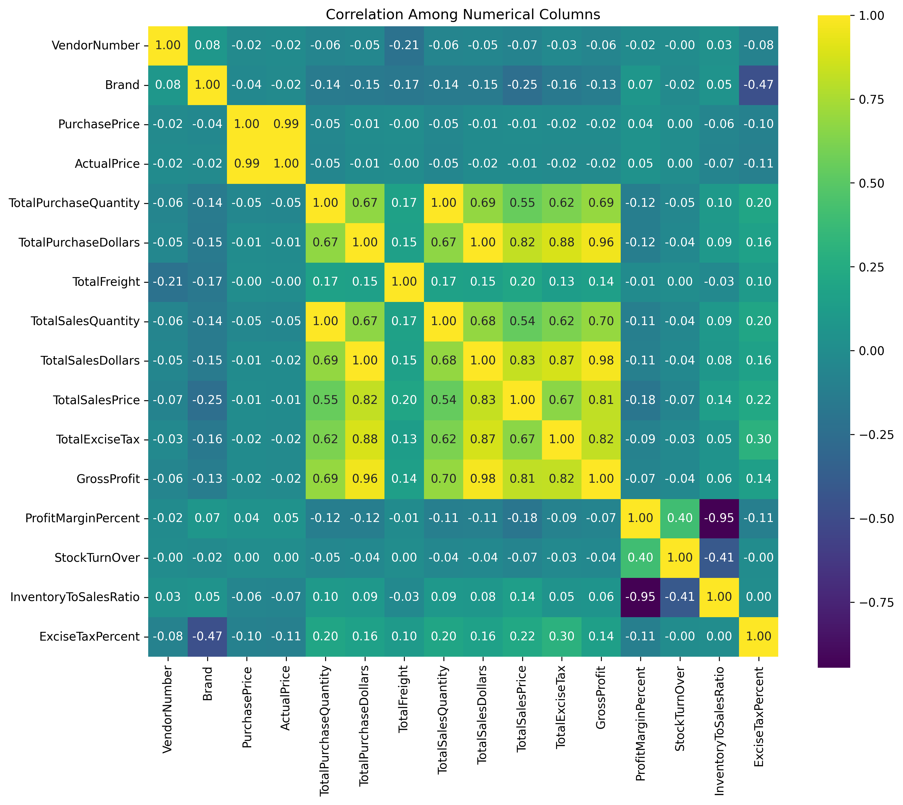
Sales growth directly drives profit — strong positive correlation. Excess inventory reduces profit margins — tighter inventory control is needed. Faster-selling products improve efficiency — prioritize high turnover items. High-tax products still deliver strong profits — focus on high-margin categories. Purchasing aligns well with sales — procurement is on track but can be optimized for margin. Focus Areas: Optimize inventory, invest in fast-moving and profitable products, and monitor high-tax categories for sustained performance.

Slide 7
From our analysis of the data, a few key patterns stand out:
Sales and Profitability Drivers : Our gross profit is heavily influenced by both sales volumes and sales prices. In simple terms, the more units we sell and the better price we achieve, the stronger our profitability. This reinforces the need to focus on both volume growth and price optimization.
Purchasing and Profit Connection : There’s a very strong link between what we spend on purchases and the profits we generate. This means that bulk buying and vendor negotiations directly support profitability. Managing purchase efficiency is critical.
Inventory Management as a Risk Factor: One of the most striking insights is that when our inventory-to-sales ratio increases, our profit margins fall sharply. This tells us that excess stock is directly eating into our margins, either through holding costs, dead stock, or discounting. Optimizing stock levels will significantly improve profitability.
Taxes and Category Impact :Excise taxes rise in line with sales, which is expected, but importantly, some brands are structurally more tax-heavy than others. These categories may require a different pricing or promotional strategy to remain competitive.
Different Strategies for Different Products : We found that fast-moving products don’t necessarily give us higher margins. This means we cannot apply a one-size-fits-all strategy — we’ll need a dual approach: Push fast-moving products for revenue growth, While protecting and enhancing margins on premium or high-priced products.
In summary: To drive profitability, we need to optimize three levers together — better purchasing efficiency, tighter inventory control, and smarter pricing. At the same time, we should adapt strategies by brand and product type, considering their tax impact and margin contribution.

Slide 8
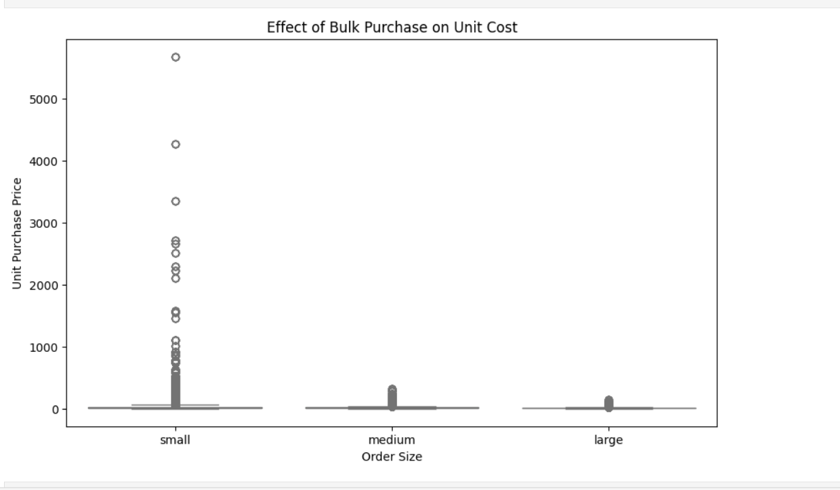
The bulk purchasing analysis demonstrates that strategic, larger-volume orders can generate substantial cost savings compared to frequent small orders, which drive up unit costs and reduce profitability. To capitalize on this, the company should implement a structured bulk purchasing strategy supported by stronger supplier negotiations. By committing to larger volumes where demand is predictable, the business can secure more favorable pricing and terms, thereby improving overall margins. At the same time, effective inventory planning is essential to ensure that bulk buying does not result in overstocking, higher holding costs, or increased risk of dead stock. Demand forecasting tools and replenishment models should be employed to strike the right balance between cost savings and inventory efficiency. Consolidating small, frequent orders into larger planned purchases will not only reduce costs but also streamline logistics, further enhancing operational performance.

Slide 9
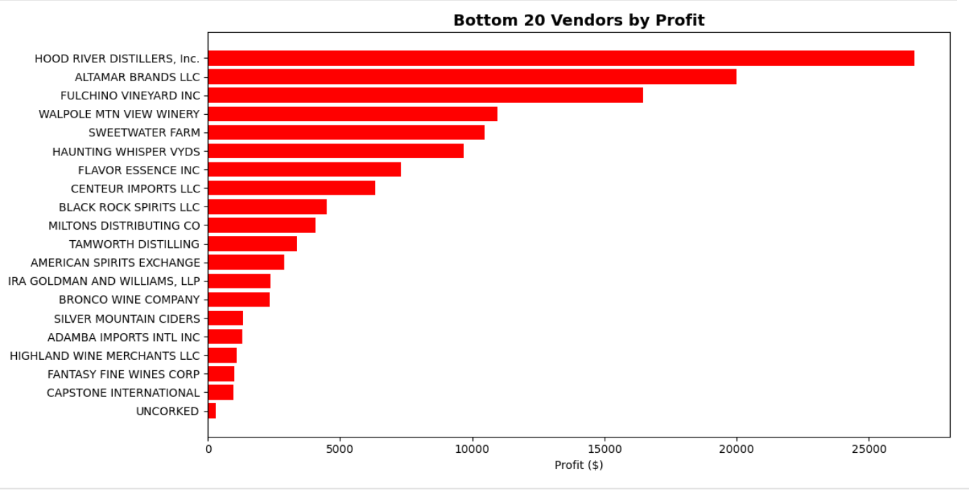
Red Flags🚩
These vendors contribute the least to the company’s bottom line, tying up resources or possibly even resulting in losses. It’s a clear signal to re-examine contracts, pricing, and strategies with these suppliers. The company might consider negotiating better terms, reducing purchases, or replacing vendors whose products don’t sell well or yield sufficient margins. Reviewing this chart helps management prioritize improvement efforts—focusing first on relationships or processes that most drag down profitability.

Slide 10
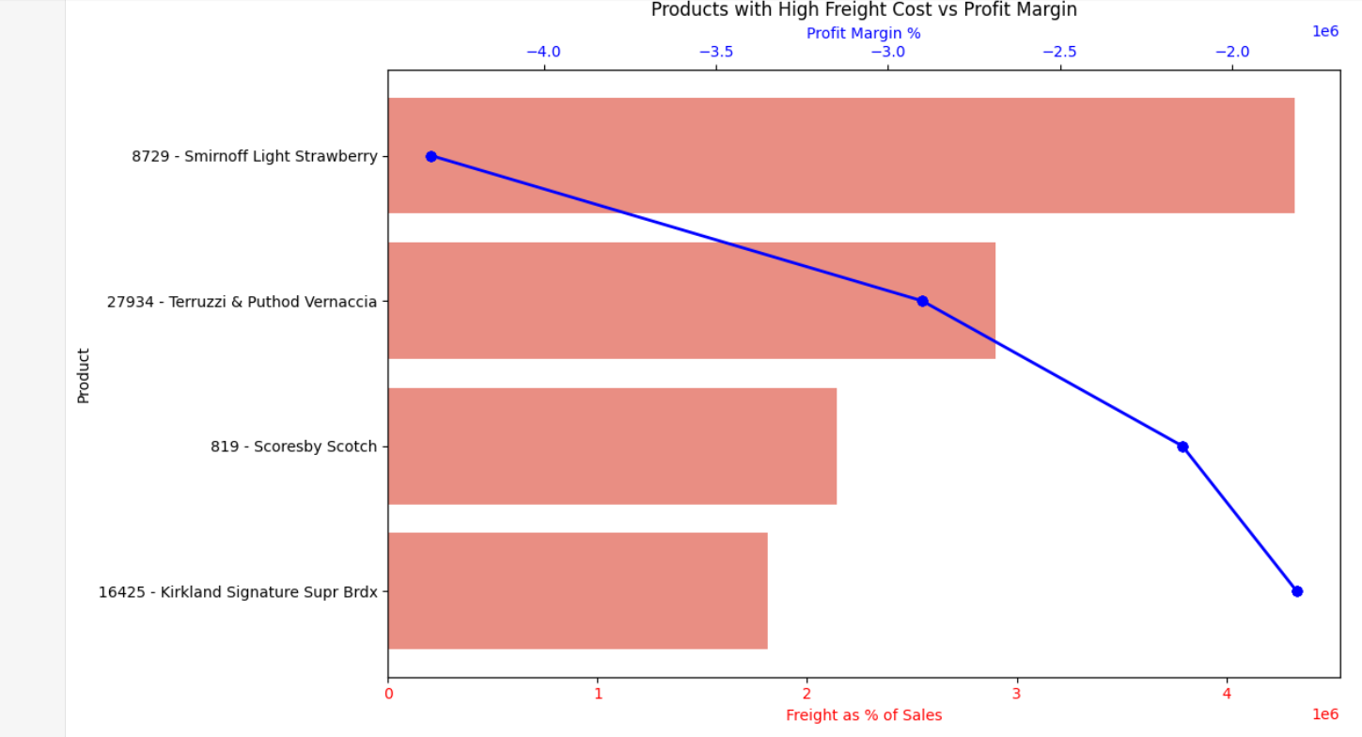
8729 - Smirnoff Light Strawberry has the highest freight cost percentage and the lowest (negative) profit margin. 27934 - Terruzzi & Puthod Vernaccia also shows high freight costs but slightly better profit margin than Smirnoff. 819 - Scoresby Scotch and 16425 - Kirkland Signature Supr Brdx have relatively lower freight percentages but still show negative profit margins. Overall, all these products have negative profit margins, with freight cost appearing as a significant contributing factor.

Slide 11
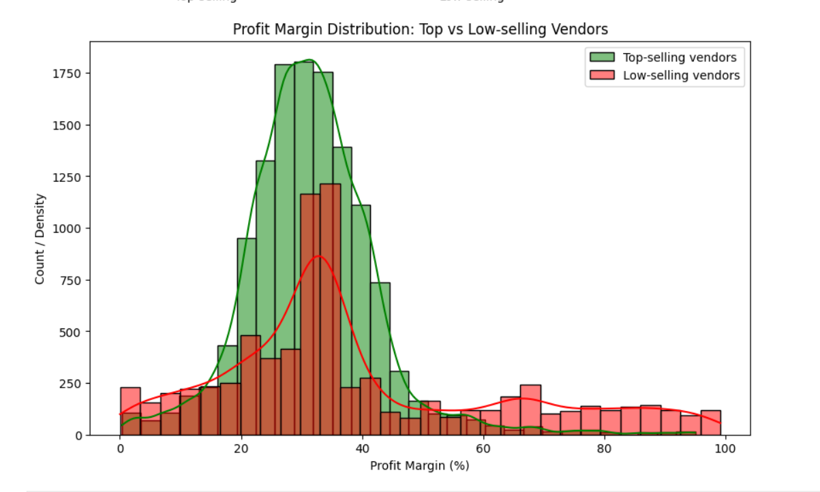
The low-selling vendors are selling products that are very profitable per unit, but their sales volume is low. This indicates untapped potential: if you can increase sales of these products, overall profitability could rise significantly. Our analysis shows that while top-selling vendors generate the highest revenue, their average profit margin is lower (~31.5%). In contrast, low-selling vendors have a higher average profit margin (~39.3%), indicating that some high-margin products are underperforming in sales. This suggests an opportunity to increase overall profitability by focusing on marketing or promoting these high-margin, low-selling products while optimizing costs for high-volume, lower-margin items.
Confidence Interval
Top vendors:
Mean Profit Margin: 31.49%
95% CI: [31.30%, 31.67%]
Low vendors:
Mean Profit Margin: 39.26%
95% CI: [38.73%, 39.79%]

Slide 12
HYPOTHESIS TESTING--
Null Hypothesis (H₀):There is no significant difference in mean profit margins between top-selling and low-selling vendors.
Alternative Hypothesis (H₁):There is a significant difference in mean profit margins between top-selling and low-selling vendors.
Performed a two-sample t-test (Welch’s t-test if variances are unequal).
Look at the p-value:
p-value < 0.05 → Reject H₀ → Means are significantly different.
p-value ≥ 0.05 → Fail to reject H₀ → No significant difference.

Slide 13
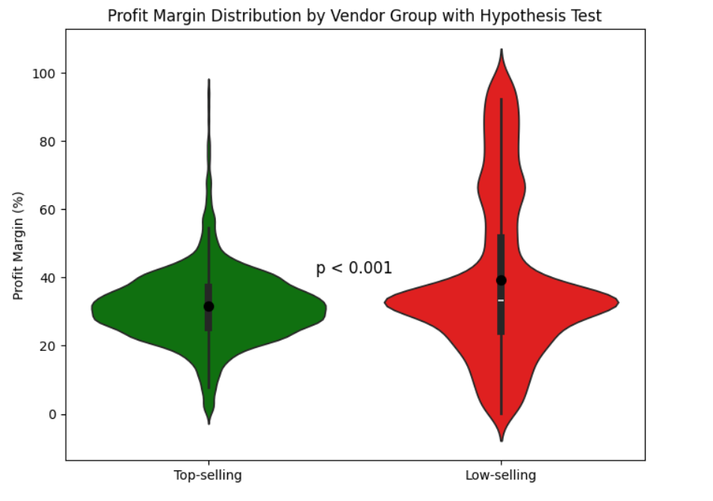
“Our analysis shows a statistically significant difference in profit margins between top-selling and low-selling vendors. The top-selling vendors have lower profit margins compared to low-selling vendors, and this difference is highly unlikely to be due to chance. In business terms, this means that while top-selling vendors drive higher revenue, the low-selling vendors are more profitable per sale. This insight suggests that we should focus not only on sales volume but also on optimizing profitability, for example by promoting high-margin low-selling items or negotiating better terms with top-selling vendors to improve their margins.”

Slide 14
Recommendation Summary :
My analysis shows that profitability can be significantly improved by addressing inefficiencies in procurement, vendor management, and inventory. Key steps include:
High freight cost variability suggests inefficiencies. By consolidating shipments and renegotiating contracts, the business can cut freight expenses by 10–12% annually.
Bulk purchasing instead of small fragmented orders can reduce unit costs by up to 15%.
Top vendors generate revenue but average only ~31.5% profit margin.
Low-selling vendors average ~39.3% profit margin, showing +8% margin potential if sales are scaled.
Eliminating or renegotiating bottom 20 vendors could free resources and improve vendor ROI by 5–7%.
Excess stock directly reduces margins. Improving turnover could save 2–4% of holding costs and release working capital.
Just-in-time purchasing and better forecasting can minimize dead stock losses, which currently erode margins significantly.
Targeted promotions on high-margin, low-selling items could lift overall profitability by +5–8%.
Dynamic pricing on fast-moving products could drive 3–5% additional revenue without major cost increases.
By implementing these combined strategies, the company can realistically aim for a 5–7% improvement in total profit margins and 3–5% reduction in operational costs.

Slide 15
Summary of Recommendations- For Executive
Negotiate Smarter Purchases – Buy in larger quantities where demand is stable to cut costs by 10–15%, and renegotiate freight contracts to save 10–12% annually.
Focus on Profitable Products – Some low-selling products give 8% higher margins than top sellers. Promoting these can boost profits without big cost increases.
Streamline Vendors – Review bottom 20 underperforming vendors. Reduce or replace them to save 5–7% of resources and strengthen profitable partnerships.
Control Inventory – Reduce excess stock, which currently eats into margins. Better forecasting can save 2–4% of costs and free up cash flow.
Smarter Pricing – Use flexible pricing: keep fast-moving items competitive for sales growth, while protecting premium product margins.
Overall Impact: If these steps are followed, the company can achieve a 5–7% improvement in profit margins and 3–5% lower operating costs, while reducing risk and strengthening long-term growth.

