Slide 1
How To GitHub
(And not piss off your next boss)

Slide 2
Prerequisites Check
git --version
python –version
cd somewhere-you-dont-care-about
git clone https://github.com/monagheo/github-lecture.git
or
git clone git@github.com:monagheo/github-lecture.git

Slide 3
Why This Matters
The average developer spends about 2 hours weekly resolving merge conflicts
Physicists are below average developers
73% of dev teams report poor git practices in their companies
Companies with perfect git workflow implementations tend to ship products up to twice as fast

Slide 4
Learning Objectives
NEVER PUSH DIRECTLY TO MAIN
Learn to branch to avoid conflicts
Practice collaborative development techniques
Write professional commit messages (yes, this matters, A LOT)
Conduct code reviews
Understand the push/pull workflow
Handle merge conflicts
Reverse fuck ups
NEVER PUSH DIRECTLY TO MAIN

Slide 5
A Standard, Correct, Nice, Never To Be Seen Again Workflow
(it's never this easy, but it should be)

Slide 6
The Main Branch
Sacred territory
Only consists of stable, tested, production ready code
Breaking something on the main branch breaks literally everything as automated deployments trigger directly from main
Create a branch within the repo to add features
Changes reach main only through pull requests
Pull requests require reviews and passing tests

Slide 7
Ideal Workflow
Start from the updated main branch
Create a feature branch for each task
Work in isolation on your feature
Submit a pull request when ready
Review, test, merge
Delete feature branch and repeat

Slide 8
Branch Naming Conventions
feature/user-authentication
bugfix/login-validation-error
hotfix/critical-security-patch
refactor/database-connection-pool

Slide 9
Add A Feature
# Start from main and ensure it's up to date
git checkout main
git pull origin main
# Create and switch to new feature branch
git checkout -b feature/add-user-profile
# Create a simple Python file
touch user_profile.py
# Stage, commit, and push
git add user_profile.py
git commit -m "feat(user): add basic user profile creation"
git push origin feature/add-user-profile

Slide 10
Collaborative Development – 2 Methods
Divide and Conquer
Split feature into sub tasks
Each dev works on different files or functions
Coordinate through communication
Push updates frequently to stay organised
Shared Feature Branch
Create a feature branch
Create sub-branches off of that branch
Merge sub-branches to feature branch then feature branch to main

Slide 11
Writing Commit Messages
This is the first place anyone will look to understand what changes have taken place
Essential for debugging and code reviews
Good example
feat(auth): add password reset functionality
Will get you put on a pip
update

Slide 12
Pair Up And Collab On A Branch
Use divide and conquer (one branch, two users) to add a feature consisting of two functions in a python file
Add two numbers
Multiply two numbers

Slide 13
Pair Up And Collab On A Branch
Use divide and conquer (one branch, two users) to add a feature consisting of two functions in a python file
Add two numbers
Multiply two numbers
git checkout main
git pull origin main
git checkout -b feature/your-feature-name
(do stuff)
git add {filename}
git commit -m "feat: add new feature description"
git push origin feature/your-feature-name

Slide 14
The Pull Request
Horribly named
If we want to put our code from a branch onto main, think of from the perspective of main
We want to 'pull' the code from a the branch you worked on
Needs to be requested because WE NEVER BLINDLY PUT THINGS ON MAIN EVER

Slide 15
The Pull Request
Pull requests *should* be a standardised thing from company to company
Each company will have a PR Template which must be adhered to
PR's should be clear and descriptive, following the commit convention
Include detailled descriptions explaining 'why', link relevant issues or tickets, have screenshots for UI changes
Keep PR's focussed and small and request specific reviewers

Slide 16
Pull Request
Push your final changes
Go to GitHub and "New Pull Request"
Use the template provided
Submit with reviewers! (monagheo + someone else)

Slide 17
Code Review Process
Does code solve intended problem?
Obvious bugs or edge cases?
Readable and Maintainable?
Unit tested?
Focus on code, not the person
Acknowledge good practices
Good practices include being horrendously brutal for no reason
Try it now

Slide 18
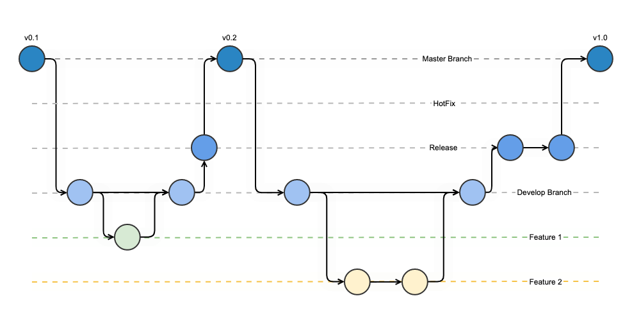

Slide 19
Push/Pull Workflow and Merge Conflicts
(what do you mean CONFLICT (content)?? What?)

Slide 20
Staying In Sync with Push/Pull and Fetch
Always pull from the branch you are working on before you do any add, commit or push
This will update the branch you're working on and make it impossible for merge conflicts to appear when you push your updates
Can see changes on your branch without altering your workspace with 'git fetch' (fetches the changes) 'git status' (shows the changes)

Slide 21
The Merge Command
git merge <branch-name>
Takes commits from the specified branch and combines them into your currently checkout branch
Like a mini pull request without the faff
Only to be used for very VERY small changes on shared feature sub-branches with lots of communication with other editors
NEVER GIT MERGE A BRANCH IF YOU ARE CURRENTLY ON MAIN

Slide 22
Merge Conflicts
Occurs when you 'merge' or 'push' to a branch where the files you have edited have been changed since you last 'pull'-ed
Can happen in many ways
Two devs edit the same function
File moved in one copy of branch and modified in another
Different formatting on the same code etc etc etc

Slide 23
Merge Conflict
# 1. Update branch with latest main
git checkout feature/your-branch
git fetch other-branch
git merge origin/other-branch
# 2. Git shows conflict markers in files:
# <<<<<<< HEAD #
Your changes
# ======= #
Their changes #
>>>>>>> origin/other-branch #
3. Edit files to resolve conflicts
# 4. Stage resolved files
git add resolved_file.py
# 5. Complete the merge
git commit -m "resolve merge conflicts with main"
git push origin feature/your-branch

Slide 24
Merge Conflicts
Understand what both changes accomplish
Communicate with other devs, as often you both need changes
Test thoroughly, this is where the majority of bugs are introduced
DO NOT DELETE YOUR REPO, PULL FRESH, EDIT AND PUSH SO HELP ME GOD THIS IS NOT IT

Slide 25


Common Issues
(and who to blame)

Slide 26
Common Issues
(and who to blame)

Slide 27
git reset (you'll need this)
Moves the current branch pointer (HEAD) to a different commit
"I want to go back in time and pretend that commit didn't happen"
Three types:
--soft: Keeps staging area and working directory unchanged
--mixed: Same as above but unstages commits (default, if you want to edit)
--hard: NUCLEAR. Sets back to stated commit and destroys everything else

Slide 28
"Someone Pushed To Main"
Sharpen axe and then do the following before hiding the body

Slide 29
"Someone Pushed To Main"
Sharpen axe and then do the following before hiding the body
# 1. Protect main branch # Settings → Branches → Add rule → Require PR reviews
# 2. If commits need to be removed from main:
git checkout main
git log --oneline # Find the commit hash before the bad commits
git reset --hard <commit-hash> # DANGEROUS: Point main to good commit
git push --force-with-lease origin main # Force update remote
# 3. Create branch with the "bad" commits for review
git checkout -b hotfix/review-direct-main-commits <bad-commit-hash>
git push origin hotfix/review-direct-main-commits
# 4. Notify team immediately about the force push

Slide 30
"How Do I Undo An Add/Staging"
# Unstage specific file
git reset HEAD filename.py
# Unstage all files
git reset HEAD
# For new files that were never committed
git rm --cached filename.py
# See what's staged vs unstaged
git status

Slide 31
"How Do I Undo Commits"
# Undo last commit, keep changes staged
git reset --soft HEAD~1
# Undo last commit, keep changes unstaged
git reset --mixed HEAD~1
# OR simply:
git reset HEAD~1
# Undo last commit and DELETE changes (DANGEROUS)
git reset --hard HEAD~1
# Undo multiple commits (replace 3 with number)
git reset --soft HEAD~3

Slide 32
"How Do I Undo A Push"
# If you're the only one who pulled the changes:
git log --oneline # Find commit before your push
git reset --hard <commit-hash>
git push --force-with-lease origin branch-name
# If others might have pulled your changes:
git revert <commit-hash> # Creates new commit that undoes changes
git push origin branch-name # Nuclear option - delete branch entirely

Slide 33
"Who The Fuck Did This?"
# See who last modified each line
git blame filename.py
# Show specific line range
git blame -L 10,20 filename.py
# Ignore whitespace changes
git blame -w filename.py

Slide 34
Conclusions, Tips, Oaths

Slide 35
Conclusions, Tips, Oaths
Tools like gitgraph for vscode can help visualise and track git branches, merges and changes but are useless if you don't unerstand the underlying CLI commands that they run on
Take the time to get familiar with git use in the terminal prior to using these tools
ChatGPT etc are good at generating git commands, but know what you're doing
"I hereby do solemnly swear never to push to main again"

