Slide 1

Forecast VAR
Agent engineering tutorial through a World Cup 2026 prediction lab
30-minute YouTube slideshow
12
48
73
3k
groups
teams
evidence docs
Monte Carlo sims
01
Hero image: Wikimedia Commons CC0 • animation generated locally
Notes:
Open with the premise: we are not building a football oracle. We are building a prediction agent that behaves like an engineering system: validate the world, retrieve sources, call deterministic tools, cite claims, disclose uncertainty, and evaluate itself. Promise the audience an exciting World Cup 2026 demo, but anchor the hook in reliability rather than pundit certainty.

Slide 2
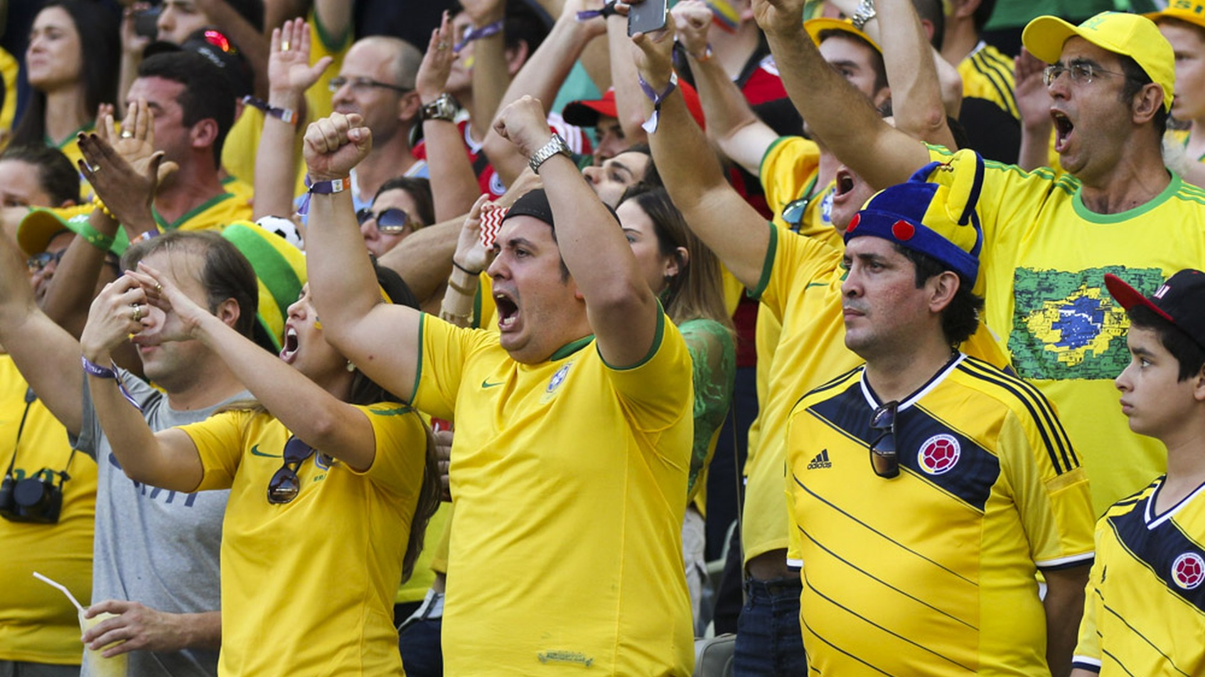
FORECAST VAR
01:00
Confident football takes are cheap. Auditable forecasts are engineered.
The episode starts with a naive prediction agent and then puts it in the VAR booth.
USA are a lock
unsupported certainty
Sample odds prove it
source misuse
No validation needed
tool skipped
02
Real match image: Agencia Brasil / Wikimedia Commons CC BY 3.0
Notes:
Frame the problem in a familiar way: sports talk rewards confidence, but agent engineering rewards traceability. The cold open should show what we are avoiding: fluent claims that skip validation, source policy, and uncertainty. Use this slide to explain why the episode uses football for energy but judges the agent as software.

Slide 3
FORECAST VAR
02:30
The tutorial arc is a controlled forecast pipeline.
A natural-language question becomes a validated, cited, reproducible simulation result.
1
Pre-flight
2
Source index
3
MCP tools
4
Claim verifier
5
Eval harness
field + inputs
evidence docs
Python forecast
typed support
quality gates
03
GIF and pipeline derived from Episode 2 README/docs
Notes:
Walk the viewer through the promise of the tutorial: every step is inspectable. The LLM does not get to freestyle a champion. It has to pass pre-flight, use the source index, call MCP tools, and survive claim verification. This is the backbone that will reappear on every experiment slide.

Slide 4
FORECAST VAR
04:00
Forecast VAR separates narration from computation.
The agent is the presenter; the simulator is the stats department; MCP is the controlled phone line.
OpenAI agent path
routes prompt • selects skill • formats answer
MCP server
read-only tool schemas • argument validation • structured outputs
Python forecast tools
match model • group sim • tournament sim • rolling state
Evidence layer
source adapters • local index • citations • support labels
Verifier + eval
typed claims • unsupported-rate • pass/fail harness
Design rule
LLM prose can vary. Tool probabilities must be reproducible from code, inputs, parameters, and seed.
04
Architecture from Episode 2 source-aware edition
Notes:
Make the division of responsibility crisp. The LLM is valuable because it reads intent and narrates the result. But the numbers come from deterministic code. MCP gives the model a narrow, typed interface to that code. The verifier and evaluation harness then check whether the final answer respected the contract.

Slide 5
FORECAST VAR
06:00
Pre-flight blocks the most embarrassing class of forecast error.
Before any prediction, the agent checks field size, feature coverage, source registry, and evidence readiness.
12
48
48
73
0
groups validated
teams in field
feature rows
evidence docs
missing teams
Tournament field
Feature table
Evidence index
Warnings
valid 12 x 4 format
one row per team
generated locally
demo priors only
Teaching line: no model output until the context is internally consistent.
05
Data: reports/data_validation.json and preflight_forecast_context()
Notes:
This is the first engineering concept: pre-flight validation. A prediction agent should not answer until it knows which world it is forecasting. In this repo that means 12 groups, 48 teams, feature rows for all 48, and a generated evidence index. The warnings are part of the product, not an apology.

Slide 6
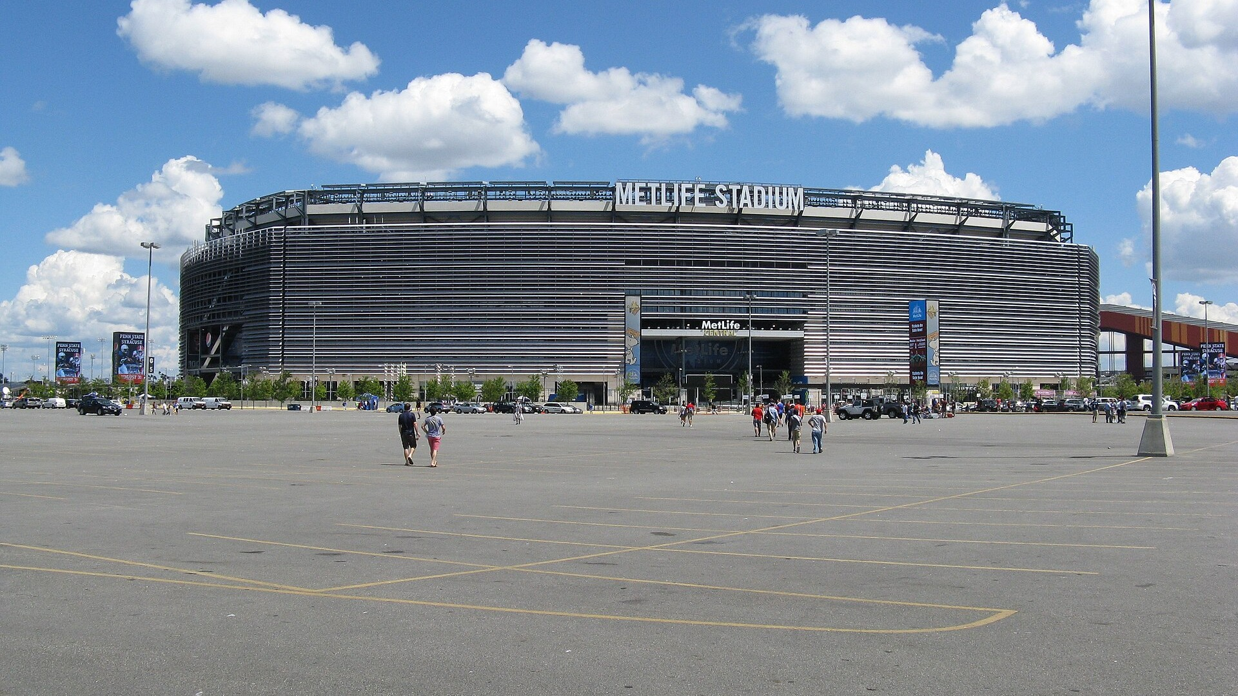
FORECAST VAR
07:30
Source adapters make evidence a first-class system boundary.
The episode stays offline by default, but it models how live sources would slot in safely.
SourceCardAdapter
policy + support labels
Evidence index
TeamFeatureAdapter
demo priors for 48 teams
73 compact documents
source_id + title + text
support labels + metadata
used by retrieval tools
MarketOddsAdapter
de-vig sample baseline
CuratedEvidenceAdapter
human-reviewed notes
APIFootballAdapter
env-gated live slot
06
Stadium image: Erik Drost / Wikimedia Commons CC BY 3.0
Notes:
Explain the source adapter pattern. Adapters turn messy external or local inputs into compact evidence documents. This lets retrieval, citations, and claim verification operate over a consistent shape. The live API adapter is intentionally opt-in because the tutorial wants reproducible offline behavior.

Slide 7
FORECAST VAR
09:00
MCP turns ordinary Python into agent-callable tools.
The server executes structured calls; the LLM decides when those calls are useful.
from fastmcp import FastMCP
mcp = FastMCP("worldcup-forecast")
@mcp.tool()
def simulate_tournament(sims: int = 3000, seed: int = 2026) -> dict:
return forecast_var.tools.simulate_tournament(sims=sims, seed=seed)
User prompt
Who wins Group D?
LLM/client
chooses tool + args
MCP server
validates schema
Python tool
runs simulation
Final answer
cited uncertainty
07
Concept source: docs/python_mcp_intro.md
Notes:
This is a good moment to demystify MCP. The MCP server is not the brain. It exposes typed tools. The AI client and model translate user intent into a structured call. That separation keeps execution in Python while retaining a natural-language interface.

Slide 8
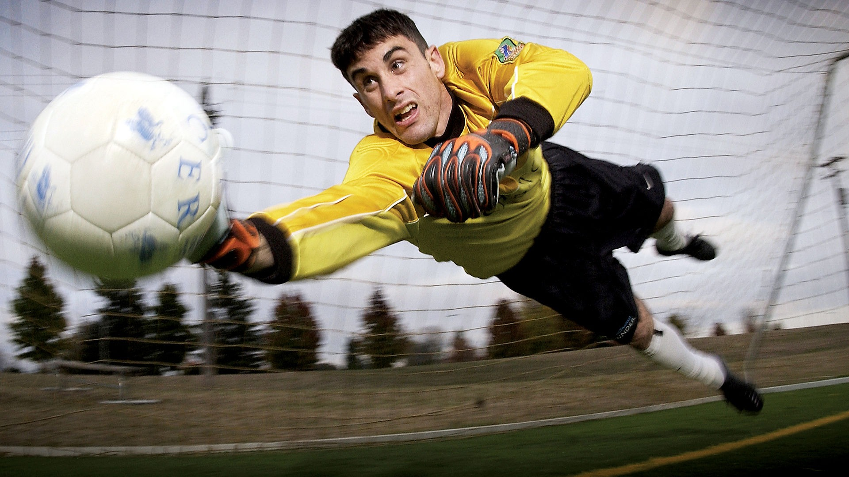
FORECAST VAR
10:30
The LLM is not allowed to invent the match probabilities.
For USA vs Australia, Forecast VAR calls the Python model and discloses the gaps.
USA win
50.9%
model probability
Gaps disclosed
Draw
21.0%
No live lineups
No live injury feed
Sample odds only
No betting advice
bounded draw probability
Australia win
28.1%
model probability
08
Image: public domain goalkeeper photo via Wikimedia Commons
Notes:
Use USA versus Australia as the match-level demo. The key teaching point is not the exact percentage; it is the boundary. The model output contains probabilities and warnings. The agent can explain those numbers, but it cannot pretend they came from fresh lineups or official odds.

Slide 9
FORECAST VAR
12:00
Experiment 1: Group D is a distribution, not a headline.
5,000 simulations make USA the favorite, but not a lock.
USA
47.5%
top 2 73.4%
top 3 89.6%
winner probability
Türkiye
22.1%
top 2 52.8%
top 3 78.1%
winner probability
Paraguay
16.3%
top 2 40.3%
top 3 70.6%
winner probability
Australia
14.1%
top 2 33.6%
top 3 61.6%
winner probability
Teaching line
A good forecast says how often, not how loudly.
09
Data: forecast_group('D', sims=5000)
Notes:
Now run the first simulation experiment. USA is the favorite to win Group D in the bundled demo priors, but nearly half the simulations produce a different group winner. This is the easiest way to show why probabilities beat pundit wording.

Slide 10
FORECAST VAR
14:00
Experiment 2: market comparison is a sanity check, not advice.
The sample de-vig baseline exposes where the model leans differently from external odds-like priors.
Model
Sample market
USA win
50.9%
52.2%
De-vig step
Convert odds to implied probabilities, remove bookmaker margin, then compare to model output.
Draw
21.0%
26.0%
Australia win
28.1%
21.8%
Margin in sample row: 5.33%
10
Data: forecast_match_with_context('USA','Australia')
Notes:
Explain de-vig in plain English: odds include margin, so the raw implied probabilities usually add to more than 100 percent. The adapter normalizes them before comparison. Then repeat the guardrail: this is an illustrative baseline, not betting advice.

Slide 11
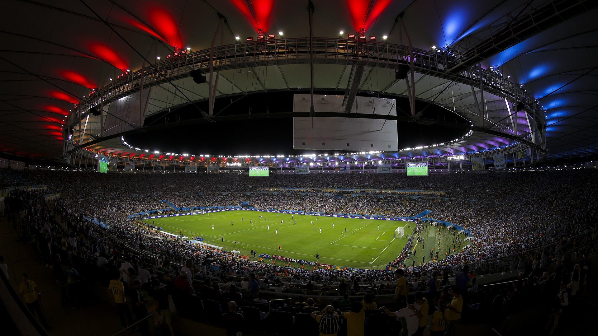
FORECAST VAR
16:00
Experiment 3: champion odds come from counting simulated titles.
The top of the table is plausible, but every number is model-derived and caveated.
Argentina
18.6%
France
15.2%
Spain
12.8%
England
10.8%
Portugal
8.3%
Brazil
7.8%
11
Photo: Agencia Brasil / Wikimedia Commons CC BY 3.0 • GIF generated locally
Notes:
This is the big YouTube moment. Let the animation play while explaining Monte Carlo: run many possible tournaments, count how often each team wins, and divide by the number of simulations. Then call out the approximation: the knockout bracket is seeded for education, not a full official FIFA path model.

Slide 12
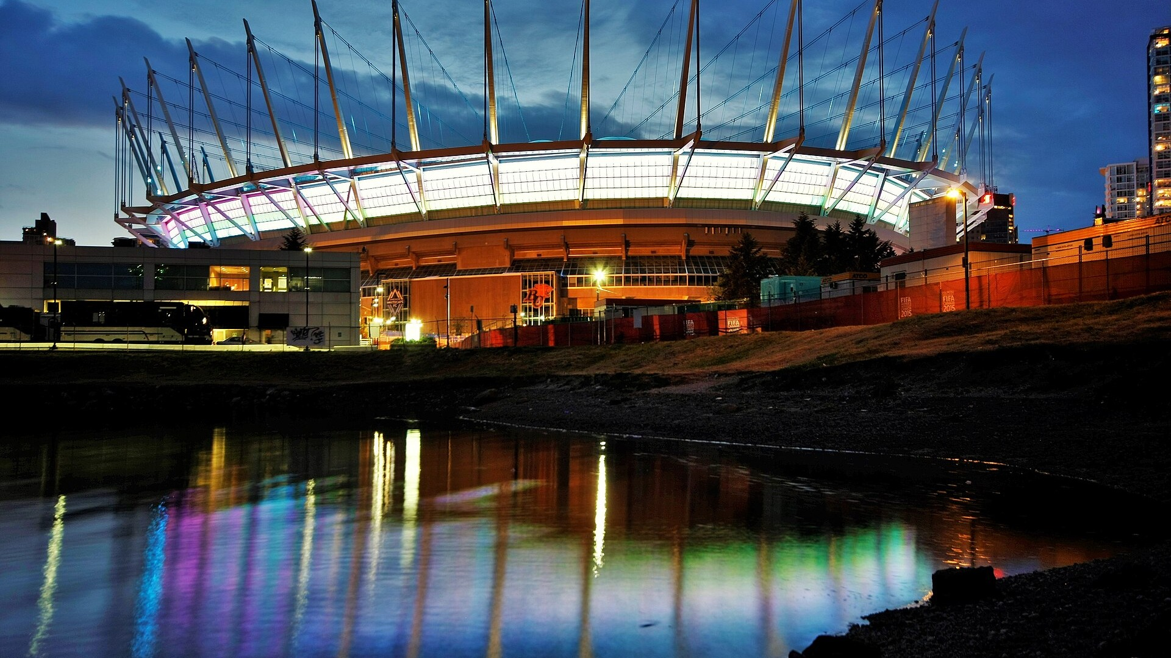
FORECAST VAR
18:00
Experiment 4: rolling state changes the forecast immediately.
After USA 2-1 Australia, completed results are locked and only remaining fixtures are sampled.
USA
47.5%
→
67.6%
Türkiye
22.1%
→
17.9%
Paraguay
16.3%
→
12.5%
Australia
14.1%
→
2.0%
12
BC Place image: GoToVan / Wikimedia Commons CC BY-SA 2.0
Notes:
Use this slide to explain agent state. If a match has already happened, the agent should not resimulate it as unknown. The rolling forecast locks the completed USA-Australia result and samples the remaining Group D fixtures. This is also a place to mention that the completed result is user-supplied in the demo, not pulled from a live feed.

Slide 13
FORECAST VAR
20:00
Experiment 5: scenario analysis makes uncertainty interactive.
Small rating adjustments change the story, which is exactly why the agent must label assumptions.
Scenario
USA
Türkiye
Paraguay
Australia
Base
48.0%
22.0%
16.5%
13.6%
Scenario contract
Every adjustment is treated as an assumption, attached to the tool call, and kept separate from sourced facts.
USA -50
38.8%
25.5%
19.5%
16.2%
Australia +80
43.1%
17.2%
12.7%
27.0%
Türkiye +60
43.6%
29.8%
15.0%
11.5%
No silent priors. No hidden knobs.
13
Data: forecast_group('D', adjustments=...) with 3,000 sims
Notes:
This is the extra experiment that makes the tutorial feel hands-on. Show how a fatigue penalty, form boost, or tactical adjustment shifts Group D. The engineering lesson is that assumptions must be explicit inputs, not invisible reasoning inside the model's prose.

Slide 14
FORECAST VAR
22:00
Typed claims turn source quality into something measurable.
Each answer is broken into claims, each claim declares its type, and citations must support that type.
field_fact
official field + group labels
model_output
model logic + input support
market_baseline
sample odds + source policy
uncertainty
model caveats + warnings
14
GIF generated from Episode 2 claim-verifier behavior
Notes:
This is where the agent-engineering story becomes testable. If a claim says the field has 48 teams, it needs field support. If a claim gives model output, it needs model-input and model-logic support. The verifier is deliberately simple, but it demonstrates the product pattern.

Slide 15
FORECAST VAR
24:00
The grounded agent wins because the harness tests behavior, not vibes.
Fourteen eval cases separate the naive baseline from the source-aware agent.
Baseline mock
Grounded mock
Pass rate
0%
100%
Tool recall
0%
100%
14 / 14
Skill recall
0%
100%
grounded cases passed
Citation recall
0%
100%
Source support
0%
100%
Probability sanity
42.9%
100%
15
Data: reports/summary_baseline_mock.json and summary_grounded_mock.json
Notes:
Show the before and after. The baseline sounds like a chatbot. The grounded mock behaves like an engineered agent: it uses tools, selects skills, cites, abstains when needed, and keeps probabilities sane. The harness is what prevents the demo from being just a nice anecdote.

Slide 16
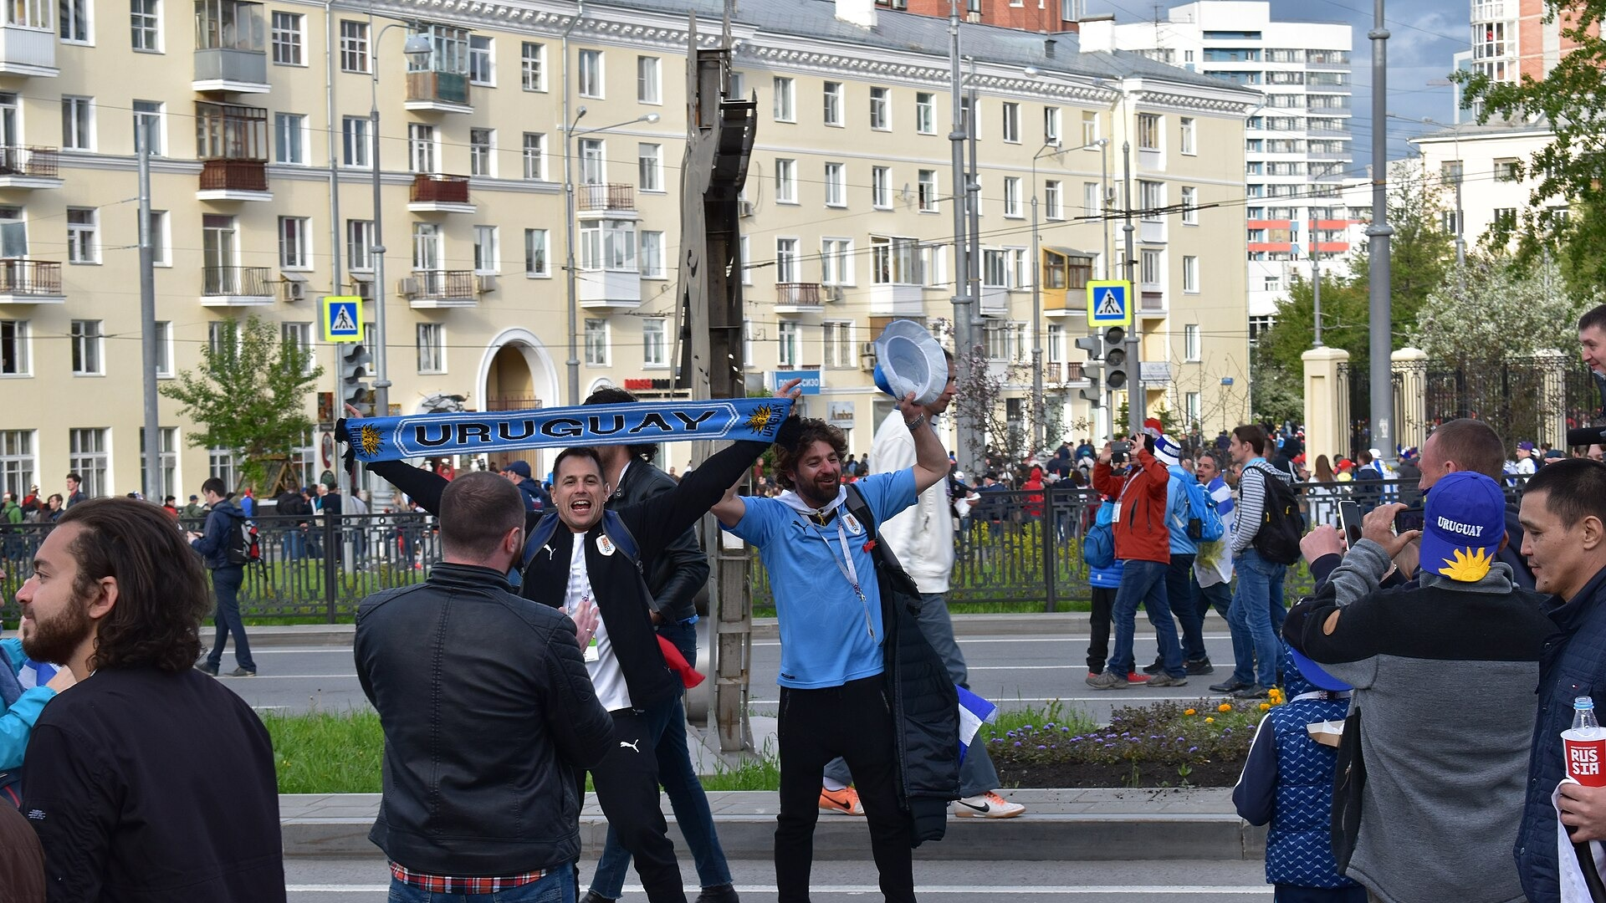
FORECAST VAR
25:30
A source-aware agent is honest about what it does not know.
Coverage is not the same as readiness for public predictions.
Field + groups
official snapshot
Team priors
bundled demo only
Before publishing
Market baseline
sample only, not advice
refresh live squads, injuries, lineups, rankings, odds, and source rights
Injuries + lineups
adapter slot / curated notes
Historical calibration
placeholder not refreshed
Rolling state
supported when results supplied
16
Fan image: A.Savin / Wikimedia Commons CC BY-SA 4.0
Notes:
This is a trust slide. The system can forecast with bundled demo priors, but a public prediction workflow needs fresher and properly licensed sources. Good agent engineering is partly about knowing when to say: this source family is weak or missing.

Slide 17
FORECAST VAR
27:00
The YouTube run of show alternates concepts with experiments.
A 30-minute episode needs rhythm: explain the pattern, run a simulation, then inspect the guardrail.
00:00
hook + promise
04:00
architecture
06:00
pre-flight
09:00
MCP boundary
12:00
Group D sim
16:00
tournament sim
22:00
claim/eval audit
28:30
recap
VIDEO LOOP
VIDEO LOOP
VIDEO LOOP
Agent loop animation
Champion bar race
Rolling forecast shift
assets/agent_loop.mp4
assets/champion_bar_race.mp4
assets/rolling_forecast_shift.mp4
17
MP4 loops are included in the media pack next to the deck output
Notes:
This slide is for producing the YouTube episode. Use the visible timing grid to guide pacing. The MP4 loops can be dropped into the final edit as B-roll or used to replace the animated GIFs if the editor prefers video assets.

Slide 18

FORECAST VAR
28:30
The reusable agent-engineering pattern is bigger than football.
Validate the world, retrieve evidence, call deterministic tools, verify claims, disclose uncertainty.
Validate
Retrieve
Compute
Verify
Evaluate
world + inputs
source context
tool boundary
typed claims
regression gates
World Cup prediction is the demo. Source-aware uncertainty is the lesson.
18
Generated pitch visual; no official marks used
Notes:
Close the main story by generalizing the pattern. The audience should leave knowing how to build any high-stakes prediction or analysis agent: do not trust fluent answers by default; build the tool boundary, evidence layer, verifier, and eval harness.

Slide 19
CREDITS + GUARDRAILS
29:30
Sources, media, and publishing caveats
• Episode 2 repo: Forecast VAR source-aware edition
Media credits
• FIFA pages checked for 2026 format/groups/schedule context
Jeremy Ng / Unsplash, CC0
• Project outputs: data_validation, source_refresh, eval summaries, simulation tools
Agencia Brasil, CC BY 3.0 BR
• All probabilities in this deck are demo-model outputs, not betting advice
Erik Drost, CC BY 3.0
• Refresh official field, squads, injuries, lineups, rankings, odds, and licensing before public forecasts
GoToVan, CC BY-SA 2.0
A.Savin, CC BY-SA 4.0
Public domain goalkeeper photo
Local GIF/MP4 loops from deterministic outputs
Deck built as editable PPTX with speaker notes and media pack.
19
Appendix / credits slide
Notes:
Use this slide as the ethical and practical close. The deck intentionally avoids official logos and does not present demo priors as live official forecasts. If the episode will be published, refresh sources and confirm media licensing one more time.

