Slide 1

WORLD CUP 2026 · AGENT ENGINEERING
Forecast VAR
A technical slide deck for building, grounding, and evaluating a World Cup prediction agent
48
12
gpt-5.4-nano
Monte Carlo
validated field
groups
agent model
simulator
teams
groups of four
orchestrator
Python tool
The drama: first the predictions. Then the VAR room: every source, tool call, claim type, and evaluation check.
Demo priors, educational simulator — not betting advice · Photo: Liondartois / CC BY-SA 4.0 / Wikimedia Commons; cropped + darkened
AI Reality Lab · Forecast VAR

Slide 2

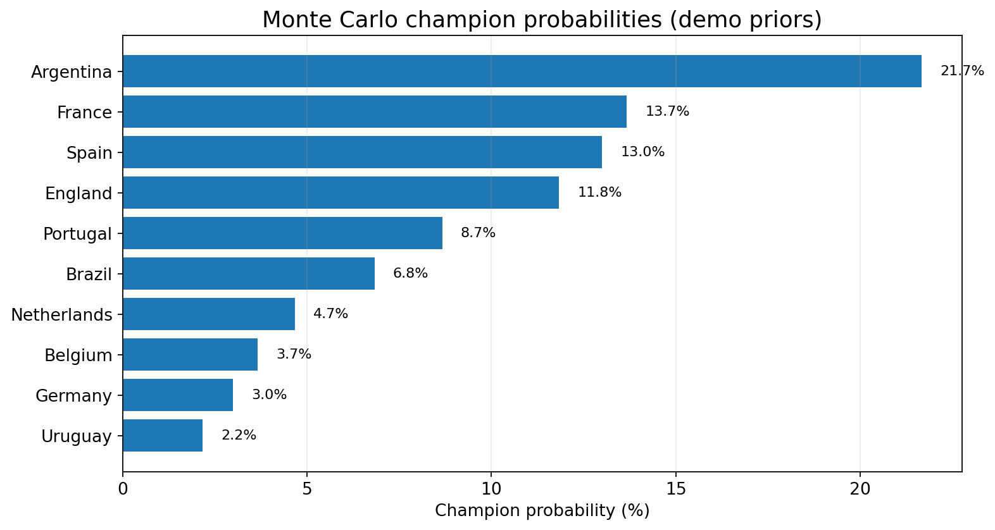
FORECAST VAR
Prediction snapshot: the model names its favourites before we inspect the machine
21.7%
13.7%
13.0%
11.8%
1. Argentina
2. France
3. Spain
4. England
Final: 35.5% · SF: 52.8%
Final: 26.7% · SF: 44.3%
Final: 23.5% · SF: 40.2%
Final: 22.0% · SF: 35.7%
Sports drama, engineering restraint
The headline is Argentina as projected champion in the educational simulation. The agent is not allowed to say “Argentina will win.” It must say: “Argentina is the top modelled favourite under demo priors, with 21.7% champion probability.”
Agent concept: predictions are model-derived claims, not facts. They need model citations, probability sanity checks, and uncertainty warnings.
Demo priors, educational simulator — not betting advice · Photo: Hossein Zohrevand / CC BY 4.0 / Wikimedia Commons; cropped + darkened
AI Reality Lab · Forecast VAR

Slide 3
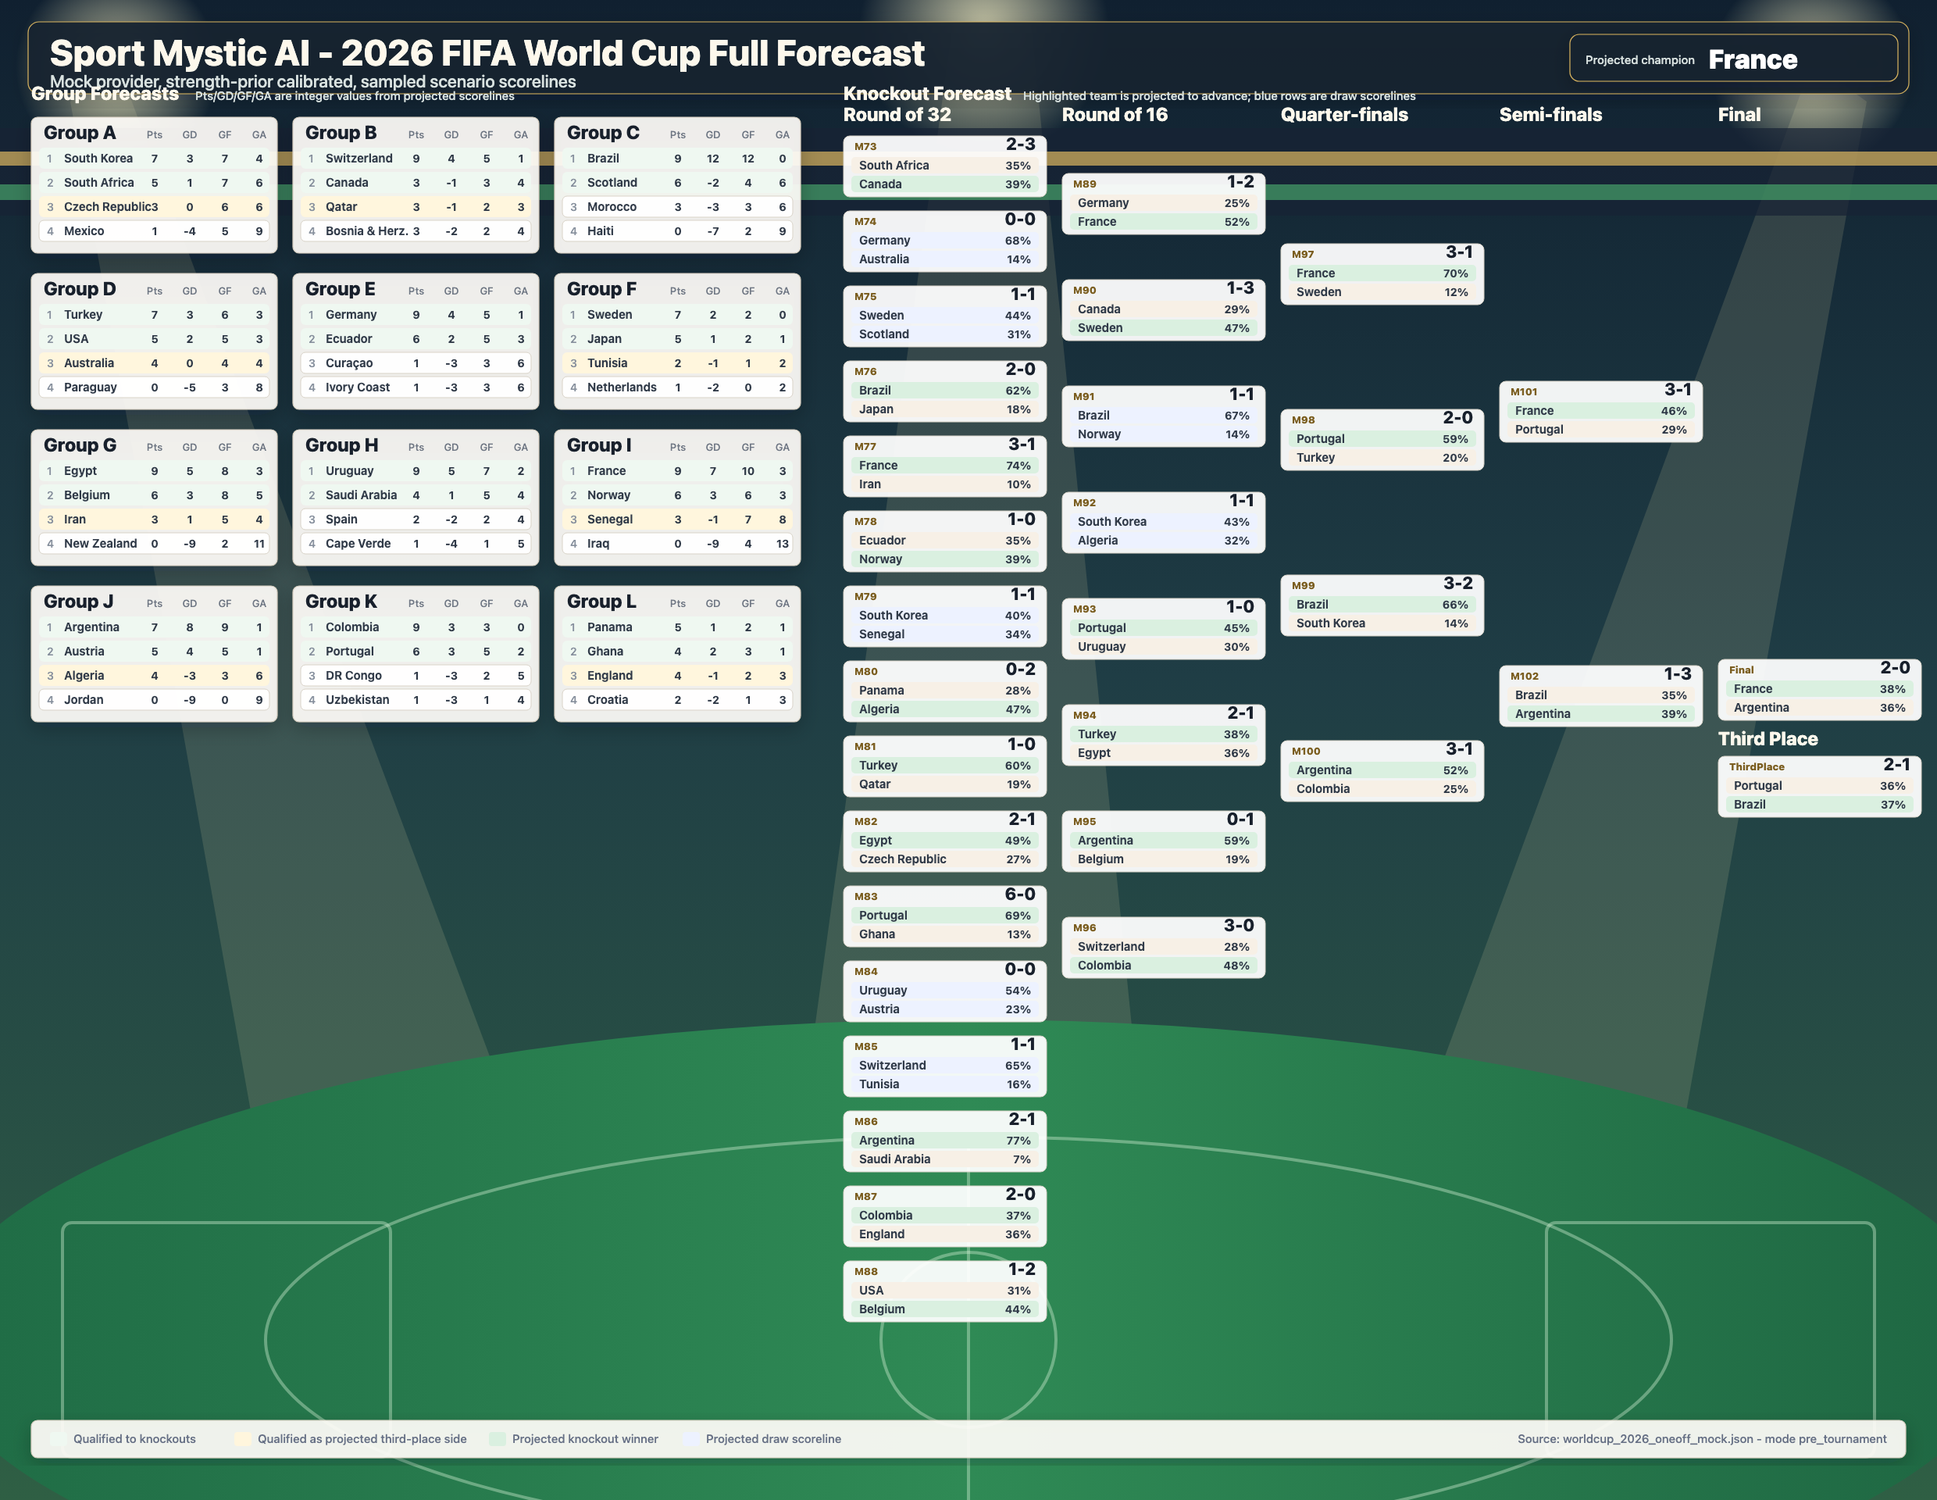
FORECAST VAR
Demo priors, educational simulator — not betting advice · Photo: Hossein Zohrevand / CC BY 4.0 / Wikimedia Commons; cropped + darkened
AI Reality Lab · Forecast VAR

Slide 4
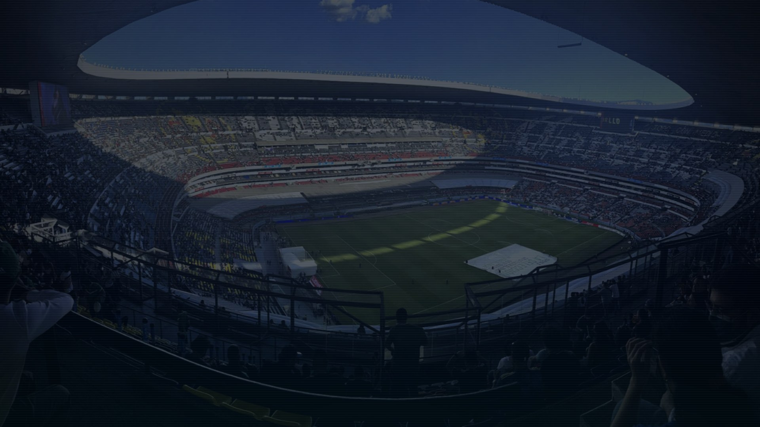
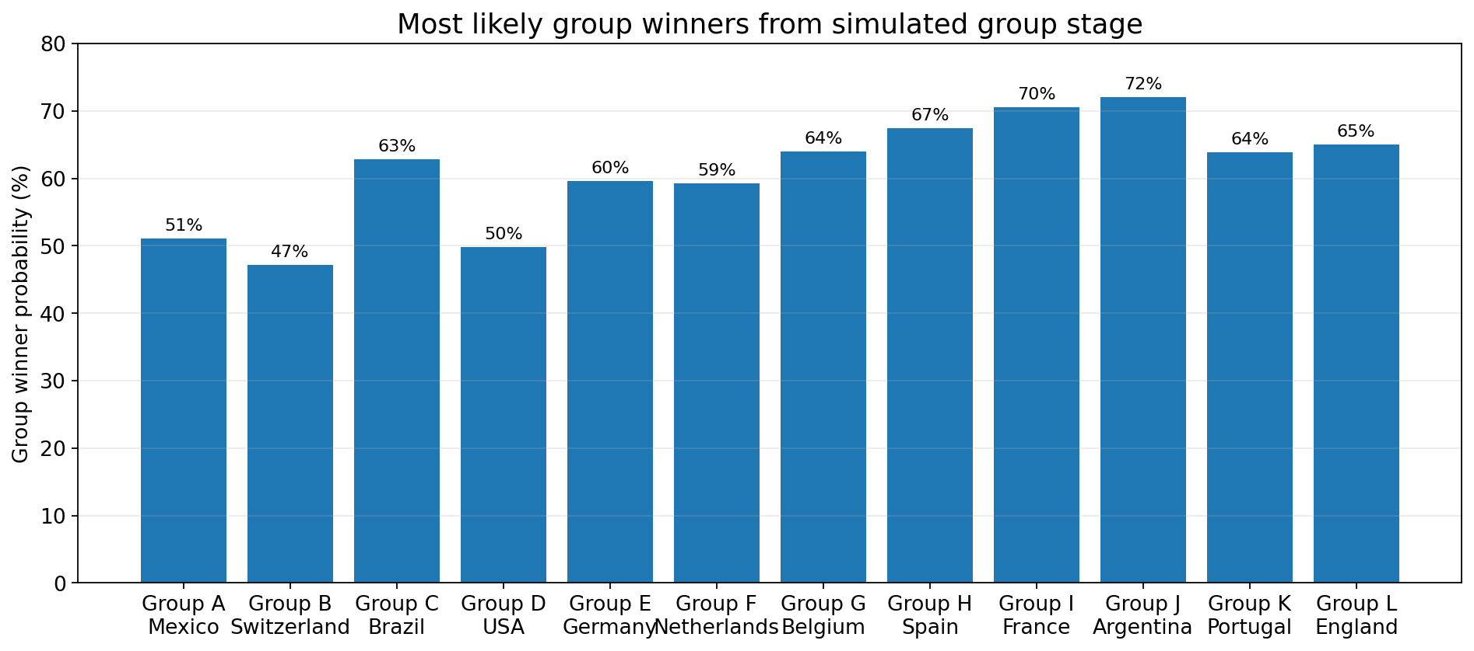
FORECAST VAR
Group stage forecast: twelve group races, twelve likely winners
Predicted group winners
Group A: Mexico (51%)
Group B: Switzerland (47%)
Group C: Brazil (63%)
Group D: USA (50%)
Group E: Germany (60%)
Group F: Netherlands (59%)
Group G: Belgium (64%)
Group H: Spain (67%)
Group I: France (71%)
Group J: Argentina (72%)
Group K: Portugal (64%)
Group L: England (65%)
Engineering note: group winners are not asserted as facts. Each is a model_output claim grounded in team priors, group membership, and the simulation routine.
Demo priors, educational simulator — not betting advice · Photo: Alejan98 / CC0 / Wikimedia Commons; cropped + darkened
AI Reality Lab · Forecast VAR

Slide 5
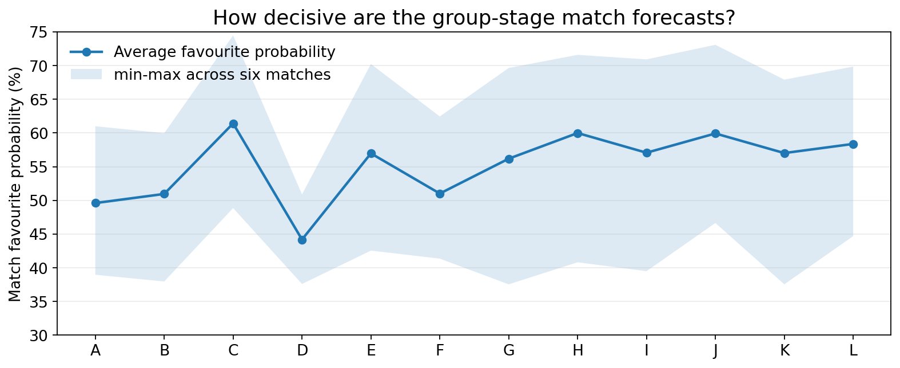
PREDICTIONS → MATCHES
Game-by-game forecasting: every group match becomes a probability distribution
Example: Group D match picks
USA vs Paraguay: USA 49.7%
USA vs Australia: USA 50.9%
USA vs Türkiye: USA 46.3%
Paraguay vs Australia: Paraguay 37.6%
Paraguay vs Türkiye: Türkiye 39.7%
Australia vs Türkiye: Türkiye 40.9%
Tool output shape
Agent engineering concept
forecast_match("USA", "Australia")
→ {
p_team_a_win: 0.5088,
p_draw: 0.2099,
p_team_b_win: 0.2813,
citations: ["SRC-SAMPLE-TEAM-PRIORS",
"MODEL-FORECAST-VAR-V1"]
}
A sport agent should never collapse a match to a single deterministic winner. It should return a structured probability distribution plus the model and data sources that produced it.
Demo priors, educational simulator — not betting advice · Photo: Hossein Zohrevand / CC BY 4.0 / Wikimedia Commons; cropped + darkened
AI Reality Lab · Forecast VAR

Slide 6

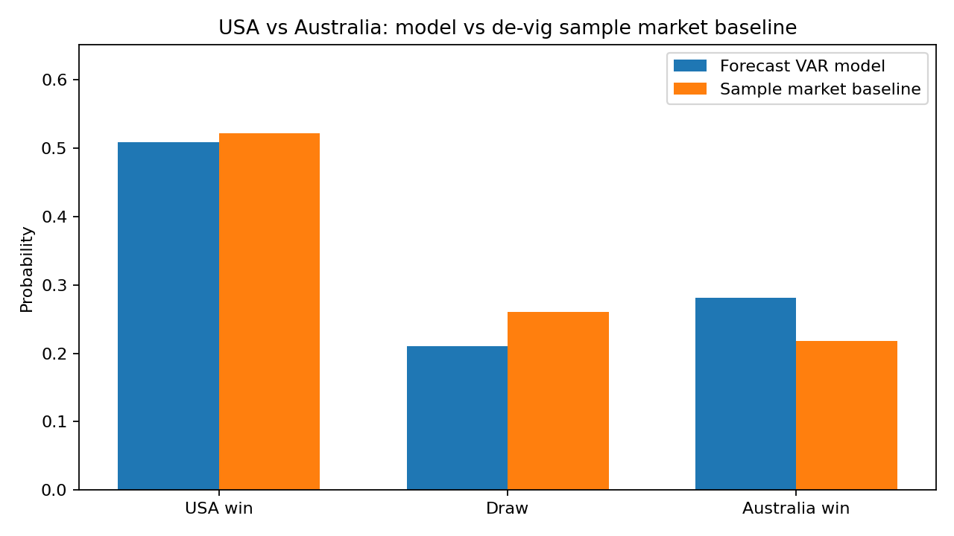
FORECAST VAR
Group D example: model forecast vs market baseline
Example: USA vs. Australia
The agent compares two different probability sources:
1. Forecast model
Uses bundled team priors and match features.
USA 50.9% · Draw 21.0% · Australia 28.1%
2. Market baseline
Takes bundled demo odds: 1.82 / 3.65 / 4.35, (as_of_utc: 2026-05-16T00:00:00Z, source_id: SRC-SAMPLE-MARKET-ODDS)
then de-vigs them by removing bookmaker margin.
USA 52.2% · Draw 26.0% · Australia 21.8%
What changes?
The market baseline is slightly higher on USA (+1.3 pts)
and lower on Australia (-6.3 pts). The agent reports the
difference, but does not turn it into a betting recommendation.
MCP tool
Claim contract
extract_market_baseline("USA", "Australia")
→ { market_p_team_a_win, market_p_draw, market_p_team_b_win, bookmaker_margin }
model_output: Forecast VAR probability from team priors
market_baseline: de-vigged probability from bundled demo odds
guardrail: disclose timestamp, margin, source, and “not betting advice”
Demo priors, educational simulator — not betting advice · Photo: Alimohammed11 / CC BY 4.0 / Wikimedia Commons; cropped + darkened
AI Reality Lab · Forecast VAR

Slide 7
ARCHITECTURE
The key design choice: the LLM is not the forecasting model
USER
AGENT
PROTOCOL
ENGINE
VAR
Question
gpt-5.4-nano
MCP tools
Python simulator
Verifier + eval
What gpt-5.4-nano does
What Python tools do
• Route the question
• Select skills
• Call MCP tools
• Explain source status
• Format structured claims
• Refuse fake certainty
• Validate the field
• Retrieve source cards
• Compute match probabilities
• Run group simulations
• Run Monte Carlo tournaments
• Verify claim support
The model presents the forecast. The tools calculate it. The harness checks it.
Demo priors, educational simulator — not betting advice · Photo: Troutfarm27 / CC BY-SA 4.0 / Wikimedia Commons; cropped + darkened
AI Reality Lab · Forecast VAR

Slide 8
PIPELINE
Full technical map: 14-step walkthrough grouped into seven runtime layers
1
2
3
4
5
6–11
12–14
Source registry
Pre-flight
RAG
Skills
MCP
Forecast tools
Output + QA
Source registry
Pre-flight
Allowed sources, statuses, demo/live policy, adapter slots.
Validate field, feature rows, and evidence before retrieval or forecasting.
RAG
Skills
Retrieve source cards after pre-flight passes; evidence is candidate support.
Procedures for source triage, forecast modelling, uncertainty, and eval review.
Forecast tools
Output + claims
Grounding split, match model, group simulation, Monte Carlo, rolling state.
Structured answer with typed claims, citations, warnings, abstention, metadata.
Eval + live path
Verifier and harness score support; live mode reuses the same contract.
Demo priors, educational simulator — not betting advice · Photo: Troutfarm27 / CC BY-SA 4.0 / Wikimedia Commons; cropped + darkened
AI Reality Lab · Forecast VAR

Slide 9

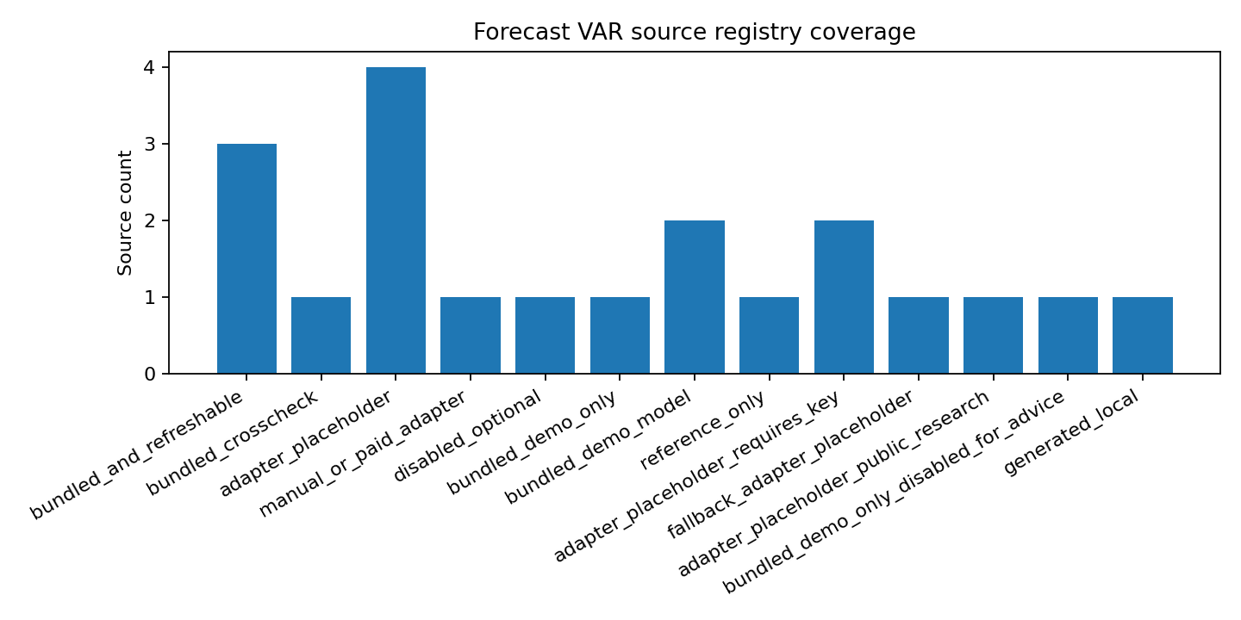
FORECAST VAR
Step 1 — Source registry: the agent must say what it is allowed to know
source_registry.json
{
"source_id": "SRC-SAMPLE-TEAM-PRIORS",
"status": "bundled_demo_only",
"adds": ["strength_rating", "travel_load"],
"forecast_use": ["match", "group", "simulation"]
}
Agent concept: source governance
The source registry is just the agent’s “allowed ingredients” list.
Example: USA vs Australia odds
It says:
• We can use this bundled odds file
• It is only demo data
• It is good enough for showing how model-vs-market comparison works
• It should not be described as live odds
So the agent can say:
“Using the demo odds row, the market-style baseline is USA 52.2%, draw 26.0%, Australia 21.8%.”
But it should not say:
“Bookmakers currently think USA will win.”
That’s the whole governance idea:
before the agent uses a source, it checks what that source is allowed to mean, and if it is allowed to be used at all.
Demo priors, educational simulator — not betting advice
AI Reality Lab · Forecast VAR

Slide 10
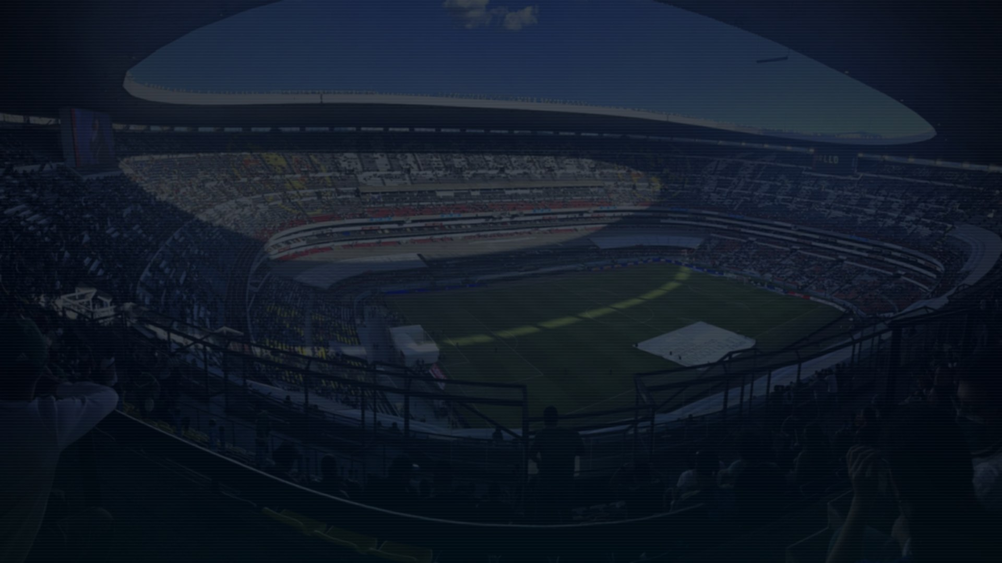
FORECAST VAR
Step 2 — Pre-flight gate: validate before RAG, tools, or forecasts
src/forecast_var/tools.py
def preflight_forecast_context():
validation = validate_tournament_field()
missing = teams - feature_rows
extra = feature_rows - teams
ready = validation["valid"] and not missing and evidence_count > 0
return {"ready_for_forecast": ready, ...}
Output format
ready_for_forecast: true
field_valid: true
teams: 48
feature_rows: 48
evidence_docs: 73
Demo priors, educational simulator — not betting advice · Photo: Alejan98 / CC0 / Wikimedia Commons; cropped + darkened
AI Reality Lab · Forecast VAR

Slide 11

FORECAST VAR
Step 3 — RAG: retrieve source cards after pre-flight passes
RAG tool
source_cards.jsonl
def search_source_cards(query, k=5):
cards = token_overlap_search(query, k=k)
return {
"query": query,
"candidate_evidence": cards,
"citations": [c["citation_id"] for c in cards],
"warning": "Retrieval is not validation."
}
{
"query": "Compare USA vs Australia model and market baseline",
"candidate_evidence": [
{
"id": "TEAM-USA",
"title": "Demo team feature profile: USA",
"supports": ["model_input", "team_strength_input"]
},
{
"id": "TEAM-Australia",
"title": "Demo team feature profile: Australia",
"supports": ["model_input", "team_strength_input"]
},
{
"id": "MARKET-G-D-USA-AUS",
"title": "Demo market baseline: USA vs Australia",
"supports": ["market_baseline"]
}
],
"warning": "retrieval is not validation"
}
Agent concept: retrieval is not enough
Example query:
“Compare USA vs Australia model and market baseline.”
RAG may retrieve:
• USA team feature row
• Australia team feature row
• bundled demo odds row
• market-baseline policy note
What RAG does:
• finds relevant source snippets
• gives the agent citation handles
• narrows the context window
What RAG does not do:
• prove the answer is correct
• check claim type
• decide whether a model probability is factual
Takeaway
RAG brings possible receipts into the room.
Grounding and verification decide whether those receipts actually support the claim.
Demo priors, educational simulator — not betting advice · Photo: ArmieVas / CC0 / Wikimedia Commons; cropped + darkened
AI Reality Lab · Forecast VAR

Slide 12

FORECAST VAR
Step 4 — Skills: procedural memory for a safer football forecaster
SKILL.md example
Why skills matter
---
name: forecast-modeling
description: use deterministic forecasting tools instead of free-form guessing. use when the user asks for match probabilities, favourites, winners, group forecasts, rankings, monte carlo simulations, rolling forecasts, or model explanations.
---
1. Call the narrowest MCP forecast tool.
2. Report probabilities, not deterministic winners.
3. Label bundled priors as demo inputs.
Skills are not data. They are compact instructions loaded when relevant.
In this project, skills enforce source triage, pre-flight checks, citation discipline, uncertainty calibration, Monte Carlo behaviour, and eval review.
skill
skill
skill
skill
skill
source triage
preflight
forecast model
uncertainty
eval review
Demo priors, educational simulator — not betting advice · Photo: Liondartois / CC BY-SA 4.0 / Wikimedia Commons; cropped + darkened
AI Reality Lab · Forecast VAR

Slide 13
FORECAST VAR
Step 5 — MCP: a strict tool boundary between the agent and the forecasting engine
MCP server tool
OpenAI live path
# mcp_servers/worldcup_forecast/server.py
@app.tool()
def simulate_tournament(sims: int = 3000,
seed: int = 2026,
limit: int = 12) -> dict:
return tools.simulate_tournament(
sims=sims, seed=seed, limit=limit
)
mcp = MCPServerStdio(
params={"command": "python", "args": ["mcp_servers/worldcup_forecast/server.py"]}
)
agent = Agent(
model=DEFAULT_OPENAI_MODEL,
mcp_servers=[mcp],
output_type=AgentAnswer,
)
Agent concept: tool contracts beat free-form guessing
MCP makes the tool list explicit, read-only, and inspectable. The agent can ask the simulator for probabilities; it cannot silently invent a source, mutate data, or claim to have run a tool it did not call.
Demo priors, educational simulator — not betting advice · Photo: Troutfarm27 / CC BY-SA 4.0 / Wikimedia Commons; cropped + darkened
AI Reality Lab · Forecast VAR

Slide 14

FORECAST VAR
Step 6 — Factual grounding vs model grounding: predictions are not facts
Factual grounding
Model grounding
Example claim:
“The tournament has 48 teams and 12 groups.”
Support required:
tournament_field, group_membership, qualified_team
Source type:
official field snapshot / cross-check
Example claim:
“Argentina has 21.7% champion probability.”
Support required:
model_input, model_logic, model_output, uncertainty
Source type:
features + simulator output
Typed claim
Verifier output
claim = {
"text": "Argentina is the top favourite under demo priors.",
"claim_type": "model_output",
"citation_ids": ["CITE-SRC-SAMPLE-TEAM-PRIORS", "CITE-MODEL-FORECAST-VAR-V1"]
}
verify_claims_against_sources(claims)
→ {
"source_support_precision": 1.0,
"support_class": "SUPPORTED_MODEL_DERIVED"
}
Demo priors, educational simulator — not betting advice · Photo: ProtoplasmaKid / CC BY-SA 4.0 / Wikimedia Commons; cropped + darkened
AI Reality Lab · Forecast VAR

Slide 15

FORECAST VAR
Step 7 — Match model: turn team inputs into a 1X2 probability distribution
src/forecast_var/forecast_model.py
Example output: USA vs Australia
def match_probabilities(team_a, team_b, scenario=None):
diff = adjusted_rating(team_a) - adjusted_rating(team_b)
p_a_no_draw = 1 / (1 + 10 ** (-diff / 420))
draw = bounded_draw_probability(diff)
p_a = (1 - draw) * p_a_no_draw
p_b = 1 - draw - p_a
return {"p_team_a_win": p_a,
"p_draw": draw,
"p_team_b_win": p_b}
USA win: 50.9%
Draw: 21.0%
Australia win: 28.1%
Inputs: strength rating, host advantage, travel-load proxy, optional scenario adjustments.
Agent concept
The LLM should not “feel” that a team will win. It should call a model tool, receive probabilities, then explain assumptions and limitations in natural language.
Demo priors, educational simulator — not betting advice · Photo: Hossein Zohrevand / CC BY 4.0 / Wikimedia Commons; cropped + darkened
AI Reality Lab · Forecast VAR

Slide 16
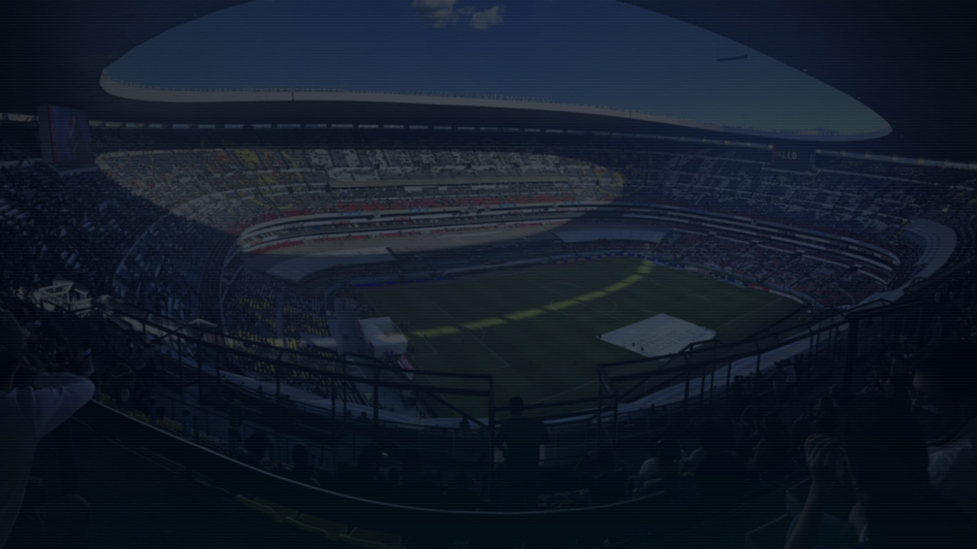
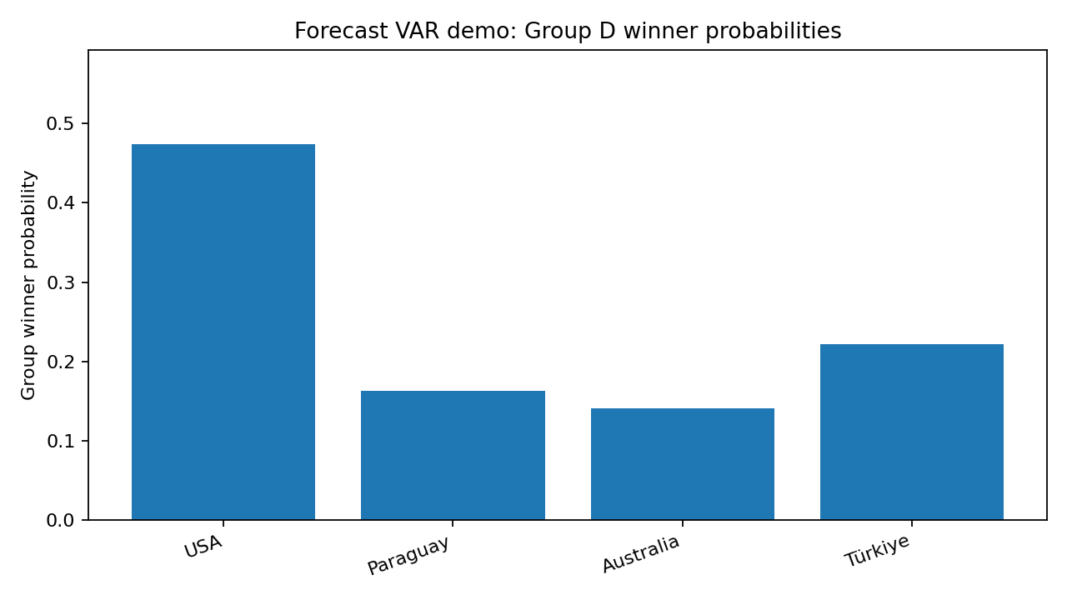
FORECAST VAR
Step 8 — Group simulation: six matches become winner/top-two probabilities
Group D output format
USA: winner 49.8% · top2 74.3%
Paraguay: winner 16.3% · top2 40.2%
Australia: winner 11.3% · top2 31.7%
Türkiye: winner 22.6% · top2 53.8%
This is generated by Monte Carlo group simulation over the six round-robin games.
MCP tool result shape
forecast_group("D", sims=5000) → { group, teams, group_probabilities: { team: { winner, top2, top3 } }, matchups, citations, warnings }
Demo priors, educational simulator — not betting advice · Photo: Alejan98 / CC0 / Wikimedia Commons; cropped + darkened
AI Reality Lab · Forecast VAR

Slide 17

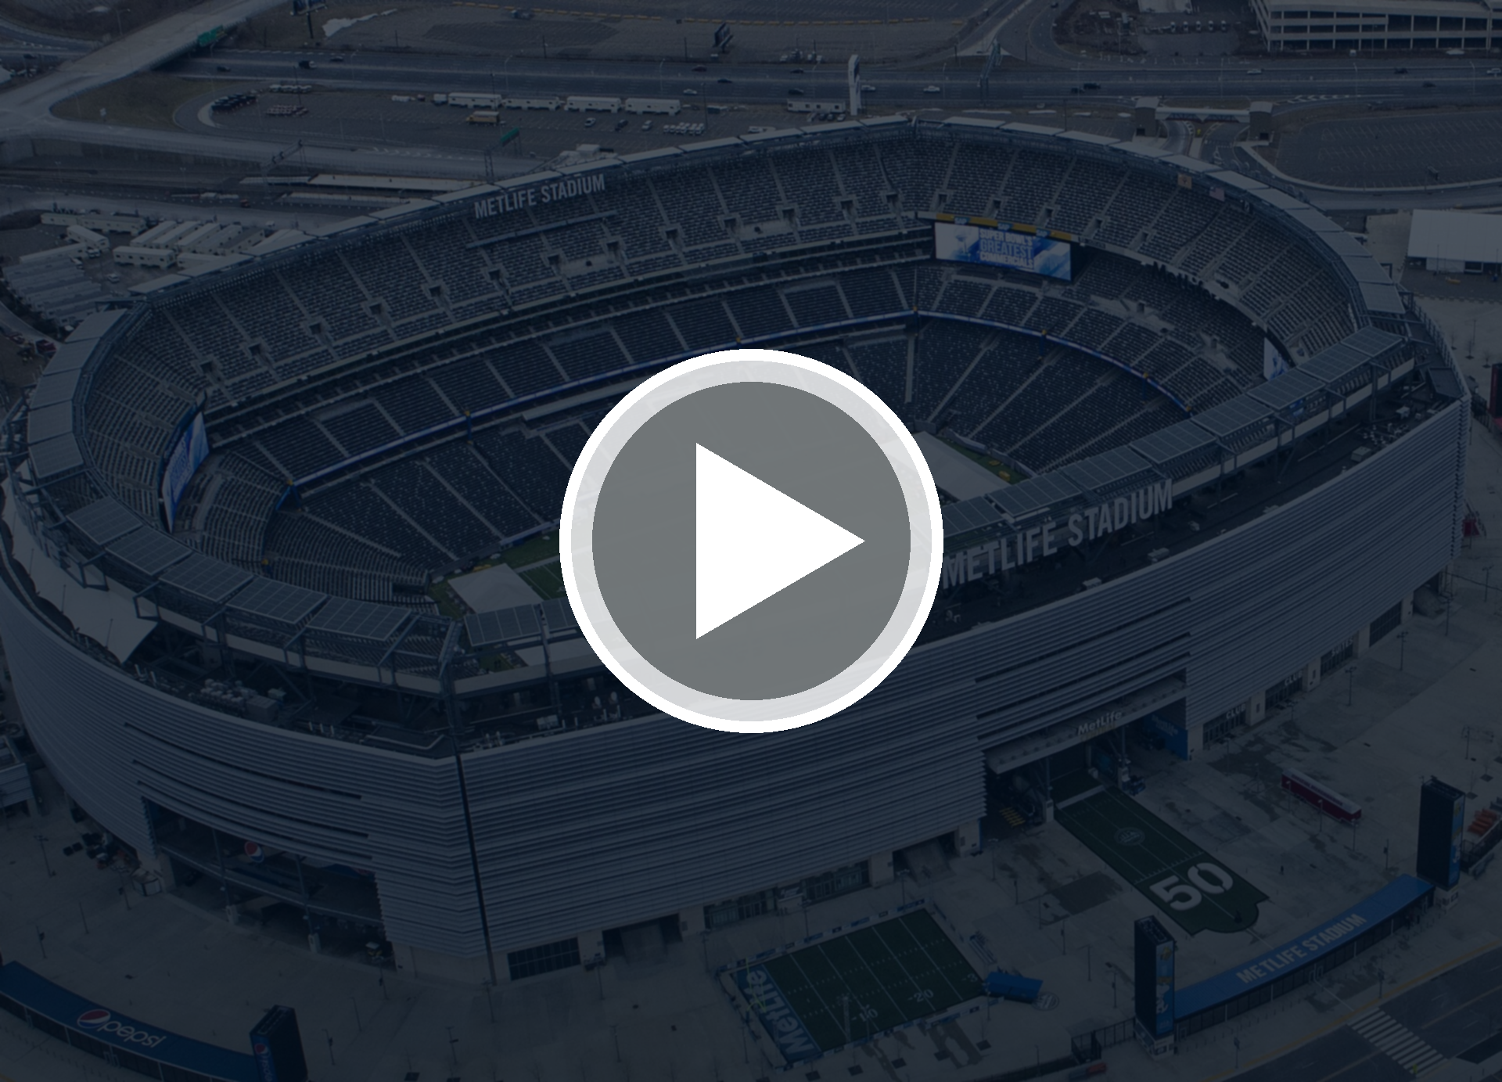
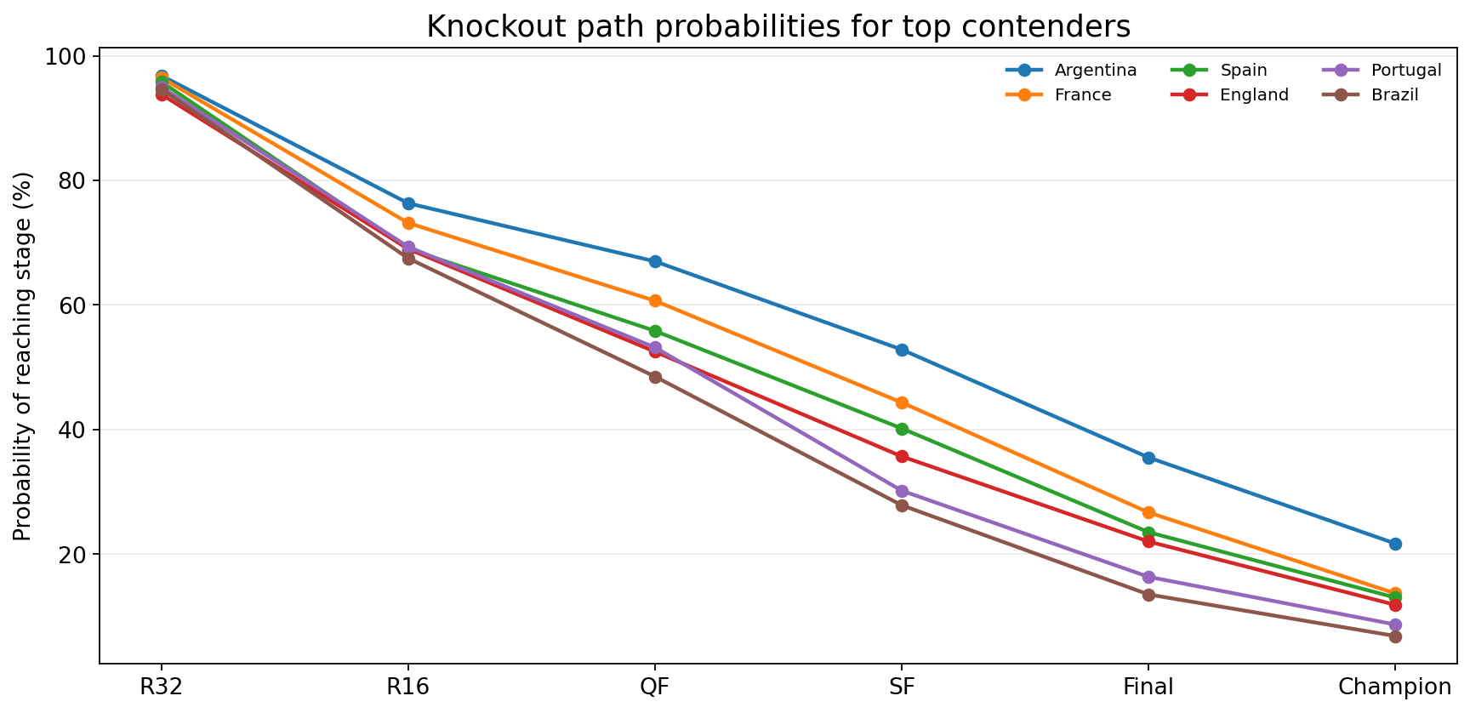
FORECAST VAR
Step 9 — Monte Carlo: thousands of possible tournaments, one probability table
Tool call
LLM vs simulator
simulate_tournament(sims=3000, seed=2026)
→ top_teams: [
{team, round32, round16, quarterfinal,
semifinal, final, champion}
]
gpt-5.4-nano decides to call the tool and explains the result. Python samples match outcomes and calculates probabilities.
Demo priors, educational simulator — not betting advice · Photo: Anthony Quintano from Hillsborough, NJ, United States / CC BY 2.0 / Wikimedia Commons; cropped + darkened
AI Reality Lab · Forecast VAR

Slide 18

FORECAST VAR
Step 10 — Rolling forecast: lock completed results, forecast only the unknown future
Input
Output after the locked result
rolling_group_forecast(
group="D",
completed_results=[
{"team_a":"USA", "team_b":"Australia", "team_a_goals":2, "team_b_goals":1}
]
)
USA: winner 68.2% · top2 90.6% · top3 99.1%
Türkiye: winner 17.4% · top2 53.6% · top3 81.8%
Paraguay: winner 12.8% · top2 40.3% · top3 76.9%
Australia: winner 1.6% · top2 15.5% · top3 42.2%
completed
lock
remove
simulate
return
result
points
played match
remaining games
updated odds
Agent concept
Rolling agents need state. A completed result must become a fixed input, not a scenario that the agent re-predicts.
Demo priors, educational simulator — not betting advice · Photo: Sebas / CC BY 3.0 / Wikimedia Commons; cropped + darkened
AI Reality Lab · Forecast VAR

Slide 19

FORECAST VAR
Step 11 — Source-aware upgrade: adapters turn the project into a living forecast system
Source refresh
Adapter slots
python scripts/refresh_sources.py
→ data/generated/evidence_index.jsonl
source cards 15 + team features 48 docs
market odds 7 + curated notes 3 docs
• API-Football: fixtures, odds, injuries, lineups
• football-data.org: matches, squads, standings
• TheSportsDB: fallback events/lineups
• StatsBomb: historical calibration
• Curated notes: manual high-signal context
Agent concept: freshness and coverage
Forecasts should carry data coverage metadata. A source-aware answer says what was used, what was missing, and whether the forecast is ready for public-facing use.
Demo priors, educational simulator — not betting advice · Photo: ArmieVas / CC0 / Wikimedia Commons; cropped + darkened
AI Reality Lab · Forecast VAR

Slide 20

FORECAST VAR
Step 12 — Structured output: make the answer machine-checkable
schemas.py
claim schema
class AgentAnswer(BaseModel):
answer: str
claims: list[ForecastClaim]
citations: list[Citation]
tools_used: list[str]
skills_used: list[str]
probabilities: dict[str, float]
abstained: bool = False
warnings: list[str]
metadata: dict[str, Any]
class ForecastClaim(BaseModel):
text: str
claim_type: ClaimType
citation_ids: list[str]
ClaimType includes field_fact, model_input,
model_output, market_baseline,
source_coverage, evidence_retrieval,
simulation_output, rolling_state,
scenario_assumption, uncertainty,
guardrail, source_policy, general.
Agent concept
The output schema is the bridge between natural language and evaluation. Without typed claims and citations, the evaluator can only judge the final text superficially.
Demo priors, educational simulator — not betting advice · Photo: roy_appleyard / CC BY-SA 2.0 / Wikimedia Commons; cropped + darkened
AI Reality Lab · Forecast VAR

Slide 21

FORECAST VAR
Step 13 — Evaluation harness: the VAR room for agent behaviour
What the harness checks
• tool_recall
• skill_recall
• preflight_recall
• citation_recall
• source_support_precision
• unsupported_claim_rate
• abstention_accuracy
• probability_sanity_rate
Eval command
PYTHONPATH=src python scripts/evaluate.py --mode grounded_mock → reports/summary_grounded_mock.json
Demo priors, educational simulator — not betting advice · Photo: ProtoplasmaKid / CC BY-SA 4.0 / Wikimedia Commons; cropped + darkened
AI Reality Lab · Forecast VAR

Slide 22
FORECAST VAR
Step 14 — Live OpenAI path: same contract, real agent model
Live example
What changes in live mode?
# src/forecast_var/config.py
DEFAULT_OPENAI_MODEL = "gpt-5.4-nano"
# Run live mode
export OPENAI_API_KEY="..."
PYTHONPATH=src python scripts/run_agent.py "Run a Monte Carlo tournament simulation" --mode openai
The agent model becomes gpt-5.4-nano.
Same sources, pre-flight, RAG, MCP tools, simulator, schema, and verifier.
same
same
same
new
same
sources
pre-flight + RAG
MCP tools
gpt-5.4-nano
schema + verifier
Demo priors, educational simulator — not betting advice · Photo: Troutfarm27 / CC BY-SA 4.0 / Wikimedia Commons; cropped + darkened
AI Reality Lab · Forecast VAR

Slide 23

FORECAST VAR
Reproducibility: every slide is backed by a notebook and project scripts
Commands
What the notebook contains
PYTHONPATH=src python scripts/validate_data.py
PYTHONPATH=src python scripts/refresh_sources.py
PYTHONPATH=src python scripts/generate_figures.py
PYTHONPATH=src python scripts/evaluate.py --mode grounded_mock
PYTHONPATH=src pytest -q
forecast_var_deck_experiments.executed.ipynb
• prediction tables
• group winners
• knockout probabilities
• match + market example
• rolling forecast state update
• source coverage
• eval metrics
• figures used in the deck
Demo priors, educational simulator — not betting advice · Photo: Anthony Quintano from Hillsborough, NJ, United States / CC BY 2.0 / Wikimedia Commons; cropped + darkened
AI Reality Lab · Forecast VAR

Slide 24

FORECAST VAR
Appendix: project map for viewers who want to run it themselves
data/facts/world_cup_2026_groups.json
mcp_servers/worldcup_forecast/server.py
canonical 48-team field and groups
local MCP stdio server
data/facts/source_cards.jsonl
src/forecast_var/forecast_model.py
lightweight RAG corpus with support labels
match and group probability model
data/sources/sample_team_features.csv
src/forecast_var/tournament_sim.py
demo team priors for the model
Monte Carlo and rolling simulations
data/generated/evidence_index.jsonl
src/forecast_var/openai_agent.py
generated evidence index
live OpenAI Agents SDK path
.agents/skills/*/SKILL.md
src/forecast_var/eval_harness.py
procedural agent skills
agent evaluation metrics
Demo priors, educational simulator — not betting advice · Photo: ArmieVas / CC0 / Wikimedia Commons; cropped + darkened
AI Reality Lab · Forecast VAR

Slide 25

Forecast VAR
The World Cup forecast is the bait. The real lesson is how to engineer prediction agents that can be audited.
Sport drama
Agent engineering
Trust layer
Group winners, knockout paths, champion probabilities.
Source registry, pre-flight, RAG, skills, MCP, deterministic tools.
Claim verification, eval harness, uncertainty and abstention.
No fake certainty. No hidden sources. No vibes-based champion.
Demo priors, educational simulator — not betting advice · Photo: Hossein Zohrevand / CC BY 4.0 / Wikimedia Commons; cropped + darkened
AI Reality Lab · Forecast VAR

