Slide 1
RBI Sectoral Credit & Portfolio Risk Analytics
An End-to-End Data Engineering Case Study (2018 - 2026)
Prepared by: Mona Jasuja Target Domain: Commercial Credit Risk & Strategic Analytics

Slide 2
Core Portfolio Insights & Core Findings
Key Portfolio Observations
• The 2026 Credit Squeeze: Data reveals a clear deceleration in total volume growth entering the final 2026 economic reporting frame.
• Lending Criteria Tightening: The sudden velocity contraction suggests a macro-level restriction of bank lending criteria across key heavy industrial segments.
• Portfolio Risk Concentration: The top 10 market drivers control a massive percentage of overall volume, increasing exposure to systemic shocks.
Strategic Risk Implications
• Priority Lending Resilience: While commercial sectors flatlined, Priority Sector Lending (PSL) including housing remained highly resilient.
• Regulatory Segment Shifting: Financial institutions shifted asset concentrations heavily toward mandated segments to preserve credit quality.
• Strategic Risk Tracking: Implementing dynamic cohort filters allows risk managers to actively flag volatile industry transitions early.

Slide 3
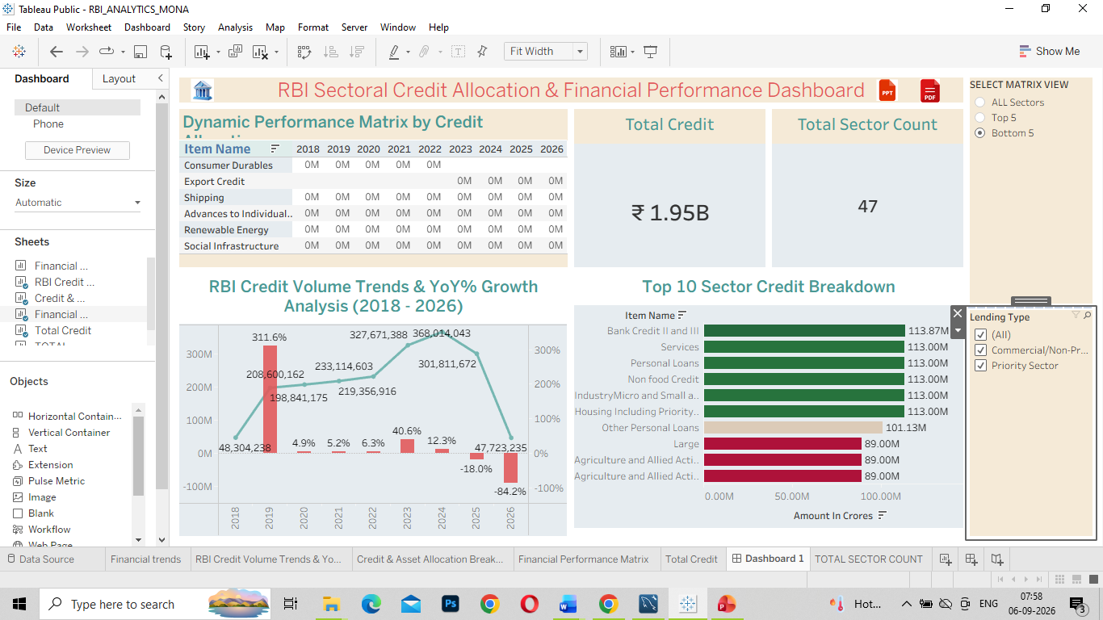

Slide 4
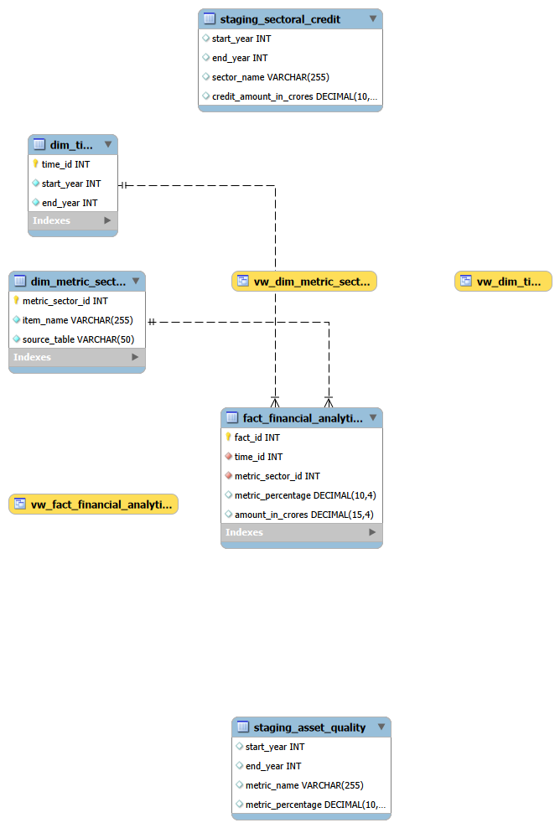

Slide 5
KPI Queries in MySQL
USE rbi_analytics;
#Query 1: Macro Credit Volume Trends & YoY% Growth Analysis
select * from dim_time;
select * from fact_financial_analytics;
select
*,CONCAT(ROUND((current_yr_credit-previous_yr_credit)/previous_yr_credit*100,1),"%") as yoy
from(
with T1 as(
select
t.start_year as yr,sum(f.amount_in_crores)as current_yr_credit
from dim_time as t
join fact_financial_analytics as f
on t.time_id=f.time_id
where amount_in_crores is not NULL
group by 1)
select
yr,current_yr_credit,lag(current_yr_credit)over(order by yr asc)as previous_yr_credit
from T1)T2
# Query 2: Top 10 Sector Credit Breakdown
select * from dim_metric_sector;
select * from fact_financial_analytics;
with T1 as(
select
ms.item_name as sector,sum(f.amount_in_crores)as credit_amount
from dim_metric_sector as ms
join
fact_financial_analytics as f
on ms.metric_sector_id=f.metric_sector_id
where f.amount_in_crores is not NULL
group by 1
order by 2 desc)
select sector,
case when credit_amount>=1000000
then concat(round(credit_amount/1000000,2),"M")
end as credit_amount_in_millions
from T1;

Slide 6
KPI Queries in MySQL
# Query 3: Dynamic Performance Matrix
#stored procedure to get the top N values as per the user's requirement
DELIMITER $$
CREATE DEFINER=`root`@`localhost` PROCEDURE `dynamic_performance_metric_by credit`(IN c1 INT)
BEGIN
-- Stage 1: Grouping credit by sector and year
WITH T1 AS (
SELECT
t.start_year AS yr,ms.item_name AS sector,
SUM(f.amount_in_crores) AS total_credit
FROM dim_metric_sector AS ms
INNER JOIN fact_financial_analytics AS f ON ms.metric_sector_id = f.metric_sector_id
INNER JOIN dim_time AS t ON f.time_id = t.time_id
WHERE f.amount_in_crores IS NOT NULL
GROUP BY t.start_year, ms.item_name
),
-- Stage 2: rank
T2 AS (
SELECT
yr, sector,total_credit,
DENSE_RANK() OVER (PARTITION BY yr ORDER BY total_credit DESC) AS rnk
FROM T1
)
-- Stage 3:display the specific rank requested by the parameter (c1)
SELECT
yr,sector, total_credit, rnk
FROM T2
WHERE rnk = c1
ORDER BY yr ASC, total_credit DESC;
END $$
DELIMITER ;

Slide 7
KPI-TOTAL CREDIT & COUNT OF SECTORS
#Query 4:TOTAL CREDIT KPI
select concat(round(sum( amount_in_crores)/1000000000,2),"B")as total_credit from fact_financial_analytics;
#Query 5: #total count of sectors
select distinct count(item_name)as total_sectors from dim_metric_sector;

Slide 8
Full-Stack Data Engineering Pipeline Architecture
Data Pipeline Summary
✔ Database Layer (MySQL): Normalized raw unstructured files into a clean relational Star Schema modeling platform consisting of dedicated Fact and Dimension tables.
✔ Backend Optimization (ETL): Structured custom SQL Views and automated Stored Procedures using parameter loops to pre-compute core KPIs and pivot year columns on the server side.
✔ Business Governance (BRD): Established business definitions and strict tracking criteria inside a formal requirement framework prior to database build.
✔ Business Intelligence UI (Tableau): Connected directly to database view extracts to build a continuous, interactive timeline dashboard featuring advanced cohort filter parameters.

