Slide 3
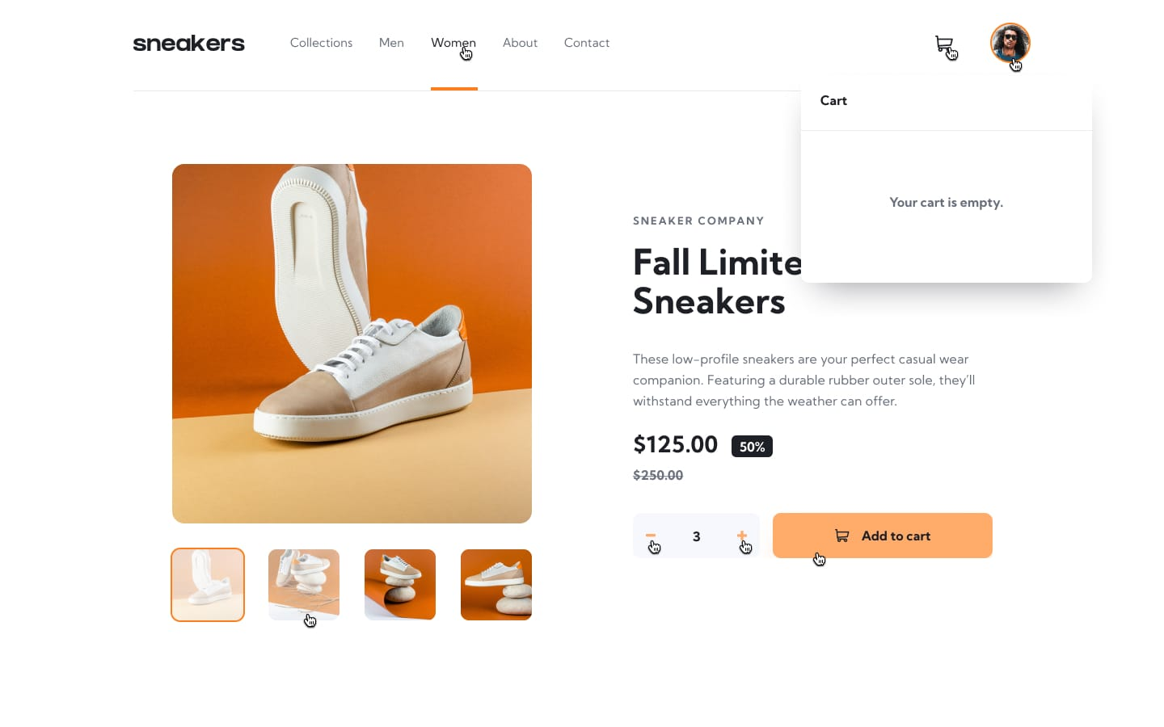

Slide 4

if we look at the header we will noice that
the header is divided into two main sections separated by a space between them

Slide 5
each of the two sections is divided into two other sections

Slide 6
let’s draw our schema
header
left-section
right-section
logo
links
cart
avatar

Slide 7
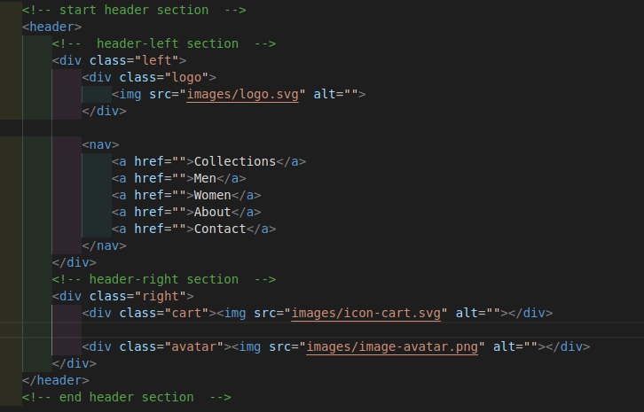
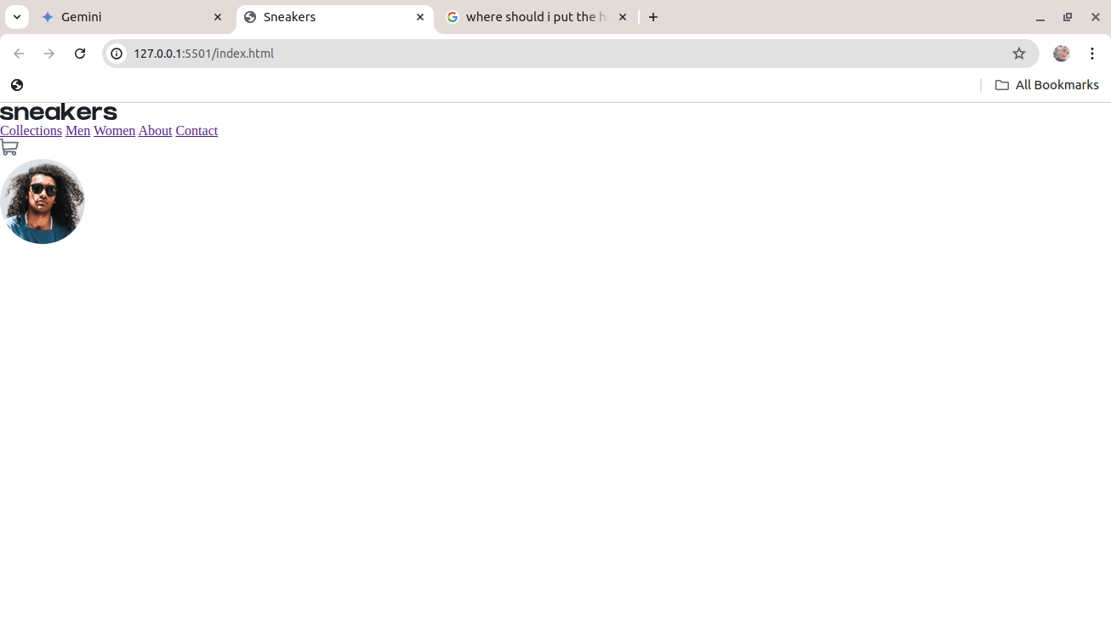
the HTML code of the header:

Slide 8
adding the css code to style the header

Slide 9
