Slide 1
Spring Framework
Presented by:
Pinki Patel, Jeffy Poozhithara, Monali Chandurkar

Slide 2
What is Spring Framework
Most popular application development framework for enterprise java.
Open source Java platform since 2003.
Supports all major application servers and JEE standards.
Inversion of control and dependency injection control container for the Java platform.
Handles the infrastructure so you can focus on your application

Slide 3
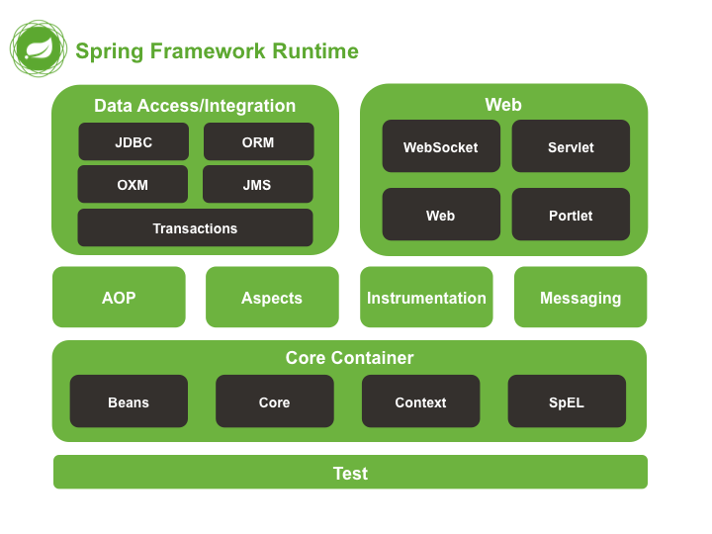
SPRING FRAMEWORK HIGH-LEVEL ARCHITECTURE

Slide 4
Implementation Details
3 Components Implemented
AnyPoolCachingSessionFactory
DynamicSessionFactory
PoolConnectionFactory
Programming Language of Implementation: Java

Slide 5
Functional/Non-Functional Requirements Implemented
Functional Requirements:
Should be capable of adding/removing multiple SFTP connections at runtime
It should be able to pool multiple TCP connections and sessions/consumers/producers such that high load systems using the framework have better throughPut
Non-Functional Requirements:
Extensibility/Flexibility
Reusability
Maintainability

Slide 6
AnyPoolCachingSessionFactory Class

Slide 7
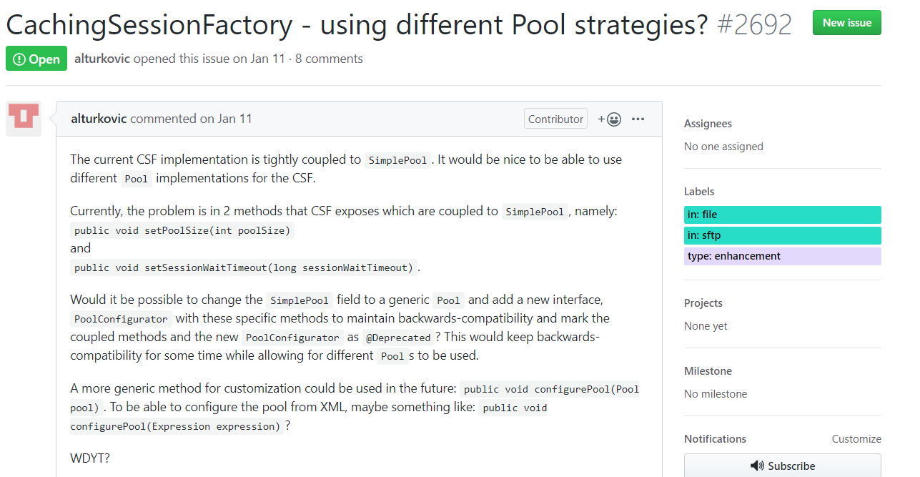
Motivation

Slide 8
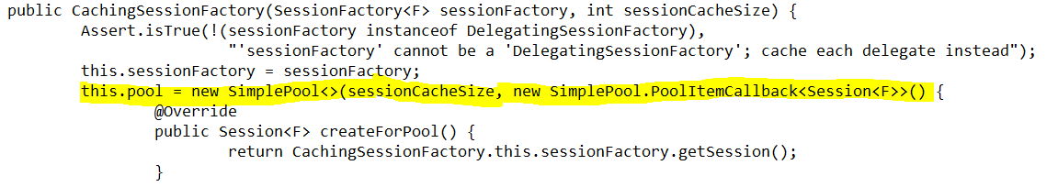
Issues of CachingSessionFactory Class
Tight coupling between SimplePool class and CachingSessionFactory

Slide 9
Issues of CachingSessionFactory Class
Violates Principal Design Decisions:
extensibility
provide choice at every level
loose coupling

Slide 10
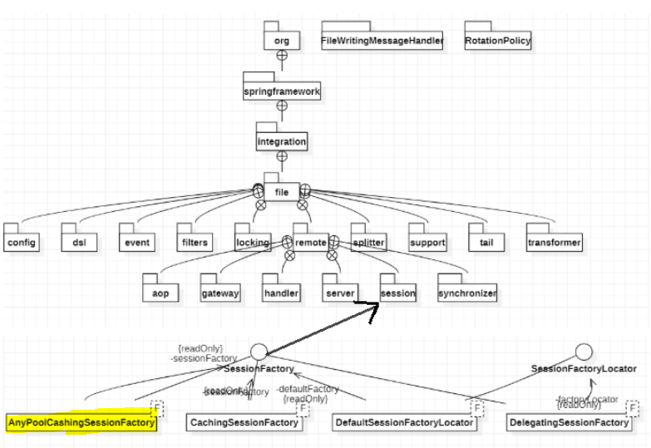
Architecture Diagram with Change

Slide 11
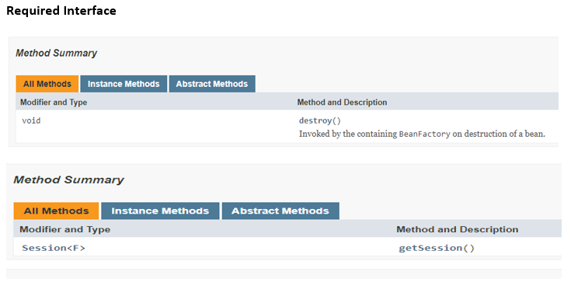
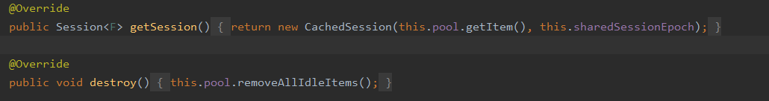
Required Interfaces

Slide 12
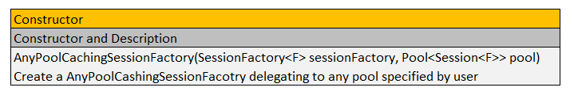
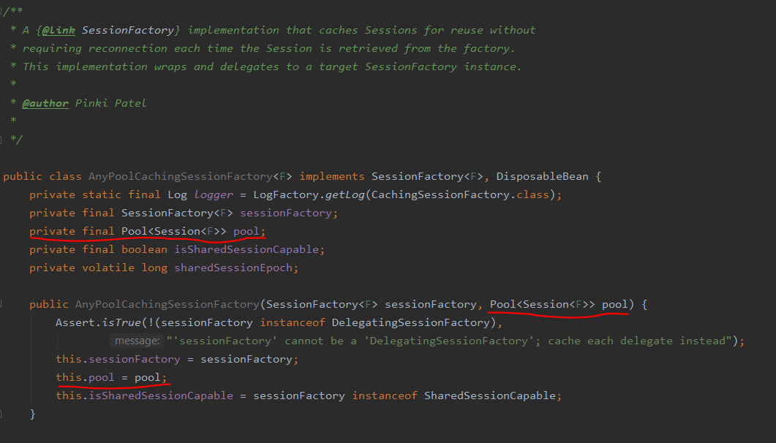
Constructors

Slide 13
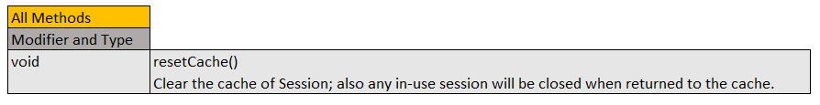
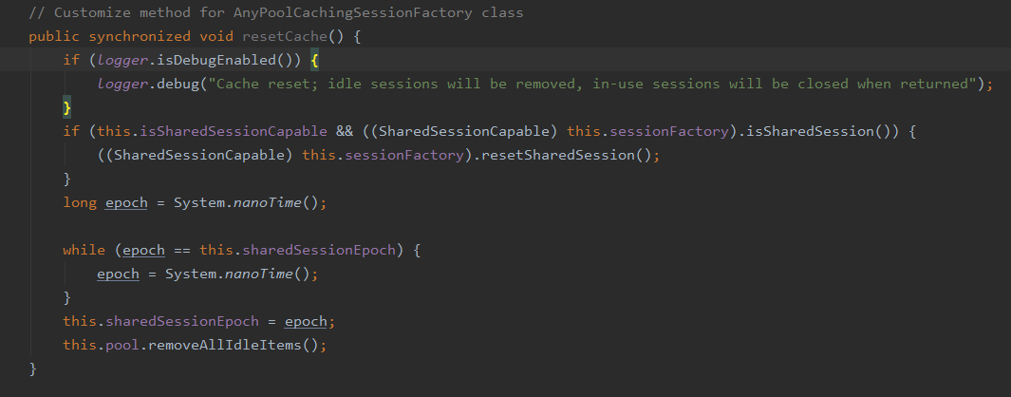
Provided Interface

Slide 14
Consistency with PDD/NFP
AnyPoolCashingSessionFactory class will only have methods to manage session in the pool and that can extend to any pool implementation. Methods such as setPoolSize and setTestSession will not be part of AnyPoolCashingSessionFactory class since they are more pool specific than Session.
Also, addition of this components resonates with the following principal design decisions and NFP:
Provide choice at every level
Extensibility
loose coupling

Slide 15
PoolConnectionFactory

Slide 16
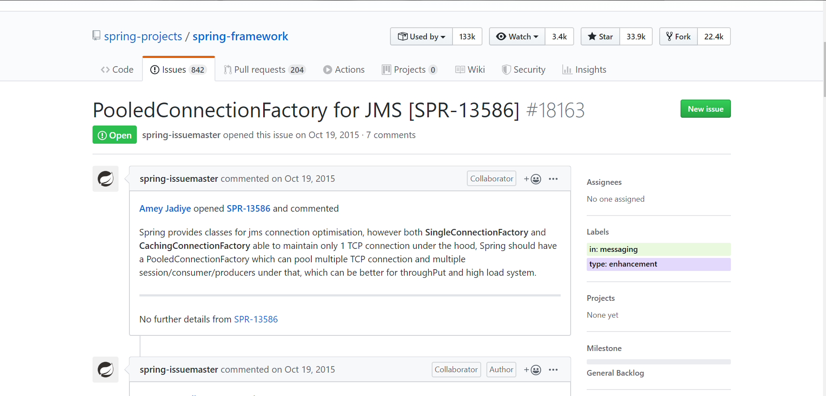
Motivation

Slide 17
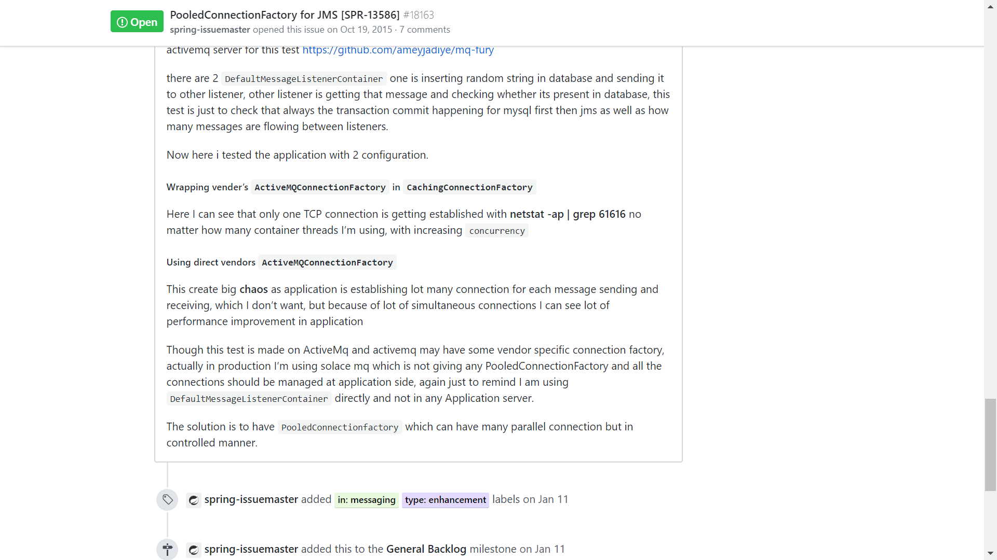
Motivation (..Continued)

Slide 18
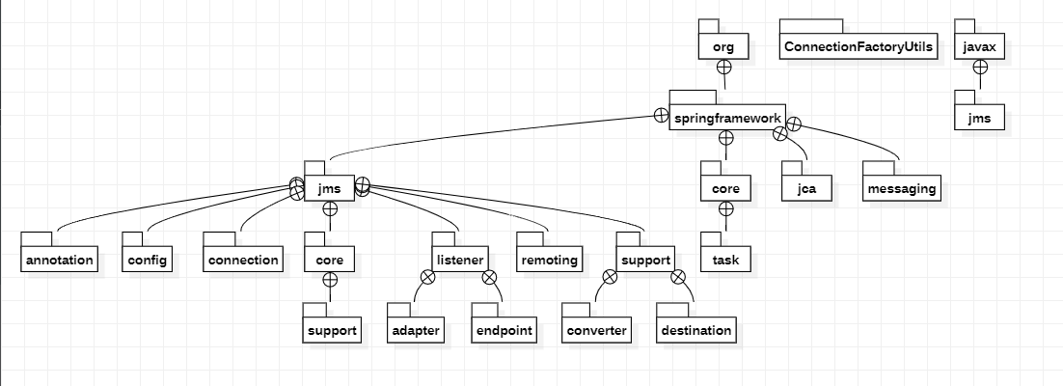
High Level Architecture of Spring-JMS

Slide 19
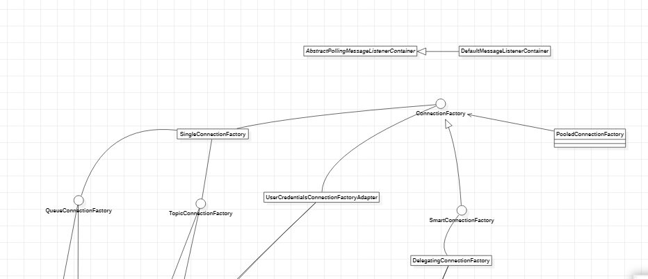
Architecture Diagram with Change

Slide 20
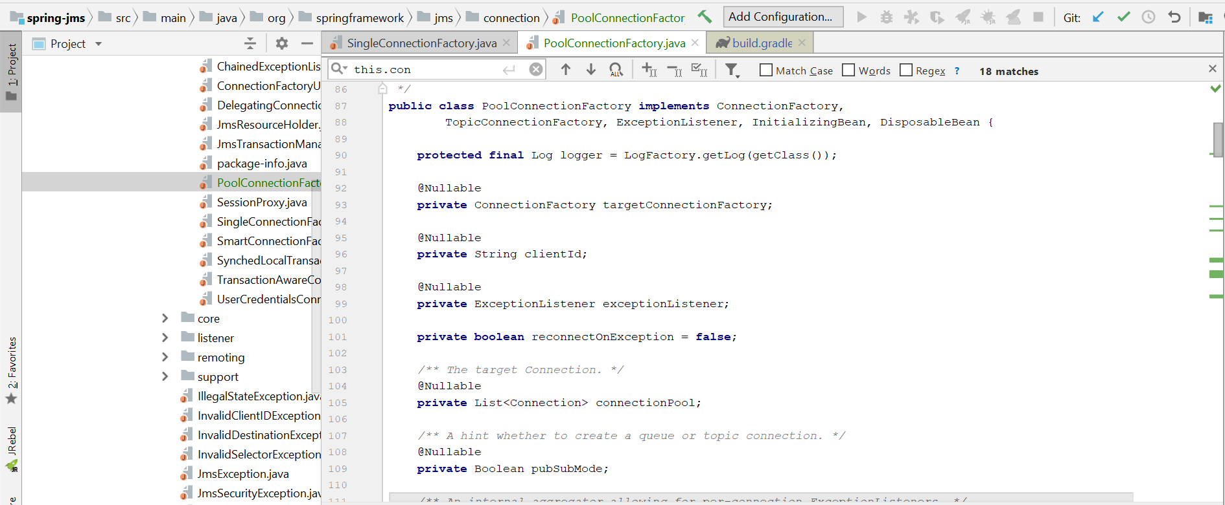
Implementation

Slide 21
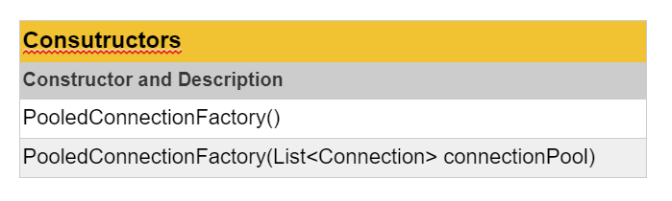
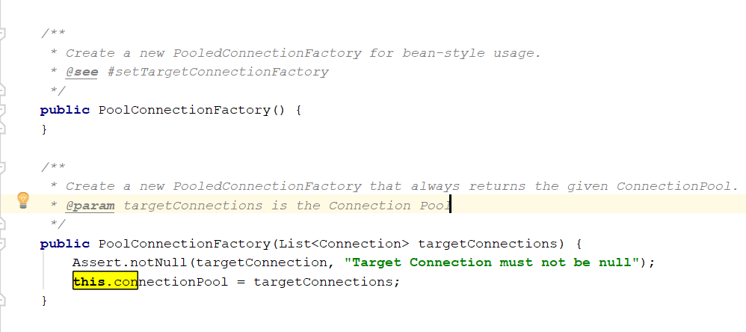
Constructors

Slide 22
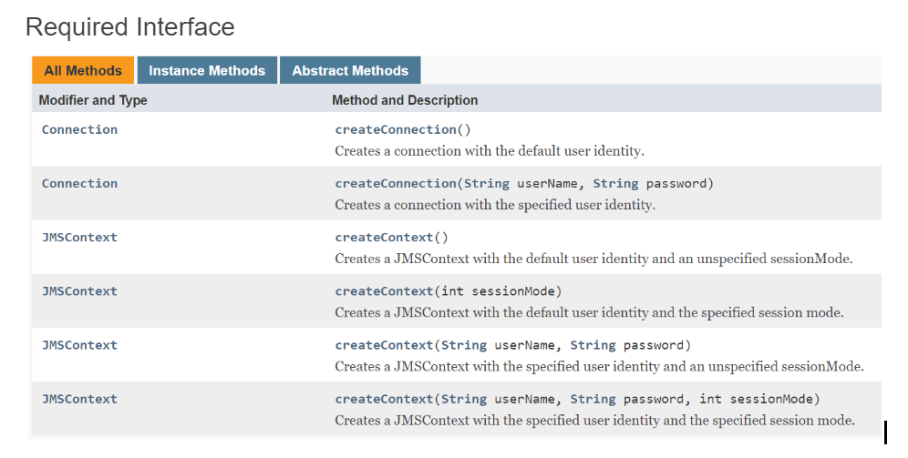
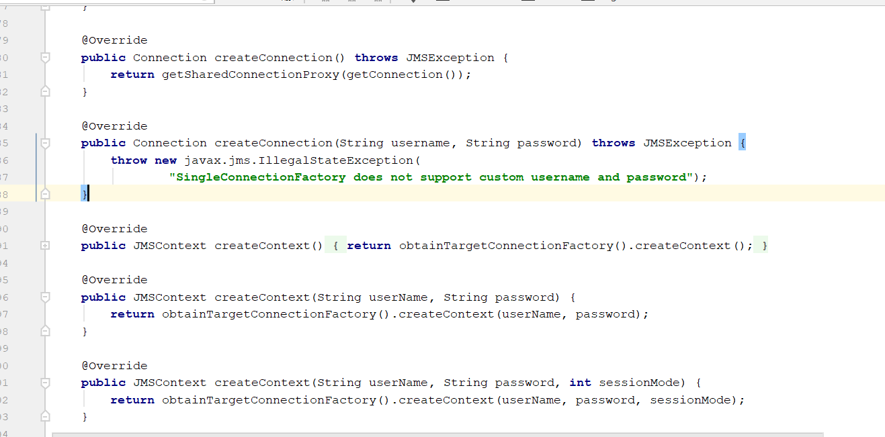
Required Interfaces

Slide 23
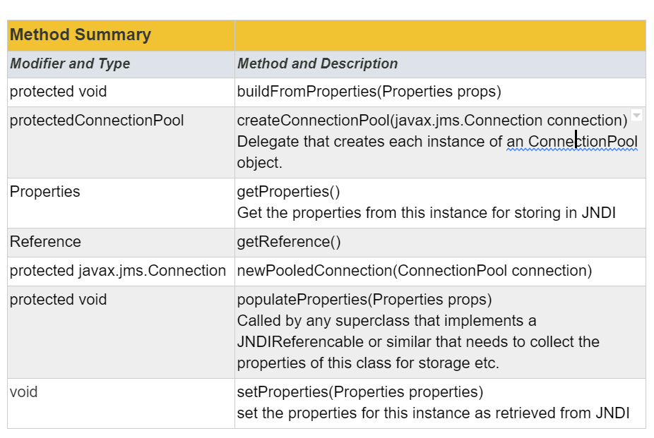
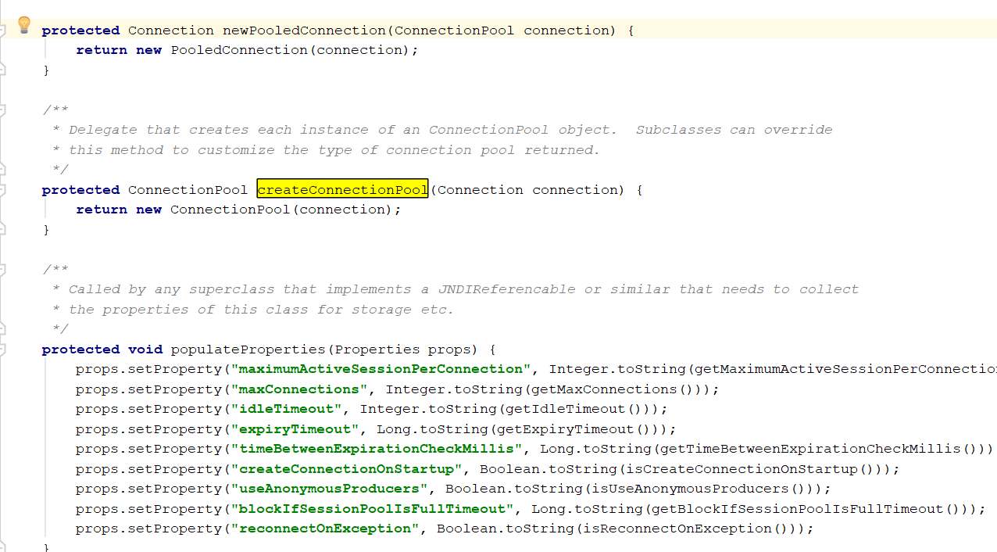
Provided Interface

Slide 24
Consistency with PDD/NFP
For performance many JMS applications that are not being deployed on EE servers choose to have only org.springframework.jms.listener.DefaultMessageListenerContainer which is lightweight. In such scenarios they also expect a PooledConnectionFactory which can give a better throughput.
Also, addition of this components resonates with the following principal design decisions
Provide choice at every level
Separation of Concerns
Promote reuse and portability

Slide 25
DynamicSessionFactory Class

Slide 26
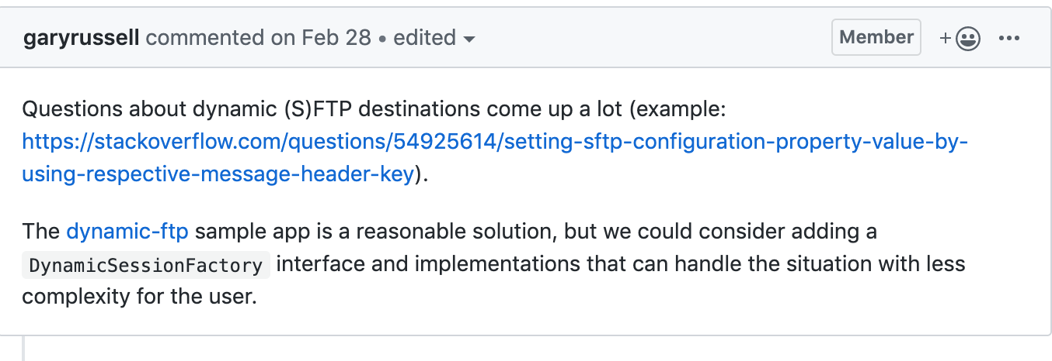
Motivation

Slide 27
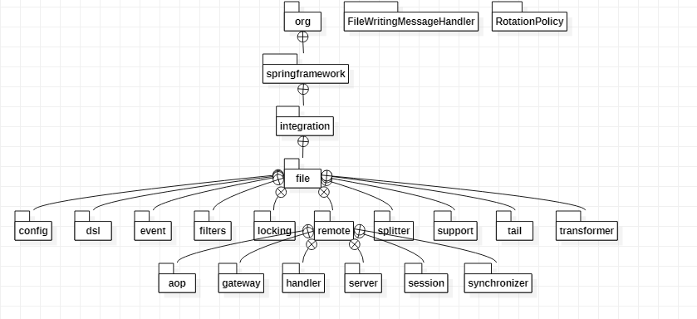
HIGH LEVEL ARCHITECTURE OF SPRING-INTEGRATION

Slide 28
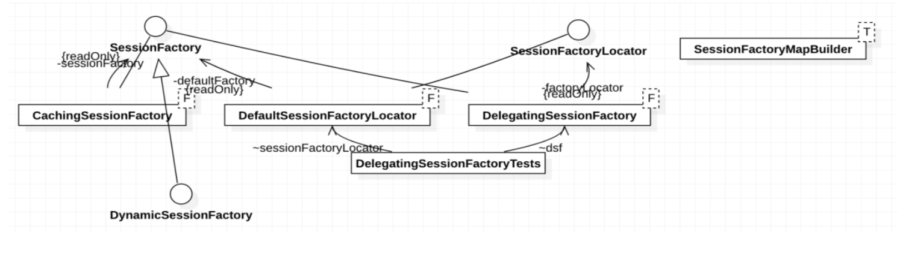
Architecture Diagram with Change

Slide 29
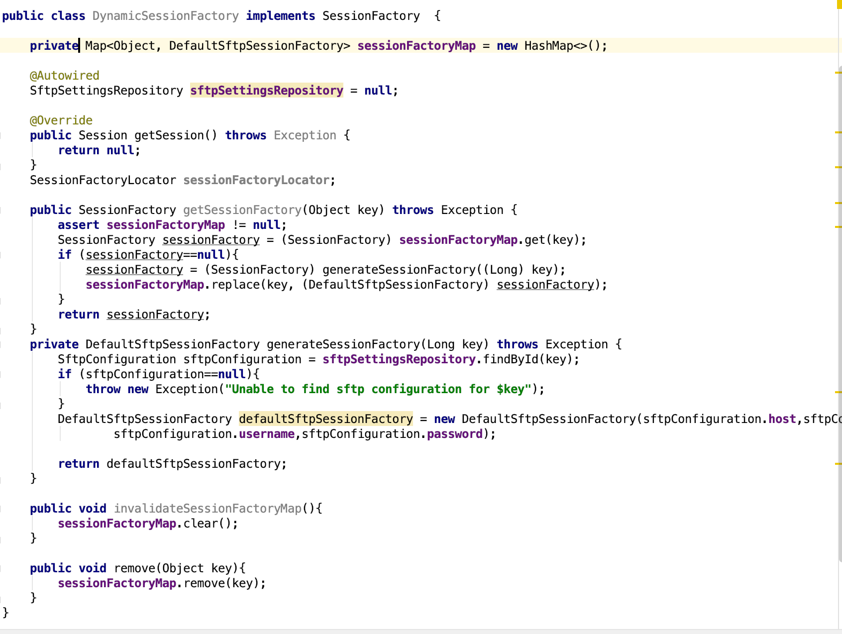
Implementation

Slide 30
Consistency with PDD/NFP
It supports following NFP’s
Extensibility/Flexibility
Maintainability

Slide 31
Challenges
Gradle enterprise plugin required for one of the project dependencies (build-scan). Pending manual approval
Large code base -> Reverse engineering tools took longer time to parse entire codes
Testing the implementation is only possible by using an external project that uses the spring-framework dependency

Slide 32
Remaining Tasks
Deploy example project that uses spring-integration and spring-jms in tomcat to monitor session creation and tcp connection creation
build-scan execution with gradle enterprise plugin
Debug and Refine Implementation
Submit implementation on official git repository of spring-framework

Slide 33
Reflection
Learning Curve
Understood one of the most widely used frameworks
Familiarised reverse engineering tools
Got the confidence to contribute to a popular open source project
Approach in Future Software Design Projects
For extending an existing architecture, understand intended architecture before implementation
Evaluate architecture degradation
For a design from scratch, finalise principal design decisions and document them with reasons

Slide 34
Thank you. Questions?

Slide 35
Principal Design Decisions (PDD)
Inversion of Control (IOC)
Provide Choice at every level
Accommodate diverse perspectives
Maintain strong backward compatibility
Don’t Repeat Yourself(DRY)

Slide 36
Principal Design Decisions (PDD)
Components should be loosely coupled for modularity and testability
Separation of concerns
Promote reuse and portability

Slide 37
CachingSessionFactory Class
A SessionFactory implementation that caches Sessions for reuse without requiring reconnection each time the Session is retrieved from the factory. This implementation wraps and delegates to a target SessionFactory instance.
Path: org.springframework.integration.file.remote.session

Slide 38
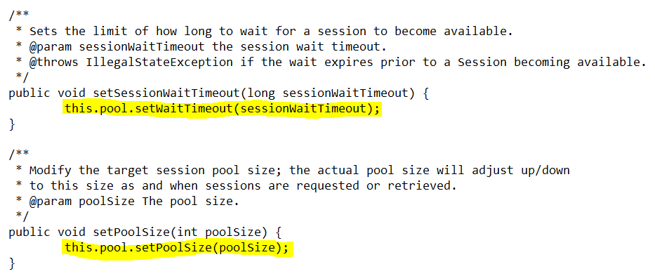
Issues of CachingSessionFactory Class

