Slide 1
welcome

Slide 2
Name : Rakhi Dipak Lokhande
Department : Physics
Sem : Msc3rd

Slide 3
TOPIC :
X-Ray Diffraction:

Slide 4
Content :
INTRODUCTION
GENERATION OF X-RAYS
PRINCIPLE
INSTRUMENTATION
METHODS
APPLICATION
CONCLUSIONS
REFERENCE

Slide 5
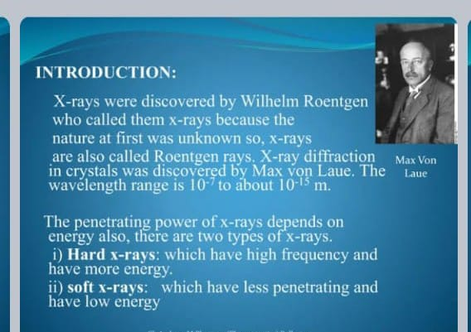
INTROUCTION:

Slide 6
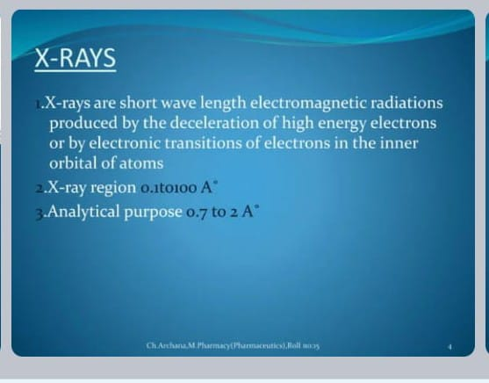
GENRATION OF X-RAY:

Slide 7
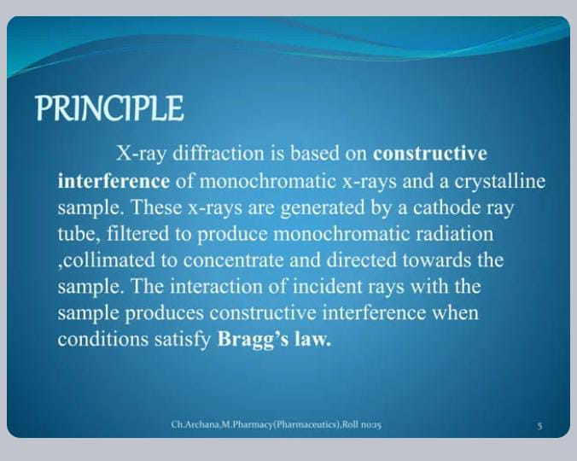
PRINCIPLE:

Slide 8
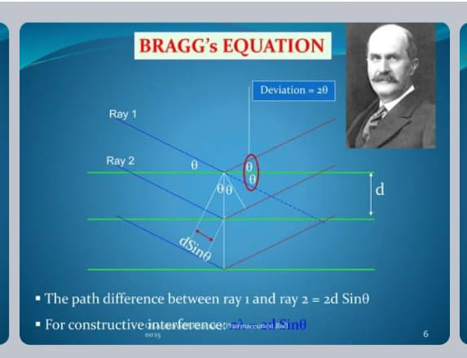
INSRUMANTTION:

Slide 9
METHODS:

Slide 10
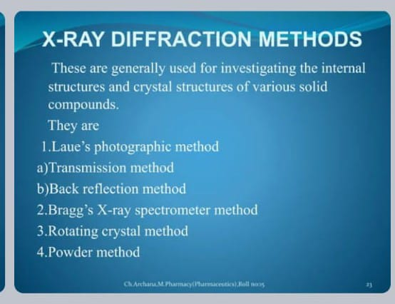

Slide 11
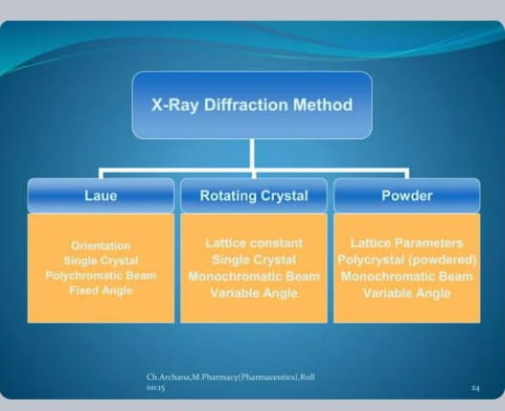

Slide 12
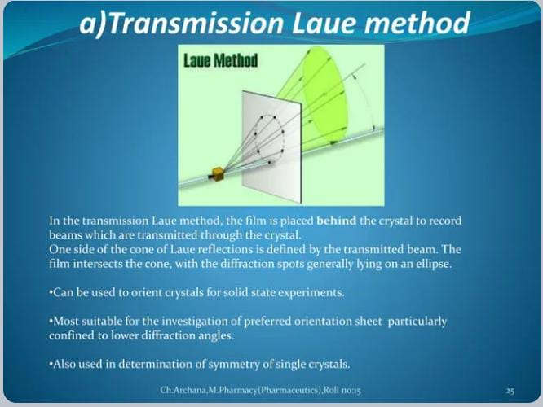

Slide 13
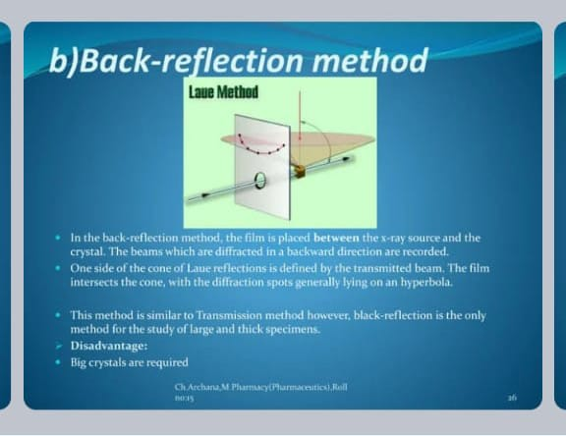

Slide 14
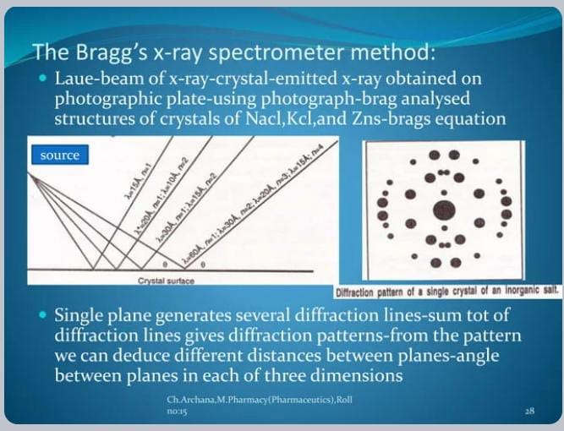

Slide 15
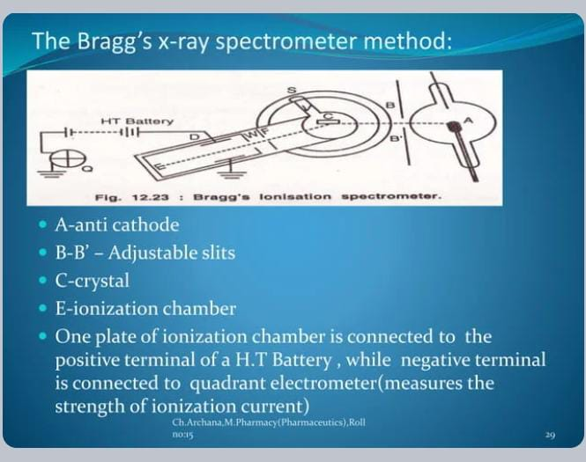

Slide 16
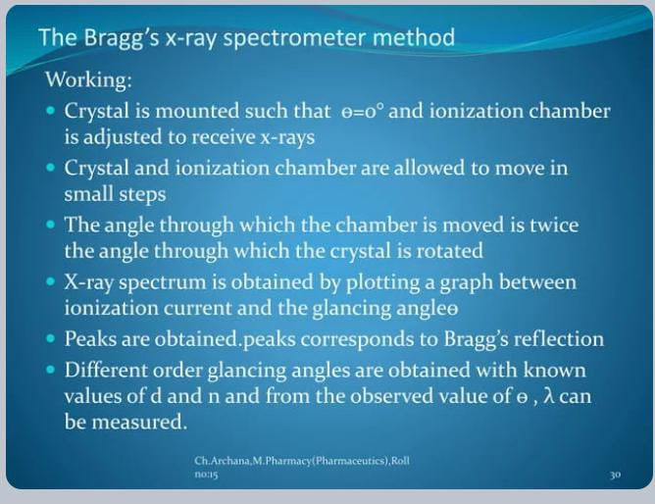

Slide 17
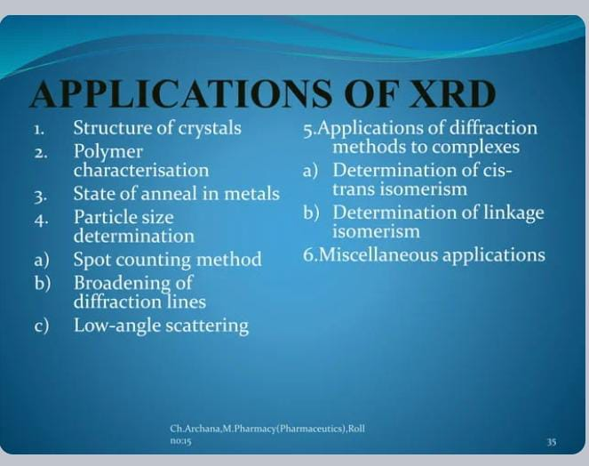
APPLICATON:

Slide 18
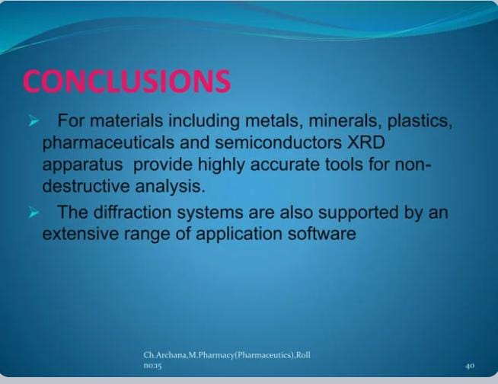
CONCLUSION:

Slide 19
THANK YOU…..

