Slide 1
E-commerce Sales Dashboard Project
Internship Report | Power BI | Business Analysis

Slide 2
Project Objective
To build an interactive E-commerce Sales Dashboard in Power BI that provides clear, actionable insights into sales performance, profit trends, customer behavior, payment modes, and inventory dynamics — enabling data-driven decisions to boost business growth and operational efficiency.
Expected Outcomes:
Identification of top-performing states, categories, and customers
Analysis of product demand and sales trends across time
Insights into payment mode preferences for financial optimization
Detection of inventory issues like overstocking, slow-moving stock, or loss-making subcategories
Recognition of unprofitable months to enable timely interventions
Enhanced visibility into KPIs like AOV, profit margin, and quantity sold
Better alignment between sales planning and inventory management

Slide 3
Tools and Technologies Used
Power BI Desktop
Power Query Editor
DAX (Data Analysis Expressions)
Excel/CSV Dataset
Data Modeling and Relationships

Slide 4
Business Problems Addressed
📉 Unclear trends in profit and sales across time, categories, and regions
🧾 No visibility into product categories driving or dragging performance
🧍 Difficulty tracking customer behavior and preferred payment modes
❌ Inability to spot unprofitable months or periods with declining revenue
📦 Poor visibility into inventory issues like overstocking or slow-moving items
🔄 Inventory and sales are not aligned, leading to stockouts or excess stock
💸 Cash flow challenges due to high COD preference and unsold inventory

Slide 5
How Dashboard Solves These Problems
📊 Tracks performance by month, quarter, state, and category with dynamic filters
🏆 Identifies top-selling products, customers, and regions to optimize focus
💳 Highlights payment mode preferences to inform financial and delivery strategies
📅 Reveals loss-making months and seasonal trends for proactive planning
📦 Surfaces potential inventory inefficiencies (e.g., underperforming SKUs, stockouts)
🔍 Provides insights into profit margins, sales vs. inventory alignment, and customer demand
💼 Helps anticipate cash flow risks by linking sales, inventory, and payment behavior

Slide 6
Quarterly Sales Performance Summary
Metric / Quarter | Q1 | Q2 | Q3 | Q4
📊 Total Sales | ₹841K | ₹420K | ₹340K | ₹572K
💰 Total Profit | ₹26K | ₹882 | -₹1.46K (Loss) | ₹12K
📦 Quantity Sold | 2008 | 1181 | 1017 | 1409
💳 Avg Order Value (AOV) | ₹9.55K | ₹5.99K | ₹5.00K | ₹7.06K
📉 Profit Margin | 3.09% | 0.21% | -0.43% | 2.03%
📍 Top States | UP, Maharashtra | Maharashtra, MP | MP, Maharashtra, UP | MP, AP, Maharashtra, UP
🧥 Top Categories | Clothing | Furniture, Electronics | Clothing, Furniture | Clothing, Electronics, Furniture
🪑 Top Subcategories | Printers, Phones, Accessories | Tables, Printers, Bookcases | Bookcases, Tables, Accessories | Printers, Sarees, Chairs, Trousers
👤 Top Customers | Harivansh, Madanmohan, Shiva | Farah, Paridha, Priyanka | – | Shishu, Uudhav, Rohan, Lalita
⚠️ Loss Months | – | May | July, September | October, December

Slide 7
Inventory Performance Summary
Business Problem | Insight / Explanation | Possible Solution
🔁 Overstocking of Low-Performing Items | Sub-categories like Bookcases or Tables appear in loss months—indicating unsold stock. | Improve demand forecasting; reduce procurement of such items.
⌛ Slow-moving Inventory | Months with high sales but low profit margins (e.g., Q2) may suggest discounts on unsold or older inventory. | Conduct inventory turnover analysis; introduce clearance campaigns.
📉 High Return or Damage Rate (Implied by Negative Profits) | Negative profits in certain months like May, July, September, December may imply high returns or spoilage. | Track product-level return rates; invest in quality control and better packaging.
🔍 Lack of Visibility into Inventory by Category | No clear stock level info for top-selling categories like Clothing (62.62% of sales). | Implement inventory dashboard with SKU-level tracking.
🏷️ Unsynchronized Sales & Inventory Planning | High-performing subcategories like Printers may face stockouts if not replenished in time. | Align procurement with sales data using predictive analytics.
💼 Seasonal Demand Not Mapped to Inventory Levels | Losses during festive or peak months (e.g., October, December) may indicate poor inventory planning for seasonal items. | Plan seasonal inventory stocking based on historical data.
🧾 Cash Flow Issues from Overstocked Inventory + COD Preference | High COD preference (43.74%) + possible unsold inventory leads to poor working capital utilization. | Promote prepaid options; optimize working capital by clearing non-moving inventory.

Slide 8
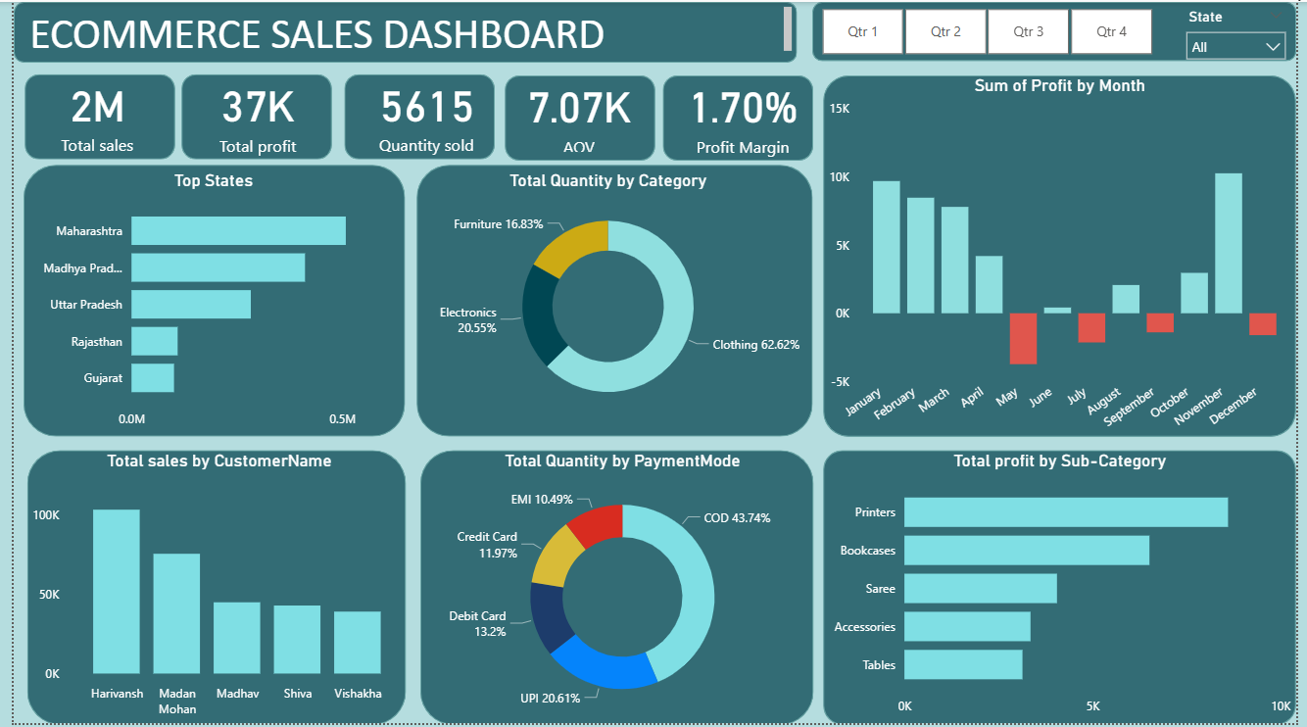
Dashboard Screenshot

Slide 9
Key Business Insights
🏆 Maharashtra is the top-performing state overall: Indicates a strong and consistent market presence; marketing and logistics can be scaled here.
📍 Madhya Pradesh performs well in Q2, Q3, and Q4: Shows growing market potential; suggests regional focus for expansion.
💸 Overall profit margin is low (1.70%): Suggests operational inefficiencies or pricing issues; needs cost optimization and better pricing strategies.
📉 Q3 is a loss-making quarter (-0.43%): Highlights need for cost control and marketing efforts during this period.
🛑 Unprofitable months: May, July, September, October, December: Losses may be seasonal or campaign-related; signals need for corrective strategies or promotions.
📈 Q1 had the best performance (Sales: ₹841K, Profit: ₹26K, Margin: 3.09%): Best-performing quarter; analyze what worked and replicate strategies.
👤 Harivansh, Madanmohan, Shiva are top customers in Q1: Valuable repeat buyers; should be targeted with loyalty or referral programs.
👥 Farah, Paridha, Priyanka performed well in Q2: Indicates diversified customer base; maintain engagement through personalized offers.
🙋 Shishu, Uudhav, Rohan, Lalita are loyal customers in Q4: Identify behavioral patterns of loyalty and replicate for other users.

Slide 10
Key Business Insights
🧥 Clothing is consistently the top-selling category (62.62%): Indicates strong consumer preference; ensure proper inventory planning and product variation.
🪑 Furniture and Electronics emerge in Q3 and Q4: Product mix diversification is evident; explore bundling or combo offers.
💳 COD is the most preferred payment mode (43.74%): May cause cash flow and return issues; suggest offering discounts for prepaid modes to encourage digital payments.
📦 AOV is highest in Q1 (₹9.55K), lowest in Q3 (₹5.00K): Indicates changes in buying behavior or product mix; adjust pricing, promotions, or upselling strategies.
🖨️ Printers and Bookcases are top sub-categories in multiple quarters: Strong profit generators; promote these through ads, bundles, or cross-sells.
🪑 Tables, Sarees, Chairs, Accessories also contribute significantly: Indicates niche interests; can be used to drive seasonal sales or focused campaigns.
📊 Dynamic filters (by quarter and state) help isolate key trends: Enables management to view segmented performance, aiding more precise business decisions.
🔍 Insights allow early detection of declining performance: For example, sudden dip in Q2/Q3 warns of operational or demand issues that can be quickly addressed.

Slide 11
Conclusion
The E-commerce Sales Dashboard supports detailed analysis of product performance, profitability, and customer trends across regions and time. It enables informed business decisions by identifying high-growth opportunities and areas needing strategic adjustments.

