Slide 1
EBAY
Under Guidance of Mrs. Vaishali mam

Slide 2
INTRODUCTION
It is a global online shopping website where people can buy and sell products.
It allows users to sell both new and used items easily.
It connects millions of buyers and sellers worldwide in one platform.

Slide 3
RESPONSIBILITIES
Planned and wrote all testcases.
Review all test cases and make corrections if needed.
Execute the test cases properly.
Create and update defect reports.

Slide 4
OVERVIEW
eBay is a global online shopping website where users can buy and sell products.
It allows people to sell both new and used items easily.
eBay connects millions of buyers and sellers worldwide in one platform.
It also provides different features like searching, adding to cart, payment, and shipping.
eBay helps sellers reach a global audience and buyers to find products at different prices.

Slide 5
MODULES
MODULE 1 :SIGN IN PAGE
->Test logging in with username and password. Check for errors with wrong details.
MODULE 2 : MULTIPLE SEARCHES
->Search for different products and ensure correct results appear.
MODULE 3 : ADD TO CART
->Add products to the shopping cart and verify items and prices are correct.

Slide 6
MODULES
MODULE 4 : DELETE FROM CART
->Remove products from the cart and check if the total updates correctly.
MODULE 5 : CHANGE LOGIN NAME
->Update the user’s display name and make sure it shows everywhere.
MODULE 6 : CHANGE CURRENT ADDRESS
->Update shipping or billing address and ensure it is saved properly.

Slide 7
MODULES
MODULE 7 : SHOP BY CATEGORIES
-> Browse products by category and verify correct items are displayed.
MODULE 8 : Select Particular Product & Check Description
-> Right-click on a product image to see its name, price, description, and availability.
MODULE 9 : Shop by All Categories & Check Functionality
-> Browse all categories and ensure the feature works properly.

Slide 8
MODULES
MODULE 10 : Change Language via Settings
->Change the website language and check if the interface and product details appear correctly.

Slide 9
DEFECTS
->A DEFECT IS AN MISTAKE OR ERROR IN SOFTWARE.
->DEFECTS MAKES THE SOFTWARE WORK INCORRECTLY.
->DEFECTS OCCUR WHEN THE PRODUCT DOESN’T MEET THE REQUIREMENTS.

Slide 10
DEFECT IDENTIFIER :- B_001
->DEFECT SUMMARY: First name field in eBay registration accepts numbers (e.g., "1234") instead of only alphabets.
->TEST ID: TC_001
->TEST CASE NAME: TC_SIGNUP_PERSONAL_ACCOUNT
->MODULE NAME: Sign Up

Slide 11
DEFECT IDENTIFIER :- B_001
->REPRODUCIBLE:
->SEVERITY: Medium
->PRIORITY: Medium
->RAISED BY: MONALISA
->ASSIGNED TO: DEVELOPER

Slide 12
DEFECT IDENTIFIER :- B_001
->DATE OF ASSIGNMENT: 19-08-2025
->STATUS: PENDING
->SNAPSHOTS: ATTACHED
->FIXED BY: DEVELOPER
->DATE OF FIXING:

Slide 13
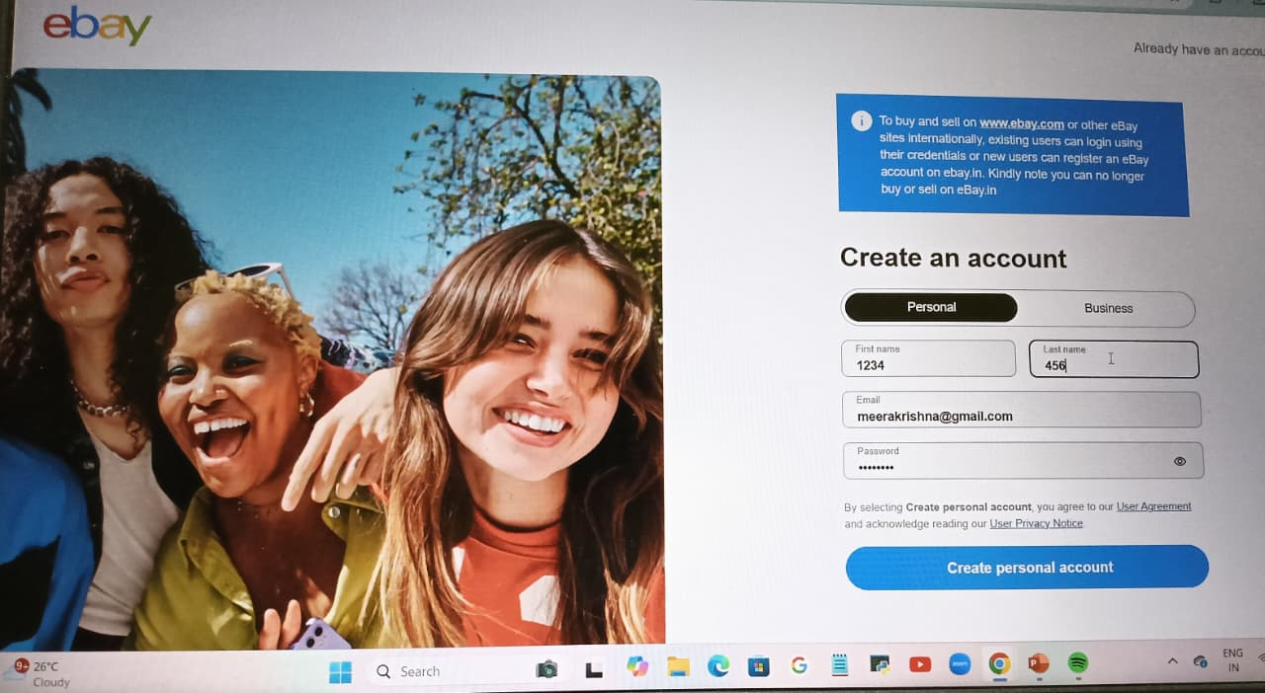

Slide 14
DEFECT IDENTIFIER :- B_002
->DEFECT SUMMARY: Mobile login forces users to set up screen lock/passkeys, while laptop login allows skipping this step.
-> TEST ID:TC_002
->TEST CASE NAME:TC_LOGIN_MOBILE_SCREENLOCK
->MODULE NAME:LOGIN / AUTHENTICATION

Slide 15
DEFECT IDENTIFIER :- B_002
->REPRODUCIBLE:
->SEVERITY:HIGH
-> PRIORITY: HIGH
-> RAISED BY: Monalisa
->ASSIGNED TO:DEVELOPER

Slide 16
DEFECT IDENTIFIER :- B_002
->DATE OF ASSIGNMENT:19-08-2025
->STATUS:PENDING
->SNAPSHOTS: Attached
->FIXED BY:DEVELOP
->DATE OF FIXING:

Slide 17
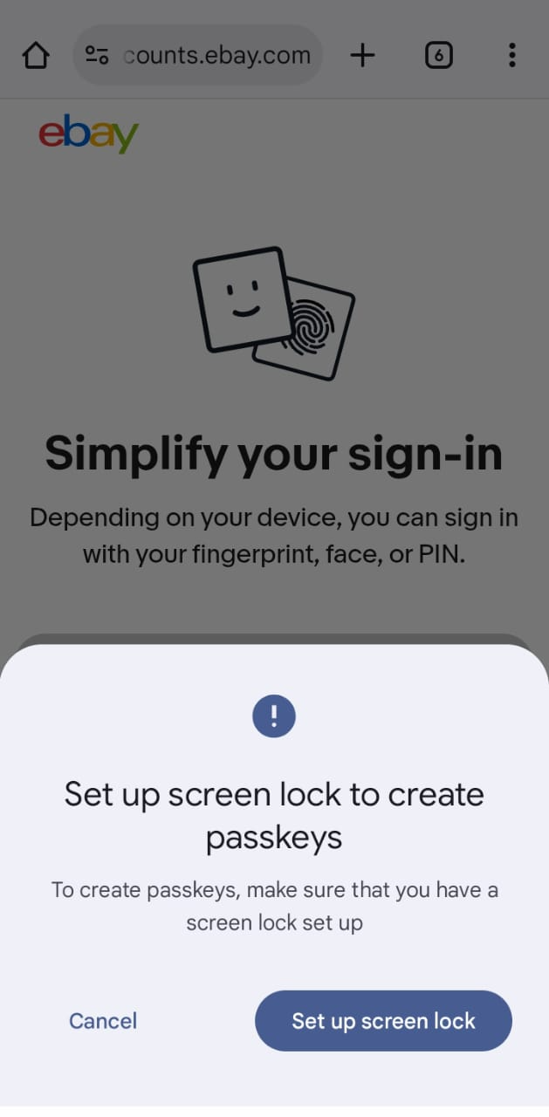
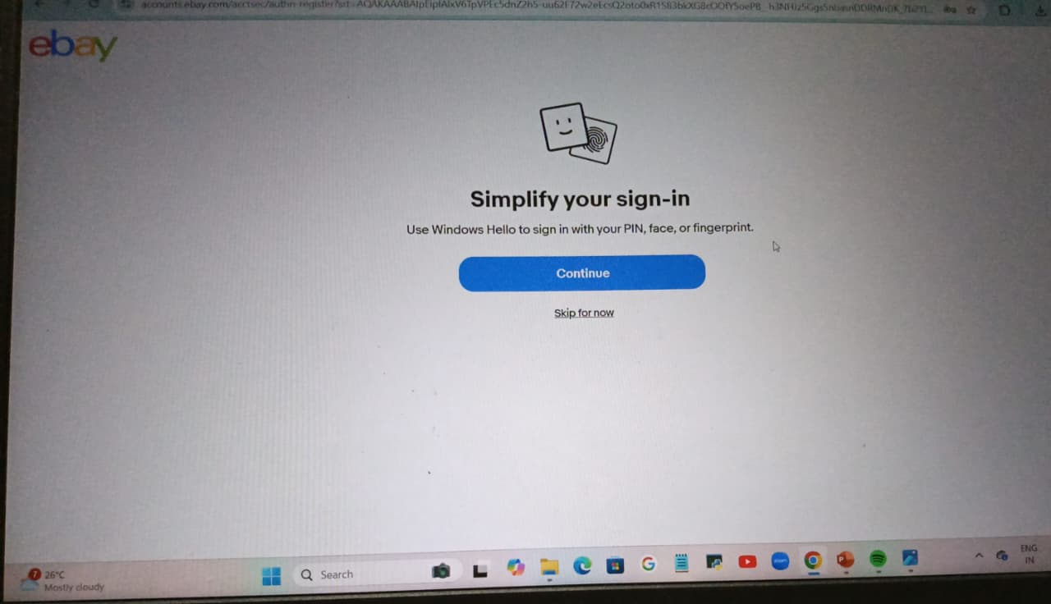

Slide 18
CHALLENGES
Testing a large website with so much data took a lot of time.
Some features worked on mobile and desktop, making testing tricky.
Taking screenshots and adding them to defect report was time-consuming.

Slide 19
EXPERIENCE
Helped me find bugs and understand real problems on the website.
Made testing easier by organizing work into smaller parts.
Improved my observation skills and taught me to think about all possible situations.
Understand how different website features work on desktop and mobile.

Slide 20
THANK YOU Vaishali Mam for guiding me throughout the project.
PREPARED BY
M.MONALISA

