Slide 1
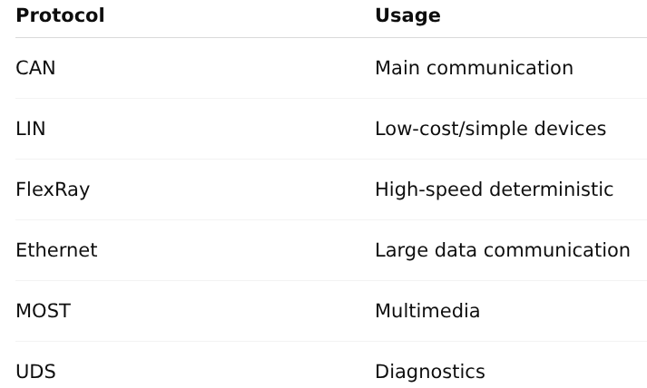
Automotive Protocols
Protocols = communication rules

Slide 2
CAN Protocol
CAN (Controller Area Network) is a communication protocol used in vehicles
It allows multiple ECUs to communicate with each other without a central computer
Developed by Bosch in the 1980s to reduce wiring complexity
Uses a two-wire bus system to connect all ECUs
Why CAN is Important
Reduces wiring and system complexity
Provides reliable and real-time communication
Helps in efficient vehicle control and coordination

Slide 3
Features of CAN
Multi-master system → Any ECU can send data
Broadcast communication → Message is received by all nodes
Message-based (not address-based)
High reliability with built-in error detection
Real-time communication for fast response
Priority-based arbitration (important messages first)
Supports speeds up to 1 Mbps (CAN) and higher in CAN-FD

Slide 4
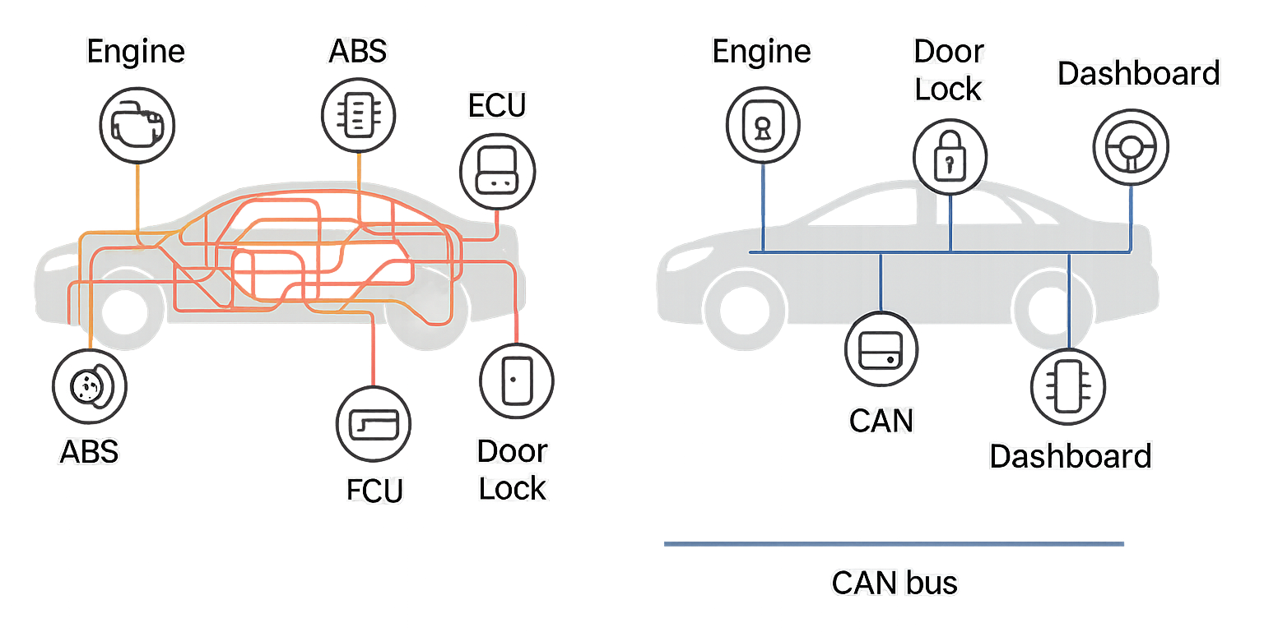
Before CAN
Vehicles used point-to-point wiring
Too many wires and connections
Increased weight, cost, and complexity
Difficult to diagnose and maintain
No proper communication between ECUs
After CAN
Introduced single shared communication bus
Reduced wiring complexity
Improved communication between ECUs
Made vehicles lighter and cost-efficient
Enabled advanced features (ABS, airbags, etc.)

Slide 5
Layers of CAN
Application Layer Defines how data is used
Data Link Layer Error detection, frame handling
Physical Layer Transmission of bits on wire
CAN mainly works on Data Link + Physical layer

Slide 6
Applications of CAN
Engine control systems
Braking systems (ABS, ESP)
Airbags and safety systems
Body control (windows, locks)
Transmission systems
Also used in:
Industrial automation
Medical devices

Slide 7
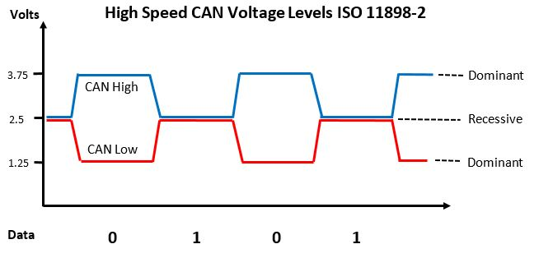
CAN Bus
CAN Bus is a network that connects all ECUs in a vehicle
It uses 2 wires: CAN High and CAN Low
It allows ECUs to share data with each other
It provides reliable communication

Slide 8
CAN Message
CAN message is the data sent on the CAN network
It contains ID and actual data
All ECUs can read the message
Important messages are given higher priority
Types of CAN Messages :
Data Frame – used to send actual data
Remote Frame – used to request data
Error Frame – shows communication error
Overload Frame – adds delay if needed

Slide 9
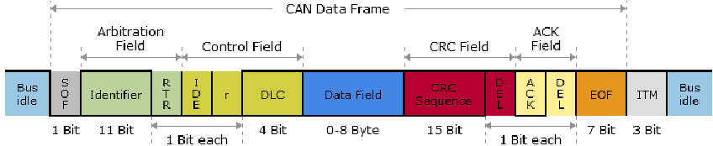
CAN Data Frame
Data frame is the most common CAN message used to send real data between ECUs
It has these main parts:
Arbitration Field – decides priority of message
Data Field – contains actual data (0 to 8 bytes)
CRC Field – checks for errors
Acknowledgement – receiver confirms message received
If no acknowledgement is received, message is sent again

Slide 10
Remote Frame
A Remote Frame is used to request data from another ECU
It contains an Identifier (ID) which tells which data is needed
It does not carry actual data, only a request
The ECU with that data will respond with a Data Frame
Example: A dashboard ECU requests vehicle speed from Engine ECU

Slide 11
Error Frame
An Error Frame is sent when a problem occurs during communication
Error may happen due to noise, wrong data, or signal disturbance
When an error is detected:
The current message is stopped immediately
All ECUs are informed about the error
The message is retransmitted again
It helps to maintain reliable and correct communication
Example: If a message gets corrupted, an error frame is sent and message is resent

Slide 12
Overload Frame
An Overload Frame is used when an ECU needs more time to process data
It temporarily delays the next message transmission
Helps prevent buffer overflow and data loss
Ensures ECU can handle all incoming data properly
Example: ECU is busy processing → asks network to wait before sending next message

Slide 13
Error Handling in CAN
CAN has strong error detection mechanisms:
CRC check → Detects data corruption
Bit monitoring → Checks transmitted bits
Frame check → Ensures correct structure
Acknowledgement check → Confirms reception
If error occurs:
Error frame is sent
Message is retransmitted automatically

Slide 14
Arbitration Process
Multiple ECUs can send messages at the same time
Each message has an Identifier (ID)
Lower ID = Higher priority
The message with highest priority continues
Other ECUs stop and try again later
This avoids collision and ensures smooth communication

Slide 15
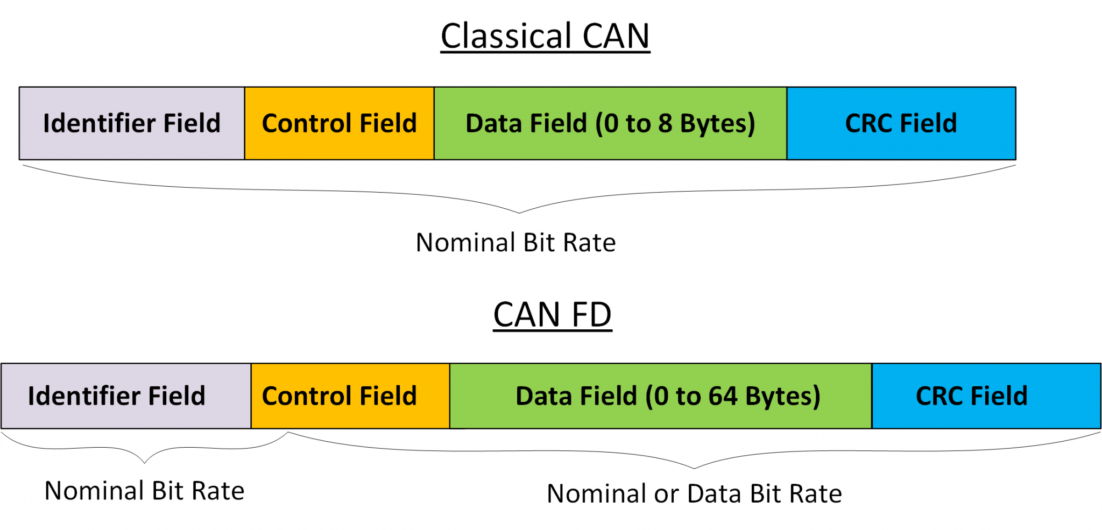
CAN FD
CAN FD is the advanced version of CAN
It is faster than CAN
It can send more data in one message
It is used in modern vehicles

Slide 16
LIN Protocol
LIN is a simple and low-cost communication protocol
It uses 1 master and multiple slave nodes
Works on single wire + ground
Speed: 1 kbps to 20 kbps (slow)
Used in windows, mirrors, seats
Supports simple data communication
Maximum wire length is about 40 meters
Less reliable than CAN, but easy to use and low cost

Slide 17
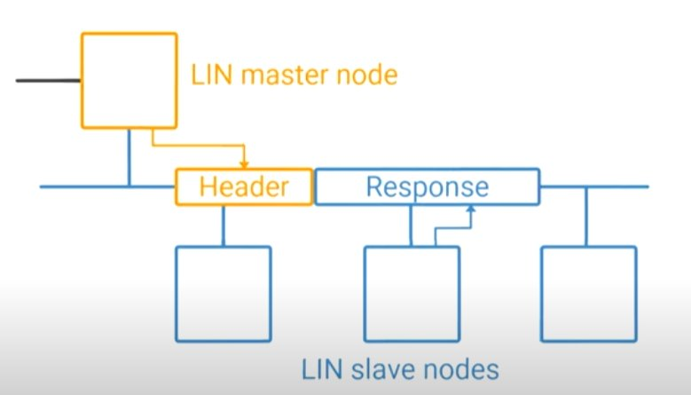
How LIN bus works
LIN uses a Master–Slave communication system
Master Node
Controls the entire communication
Sends requests (header) to slave nodes
Slave Nodes
Wait for master request
Send response (data) when requested
Working Flow
Master sends header (request message)
Selected slave sends response (data)
Communication happens one-by-one (no collision)
Only master controls timing
Simple and low-speed communication (~20 kbps)
Used for basic functions (window, door, seat)

Slide 18
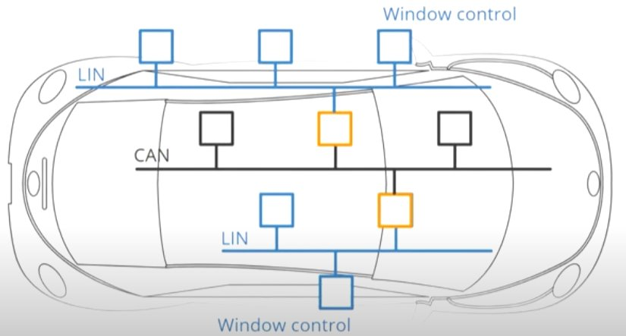
Interaction between LIN and CAN​
LIN nodes are organized into clusters, and each cluster has a master node that connects to the main CAN network (backbone bus)
For example, a passenger sitting on one side of the car wants to control a window on the other side
When the button is pressed, a message is sent through the local LIN cluster
This message is passed to the CAN network via the LIN master
The CAN network then forwards the message to another LIN cluster
The master in that cluster sends the command to the appropriate slave node
As a result, the window operation is performed

Slide 19
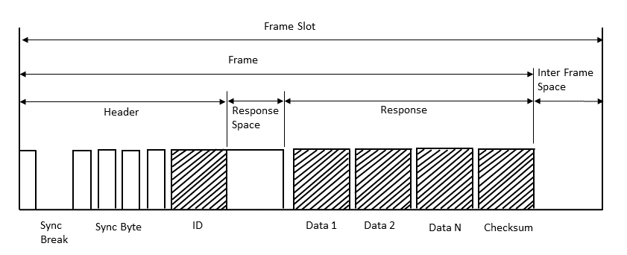
LIN Frame Format
A frame starts with the header, which is always sent by the master node.
After the header, there is a small response space where the slave prepares to reply.
Then the response is sent, which includes the data and checksum.
The data bytes contain the actual information, and the checksum is used to detect errors.
After the frame is complete, there is an inter-frame space before the next frame starts.
The complete cycle from start to end is called a frame slot.

Slide 20
LIN Frame Types
Unconditional Frame: Master requests data from a specific slave, and that slave sends the response.
Event Triggered Frame: Master asks multiple slaves, and only the one with updated data responds.
Sporadic Frame: Master sends data only when it knows information has changed.
Diagnostic Frame: Used to read or check faults and system status between master and slave.
User Defined Frame: Custom frame used for special or user-specific data.
Reserved Frame: Reserved for future use and should not be used in LIN communication.

Slide 21
CAN vs LIN
Feature | CAN (Controller Area Network) | LIN (Local Interconnect Network)
Speed | Fast (up to 1 Mbps) | Slow (up to 20 kbps)
Cost | Higher | Low cost
Complexity | Complex system | Simple system
Communication | Multi-master | One master, multiple slaves
Wires | Two wires (CAN High, CAN Low) | Single wire + ground
Use | Engine, braking systems | Windows, mirrors, seats
Reliability | High | Lower than CAN
Data Handling | Handles critical data | Handles simple data

Slide 22
Automotive Ethernet
A high-speed communication network used in modern vehicles. It connects multiple ECUs for fast and reliable data transfer. Based on standard Ethernet technology (like computer networks)
Why Automotive Ethernet is Needed
Modern vehicles generate large amounts of data
Required for:
Safety systems (ADAS, braking, sensors)
Infotainment (video, audio streaming)
Autonomous driving systems
high speed (10 Mbps to Gbps)
Key Features
High bandwidth → handles huge data easily
Low delay (latency) → fast real-time response
Scalable → supports future technologies
Reliable communication for critical systems
Very high speed network
Used in ADAS systems
Supports cameras & sensors
Acts as backbone network

Slide 23
Tools: CANoe & CANalyzer
Used for testing and analyzing CAN communication
Widely used in the automotive industry
CANalyzer :
Used to capture and analyze CAN messages
Helps monitor real-time communication
Used for debugging issues
CANoe :
Used for simulation and testing of ECUs
Supports network simulation and diagnostics
Helps in validation of complete system

Slide 24
UDS (Diagnostics)
A standard protocol used for vehicle diagnostics and communication
Helps to detect faults and issues in ECUs
Allows reading and clearing error codes (DTCs)
Key Functions
Monitoring & Diagnosis Check ECU status, sensor data, and system health
Firmware Update (Reprogramming) Supports software/firmware updates in ECUs
Configuration & Testing Used to test and configure ECU functions

Slide 25
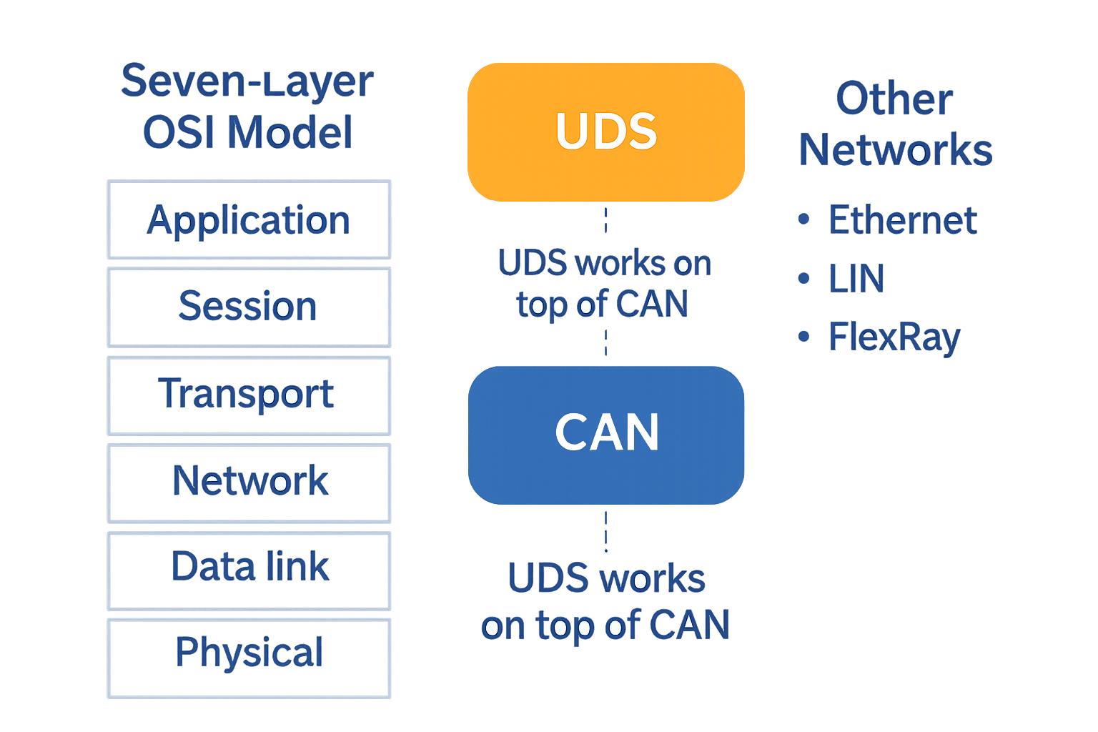
UDS in OSI Model
UDS works at the Application Layer of the OSI model
It is used for diagnostics and control of ECUs
Below UDS, communication protocols like CAN handle data transfer
CAN works in lower layers (network, data, physical)
How It Works
UDS sends diagnostic requests to ECUs
CAN/Ethernet carries these messages between ECUs
ECU processes the request and sends back a response

Slide 26
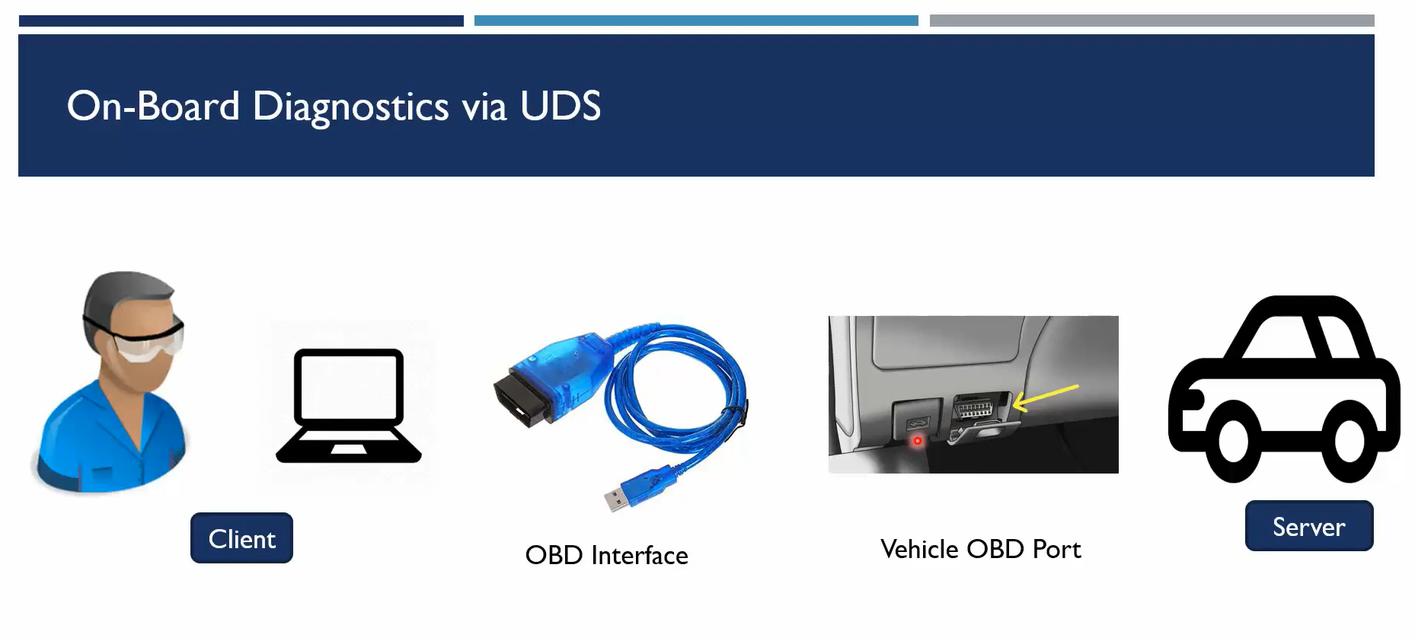
A service engineer (client) uses a laptop with diagnostic software
The laptop is connected using an OBD cable (interface)
The cable is plugged into the vehicle’s OBD port
The laptop sends UDS requests to the vehicle
The vehicle (server / ECUs) receives the request
ECUs process the request and send a response back

Slide 27
UDS Message structure
Shows how a UDS request message is formed over CAN
Each field has a specific purpose
CAN ID → Identifies the target ECU
SID (Service ID) → Type of diagnostic request
Sub-function → Extra details (optional)
Data → Actual information or parameters
Padding → Fills remaining space if needed

Slide 28
Automotive Networking
Connects all ECUs
Allows data flow
Uses CAN, LIN, Ethernet
Ensures proper vehicle operation

Slide 29
Network Topologies (Connection Types)
Point-to-Point → One device connected to one device
Bus / Multi-drop → Multiple ECUs connected on same line (e.g., CAN)
Ring → ECUs connected in circular form
Star → All ECUs connected to a central unit

Slide 30
Types of Data in Vehicle Network
Control Data → Engine, transmission, motor control
Safety / Time-Critical Data → Airbag, braking, ADAS (very fast response required)
Infotainment Data → Audio, video, navigation
Backbone Data → Connects different vehicle networks
Low-Speed Data → Doors, windows, seat control

Slide 31
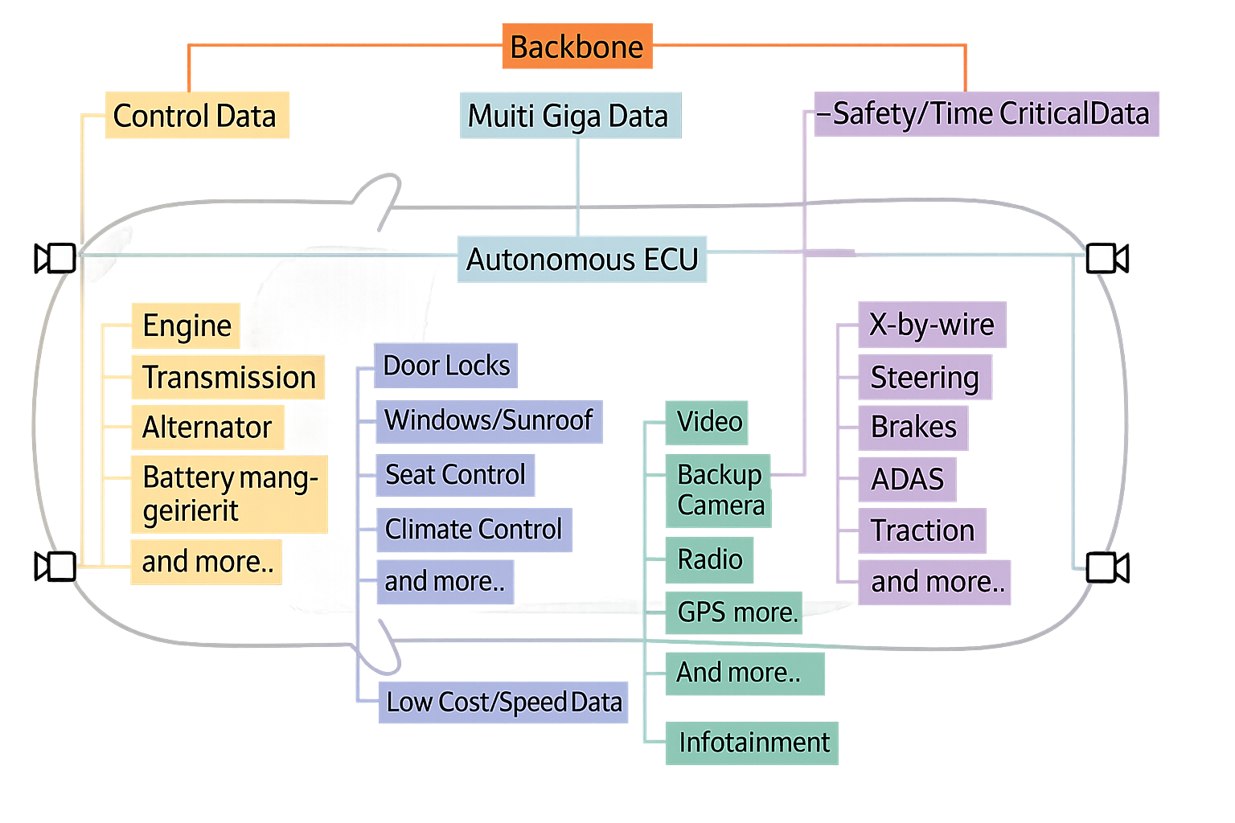
Vehicle Network Application
Safety / Time-Critical Data → Requires high speed and fast response → Example: Airbag, braking (ADAS systems)
Control Data → Used for controlling sensors and actuators → Example: Engine, transmission systems
Backbone Data → Transfers data between different networks → Used in gateway communication
Infotainment Data → Audio, video and navigation data → Requires high bandwidth (> 25 Mbps)
Multi Giga Data → Very high-speed data for advanced systems → Used in autonomous driving (ADAS, cameras)
Low Cost / Speed Data → Low-speed simple communication → Example: Door locks, window control

Slide 32
Stellantis’ STLA Platform
What is STLA?
STLA (Stella) = Dedicated electric vehicle (EV) platforms
Common base used across multiple Stellantis brands
Platform Types:
STLA Small → Small cars
STLA Medium → Mid-size cars
STLA Large → Premium & performance cars
STLA Frame → SUVs, pickup trucks
Key Features:
Driving range: 500–800+ km
Fast charging (~320 km in 10 min)
High performance (0–100 km/h ~2 sec)
Supports FWD, RWD, AWD configurations

Slide 33
Technology and Future Vision
Battery & Powertrain:
Battery size: 37–200 kWh
Dual battery chemistry (low-cost & high-performance options)
Power output: 95 hp – 449 hp
Smart Technology (STLA Brain):
Central control system for:
Driving
Connectivity
Autonomous features
Supports OTA updates (like smartphones)
Future Goals:
Fully electrified lineup by 2030
Improved efficiency, performance & sustainability
Continuous feature upgrades via software

Slide 34
Thank You

