Slide 1
Basics of Automotive
Monal Sutar

Slide 2
Automotive Industry Overview
Global industry with many companies involved in vehicle design, manufacturing, and services
OEMs (Original Equipment Manufacturers) → Companies that manufacture vehicles (cars, trucks, EVs)
Suppliers → Provide components like engines, sensors, ECUs, electronics
Industry Growth & Changes
Shift from mechanical to electronic to software-based vehicles
Increasing use of ECUs and embedded systems
Growth of:
Electric Vehicles (EVs)
ADAS (driver assistance systems)
Connected and smart cars

Slide 3
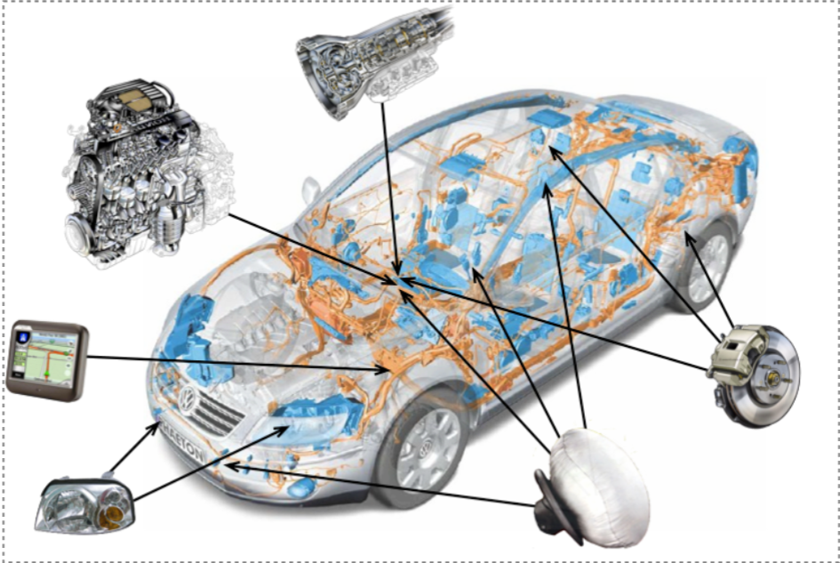
Key Systems in a Vehicle
A vehicle is made up of different systems working together. Each system has a specific role, but all are connected
Engine – Power Generation Produces power to move the vehicle by converting fuel into energy
Brakes – Safety System Slows down or stops the vehicle to ensure safe driving
Transmission – Speed Control Sends power from engine to wheels and controls gear changes
Electrical System – Support System Provides power to all electronic parts like sensors and ECUs
Infotainment – User Experience Offers navigation, music, and connectivity for comfort

Slide 4
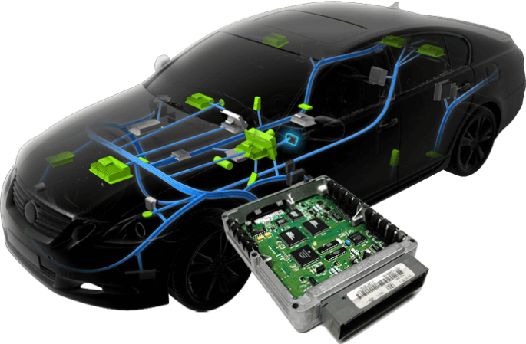
What is ECU?
Earlier, vehicles were mainly mechanical systems. With the advancement of technology, electronics were introduced, bringing major changes to the automotive industry.
In the 1970s, the Electronic Control Unit (ECU) was introduced. Since then, modern vehicles have become highly dependent on electronic systems.
Today’s vehicles contain many electronic devices, and the ECU is one of the most important components.
The ECU is known as the brain of the vehicle
It controls multiple functions such as engine, braking, and more
It helps make the vehicle smart, efficient, and automated

Slide 5
Common Types of ECU
Engine Control Unit (ECU): Controls engine functions like fuel and ignition for smooth performance
Body Control Module (BCM): Manages features like AC, windows, and door locks
Transmission Control Unit (TCU): Controls gear shifting using sensor and engine data
Powertrain Control Module (PCM): Combines ECU and TCU functions into one unit
Telematics Control Module: Provides GPS, internet, and phone connectivity
Battery Management System (BMS): Manages and protects batteries in electric vehicles

Slide 6
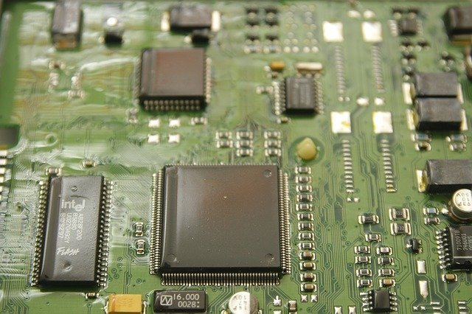
Main Parts of ECU
Microcontroller Small computer that makes decisions
Memory Stores data and programs (RAM, EEPROM, Flash)
Communication Connects with other ECUs using CAN, K-Line, etc.
Software Includes Bootloader and Application Software for control and processing
Inputs Receives signals from sensors and other ECUs (analog/digital)
Outputs Sends commands to actuators to perform actions

Slide 7
How ECUs Communicate
A vehicle has multiple ECUs working together
ECUs share data continuously for proper functioning
They communicate using a common network (bus)
One ECU sends a message to all ECUs
All ECUs receive the message at the same time
Each ECU uses it if needed, otherwise ignores it
Communication is fast and real-time
Examples: CAN, LIN, MOST

Slide 8
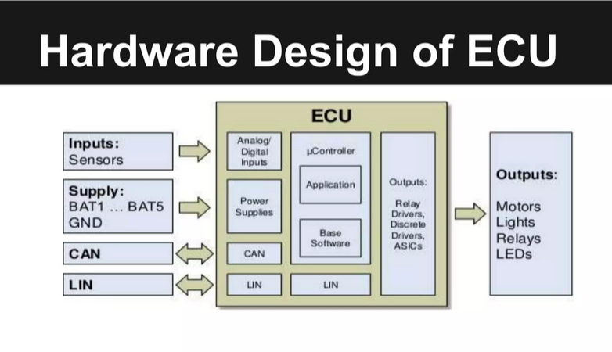

Slide 9
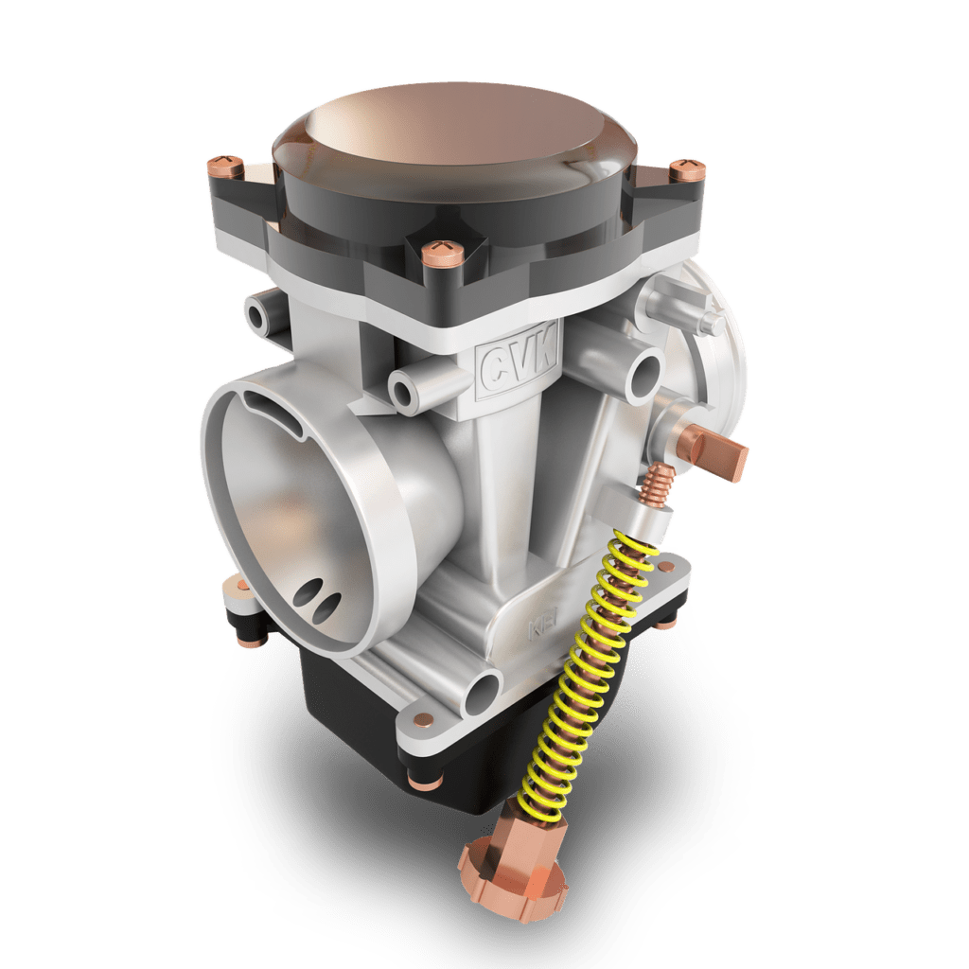
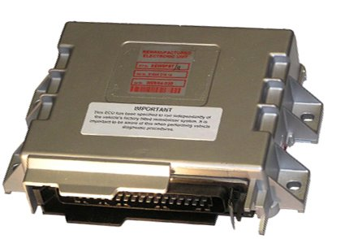
Mechanical Control
Electronic Control
Uses a carburetor to mix air and fuel
Air passing through a narrow section (venturi) creates suction to pull fuel
Fuel amount depends on throttle position (accelerator pedal)
System is fully mechanical, with less accuracy
Results in lower efficiency and higher fuel consumption
Uses ECU-controlled fuel injection system
ECU collects data from sensors (pedal position, temperature, engine speed)
Uses algorithms to calculate exact fuel needed
Controls fuel injectors precisely
Results in better fuel efficiency, performance, and reduced emissions

Slide 10
ECU working principle
An ECU has an application software which is a set of algorithms.
ECU receives inputs from sensors and other ECUs (speed, temperature, etc.)
It checks the data to ensure it is correct
ECU uses application software (algorithms) to process the inputs
Based on logic, it calculates the required output
Sends commands to actuators to perform actions
This process runs continuously in real-time

Slide 11
MOST Protocol in ECU
In an automotive system, each ECU (Electronic Control Unit) acts as both a sender and receiver
An ECU broadcasts messages (e.g., sensor data) to all ECUs on the network
Every ECU reads all incoming messages and determines if the data is relevant
Relevant ECUs process the message, while others ignore it
Each ECU performs error checking to ensure reliable communication
ECUs send acknowledgements confirming successful reception
Supports real-time, synchronized data sharing between multiple ECUs

Slide 12
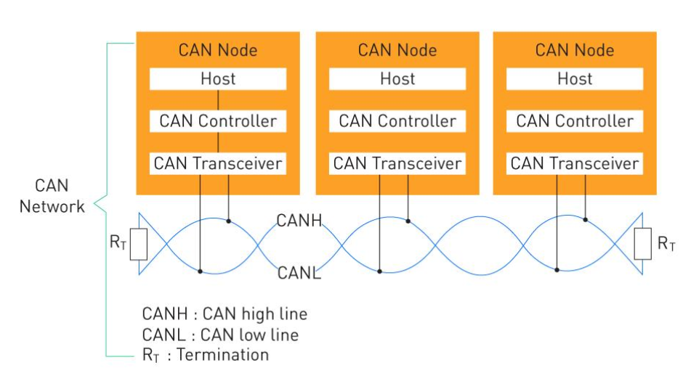
CAN BUS Network Diagram and ECU interaction

