Slide 1
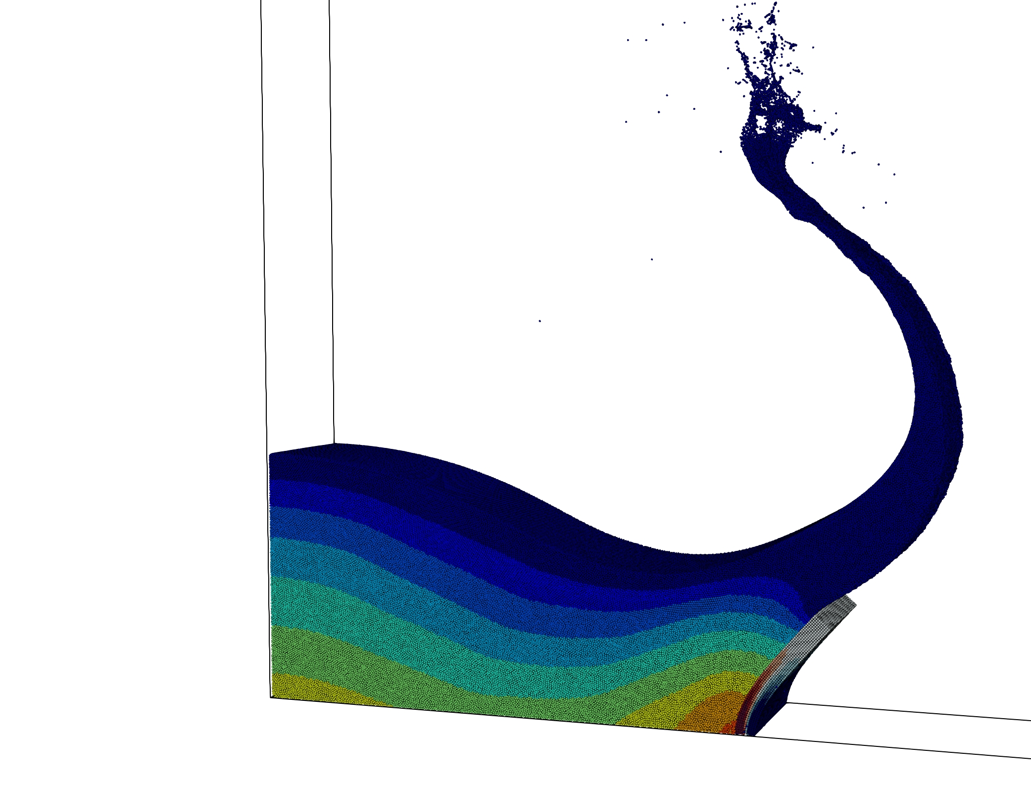
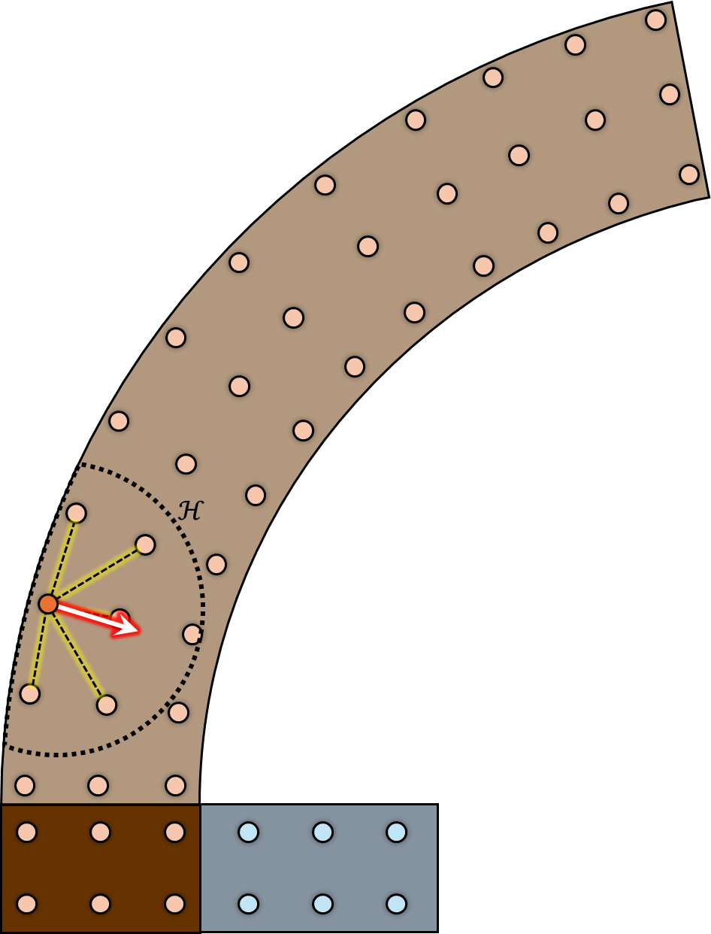
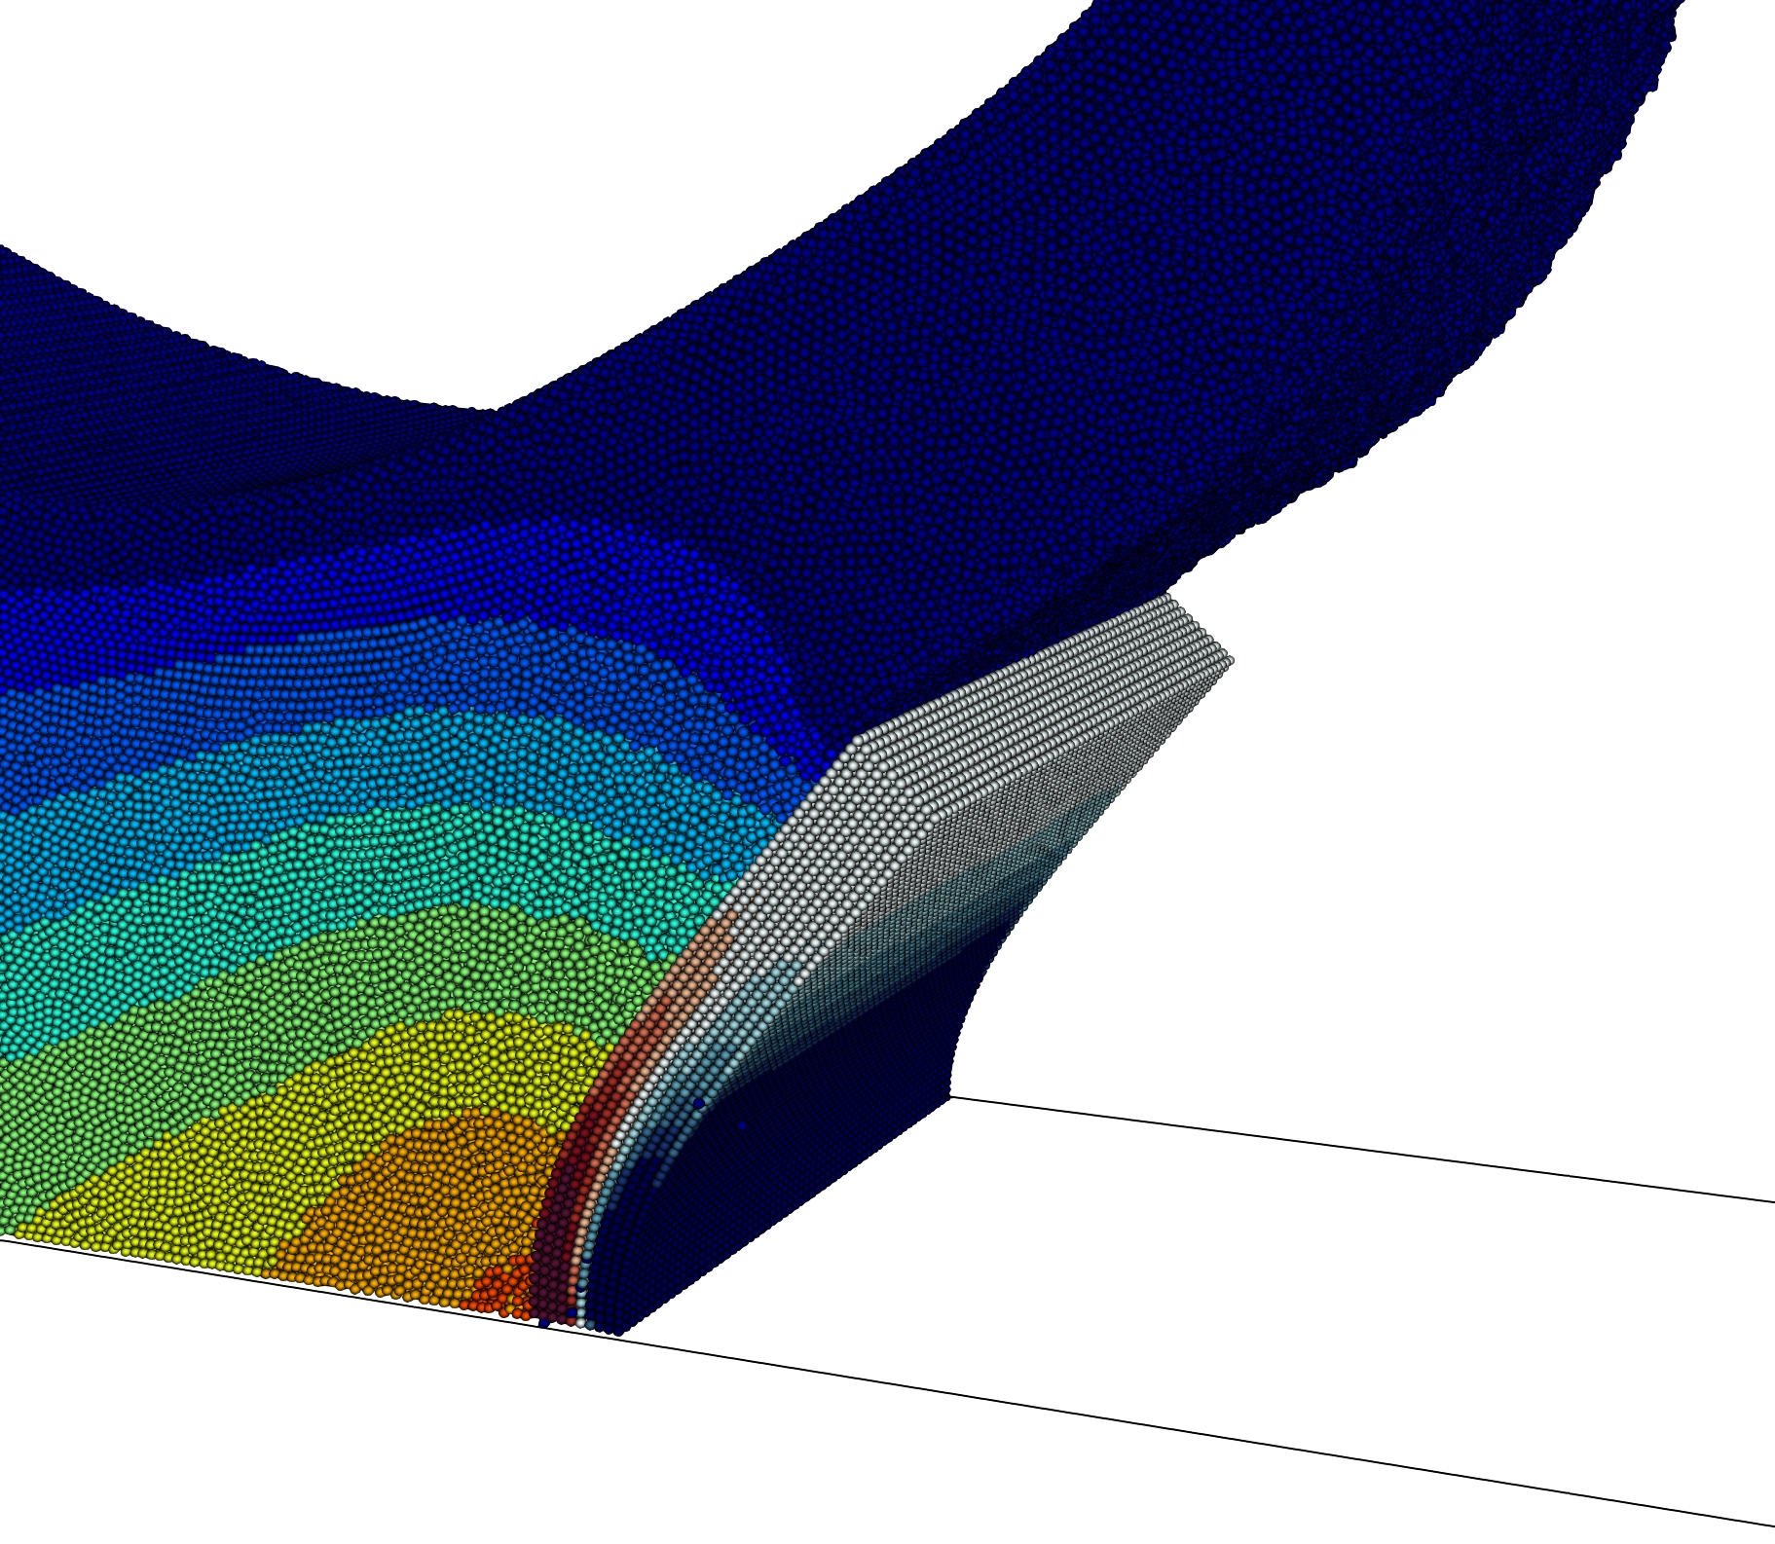
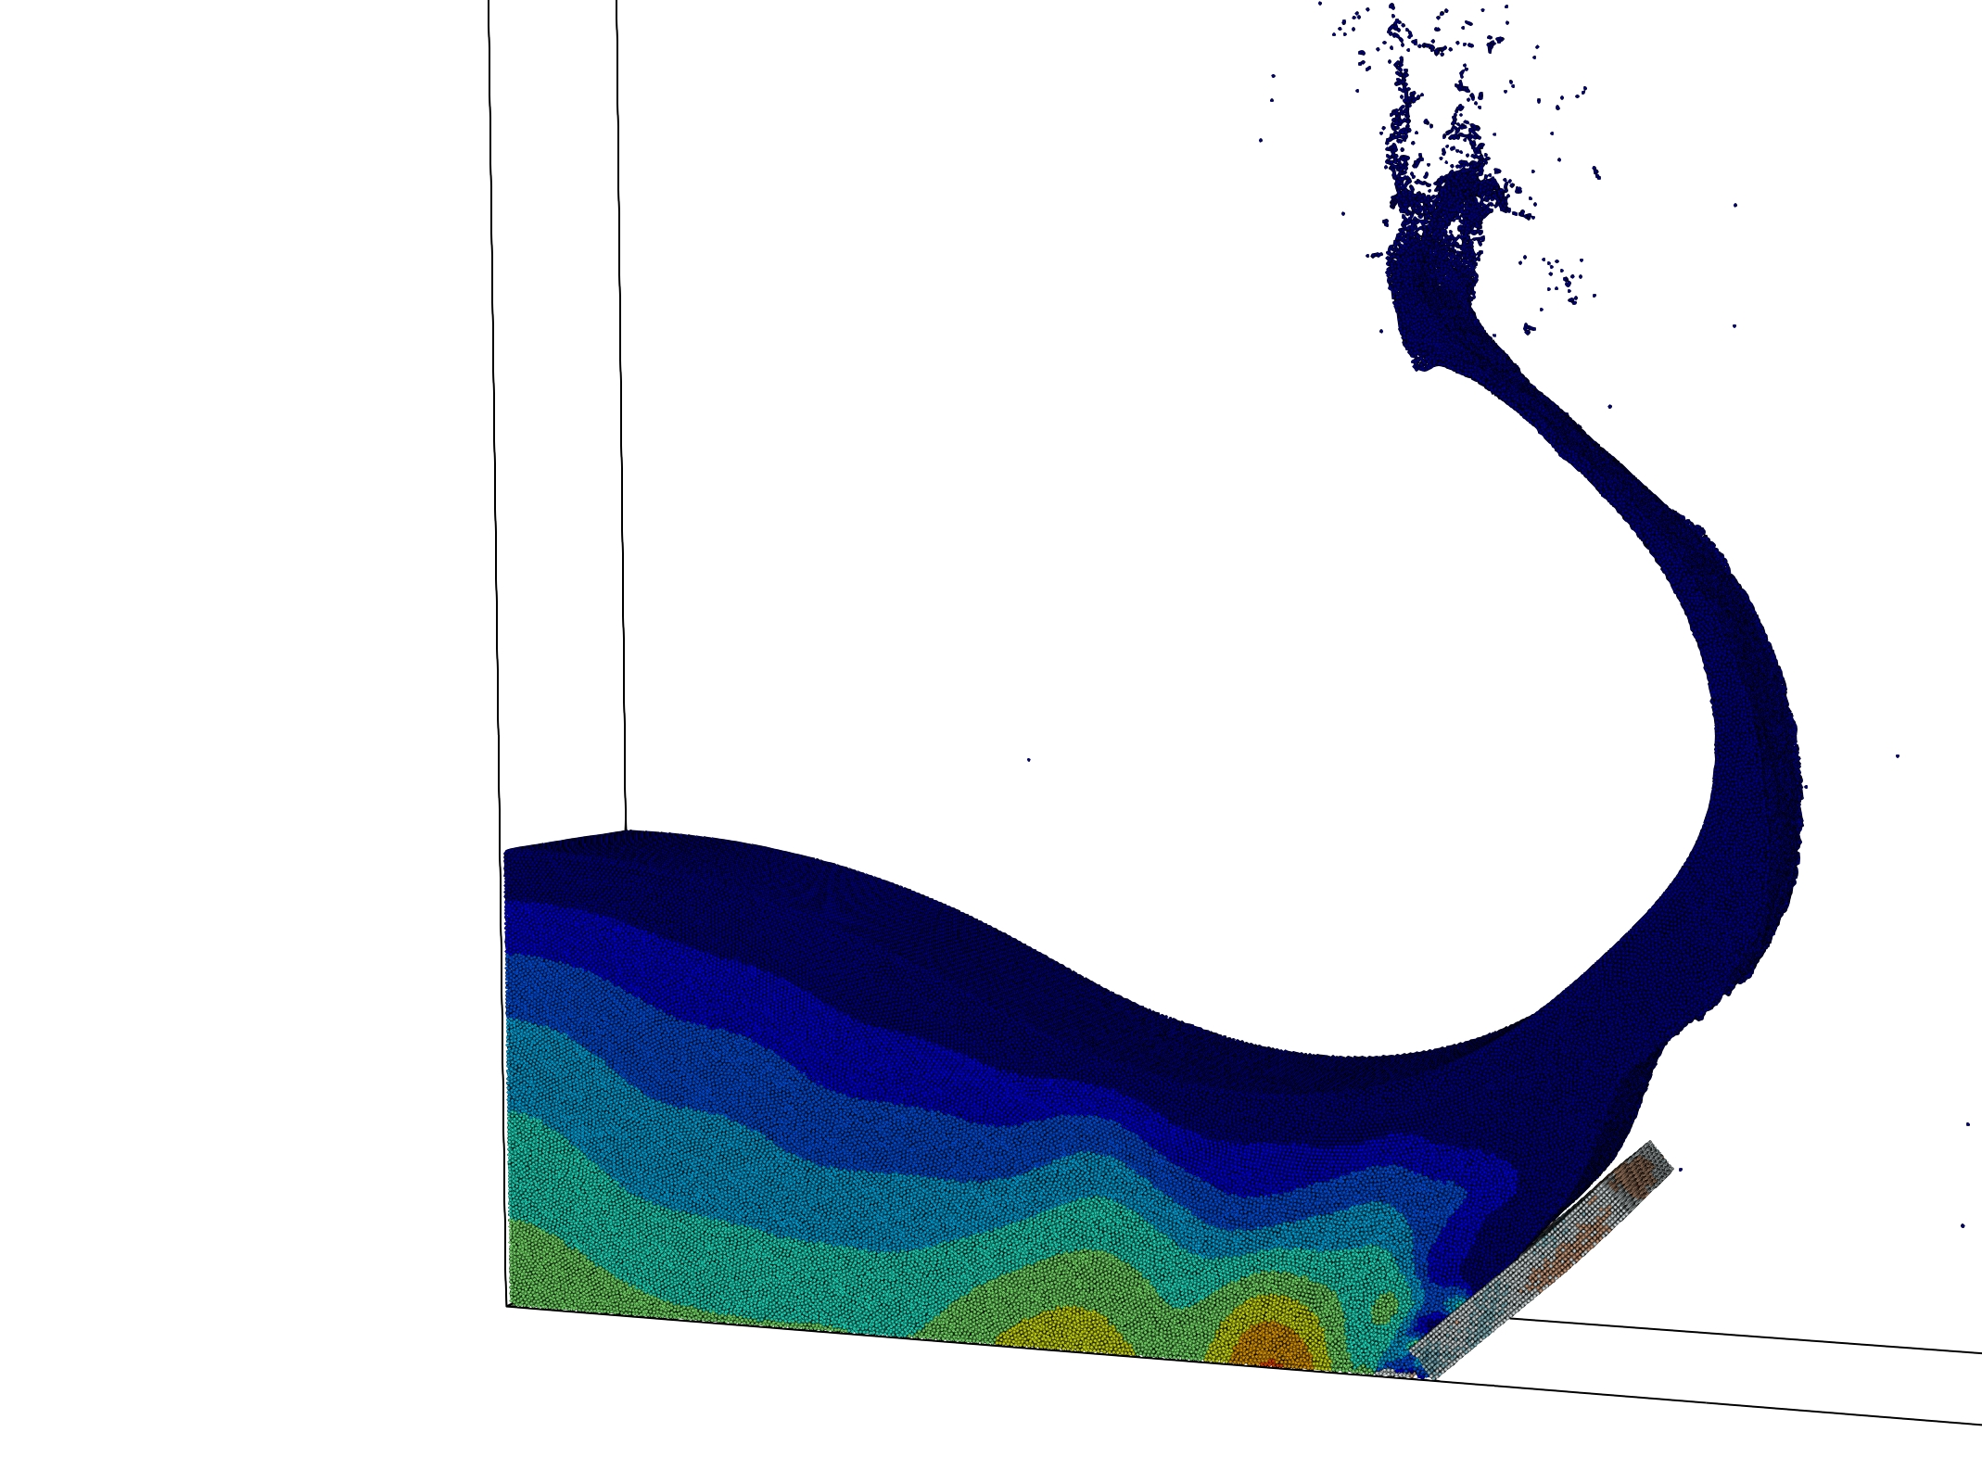
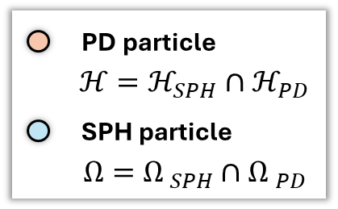
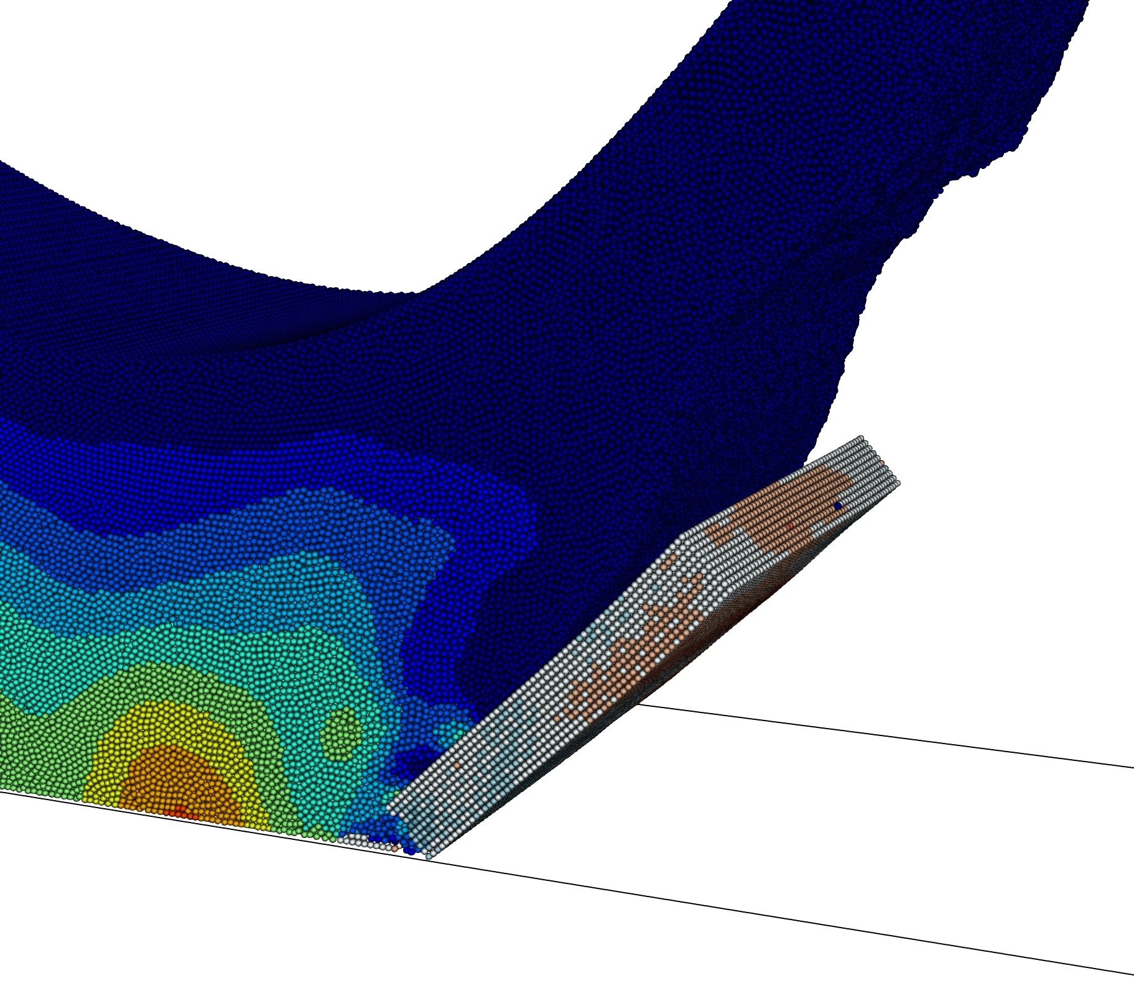








< Elastic Response >
Momentum Exchange
$$Ω$$
$$Ω_{SPH}$$
Structure
$$Ω_{PD}$$
Fluid
$$ℋ_{SPH}$$
$$ℋ$$
$$ℋ_{PD}$$
Peridynamic
Force
< Brittle Fracture >
Peridynamic
Force
$$ℋ_{SPH}$$
$$ℋ$$
Wall

