Slide 1
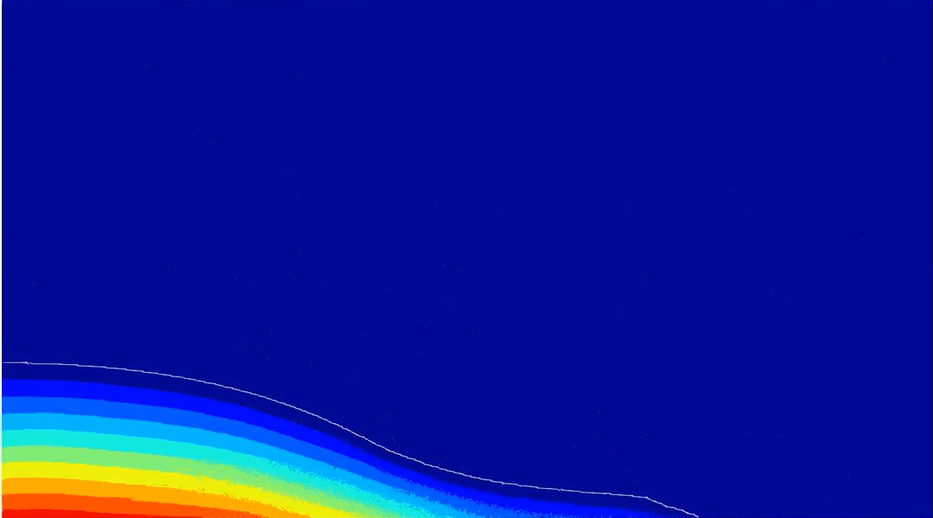
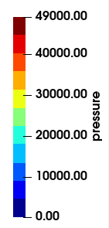




3H
2H
Compressible
phase
$$\frac{dρ}{dt}=−ρ∇∙u+δ∇^{2}ρ$$
P/ρ_{w}gH
H
1
$$u, P$$
$$u, P$$
Incompressible
phase
$$∇^{2}P=b_{i}$$
0
0
0
H
2H
3H
4H
5H

