Slide 1
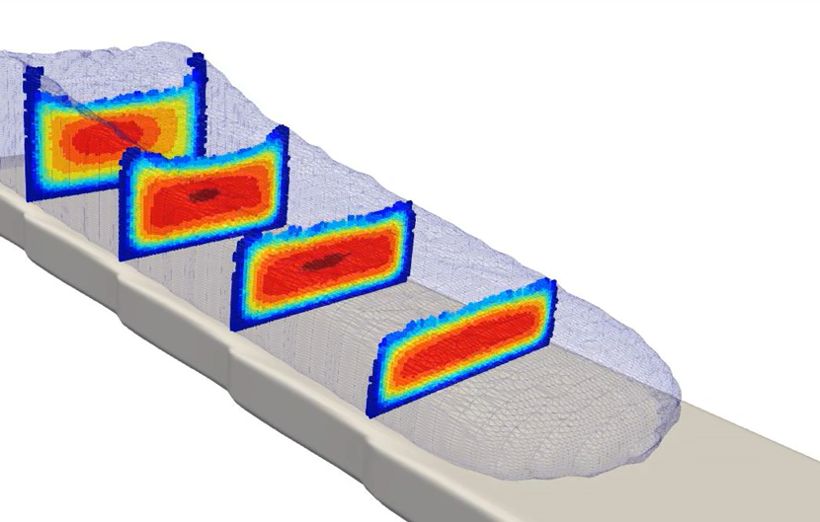
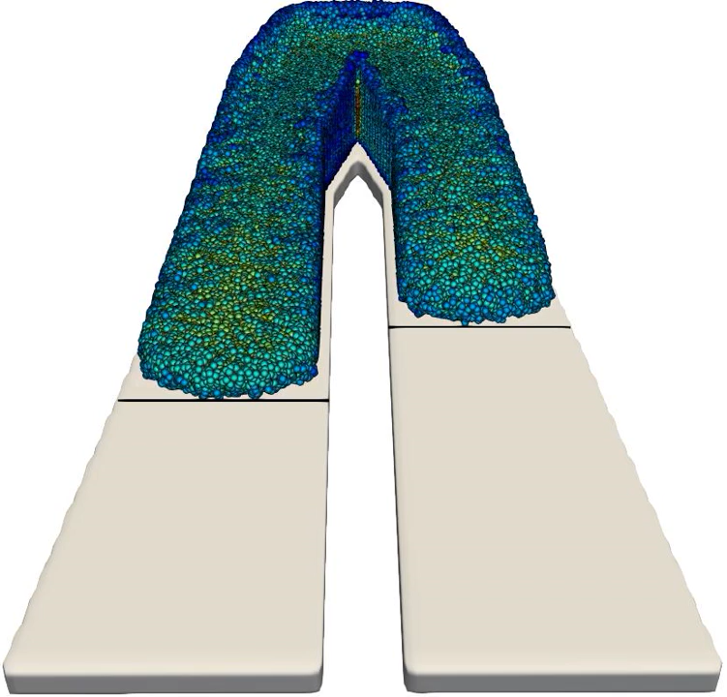
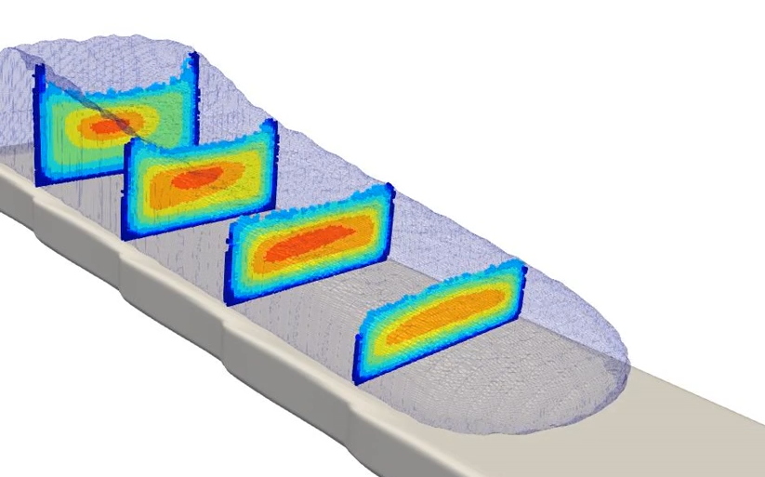
VULCANO Experiment
(Wide mushy Zone)
Temperature [K]
1250
2450
Solid fraction
0.5
1.0
Experimental result
Ceramic
Concrete

