Slide 1
AI-CONTROLLED MULTI-SOURCE POWER INTEGRATION
IN SUSTAINABLE EV CHARGING STATIONS
Major Project
Presented By
Maddala Monanjali
Department of Electrical and Electronics Engineering
Shri Vishnu Engineering College for Women (A)
Bhimavaram, Andhra Pradesh - 534201
Notes:
Station

Slide 2
Contents:
Introduction
Problem Statement
Literature survey
Block Diagram
Objectives
Output
Conference Acceptance
Paper Publication
References

Slide 3
Introduction:
This project focuses on developing a sustainable EV charging station using multisource power integration.
It integrates solar energy, battery storage, and grid power to ensure uninterrupted EV charging.
An ESP32 microcontroller monitors voltage and current from all power sources in real time.
An AI-based control intelligently selects the optimal power source based on availability and demand.
The system improves energy efficiency, reliability, and reduces dependency on conventional grid power.

Slide 4
Problem Statement:
Most EV charging stations depend only on grid power, which increases electricity cost and carbon emissions.
Solar energy availability is not continuous, so charging becomes unreliable when solar power is low.
Existing systems do not have smart control to efficiently manage and switch between multiple power sources.
Due to poor power management, EV charging stations face energy wastage, interruptions, and low efficiency.

Slide 5
Literature Survey:
Si.No | Title and Author’s | Paper Details | Description | Key Findings
1. | Title:Charge Scheduling Optimization of Electric Vehicles. Author’s:Shereen Siddhara Abdul Salam, Veena Raj, Mohammad Iskandar Petra, Abul Kalam Azad, Sathyajith Mathew, and Sheik Mohammed Sulthan | Published in IEEE Access, 2024 DOI: 10.1109/ACCESS.2024.3433031 | This paper presents a comprehensive review of electric vehicle (EV) charge scheduling optimization, highlighting its growing importance in the shift toward sustainable transportation. | Uncoordinated EV charging can overload the grid, cause voltage drops, and lead to energy losses. Coordinated charging strategies help optimize grid use and maintain stability. AI-based models, especially Machine Learning (ML) are increasingly used to optimize charging decisions in real time, predict demand, and manage user priorities and grid constraints
2. | Title:Review of Electric Vehicle Charging Technologies, Standards, Architectures, and Converter Configurations Author’s:M. S. Altaf, S. S. Dash, and S. Pattnaik | 2022 International Conference on Smart Technologies and Systems for Next Generation Computing (ICSTSN) DOI: 10.1109/ICSTSN54951.2022.9780481 | This paper presents an AI-based control system for managing power in electric vehicle (EV) charging stations using multiple energy sources such as solar, wind, and the utility grid. The proposed model ensures efficient energy use, reduces environmental impact, and improves the sustainability and reliability of EV charging by dynamically selecting the most optimal power source in real time. | AI-based control system enables real-time selection of optimal power sources (solar, wind, grid), improving energy efficiency in EV charging stations. Integration of renewable energy reduces dependency on the conventional grid, promoting sustainability and lowering carbon emissions.

Slide 6
Block Diagram:
Solar Panel
DC-DC converter
Ac Supply
ESP32
Micro-controller
Web Server Interface
Load

Slide 7
Objectives:
To integrate multiple power sources like solar and grid for reliable EV charging.
To monitor voltage and current from each source using sensors and ESP32.
To implement intelligent power management for efficient source selection.
To prioritize renewable energy usage to improve sustainability and reduce grid dependency.

Slide 8
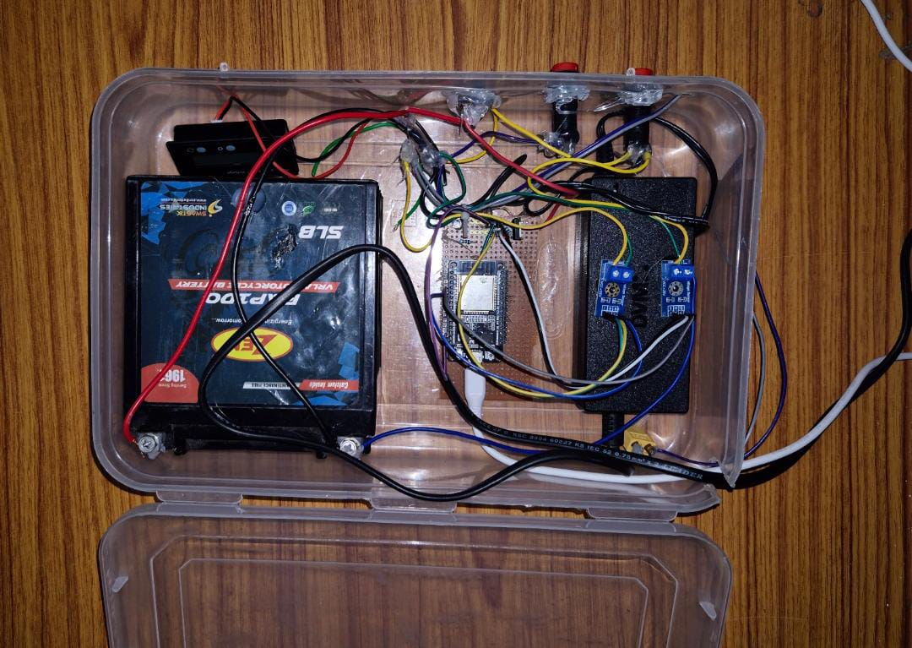
Prototype:

Slide 9
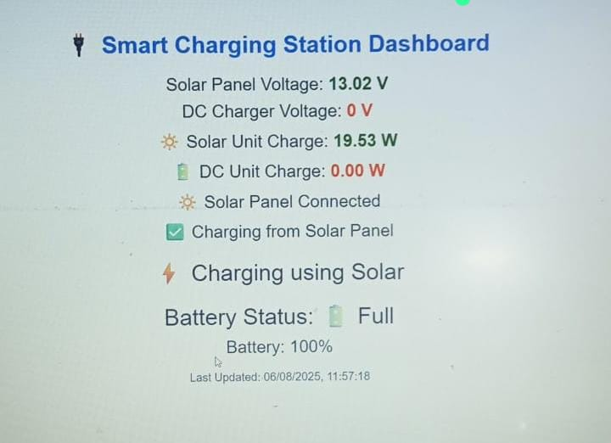
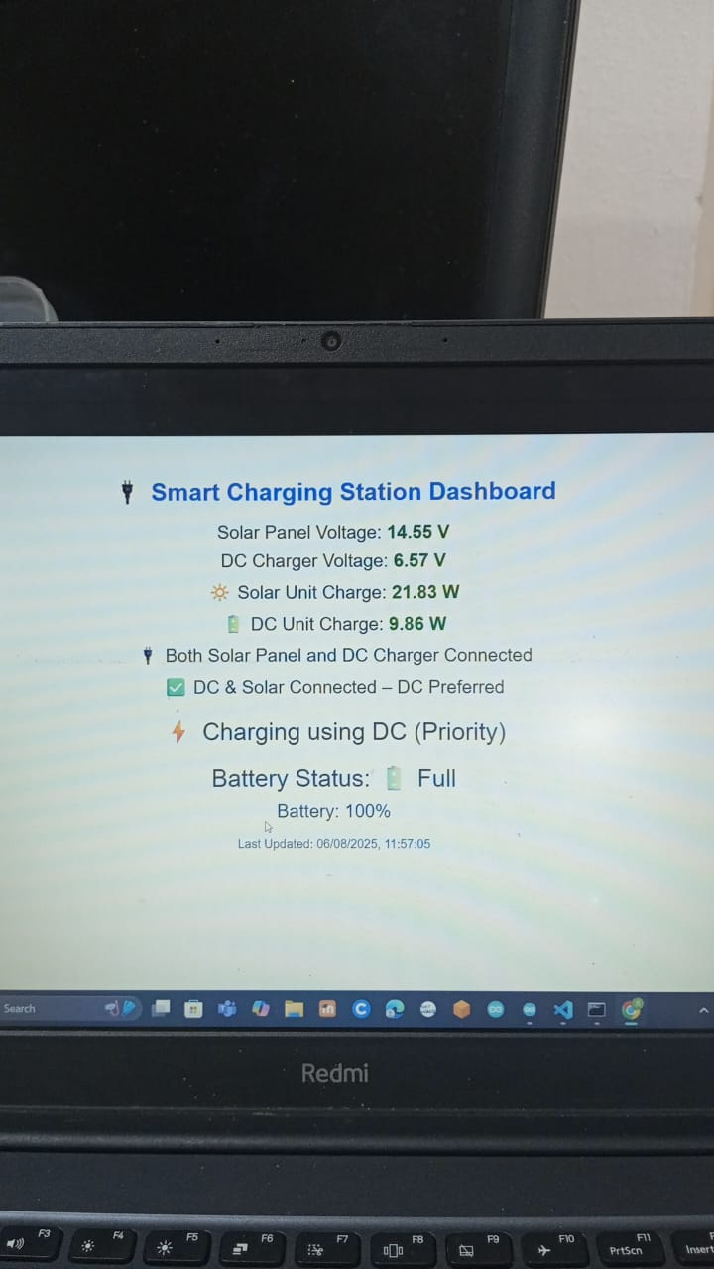
Output:

Slide 10
Conference Acceptance & Publication Status:
Paper accepted and presented at IEEE EPREC-2026 (International Conference on Electric Power & Renewable Energy).
Conference publication strengthens academic credibility and industry relevance.

Slide 11
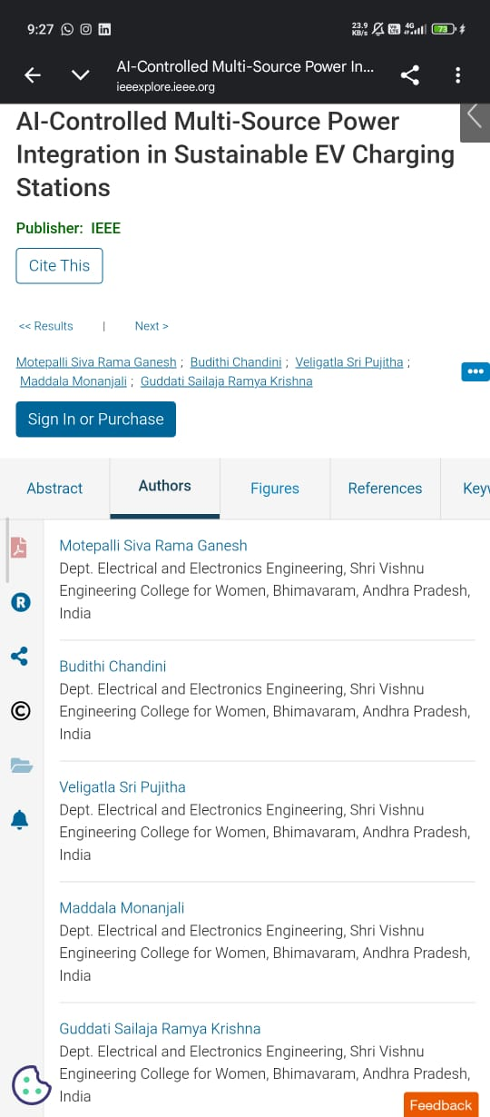
This project titled “AI-Controlled Multi-Source Power Integration in Sustainable EV Charging Stations” has been published in the IEEE Research Paper at IIT Bhilai.This publication highlights our proposed system for integrating multiple power sources to support efficient and sustainable EV charging.
Paper Publication at IIT Bhilai:

Slide 12
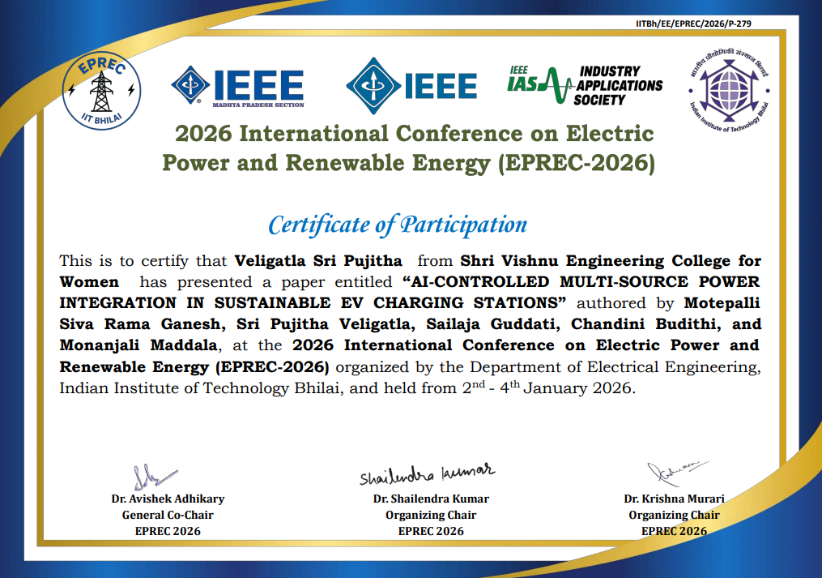

Slide 13
References:
2022 – IEEE Transactions on Smart Grid: AI-based systems can reduce charging costs by 25% through predictive source switching.
2021 – Elsevier Renewable Energy Journal: Multi-source hybrid charging stations show improved uptime and energy independence.
2023 – Journal of Cleaner Production: Integration of solar with smart control reduced emissions by 30% compared to grid-only systems.
2022 – Energy Reports (Elsevier): Hybrid systems combining solar and battery storage showed reliable off-grid performance and lower lifecycle costs.
2023 – Sustainable Cities and Society: AI-enabled demand response in EV stations led to 15–20% energy savings during high-tariff hours.
2012 – IEEE International Electric Vehicle Conference: A. Arancibia and K. Strunz, “Modeling of an electric vehicle charging station for fast DC charging,”Greenville, SC, USA, 2012, pp. 1-6.
2016 – IEEE Transportation Electrification Conference and Expo: A. B. Khan, et al., “Multistage constant-current charging method for Li-Ion batteries,”.

Slide 14
THANK YOU

