Slide 1
SEPIO: A Semantic Model for the Integration and Analysis of Scientific Claims
Matthew Brush

Slide 2
Evidence and Provenance (E/P)
Explain why we believe a claim to be true (or not)
Evidence is information used to evaluate the validity of an assertion (aka a claim)
research data and observations, prior claims, established facts
Provenance information describes the process history of a claim and its evidence
who made the claim, how, when
who generated data used as evidence, how, when
The validity of claims ultimately rests on critical evaluation of all relevant evidence and provenance.

Slide 3
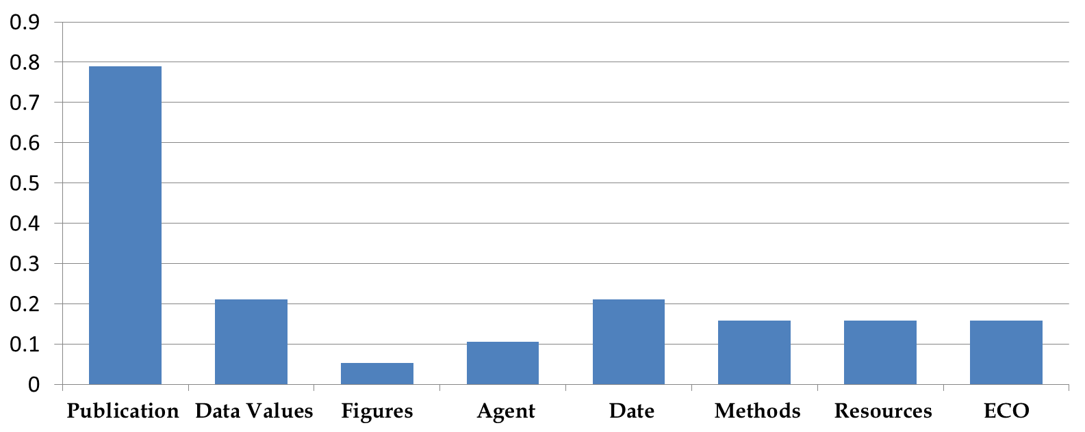
Evidence and Provenance Metadata are Minimally and Inconsistently Described
Structured Metadata Reported in G2P Databases
% of Databases Reporting (n=20)
Type of Metadata Reported
Majority provide only references to supporting publications
Evidence codes can offer summary-level annotations
No standards supporting consistent representation
, www.monarchinitiative.org
Notes:
---------------------
SGD Flybase Wormbase ZFIN MPD IMPC MGI MMRC RDG CTD OMIA Orphanet GWAS catalog AnimalQTL KEGG Clinvar Coriell OMIM Pombase , GO

Slide 4
Evidence and Provenance Metadata are Minimally and Inconsistently Described
Notes:
a deeper look at E/P metadata in some exemplar sources . . .
human variation interpretation data sources often provide more diverse and complex evidence and provenance scenarios - ClinVar, CIViC, ClinGen . . .

Slide 5
Clinical Variant Interpretation (VI)
Variant interpretations are assertions about the causative relationship between a genetic variant and a disease or its treatment
Pathogenicity: contributes to disease onset/susceptibility
Diagnostic: is marker for a particular diagnosis
Prognostic: correlates with disease severity/outcome
Predictive: correlates with response to treatment
Variant Interpretations:
rely on complex and diverse types of evidence requiring nuanced and subjective interpretation
are generated through systematic curation pipelines
often conflict with each other
have direct clinical application

Slide 6
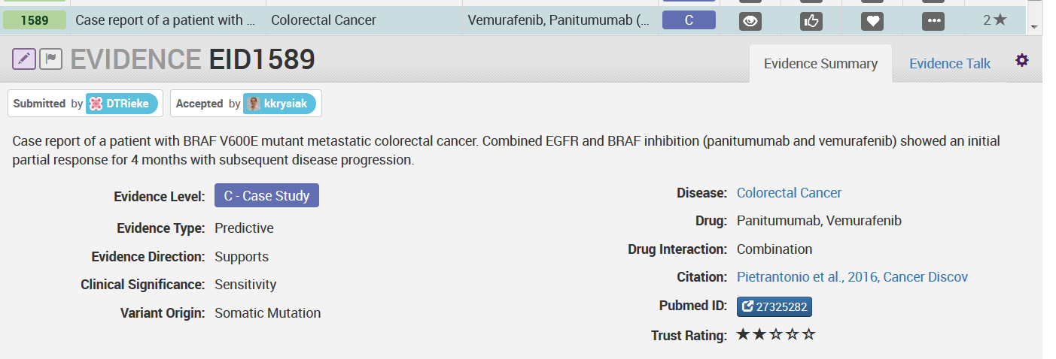
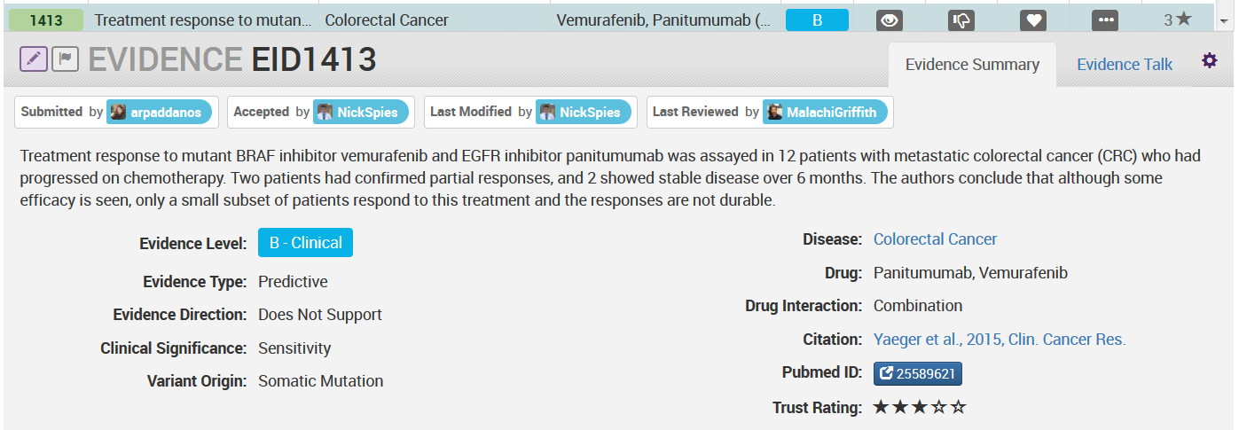
Evidence and Provenance in CIViC
Claim: BRAF V600E correlates with sensitivity to Vemurafenib+Panitumimab treatment of Colorectal Cancer
Notes:
VI example from CIVIC –an assertion about the correlation between a variant and response to a particular treatment for colorectal cancer.
Whereas ClinVar aggregates assertions made by other agents, CIViC curators aggregate evidence for a particular claim by reviewing study outcomes form the literature.
one line of Evidence that “Supports Sensitivity” and the other that “Does Not Support Sensitivity”

Slide 7
Standards for Variant Interpretation
Many isolated curation pipelines and data systems
Many public databases curating and/or aggregating VI claims (ClinVar, CIViC)
Many consortia and WGs coalescing around need for standards for interoperability and exchange - with focus on E/P (GA4GH, VICC, ClinGen)
Push for standardization of VI curation processes as well (ACMG Guidelines, Invitae-Sherloc)
SEPIO-ClinGen Collaboration to develop a comprehensive SEPIO-aligned VI model to support ACMG-based workflows
Notes:
many efforts towards standardizing process and models for data sharing

Slide 8
SEPIO Use Cases for E/P Metadata
Communication: common language and conceptual model
Human Consumption: provide context to support assessment of credibility and utility
Knowledge Discovery and Re-Use: filter/facet based on E/P
Computational Evaluation: assess credibility, resolve conflicts, identify evidence gaps, apply new knowledge
Attribution: assess contributions, feedback to data and resource creators
Knowledge Creation: identify ‘outlier’ agents, allow curation in context of prior evidence and knowledge

Slide 9
SEPIO Framework
A semantic and tooling infrastructure to support ontology development, curation, data integration and exchange, and evidence-based computational analysis of scientific claims
Three Components
Semantic Data Model: A domain-agnostic, extensible, semantic data model that captures key perspectives on evidence and provenance information
Supporting Ontologies: A suite of integrated modules from orthogonal ontologies to support rich semantic descriptions of evidence and provenance
Tools and Algorithms: A suite of tools supporting metadata curation, ontology engineering, data integration, and evidence-based evaluation of scientific claims

Slide 10
SEPIO Framework
I. SEPIO Ontology and Data Model
A domain-agnostic, extensible, semantic data model that can capture key perspectives on evidence and provenance information

Slide 11
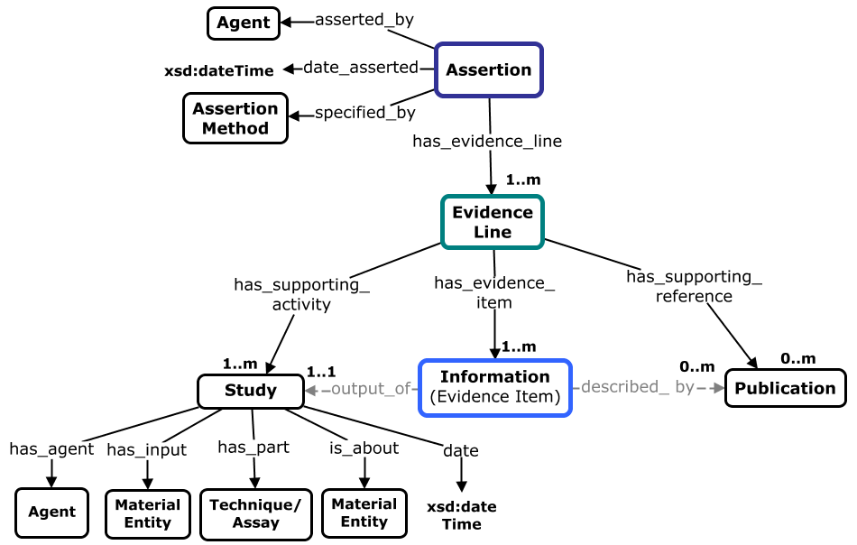
SEPIO Core Concepts and Relationships
(aka ‘Claim’) A statement of purported truth, as made by a particular agent on a particular occasion
An independent and meaningful argument for or against a particular proposition.
A single piece of information used as evidence

Slide 12
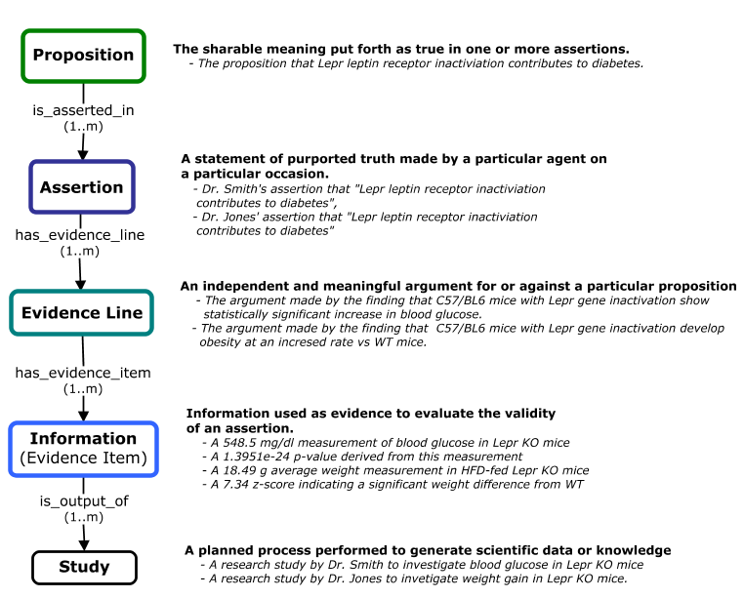
SEPIO Core Concepts and Relationships
Notes:
two assertions here put forth the same fact or proposition as true (proposition represents the abstract meaning expressed in an assertion) – many assertions can put forth the same proposition, as seen here.
Evidence lines make separate arguments – so for these assertions there may be one evidence line representing the argument that Lepr gene inactivation leads to inc blood glucose and another that it leads to obesity.
Each evidence line is supported by one or more evidence item – here are four examples, that are generated by different research studies.

Slide 13
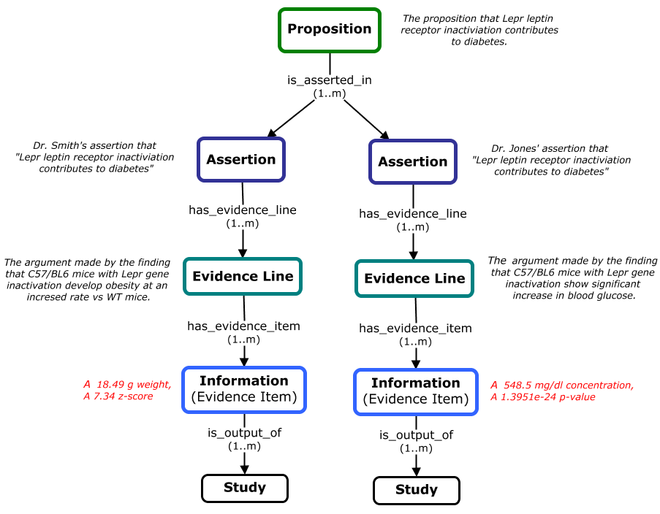
SEPIO Organizes Evidence at Different Levels
Notes:
SEPIO allows us to organize fundamental info used as evidence at different levels to support different types of questions and use cases
Studies let us organize these evidence items according to their experimental provenance – to understand different studies involved in generating evidence for a claim
Evidence Lines organize evidence items to reveal the distinct arguments that emerge from their interpretation
Assertions let us understand what arguments and evidence are used by a particular agent in making a particular claim
Propositions reveal the total evidence that exist for **or against** a proposed fact. A single proposition will group all assertions that support or refute this fact, and inherit the evidence these assertions use in doing so.

Slide 14
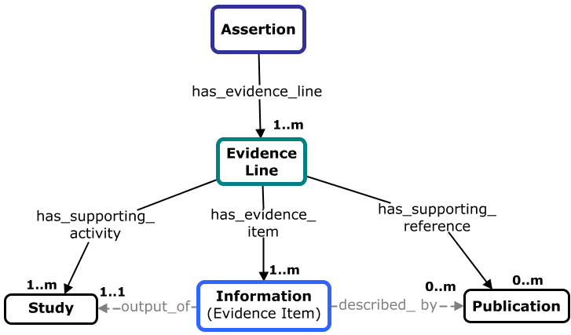
SEPIO “Evidence Graphs”
Location of common forms of E/P metadata in a SEPIO graph
“BRAF V600E correlates
with sensitivity of
Colorectal Cancer to
Vemurafenib + Panitumumab”
agent,
date
evidence
codes
agent, date,
tools, techniques
research data,
prior assertions
literature
citation
Notes:
SEPIO structures data into “evidence graphs” that allow us to trace E and P for an assertion through one or many levels of argument and interpretation.
highest level SEPIO concepts, and where most common types of E/P information fit into the model

Slide 15
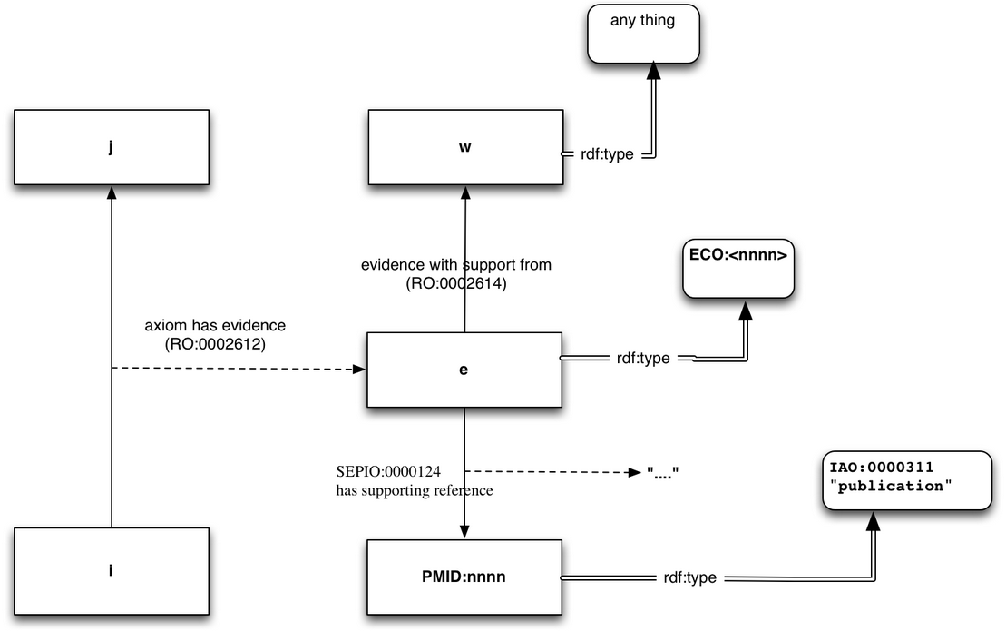
SEPIO v GO-CAM Evidence Models
Similar core structure, but SEPIO more explicit about nature of the evidence object, and allows captures richer context of evidence items
Notes:
similar in that a claim (here a reified triple) is linked to an evidence object typed using ECO, which is linked to things that “support” this evidence (studies, data, publications)
SEPIO is explicit about this E object representing ‘evidence line’. And SEPIO allows for more fine grained organization of evidence items and representation of its provenance. (which items were generated in a particular study, which support distinct lines of evidence, which were used in making different assertions)

Slide 16
SEPIO Evidence Graphs
Example 1. ZFIN G2P: literature citation, ECO evidence code, figure
'ndr2<tf219>/ndr2<tf219>;
shha<Df(Chr07)t4>/shha<Df(Chr07)t4>
has_phenotype
'abnormal(ly) decreased size otolith'
ECO:0000059
Figure 7, Hammond
et al 2003
PMID:
12588855
Notes:
a simple example – ZFIN provides a literature citation, ECO code, and figure showing supporting data for the G2P assertions it reports.

Slide 17
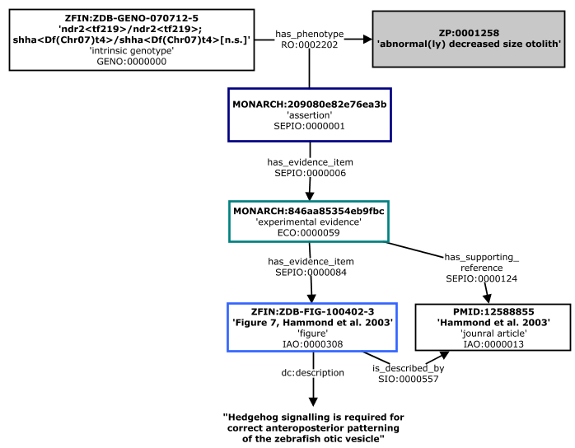
SEPIO Evidence Graphs
Example 1. ZFIN G2P: literature citation, ECO evidence code, figure
Notes:
An actual ZFIN record – where the assertion is supported by a single evidence line from a single experimental study, and a published figure from this study is provided as an evidence item.

Slide 18
SEPIO Evidence Graphs
Example 2. IMPC G2P: measurement data, statistical scores, methods
'Mysm1<tm1a(KOMP)Wtsi/tm1a(KOMP)Wtsi>
[C57BL/6Dnk]
has_phenotype
'abnormal bone mineralization''
methods,
agents
measurement data,
statistical scores
Notes:
A G2P assertion from IMPC – provides richer E/P information including measurement data, statistical scores, and methods.

Slide 19
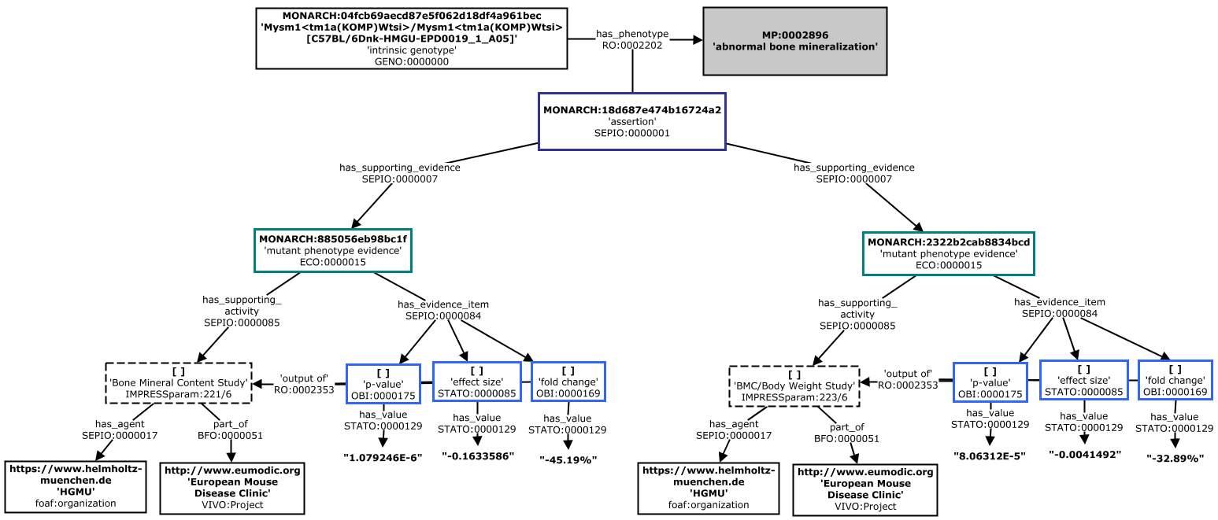
SEPIO Evidence Graphs
Example 2. IMPC G2P: measurement data, statistical scores, methods
'Mysm1<tm1a(KOMP)Wtsi/tm1a(KOMP)Wtsi>[C57BL/6Dnk] has_phenotype 'abnormal bone mineralization''
Notes:
example record, assertion has two supporting evidence lines based on data from two studies. Detailed measurement data and statistical scores reported for each.
highlights role of Evidence Lines in organizing evidence data from two studies into two distinct arguments for the assertion.

Slide 20
SEPIO Evidence Graphs
Example 3. CIViC variant interpretation: finding, study type, literature, evidence strength
“BRAF V600E correlates
with sensitivity of
Colorectal Cancer to
Vemurafenib + Panitumumab”
CIViC
Trust Rating
CIViC
‘Evidence Level’
CIViC ‘Evidence
Statement’
Literature
Reference
Notes:
example from CIViC variant interpretation from earlier

Slide 21
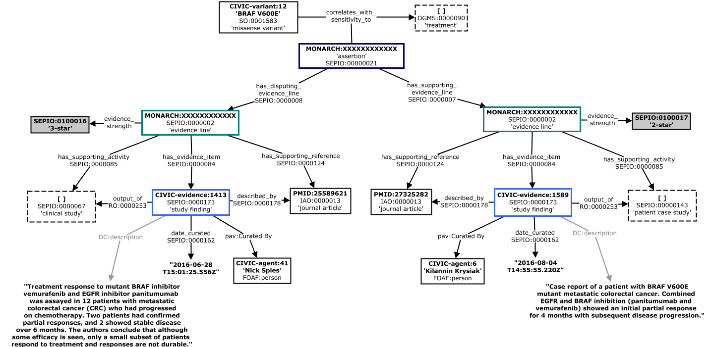
SEPIO Evidence Graphs
Example 3. CIViC variant interpretation: finding, study type, literature, evidence strength
“BRAF V600E correlates with sensitivity of Colorectal Cancer to Vemurafenib + Panitumumab”
Notes:
assertion has conflicting evidence, so it is shown here with one supporting and one disputing evidence line.

Slide 22
Modeling the ACMG VI Workflow
ACMG Guidelines define key types of evidence, offers guidance for evaluating individual evidence lines, and provides rules for combining them to reach a final interpretation
Pathogenic, Likely Pathogenic, Uncertain Significance, Likely Benign, Benign
16 weighted criteria that support a variant being pathogenic (P), 12 weighted criteria that support a variant being benign (B)
Computational Evidence - PVS1: Variant is predicted to be a null variant of a gene where LOF is a known mechanism of disease
Functional Evidence - PS3: Variant shown deleterious by functional studies in vitro/in vivo
Population evidence -BS1: Variant allele frequency is too high for disorder (>5%/too high for disorder)
Notes:
Final example highlight work with CG to align their VI data model with SEPIO.
Used to exchange and analyze data generated from VCI – implements ACMG workflow ad captures detailed EP metadata for each step.

Slide 23
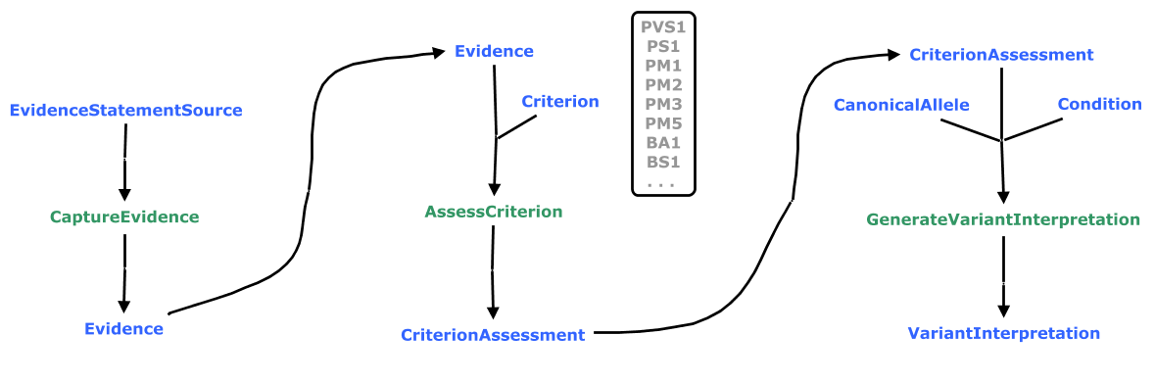
Modeling the ACMG VI Workflow
Notes:
three actives in green that use or generate artifacts in blue.
1. a curator captures elemental data that will be used as evidence
2. evidence data is then evaluated according to the ACMG criteria to generate a CA (an assertion as to whether the criterion is met for the variant)
3. all relevant CAs for a variant are evaluated together using an ACMG rubric to generate a final VI.

Slide 24
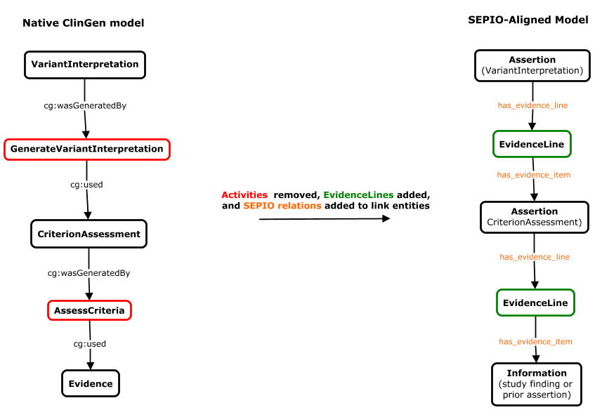
Modeling the ACMG VI Workflow
Notes:
This workflow translated quite nicely into a SEPIO-shaped graph.

Slide 25
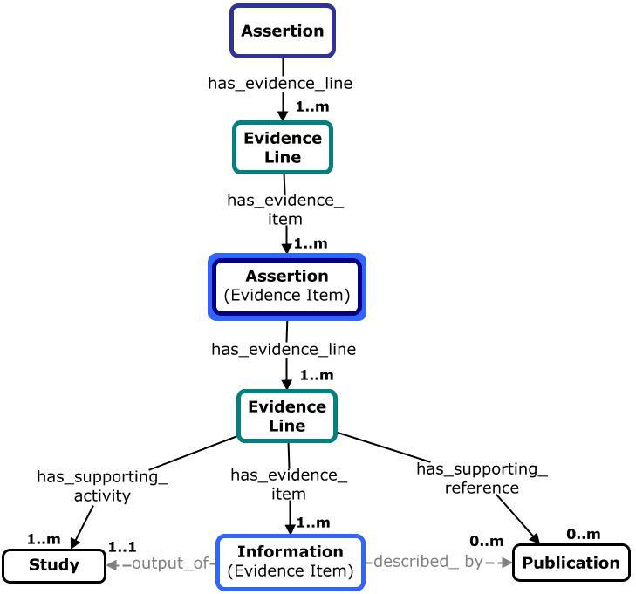
SEPIO Evidence Graphs
Example 4. ClinGen/ACMG variant interpretation: full provenance and evidence
DSC2:c.631-2A>G is likely_pahogenic_for arrhythmogenic ventricular cardiomyopathy
agent,
date, role,
method
(Variant Interpretation)
evidence
strength
agent,
date, role,
method
Criterion Assessment
research data,
prior assertions
Literature
Reference
Notes:
how E/P data collected in the CG tool maps to the SEPIO model.
note there are two levels of assertion. the first tier of evidence for the VI is several prior assertions that result from assessing the variant against different ACMG evidence criteria. and each of these assertions in turn has its own set of one or more evidence lines and supporting data.

Slide 26
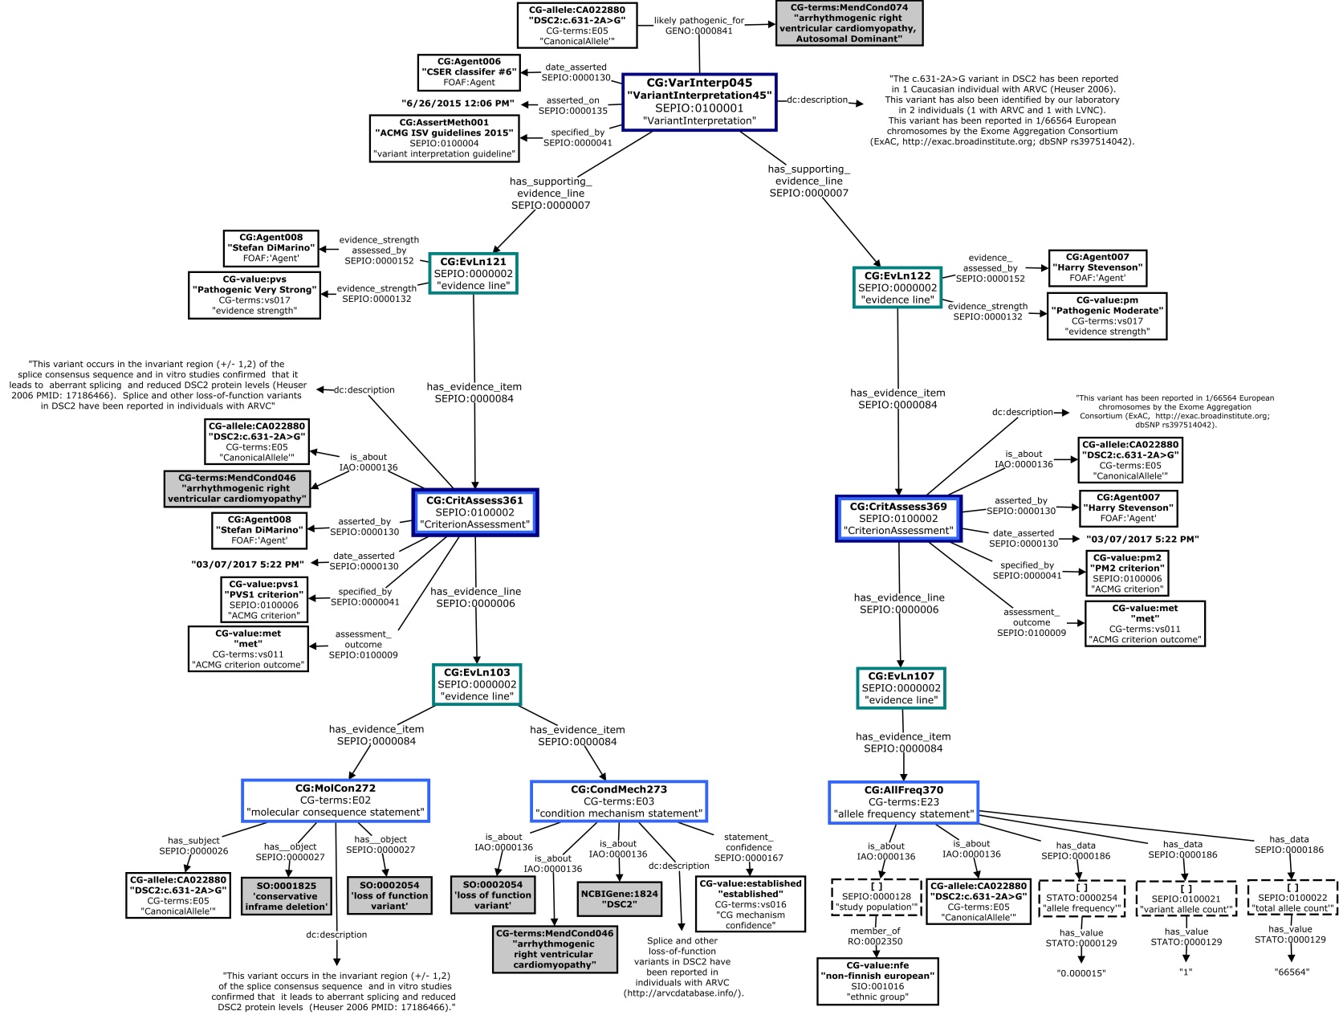
SEPIO Evidence Graphs
Example 4. ClinGen/ACMG variant interpretation: full provenance and evidence
DSC2:c.631-2A>G is likely_pahogenic_for arrhythmogenic right ventricular cardiomyopathy
Notes:
evidence graph for a VI provided by the CG tool, which collects very detailed E/P info as shown. describes a complex interpretation scenario performed by multiple agents and involving several levels of assertions each with multiple lines of evidence.

Slide 27
Key Features of the SEPIO Data Model
SEPIO Concepts and relationships are generic and apply universally in any domain – based in realism that mirrors the cognitive processes involved in making an evidence-based assertion
Organizes evidence data at different levels to support different use cases (Study, Evidence Line, Assertion, Proposition)
Explicitly represents provenance of assertions, and separately tracks the provenance of all evidence supporting or refuting it (typically by describing studies that generate data or findings used as evidence)
Evidence lines are key organizing nodes that let us capture how info interpreted and applied as evidence to support or refute a claim
Evidence lines also essential for assess the quantity, quality, diversity, and concordance of evidence for a claim – four key dimensions that are essential for computational evaluation use cases
SEPIO allows us to organize evidence date at different levels and represent many perspectives on evidence, to support different types of questions and use cases

Slide 28
SEPIO Framework
II. Supporting Ontologies
Modules from orthogonal ontologies that support rich semantic descriptions of evidence and provenance.

Slide 29
Orthogonal Domains (and Term Sources)
Study/Technique Types: OBI, ERO, EFO, CMO, Fbbi, MMO, PSI-MI , NPO
Evidence Types: ECO
Data Types: OBI, IAO, STATO, ERO, . . .
Value Sets:
clinical significance terms (e.g. P, LP, B, LB, VUS)
evidence strength terms (e.g. A, VS, S, M, P)
Biomedical Concepts:
- genes, diseases, drugs
4a
2
4b
1
3
Notes:
different domains of terms needed to support SEPIO E/P descriptions, and potential sources for these terms.
These terms are often fragmented across many ontologies, or don’t exist at all - there is an opportunity here to build integrated ontologies that provide unified and comprehensive representations of these domains – analogous to MONDO for diseases.

Slide 30
Added Value Through Ontology Re-Use
Re-use of terms from orthogonal ontologies to capture E/P metadata
interoperability through use of community standards
knowledge encoded in ontologies can be leveraged for computational analysis
Measuring Evidence Diversity Using ECO to assess Semantic Similarity
:claim1
“pathogenic”
:claim2
“benign”
:e1
:e2
:e3
:e4
:e5
co-immunoprecipitation evidence
imaging evidence
microscopy evidence
functional complementation evidence
co-localization evidence
Notes:
Example here shows how we could leverage structure of terms in ECO that we use to type evidence lines in SEPIO models to support semantic similarity based assessment of evidence diversity – to assign higher credibility to claims based on more diverse evidence.

Slide 31
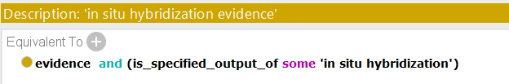

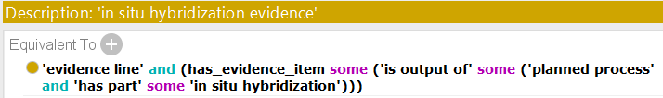
ECO Improvements Needed for Max Benefit
Extend coverage (e.g. into clinical domain)
Complete logical definition coverage
Align ECO logical design patterns with SEPIO data modeling patterns
ECO logical definition of ‘in situ hybridization evidence’
SEPIO evidence graph
ECO logical definition required for classification
Notes:
improvements to ECO that will be required to fully leverage this resource in SEPIO
aligning logical def patterns would allow automatic assignment of ECO terms to untyped evidence line instances.

Slide 32
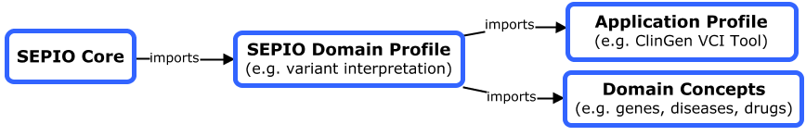
SEPIO Modules and Profiles
SEPIO Core: holds domain-agnostic core terms
SEPIO Domain Profiles: hold specific subtypes or instances of core classes
SEPIO Application Profiles: hold terms specific to a particular application
Domain Concept Extensions: holds terms relevant to the profiled domain
Notes:
To facilitate application of SEPIO in different domains and applications, need a system where the Core SEPIO model can be extended to create Domain and Application Profiles

Slide 33
SEPIO Framework
III. Supporting Tools
A suite of tools supporting metadata curation, ontology engineering, data integration, and evidence-based evaluation of scientific claims

Slide 34
Tools for Metadata Creation
E/P metadata in existing databases is minimal and inconsistently structured
No standard model for interoperability or tools to leverage this metadata
Solution: SEPIO + Table Editor?
Notes:
Lack of E/P data at all is really the biggest challenge – time and effort required, and benefit often not immediately apparent
no standard models or tools to capture and leverage this metadata – hoping SEPIO can provide this and incentivize curation of E/P info

Slide 35
Tools for Ontology Engineering
Ontology Extension - INCA
Ontology Subsetting - Robot
Ontology Integration – kBoom
Ontology Modules/Profiles – Robot

Slide 36
Tools for Data Interoperation
Data Transformation/Integration
Translating non-SEPIO data into SEPIO compliant data
Scripts/ETL pipelines (e.g. Dipper)
JSON LD contexts (automated conversion of json -> RDF)
Data Conversion Between "Levels“ of Complexity
Translating between SEPIO-defined ‘levels’
Reasoner-based: provide property chains or SWRL rules
Programmatic : pre-packaged SPARQL queries or scripts

Slide 37
Tools for Evidence-Based Evaluation
Assess credibility: understand how strongly supported a claim is.
Resolve conflicts: determine when conflicts exist, understand why, and establish which is more likely to be true
Address ‘evidence gaps’: what types of evidence might bolster dubious claims with insufficient evidence
Algorithms would leverage four dimensions of evidence to which SEPIO provides access
(Quantity, Quality, Diversity, Concordance)
Notes:
algorithms to support computation evaluation of claims based on E/P metadata

Slide 38
SEPIO In Monarch
Current Use
most sources don’t use SEPIO for E/P data
a simple dc:source and ro:has_evidence model suffices
SEPIO tested for selected sources that provide richer E/P
ClinVar, IMPC, CIViC
Short Term Work
migrate all data to use SEPIO
simple dc:source and ro:has_evidence model suffices
refactor association modeling?
SEPIO release
Longer Term Work
improve display of E/P info in Monarch app/services?
implement SEPIO in phenopackets?
TE configurations for curating SEPIO-compliant E/P metadata?

Slide 40
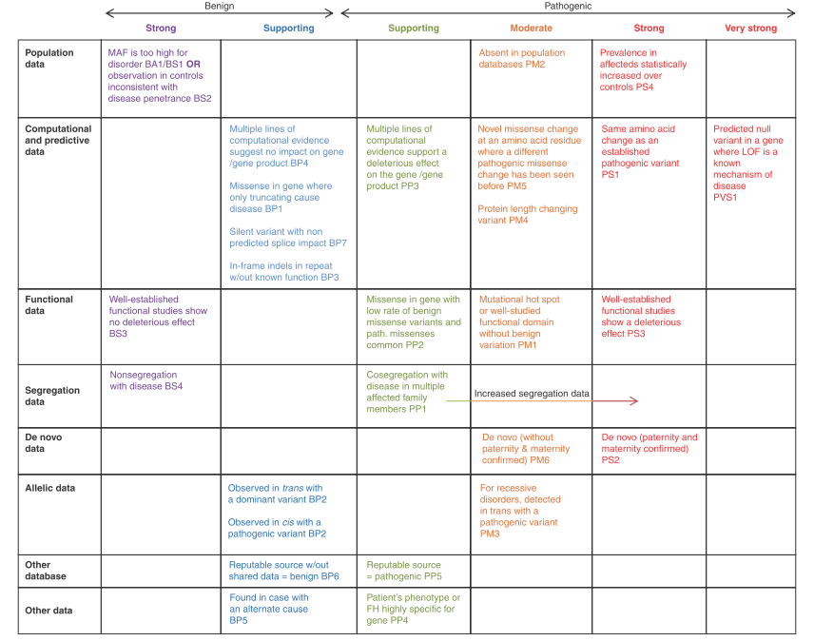
ACMG Evidence Framework
Richards, Sue, et al. "Standards and guidelines for the interpretation of sequence variants: a joint consensus recommendation of the American College of Medical Genetics and Genomics and the Association for Molecular Pathology." Genetics in Medicine (2015).
Notes:
A matrix showing all criteria organized by type of evidence on the right, and direction and strength of the evidence on the top
Richards, Sue, et al. "Standards and guidelines for the interpretation of sequence variants: a joint consensus recommendation of the American College of Medical Genetics and Genomics and the Association for Molecular Pathology." Genetics in Medicine (2015).

