Slide 1
E-MANAGER
LAB EVALUATION PROJECT
PRESENTATION
Submitted To –
Mrs Rishu Taneja
Submitted by-
1) AYUSH SHARMA (2210991430)
2) AYUSH RANA (2210991429)
3) ATUL SHARMA (2210991412)

Slide 2

Abstract
ESSENTIALLY, AN ECOMMERCE MANAGER OVERSEES ALL ONLINE ACTIVITIES AND MAINTAINS THE COMPANY'S BRAND ON ALL DIGITAL PROPERTIES.

Slide 3
Introduction
E-manager is a convenience store managing app. That can be used to create a fully automated environment , weather its about billing or product management or stocks management or even making the shopping convenient and systematic.

Slide 4
DESCRIPTION
Parts Of E-MANAGER
BILLING SYSTEM
INTERNAL MANAGEMENT
Token number
Bill Making
STOCK AVAILABILTY
STOCK UPDATION

Slide 5
Contd...
BILLING SYSTEM
Token number
It’s basically serial number given to customer to make the shopping convenient , systematic and less hectic .
Bill Making
Bill making consists of token number , quantity of items , cost of each and total.
INTERNAL MANAGEMENT
STOCK AVAILABILTY
it gives out list of all the available items with their respecvtive quantity
Stock updation
It’s consists of management of total product stock and adding of new stock by the store staff

Slide 6
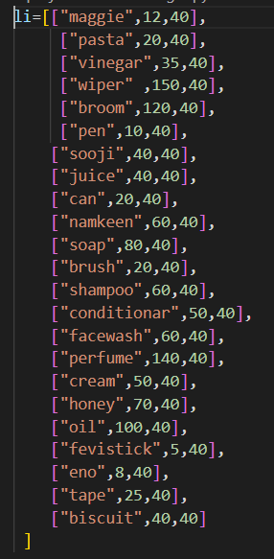
INTERNAL DATABASE
2d list concept is being used in the database
The first element in every sublist represents the item name ,second represents the item’s price and third represent initial stock

Slide 7
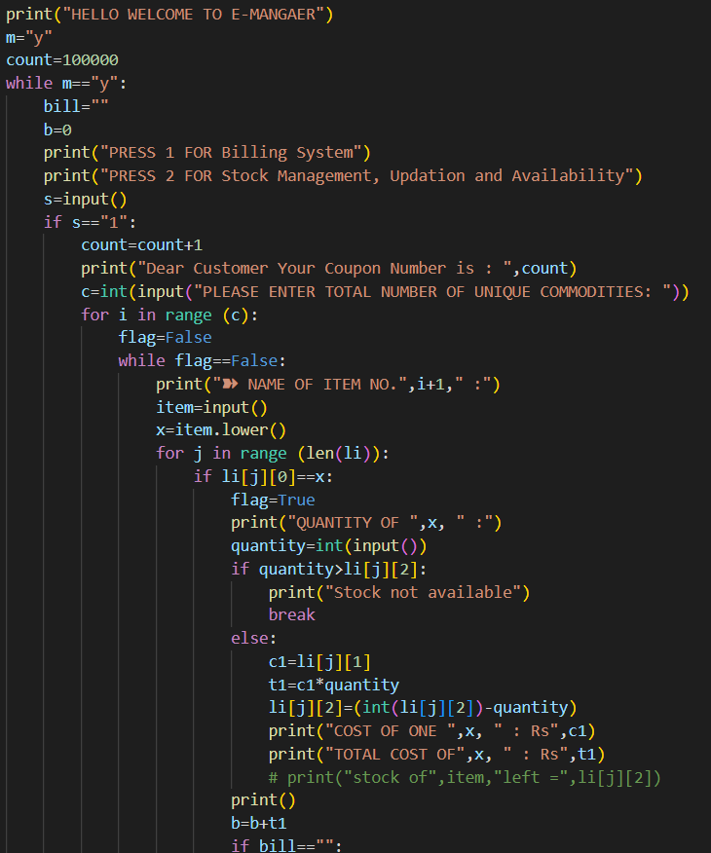
SOURCE CODE

Slide 8
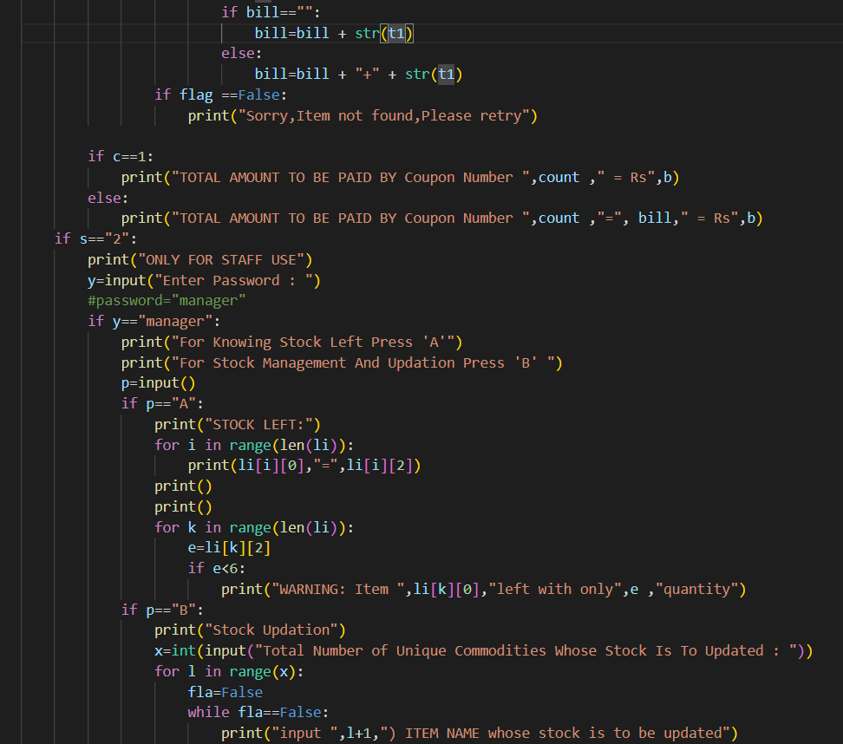
Contd….

Slide 9
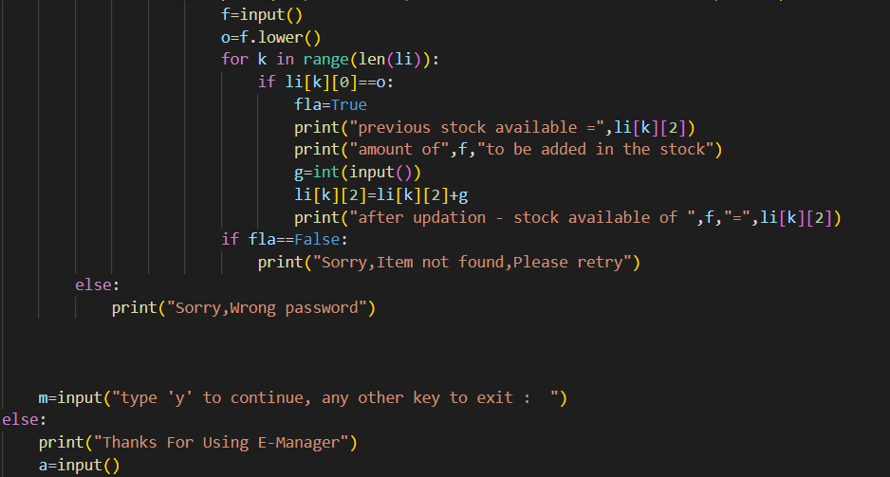
Contd….

Slide 10
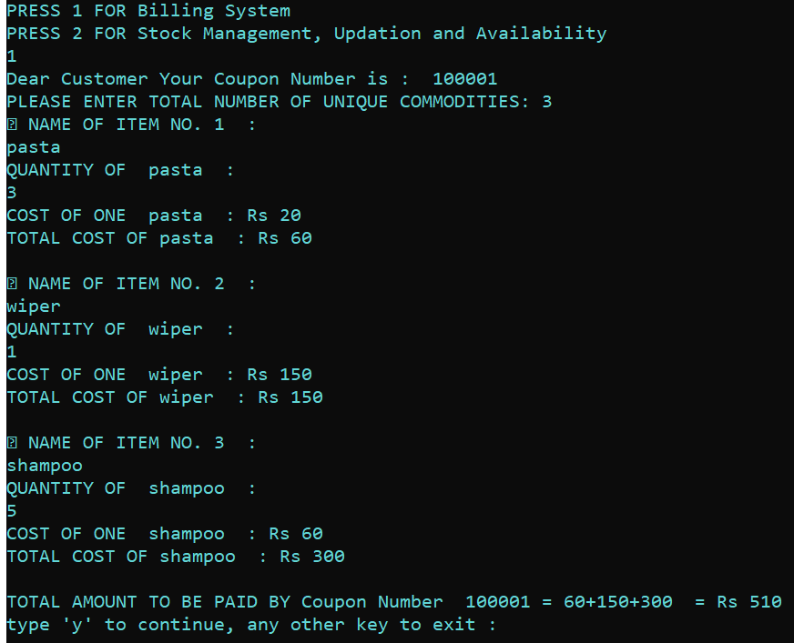
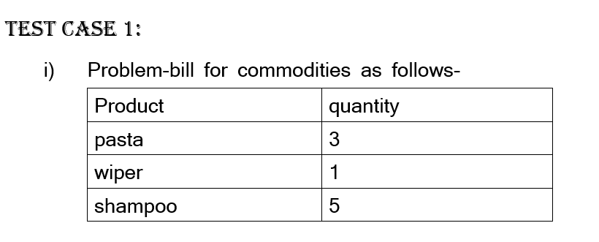
TEST CASE 1) bill making and automatic stock reduction
Bill generation

Slide 11
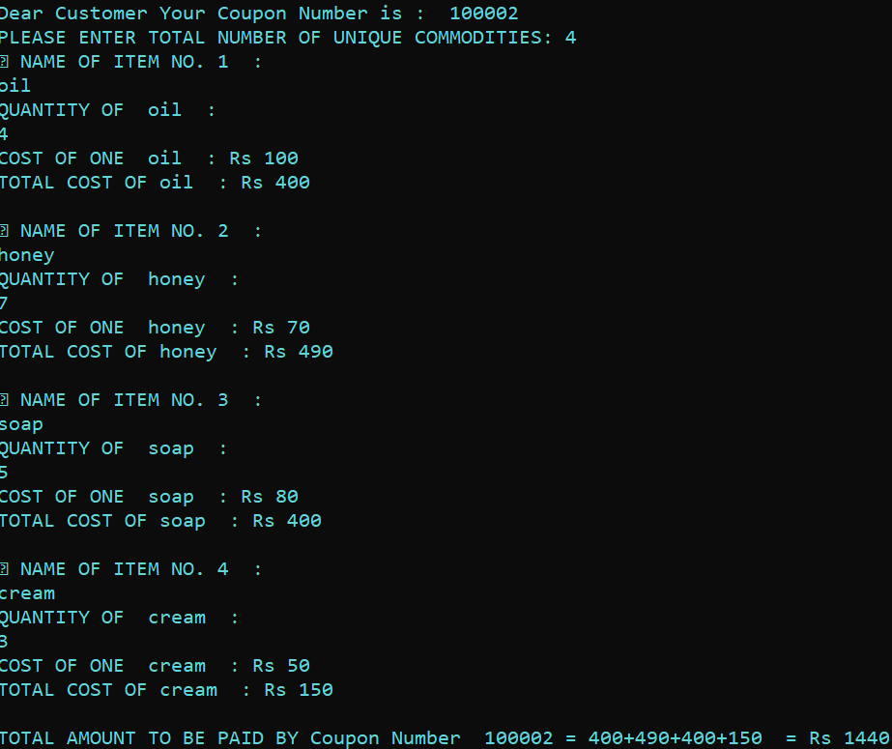
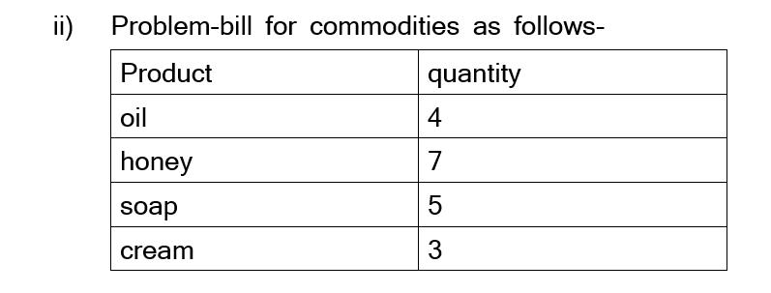
Contd…..

Slide 12
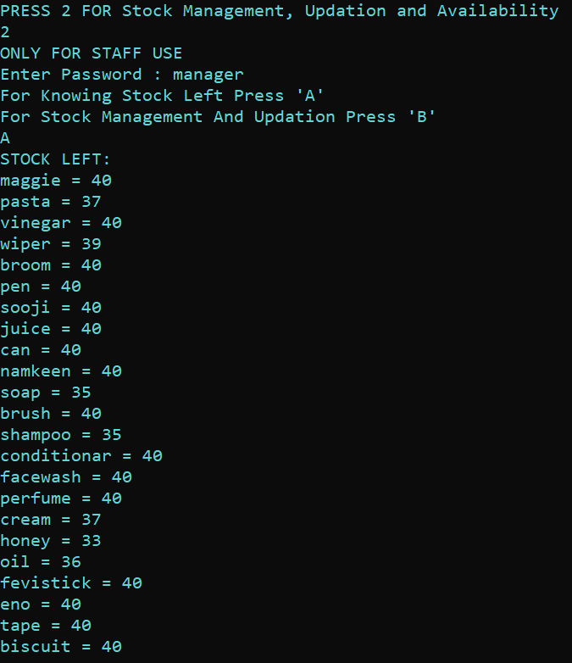
Contd….
Automatic stock updation- the quantity of items sold automatically gets subtracted from the internal stock of that item

Slide 13
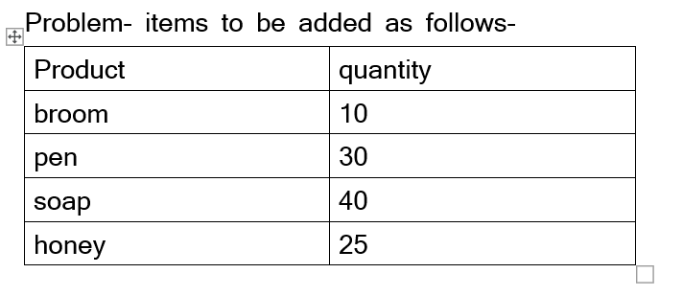
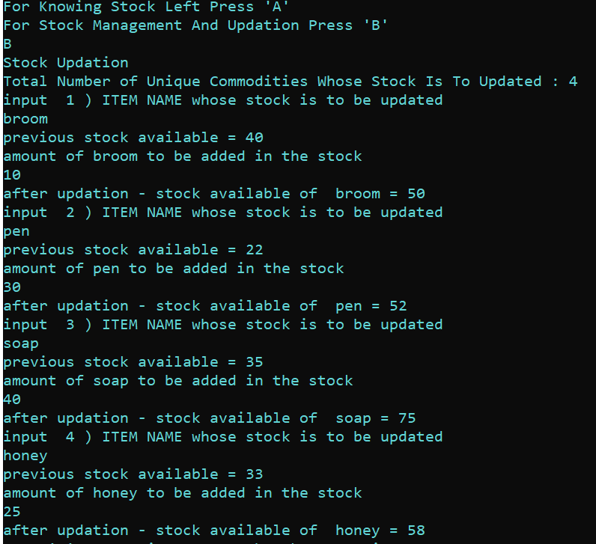
TEST CASE 2) stock upgradtion

Slide 14
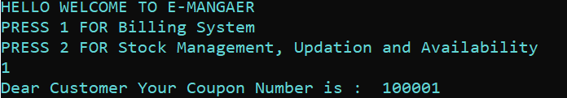
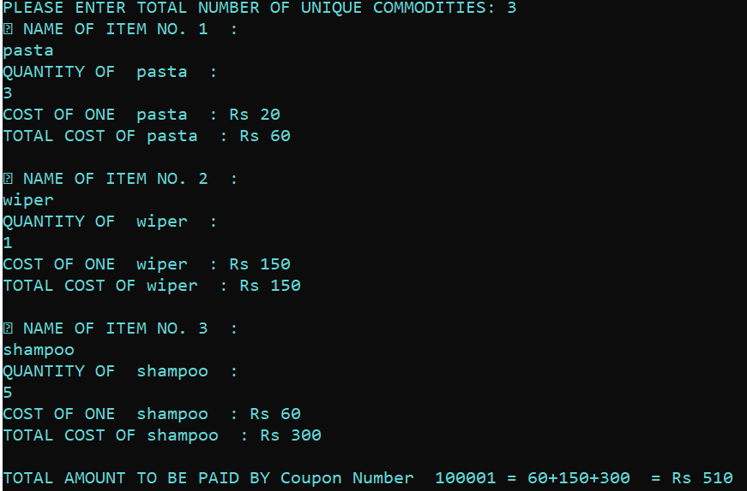
ADVANTAGES
CUSTOMER FRIENDLY
The system automatically generates the coupon number
Complete detailed billing

Slide 15
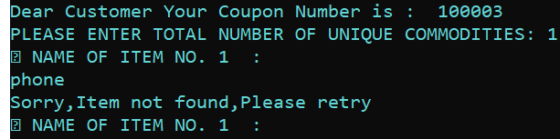
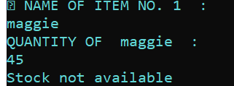
ADVANTAGES
If incase the customer enters the wrong item name the system displays error and prompts the user to re-enter correct item name
If the quantity of the item demanded by the customer is unavailable the system automatically displays the status “stock not available”

Slide 16
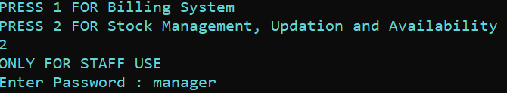
ADVANTAGES
USEFUL FOR STOREKEEPER
Helps in generation of electronic bill ,thus reducing use of paper,pen and calculator by the store staff
Password protected :
as the internal management system is to used by only the store staff members so it is password protected so that only staff members can access or update the stock related data
If any item has less stock left the stock manager gives warning

Slide 17
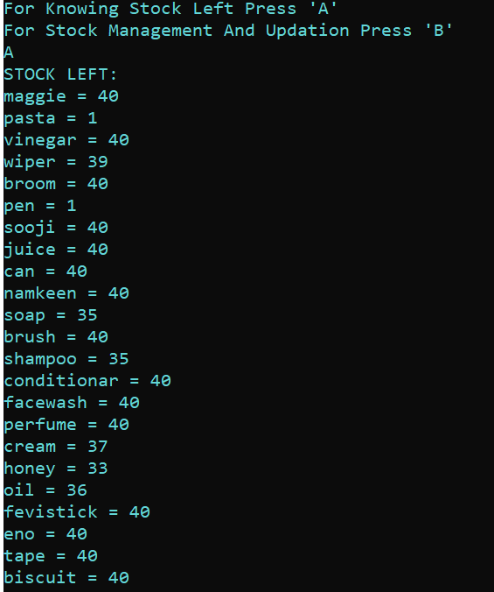
ADVANTAGES
Displays complete list of items with their quantity available after deducting the items which are sold

Slide 18
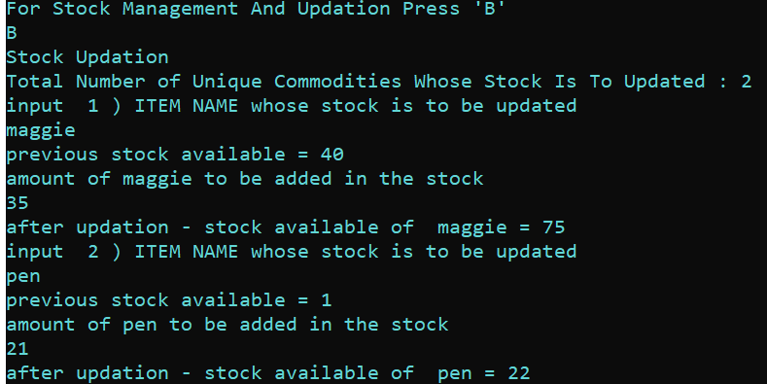

ADVANTAGES
Stock updation option available
Can be used multiple times for billing and internal management

Slide 19

FUTURE SCOPE
Scope of e-manager businesses is largely a mobile first approach.
Can be used in malls , convenience stores .
Items can be made to be added and get saved permanently in the internal management by the use of dbms
Graphical User Interface(GUI) can be added to the program with help of python’s modules like kivy etc. to make the program more user friendly
Items can be associated with bar code instead of entering its name in order to make billing and stock updation process more quick

Slide 20

Contd….
Many more number of items can be added varying according to product type, manufacturer’s name etc.
Option of bill with added tax like GST can be made
Option of discounts in bills during festive seasons can be done

Slide 21


Slide 22
MEMBERS and their CONTRIBUTION
AYUSH SHARMA (2210991430)
Discovering the idea of the project
Thinking and building logic for internal management system
Making and writing code for internal management system
AYUSH RANA (2210991429)
Project designing
Building logic for the billing system
Writing code for the billing system
ATUL SHARMA (2210991412)
Helping in finding errors and bugs in the code

