Slide 1
Show Me the money !
Submitted by Group 10
Monarch Nigam
Balakrishnan Arumugam

Slide 2
Introduction
What is Show me the Money?
Show Me The Money is a cloud-based accounting solution built for a local community college to replace their outdated and inefficient legacy system. This system helps students, faculty, and auditors manage budgets, financial transactions, approvals, and audit trails, all within a modern, cloud-native architecture.
KEY Challanges:
To design a non-web-based, secure, scalable, and user-friendly system that supports custom workflows, auditability, and cloud-based performance all while keeping costs low.

Slide 3



Key Requirements
1. Non-Web-Based Interface​ : The system must not be a web application.​ Instead, a desktop-based solution is required for interaction.​
2. Role-Based Access : The tool must support different user roles:
Students (submit budget requests)
Faculty (approve/reject requests)
Auditors (view all financial data
3. Financial Management: Users should be able to manage:
Accounts, Budgets, Journals, Ledgers, and Transactions. Also the data should be handled in a secure, accurate, and consistent way.

Slide 4
Key Requirements
4. Usability and Maintainability : The interface should be easy to use for students, faculty, and auditors. The system should be easy to maintain and extend as requirements grow.

Slide 5

Actors and their Roles
Student
Request budget allocations, track personal budget usage, pay tuition and other fees and view transaction history
Faculty
Approve or reject budget requests and view and monitor departmental financial reports
️ Auditor
View all transactions across the system and ensure compliance and audit integrity

Slide 6
Key Use Cases
Secured Login and Access Control
Accounting Workflow Automation
Basic Financial Data Entry
Department Budget Management
Continuous Audit Trail Logging
Financial Reporting and Analytics

Slide 7
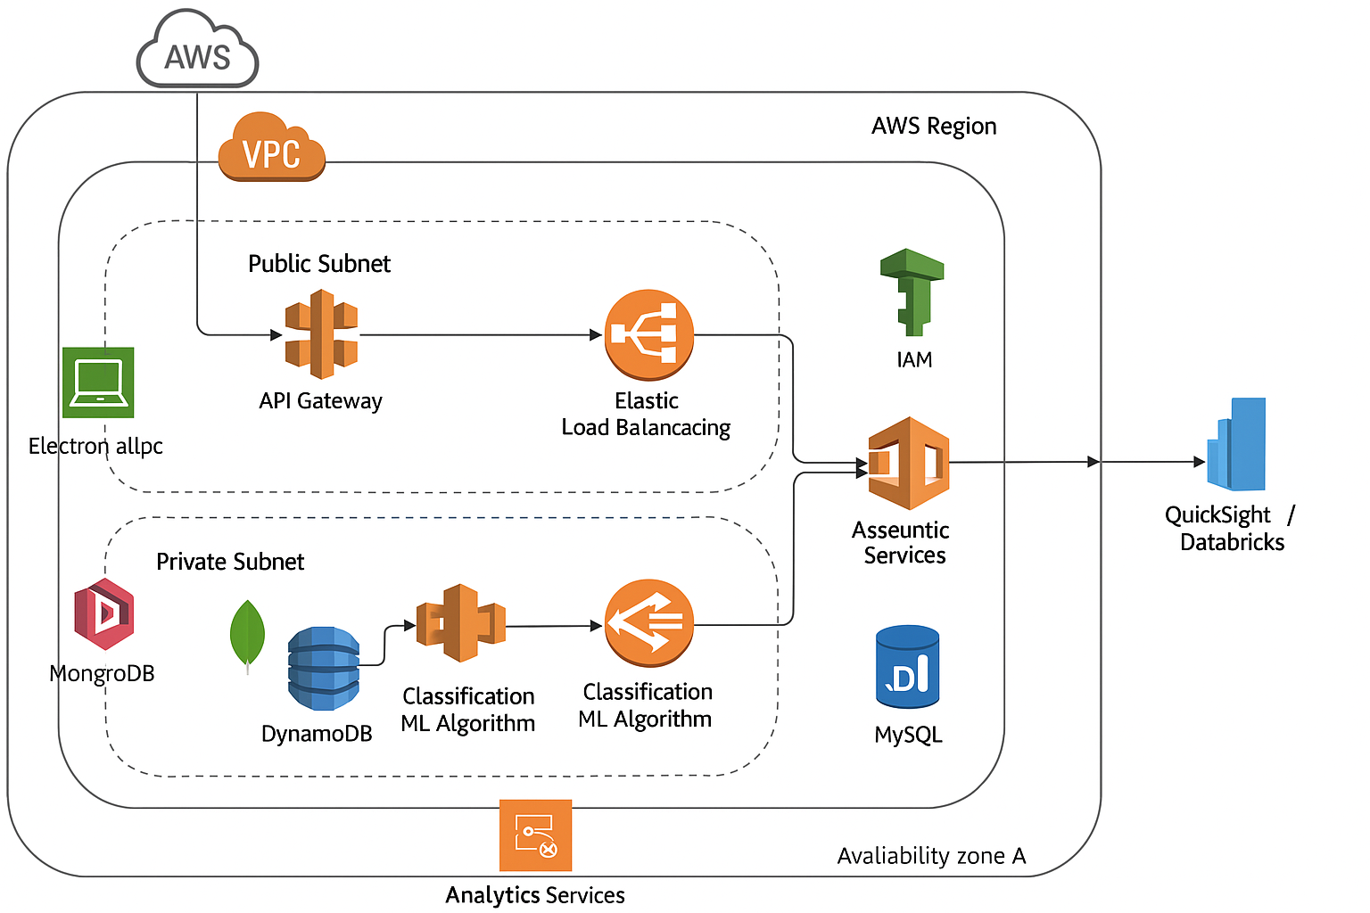
Proposed Architectural Solution

Slide 8
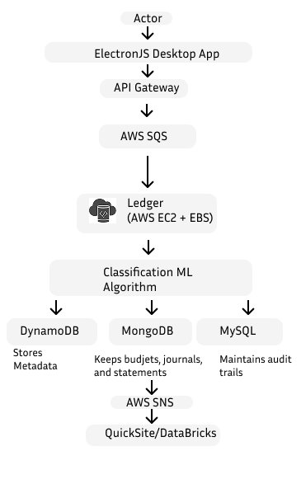
How Our Solution Works
Users (students, faculty, auditors) interact with the system through a secure desktop app built using ElectronJS.
Their requests go through the API Gateway, which handles routing and authentication.
Requests are placed in a queue using AWS SQS to ensure reliable, decoupled processing.
The Ledger service (hosted on EC2 with EBS) processes all transactions in order, maintaining financial integrity.
A Machine Learning algorithm classifies and flags unusual activity (e.g., fraud detection).
Data flows into:
DynamoDB – for storing metadata.
MongoDB – for handling budgets, journals, and statements.
MySQL (RDS) – for storing audit trails.
AWS SNS sends real-time notifications (e.g., approvals, alerts).
QuickSight/DataBricks are used for reports, analytics, and visual dashboards.

Slide 9
List of AWS Services Used
Compute & Processing
Amazon EC2 – Hosts the Ledger service and ML classification engine
AWS Lambda – For serverless triggers and real-time alerting
Amazon EC2 Auto Scaling – Automatically scales compute resources based on load
Messaging & Queues
Amazon SQS – Decouples services and handles asynchronous processing
Amazon SNS – Pushes notifications and triggers downstream processes
Storage & Databases
Amazon DynamoDB – Stores metadata and supports high-speed reads/writes
Amazon RDS (MySQL) – Maintains audit trails with relational integrity
Amazon EBS – Provides persistent storage for the EC2-based ledger
MongoDB (self-managed or Atlas on AWS) – Stores budgets, journals, and statements

Slide 10
List of AWS Services Used
Security & Identity
AWS IAM – Role-based access control and fine-grained permissions
AWS KMS – Encryption of data at rest
Amazon Cognito / JWT – Authentication and secure identity management
SSL/TLS – Encrypts data in transit
Monitoring & Logging
Amazon CloudWatch – Logs system activity and monitors infrastructure health
CloudWatch Alarms + Lambda – Sends real-time alerts on anomalies
Analytics & Reporting
Amazon QuickSight – Dashboards and financial reporting
AWS DataBricks – Advanced analytics and machine learning insights

Slide 11
Key Risks and Mitigation
1. Data Quality Issues
Risk: Inconsistent data or outdated code may affect system performance.
Mitigation: Regular patching, schema validation, and testing.
2. Missing Audit Alerts
Risk: Delayed alerts may allow unauthorized activity.
Mitigation: Real-time alerting with CloudWatch + Lambda.
3. Delayed Onboarding
Risk: Batch account creation slows down access.
Mitigation: Use event-driven processing via AWS Lambda & SQS.

Slide 12
Key Risks and Mitigation
4. Event Ordering Problems
Risk: Financial records may become inconsistent.
Mitigation: Use sequence keys and idempotent processing in DynamoDB.
5. Human Error in Calculations
Risk: Incorrect data entry may cause calculation mistakes.
Mitigation: Standardize inputs and use auto-calculations.
6. Data Breach
Risk: Unauthorized access to sensitive data.
Mitigation: IAM roles, encryption (SSL/KMS), JWT authentication.

Slide 13
Key Risks and Mitigation
7. Misconfigured Cloud Resources
Risk: Open security settings may lead to vulnerabilities.
Mitigation: Use AWS Config, Trusted Advisor, and IaC policies.
8. Cost Overruns
Risk: Auto-scaling or message flooding increases expenses.
Mitigation: Budget alerts, throttling, and usage limits.
9. Single Point of Failure
Risk: Failure of key components (ML model, sequencer).
Mitigation: Multi-AZ, failover plans, auto-recovery setups.

Slide 14
Software Qualities & Trade-Offs
1. Scalability
Why it matters: Supports growth in users and spikes in activity (e.g. refunds, payroll).
Solution: EC2 Auto Scaling, DynamoDB, and SQS for workload distribution.
Trade-Off: Higher operational costs; needs careful monitoring and provisioning.
2. Ease of Use
Why it matters: Used by students and faculty with varied tech skills.
Solution: ElectronJS app for a native-like, cross-platform experience.
Trade-Off: Extra dev effort for packaging and cross-platform support.
3. Security
Why it matters: System handles sensitive personal and financial data.
Solution: Role-based IAM, JWT auth, data encryption via AWS KMS.
Trade-Off: Ongoing effort in key rotation, audits, policy updates, and scans.

Slide 15
Software Qualities & Trade-Offs
4. Performance
Why it matters: Smooth user experience even under load (e.g. bulk uploads).
Solution: Async processing with SQS, fast queries via DynamoDB.
Trade-Off: Complexities with eventual consistency, retries, and duplicate handling.
5. Maintainability
Why it matters: Enables quick updates and integration of new features.
Solution: Microservices, CI/CD pipelines, containerization.
Trade-Off: Requires DevOps knowledge and team training on tooling.
6. Flexibility
Why it matters: Needs to support future features or departmental changes.
Solution: Modular, service-oriented architecture.
Trade-Off: Adds complexity in inter-service coordination and orchestration.

Slide 16
Software Qualities & Trade-Offs
7. Reliability
Why it matters: Financial delays (e.g. payroll, refunds) are unacceptable.
Solution: Multi-AZ EC2, load balancers, and durable SQS queues.
Trade-Off: Increases infra cost and complexity (failover, redundancy).
8. Cost-Efficiency
Why it matters: Public institutions have tight budgets.
Solution: Spot instances, on-demand DB scaling, and open-source analytics.
Trade-Off: Needs cost monitoring, cleanup of unused resources, and budget alerts.

