Slide 1


Slide 2

HEALTH INSURANCE MARKET PLACE
Team Members:
Janki Dharmendra Rathod (0864129)
Krima Gurudutt Patel (0859652)
Mohana Santhosh Reddy (0688824)
December 15, 2017

Slide 3
Introduction
Problem Statement - It is important for everyone to have best affordable insurance with maximum benefits. - How rates and plans are associated.
What you did? - We analyzed how plan rates and its benefits vary across states. - Predicted the Individual Tobacco Rate based on Individual Rate.
Highlight of the research - Linear Model built is Accurate and Error Free.

Slide 4
Methodology
Data Source - Dataset is taken from CMS Government website for the year 2017. - Dataset contains ~ 1000,000 samples, with attributes such as Age, Individual Rate, Individual Tobacco Rate, State Code, Issuer Id, Carriers, Plan Id, Tobacco, Business Year, Dental Only, Plan Market etc.,
Preprocessing - Pearson’s Correlation is used as variable selection method. - All the Null values (blank space) in the dataset are discarded. - Boxplot is used as outlier detection method.

Slide 5
Technique used
- Histogram (to analyze the relation between carrier and plans available by state)
- Predictive Analysis: Statistical model – Linear Regression
- Min Max Accuracy & Standard Error Deviation
- ROC Curve
- K Fold Validation

Slide 6
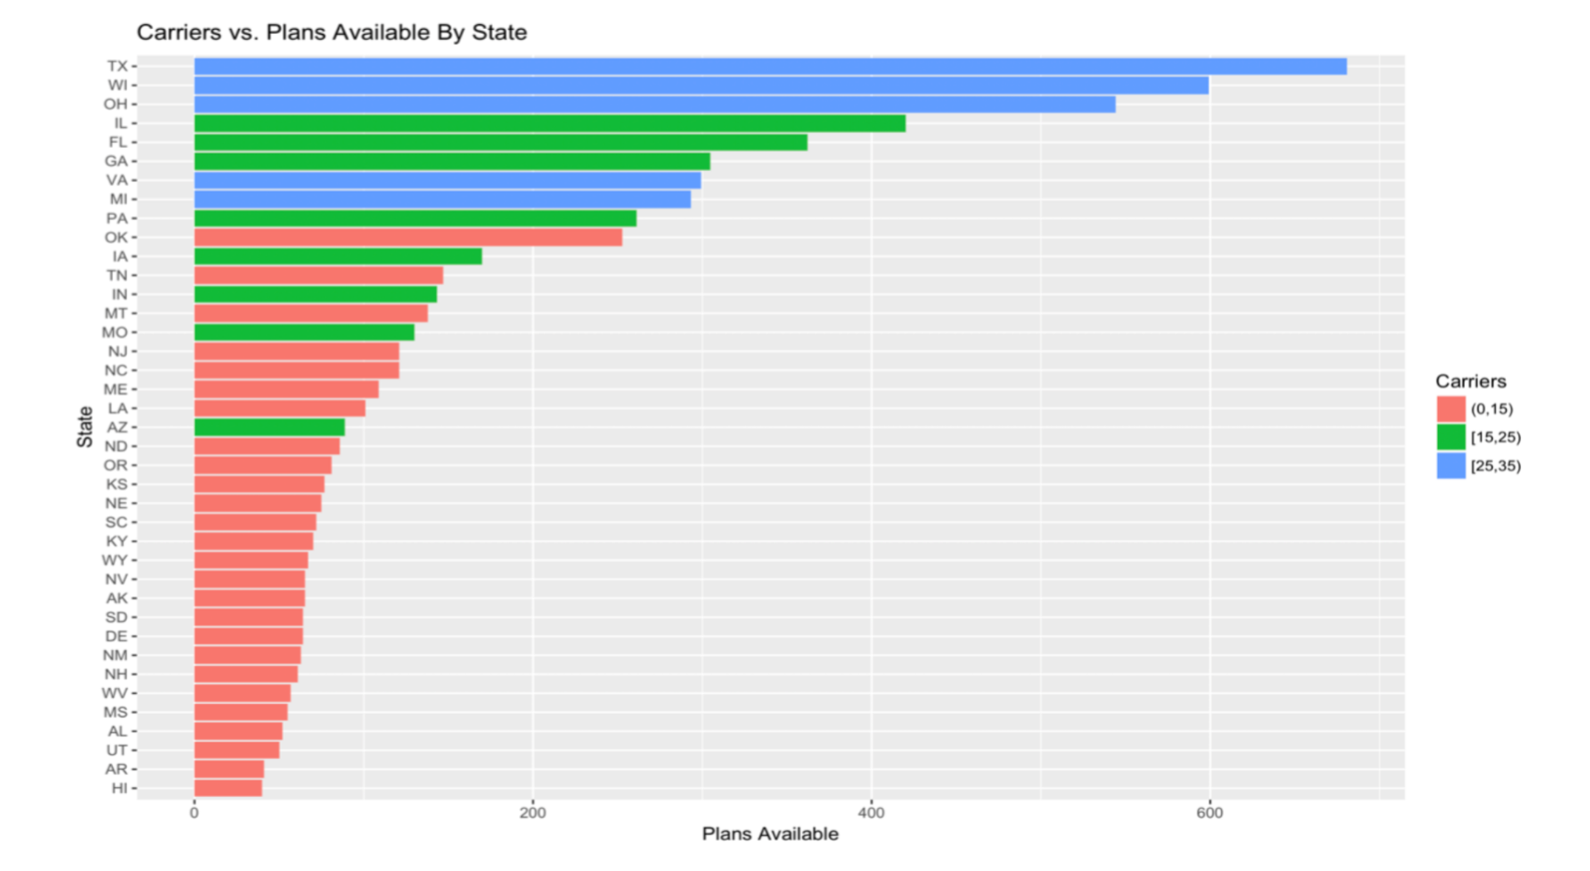
Histogram

Slide 7
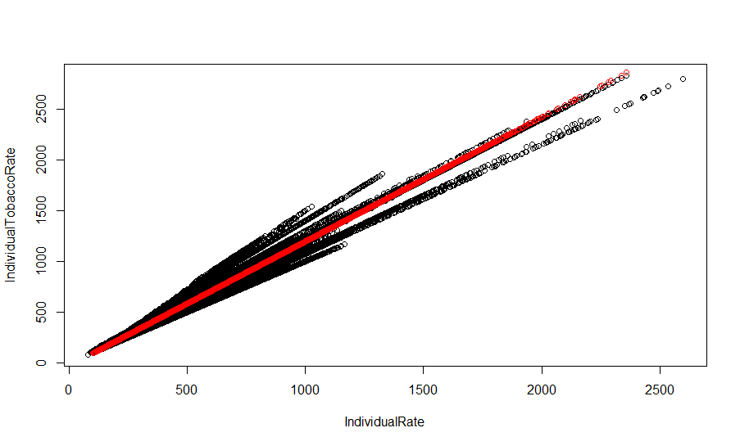
Linear Model

Slide 8
Results
Minimum Maximum Accuracy and Error Rate - Min Max Accuracy of the model is 95.01% and Standard Error Deviation is 5.21%. - From ROC, AUC of the model is 88.78%.

Slide 9
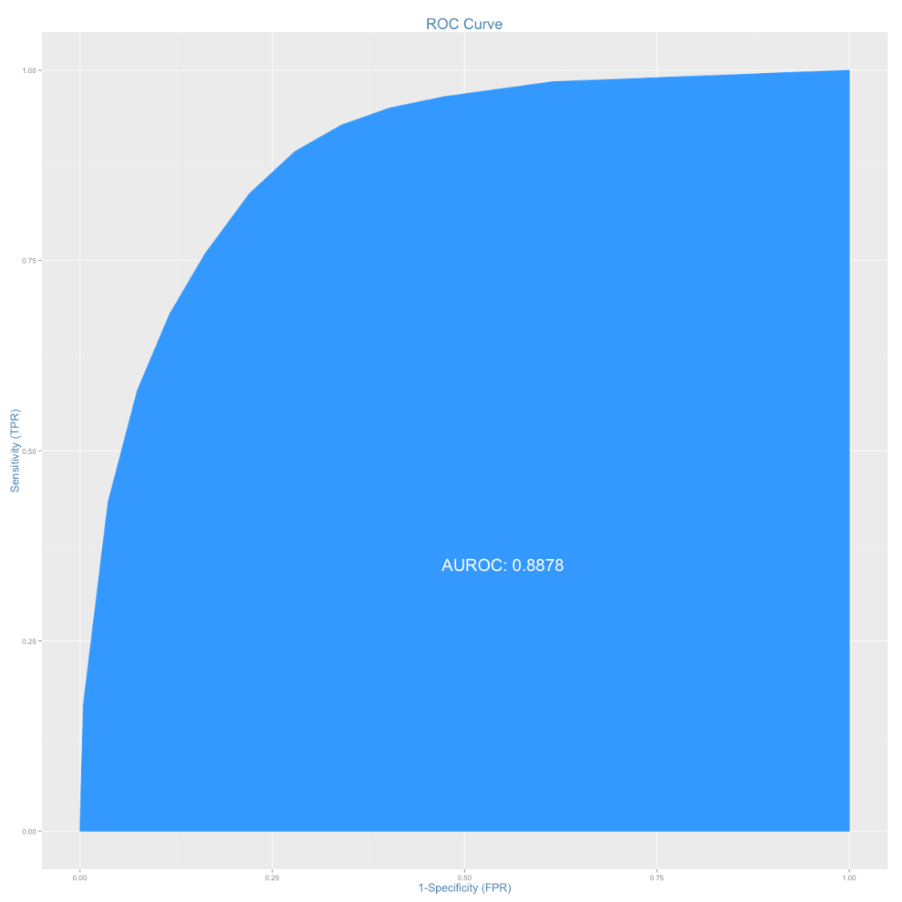
Results

Slide 10
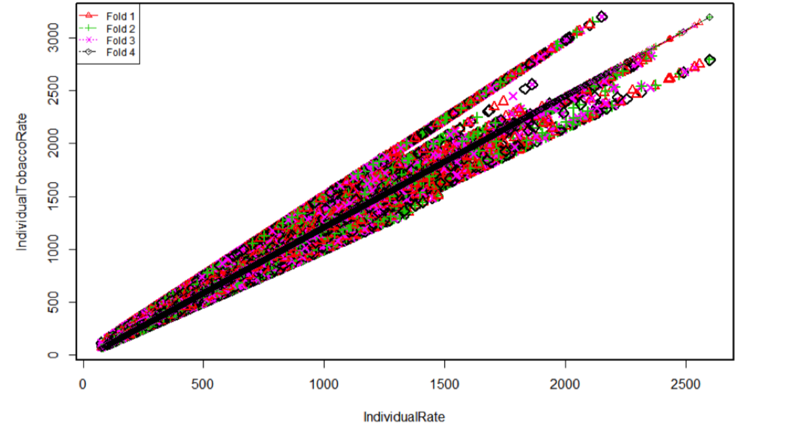
Results
K-Fold Cross Validation

Slide 11
Discussion and Future Work
- States: Texas, Wisconsin & Ohio have maximum number of carrier as well as plans available.
- Relation: IndividualTobaccoRate = -35.318 + (1.245 * IndividualRate) - Insurance rate for tobacco user is always high compared to non-tobacco user.
- Future work: Need more data like since how many years person is using tobacco and age of the person to find more accurate rate.

Slide 12
One Question From The Audience

