Slide 1


SecondHope
Janki Rathod (0864129)
Krima Patel (0859652)
Mohana Santhosh Reddy (0688824)

Slide 2

PROJECT DESCRIPTION:
Our mission is to provide information, referral and support to intended parents and surrogate mothers in Canada.
Our passion is to assist intended parents and surrogate mothers throughout every step of this life-changing process, acting as both a resource for information and a support system.
The main aim of this project is to reduce the gap between the surrogates and parents.
We want to help make this journey as stress free and enjoyable as it can and should be.

Slide 3
PROJECT FEATURES:
The Project has 3 modules : Surrogates , Parents and Doctors Module.
Surrogates can apply online by filling up various forms which includes personal data as well as health information.
Professional doctors will give approval to surrogate after verifying and checking all details. Surrogates needs to be healthy enough and also she should satisfy all the medical conditions before taking any responsibility.
Parents can consult with doctor to get some idea about surrogate and surrogacy process.

Slide 4
PROJECT DEVELOPMENT TOOLS :TECHNOLOGIES USED
Front End:
MVC.NET Framework 4.5.2
HTML
JAVASCRIPT
CSS
Back End:
SQL Server
Development Tools:
Visual Studio 2015
SQL Server Management Studio

Slide 5
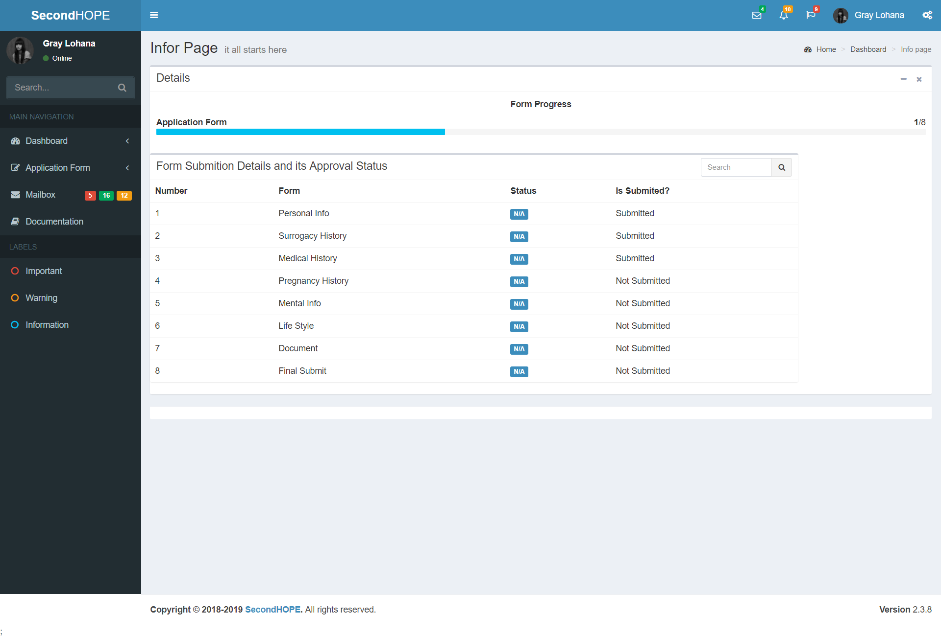
PROTOTYPE

Slide 6
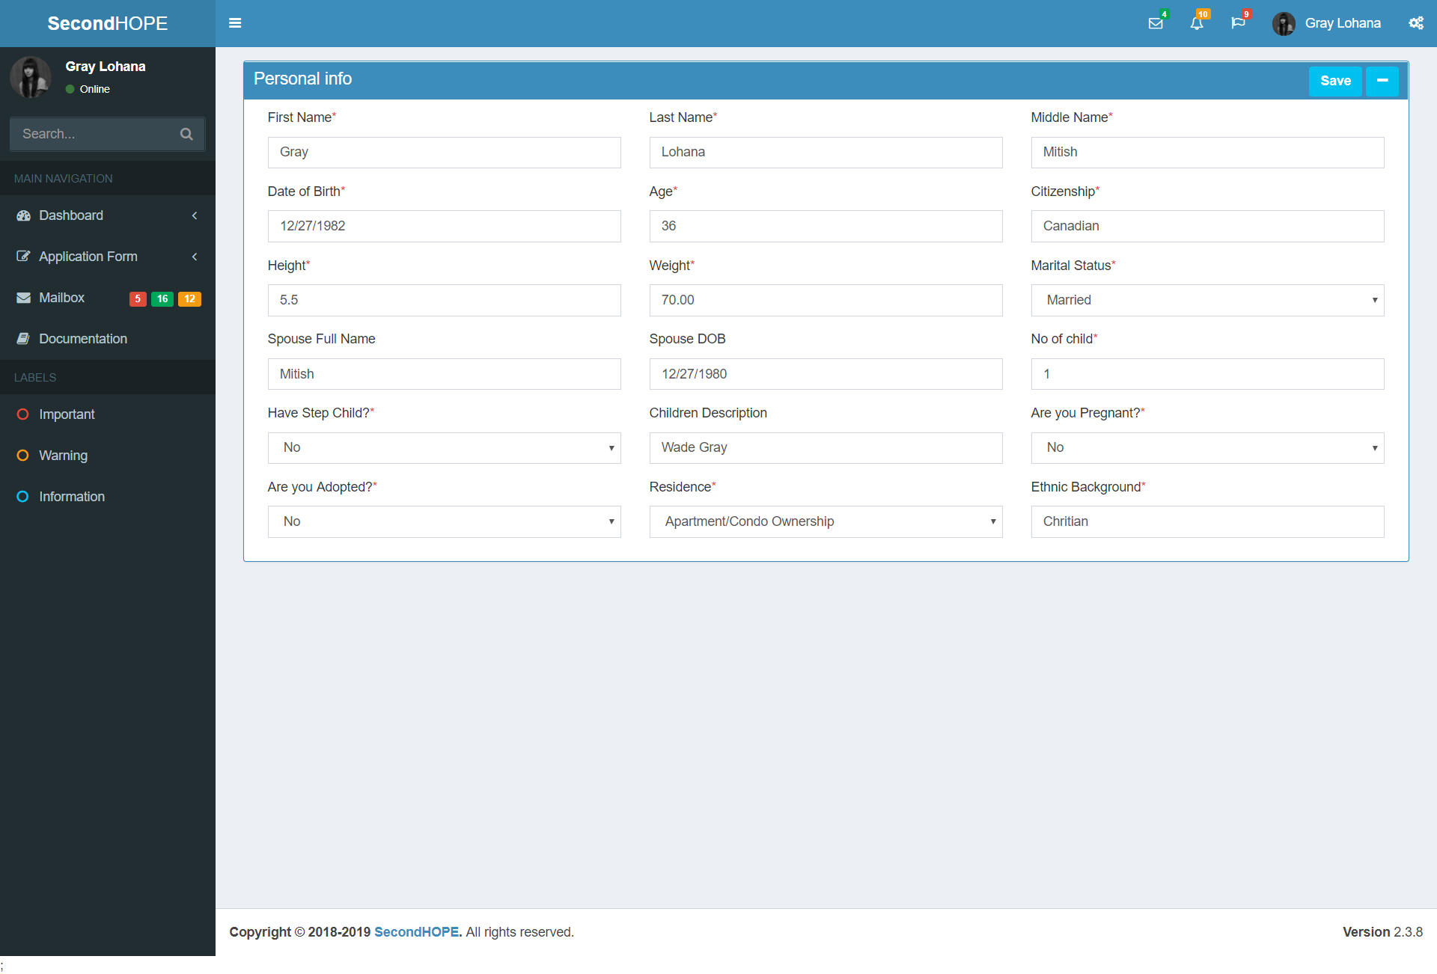
PROTOTYPE

Slide 7
THANK YOU

