Slide 1
Network Layer Protocols
19.<number>

Slide 2
Chapter 4: Outline
19.1 IPv4
19.2 ICMPv4
Notes:
19.#

Slide 3

Chapter 19: Objective
The first section discusses the IPv4 protocol. It first describes the IPv4 datagram format. It then explains the purpose of fragmentation in a datagram. The section then briefly discusses options fields and their purpose in a datagram.
The second section discusses ICMPv4, one of the auxiliary protocols used in the network layer to help IPv4. First, it briefly discusses the purpose of each option. The section finally shows how the checksum is calculated for an ICMPv4 message.
Notes:
19.#

Slide 4
    19.1 NETWORK-LAYER PROTOCOLS
The network layer in version 4 can be thought of as one main protocol and three auxiliary ones. The main protocol, IPv4, is responsible for packetizing, forwarding, and delivery of a packet. The ICMPv4 helps IPv4 to handle some errors that may occur in delivery. The IGMP is used to help IPv4 in multicasting. ARP is used in address mapping.
19.<number>
Notes:
19.#

Slide 5
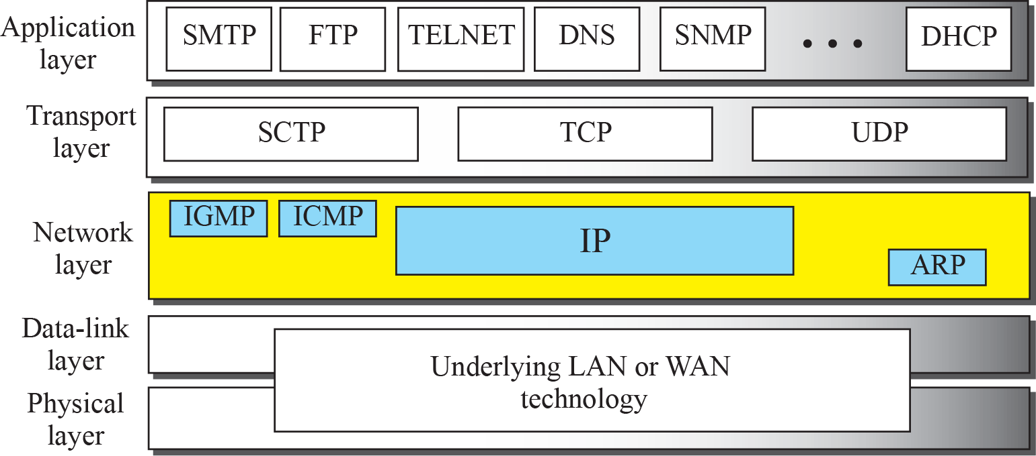
Figure 19.1: Position of IP and other network-layer protocols in
TCP/IP protocol suite
19.<number>
Notes:
19.#

Slide 6
19.19.1 Datagram Format
Packets used by the IP are called datagrams. Figure 19.2 shows the IPv4 datagram format. A datagram is a variable-length packet consisting of two parts: header and payload (data). The header is 20 to 60 bytes in length and contains information essential to routing and delivery. It is customary in TCP/IP to show the header in 4-byte sections.
19.<number>
Notes:
19.#

Slide 7
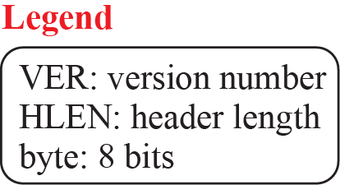
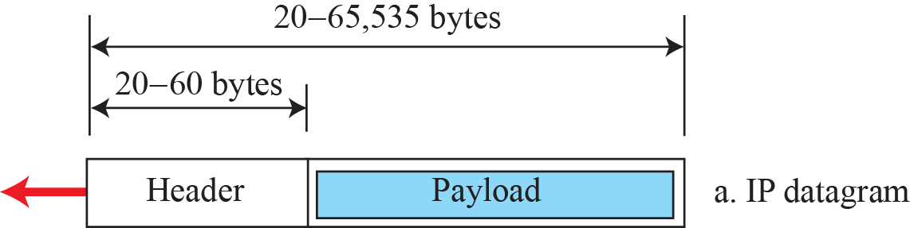
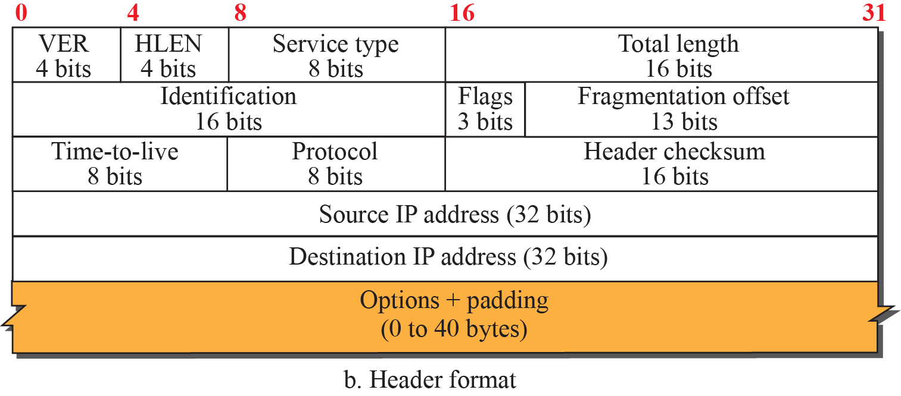
Figure 19.2: IP datagram
19.<number>
Notes:
19.#

Slide 8

Note
The total length field defines the total length of the datagram including the header.
20.<number>

Slide 9

Figure 19.4 Encapsulation of a small datagram in an Ethernet frame
20.<number>

Slide 10
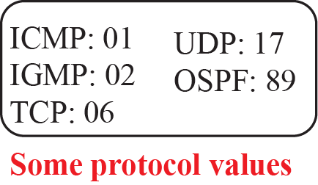
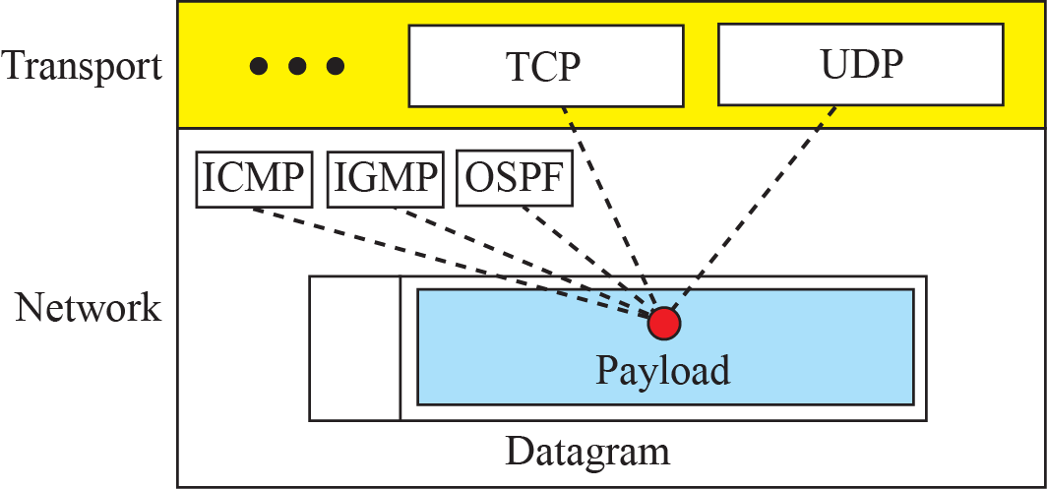
Figure 19.3: Multiplexing and demultiplexing using the value of
the protocol field
19.<number>
Notes:
19.#

Slide 11
Example 19.1
An IPv4 packet has arrived with the first 8 bits as (01000010)₂. The receiver discards the packet. Why?.
Solution
There is an error in this packet. The 4 leftmost bits (0100)₂ show the version, which is correct. The next 4 bits (0010)₂ show an invalid header length (2 × 4 = 8). The minimum number of bytes in the header must be 20. The packet has been corrupted in transmission.
19.<number>

Slide 12
Example 19.2
In an IPv4 packet, the value of HLEN is (1000)₂. How many bytes of options are being carried by this packet?
Solution
The HLEN value is 8, which means the total number of bytes in the header is 8 × 4, or 32 bytes. The first 20 bytes are the base header, the next 12 bytes are the options.
19.<number>

Slide 13
Example 19.3
In an IPv4 packet, the value of HLEN is 5, and the value of the total length field is (0028)₁₆. How many bytes of data are being carried by this packet?
Solution
The HLEN value is 5, which means the total number of bytes in the header is 5 × 4, or 20 bytes (no options). The total length is (0028)₁₆ or 40 bytes, which means the packet is carrying 20 bytes of data (40 − 20).
19.<number>

Slide 14
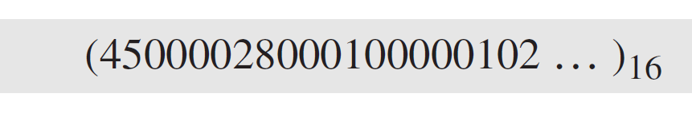
Example 19.4
An IPv4 packet has arrived with the first few hexadecimal digits as shown.
How many hops can this packet travel before being dropped? The data belong to what upper-layer protocol?
Solution
To find the time-to-live field, we skip 8 bytes (16 hexadecimal digits). The time-to-live field is the ninth byte, which is (01)₁₆. This means the packet can travel only one hop. The protocol field is the next byte (02)₁₆, which means that the upper-layer protocol is IGMP.
19.<number>

Slide 15
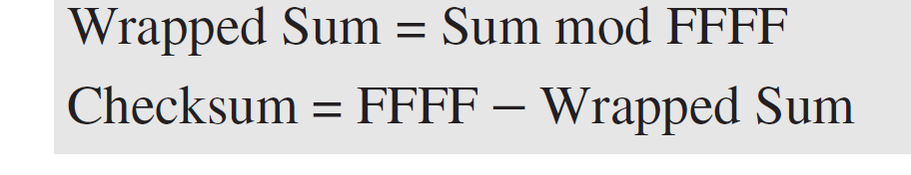
Example 19.5
Figure 19.4 shows an example of a checksum calculation for an IPv4 header without options. The header is divided into 16-bit sections. All the sections are added and the sum is complemented after wrapping the leftmost digit. The result is inserted in the checksum field.
Note that the calculation of wrapped sum and checksum can also be done as follows in hexadecimal:
19.<number>

Slide 16
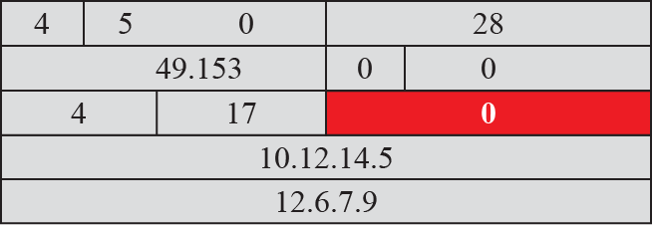

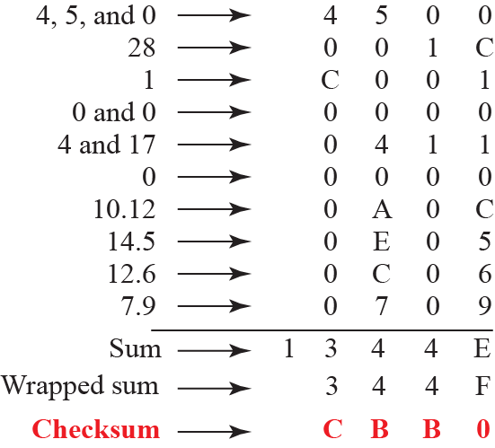
Figure 19.5:
19.<number>
Notes:
19.#

Slide 17
19.19.2 Fragmentation
A datagram can travel through different networks. Each router decapsulates the IP datagram from the frame it receives, processes it, and then encapsulates it in another frame. The format and size of the received frame depend on the protocol used by the physical network through which the frame has just traveled. The format and size of the sent frame depend on the protocol used by the physical network through which the frame is going to travel. For example, if a router connects a LAN to a WAN, it receives a frame in the LAN format and sends a frame in the WAN format.
19.<number>
Notes:
19.#

Slide 18
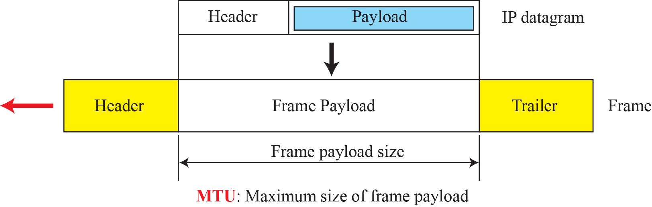
Figure 19.6: Maximum transfer unit (MTU)
19.<number>
Notes:
19.#

Slide 19

Table 19.1 MTUs for some networks
20.<number>

Slide 20

Figure 19.7 Flags used in fragmentation
20.<number>

Slide 21
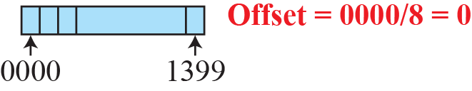
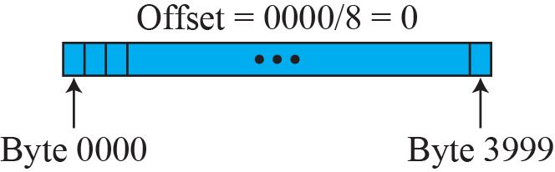
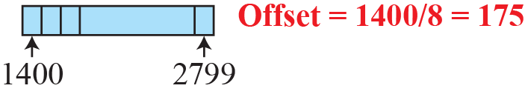
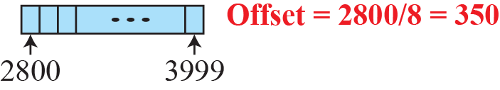
Figure 19.8: Fragmentation example
19.<number>
Notes:
19.#

Slide 22
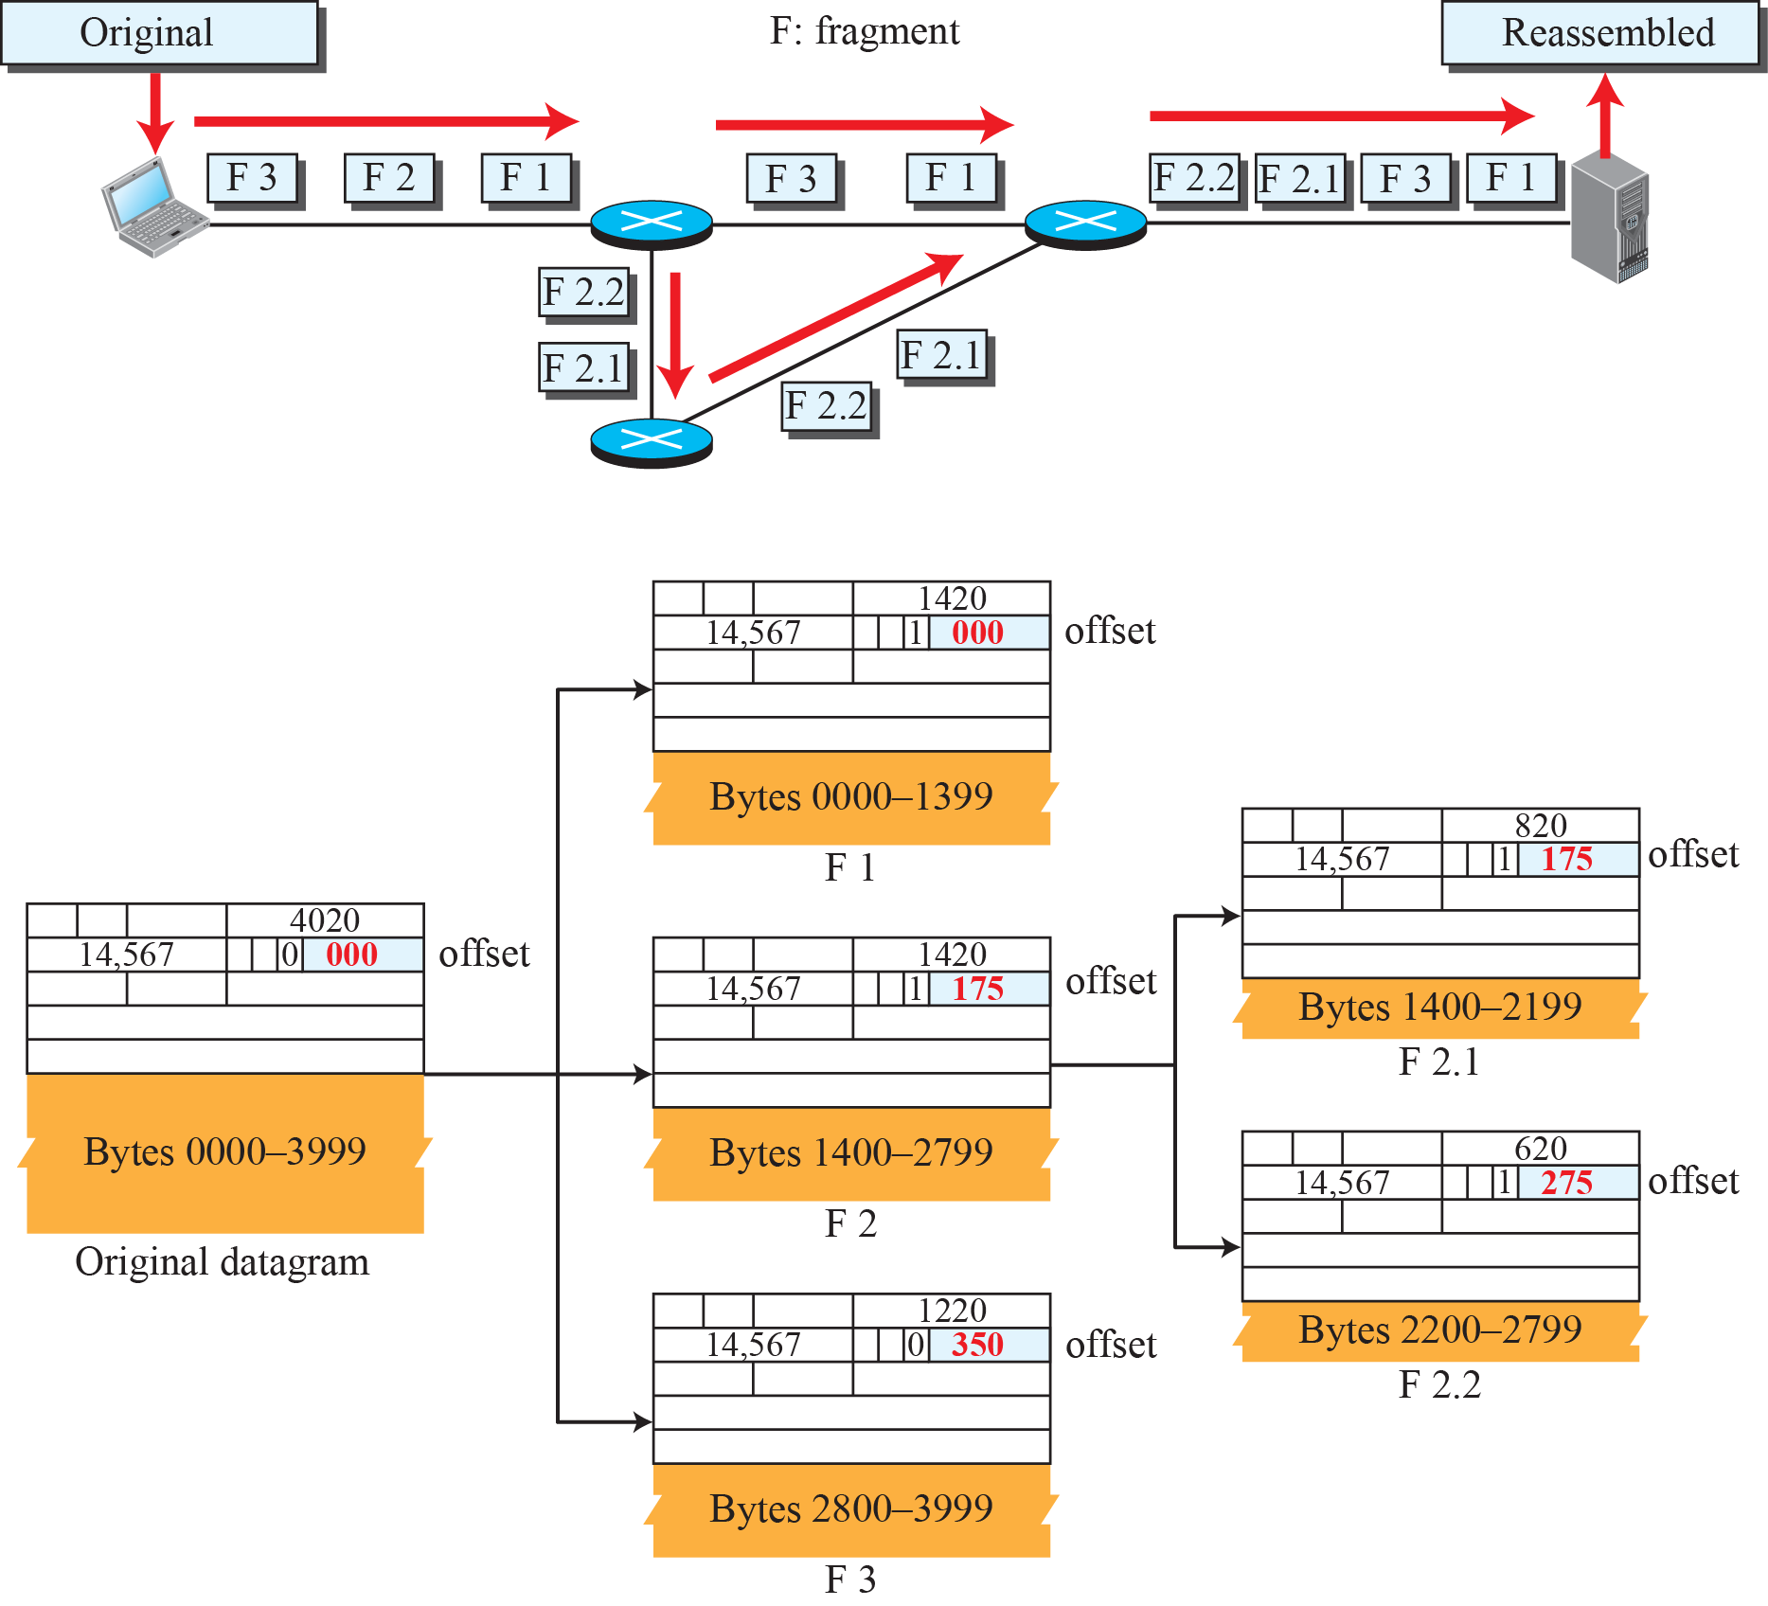
Figure 19.9: Detailed fragmentation example
19.<number>
Notes:
19.#

Slide 23
Example 19.6
A packet has arrived with an M bit value of 0. Is this the first fragment, the last fragment, or a middle fragment? Do we know if the packet was fragmented?
Solution
If the M bit is 0, it means that there are no more fragments; the fragment is the last one. However, we cannot say if the original packet was fragmented or not. A nonfragmented packet is considered the last fragment.
19.<number>

Slide 24
Example 19.7
A packet has arrived with an M bit value of 1. Is this the first fragment, the last fragment, or a middle fragment? Do we know if the packet was fragmented?
Solution
If the M bit is 1, it means that there is at least one more fragment. This fragment can be the first one or a middle one, but not the last one. We don’t know if it is the first one or a middle one; we need more information (the value of the fragmentation offset).
19.<number>

Slide 25
Example 19.8
A packet has arrived with an M bit value of 1 and a fragmentation offset value of 0. Is this the first fragment, the last fragment, or a middle fragment?
Solution
Because the M bit is 1, it is either the first fragment or a middle one. Because the offset value is 0, it is the first fragment.
19.<number>

Slide 26
Example 19.9
A packet has arrived in which the offset value is 100. What is the number of the first byte? Do we know the number of the last byte?
Solution
To find the number of the first byte, we multiply the offset value by 8. This means that the first byte number is 800. We cannot determine the number of the last byte unless we know the length of the data.
19.<number>

Slide 27
Example 19.10
A packet has arrived in which the offset value is 100, the value of HLEN is 5, and the value of the total length field is 100. What are the numbers of the first byte and the last byte?
Solution
The first byte number is 100 × 8 = 800. The total length is 100 bytes, and the header length is 20 bytes (5 × 4), which means that there are 80 bytes in this datagram. If the first byte number is 800, the last byte number must be 879.
19.<number>

Slide 28
19.19.3 Options
The header of the IPv4 datagram is made of two parts: a fixed part and a variable part. The fixed part is 20 bytes long and was discussed in the previous section. The variable part comprises the options that can be a maximum of 40 bytes (in multiples of 4-bytes) to preserve the boundary of the header.
19.<number>
Notes:
19.#

Slide 29

Figure 19.10 Taxonomy of options in IPv4
20.<number>

Slide 30
    19.2 ICMPv4
The IPv4 has no error-reporting or error-correcting mechanism. The IP protocol also lacks a mechanism for host and management queries. The Internet Control Message Protocol version 4 (ICMPv4) has been designed to compensate for the above two deficiencies.
19.<number>
Notes:
19.#

Slide 31
19.2.1 MESSAGES
ICMP messages are divided into two broad categories: error-reporting messages and query messages. The error-reporting messages report problems that a router or a host (destination) may encounter when it processes an IP packet. The query messages, which occur in pairs, help a host or a network manager get specific information from a router or another host. For example, nodes can discover their neighbors. Also, hosts can discover and learn about routers on their network and routers can help a node redirect its messages.
19.<number>
Notes:
19.#

Slide 32
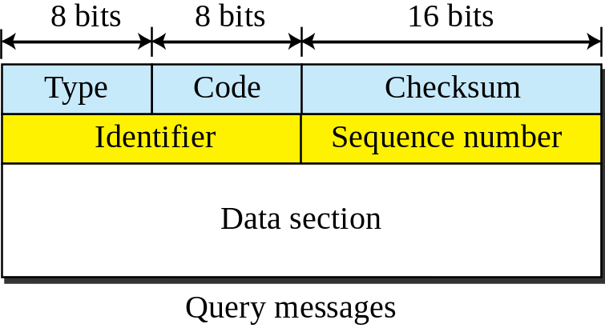
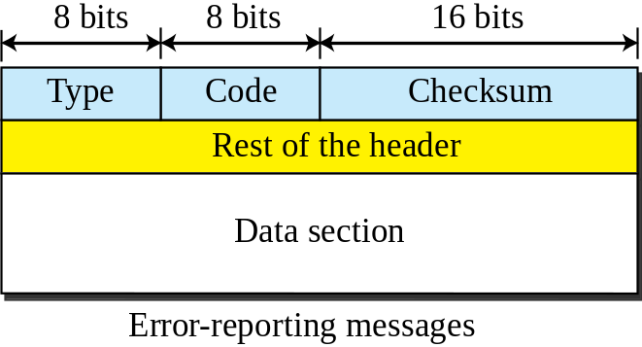
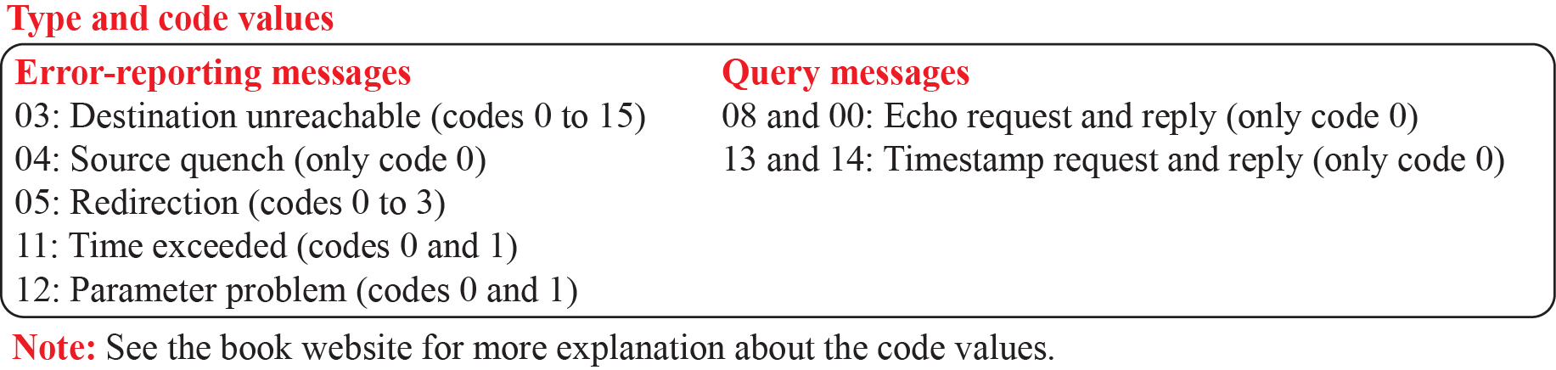
Figure 19.8: General format of ICMP messages
19.<number>
Notes:
19.#

Slide 33
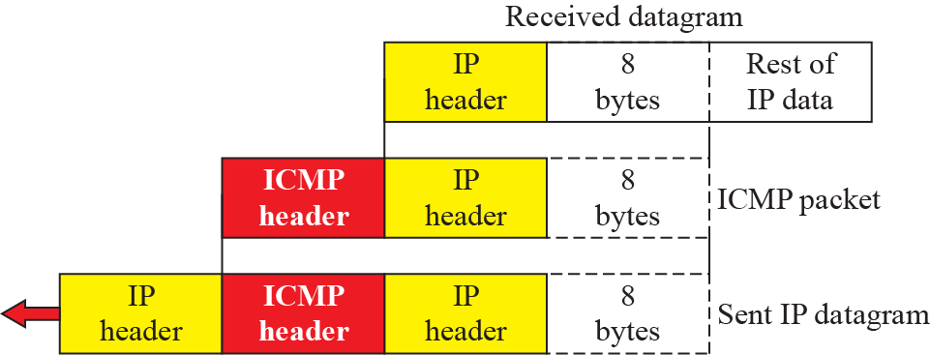
Figure 19.9: Contents of data field for the error messages
19.<number>
Notes:
19.#

Slide 34
19.2.3 ICMP Checksum
In ICMP the checksum is calculated over the entire message (header and data).
19.<number>
Notes:
19.#

Slide 35
Example 19.12
Figure 19.11 shows an example of checksum calculation for a simple echo-request message. We randomly chose the identifier to be 1 and the sequence number to be 9. The message is divided into 16-bit (2-byte) words. The words are added and the sum is complemented. Now the sender can put this value in the checksum field.
19.<number>

Slide 36
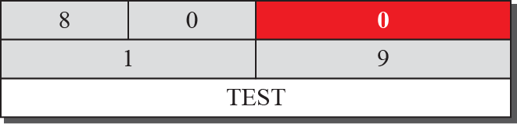
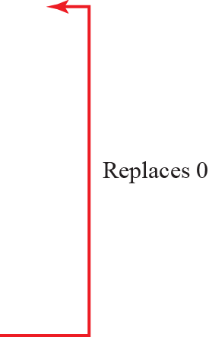
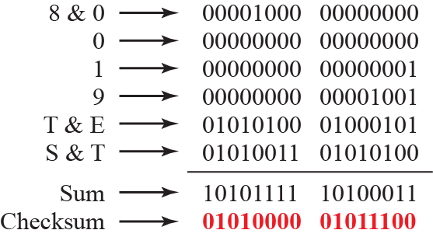
Figure 19.11: Example of checksum calculation
19.<number>
Notes:
19.#

