Slide 1

Food Waste management system
By:
Akanksha harshe - 001228921
Dhanashree chavan – 001222495
Monas Bhar - 001232781

Slide 2
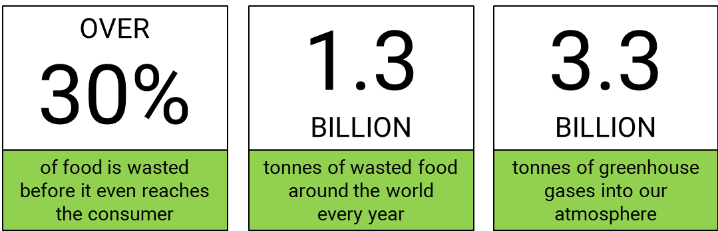
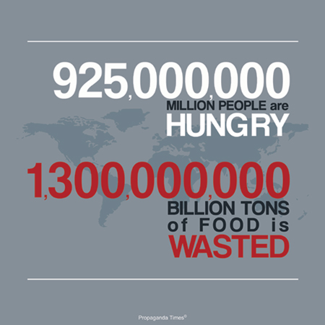
Problem statement
According to the Food and Agriculture Organization of the United Nations, approximately 40 percent of food in the U.S. goes to waste. Household food waste is another major concern in the developed world. A single restaurant in the U.S. can produce approximately 25,000 to 75,000 pounds of food waste in a year also 20 percent of initial food production is lost from products not meeting grading requirements in North America, Europe, Oceania, and Latin America.
Thus, it is the need of the hour to look for solutions that would help these organizations to communicate and thereby try to reduce the food wastage collectively.

Slide 3
approach
Workflow 1: Grocery Manager publishes ‘Ugly Looking’ Grocery request:
http://prezi.com/gmxeahdivom6/?utm_campaign=share&utm_medium=copy&rc=ex0share
Workflow 2: Restaurant Manager publishes the ‘Food Items’ at discounted price:
http://prezi.com/dkvvkd4j3bzw/?utm_campaign=share&utm_medium=copy&rc=ex0share

Slide 4
Structural diagram

Slide 5
Use cases

Slide 6
Object model

Slide 7
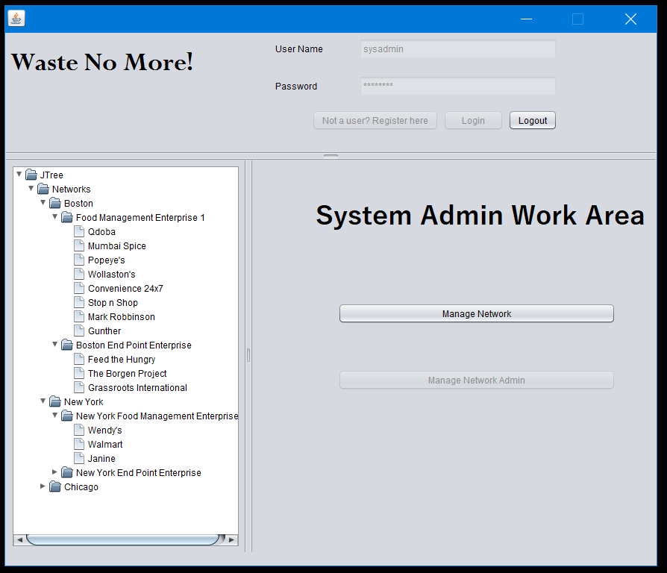
Screenshot 1 – System Admin Work Area

Slide 8
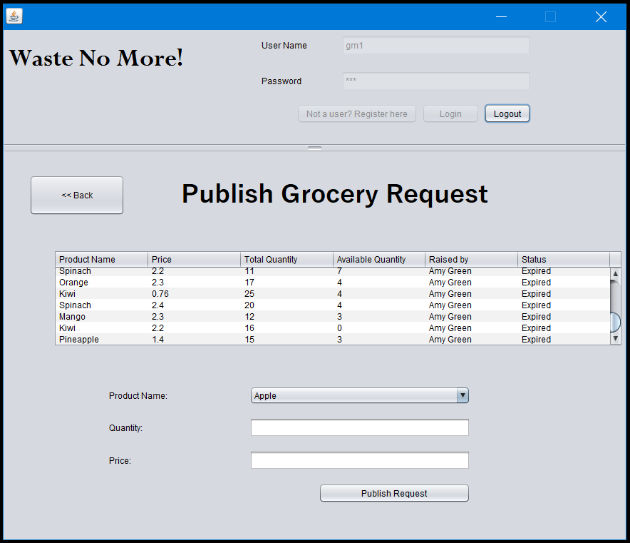
Screenshot 2: Publish grocery request

Slide 9
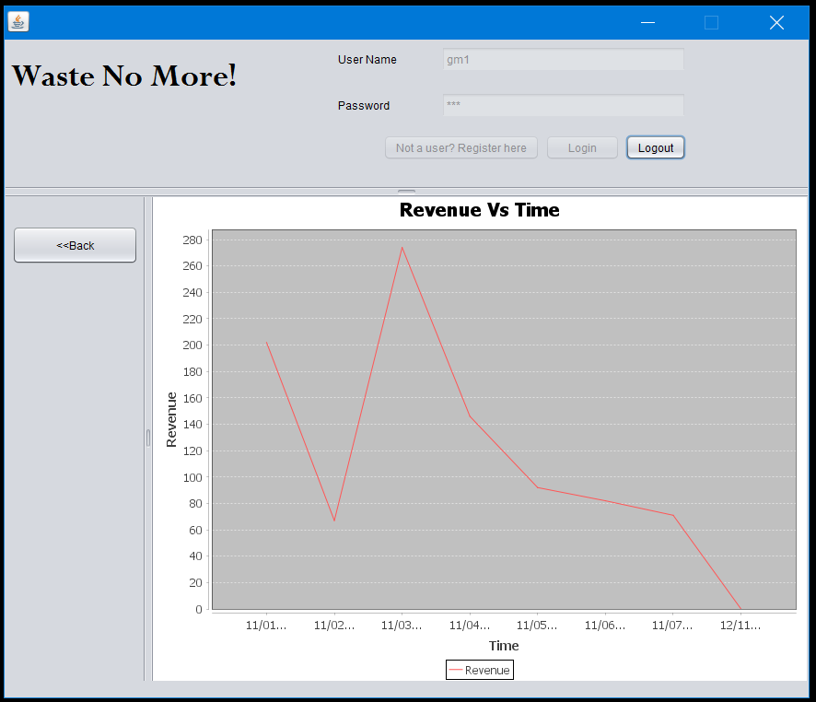
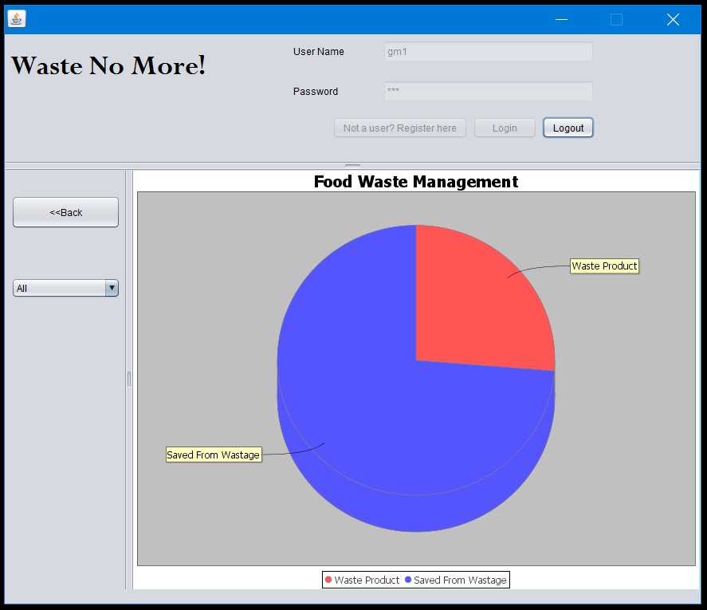
Screenshot 3: Grocery Manager Report view

Slide 10
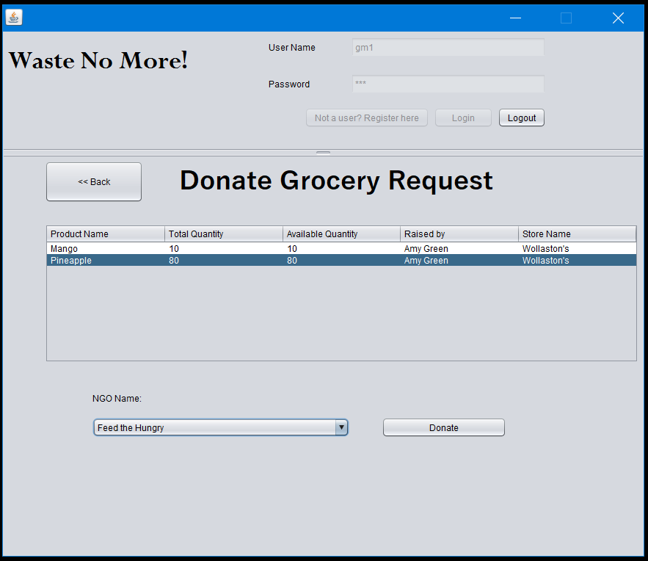
Screenshot 4: Donate Grocery

Slide 11
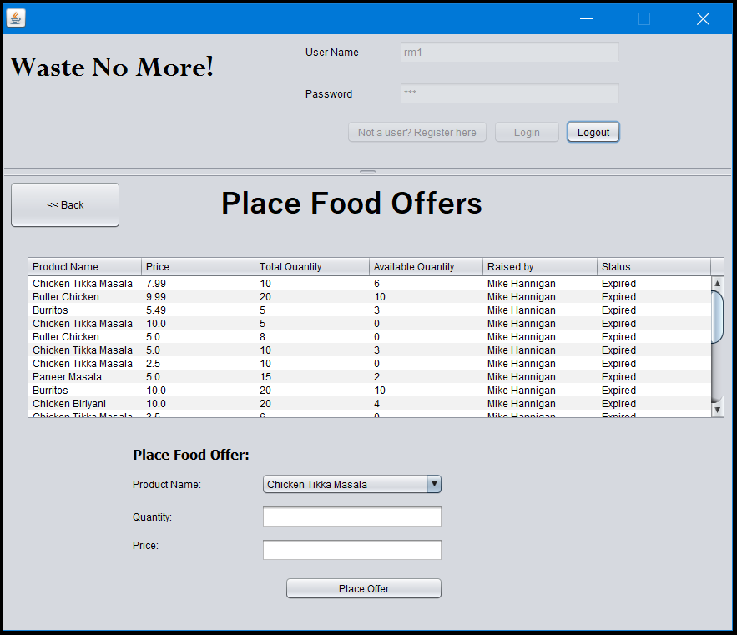
Screenshot 5: Publish Menu ITEM at discounted price

Slide 12
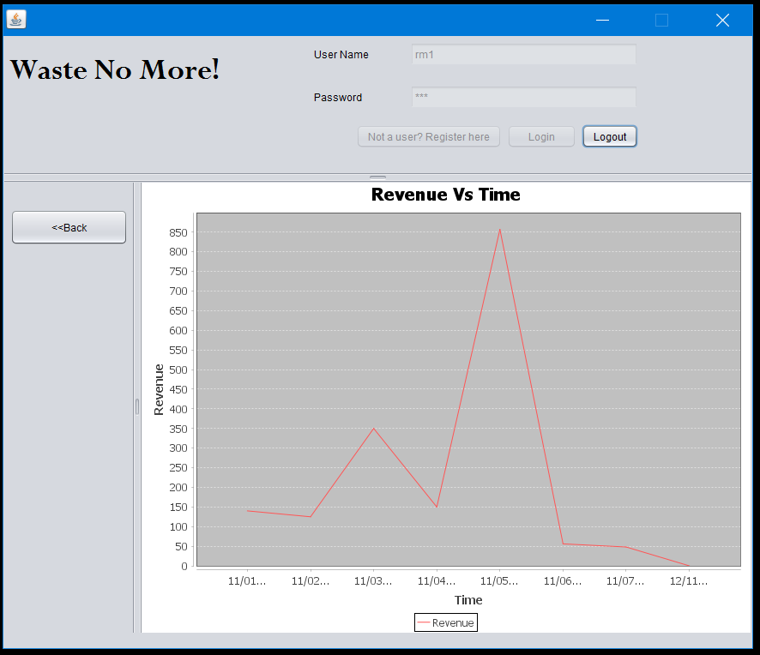
Screenshot 6: Restaurant Manager Report view

Slide 13
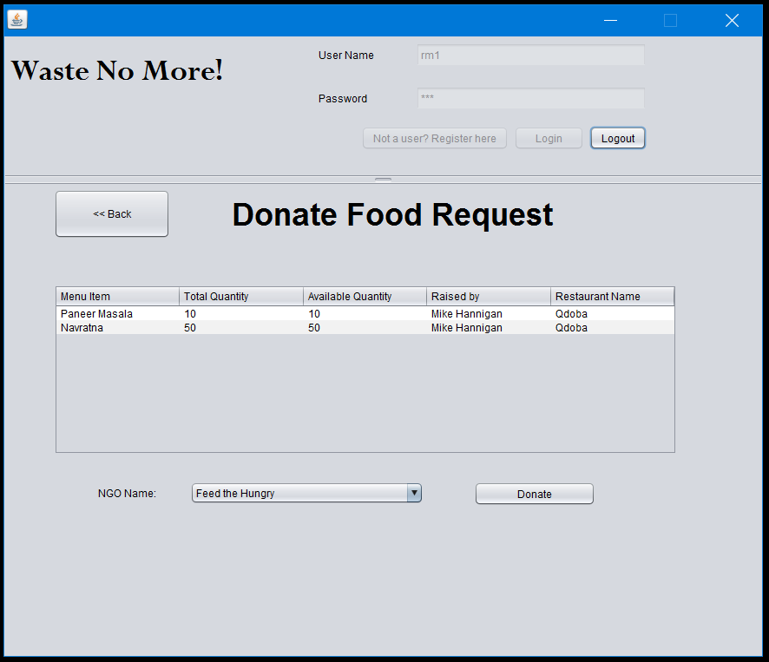
Screenshot 7: Donate Food Items

Slide 14
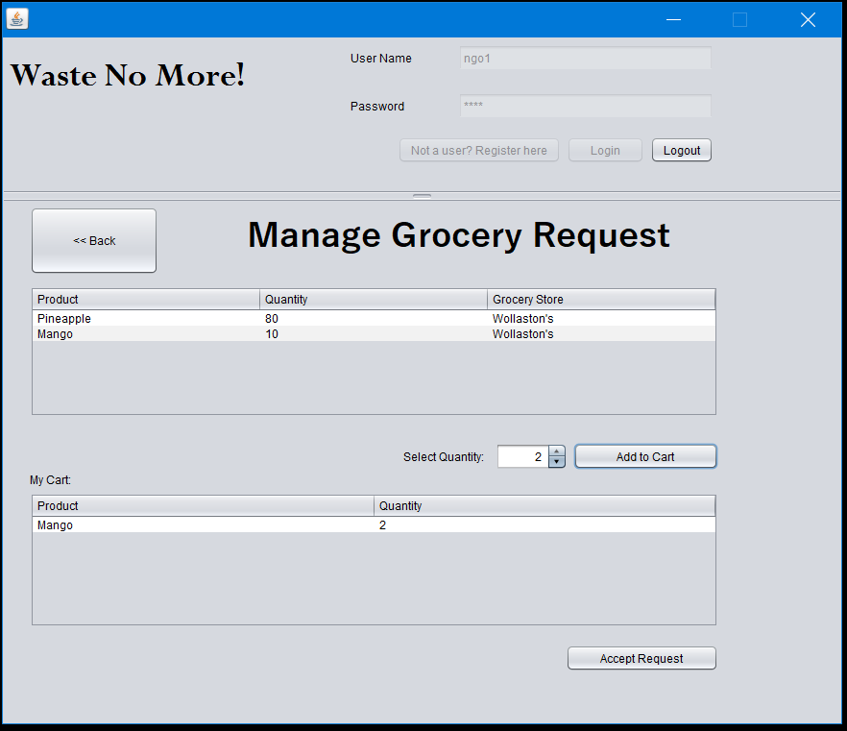
Screenshot 8: NGO Accepting donation

Slide 15
Future scope
Adding compost waste management part in the End Point Enterprise, so that any leftover, perishable food materials can be sent across to the Compost Management organization.
We can also include Farmers Organization(Farmer’s market) and help them place produce requests directly to the Household, Restaurants and Grocery Stores. Thus, assisting small farmers to link directly to buyers and also avoiding food losses during harvest and in storage.

Slide 16

Thank you

