Slide 1
THIS IS YOUR PRESENTATION TITLE

Slide 2
INSTRUCTIONS FOR USE
EDIT IN GOOGLE SLIDES
Click on the button under the presentation preview that says "Use as Google Slides Theme".
You will get a copy of this document on your Google Drive and will be able to edit, add or delete slides.
You have to be signed in to your Google account.
EDIT IN POWERPOINT®
Click on the button under the presentation preview that says "Download as PowerPoint template". You will get a .pptx file that you can edit in PowerPoint.
Remember to download and install the fonts used in this presentation (you’ll find the links to the font files needed in the Presentation design slide)
More info on how to use this template at www.slidescarnival.com/help-use-presentation-template
This template is free to use under Creative Commons Attribution license. You can keep the Credits slide or mention SlidesCarnival and other resources used in a slide footer.

Slide 3

HELLO!
I am Jayden Smith
I am here because I love to give presentations.
You can find me at @username

Slide 4
TRANSITION HEADLINE
1
Let’s start with the first set of slides

Slide 5
Quotations are commonly printed as a means of inspiration and to invoke philosophical thoughts from the reader.

Slide 6
Data PreProcessing and EDA
Data Cleaning
Cherry picked the restaurant data from business file
Select top states with most restaurants and ratings
Filtering the data state wise
.

Slide 7
Technological stack
Apache Spark (PySpark) for data cleaning and segregation
GraphFrames and GraphX for Network Analysis
Spark ML for ALS Matrix Factorization Model

Slide 8
Recommender system
Collaborative Filtering
Automatic prediction using users preference and data
Memory-based CF (ALS)
Model-based CF
Content based Filtering
Recommendation using users past preference and examining current data

Slide 9
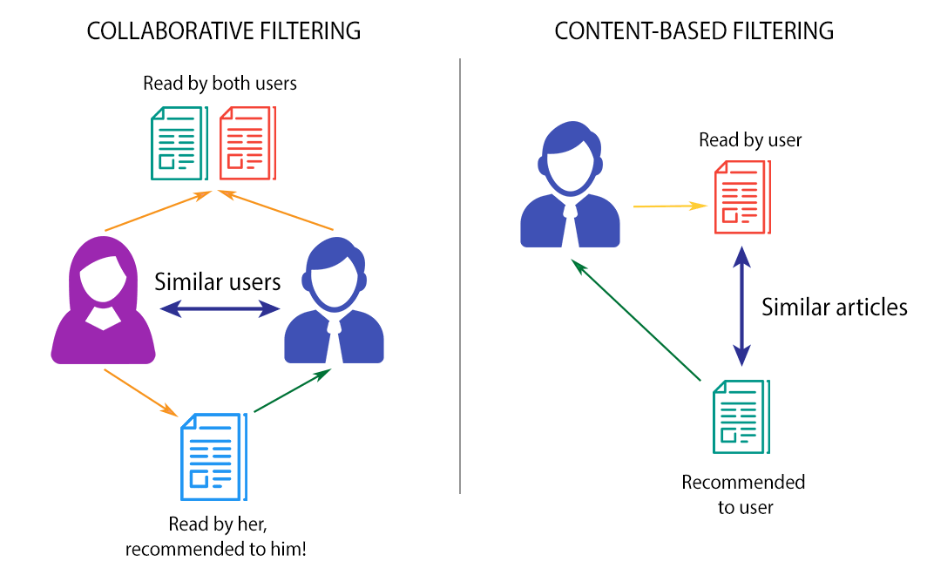

Slide 10

Model Based Collaborative Filtering
Unsupervised learning method for latent variable decomposition and dimensionality reduction.
ALTERNATING LEAST SQUARES (ALS) Matrix Factorization

Slide 11
Alternating LEAST Squares
We construct a Matrix Factorization model using three features of data
Resulting model is capable of answering the following:
Products for Users
Users of a given Product
We evaluate the model on basis of RMSE score

