Slide 1


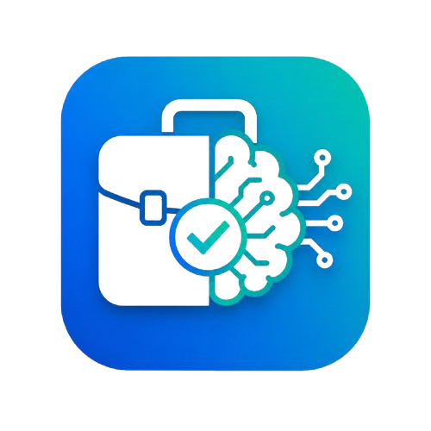

Damietta University
SMART JOB PORTAL
GRADUATION PROJECT
AI-Powered
Recruitment Platform
Presented by :
Mohamed Ibrahim Nasr Ali Asal Mohamed Nasser Ahmed Sand Yousef Mostafa Yousef Abdelaziz Ahmed Kamal Ahmed Mohamed Ahmed Saad Saad Al-Mutawalli Mahmoud Alaa Mahmoud Gabal
Supervisor Prof. Ahmed Mohammed Rabie
2025/2026

Slide 2









OVERVIEW
Presentation Agenda
01
Introduction & Problem
02
Objectives & Users
03
Features & System
04
Frontend & UI / UX
05
Backend & AI Engine
06
Database & Diagrams
07
Demo & Challenges
08
Conclusion & Future Work
Smart Job Portal
AGENDA
02 / 31

Slide 3
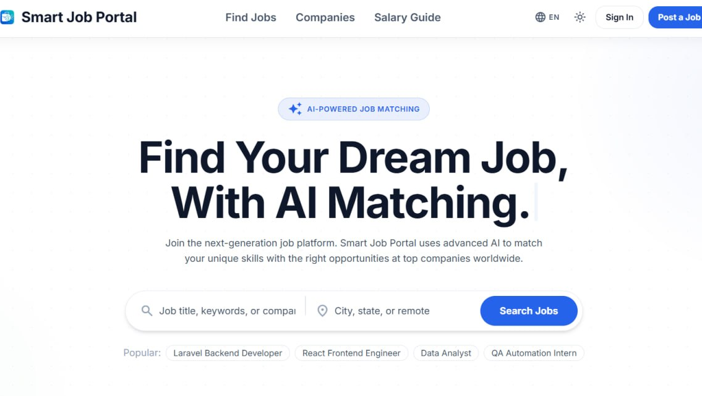

PROJECT OVERVIEW
An AI-assisted recruitment platform
smart-job-portal
Smart Job Portal streamlines hiring end-to-end. Job seekers upload a CV that an AI service parses into structured data, then receive jobs ranked by a skill-match score with one-click applications. Companies review applicants auto-ranked in a Smart ATS, and an admin oversees the whole platform.
Home Page
3
EN / AR
Replace with a screenshot of your site
User roles
Bilingual + RTL
AI
1-click
CV parsing & matching
Apply with score
Smart Job Portal
PROJECT OVERVIEW
03 / 31

Slide 4





PROBLEM STATEMENT
Hiring is slow, manual, and low-signal
Manual resume entry
Low-relevance search
Generic rejections
Seekers re-type CV data into every application form.
Keyword search ignores a candidate's real skills.
Candidates get no actionable reason to improve.
Applicant overload
Manual notifications
Limited oversight
Recruiters drown in unranked, unqualified applicants.
Notifying rejected candidates takes manual effort.
Admins lack tools to moderate users and jobs.
Smart Job Portal
PROBLEM STATEMENT
04 / 31

Slide 5
OBJECTIVES
What the system sets out to achieve
01
Automate CV ingestion
05
Transparent feedback
Extract structured data and skills from resumes.
Gap-analysis emails list missing skills.
02
Skill-based recommendations
06
Administration & analytics
Rank jobs by a transparent matching score.
Moderate users and jobs with platform stats.
03
One-click applications
07
Bilingual access (EN / AR)
Apply instantly with an auto-computed score.
Full right-to-left support across the UI.
04
Smart ATS for recruiters
Auto-rank applicants; search, filter, sort.
Smart Job Portal
OBJECTIVES
05 / 31

Slide 6


TARGET USERS
Three roles, one connected workflow
Job Seeker
Company / Recruiter
Administrator
Upload CV & auto-fill profile
Ranked recommendations
One-click apply & track
View rejection gap analysis
Post jobs with skills
Smart ATS auto-ranks
Change status & message
Dashboard insights
Platform statistics
Manage & moderate users
Verify / ban accounts
Manage and remove jobs
Internal actors: AI Engine - Email Service
Smart Job Portal
TARGET USERS
06 / 31

Slide 7
PART 01
Features & System
The core capabilities, system modules, architecture, and technology stack.

Slide 8



MAIN FEATURES
The capabilities that make it smart
AI CV Parsing
Skill-Based Matching
One-Click Apply
Extracts skills, education & experience from PDF/DOCX.
Scores jobs vs. skills with a weighted 70/30 model.
Match score & missing skills computed on submit.
Smart ATS Ranking
Gap-Analysis Feedback
Messaging & Alerts
Applicants auto-ranked with search, filter & sort.
Automated rejection emails list missing skills.
In-app messaging, notifications and saved jobs.
Smart Job Portal
MAIN FEATURES
08 / 31

Slide 9

SYSTEM MODULES
60+ screens across four module groups
Public
Job Seeker
Company
Admin
11 pages
18 pages
17 pages
8 pages
Home, About, Contact, FAQ
Jobs & job details
Companies & profiles
Salaries, Privacy, Terms
Dashboard & CV review
Search & recommendations
Applications & feedback
Skills, messages, settings
Dashboard & profile
Create / manage jobs
Smart ATS & applicants
Messages & notifications
Dashboard & statistics
User management
Job moderation
Activity log & settings
Smart Job Portal
SYSTEM MODULES
09 / 31

Slide 10


SYSTEM ARCHITECTURE
A three-tier service architecture
CLIENT
API SERVER
AI ENGINE
React 19 SPA
HTTPS / REST (cookies + CSRF)
Laravel 12 REST API
HTTP + X-API-Key
FastAPI Microservice
Vite - Tailwind - Router - i18n (EN/AR) - Framer Motion
Controllers - Services - Sanctum auth - Queue worker - MySQL
spaCy parsing - skill matching - gap analysis
Email Service (verification, approval & gap-analysis emails) - Queue worker (async CV parsing, score refinement, mail) - MySQL (Eloquent migrations).
Smart Job Portal
SYSTEM ARCHITECTURE
10 / 31

Slide 11
TECHNOLOGIES USED
A modern three-tier stack
Frontend
Backend
AI Engine
Data & Auth
React 19 + Vite 8
Tailwind CSS + RTL
React Router 7
i18next - Framer Motion
PHP 8.2 - Laravel 12
Sanctum (SPA auth)
Queues & events
PHPUnit + GitHub CI
Python - FastAPI
spaCy NER parsing
scikit-learn matching
PyPDF2 - python-docx
MySQL database
Eloquent migrations
Role-based access
Hashing - CSRF - throttling
Tools: VS Code - Git & GitHub - Composer / npm - Postman - XAMPP / MySQL
Smart Job Portal
TECHNOLOGIES
11 / 31

Slide 12
PART 02
Frontend & UI / UX
The React single-page app, the user interface, and the design system.

Slide 13

FRONTEND / REACT SPA
A fast, modular single-page app
Component architecture
Routing & guards
State & data layer
Reusable components split by role: admin, company, jobSeeker & shared UI.
React Router 7 with ProtectedRoute & RoleRoute gating pages by role.
Context for auth/theme; Axios client with CSRF & 401 interceptors.
Bilingual + RTL
Motion & feedback
Responsive design
i18next with full English / Arabic and right-to-left layout.
Framer Motion transitions, skeleton loaders and toasts.
Tailwind utility system - mobile, tablet and desktop layouts.
Smart Job Portal
FRONTEND
13 / 31

Slide 14
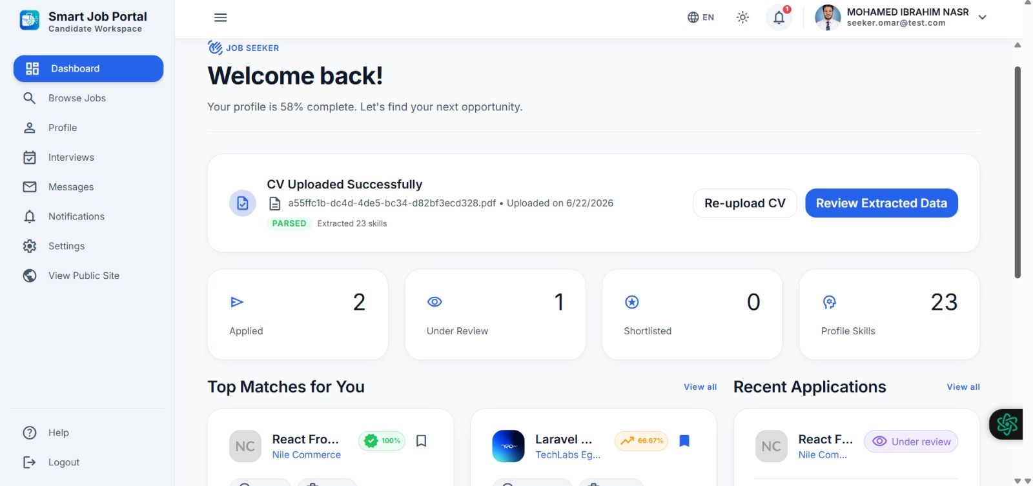
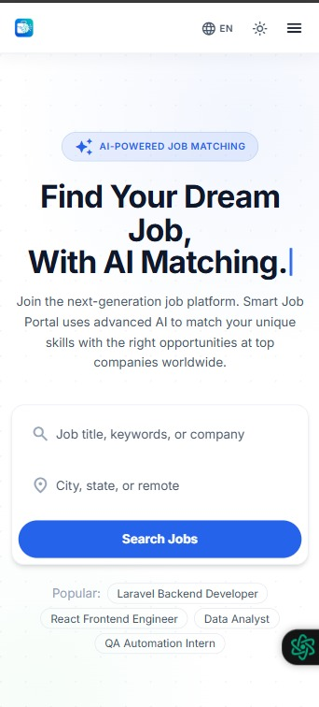

WEBSITE PAGES / UI SHOWCASE
A clean, responsive interface
smart-job-portal
RESPONSIVE
Light & dark themes
Bilingual EN / AR
RTL support
Material-3 tokens
Mobile-friendly
Mobile view
Replace with screenshot
Dashboard / Job Search
Replace with a desktop screenshot
Smart Job Portal
USER INTERFACE
14 / 31

Slide 15

UI / UX - DESIGN SYSTEM
A clean, professional brand system
COLOR PALETTE
Smart Job Portal
Briefcase + AI brain + checkmark - careers powered by intelligence.
Navy
Action Blue
AI Teal
Slate
Surface
#0F172A
#2563EB
#14B8A6
#475569
#F8FAFC
TYPOGRAPHY
Light & dark themes
Bilingual EN / AR + RTL
Inter
Aa Bb Cc 0123 - Display / Headings / Body
Geometric sans-serif - weights 400-800 - Material Symbols icons
Material-3 tokens
Rounded cards, soft shadows
Smart Job Portal
DESIGN IDENTITY
15 / 31

Slide 16
PART 03
Backend & AI Engine
The Laravel REST API, request lifecycle, the AI microservice, and testing.

Slide 17
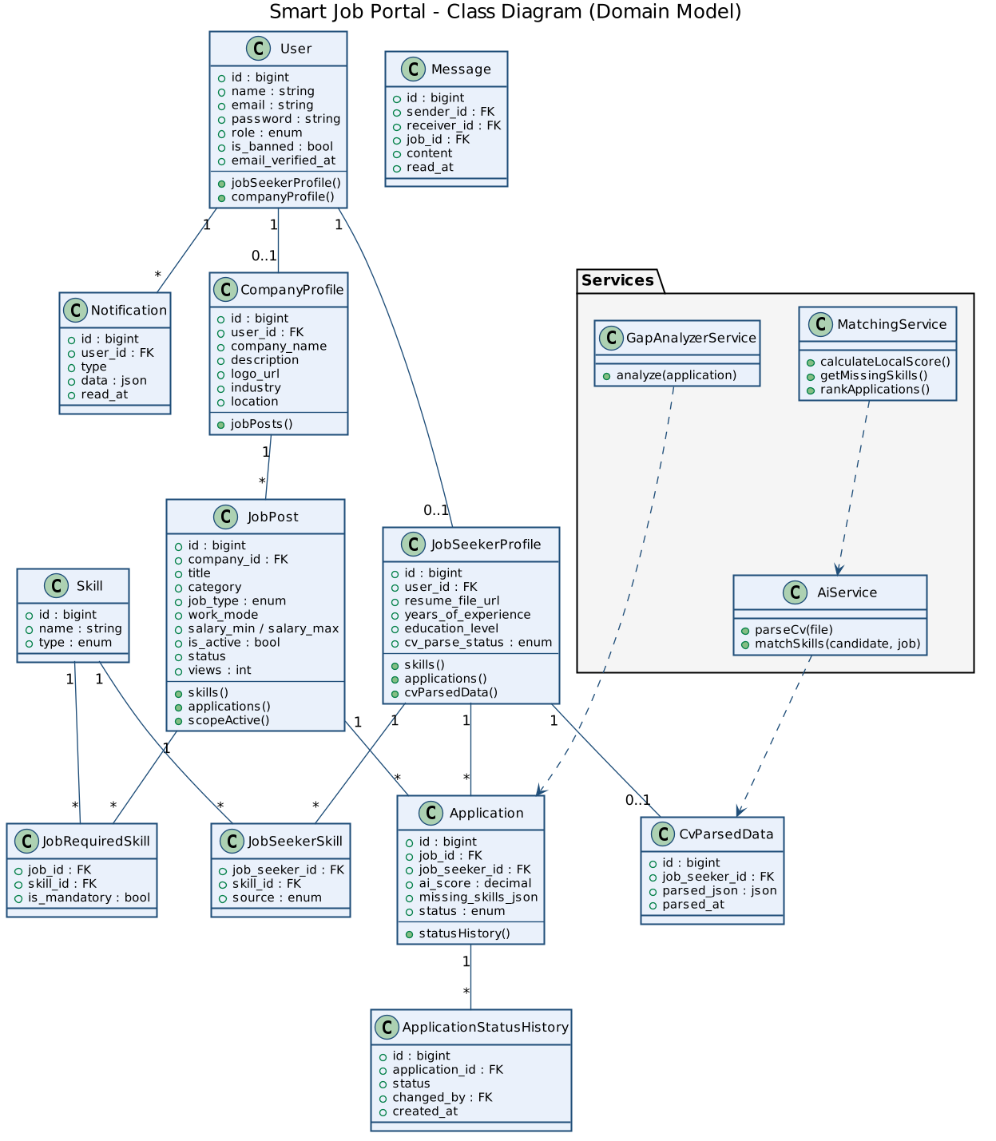

BACKEND / LARAVEL API
A layered, secure REST API
REST API & routing
Versioned routes, controllers and a consistent JSON envelope (ApiResponse trait).
Auth & security
Sanctum SPA cookie auth, CSRF, role middleware, policies, ban & verification checks.
Service layer
Business logic (matching, gap analysis, CV parsing handoff) isolated in services.
Async & events
Queue jobs for CV parsing, score refinement and emails; events & listeners.
Class / data-model diagram
Smart Job Portal
BACKEND ARCHITECTURE
17 / 31

Slide 18
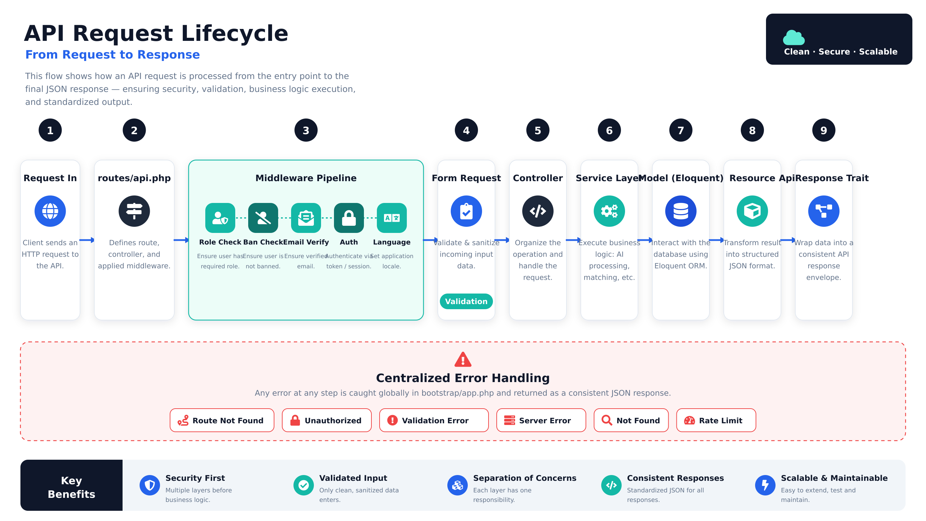
BACKEND / REQUEST FLOW
API Request Lifecycle
Smart Job Portal
API REQUEST LIFECYCLE
18 / 31

Slide 19


DEMO FLOW
From CV upload to smart decision
JOB SEEKER JOURNEY
Register
Upload CV
AI Parses
Recommended
One-Click Apply
COMPANY JOURNEY
Post Job + Skills
ATS Auto-Ranks
Review & Status
Gap-Analysis Email
Smart Job Portal
DEMO FLOW
28 / 31

Slide 20
AI / THE CORE ENGINE
AI is the brain of the platform
A dedicated FastAPI microservice powers the intelligence behind Smart Job Portal. It turns raw CVs into structured data and scores candidates against jobs, so matching is based on real skills - not keywords.
CV Parsing (NLP)
Skill-Based Matching
Gap Analysis
Resilient Pipeline
spaCy NER + regex extract name, contact, skills, education & experience from PDF / DOCX.
Required vs. candidate skills scored with a weighted 70/30 model; cosine similarity ready.
On rejection, computes the exact missing skills returned to the candidate by email.
Async queue jobs, 30s timeout, and a local fallback scorer keep the product working offline.
Stack: Python - FastAPI - spaCy (en_core_web_sm) - scikit-learn - PyPDF2 - python-docx
Smart Job Portal
THE AI ENGINE
19 / 31

Slide 21
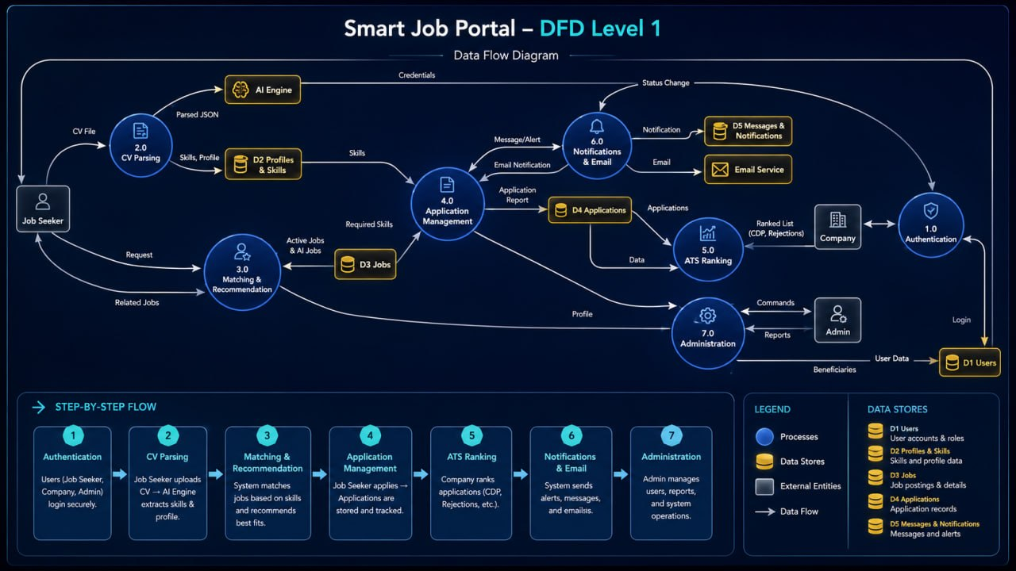
AI / DATA FLOW (DFD LEVEL 1)
How data moves through the AI engine
1
CV uploaded & stored
2
AI parses -> structured JSON
3
Skills saved to profile
4
Skills vs. job requirements
5
Score, recommend & rank
Smart Job Portal
AI DATA FLOW
20 / 31

Slide 22
QUALITY ASSURANCE
Tested and continuously integrated
Feature tests
Unit tests
CI / tooling
Auth: register & verify gating
CV upload & parse status
Job posting (company)
Apply & company rejection
Smart ATS ranking
MatchingService scoring
Perfect / partial / zero match
Weighting (70 / 30) logic
Empty-requirements case
GitHub Actions pipeline
MySQL 8 service + migrate
PHPUnit suite on push
ESLint on the frontend
Smart Job Portal
TESTING & QA
21 / 31

Slide 23
PART 04
Database & Diagrams
Use cases, the data model, class & sequence diagrams, and user workflows.

Slide 24
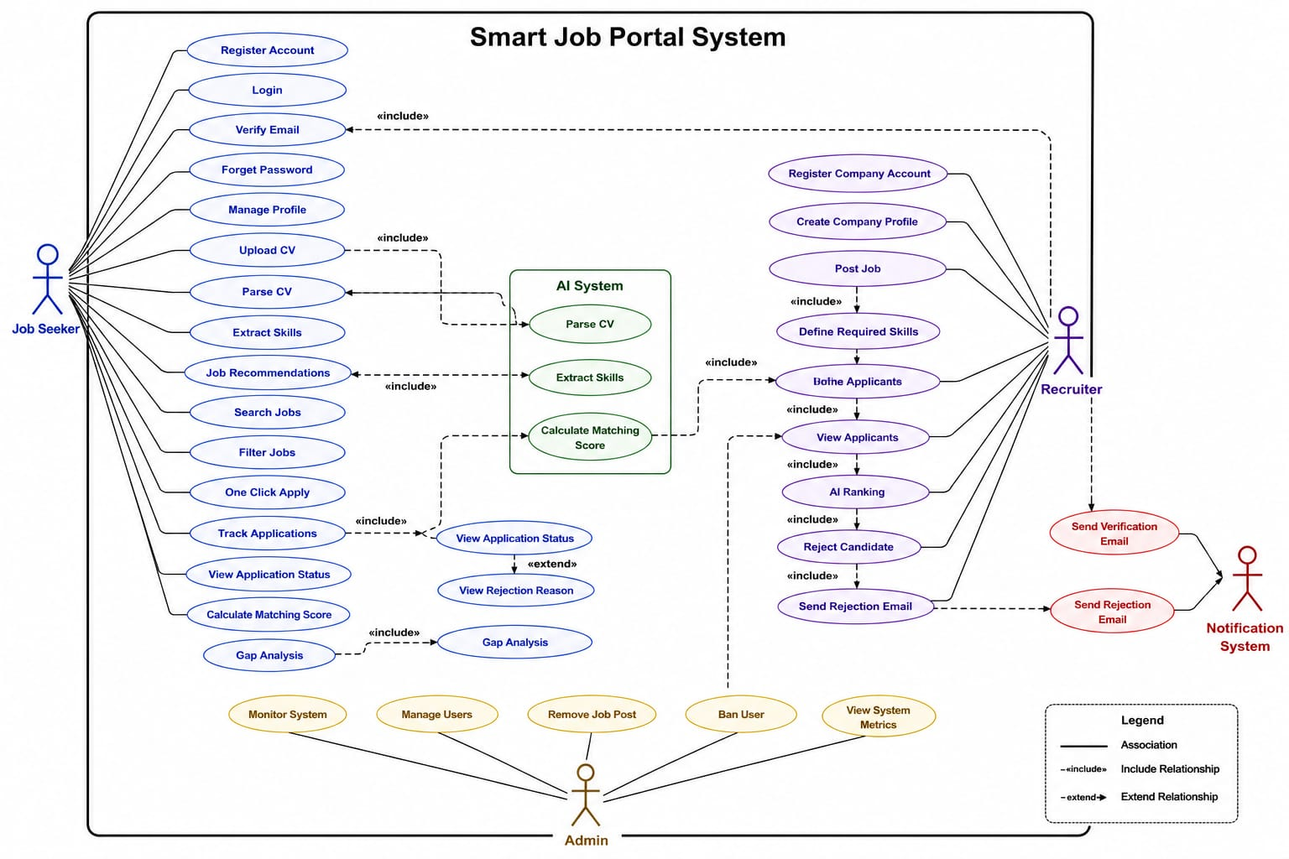
SYSTEM DESIGN / USE CASES
What each actor can do
The use-case diagram maps every actor to the actions the system supports - across public visitors, job seekers, companies, and the administrator, with the AI engine and email service as supporting actors.
Job Seeker
Company / Recruiter
Administrator
AI Engine & Email
Smart Job Portal
USE CASE DIAGRAM
23 / 31

Slide 25
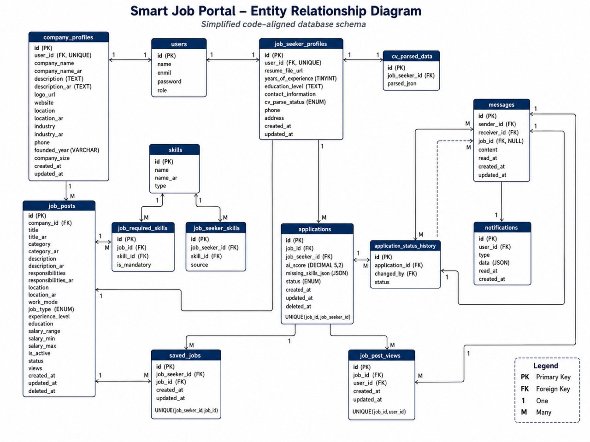
SYSTEM DESIGN / DATA MODEL
Entity-Relationship schema
The relational schema models users and role profiles, job posts and required skills, applications with status history, plus messaging, notifications, saved jobs and parsed CV data - all in MySQL via Eloquent migrations.
users & profiles
job_posts & skills
applications & history
cv_parsed_data
messages & notifications
Smart Job Portal
DATABASE / ERD
24 / 31

Slide 26
SYSTEM DESIGN / CLASS DIAGRAM
The application model layer
Eloquent models and their relationships: User with role-specific profiles, JobPost with required skills, Application with status history, and supporting models for messages, notifications and parsed CV data.
User / Profiles
JobPost / Skill
Application / History
Message / Notification
CvParsedData / SiteSetting
Smart Job Portal
CLASS DIAGRAM
25 / 31

Slide 27
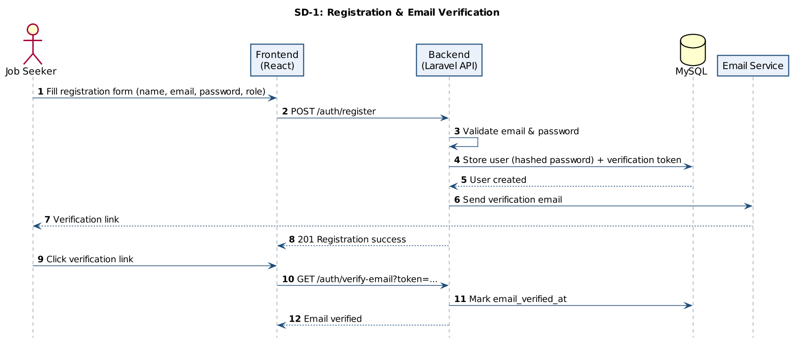
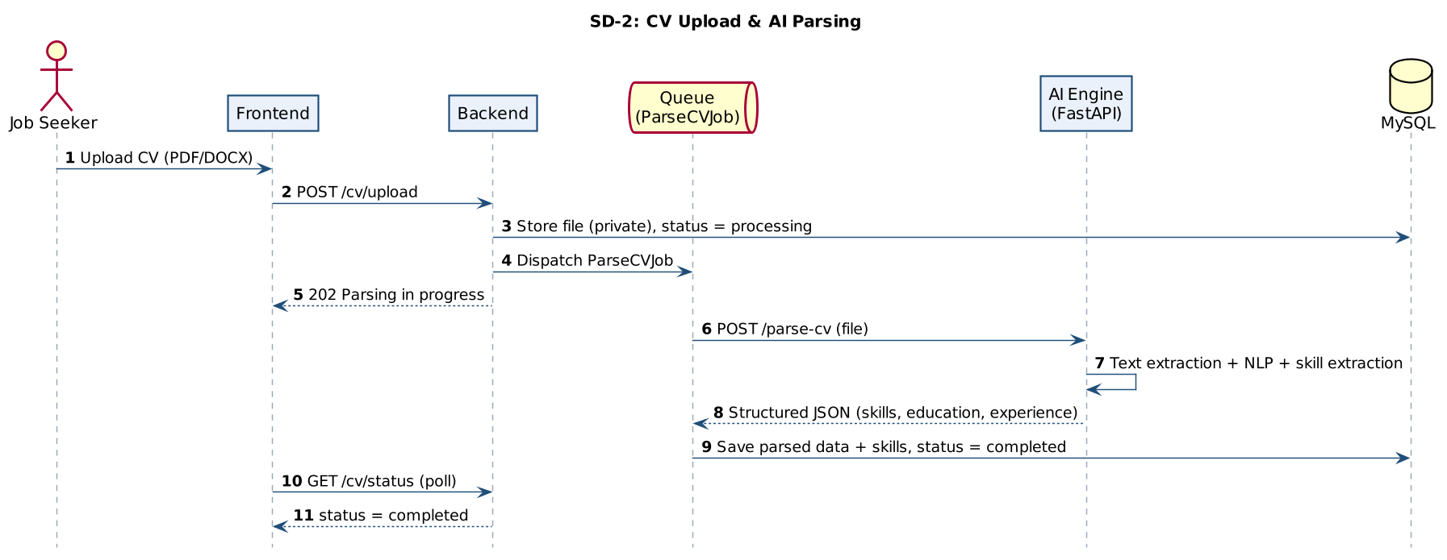
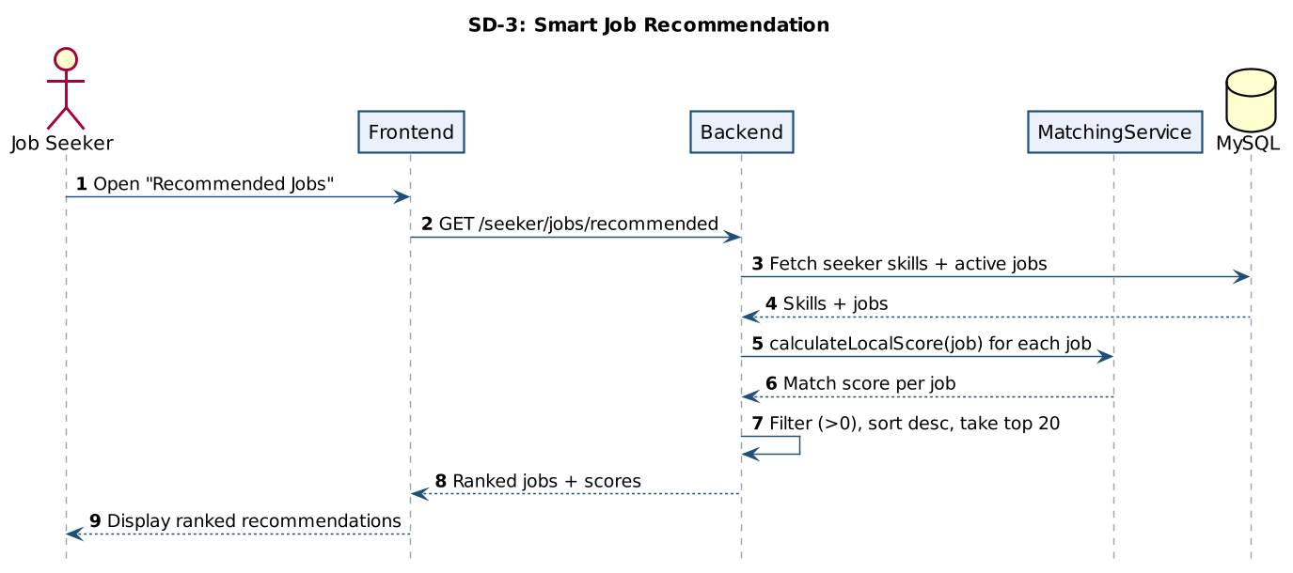
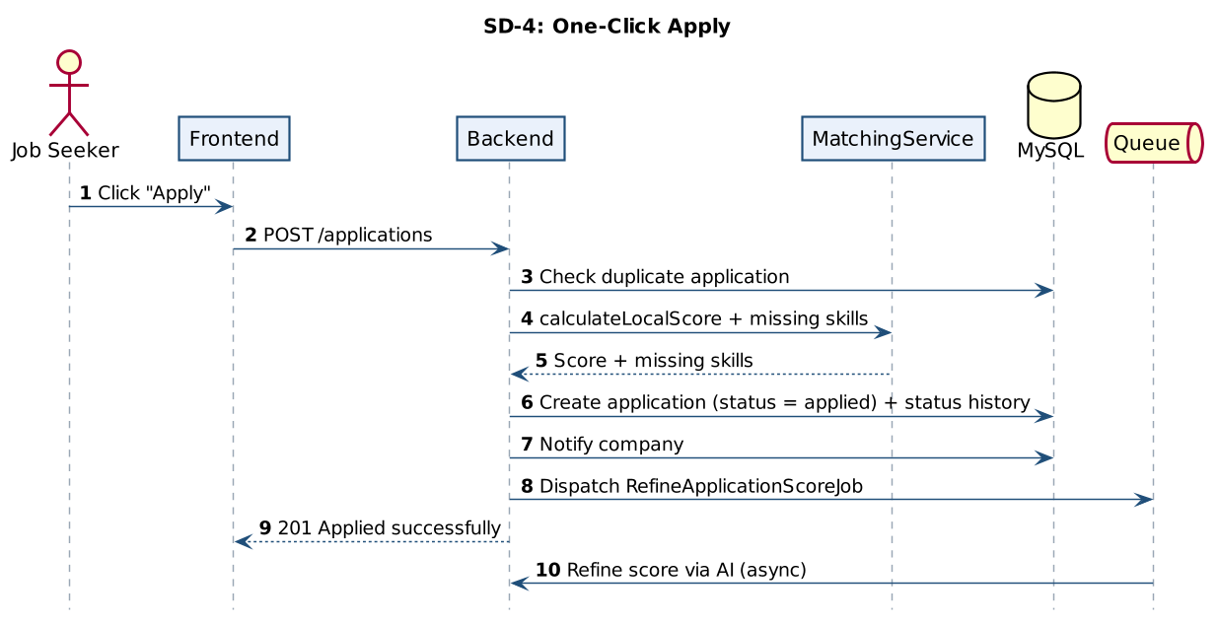
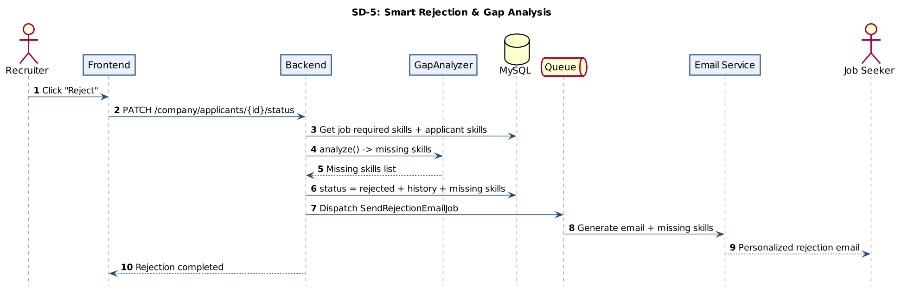
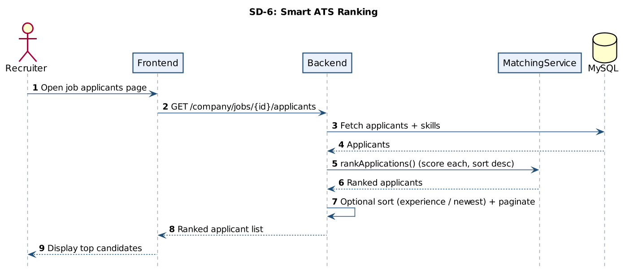
SYSTEM DESIGN / SEQUENCE DIAGRAMS
Key interaction flows
Registration & Verification
CV Upload & AI Parsing
Smart Recommendation
One-Click Apply
Rejection & Gap Analysis
Smart ATS Ranking
Smart Job Portal
SEQUENCE DIAGRAMS
26 / 31

Slide 28
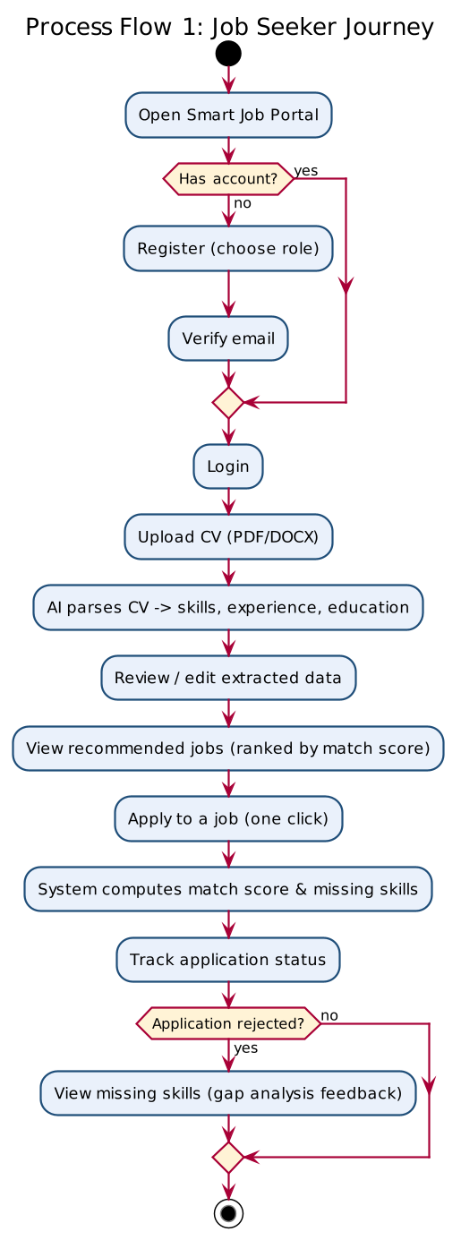
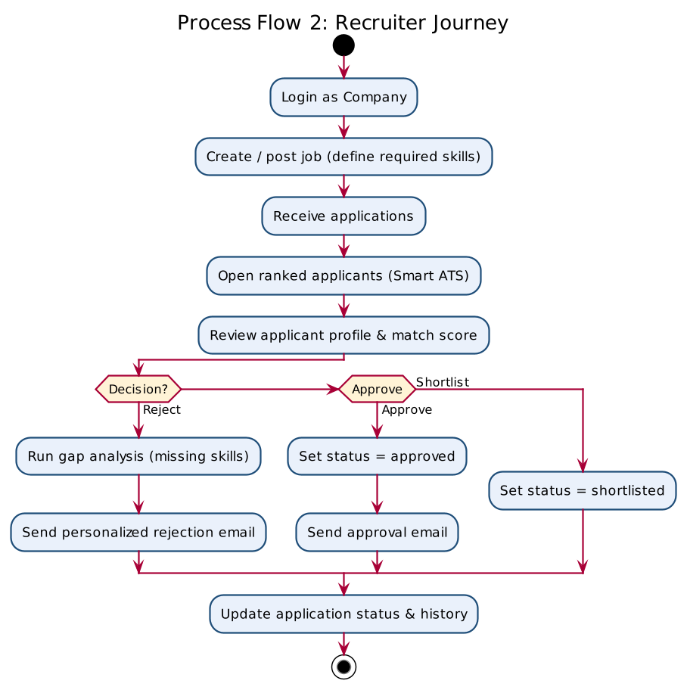
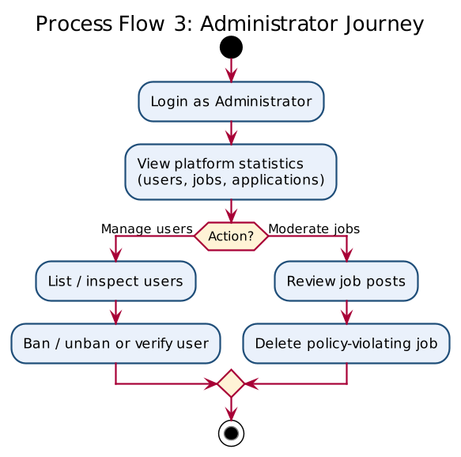
SYSTEM DESIGN / WORKFLOWS
End-to-end user flows
Job Seeker
Recruiter
Admin
Smart Job Portal
USER WORKFLOWS
27 / 31

Slide 29
CHALLENGES & SOLUTIONS
Engineering trade-offs we solved
CHALLENGE
SOLUTION
AI service could be slow or down
Every AI call has a timeout and falls back to a local weighted scorer, so the product stays usable offline.
Per-request latency on job lists
Recommendations use a fast local scorer; the heavier AI score is refined asynchronously via a queue job.
CV files are sensitive data
Stored on a private disk with UUID names; downloads restricted to the owning company; magic-byte checks.
High applicant volume
The Smart ATS auto-ranks every applicant by match score with search, filter and sort.
Substring skill mismatches
Identified as a limitation; planned fix is a canonical skill taxonomy with synonyms.
Smart Job Portal
CHALLENGES & SOLUTIONS
29 / 31

Slide 30
CONCLUSION
A working, end-to-end smart hiring platform
Smart Job Portal delivers a complete recruitment workflow across three roles - automated CV parsing, skill-based matching, a smart ATS, and transparent feedback - on a clean, bilingual, three-tier architecture.
FUTURE WORK
Activate semantic (embedding) matching
Canonical skill taxonomy & synonyms
Richer CV understanding + Arabic parsing
Containerized deploy + HTTPS
Real-time messaging & notifications
Frontend & AI automated tests
60+
3
Implemented screens
Cooperating services
EN/AR
AI
Bilingual + RTL
Parsing & matching
Smart Job Portal
CONCLUSION
30 / 31

Slide 31
Thank You
Questions & Discussion
Smart Job Portal - AI-Powered Recruitment Platform

